Slide 1
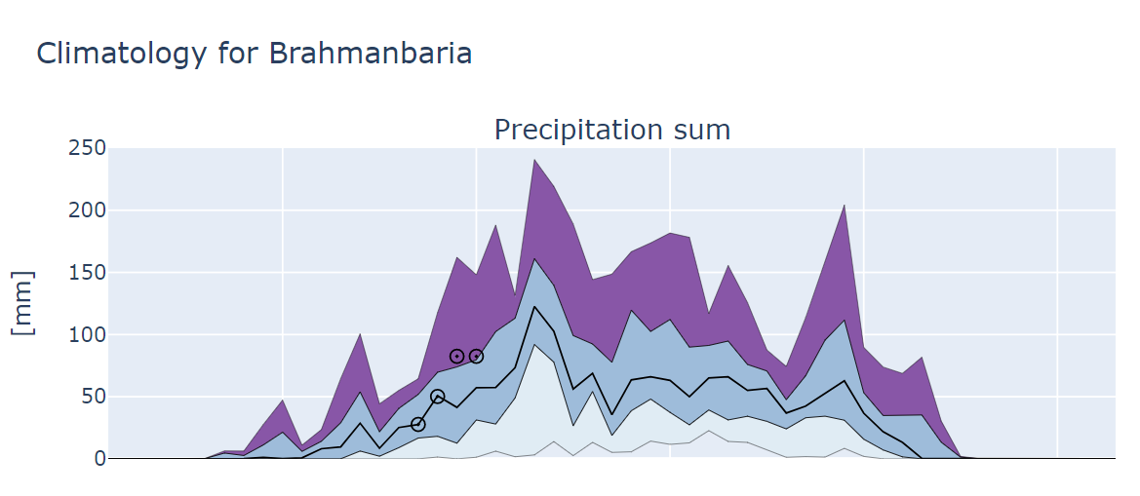
Max
S2S forecasts
75 Perc.
Median
25 Perc.
Min
10
20
30
40
50
Week in the year

