Slide 1
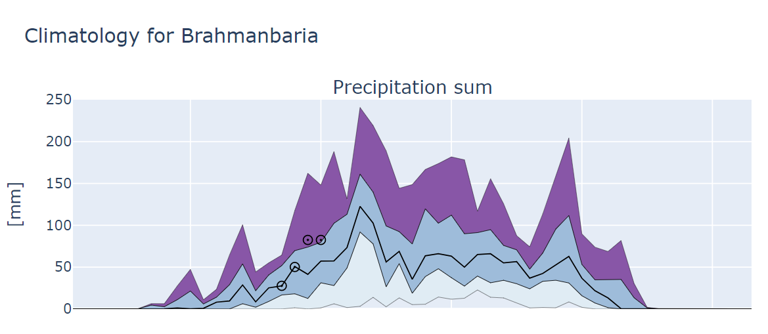
Max
S2S forecasts
75 Perc.
Median
25 Perc.
Min
10
20
30
40
50
Week in the year

Slide 2
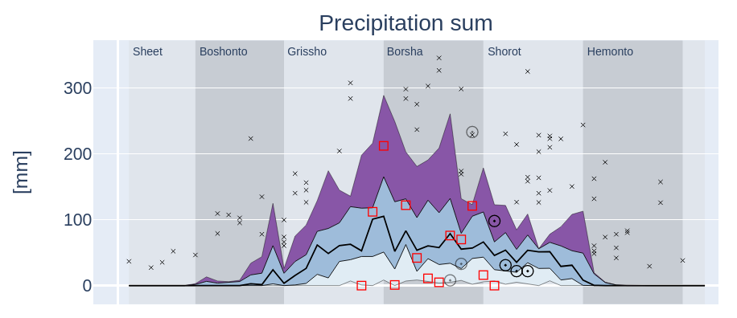
Climatology
Max
Extreme events in the historical record
Upper [25%]
Median[50%]
Lower [25%]
Min
Observed values from weather stations
“old” S2S forecasts from previous 4 weeks
Current S2S forecasts

