Slide 1


G-distance on the comparison of model and human heterogeneity
Andy J. Wills @ajwills72
Lenard Dome

Slide 2

What is a model?
A mathematically-specified theory that is implemented as a computable algorithm for the purpose of simulating some aspect of human, or animal, behaviour.
Wills & Pothos (2012)

Slide 3
IS this model any good?
Goodness of fit: Extent to which a model can accommodate already-observed data pattern(s).
Model and human heterogeneity

Slide 4
Model adequacy as overlapping sets

Slide 5


Model adequacy as overlapping sets
Accommodation
Excess flexibility

Slide 6
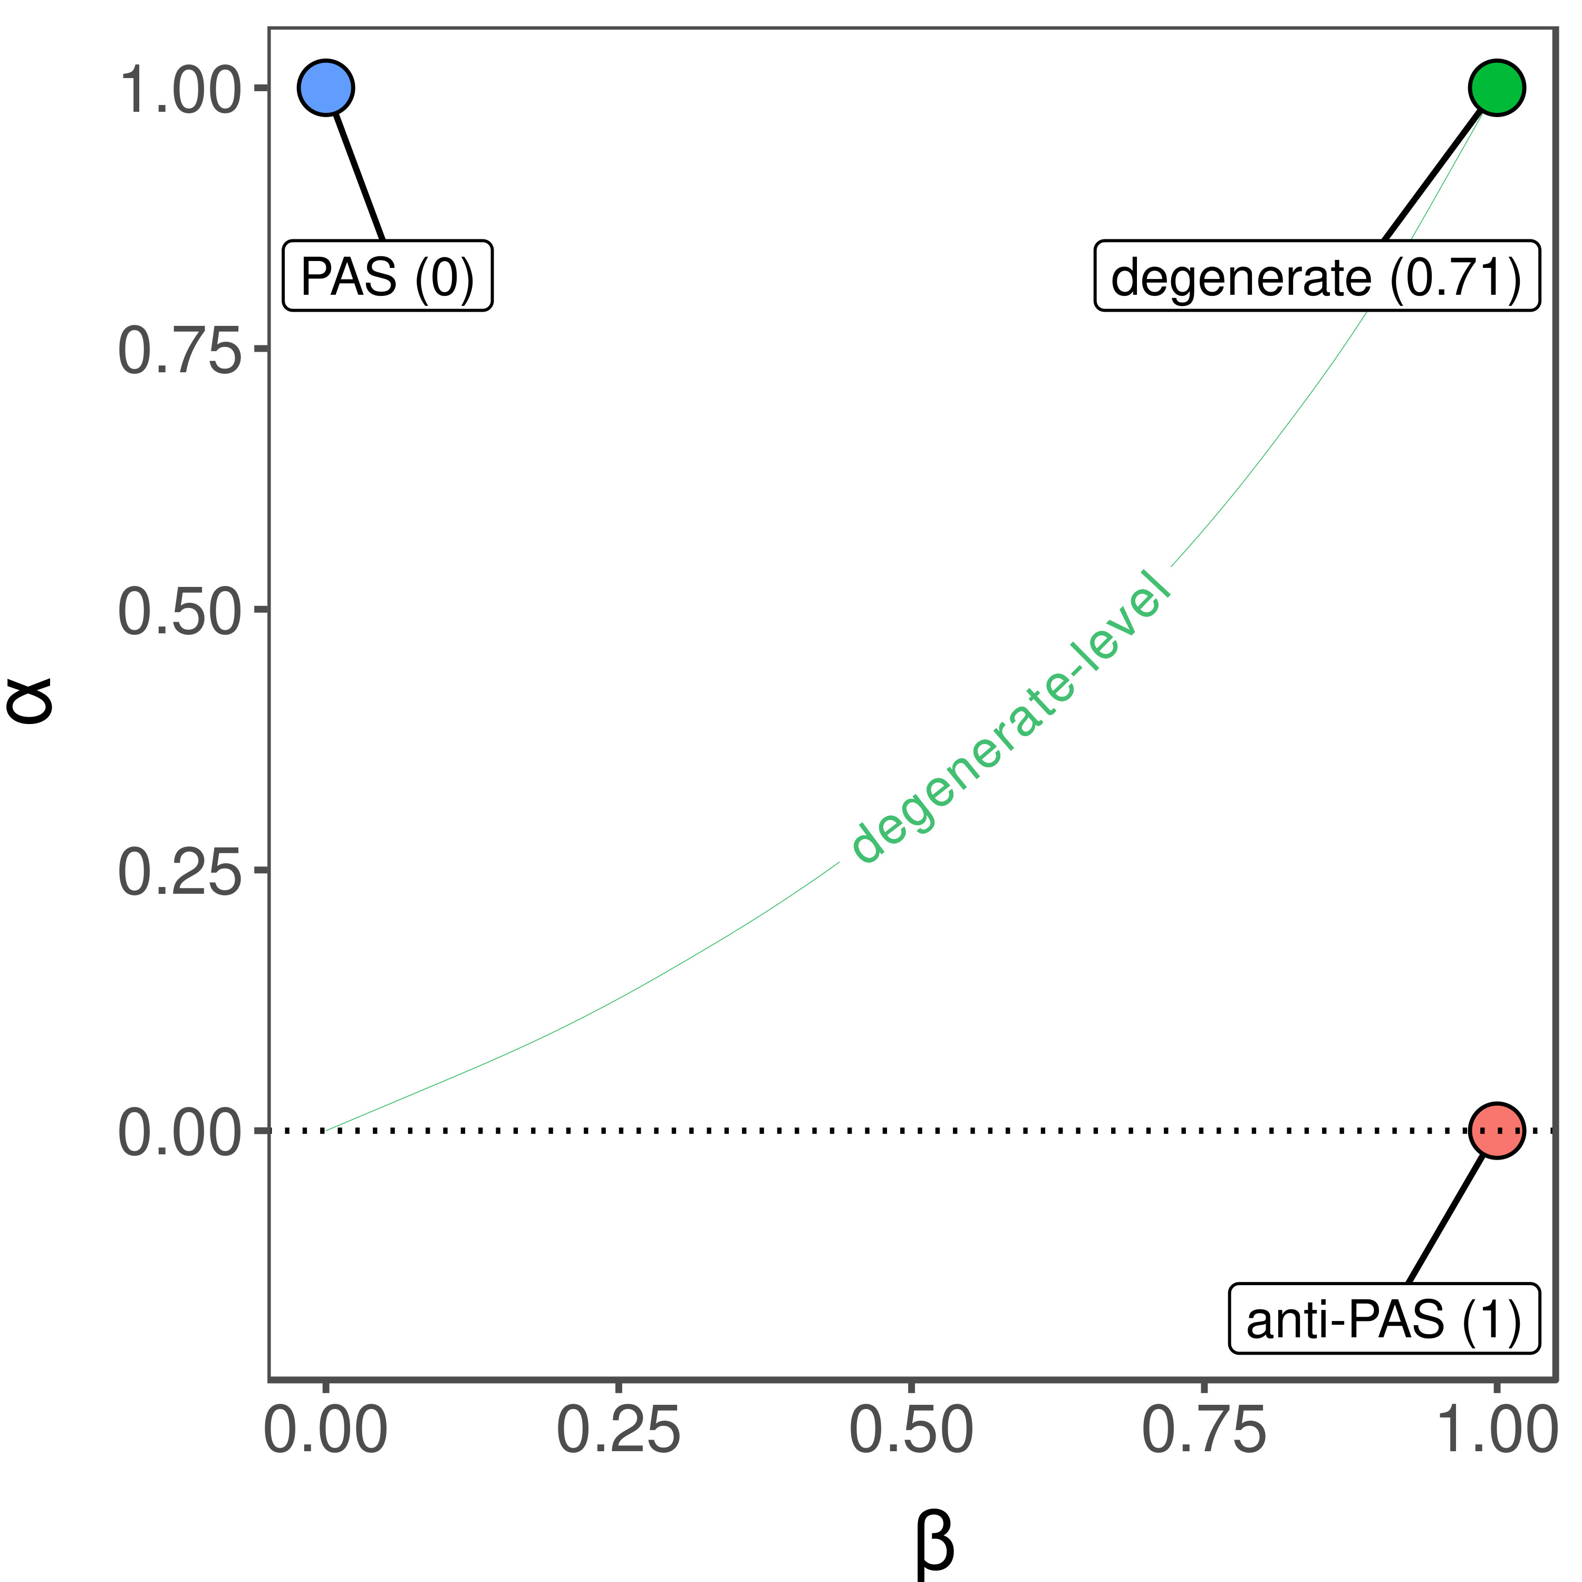

G-distance

Slide 7
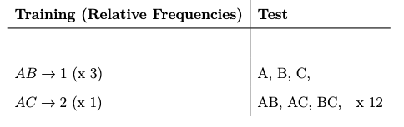
Inverse base-rate effect

Slide 8
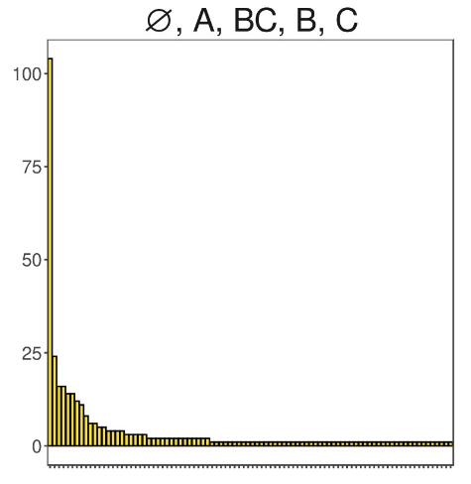
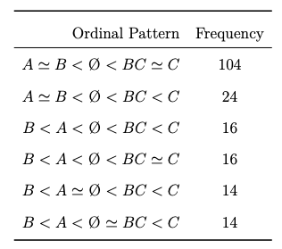
Inverse base-rate effect
|U| = 2,131
|H| = 90

Slide 9

MODELS OF THE IBRE
- Attentional associative-learning models
  EXIT (Kruschke, 2001) - ”Market leader”
  NNRAS, NNCAG (Jones & Paskewitz, 2020) – Simplified versions of EXIT
- Plain-associative model (known poor model)
  LMSNET (Gluck & Bower, 1988; see also Rescorla & Wagner, 1972).
- Dissimilarity-Exemplar models
  DGCM18 (O’Bryan et al., 2018)

Slide 10
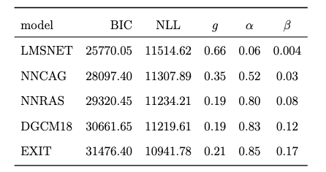
Model adequacy
Split-half on human data

Slide 11

summary
- g-distance is a formal measure of model adequacy, which combines:
  Accommodation
  Excess flexibility
- The inverse base-rate effect (IBRE) is a robust non-rational learning phenomenon.
- Applying g-distance to models of the IBRE
  The success of ‘market leader’ model EXIT may be due to its excess flexibility
  It’s simpler derivative (NNRAS) and a notable alternative (DGCM18) generally outperformed EXIT
- At least in the current case, g-distance better captures model adequacy than the commonly-used Bayesian Information Criterion (BIC) metric.

Slide 12



Special Issue: Advanced Studies in Human-Centred AI
Guest Editor
Prof. Dr. Andy J. Wills
Plymouth University
Dome, L. & Wills, A.J. (2025). g-distance: On the comparison of model and human heterogeneity. Psychological Review, 132, 632–655.
Special Issue Information:
Human-centred AI puts human behaviour and experience at the heart of artificial intelligence research. We welcome original papers on topics in human-centred AI. The papers may be theoretical, empirical, or both. They may report new findings, or synthetically review the existing literature.

