Slide 1
Categorical Decisions
Andy Wills
Fergal Jones, Stian Reimers, Neil Stewart
Mark Suret, Ian McLaren.
Notes:
Collaborators
Many learnig/memory theories
Psychological Magnitude term
Categorical Example
Connectionist - Activation
Associative - e.g. Sum assoc. str.
Exemplar - Summed similarity
Normative
General Decision mechanism issue
Specific topic here

Slide 2
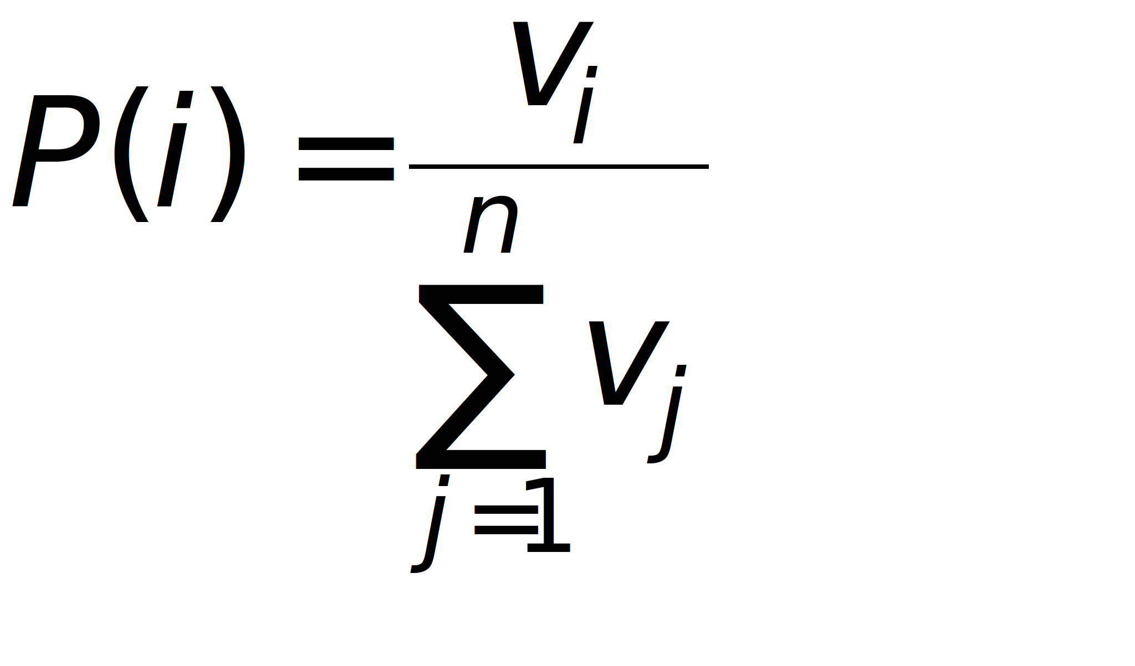
The Ratio Rule
Constant-Ratio Rule (Clarke, 1957)
Luce Choice Axiom (Luce, 1959)
Notes:
A common answer
IAM, Distributed memory model, ALCOVE, GCM.
Not justified
Pair-comparison experiments
Full-set vs. sub-set.
My idea - Test what seems to be a central tenet of this theory:
It’s the ratio of magnitudes that matters, not the absolue levels.

Slide 3
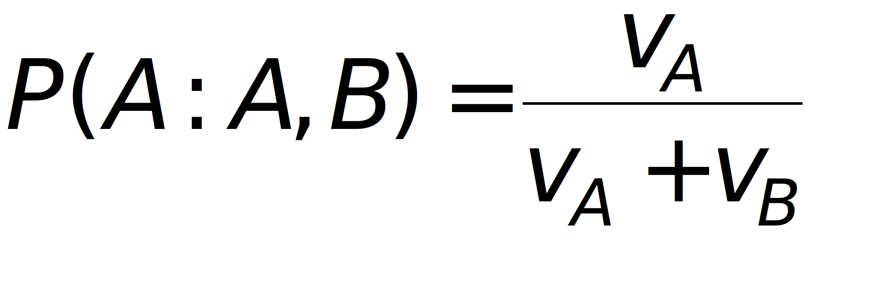
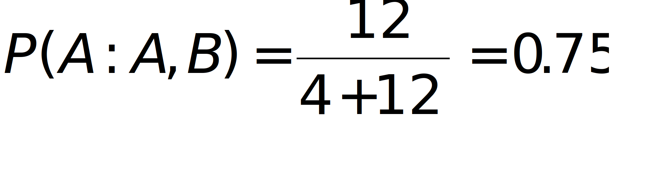
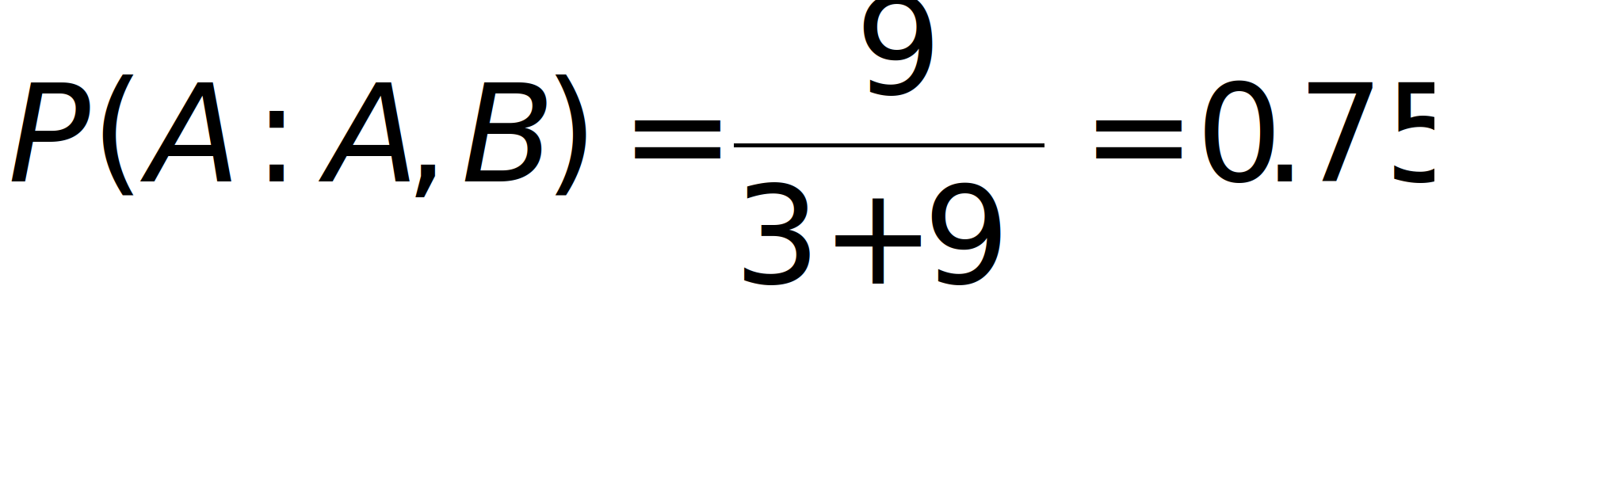
Notes:
Ilustrative example
THINKS - Shouldn’t be too difficult to disprove experimentally.
Use of Ratio Rule particularly common in theories of categorization.
Define categorization.
Test Ratio principle in simple 2 category task

Slide 4
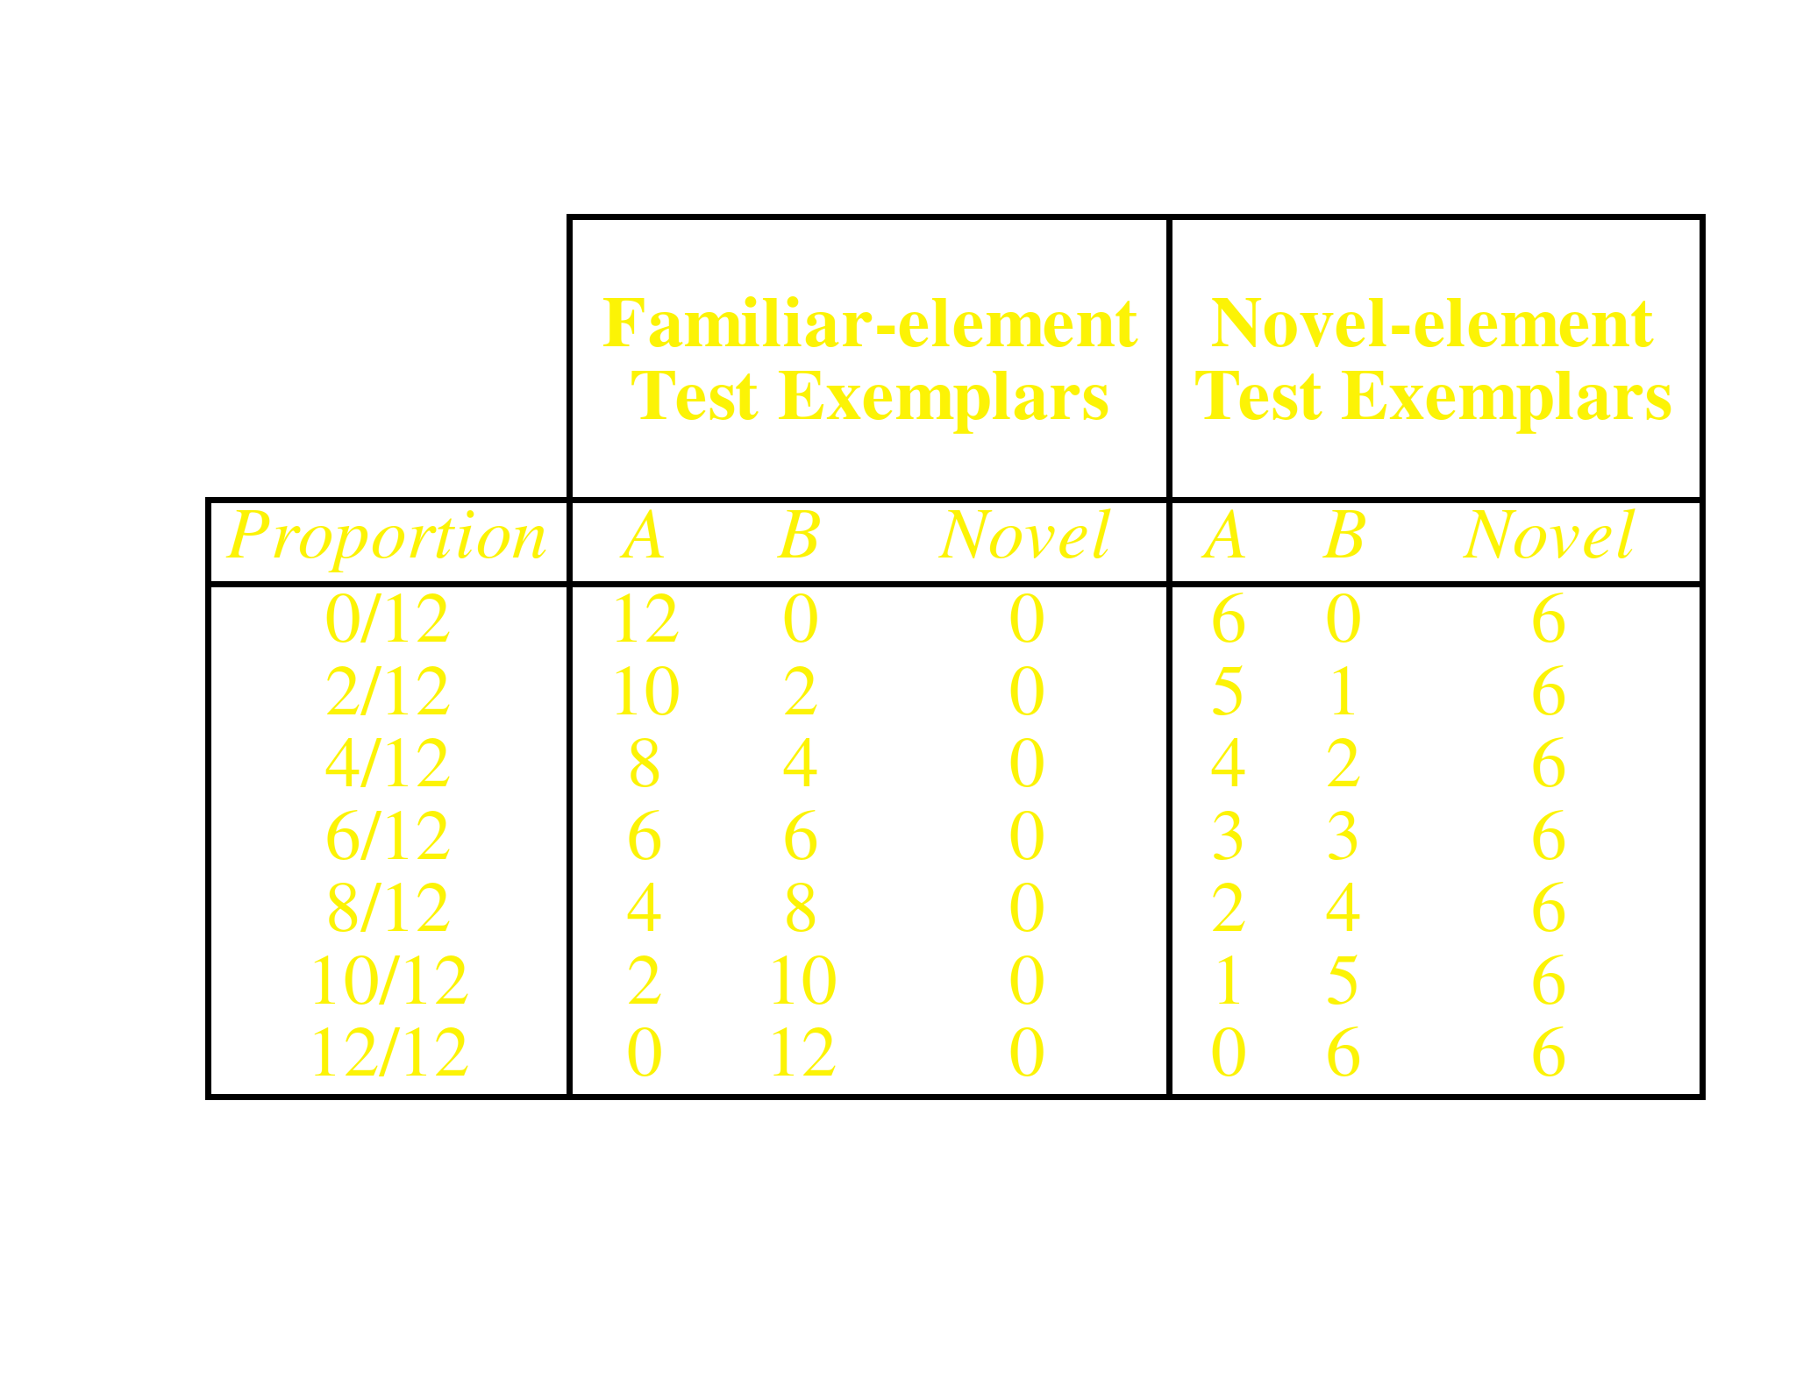
Generalisation Test
Notes:
Two types of test stimuli
Familiar - Examples range from all A features to all B features
Novel - Equivalent proportions, but inserted novel elements.

Slide 5
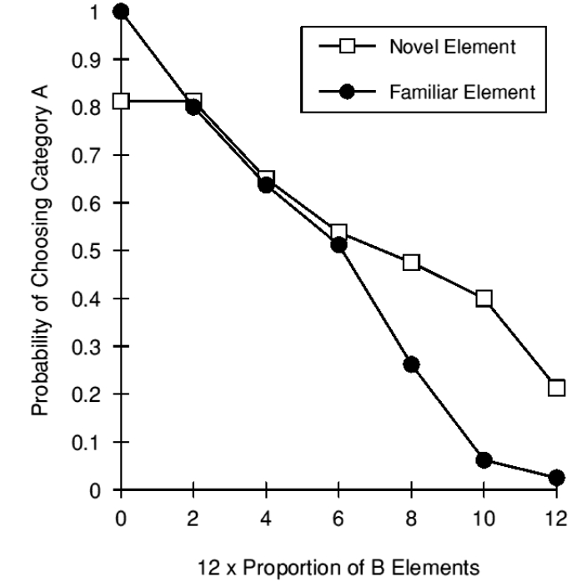
Notes:
Highly significant effect on response probabilities. As one might expect.
Most models of categorization would predict magnitude terms for categories A and B increase equally as a result extended training
Hence, Ratio would be preserved, and generalisation function should not be affected by increasing training.

Slide 6
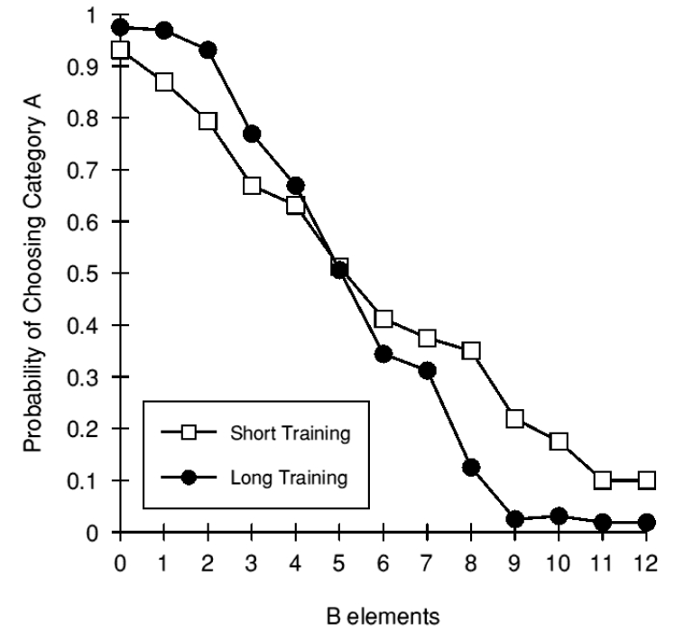
Notes:
Not the case
Results can be reconciled with RR
Category-appropriate elements as similarity measure.

Slide 7
Non-linear Magnitude Functions
Magnitude term
Low
High
Similarity
Notes:
Non-linear relationship to magnitude?
Ratio of magnitude terms is not preserved when ratio of similarity index is.
NB: Accelerating!
A number of theories e.g. a simple elemental delta rule network, would predict linear magnitude functions. Is RR wrong for them?

Slide 8
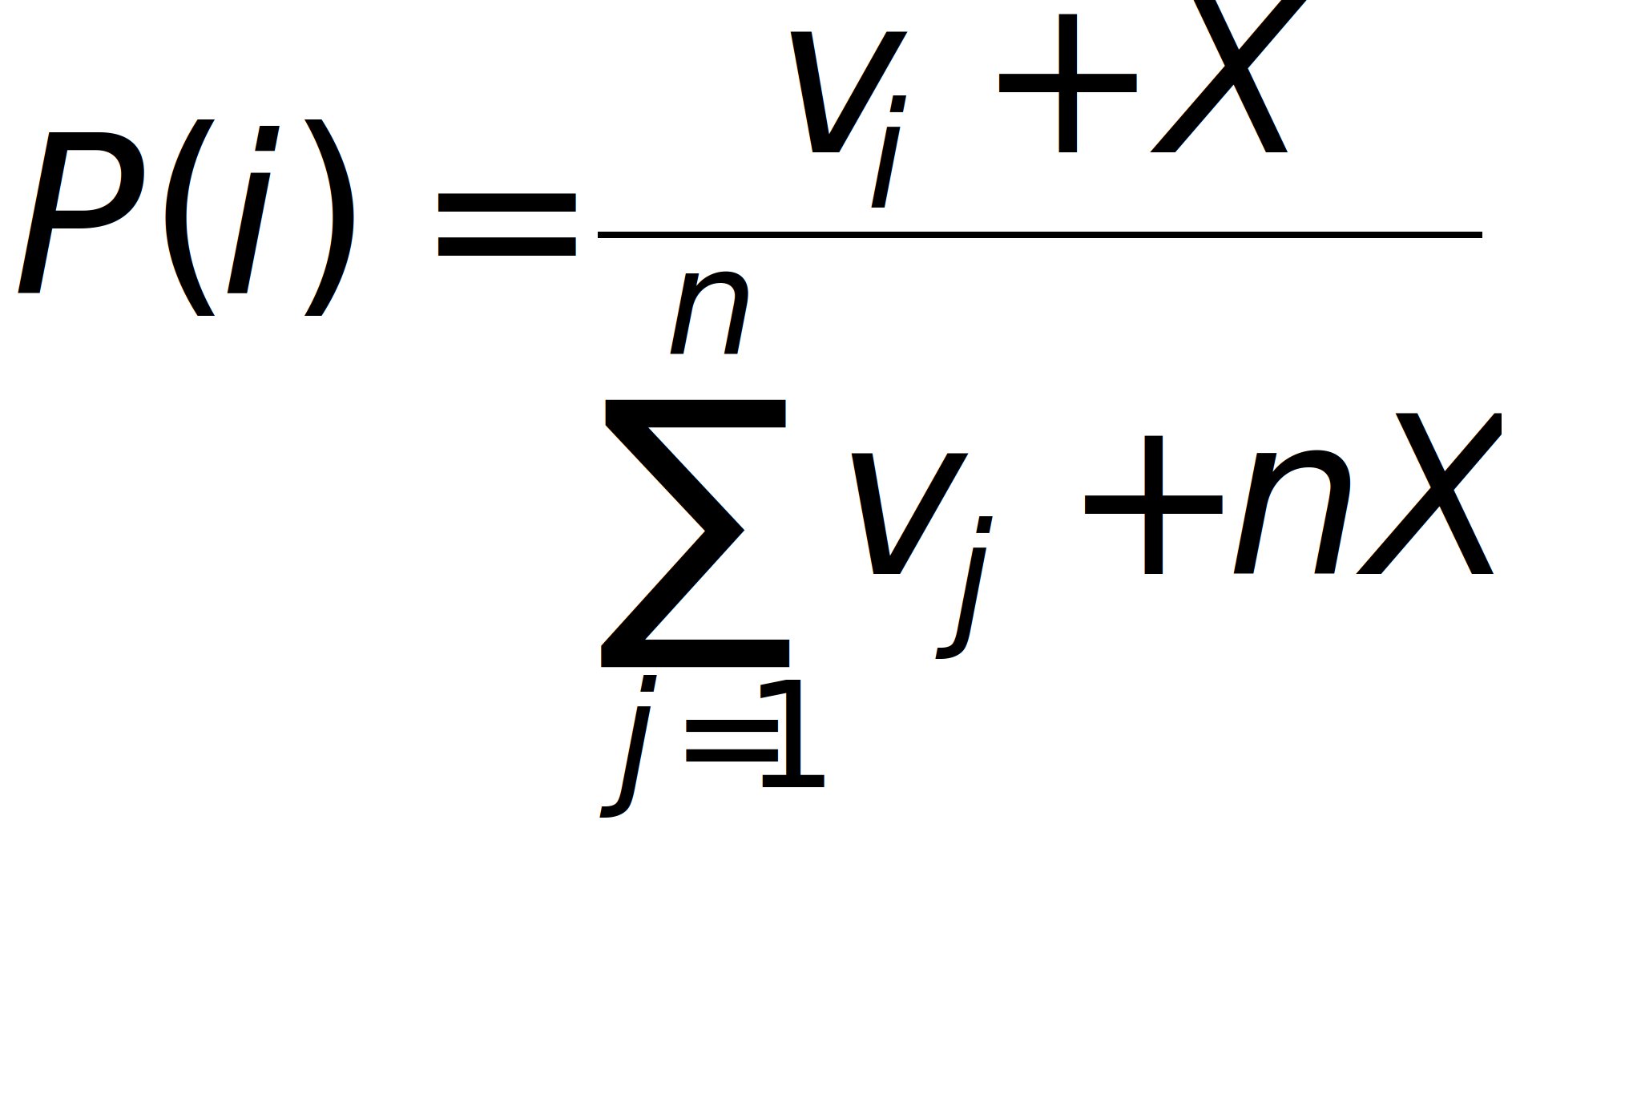
Background Noise Constant
Aitken (1996)
Nosofsky & Zaki (1998)
Notes:
Technically yes.
A minor modification fixes it though.
OK - so let’s design an experiment not affected by exact shape of magnitude function, or this background noise modification.
Difficult to empirically test anything without some assumptions.

Slide 9
Central Assumption
The magnitude term for a specific category produced by a stimulus is a univariate function of the number of category-appropriate elements that stimulus contains.
Notes:
This is the crucial one - explain, example.
Return to the implications of this assumption later.

Slide 10
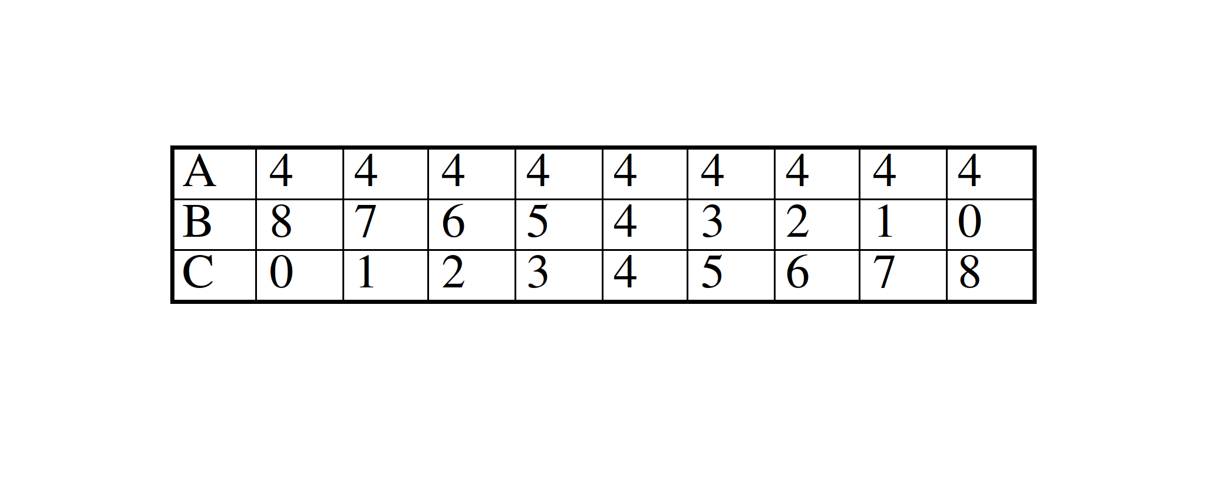
Full-set / Sub-set Relationship
Train on three categories
Test on examples where magnitude for one category is fixed:
Ask subjects one of two questions:
  Category A, B or C?
  Category B or C (A disallowed)?
Notes:
Variant of the full-set / sub-set test
Describe.
Prediction of Ratio Rule under test involves two measures, and the relationship between the two.

Slide 11
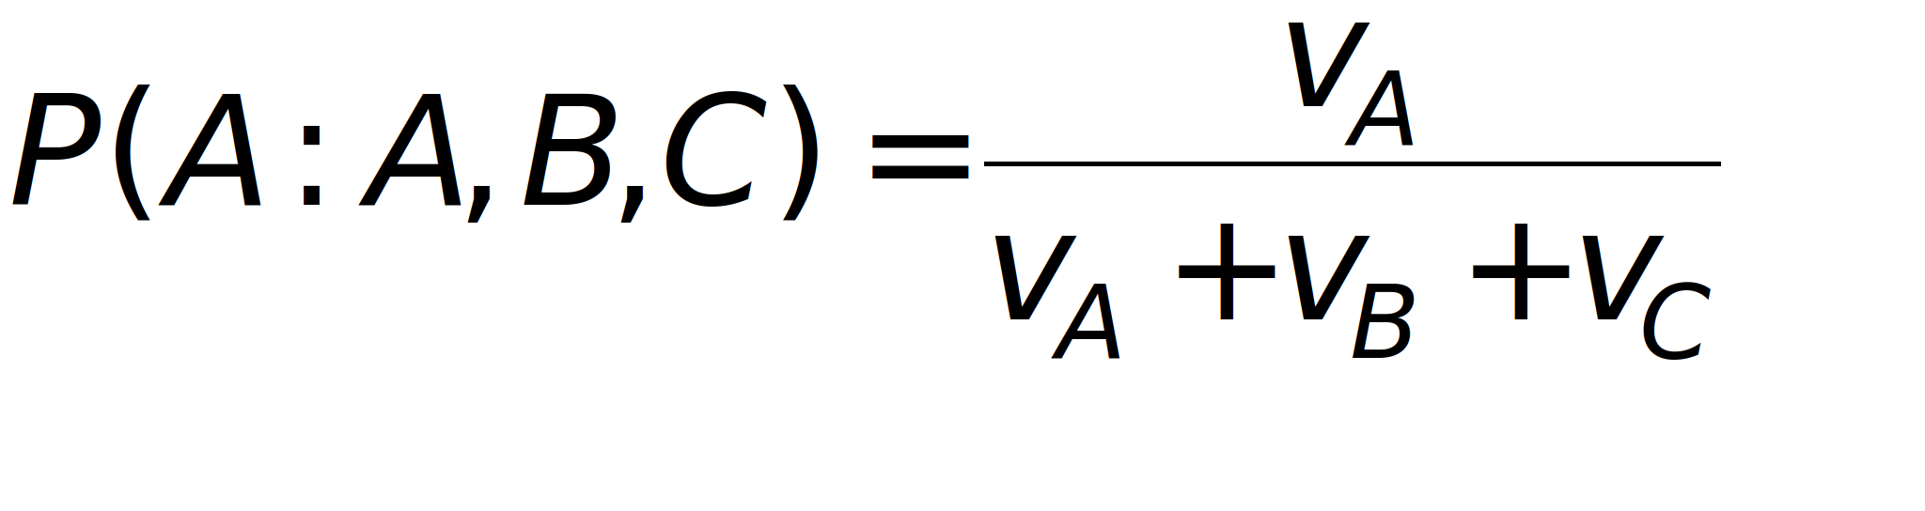
Dependent Measure I
Probability of choosing the fixed-magnitude alternative:
Notes:
Descibe

Slide 12
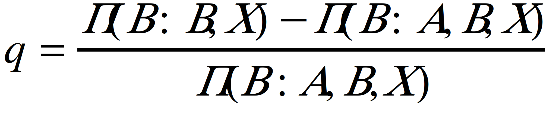
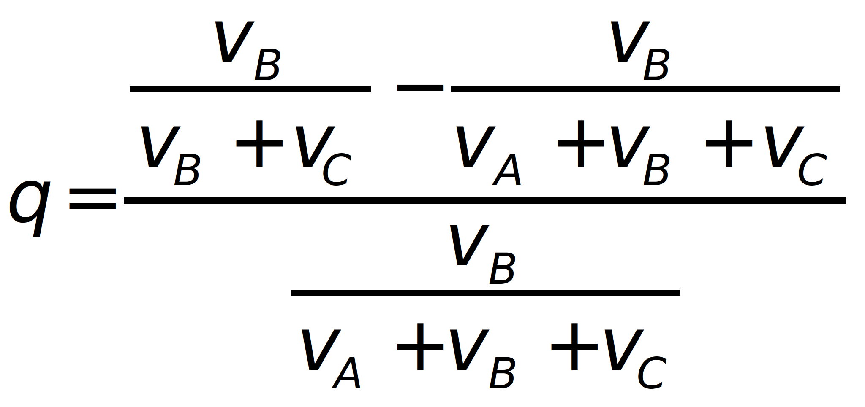
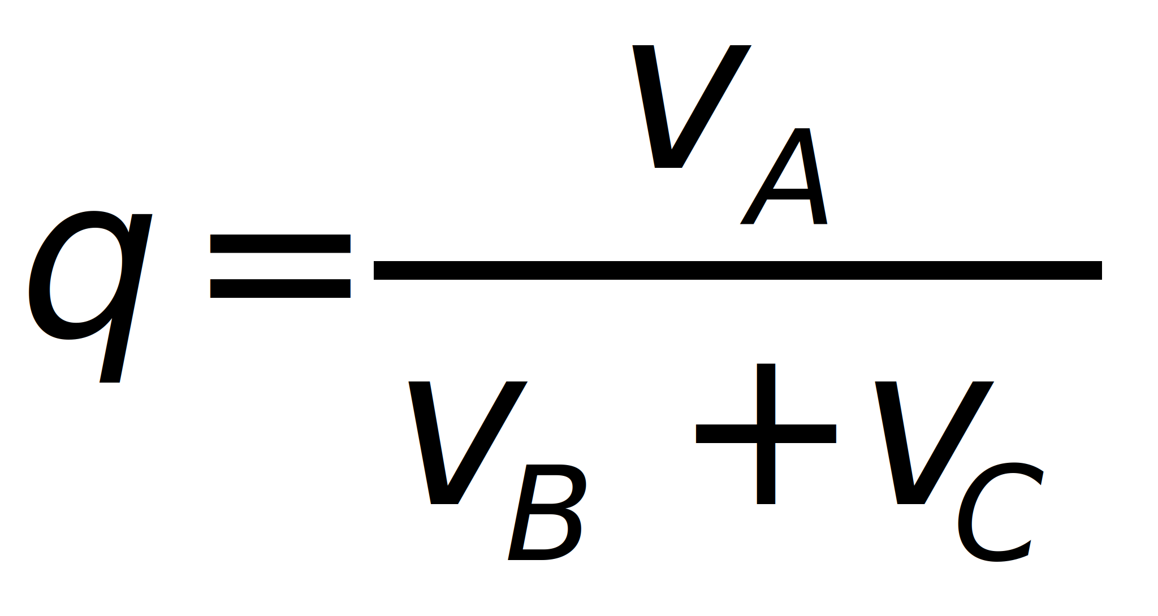
Dependent Measure II
Notes:
Describe

Slide 13
A Prediction of the Ratio Rule
Compare the two equations:
Any given change in (v_{B}+v_{C}) must produce the same direction of change in q and P(A:A,B,C)
Notes:
Describe
Not affected by background noise modification
Assumption of equivalent functions

Slide 14
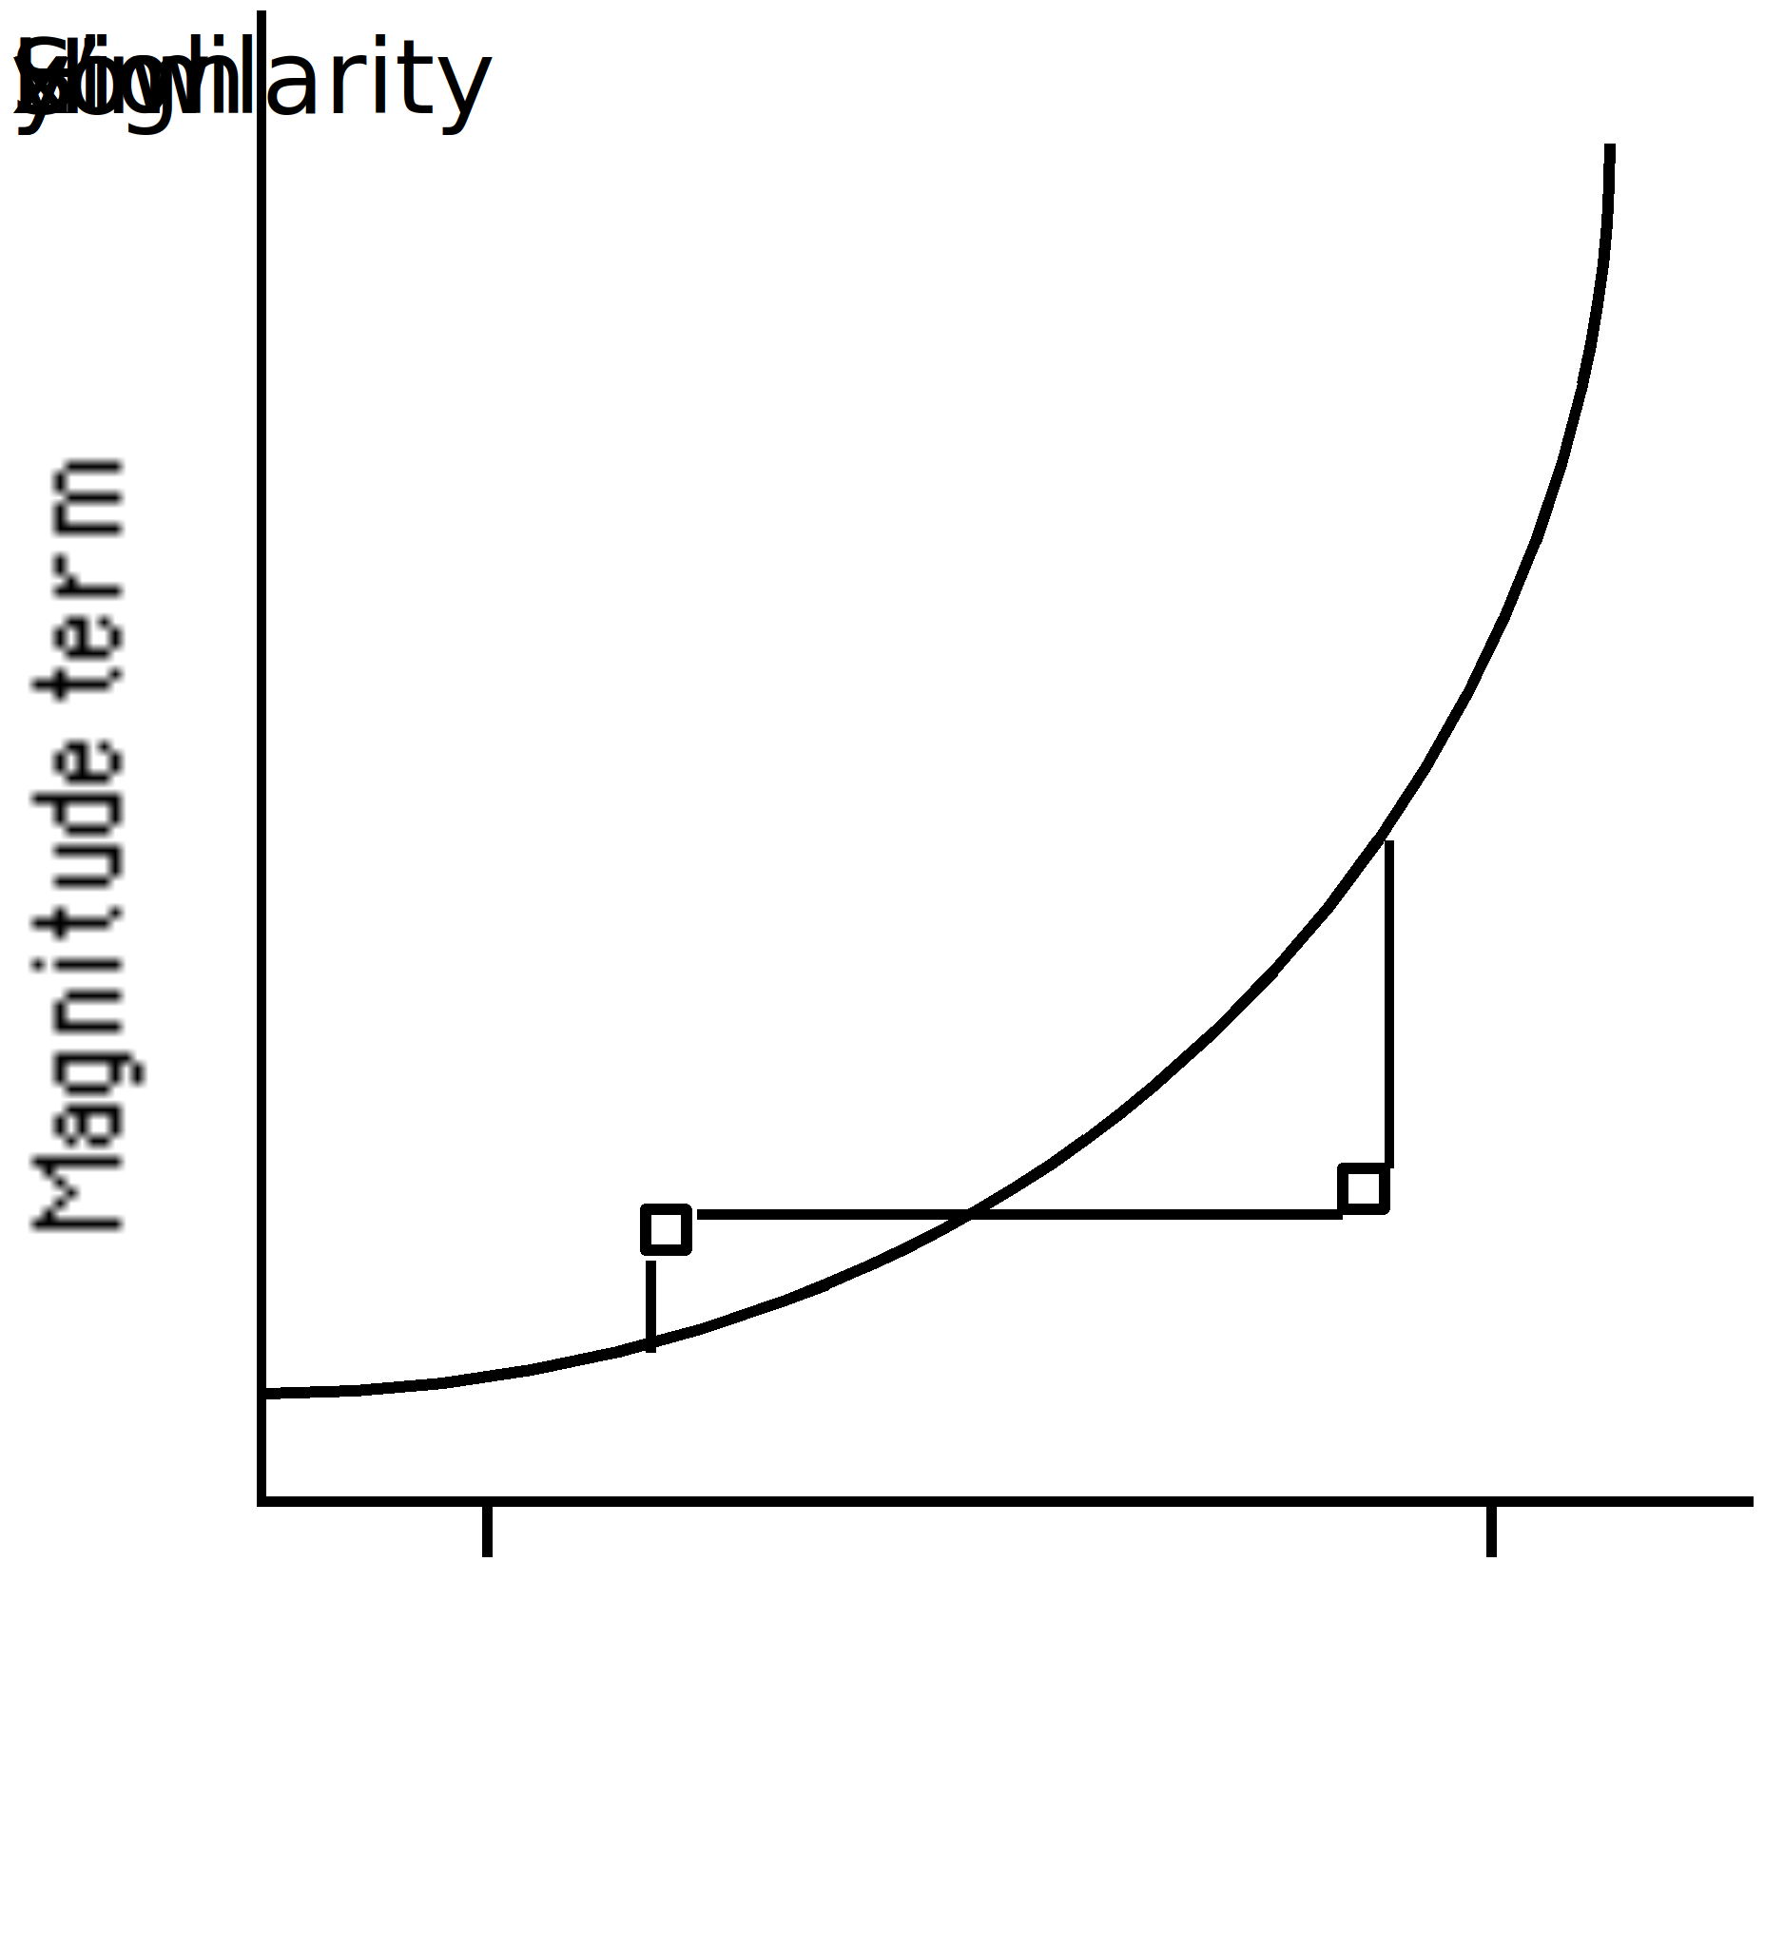
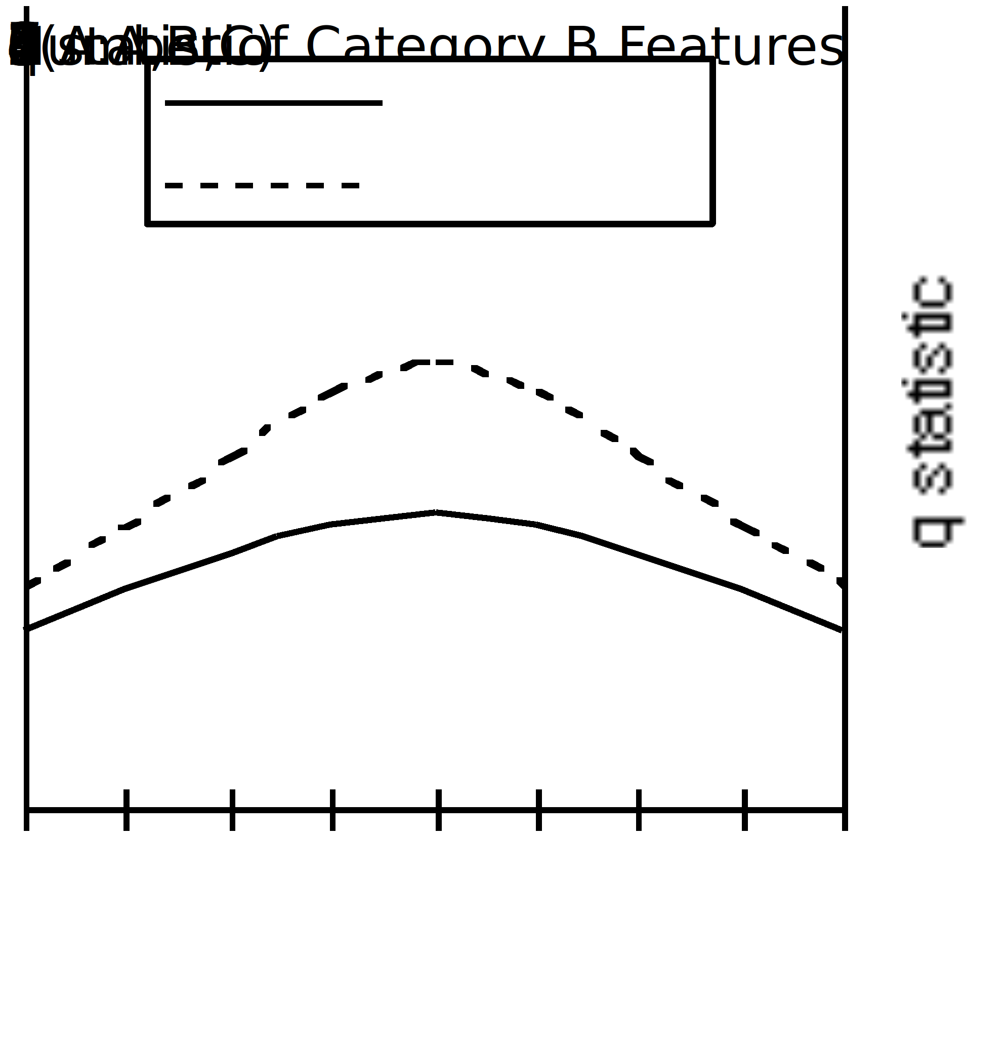
Further Predictions
Notes:
If true, functions symmetrical about 4.
Shape of functions determined by shape of magnitude function
Describe accelerating.

Slide 15
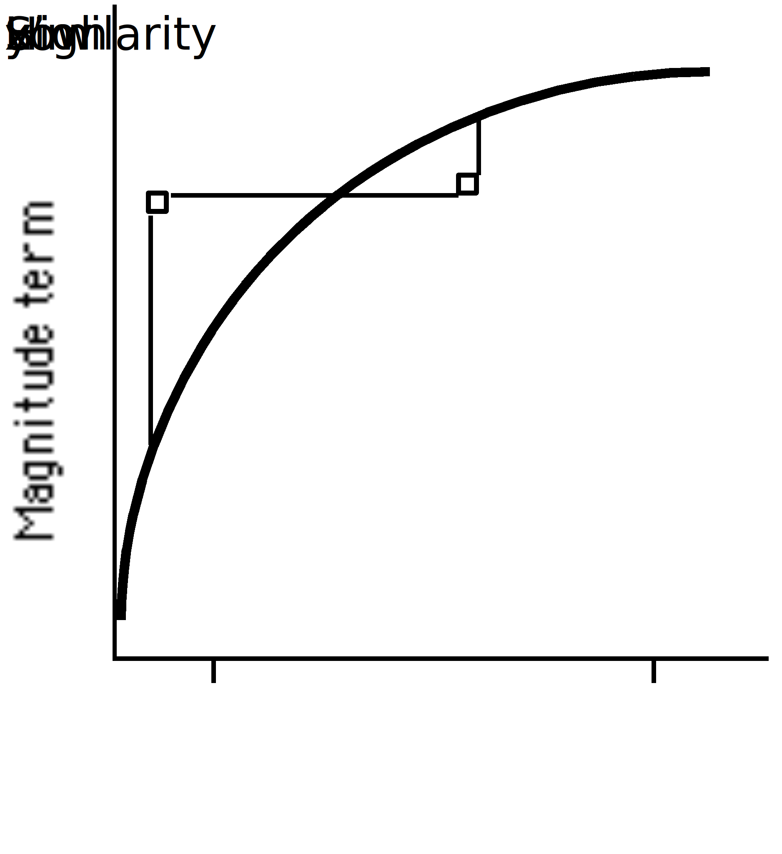
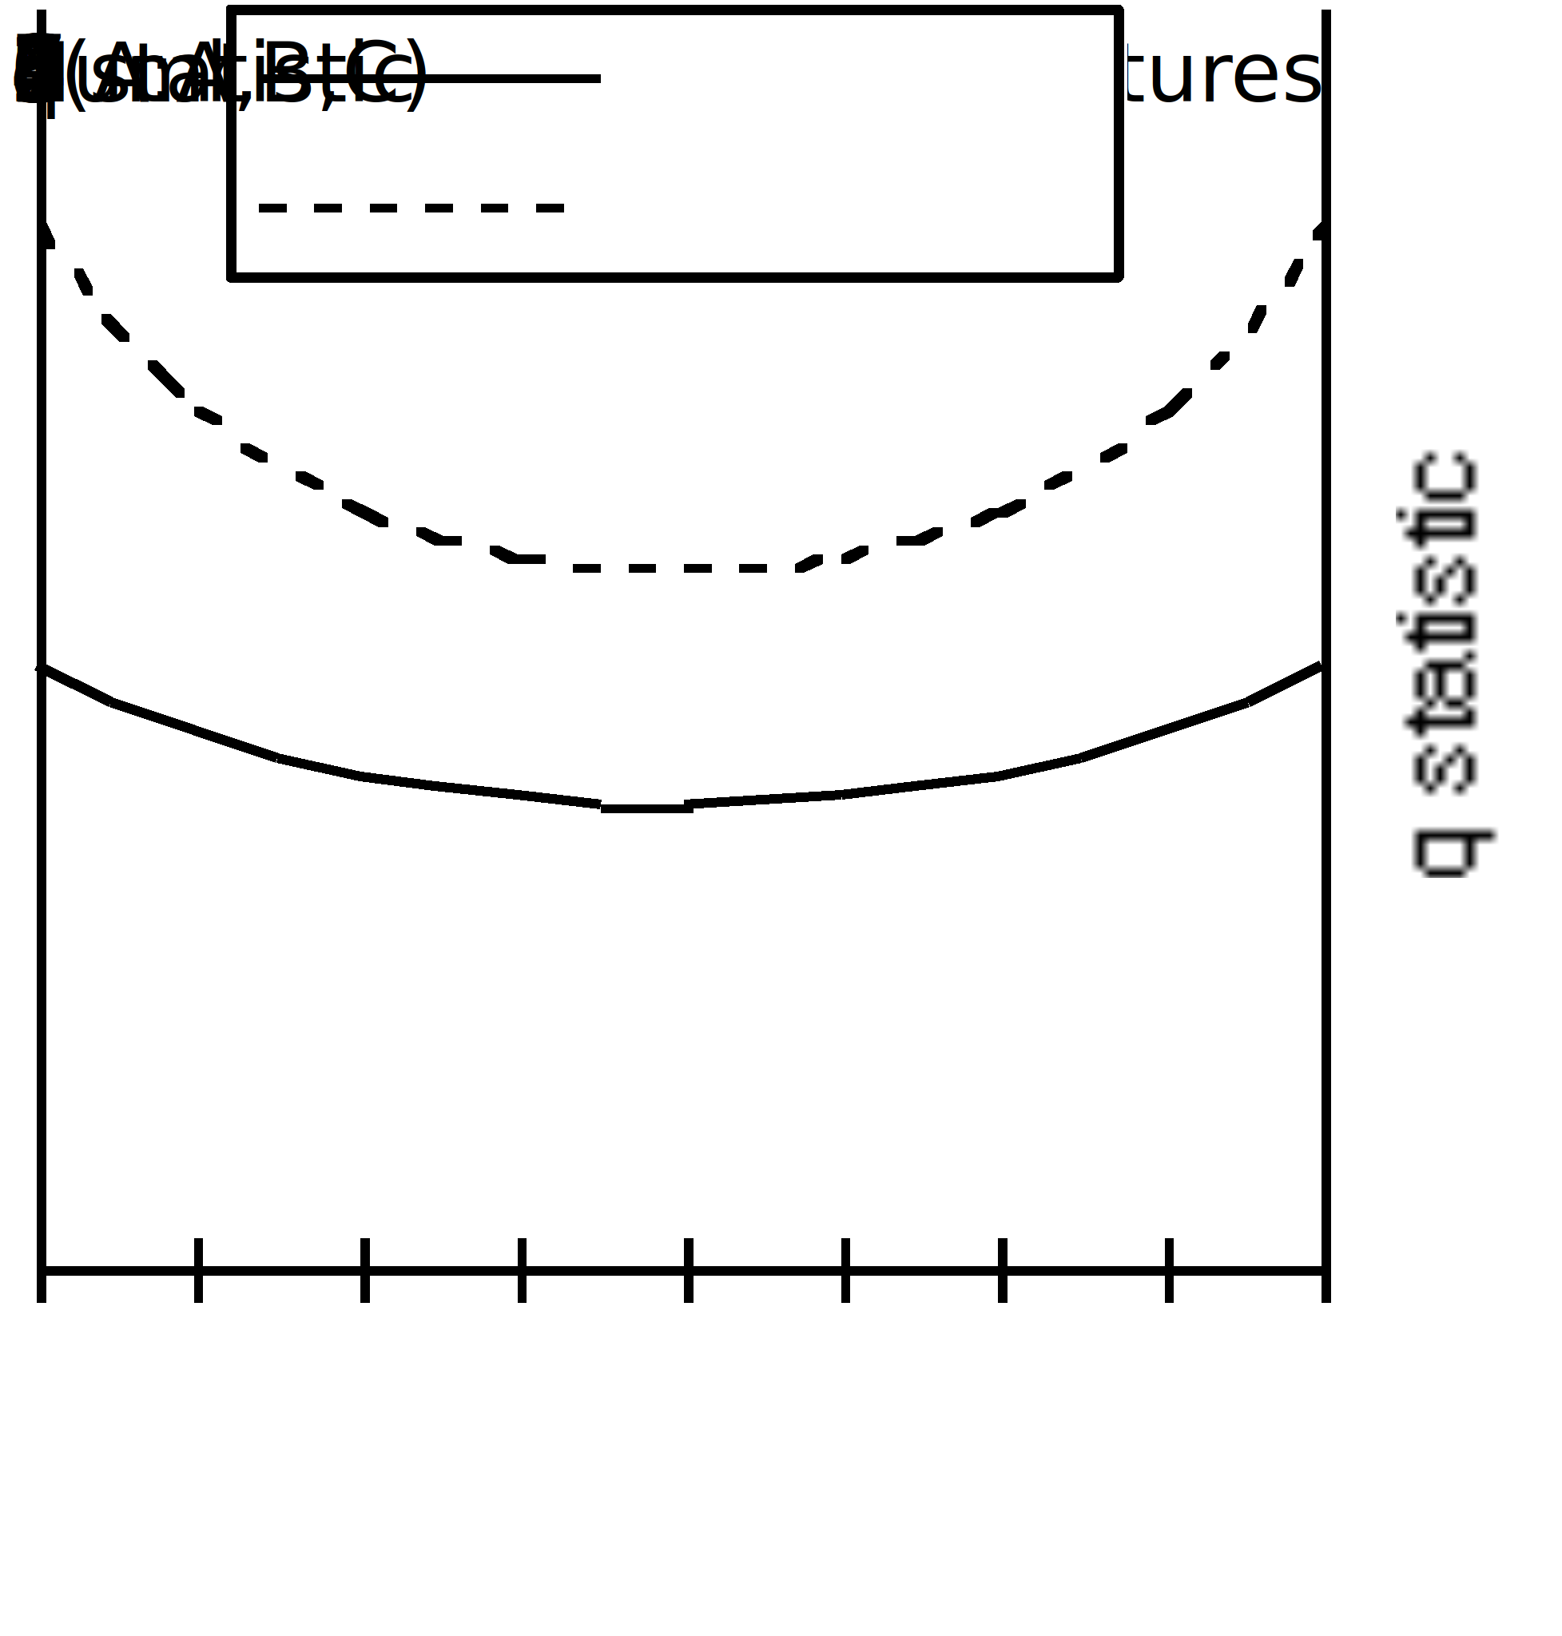
Further Predictions
Notes:
Describe decelerating.

Slide 16
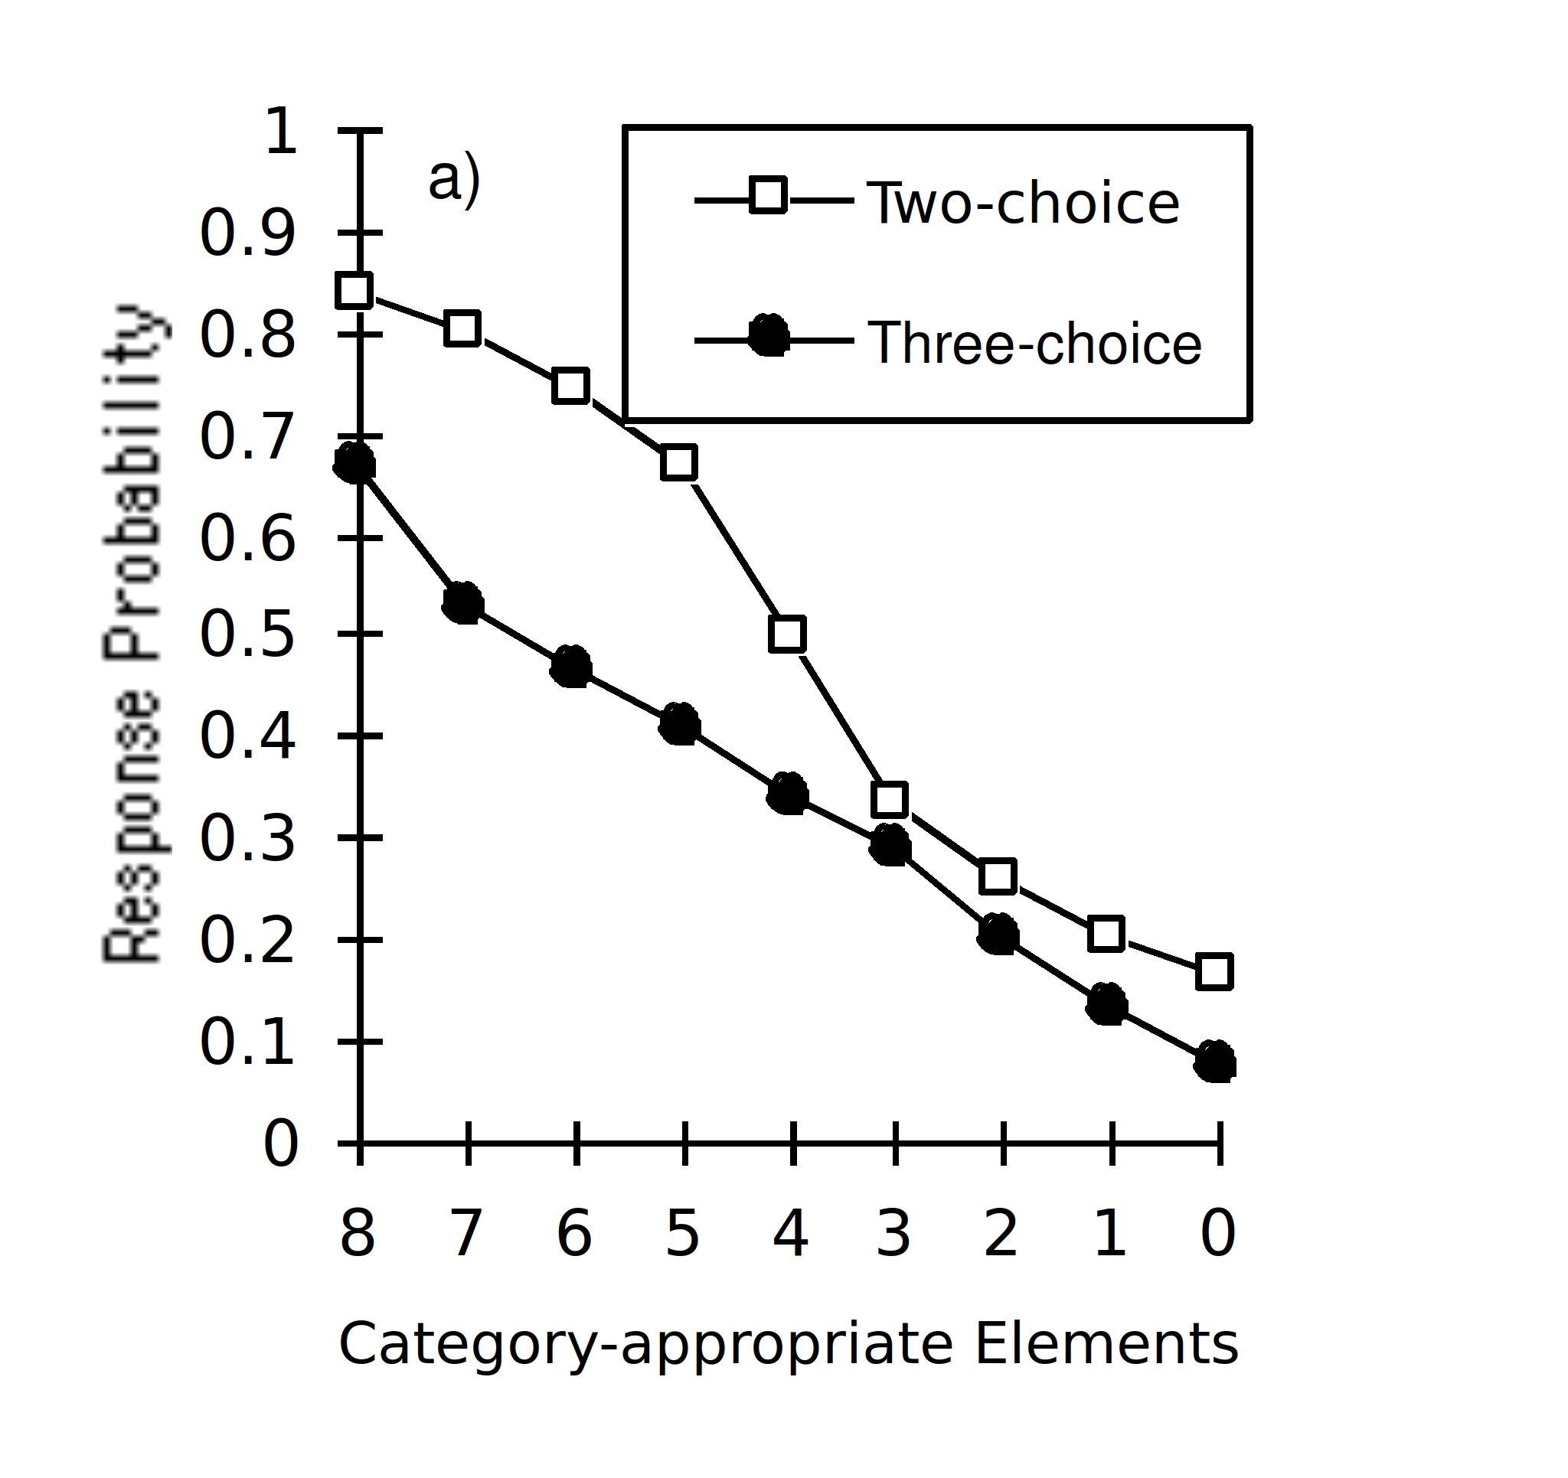
Notes:
Describe

Slide 17
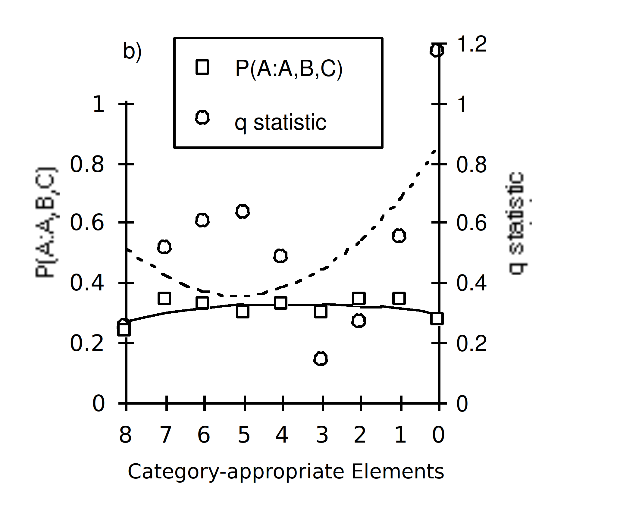
Notes:
Describe
Not same direction of change
Best-fitting quadratics not of same sign
But neither function a significant fit
q cubic? Possible, but not replicated.
What about under further assumption?
q certainly doesn’t seem symmetrical, but maybe just random variation
If so, must be reasonable to average from centre...

Slide 18
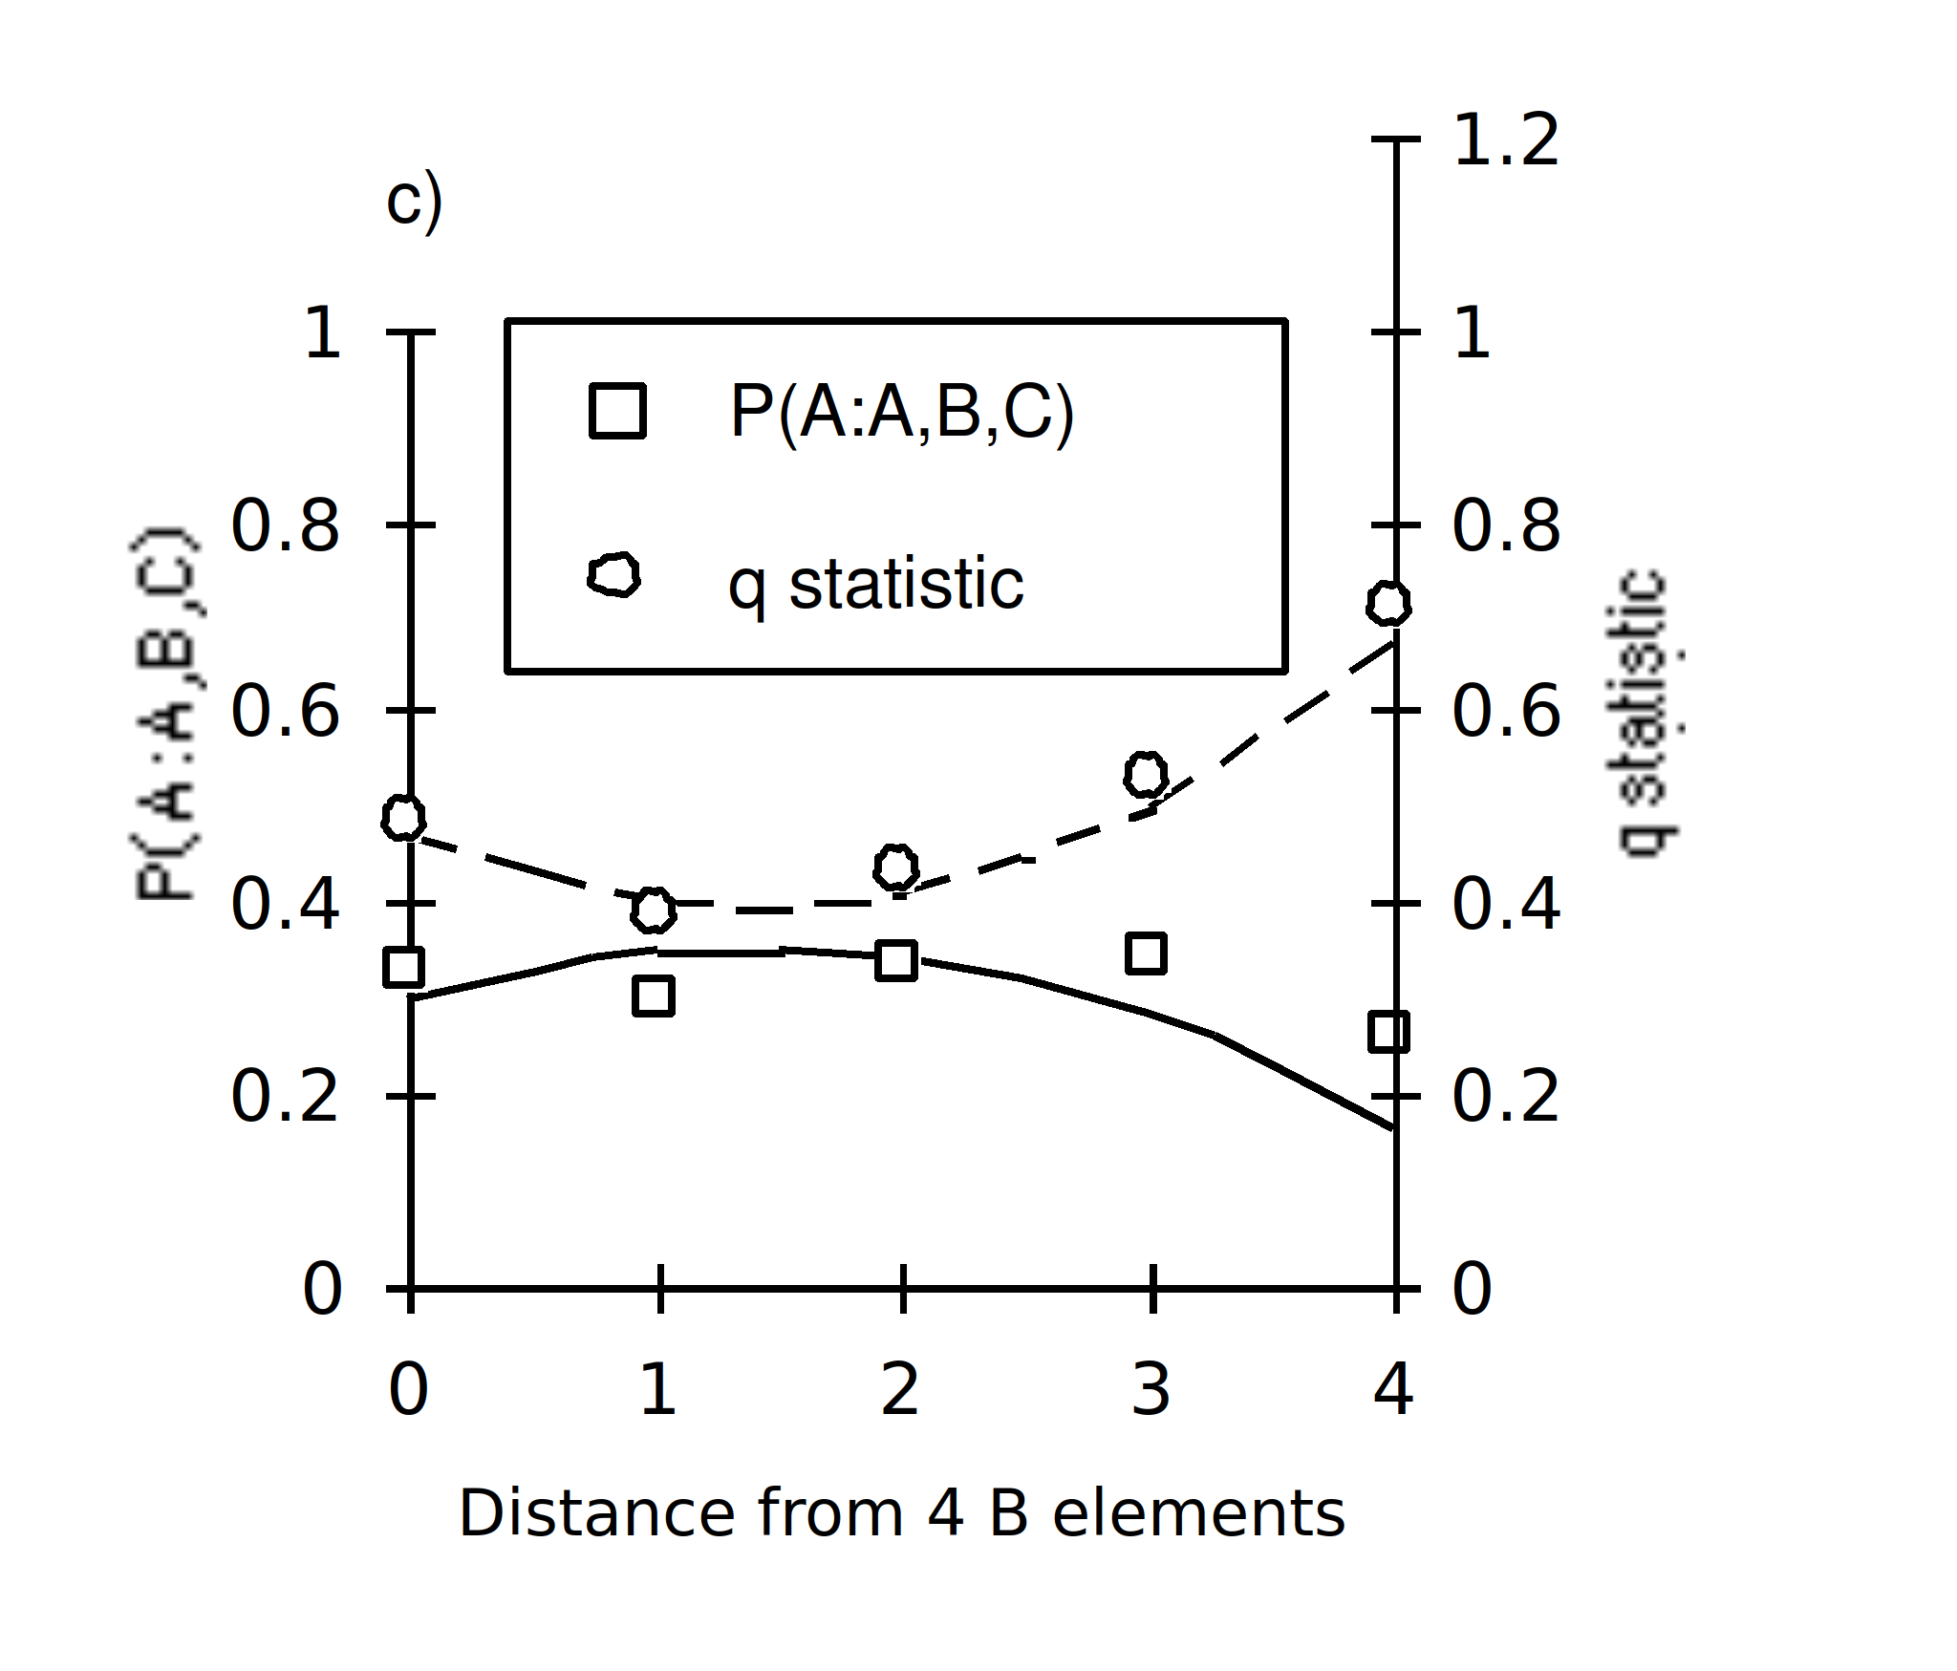
Notes:
Do this. q now a significant fit to U quadratic.
P(A) best fit is a inverted-U-shaped. But fit not quite signficiant.
Monotonically accelerating out,
Decelerating possible, but opposite to what’s needed for earlier experiments.
Seemed anomalous enough (from RR perspective) to merit replication.
In replication - COUNTERBALANCE
Did this - plus extension

Slide 19
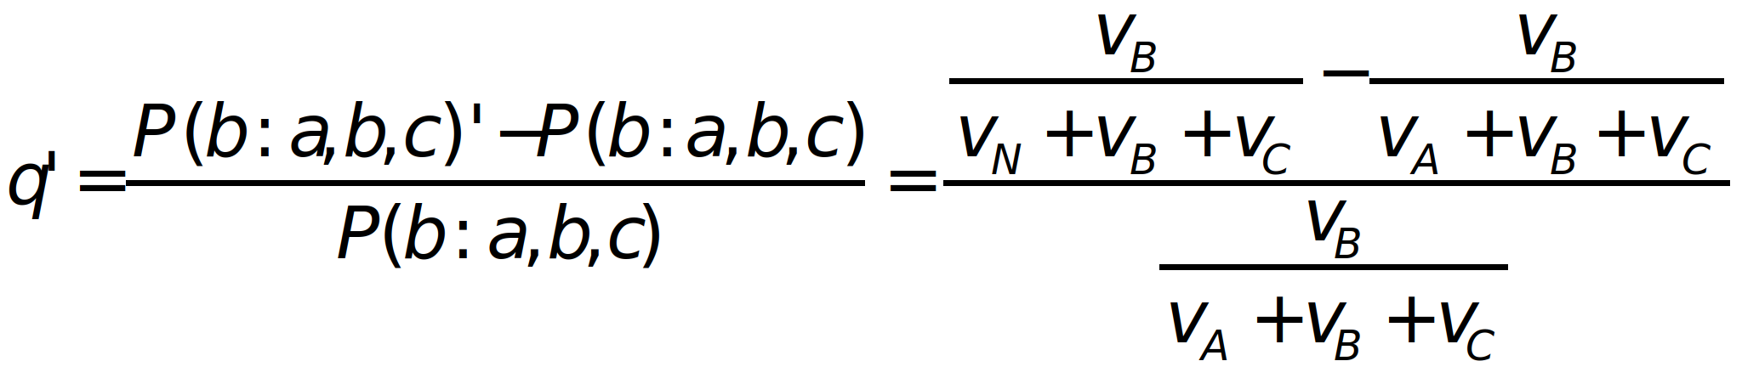
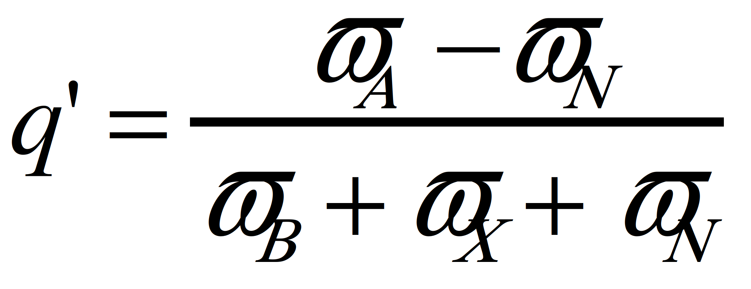
Replication and Extension
Extra three-choice condition - category A elements replaced with novel elements at test.
Notes:
Describe

Slide 20
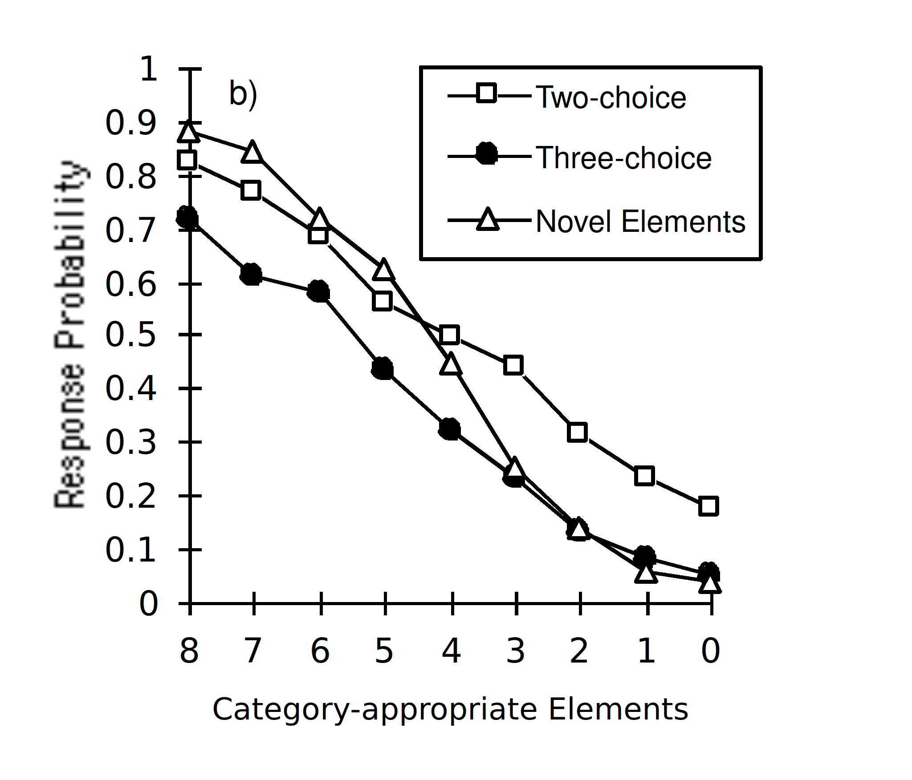
Notes:
Describe

Slide 21
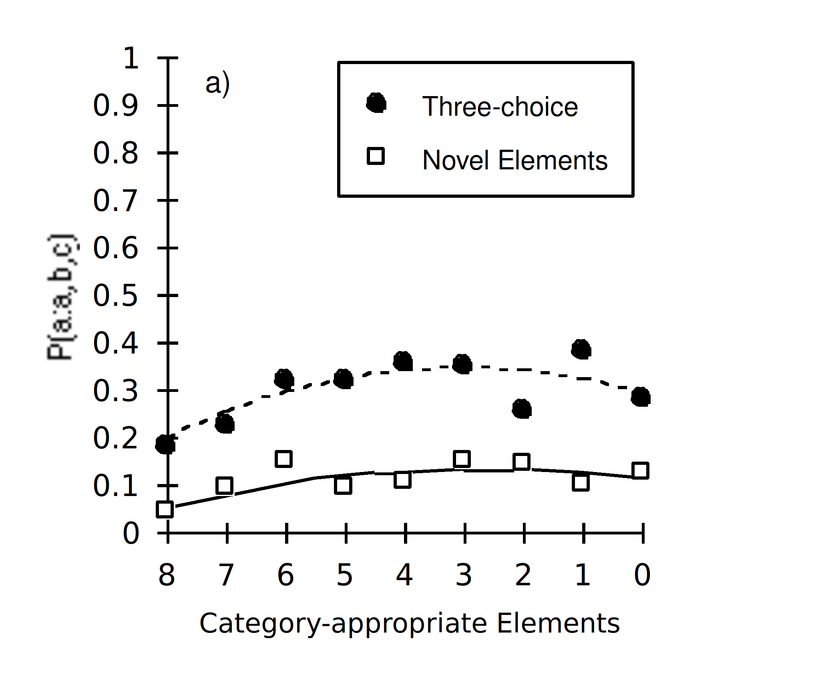
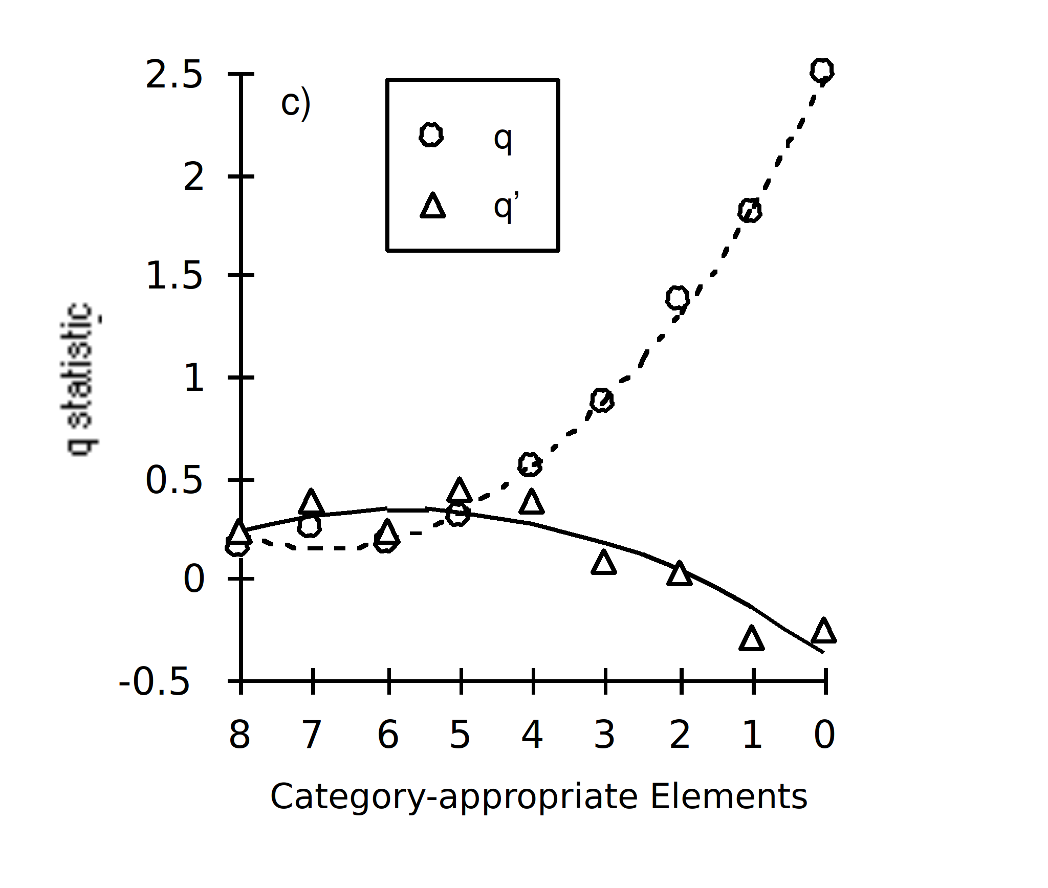
Notes:
Desribe
All fit quadratics except p(A) prime
Compound problems. Ratio Rule in big trouble.
It’s a big issue - lots of models based on it.
How might one avoid the conclusion
1) Not univariate for specific models. Nosofsky GCM example
2) Magnitude terms affected by available alternatives

Slide 22
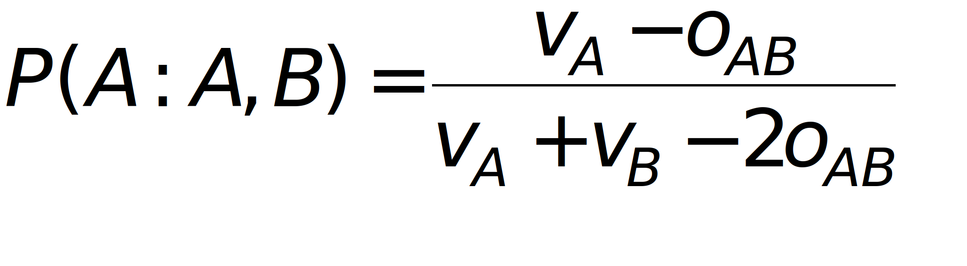
Modification of the Ratio Rule?
Restle modification
Tversky extension
Notes:
E.g. Restle’s modification
Not extended to N-case
Tversky eliminatio by aspects is but...
Replaces mag. terms with set of numbers for importance of aspects of each alternative.
Significant modification to current models needed.
Is there a more straightforward alternative?

Slide 23
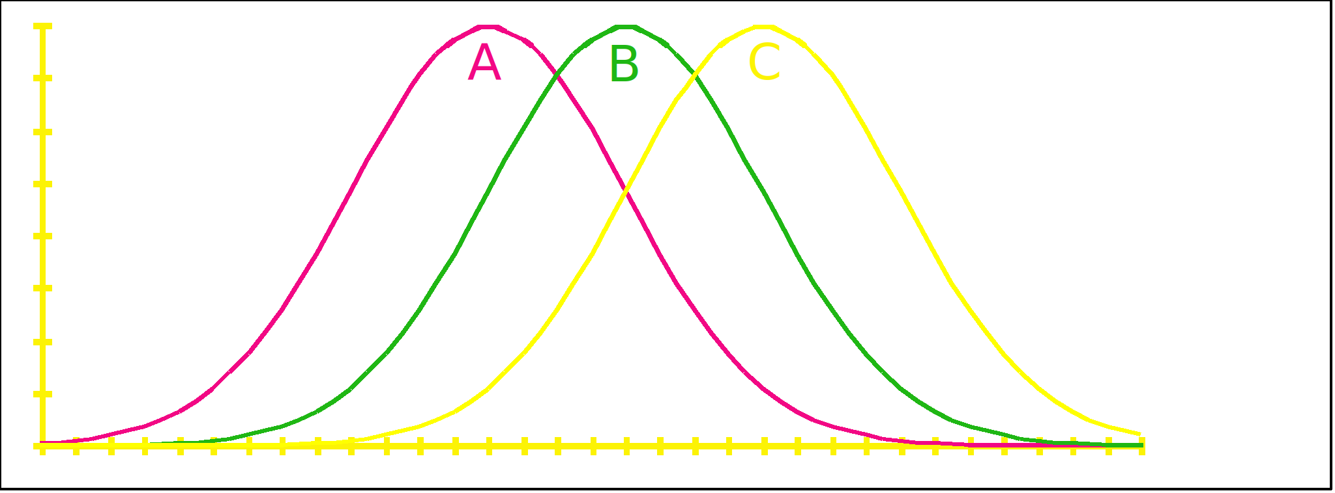
Thurstonian Choice
Pick the biggest from noisy alternatives
Notes:
Describe
Nonsenseabout being equivalent to Ratio Rule or empirically indistinguishable

Slide 24
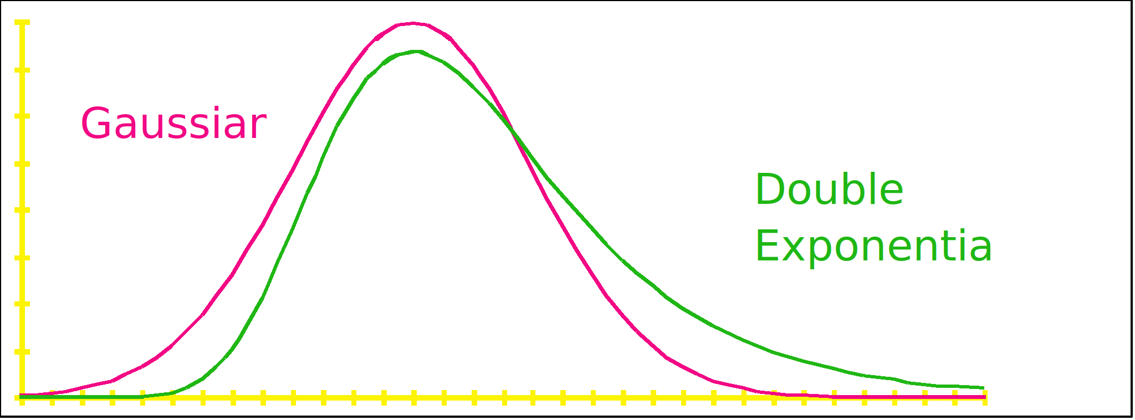
Thurstonian Choice
Ratio Rule and Thurstonian Choice not equivalent
Notes:
Neither true - Yellot’s proof
Been distiguished on goodness-of-fit tests in pair-comparison before. Results unclear
Application of Thurstone to >2 choices non-trivial. No simple analytic solution.
Simulation of previous experiment, assuming linear magnitude function and Gaussian noise

Slide 25
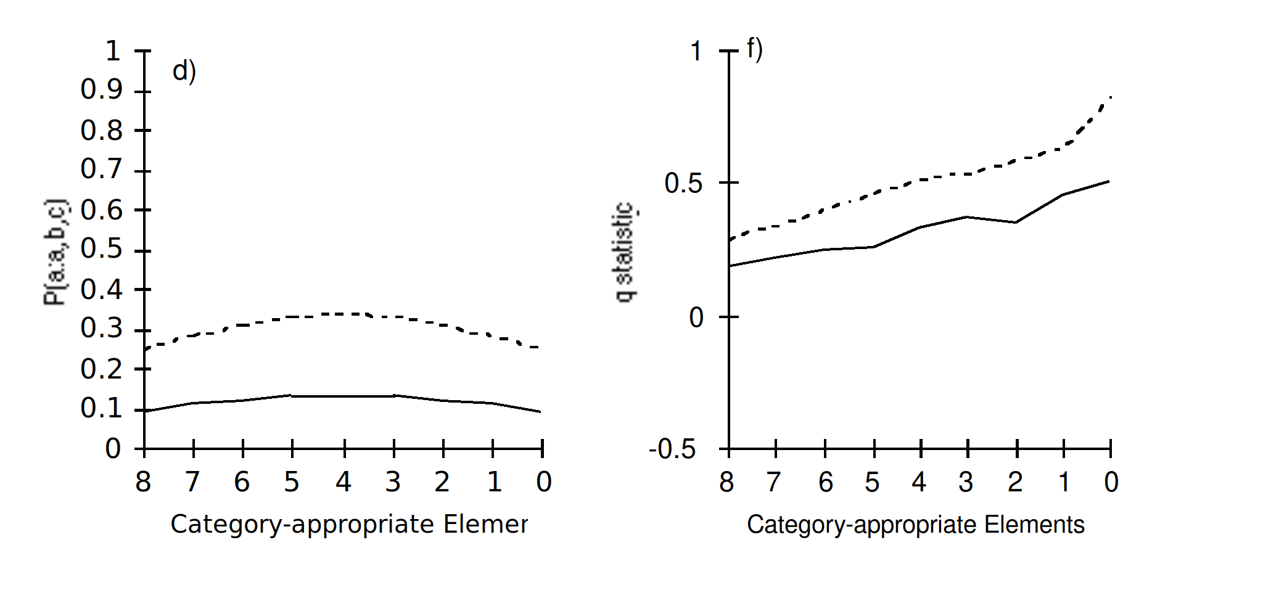
Simulation
Notes:
Predicts basic trends in P(A) and q
BUT spend no more time on it because:
Not very quantitatively close
Doesn’t predict q’ data
Like Ratio Rule, says nothing about process by which decision is actually made
Early as mid-60s, Stephen Grossberg demonstrated how one might get a collection of neuron-like units to come to a decision.

Slide 26
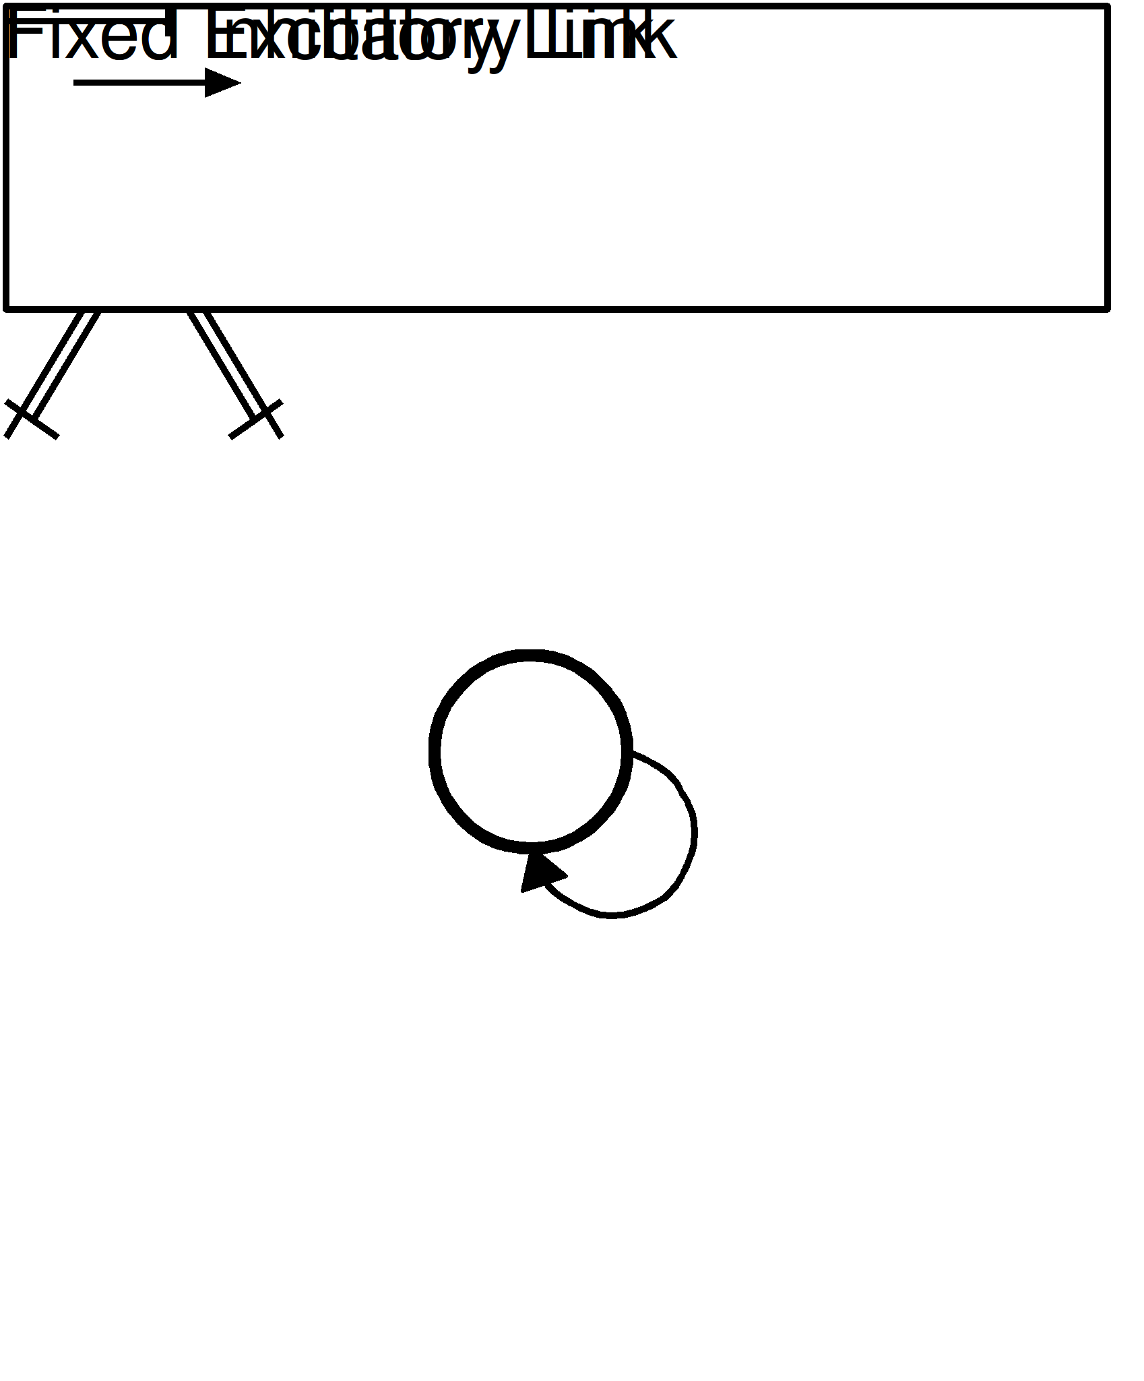
Connectionist Implementation
Notes:
S elf-excitation and mutual inhibition.
Left to settle - only one unit with non-zero activity
Noisy inputs - connectionist implementation of Thurstonian choice
I proposed a couple of years ago, that the rate at which this system comes to a decision might be under external control
Decision threshold.
Increase threshold - trade speed for accuracy
Hypothesis: People do this in response to the novel test items.

Slide 27
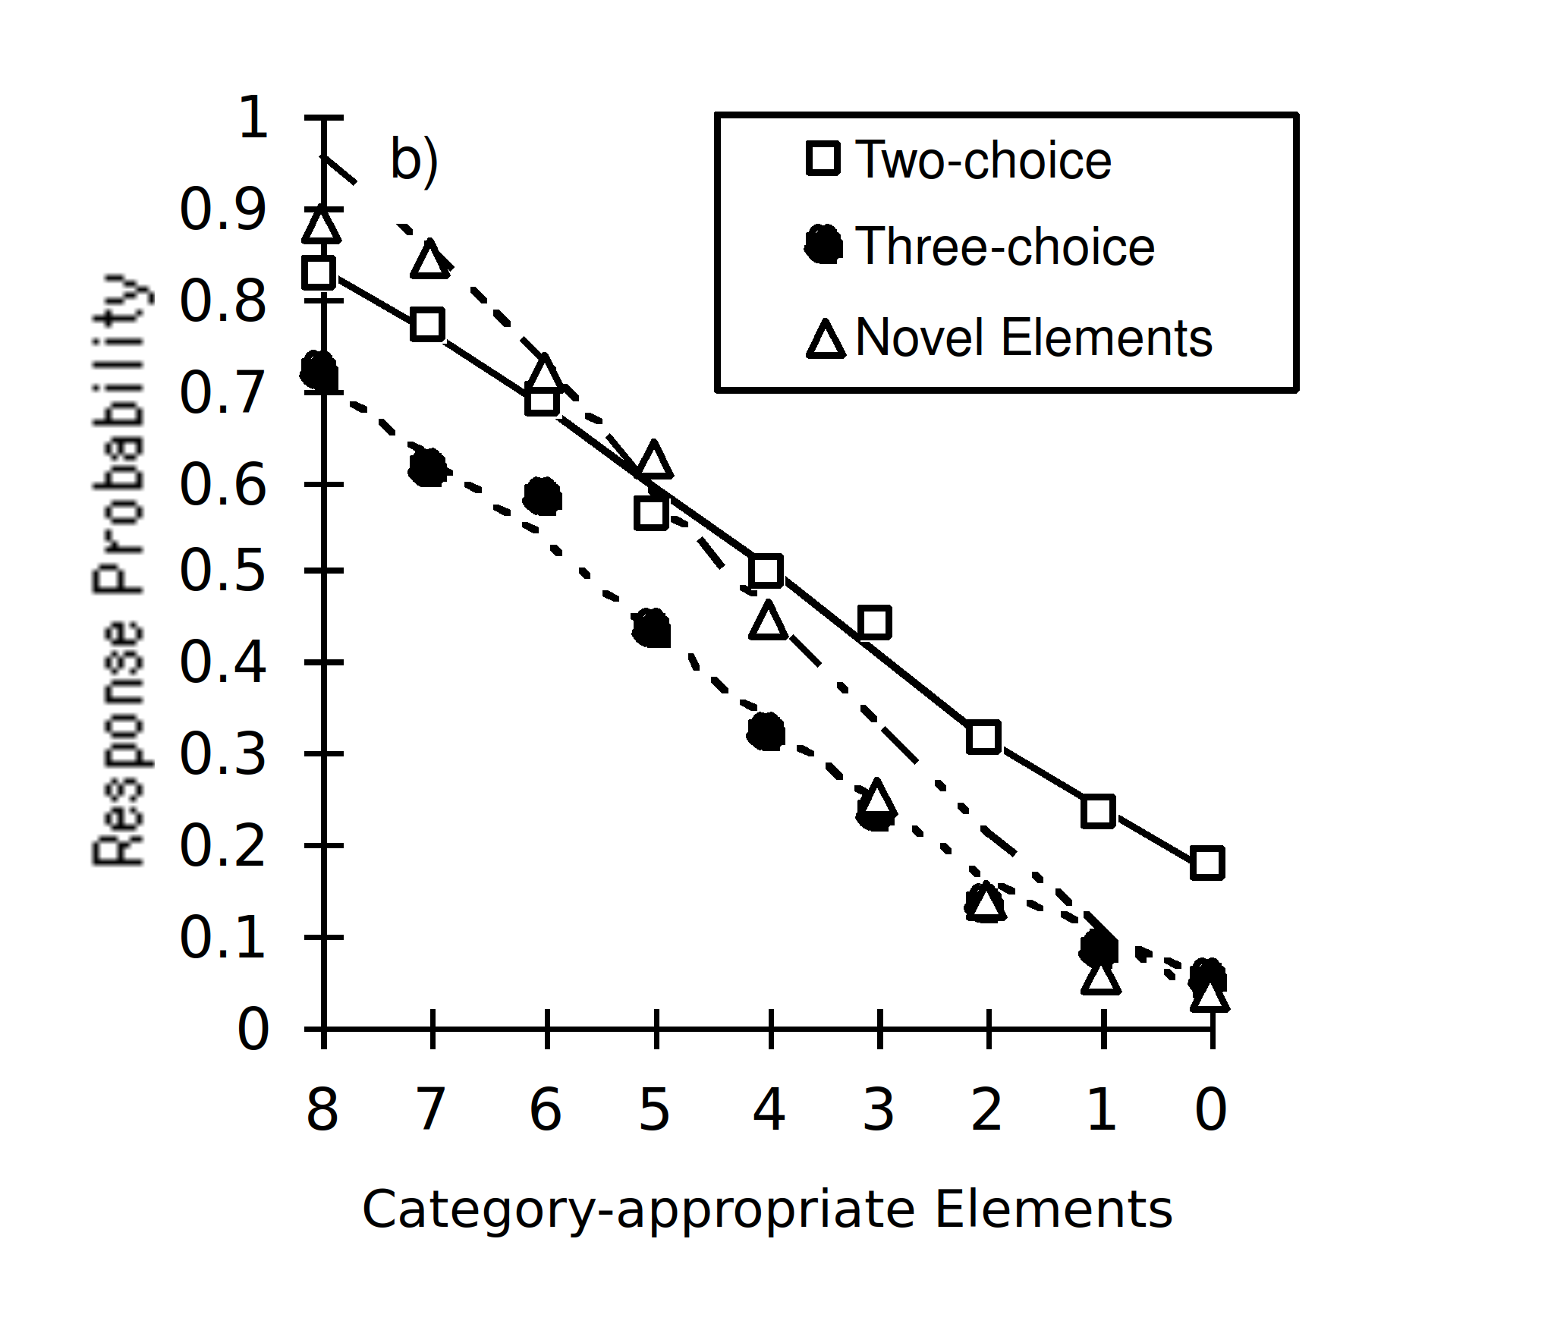
Simulation
Notes:
Describe

Slide 28

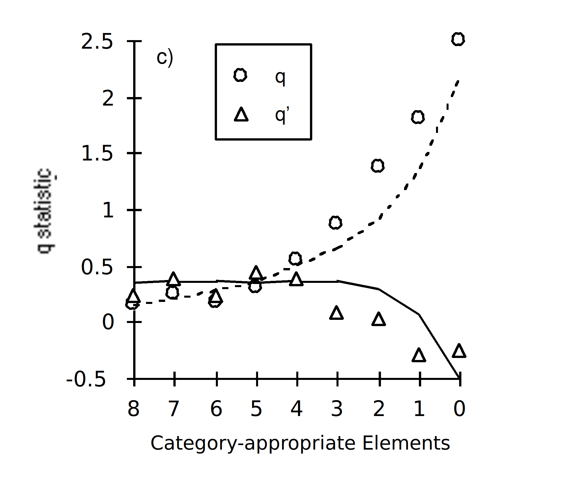
Simulation
Notes:
Predicts same trends as a simple Thurstonian choice process
Quantitatively close
Predicts correct trend for q’
WHY?If Nov El & 3 choice conditions had same S then P(B) 3choice always lower ‘cos more competition. BUT - Decision param is higher in Nov El condition. Higher S means lower prob of choosing incorrect alternative
Extension to RT
Simple speed-accuracy in categorization Expt

Slide 29
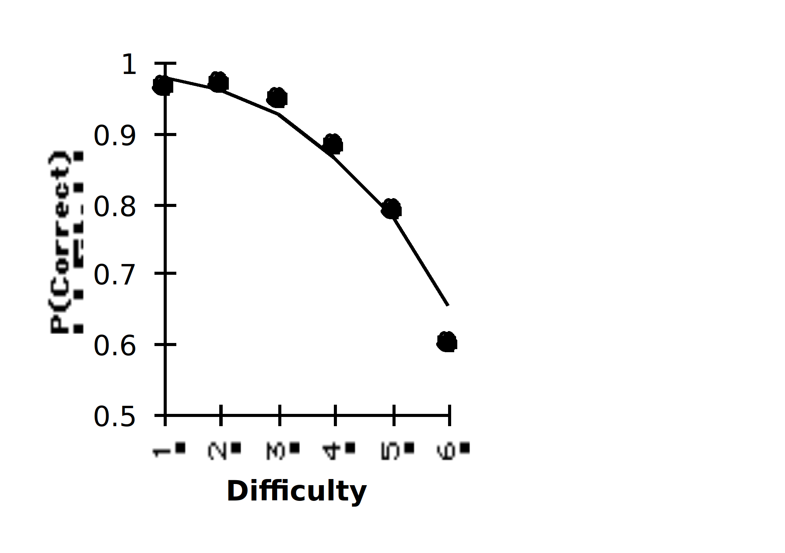
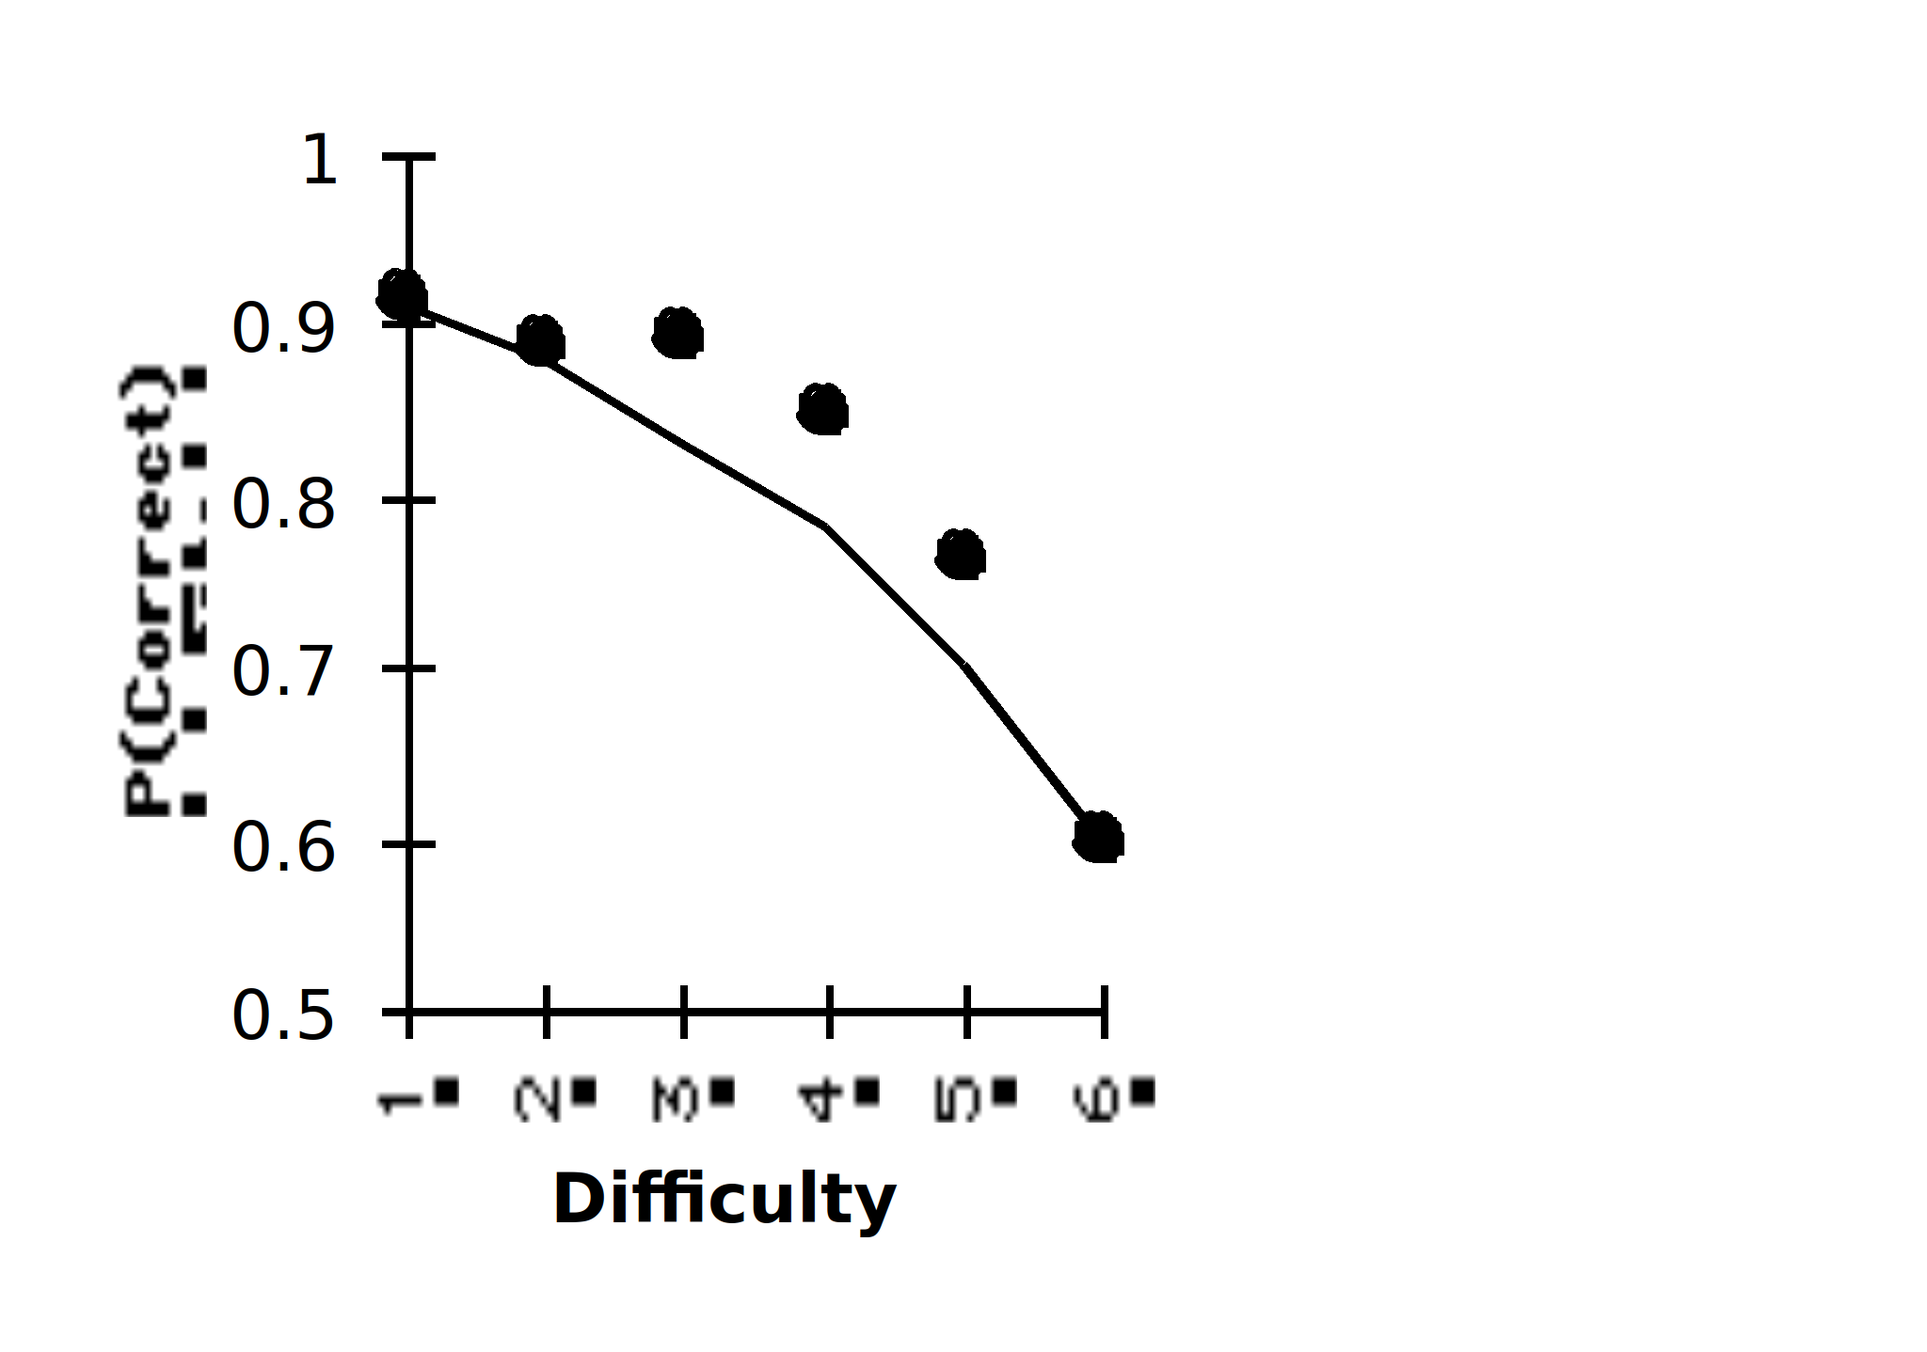
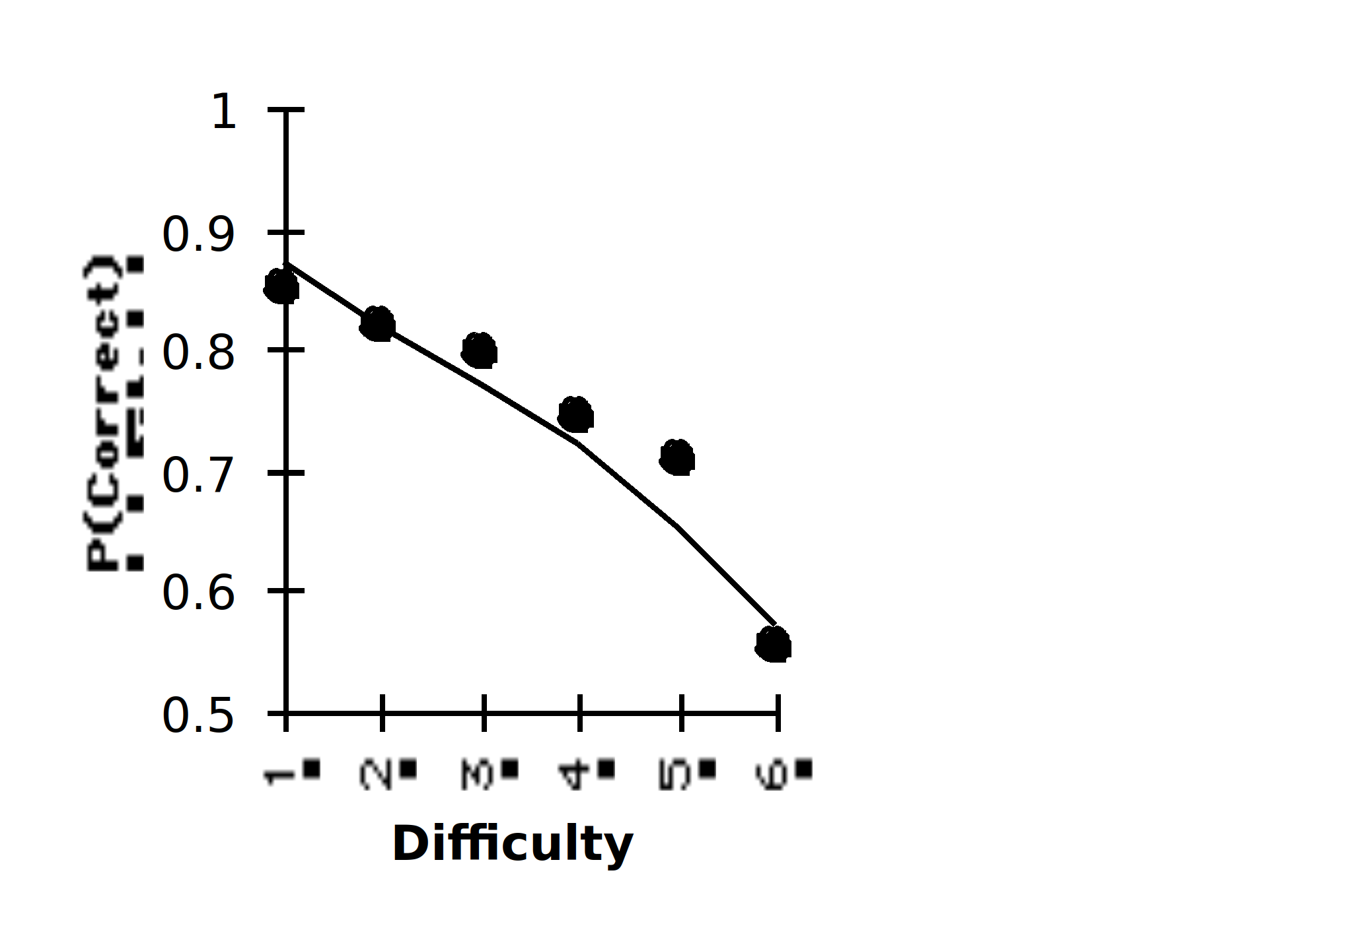
Time Pressure
No Timeout
2.5s Timeout
1s Timeout
Notes:
Describe

Slide 30
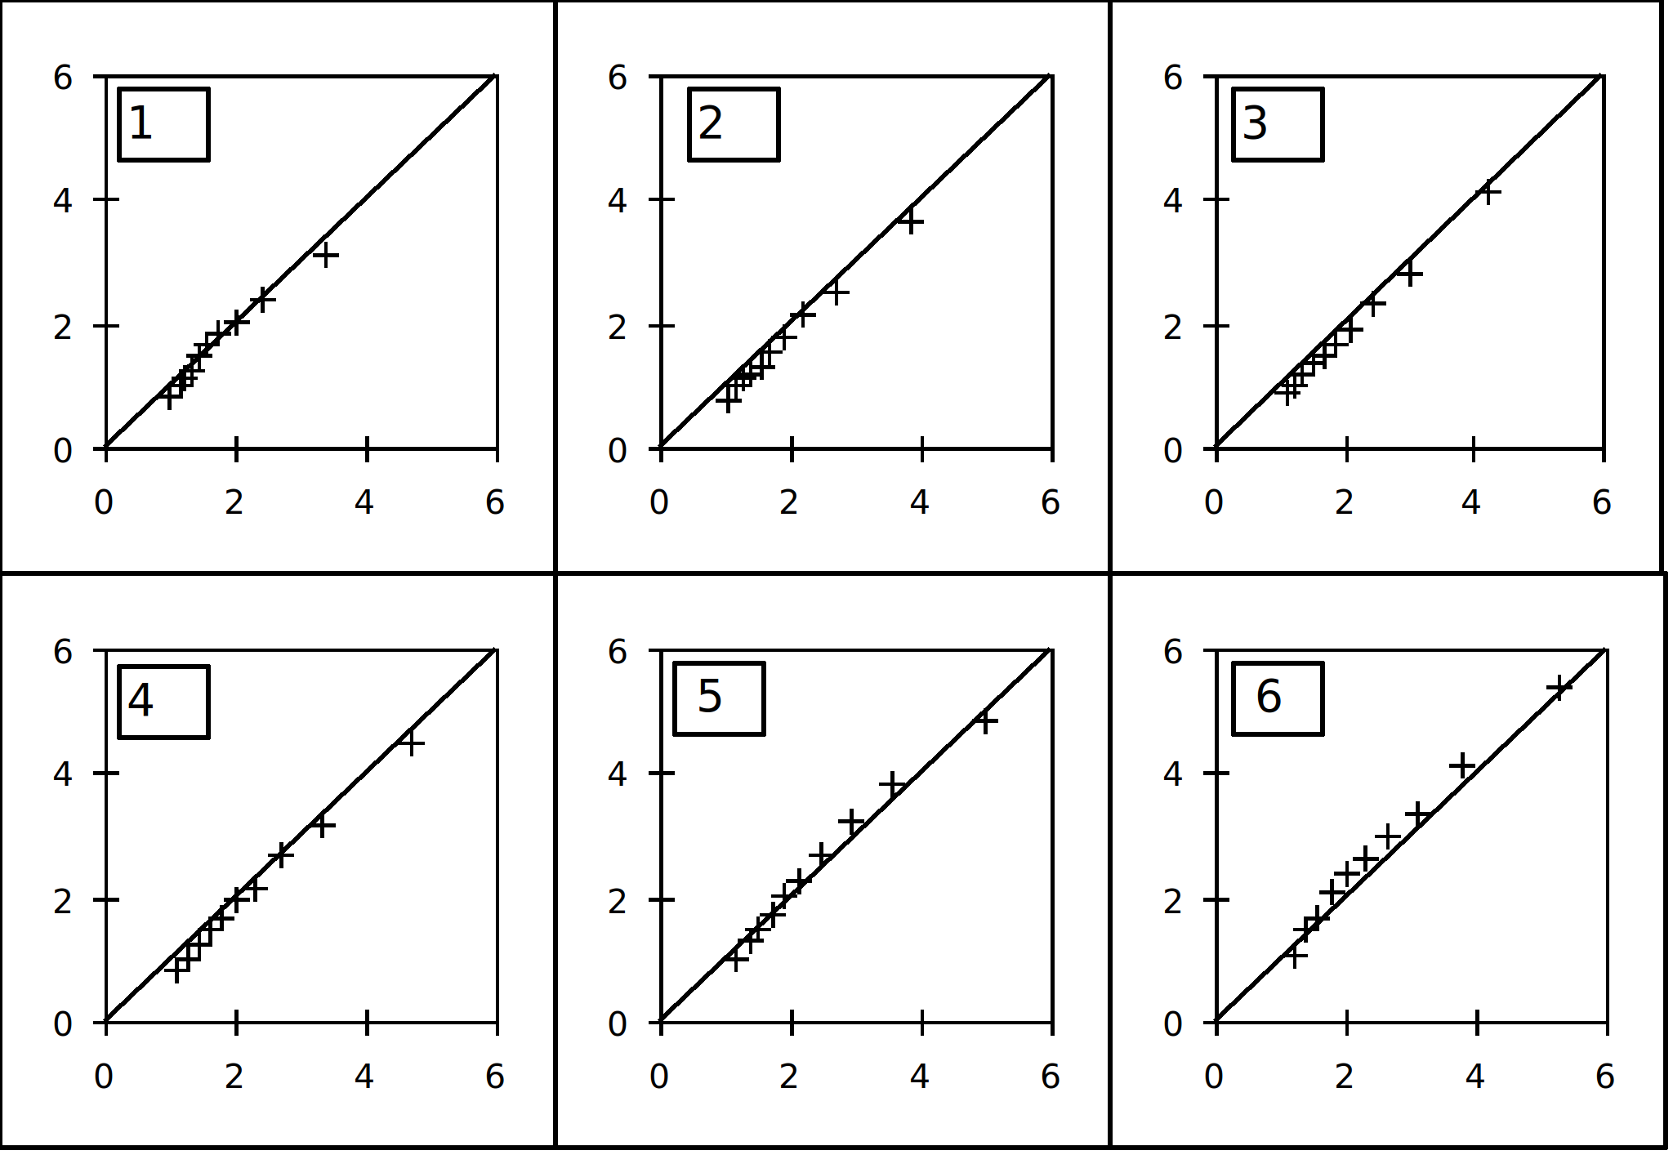
No Timeout
Notes:
Quantile-quantile plots

Slide 31
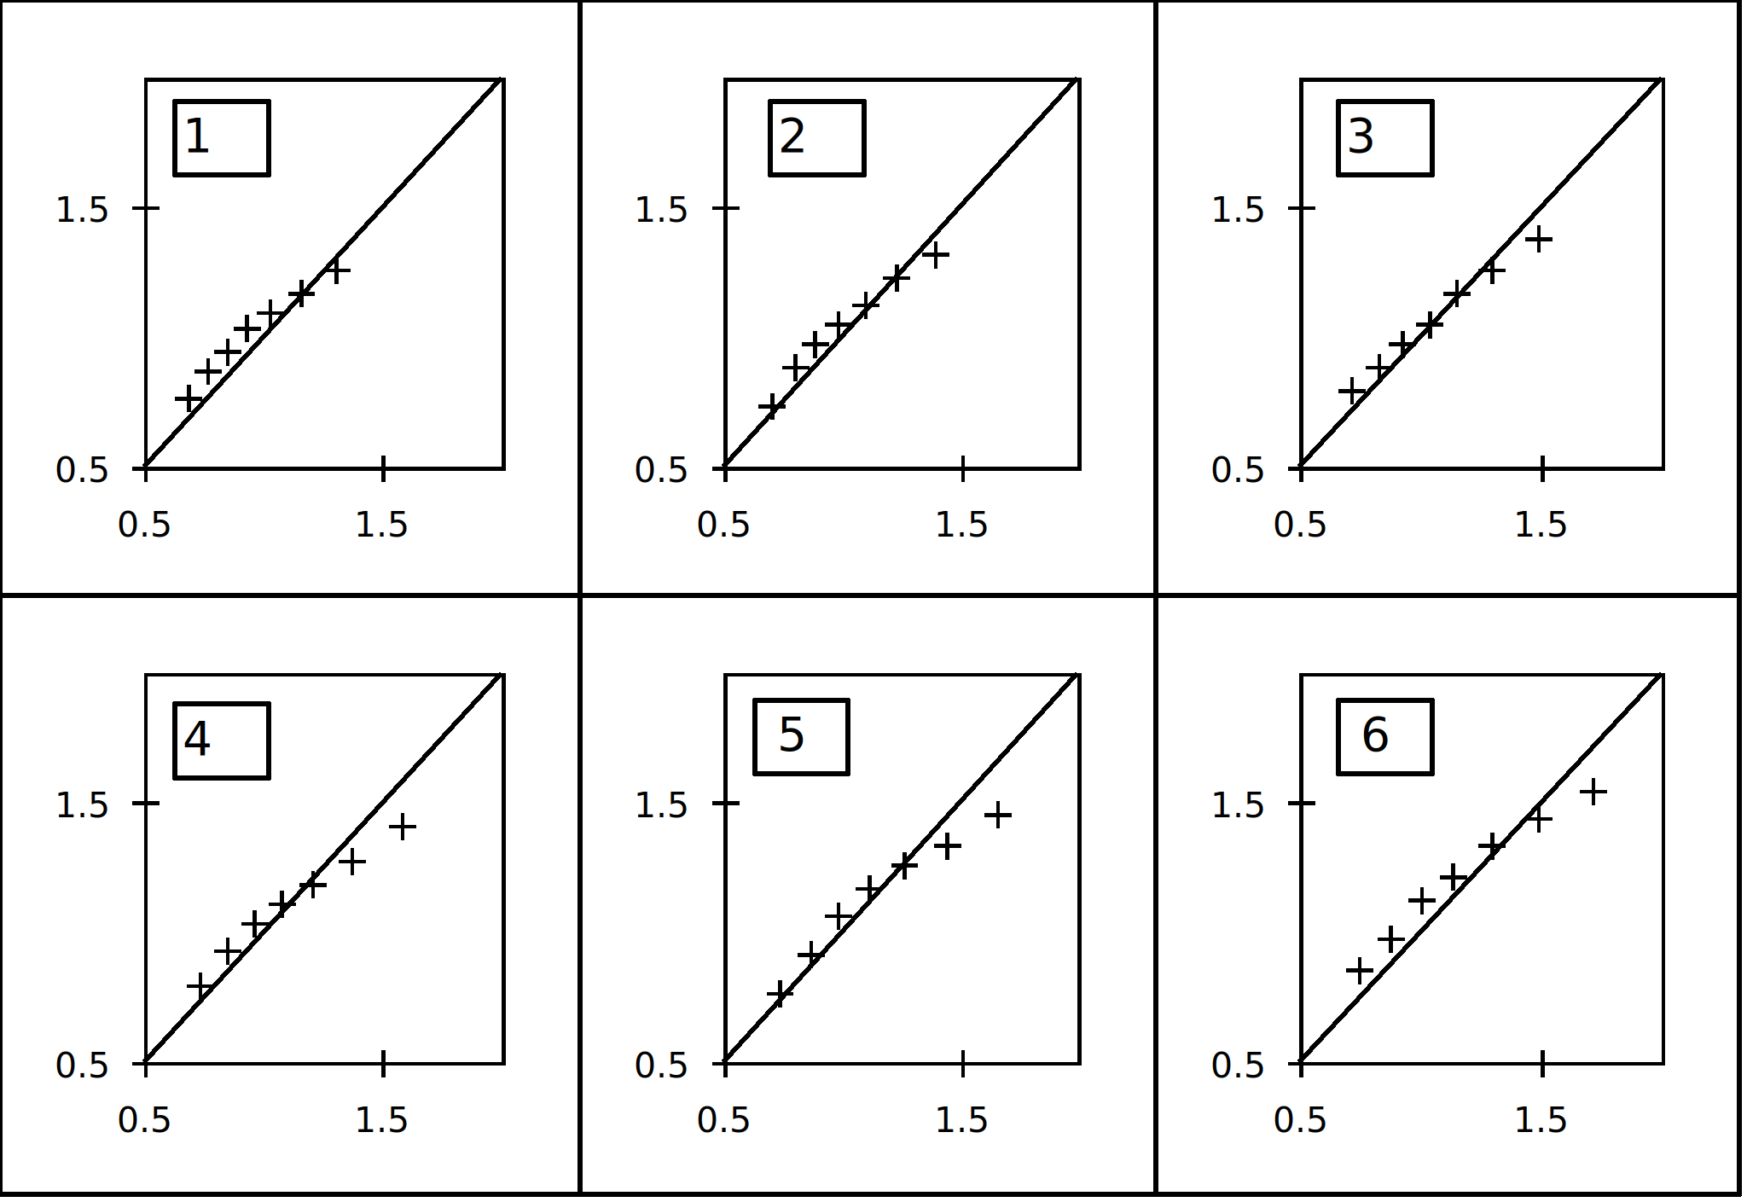
2.5s Timeout

Slide 32
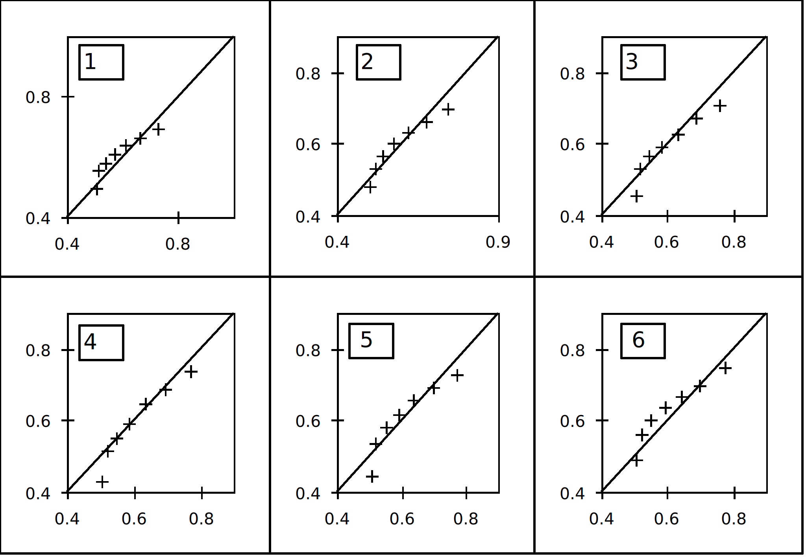
1s Timeout
Notes:
That’s it thus far, where next?
Within-subjects demonstration of q experiment with numerosity judgements
Uniform expansion paradox
Alternative models of speeded categorization
Free classification

Slide 33
Summary
The Ratio Rule is not a good theory of categorical decisions
Could radically revise magnitude-based theories a la Tversky (1972)
Or make the straightforward switch to Thurstonian choice
Notes:
Read and finish

