Slide 1

Aspects of consciousness
3. Altered states of consciousness
Public domain image
Notes:
http://en.wikipedia.org/wiki/File:RobertFuddBewusstsein17Jh.png

Slide 2
Scientific study of consciousness
Consciousness
Perception
Attention
Memory
Action
Blindsight
Meditation
Episodic
Frontal patients
Normal awareness
Hallucinogens
Autonoetic
Drug addiction
Voluntary action
P- consciousness
A- consciousness

Slide 3
Key concepts for today
Cognitive phenomena
Binocular rivalry
Stroop effect
Attentional “blink”
Erickson flanker task
Spatial working memory
Pavlovian conditioning
Research methods
Control group
Hawthorne effect
Neuroscience methods
EEG; gamma waves.
Salivary cortisol
Agonist / antagonist
Neuroanatomy
Neocortex
Thalamus
Amygdala
Neurotransmitters
5-HT (serotonin)
Dopamine

Slide 4

Meditation
Key reference:
Lutz, A., Slagter, H., Dunne, J. D., & Davidson, R. J. (2008). Attention regulation and monitoring in meditation. Trends in Cognitive Sciences, 12 , 163-169.
Image credit: Vicki Watkins. Creative Commons Attribution 2.0 Generic Licence
Brief introductory video – Andy Puddicombe's TED talk
https://www.youtube.com/watch?v=qzR62JJCMBQ
Notes:
https://commons.wikimedia.org/wiki/File:Dhyana_Tapasya_Meditate.jpg

Slide 5
Two categories of meditation
Meditation by focussed attention (FA)
There’s also OM (open monitoring) meditation; I’m not going to focus on that today – see Lutz et al. (2008).

Slide 6
FA meditation
Meditation by focussed attention
  Focus your attention on the sensation in your nostrils as you breath in and out.
  You may become distracted.
  Recognize that distraction, and thereby be released from it. Return to your nostrils

Slide 7
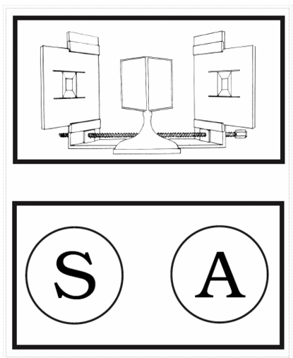
Effects of FA meditation
Increased duration of superimposed image in Bhuddist monks before and after FA meditation (Carter et al. 2005, binocular rivalry procedure).
Image credit: Randolph Blake & Frank Tong. Creative Commons Attribution-NonCommerical-ShareAlike 3.0 Unported licence.
Notes:
http://www.scholarpedia.org/article/Binocular_rivalry

Slide 8

Effects of FA meditation
Reduction in Stroop interference after meditation (Wenk-Sormaz, 2005).
Public domain image
Notes:
https://commons.wikimedia.org/wiki/File:Stroop_icon.svg

Slide 9
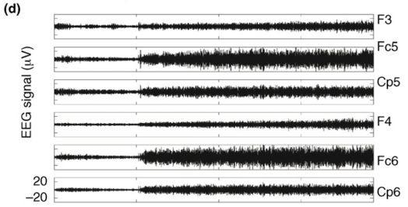
Brain correlates of FA meditation
Meditation in the highly practiced is easily detectable from EEG recordings (due to increased relative power of gamma (40Hz) activity).
Lutz, A. et al. (2004) Long-term meditators self-induce high-amplitude gamma synchrony during mental practice. Proc. Natl. Acad. Sci. U. S. A. 101, 16369–16373. Image copyright (2004) National Academy of Sciences.

Slide 10
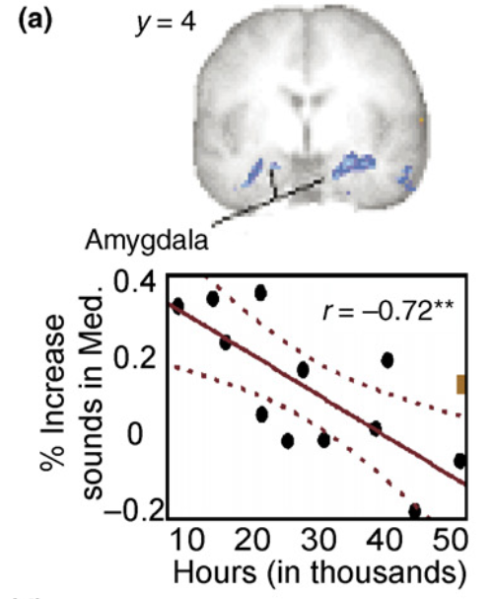
Cognitive Effects of FA meditation
Reduced amygdala activation (emotional reactivity) to distracting sounds correlates with hours of FA meditation practice (Brefczynski-Lewis et al., 2007)
Image credit: Brefczynski-Lewis et al. (2007). Proc. Natl. Acad. Sci., 104, 11483. Copyright (2007) National Academy of Sciences
Notes:
From review paper

Slide 11
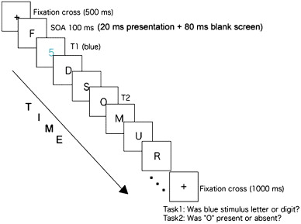
Cognitive Effects of FA meditation
Image credit: Heleen Slagter. Creative Commons Attribution Licence.
Notes:
From review paper

Slide 12
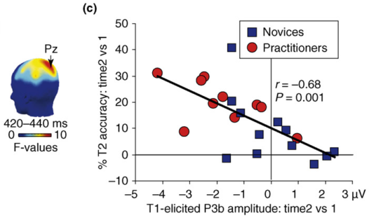
Cognitive Effects of FA meditation
Image credit: Heleen Slagter. Creative Commons Attribution Licence.
Reduced attentional blink (increased T2 accuracy), and reduced P3b component to T1 (T1 attracts fewer “resources”) in practitioners.
  Slagter, H.A. et al. (2007) Mental training affects distribution of limited brain resources. PLoS Biol. 5, e138
Notes:
From review paper

Slide 13
Meditation and consciousness
Meditation changes EEG activity in the highly practiced, with widespread gamma activity.
  Suggests that, at least for these people, it is an altered state of consciousness, distinct from sleeping or waking.
People who meditate a lot seem less prone to interference; seem more able to distribute their attention flexibly in a task-relevant manner.
  The question is… does meditation practice do this?
  Or, is there something different about people who meditate a lot? A pre-existing difference in attentional allocation that leads them to be good at (and hence pursue) meditation?

Slide 14
Better control
Tang et al. (2007)
  Random allocation to short meditation training vs. relaxation training.
  No pre-existing differences on measures.
  Studied: attention, mood, stress response.

Slide 15
Tang - Attention
RT(incongruent) – RT (congruent) = Conflict score.
Lower score – better selective attention.
Meditation practice lowers score.
Congruent
Incongruent

Slide 16
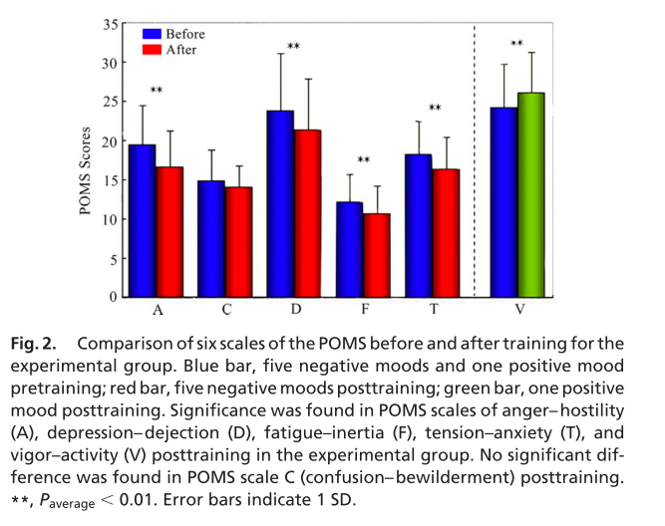
Tang - Mood
Various beneficial mood effects.
Image credit: Tang et al. (2007). Proc. Natl. Acad. Sci., 104, 17152. Copyright (2007) National Academy of Sciences

Slide 17
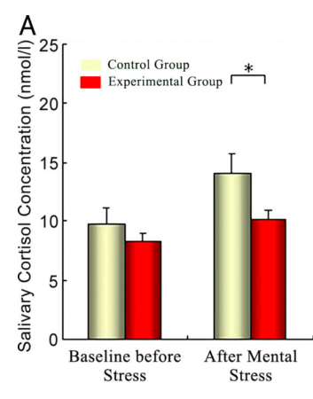
Tang - Stress management
Mental arithmetic as a stressful event.
Salivary cortisol higher in control group than experimental group (cortisol is a stress hormone).
Image credit: Tang et al. (2007). Proc. Natl. Acad. Sci., 104, 17152. Copyright (2007) National Academy of Sciences

Slide 18
Tang – Other possible issues
Hawthorne effect
  Experimental group taught by enthusiastic world experts with many years experience; not clear the relaxation training was as engaged or enthusiastic.
  Is meditation helpful? Or relaxation therapy actively unhelpful? Time 1 data might help here, but it’s not presented.

Slide 19
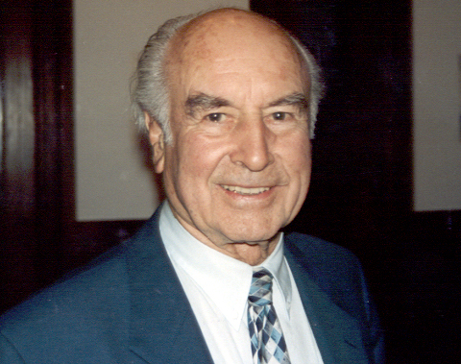
Hallucinogens
HEALTH AND LEGAL WARNING: Hallucinogen possession is illegal (Class A). Those under the effects of hallucinogens are at significantly higher risk of death by misadventure. Use of hallucinogens can lead to permanent and serious medical consequences.
“Hallucinogenic” – although hallucinations, in the sense of believing something to be there which is not, are rare.
Users sometimes report altered states of consciousness including:
  Closed eye visions
  Contemplative mood
What might altered states of consciousness tell us about consciousness?
Albert Hoffman
Image credit: Philip H. Bailey. CC BY-SA 2.5
Notes:
Author(s): Nichols DE Source: PHARMACOLOGY & THERAPEUTICS Volume: 101 Issue: 2 Pages: 131-181 Published: FEB 2004 [Review]
Author(s): Gonzalez-Maeso J et al. Source: NEURON Volume: 53 Issue: 3 Pages: 439-452 Published: FEB 1 2007 [One interesting article]

Slide 20
Basic information
Hallucinogens = Mescaline, psilocybin, LSD.
  Other substances e.g. Ectasy, have different mechanisms of action. Thus, although sometimes classed as hallucinogens, they are not the topic today.
Hallucinogens are physiologically safe molecules (no recorded deaths as a direct result of ingestion).
Are not considered reinforcing (O’Brien, 2001)
  Most dependence-liability substances are dopaminergic – opiates, nicotine, cannabis, PCP, cocaine, amphetamine, alcohol, benzodiazepines, barbituates, caffeine (see session 5).
  Most hallucinogens are not dopaminergic (LSD is an exception).
Hallucinogen persisting perception disorder (“flashbacks”)
  Low incidence.
  No treatment.
Contributory factor in fatal and serious accidents
  Flying delusions
  Starting into the sun
Largest risk is induced psychosis
  About 1:250 to 1:1000
  Pre-disposed individuals.

Slide 21
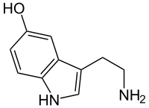
Mechanism of action
Hallucinogens are 5-HT agonists.
  Drug discrimination tests in rats using 5-HT antagonists (Glennon et al., 1983)
  Tolerance to LSD correlates with down-regulation of 5-HT in rats (Buckholtz et al., 1990)
  5-HT antagonists in humans block reported effects of psilocybin (Vollenweider et al. 1998)
  Other possible effects too, including some DA in LSD, see review.
Note: This is not a pharmacology course – you do not need to follow the neurochemistry of this; we are concerned with the cognitive / cognitive neuroscience consequences.
Public domain image
Notes:
https://commons.wikimedia.org/wiki/File:Serotonin_(5-HT).svg

Slide 22
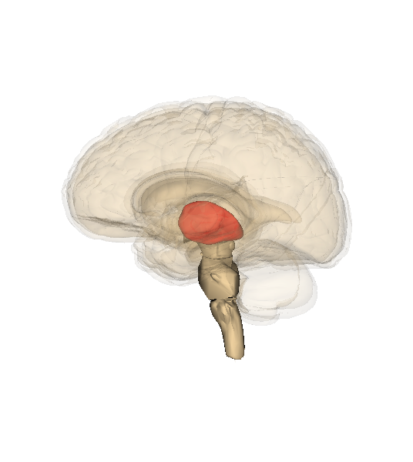
5-HT affinity
5-HT receptors concentrated in the neocortex (Pazoz et al., 1987)
5-HT agonists also affect thalamic activity
Theory
  Hallucinogens greatly increase cortical neuron sensitivity
  At the same time they lead to thalamic afferent activation that would normally signal incoming sensory input to be processed.
  Thus… amplified/distorted sensory input
  Plus impaired sensory gating/filtering
  …leading to problems with selective attention
(Vollenweider & Geyer, 2001)
Image credit: Life Science Databases. CC BY-SA 2.1 Japan
Notes:
http://commons.wikimedia.org/wiki/File:Thalamus.png

Slide 23
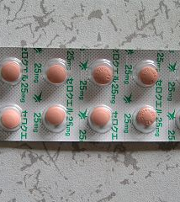
Relation to schizophrenia
This is also the symptomology of acute schizophrenia
Antipsychotic drugs seem to work by 5-HT antagonism (see review)
Quite a close correspondance between hallucinogen ingestion and acute schizophrenia – at least in terms of some symptomology and likely mechanisms of action.
Image credit: 膀胱眼球胎 GNU Free Documentation Licence
Notes:
http://commons.wikimedia.org/wiki/File:クエチアピン（Quetiapine）セロクエル25mg錠5264493.jpg

Slide 24
Other effects
Increased indirect semantic priming (Spitzer et al., 1996)
  Basically, the increased availability of remote associations
Binocular rivalry – change in distribution of switch times (Carter & Pettigrew, 2003)
Spatial working memory deficits (Vollenweider et al., 1998)
Enhanced Pavlovian conditioning in rabbits (Romano & Harvey, 1994)

Slide 25
Summary
One (medical) way of conceiving consciousness is as a progression in arousal (Awake -> Asleep -> Coma -> Death)
Studies of FA meditation, and of hallucinogen ingestion, suggests the presence of multiple, distinct, forms of waking consciousness – sometimes called altered states of consciousness (ASC).
One common thread to these two different ASCs are the processes of selective attention
  FA meditation seems to promote the more flexible (task-relevant) and adaptive use of selective attention.
  Hallucinogens seem to massively disrupt sensory gating mechanisms, leading to sensory overload; a failure of task-relevant selective attention.
Thus, one defining feature of the phenomenology of both our typical waking state, and ASCs, may be the function selective attention plays in preventing us from becoming overwhelmed by the “buzzing, blooming confusion” of an information-rich world.

