Slide 1
Drug addiction
Robinson, T. E. (2003). Addiction. Annual Review of Psychology, 54 , 25-53.

Slide 2
Scientific study of consciousness
Consciousness
Perception
Attention
Memory
Action
Blindsight
Meditation
Episodic
Frontal function
Normal awareness
Hallucinogens
Autonoetic
Drug addiction
Voluntary action
P- consciousness
A- consciousness

Slide 3
Nature of drug addiction
“compulsive pattern of drug-seeking and drug-taking behavior that takes place at the expense of most other activities”
Clear relation to intentional action / free will.
Drug exposure high (60%; 90% inc. alcohol)
Addiction (at least as defined above) rare (cocaine: 15% in 10yrs use)

Slide 4
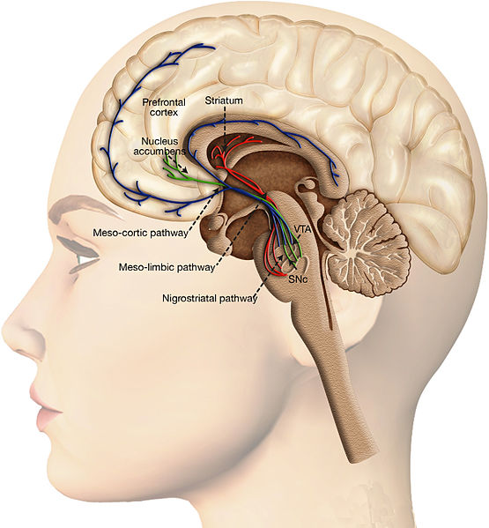
Brain systems
The basic neuroscience is well understood, and applies to most addictive drugs.
dopamine projections from the ventral tegmental area and substantia nigra to the nucleus accumbens(NAcc) and striatum, as well as glutamate inputs from the prefrontal cortex, amygdala and hippocampus.
In other words, central reward system.
Addictive drugs not only operate on but also change these pathways.
But what are the psychological effects?
Image credit: Oscar Arias-Carrión et al. CC BY 4.0 International

Slide 5
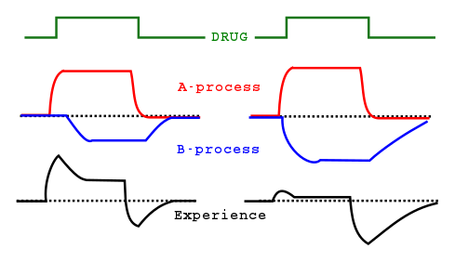
Tolerance and withdrawal symptoms
Drug taking is initially reinforced by the “highs”, but pharmacological tolerance sets in, and then drug taking is maintained by avoidance of the “lows”.
Formally, “opponent process” theory.
But the relation between withdrawal symptoms and recidivism is pretty weak (hence the relatively poor record of detox-based drug rehabilitation programmes).
Also some interesting animal studies considering a-process and b-process induction by drugs, and effects on relapse (turns out to be a rather than b).

Slide 6
Goal versus Habit learning systems
Action-outcome (goal directed learning)
Stimulus-response (habitual learning)
Even with reinforcers such as food, or secondary reinforcement, repeated actions become habitual (hence “slips of action”).
Neuroscience indicates drugs of addiction powerfully activate reward systems in the S-R system (corticostriatal loops).
Good support from animal studies
Some (e.g. Robinson & Berridge) think it’s unlikely because many habitual behaviours do not appear to be “addictive” in the same sense as drug taking. A rather phenomenological argument.
One real paradox - drug-seeking behaviour in humans seems highly goal-directed and flexible.

Slide 7
Incentive sensitization: Compulsive “wanting”
“Wanting” (incentive motivation) and “liking” (reward systems) are dissociable.
Not all drug effects habituate (tolerance), some sensitive (increase).
Addictive drugs seem to cause psychomotor sensitization (e.g. Heightened locomotion, exploration, approach).
Psychomotor sensitization is context-specific (and hence seems to involve learning) – both in terms of generalization decrement, and the absolute novelty of the learning context.
Drug-induced sensitization leads rats to work harder for a reward, and increases incentive value of a reward (e.g. as measured by running speed)
Drug-related cues (in animal models) seem to do the same ie. Make them work harder for a reward.
Implication: Drug-related cues in humans produce excessive “wanting” of those drugs.
Animal models suggest this psychomotor sensitization can persist for years after drugs administration has stopped.
Psychomotor sensitization shows stark individual differences.
There may be cross-sensitization to other drugs. And to stress.

Slide 8
Frontal damage: “Blowing your brains out”
Chronic drug exposure depresses neural processing in frontal regions – both activity and, in polysubstance abuse – sometimes also volume.
Chronic drug users show a similar profile of deficits on cognitive tasks to those seen in patients with frontal lobe damage.
Frontal regions are involved in inhibitory control. Damage leads to difficulty in inhibiting prepotent responses.

