Slide 1
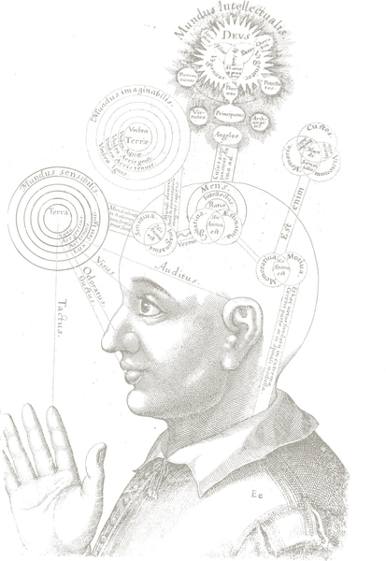
Aspects of consciousness
Except where noted, this work is licensed under a Creative Commons Attribution-ShareAlike 4.0 International License.
Conceptions of consciousness
Public domain image
Notes:
http://en.wikipedia.org/wiki/File:RobertFuddBewusstsein17Jh.png

Slide 2
Aspects of consciousness
Religious experience
Pride and Prejudice
Medical
Sleep, dreams
Language use
Access consciousness
Evolutionary fitness
Phenomenal consciousness
Zombies
Soul
Free will
Non-human animals
Computers
Episodic / autobiographical memory
Hypnosis
Meditation
Mindfulness
Notes:
Medical
Phenome

Slide 3
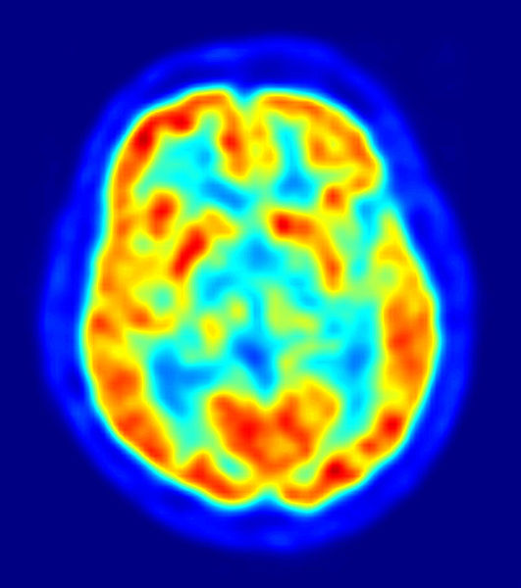

The “explanatory gap”
"How it is that anything so remarkable as a state of consciousness comes about as a result of irritating nervous tissue, is just as unaccountable as the appearance of Djin when Aladdin rubbed his lamp.”
- T.H. Huxley (1866)
Public domain images
Notes:
https://commons.wikimedia.org/wiki/File:Genie_Lamps_2.JPG
https://commons.wikimedia.org/wiki/File:PET-image.jpg

Slide 4
Two types of consciousness
Phenomenal Consciousness
  P-consciousness is experience. We have P-conscious states when we see, smell, hear, taste and have pains.
Access consciousness
  A-consciousness is control. A state is A-conscious if it is available for rational control of action.
The explanatory gap refers principally to P consciousness.

Slide 5
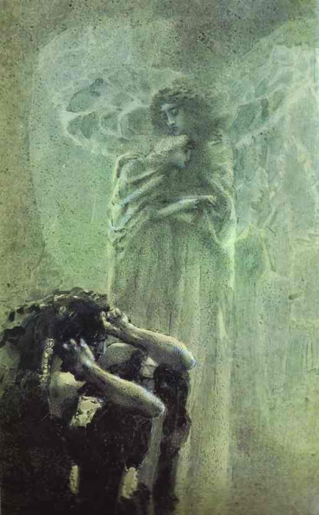
The problem of free will
Laplace’s demon – Imagine an entity who knows the entire history of the universe, and knows all physical laws. This entity could predict the future, including what you will do next. Therefore, you do not have free will.
In other words, if determinism is true, free will is false.
The problem is that most people believe they have free will.
How do we resolve this?
Mikhail Vrubel (1856-1910) - "Demon and angel with Tamara's soul"
Public domain image.
Notes:
https://commons.wikimedia.org/wiki/File:Demon_%26_angel_with_Tamara%27s_soul.png

Slide 6
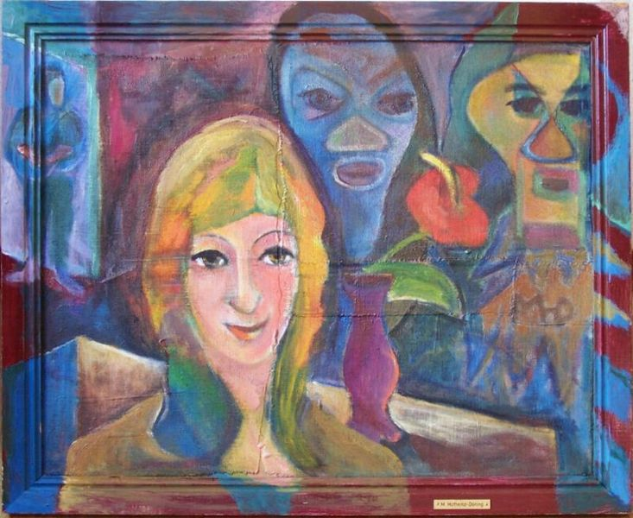
Answer 1: Theological libertarianism
Determinism is an attribute of the physical world.
The soul is non-physical and hence non-deterministic.
The soul controls our actions.
Hence we have free will
Mind-body problem
  How does the non-physical control the physical? What possible mechanism could there be?
  Is the soul amenable to scientific study?
  If theological libertarianism is true, is this whole course (and psychology in general) rather misguided?
Image: Margret Hofheinz-Döring / Galerie Brigitte Mauch Göppingen
Creative Commons Attribution-Share Alike 3.0 Unported
Notes:
https://commons.wikimedia.org/wiki/File:R%C3%A4tsel_der_Psyche,_Margret_Hofheinz-D%C3%B6ring,_%C3%96l,_1970_(WV-Nr.5010).jpg

Slide 7
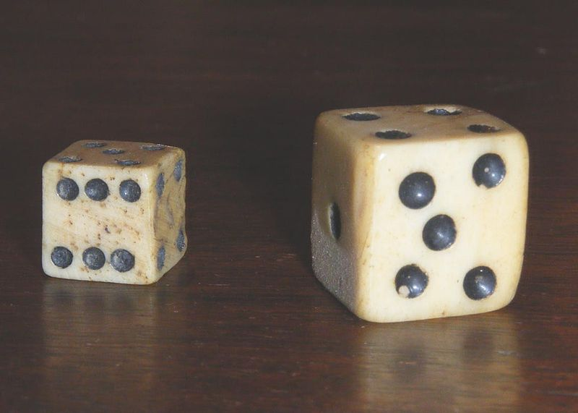
Answer 2: Physical libertarianism
Determinism, plus random chance
  Quantum mechanics.
  Neural noise.
  Issue: Is that really free will? The Dice Man (Luke Rhinehart) as a model of a free agent?
Public domain image
Notes:
https://commons.wikimedia.org/wiki/File:Dadi_antichi.jpg

Slide 8
Answer 3: Determinism is correct
Objections to determinism:
  How can something as dry, simplistic, and reductionist, as deterministic physical laws give rise to something as complex, multifaceted, asethetic, and beautiful, as the behaviour of biological systems?
  Are you serious? We could never predict human behaviour in the way we predict, for example, planetary motion.

Slide 9
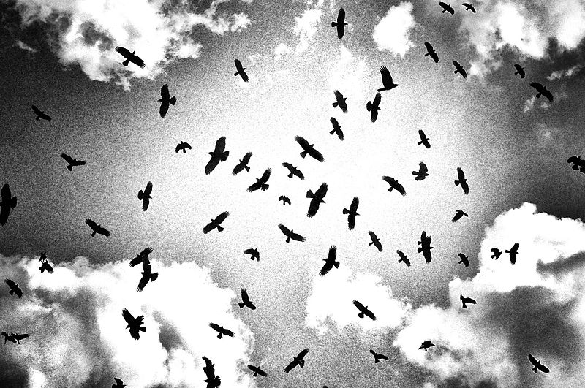
Answer 3: Determinism is correct
Answers to these objections:
1. Emergence: Perhaps, free will is an illusion brought on by a lack of understanding of emergent properties
Image: Benjamin Ebel
Creative Commons Attribution-Share Alike 3.0 Unported
http://www.willslab.org.uk/vid/flockofbirds.mp4
http://www.willslab.org.uk/vid/boids.mp4
http://www.vergenet.net/~conrad/boids/
In order to get that last link to work, you may have to change your Java security settings.
Notes:
https://commons.wikimedia.org/wiki/File:Benjamin_Ebel_Birds.jpg

Slide 10
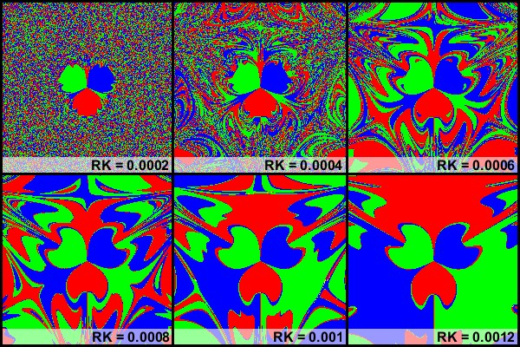
Answer 3: Determinism is correct
  Answers to these objections:
2. Chaos - We can’t predict the weather that well either. Complex systems, like the weather – or even two magnets and a pendulum – are chaotic. This means they are incredibly sensitive to starting conditions. It’s unlikely that we could ever measure starting conditions accurately enough to make deterministic predictions about individual behaviour.
Image and video believed to be in the public domain.
www.willslab.org.uk/vid/magpend1.mp4

Slide 11
Voluntary action
Haggard, P. (2005). Conscious intention and motor cognition. Trends in Cognitive Sciences, 9 , 290-295. [start with this one].
Libet, B., Gleason, C., Wright, E. W., & Pearl, D. K. (1983). Time of conscious intention to act in relation to onset of cerebral activity (readiness-potential). the unconscious initiation of a freely voluntary act. Brain, 106 , 623-642. [classic EEG study].
Lau, H. C., Rogers, R. D., Haggard, P., & Passingham, R. E. (2004). Attention to intention. Science, 303 , 1208-10. [classic fMRI study].

Slide 12
Voluntary action
Q: “What is left over if I subtract the fact that my arm goes up from the fact that I raise my arm?” – Wittgenstein
A: Intention.
Philosophy, and folk psychology, often assume:
Conscious intentions -cause-> actions
Neuroscience rejects this mind-body causation and argues:
Action preparation in frontal and parietal lobes
-causes->
Conscious experience of intending to act

Slide 13
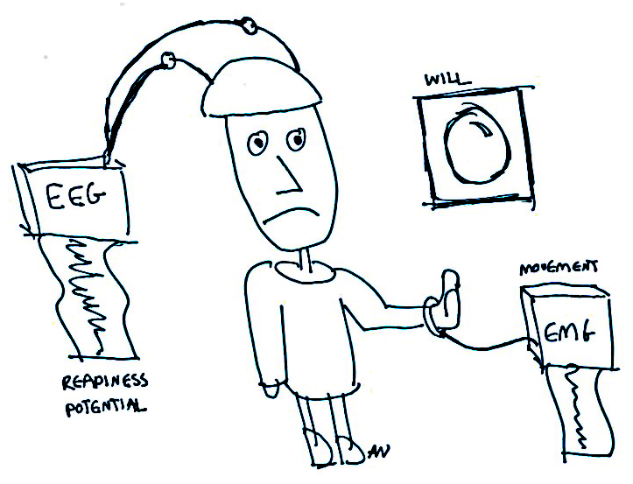
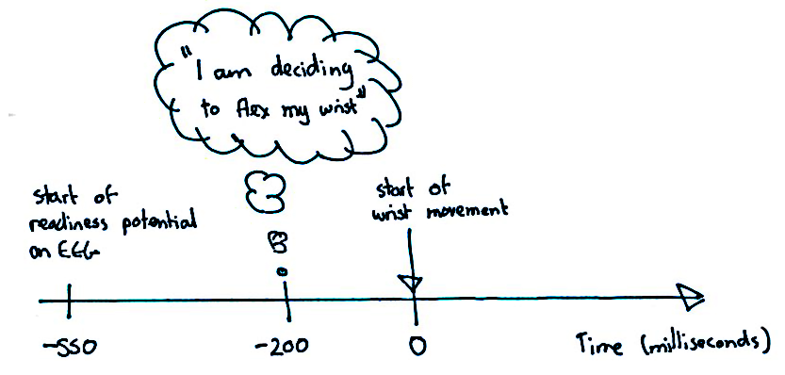
Libet et al. (1983)
The brain starts preparing for the movement about 350ms before the conscious awareness of the intention to move.
Notes:
http://thebrain.mcgill.ca/flash/d/d_12/d_12_s/d_12_s_con/d_12_s_con.html

Slide 14
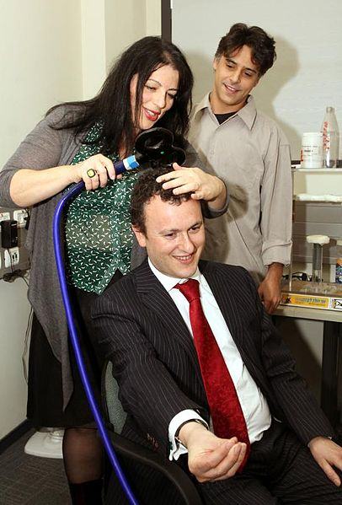
Influencing intention unconsciously
Ammon & Gandevia (1990)
  Participants voluntarily choose to make a left or right response.
  Stimulating with left pre-SMA with TMS increases likelihood of a right response, and vice versa.
  Participants reported no awareness that their actions had been influenced.
Image credit: UK in Israel
Licence: Creative Commons Attribution 2.0 Generic
Notes:
https://commons.wikimedia.org/wiki/File:Ambassador_visits_Bar-Ilan_University_(5287646698).jpg

Slide 15
Further reading
Concepts of consciousness:
https://plato.stanford.edu/entries/consciousness/#ConCon
Free will:
https://en.wikipedia.org/wiki/Free will

