Slide 1
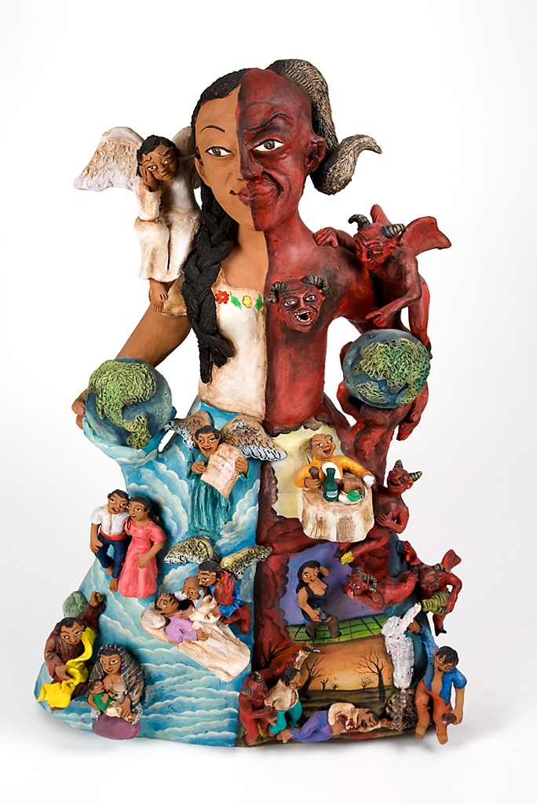
Praise, punishment, good, and evil
Andy Wills
2018

Slide 2
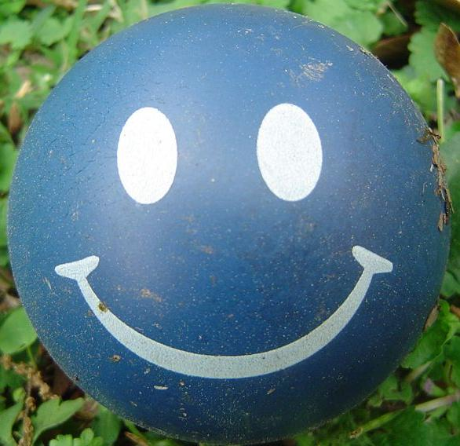
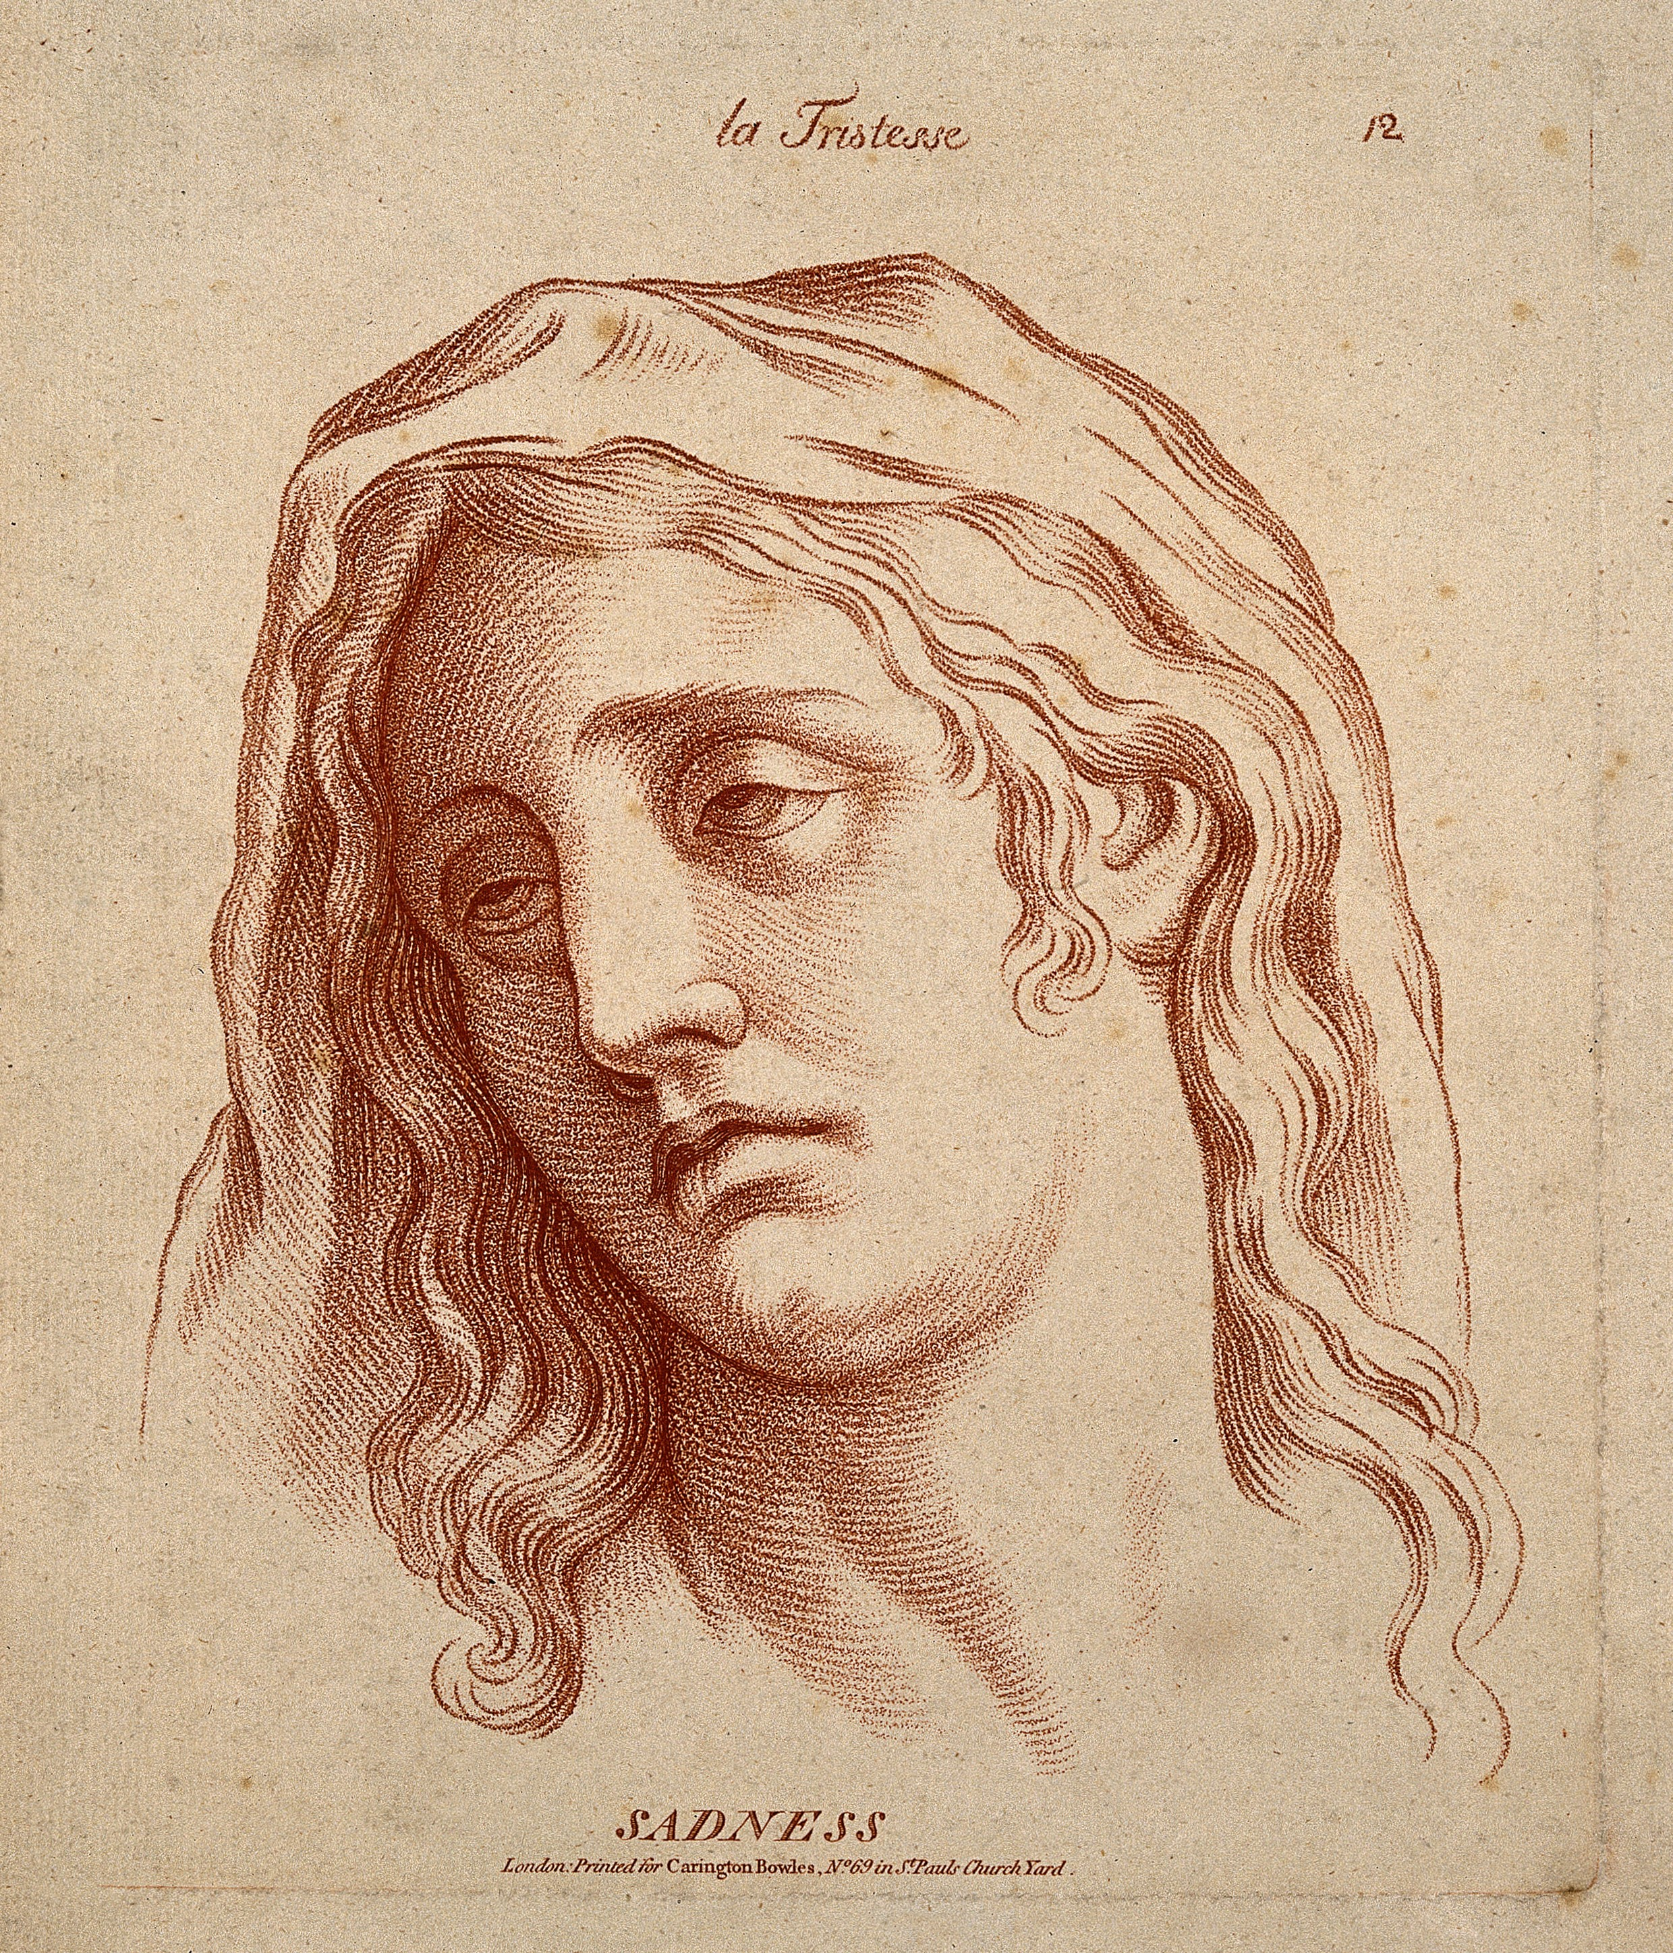
Praise and punishment
10 min activity
What improves performance more:
  Praising people when they do well?
  Criticising them when they do badly?
https://upload.wikimedia.org/wikipedia/commons/9/94/A_woman_whose_face_expresses_sadness._Etching_in_the_crayon_Wellcome_V0009337.jpg
https://commons.wikimedia.org/wiki/File:Happy_face_ball_crop.jpg

Slide 3
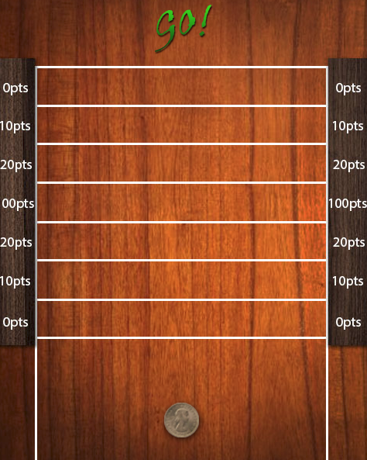
Shove ha’penny
Get into pairs. Each pair needs:
One computer.
One paper record sheet.

Slide 4
Shove ha’penny
Hold the space bar down to shove the coin.
The longer you hold it down, the further it goes.
Try to score the highest number of points!

Slide 5
How to play… part 1.
Split into pairs.
Decide who plays first.
If you’re the player, press the key, try to get 100pts!
If you’re not the player, you’re the games teacher:
  If your pupil gets 100pts, yell “Woo, yeah, well done!”
  Otherwise, say nothing.
Player: take your next go.
Games teacher: If you praised last time, note down on your record sheet whether they did just as well this time (100 pts), or did worse this time (less than 100 pts).
Repeat until the player has had 30 goes.

Slide 6
How to play… part 2.
Swap over, so the player is now the games teacher, and vice versa.
If you’re the player, press the key, try to get 100pts!
If you’re not the player, you’re the games teacher:
  If your pupil gets 0 pts, yell “That was bad! Do better next time!”
  Otherwise, say nothing.
Player: take your next go.
Games teacher: If you criticised last time, note down on your record sheet whether they did just as badly this time (0 pts), or did better this time (more than 0 pts).
Repeat until the player has had 30 goes.

Slide 7
Praise and criticism
When you praised your partner, what tended to happen?
When you criticised your partner, what tended to happen?
What does this tell us about praise versus critcisim?
https://upload.wikimedia.org/wikipedia/commons/9/94/A_woman_whose_face_expresses_sadness._Etching_in_the_crayon_Wellcome_V0009337.jpg
https://commons.wikimedia.org/wiki/File:Happy_face_ball_crop.jpg

Slide 8
A secret is revealed...
...come to class to find out what it is!

Slide 9
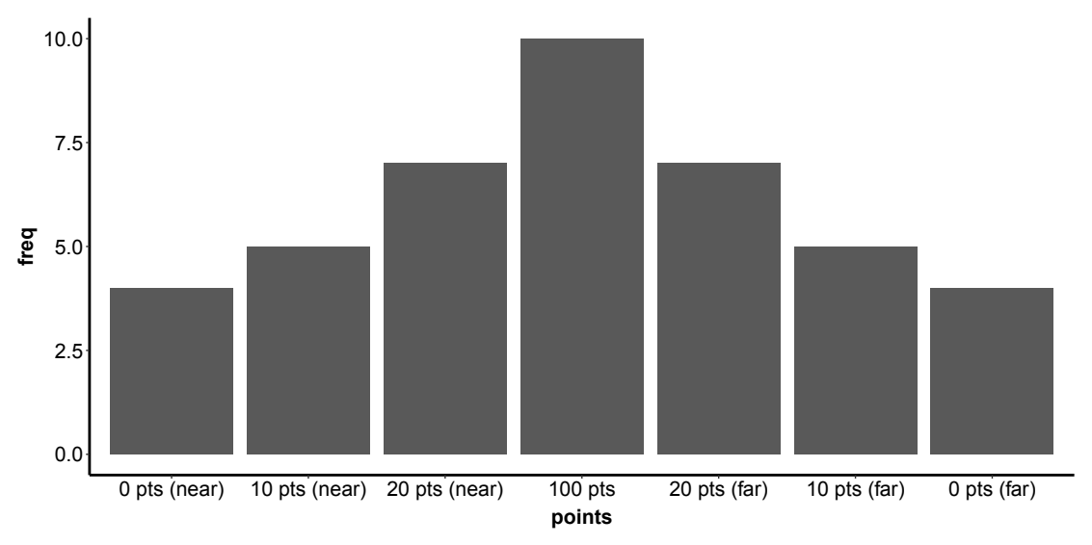
Distribution of scores

Slide 10
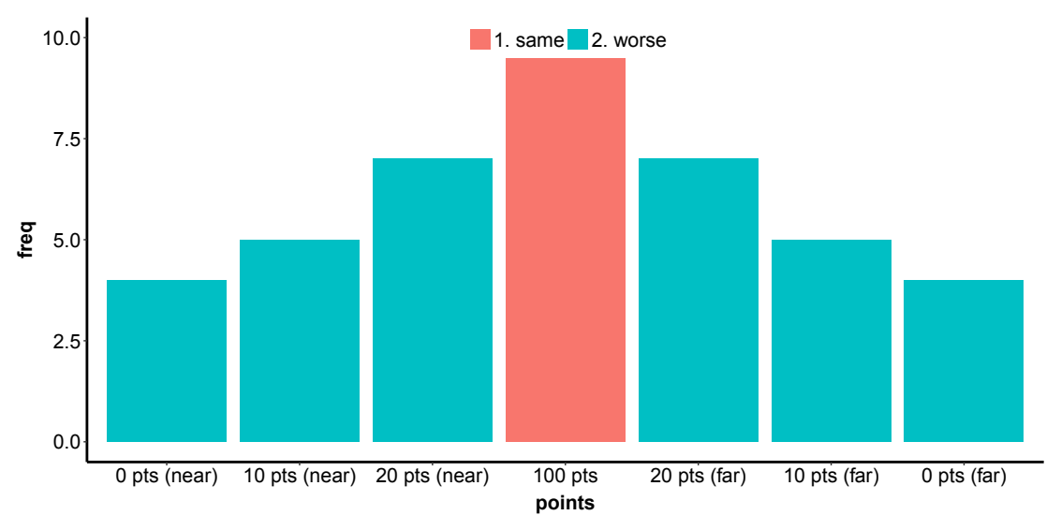
When you praise...

Slide 11
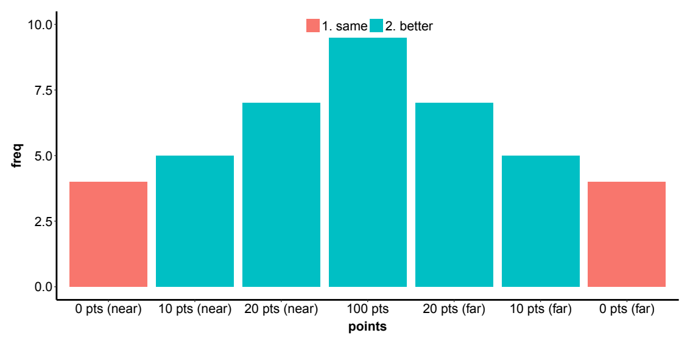
When you criticise...

Slide 12
Regression to the mean
Other areas it (may) apply to:
  OFSTED school inspections
  Remedial classes
  Evidence for unconscious learning
  “Difficult” second film / second novel.

Slide 13
Good and evil
Stay in your pairs.
Each pair needs:
  - a computer
Each person needs:
  A response sheet.
https://upload.wikimedia.org/wikipedia/commons/1/1f/Good_and_Evil_figure_by_Demetrio_Garci%C2%A6%C3%BCa_Aguilar.jpg

Slide 14
How to play
Go through the “Good and evil” slides on the DLE in your pair.
Each person fills out the questionnaire seperately.
Hold it up in the air when you’re done, we’ll collect it.

Slide 15

Spoiler alert!
DON’T LOOK AT THE LAST SLIDE UNTIL AFTER YOU HAVE ANSWERED THE QUESTIONAIRE !!!
https://upload.wikimedia.org/wikipedia/commons/5/56/Answer_to_Life.png

Slide 16
The same information in a table...
 | Group A | Group B
Desirable | 18 | 9
Undesirable | 8 | 4
18: 8 = 9 : 4

