Slide 1
Data games
Andy Wills
CC-BY-SA 4.0

Slide 2
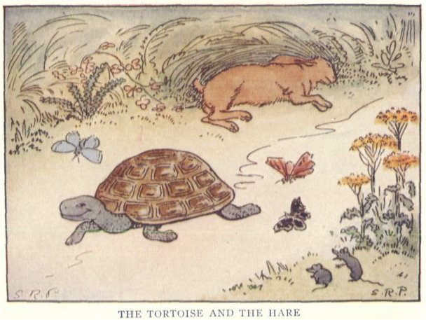
Animal racing!
20 min activity
https://commons.wikimedia.org/wiki/File:The_Tortoise_and_the_Hare_-_Project_Gutenberg_etext_19993.jpg

Slide 3
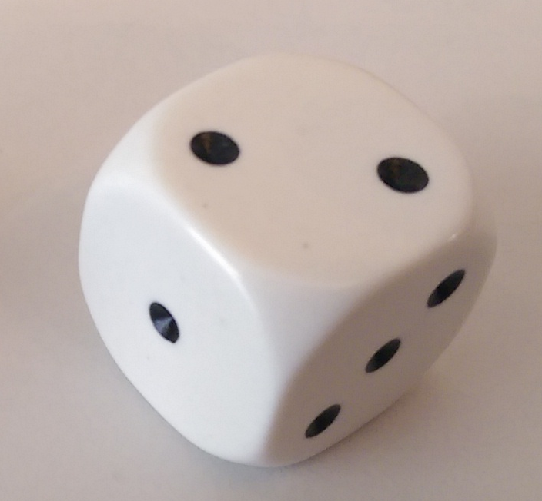
Question
Is any number on one dice more likely than any other?
https://upload.wikimedia.org/wikipedia/commons/2/2d/D3_Pipped.png

Slide 4
Distribution on a single dice
1 : IIIIIIII
2 : IIIIIII
3 : IIIIIIIIII
4 : IIIIIII
5 : IIIIIIII
6 : IIIIIIIII
Does the animal racing distribution look like this?
Why / why not?

Slide 5
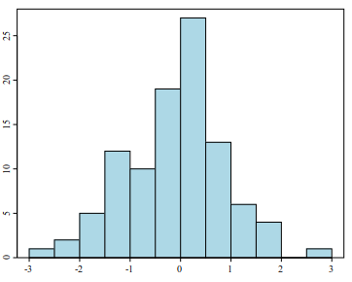
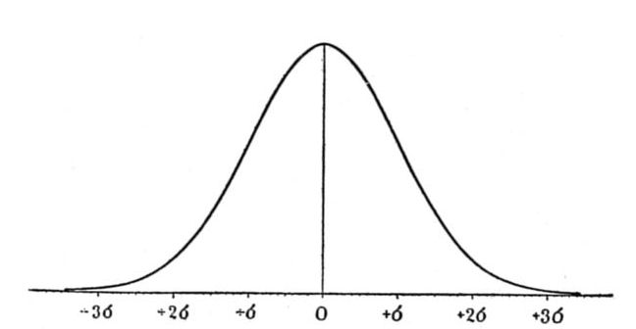
Central Limit Theorem
If a total score is the sum of a bunch of different scores, it will have approximately the same distribution whatever the distribution of the individual scores.
A theorem, not a theory.
Known as a normal or Gaussian distribution.
https://commons.wikimedia.org/wiki/File:Histogram_example.svg
https://commons.wikimedia.org/wiki/Category:Normal_distribution#/media/File:Critique_of_the_Theory_of_Evolution_Fig_074.jpg

Slide 6
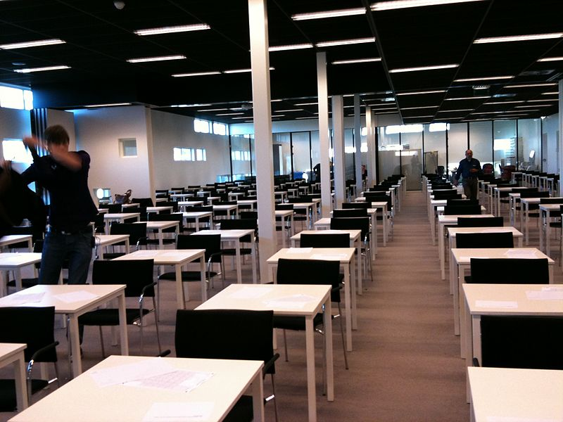
Exam hall bingo!
10 min activity
https://upload.wikimedia.org/wikipedia/commons/thumb/c/c2/Exam_room_at_Stenden_University.jpg/800px-Exam_room_at_Stenden_University.jpg

Slide 7
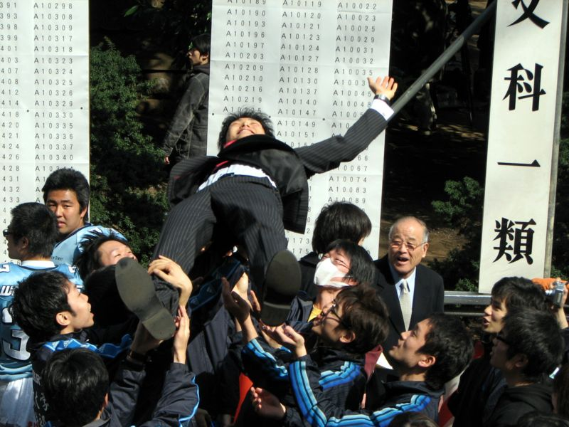
The Results
To be revealed in class…
What each group decided, and how long they took.
Which team (red or blue) is actually smarter.
How big the difference between the two teams really is.
https://commons.wikimedia.org/wiki/File:Tokyo_University_Entrance_Exam_Results_8.JPG

Slide 8

Sample sizes
This game is much like a psychology experiment:
  You collect some data about two groups.
  You collect enough of it to be confident that you know whether the groups differ.
Looking back, how soon do you think you should have stopped?
To be revealed in class…
  What the minimum sample size a psychologist should accept for these two groups is.
To be revealed next year:
  How I worked out the minimum sample size.
https://upload.wikimedia.org/wikipedia/commons/a/a2/Stack_of_papers_tied.svg

Slide 9
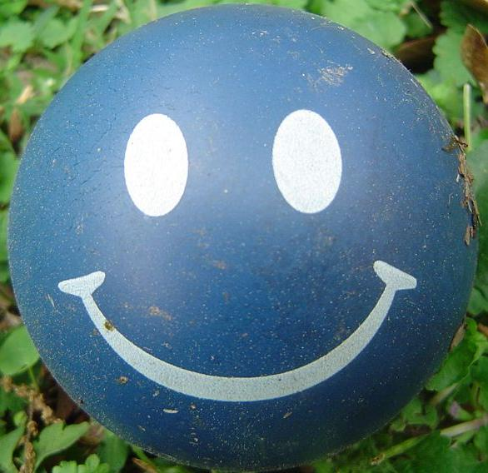
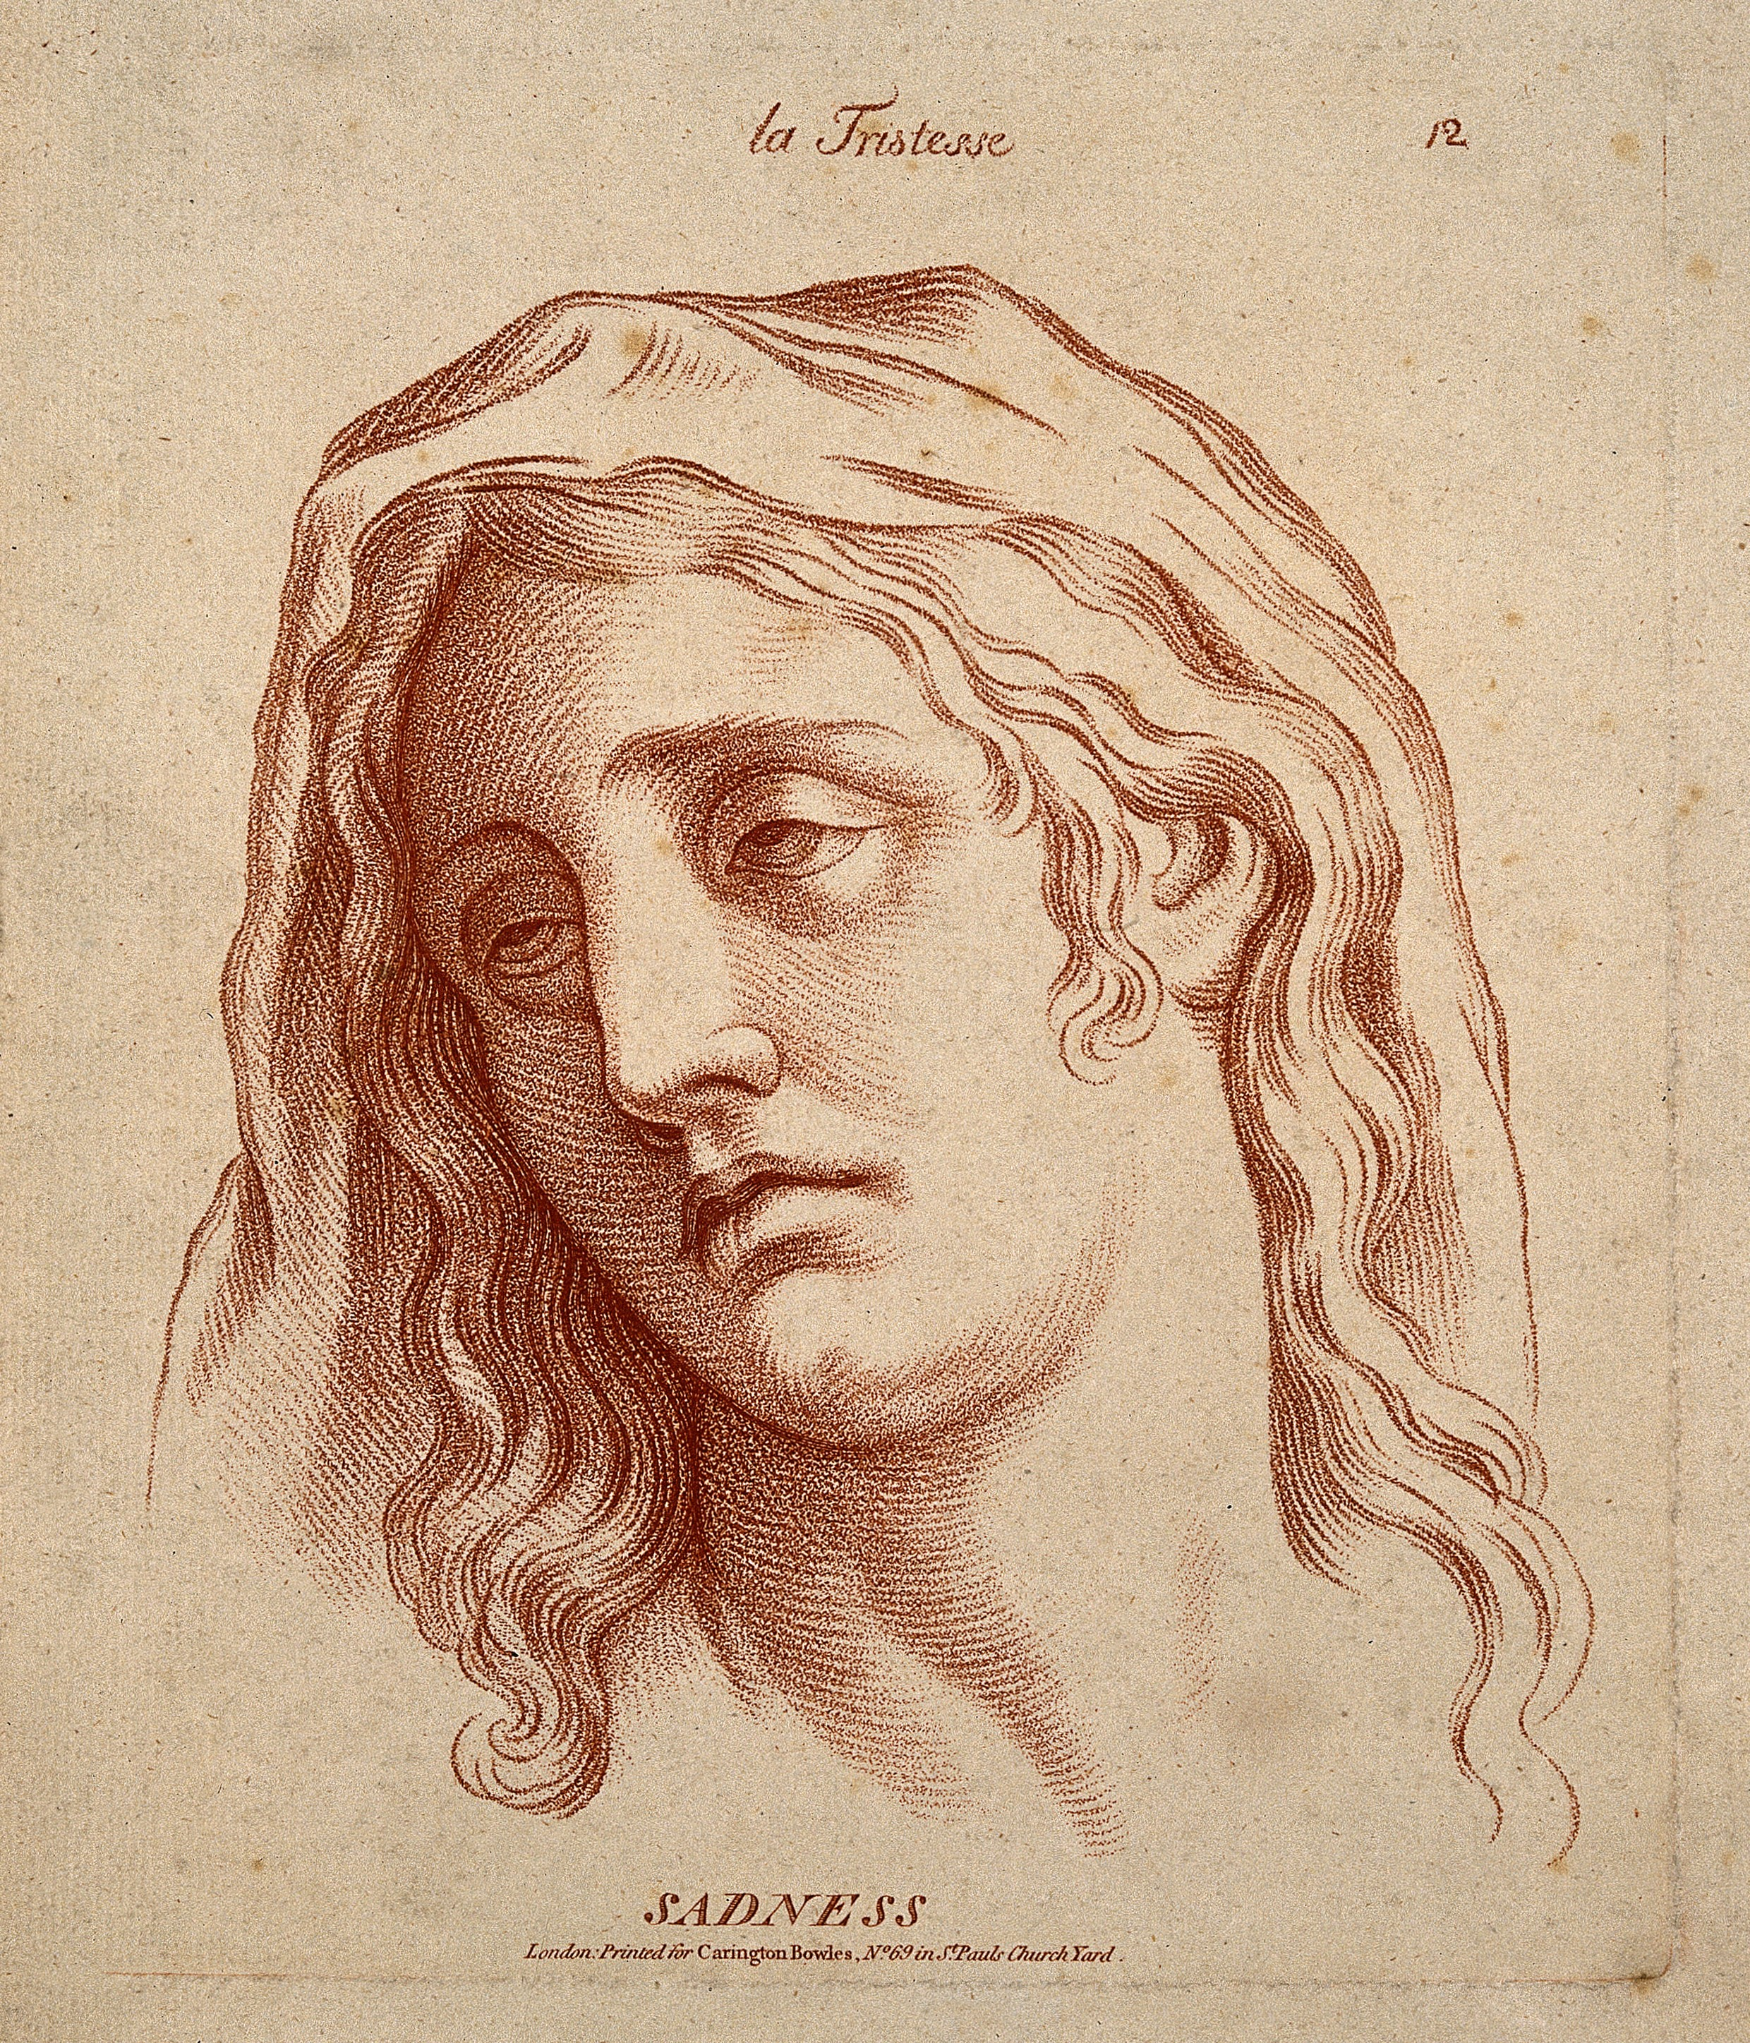
Praise and punishment
10 min activity
What improves performance more:
  Praising people when they do well?
  Criticising them when they do badly?
https://upload.wikimedia.org/wikipedia/commons/9/94/A_woman_whose_face_expresses_sadness._Etching_in_the_crayon_Wellcome_V0009337.jpg
https://commons.wikimedia.org/wiki/File:Happy_face_ball_crop.jpg

Slide 10
Praise and criticism
When you praised the player, what tended to happen?
When you criticised the player, what tended to happen?
What does this tell us about praise versus critcisim?
https://upload.wikimedia.org/wikipedia/commons/9/94/A_woman_whose_face_expresses_sadness._Etching_in_the_crayon_Wellcome_V0009337.jpg
https://commons.wikimedia.org/wiki/File:Happy_face_ball_crop.jpg

Slide 11
A secret is revealed...
...come to class to find out what it is!

Slide 12
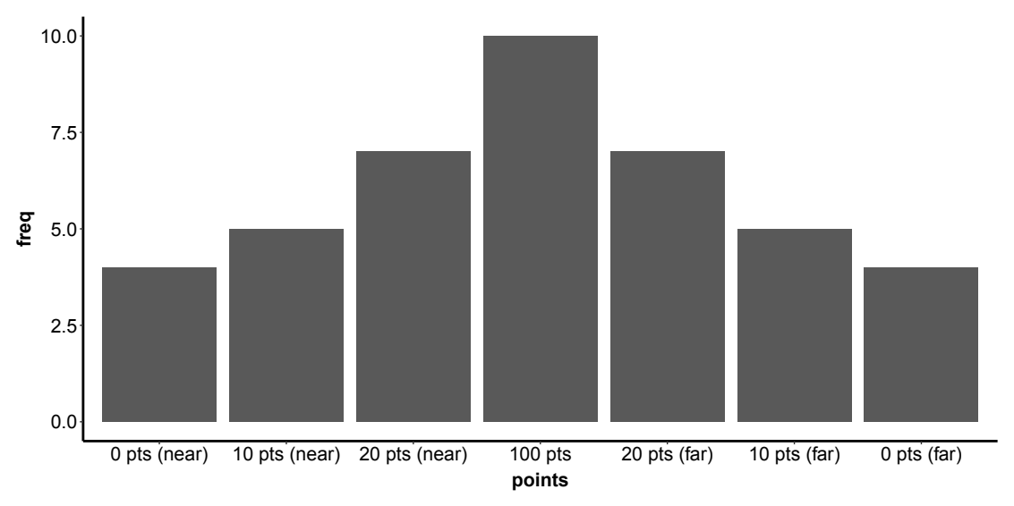
Distribution of scores

Slide 13
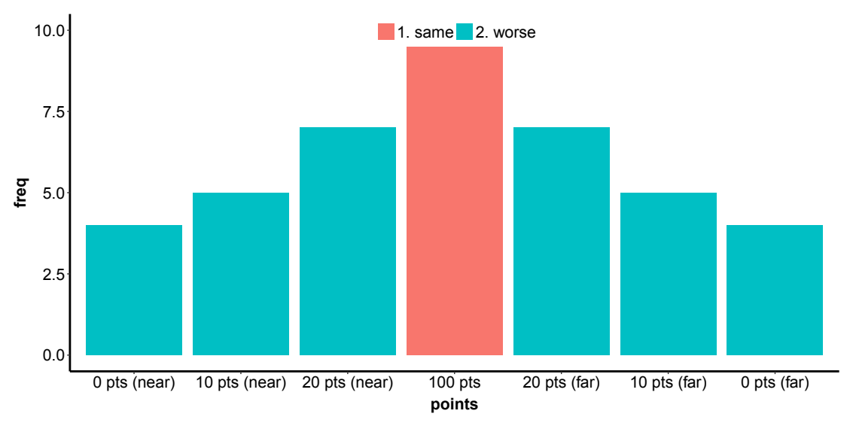
When you praise...

Slide 14
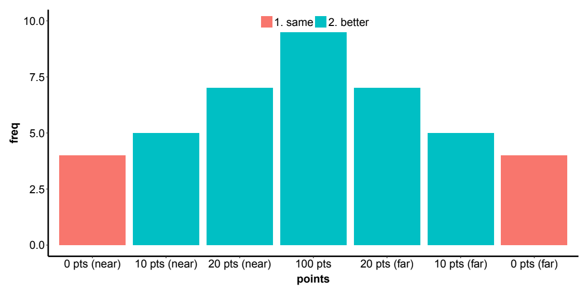
When you criticise...

Slide 15
Regression to the mean
Other areas it (may) apply to:
  OFSTED school inspections
  Remedial classes
  Evidence for unconscious learning
  “Difficult” second film / second novel.

Slide 16
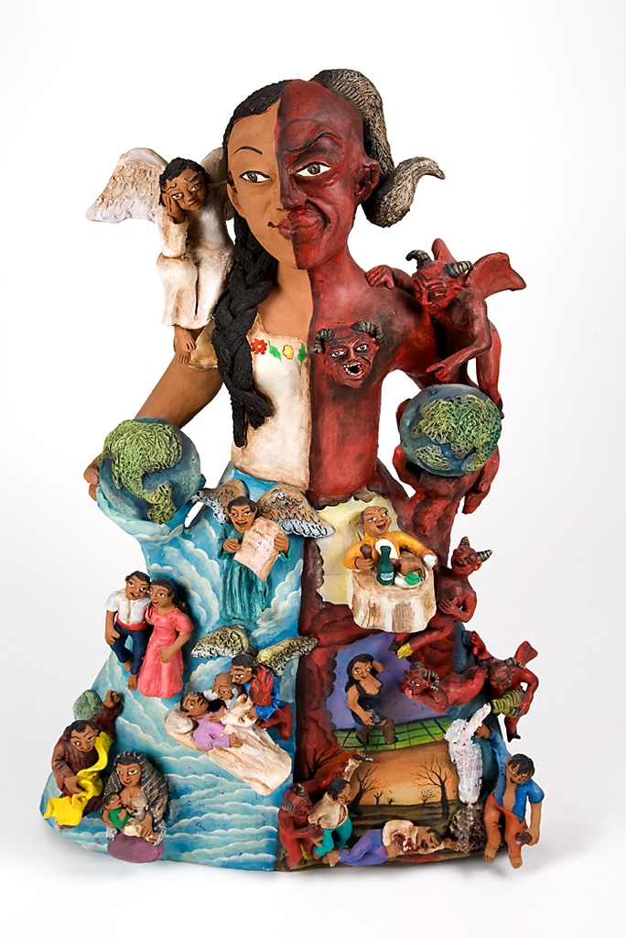
Groups and behaviours
https://upload.wikimedia.org/wikipedia/commons/1/1f/Good_and_Evil_figure_by_Demetrio_Garci%C2%A6%C3%BCa_Aguilar.jpg

Slide 17

Spoiler alert!
DON’T LOOK AT THE LAST SLIDE UNTIL AFTER YOU HAVE ANSWERED THE QUESTIONAIRE !!!
https://upload.wikimedia.org/wikipedia/commons/5/56/Answer_to_Life.png

Slide 18
The same information in a table...
 | Group A | Group B
Desirable | 18 | 9
Undesirable | 8 | 4
18: 8 = 9 : 4

