Slide 1
Behaviourism and Animal Psychology
Chung & Hyland (2012). History and Philosophy of Psychology. Chapter 7.

Slide 2
Before behaviourism
During the 19th century animals were studied in their own right
    George Romanes - published Animal Intelligence in 1881
      ‘I thought it desirable that there should be something resembling a text-book of the facts of comparative psychology. Romanes
      ‘The archetypal purveyor of anecdotes about animals (Boakes 1984)
Animals can’t introspect

Slide 3
Thorndike 1874-1949
Poorly supported by biology departments
Not supported at Harvard, so used James’ basement as laboratory
Due to lack of support, moved from animal psychology to educational psychology
Published Animal Intelligence in 1911
his ‘few short years of animal work’

Slide 4
Thorndike’s law of effect
    Of several responses made to the same situation, those that are accompanied or closely followed by satisfaction to the animal will, other things being equal, be more firmly connected with the situation, so that, when it recurs, they will be more likely to recur’ those which are accompanied or closely followed by discomfort to the animal will, other things being equal, have their connections with that situation weakened, so that, when it recurs, they will be less likely to recur.

Slide 5
Thorndike’s law of exercise
Any response to a situation will, other things being equal, be more strongly connected with the situation in proportion to the number of times it has been connected with that situation and to the average vigor and duration of the connections.

Slide 6
Pavlov 1849-1936
Experiments on sham feeding - release of gastric juices in the stomach even though no food present
Called these ‘psychical secretions’

Slide 7
Pavlov and the conditioned reflex
An UCS (unconditioned stimulus) gives an unconditioned response (UCR)
CS (conditioned stimulus) paired with UCS (unconditioned stimulus)
After a while the CS gives a CR (conditioned response)

Slide 8
Phenomena worked on by Pavlov
Extinction
    present CS without UCS
Spontaneous recovery
    after a rest following extinction, the is a spontaneous recovery of the CR
higher order conditioning
    associating the CS with some other stimulus
experimental neurosis
    dogs become disturbed if discrimination tasks become too difficult

Slide 9
J. B. Watson 1878-1958
Didn’t enjoy introspection tasks
Developed his manifesto for Behaviourism in Psychological Review 1913.
    Psychology as the behaviourist views it is a purely objective experimental branch of natural science. Its theoretical goal is the prediction and control of behavior. Introspection forms no essential part of its methods, nor is the scientific value of its data dependent upon the readiness with which they lend themselves to interpretation in terms of consciousness.

Slide 10
Watson’s life
“I never wanted to use human subjects. I hated to serve as a subject…I was always uncomfortable and acted unnaturally. With animals I was at home”. 1936.
Divorced in 1920, and married his assistant, Raynor – and dismissed from the university.

Slide 11
Methodological behaviourism
Believed that psychology had failed as a science
introspection worthless
behaviour can be studied in animals
study humans like animals using only objective observation

Slide 12
Main ideas of Watson’s behaviourism
Stimulis response bond S ----------- R
some innate and some learned
Associationist - but never developed an entirely satisfactory theory of learning

Slide 13
The case of little Albert
Wanted to show that phobias were learned - in contrast to Freud
The story of little Albert
      Albert - aged 11 months was afraid only of loud noises
      white rat placed in front of Albert - when Albert reaches out loud noise
      After 7 noise-rat presentations Albert cried at seeing rat.
      Later reports say fear generalised to rabbit, dog, fur coat - but not cotton wool (!!)
      Still cried 5 days later (but response needed to be ‘freshened up’!)

Slide 14
B.F. Skinner 1904-1990
Radical behaviourism
rejected ‘theoretical terms because they are superfluous S-------O--------R S-----------------R

Slide 15
Skinner’s achievements
The behaviour of organisms
Classical versus operant conditioning
Influenced behavioural techniques of therapy
Notes:
.

Slide 16
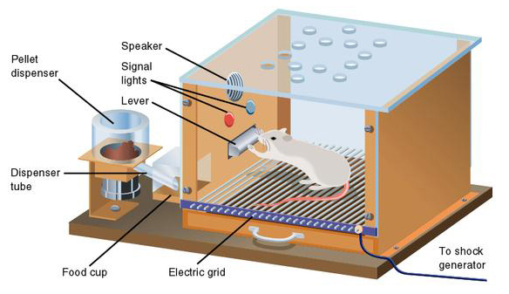
The Skinner box

Slide 17
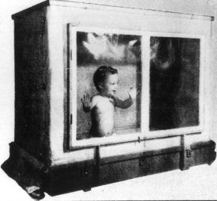
The air-crib – baby in a box

Slide 18
Skinner’s achievements
Walden Two (1948), Beyond Freedom and Dignity (1971) - Skinner’s writings on Utopia based on operant conditioning
    freedom and dignity are subjective impressions that have no basis in objective reality

Slide 19
Neobehaviourism
Unobservables are OK as long as they are objectively defined
eg., Hull, Tolman Guthrie S--------O-----------R

Slide 20
Reasons why the neobehaviourists wanted to include theoretical terms
Rats behave differently depending on past experiences
e.g., depending on whether they have eaten or prior experience

Slide 21
Clark Hull (1884-1952)
Sympathetic to Watson’s rejection of introspection but felt that something needed to be put in its place.

Slide 22
Hull’s theory
Principles of behaviour 1943
_{S}E_{R} = D x H
_{S}E_{R} = net reaction potential
D = Drive = number of hours without food
H = Habit = number of left/right turns in maze

Slide 23
Intervening variables versus hypothetical constructs
Intervening variable
    Intelligence is what intelligence tests measure
    Concept is defined by its measurement procedure
Hypothetical construct
    Intelligence tests measure intelligence
    Concept exists independently of its measurement
Notes:
.

Slide 24
Contributions of Tolman
Demonstrated latent learning - showed that Thorndike’s law of effect was not needed for learning
    if a rat walks round a maze when not hungry, the rat learns he layout of the mze
    Rats have a ‘cognitive map’ of the maze
      note first use of the term cognitive map

Slide 25
Contributions of Tolman
Thought that behaviour was goal oriented
Rats used cognitive map to reach their goals.
Tolman uses hypothetical constructs rather than intervening variables

