Slide 1
Distributions and samples
Andy Wills
CC-BY-SA 4.0

Slide 2
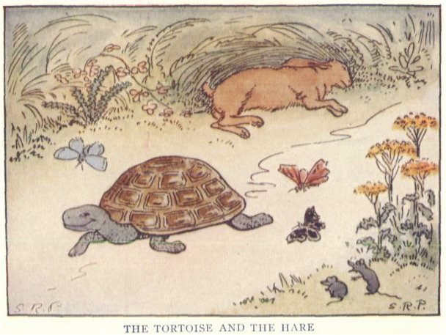
Animal racing!
Your group will need:
One toy animal each.
Four dice per group.
One 30cm rule per group.
One “start” and one “end” marker per group.
20 min activity
https://commons.wikimedia.org/wiki/File:The_Tortoise_and_the_Hare_-_Project_Gutenberg_etext_19993.jpg

Slide 3
How to play
Put the start marker at one end of the table.
Measure 45cm from that and place your end marker.
Put your toy animals on the starting line.
On your turn:
  Roll four dice, add up the score.
  Move your animal forward that many centimetres.
  Record you score on Mentimeter.
First person past the line wins!

Slide 4
Details, details...
Put the front of the animal at the front of the start line.
Measure your distance from the front of the animal.
If your animal accidentally gets knocked, put it back.

Slide 5
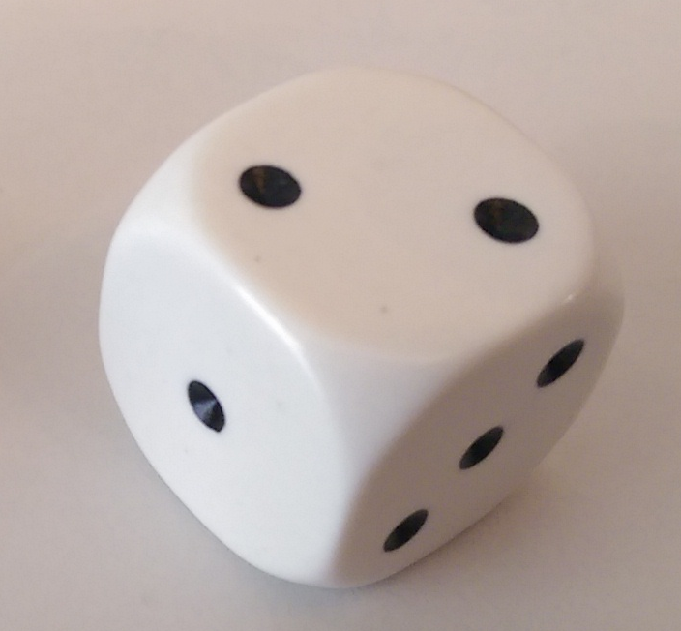
Question
Is any number on one dice more likely than any other?
https://upload.wikimedia.org/wikipedia/commons/2/2d/D3_Pipped.png

Slide 6
Distribution on a single dice
1 : IIIIIIII
2 : IIIIIII
3 : IIIIIIIIII
4 : IIIIIII
5 : IIIIIIII
6 : IIIIIIIII
Does the mentimeter distribution look like this?
Why / why not?

Slide 7
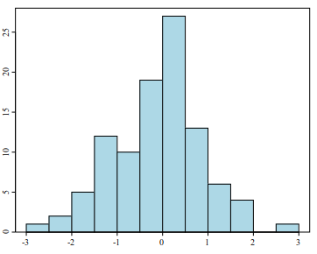
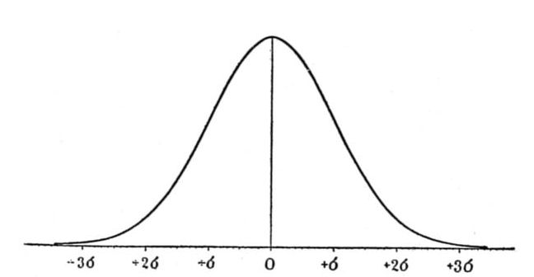
Central Limit Theorem
If a total score is the sum of a bunch of different scores, it will have approximately the same distribution whatever the distribution of the individual scores.
A theorem, not a theory.
Known as a normal or Gaussian distribution.
https://commons.wikimedia.org/wiki/File:Histogram_example.svg
https://commons.wikimedia.org/wiki/Category:Normal_distribution#/media/File:Critique_of_the_Theory_of_Evolution_Fig_074.jpg

Slide 8
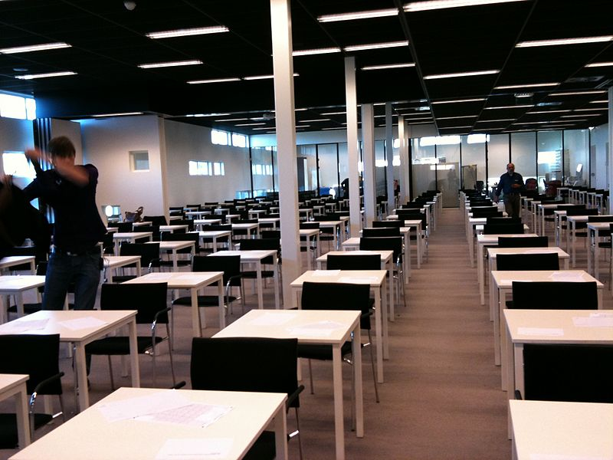
Exam hall bingo!
Two groups of the students, the blues and the pinks, take an exam.
I’ll show you one exam score at a time.
Without a calculator and without pen and paper, try to work out which group scores higher on exams, on average, and enter your answer into Mentimeter.
Do this as quickly as possible, BUT
Don’t stop until you are sure you have the right answer.
10 min activity
https://upload.wikimedia.org/wikipedia/commons/thumb/c/c2/Exam_room_at_Stenden_University.jpg/800px-Exam_room_at_Stenden_University.jpg

Slide 9
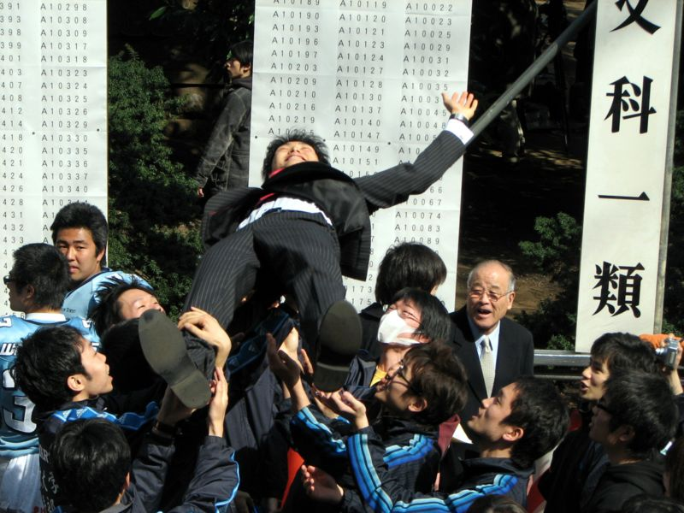
The Results
To be revealed in class…
https://commons.wikimedia.org/wiki/File:Tokyo_University_Entrance_Exam_Results_8.JPG

Slide 10

Sample sizes
This demonstration is much like a psychology experiment:
  You collect some data about two groups.
  You collect enough of it to be confident that you know whether the groups differ.
To be revealed in class…
  What the minimum sample size a psychologist should accept for these two groups is.
To be revealed next year:
  How I worked out the minimum sample size.
https://upload.wikimedia.org/wikipedia/commons/a/a2/Stack_of_papers_tied.svg

