Slide 1
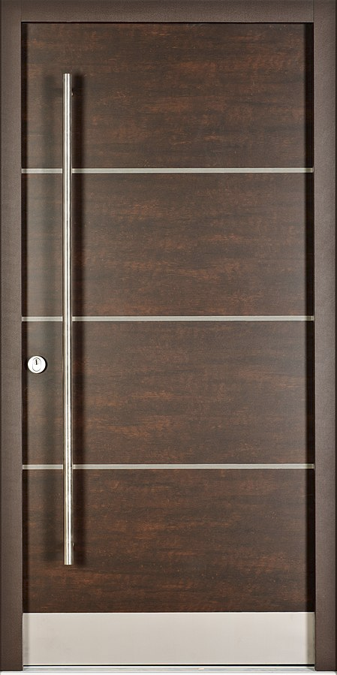

Slide 2
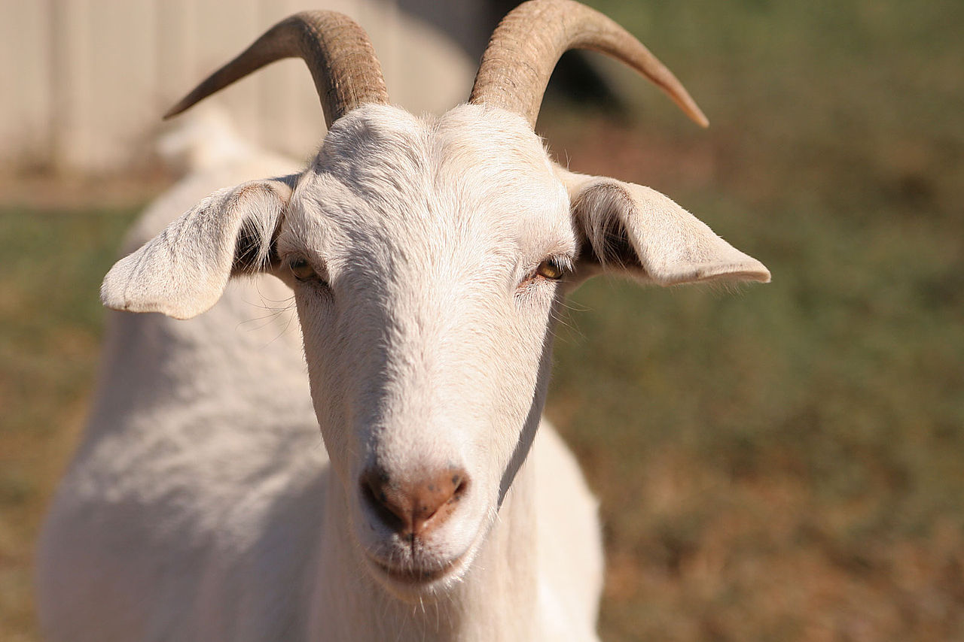

Slide 4
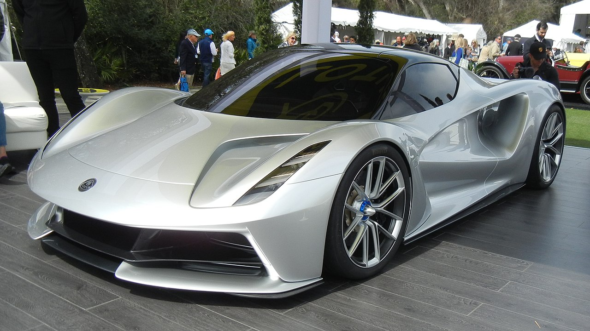

Slide 5
Understanding Monty Hall
Monty will never open the door with the car behind it.
If you originally picked the goat, Monty will show you a goat. The car will be behind the other door, so you should switch.
If you originally picked the car, you should stick.
There are two goats, and one car, so P(win|switch) = 0.67, and P(win|stick) = 0.33.
To maximize your cnace of winning, you should always switch.

