Slide 1
George Kelly (1905-1967)
Chung & Hyland (2012) History and Philosophy of Psychology. p. 233-241.

Slide 2
George Kelly (1905-1967) psy201 p233-241 of ebook
Trained as a psychologist
Developed a clinical-psychology service for the state school system and students at his University
Developed his theory of personal constructs and applied it to these clients

Slide 3
Kelly’s view of science
There isn’t an objective reality
We construct reality. Reality is subjective
    NB Hanson 1958
Scientists construct a scientific reality by forming hypotheses.
    Hypotheses have a focus
Ordinary people are no different from scientists -
    they too form a reality by forming hypotheses
Scientists and ordinary people are trying to predict and anticipate events

Slide 4
Kelly’s view of humans
Not driven by drives
Simply trying to understand the world in which they live
Naïve scientists
    predict and control phenomena - phenomena are subjective
    The difference between scientists and non-scientists is imaginary

Slide 5
Kelly’s theory of personality
Key concept is the personal construct
a way of construing or interpreting the world
people have different ways of construing or interpreting the world - they have different constructs

Slide 6
What is a personal construct?
A personal construct is a dichotomy which is used to make sense of the world: example
Take three objects
    e.g., a whale, a rat, and a trout
In what way are two similar and one different?
Similarity pole and contrast pole
    Note a construct is not a dimensions - complexity is built up by constructs of quantity or degree

Slide 7
More about constructs
A construct is like a theory
    like a theory, a construct has a focus. It always applies to a particular type of context.
Core constructs versus peripheral constructs
    consistently used versus sometimes used
Tight constructs versus loose constructs
    always lead to the same conclusion versus lead you to expect one thing on one occasion and something else on another
Constructs not always verbal

Slide 8
Kelly’s theory of personality
An individual’s personality is his construct system.
People have different constructs - they construe the world in different ways.
Finding out about someone’s constructs tell us what that person is like and how they will respond to different situations

Slide 9
The Repertory Grid Test - Rep test - part 1
A way of finding out about a person’s constructs
Start with a role title list
    remember that a construct always has a focus
E.g., write down a list of 6 people you know
    this exercise will help you find out about the constructs you use when interpreting other people. I.e., the focus is construct about people

Slide 10
Rep test (part 2)
Write down six people you know
    e.g., Bob, Mary, Peter, Sue, Alison, Roger
Take the first three and ask yourself, in what way are two similar and one different?
    E.g., Bob and Mary have a sense of humour, Peter hasn’t
Write down the similarity pole (the way two are similar) and the contrast pole (the way the third person is different
    Has a sense of humour vs No sense of humour

Slide 11
Rep test (part 3)
You now have your first construct (has sense of humour vs has no sense of humour)
Now take another three people from you list
    e.g., Peter, Sue and Alison
Ask yourself again, in what way are two similar and one different
    Peter and Sue are old, Alison is young
You now have your second construct - keep doing this till you stop producing new constructs

Slide 12
Interpretation of Rep test
Examiner considers constructs
Often constructs which use different words have similar meanings
    e.g., bright versus thick, education versus uneducated
Examiner considers the total number and nature of the constructs
    considers how tight or loose they are

Slide 13
Interpreting the Rep test
What is the characteristics of the person who has these constructs?
    Easy going - hypercritical
    Feels inferior - feels confidant
    Socially skilled - unpleasant
    Tense - easy to be with
    Maladjusted - easy going
    Understanding - hypercritical

Slide 14
Interpretation of Rep test
Limited number of constructs so limited versatility in dealing with people
    although different constructs are used they all concern ways in which people relate to the client
Concerned about social confidence
    Clearly there is an issue of perceived criticism, and being criticised by others is an important part of this client’s construct system
therapist will either be interpreted as critical or friendly/easy going
Notes:
This slide provides an interpretation of the set of constructs presented in the previous slide. Note that the therapist should be aware that he or she will fit somewhere into the client’s constructs - as everything does!

Slide 15
Complexity of construct system
How many different constructs does the client have?
Anxiety
    recognition that the events one is confronted with lie outside the range of convenience of one’s construct system
Threat
    awareness of imminent comprehensive change in construct.

Slide 16
How people use constructs in everyday life
Circumspection-preemption- control cycle
Circumspection
    What constructs can I use in relation to the present situation?
Preemption
    Choose the construct or constructions to be used
Control
    Act on the conclusions drawn from the application of the preempted constructs

Slide 17
Pathology
Everyone has their own constructs
Pathology is disordered functioning in relation to the application of the construct system to events
To treat pathology, it is necessary to change the construct system

Slide 18
Therapy - changing constructs
Conditions needed for therapeutic change of constructs to take place
  Atmosphere of experimentation
    constructs can be tried out within a context of experimentation - not ‘playing for keeps’
  Provision of new elements
    Therapist provides new constructs in a protected environment - awareness that therapist will be construed in a particular way
  Availability of validating data
    Provide evidence that new constructs work

Slide 19
Fixed role therapy
Client presented with a new personality sketch and asked to act it out
Opportunity to construe the world differently and so behave differently in a protected environment
Then given the opportunity to ‘become’ the person being acted
    Client may resist - therapist suggests that it is temporary attempt to act like another person and see how it works.

Slide 20
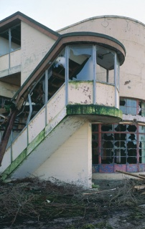
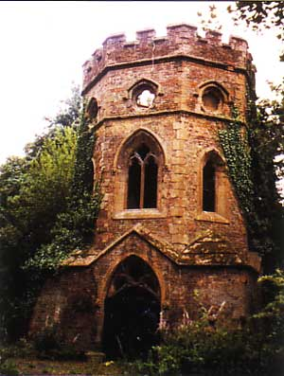
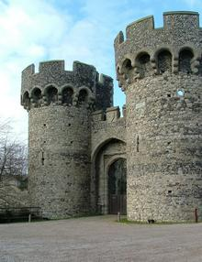
Evaluation of Kelly
    Rep test used in lots of contexts, e.g., In architecture

Slide 21
Evaluation of G. Kelly
Consistent theory of people as rational scientists
A cognitive theory -an alternative to theories suggesting that people are motivated by desires
Are people always that rational?
Is the lack of motivation important?
Precursor to cognitive psychology – the idea that people are rational information processing machines

