Slide 1
Psychophysics and Psychometrics
Chung & Hyland (2012) History and Philosophy of Psychology. Pages 37-40, 109-118

Slide 2
Psychophysics and Psychometrics
In this lecture you will learn about
  Psychophysics - measurement of physical sensation
  Psychometrics - Questionnaire scale construction

Slide 3
Psychophysics
Predates Wundt’s laboratory
Originally known as sensorypsychophysiology
The aim was to measure sensory experience
    i.e., experience from sound, sight, touch, hearing, or temperature
    What is the relationship between a sensation (e.g., weight and perception (e.g., heaviness)?

Slide 4
Psychophysics - basic concepts
Threshold (Latin word limen) of which there are two kinds
    absolute threshold (also called stimulus threshold and often abbreviated to RL form the German Reiz Limen. This is the difference between something being there and not there.
    Difference threshold (also called just noticeable different - JND - or DL from Differenz Limen. Example: Weber’s (1934) ‘compass test’ of spatial discrimination - try it out yourself! Mapping the sensitivity of skin in different parts of the body

Slide 5
Psychophysics - basic concepts
Point of subjective equality (PSE) when two stimuli are perceived as equal
Note: so the basic measurement technique involves finding things are different and finding they are the same

Slide 6
Psychophysical methods for determining thresholds
1. Method of limits
    You adjust from below and above the threshold until the participant notices a change
2. Method of adjustment
    The participant adjusts up and down until it is at the threshold
3. Method of constant stimuli
    participant presented with a random array of stimuli - point at which 50% detected is threshold

Slide 7
Example of method of limits
12 N N
13 N N N
14 N N N
15 Y N N N Y
16 Y Y
17 Y Y
18 Y

Slide 8
Weber’s law
Weber noticed that the DL (difference threshold) increased with the stimulus intensity - and this happened for all sensory modalities
e.g., the JND of 20 Kilos is more than the JND for 1 Kilo
Weber found that the JND/stimulus size was constant - and Fechner called this Weber’s fraction

Slide 9
Fechner
Fechner gave Weber’s fraction a mathematical form:
δR = a constant
R
Through a series of mathematical exercises he changed this to
S = k Log R
Where R is the stimulus magnitude (German word Reiz),
δR is the amount of change needed to detect a difference (I.e. JND), and S is the psychological sensation

Slide 10
Fechner’s law can be expressed as a graph
Sensation
intensity
(S)
Physical stimulus intensity

Slide 11
Some interesting facts about Fechner
His Father
Depression and recovery

Slide 12
Psychophysics versus Psychometrics
What happens if there is no physical stimulus?
Psychophysics - if there is a physical stimulus
Psychometrics if there isn’t
    but psychometrics can be related to psychophysical techniques (see next overhead)

Slide 13
How the paired comparison method can be used for a psychometric scale
Note: Fechner’s first publication was on experimental aesthetics
Example: A scale of beauty
Imagine five paintings, and participants select the most beautiful painting
Painting A 45% preference
Painting B 25% preference
Painting C 15% preference
Painting D 10% preference
Painting E 5% preference

Slide 14
3 Types of psychometric tests
Individual tests (questionnaire)
    people tested individually - used for Binet’s intelligence tests, also tests of attitude and aptitude
Group tests (questionnaire)
    tested in groups - e.g., army batteries, group attitude testing etc
Projective tests
    people write stories and so reveal their motivations
Notes:
.

Slide 15
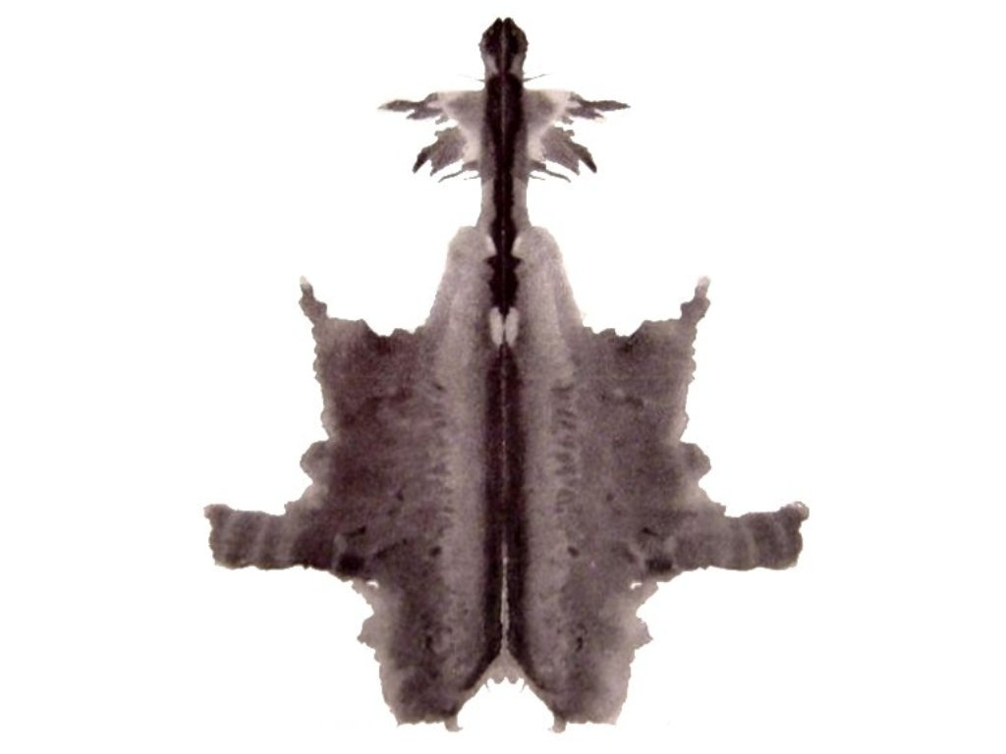
Rorschach test
.

Slide 16
Thematic apperception test

Slide 17
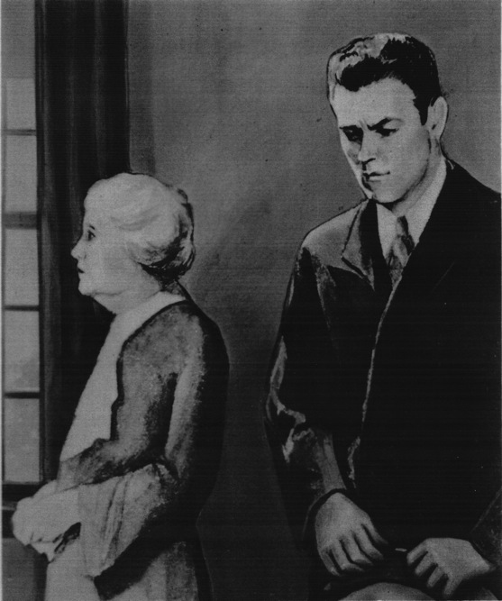

Slide 18
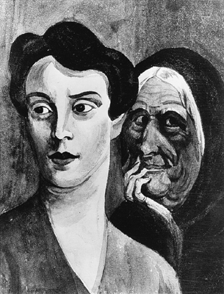

Slide 19
Measuring attitude
Two methods of developing an attitude questionnaire
Thurstone method
Lickert method

Slide 20
Thurstone method (1)
1. Choose a subject about which you want to measure attitude
2. Create a list of attitude statements
3. Ask judges to rate each statement on how positive or negative to the subject. E.g.
Smoking is an important pleasure in life
Smoking is harmful to smokers
Smoking is harmful to other people
Positive to Negative to
smoking smoking
1 2 3 4 5 6 7 8 9 10

Slide 21
Thurstone method (2)
OK, you now have several statements about your attitude subject which have been rated by judges.
1. Take the mean position for the judges rating for each item - rejecting any items that have wide discrepancies (why?)
2. Now, and only now are you ready to give the scale to the participants whose attitude is to be measured. Ask participants whether they agree or disagree with each item. Note: a binary choice.
3. Attitude score is the point of change between agree and disagreed with items

Slide 22
Lickert method for measuring attitude (1)
1. Choose a subject about which you want to measure attitude
2. Create a list of attitude statements. So far the same as for the Thurstone method
3. Now, you don’t need to get judges to rate items. The reason is that you ask participants to judge items on a 7- point scale, not a binary scale

Slide 23
Lickert method for measuring attitudes (2)
1. Smoking is an important pleasure in life
Disagree -3 -2 -1 0 1 2 3 Agree
2. Smoking is harmful to smokers
Disagree -3 -2 -1 0 1 2 3 Agree
3. Smoking is harmful to other people
Disagree -3 -2 -1 0 1 2 3 Agree
Add up total from scores (a lot easier, and so a commonly used method …but

Slide 24
Lickert method - points to watch
1. Make sure you have a range of items - it is less easy to be sure about this than the Thurstone method
2. You need a method for checking that an item is understood in a consistent way - otherwise it is an unreliable - this is something that Thurstone does anyway (This is usually done through item analysis, but see later)

Slide 25
The concept of latent variables
Latent variables, are hypothetical constructs that determine response to items in a questionnaire.
Example of factor analysis to discover latent variables - examining inter-correlations
1 2 3 4 5 6 7 8
X Y

Slide 26
Factor analysis
Developed by Charles Spearman
Book: The abilities of man 1927
Follows earlier work by Binet and others who were trying to develop scales measuring ability.

Slide 27
Questionnaires should be reliable and valid
Reliability - do you get the same result if you test on a subsequent occasion?
Test-retest reliability
Spilt halves
Internal consistency
Practical consequence of poor reliability

Slide 28
Validity: does the test measure what you say it is measuring? - 3 kinds
Criterion validity
    Does the scale measure the same thing as some other criterion or ‘gold standard’
Content validity
    Does the content of the scale reflect the subject to be assessed
Construct validity
    Does the scale measure some hypothetical construct?

Slide 29
Examples of factor analysis in practice
Intelligence testing - the concept of ‘g’
    Suggested by Spearman, and then a large influence in education
Personality testing - the five factor theory
Cattell’s theory
Big one and two factor theory

Slide 30
Recapitulation and final thought
Psychophsics - measuring sensation
Psychometrics - measuring other things

