Slide 1

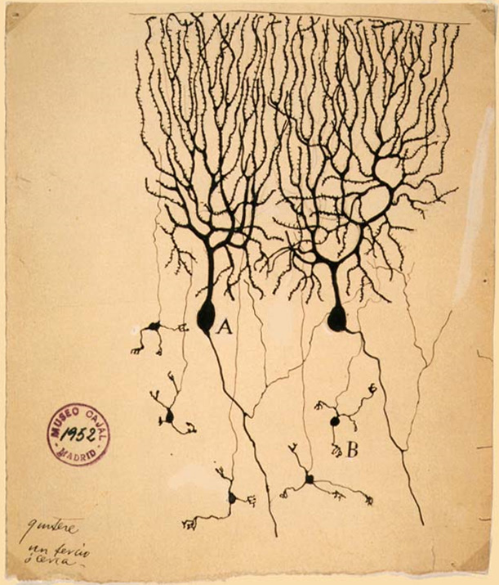

How To Build A Brain
History And Core Concepts

Slide 2
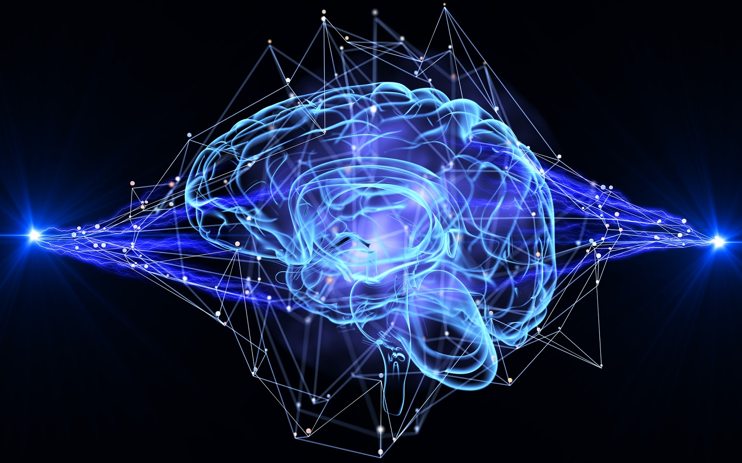
Goals
To help you understand the history and core concepts of brain-inspired artificial intelligence.

Slide 3
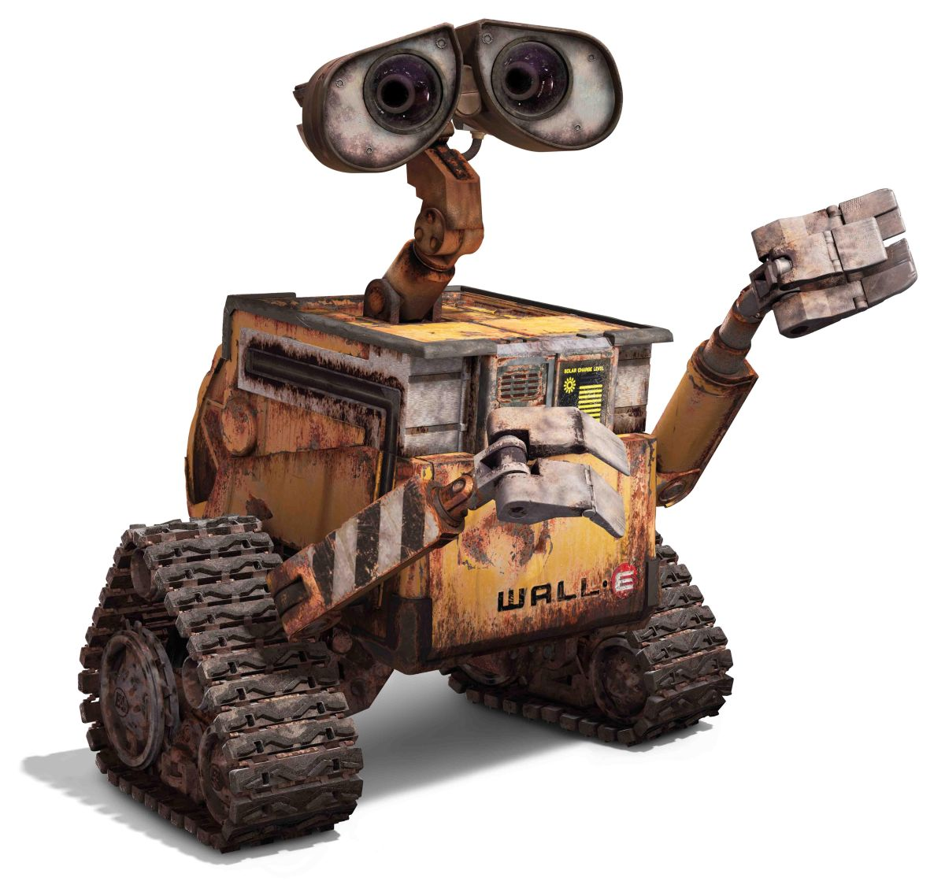
Topics
History and core concepts
Perception
Action
Philosophy & ethics

Slide 4

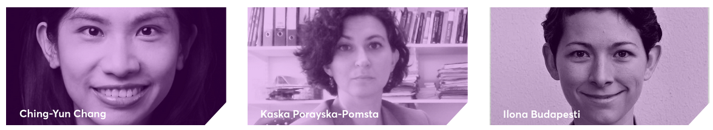
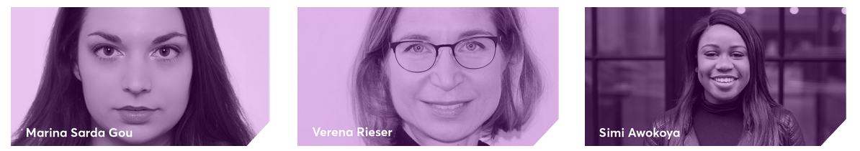
AI: Not just for old white men

Slide 5
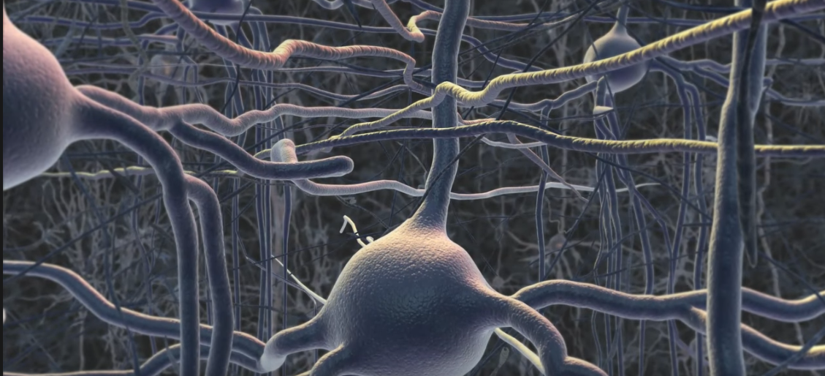
Early history

Slide 6
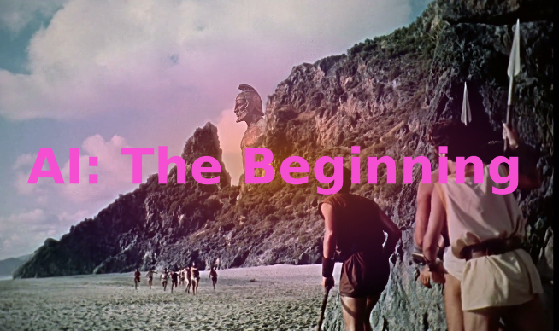
400BC - 1900AD

Slide 7
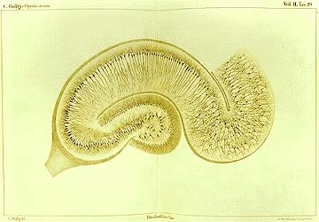
Golgi
Neurons
Cajal

Slide 8
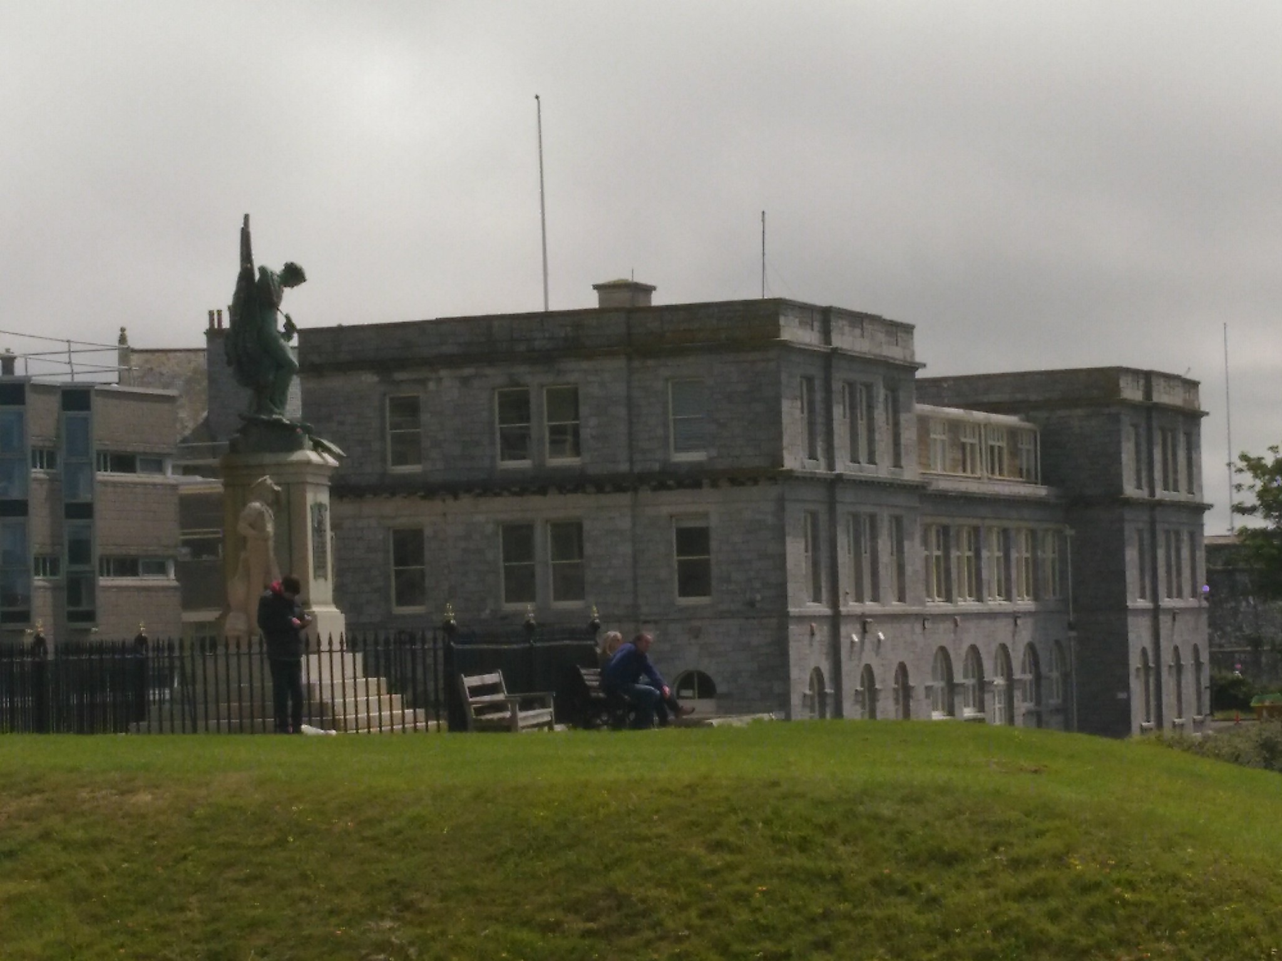
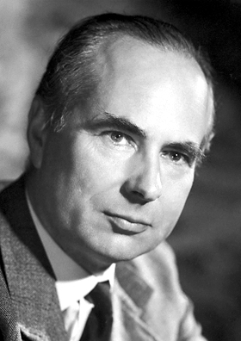
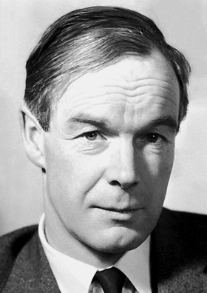
Plymouth
Marine Laboratory
Andrew
Huxley
Alan
Hodgkin

Slide 9
Three abstractions

Slide 10
Output Activation
0.42
The activity of a neuron, as a single number

Slide 11
Output Activation
0.02
0.42
Out = 0.02 + 0.40 = 0.42
Out = Σ in
0.40
Output activation is the sum of the inputs.

Slide 12
Input activation
a_{out} = 0.2 x 0.1 = 0.02
a_{out} = a_{in}w
0.20
0.1
0.02
Input activation = output activation multiplied by the connection strength

Slide 13
Putting it together
a_{out} = 0.2 x 0.1 + 0.8 x 0.5 = 0.42
a_{out} = Σaw
0.20
0.1
0.42
0.5
0.80
Output activation of a neuron is the sum of the outputs of other neurons multiplied by the connection weights.

Slide 14
Test your understanding...
0.25
0.80
a_{out} = Σaw
0.01
?
1.00
Output activation of a neuron is the sum of the outputs of other neurons multiplied by the connection weights.

Slide 15
Test your understanding (2)
-1
0.50
a_{out} = Σaw
0.5
?
0.10
Output activation of a neuron is the sum of the outputs of other neurons multiplied by the connection weights.

Slide 16
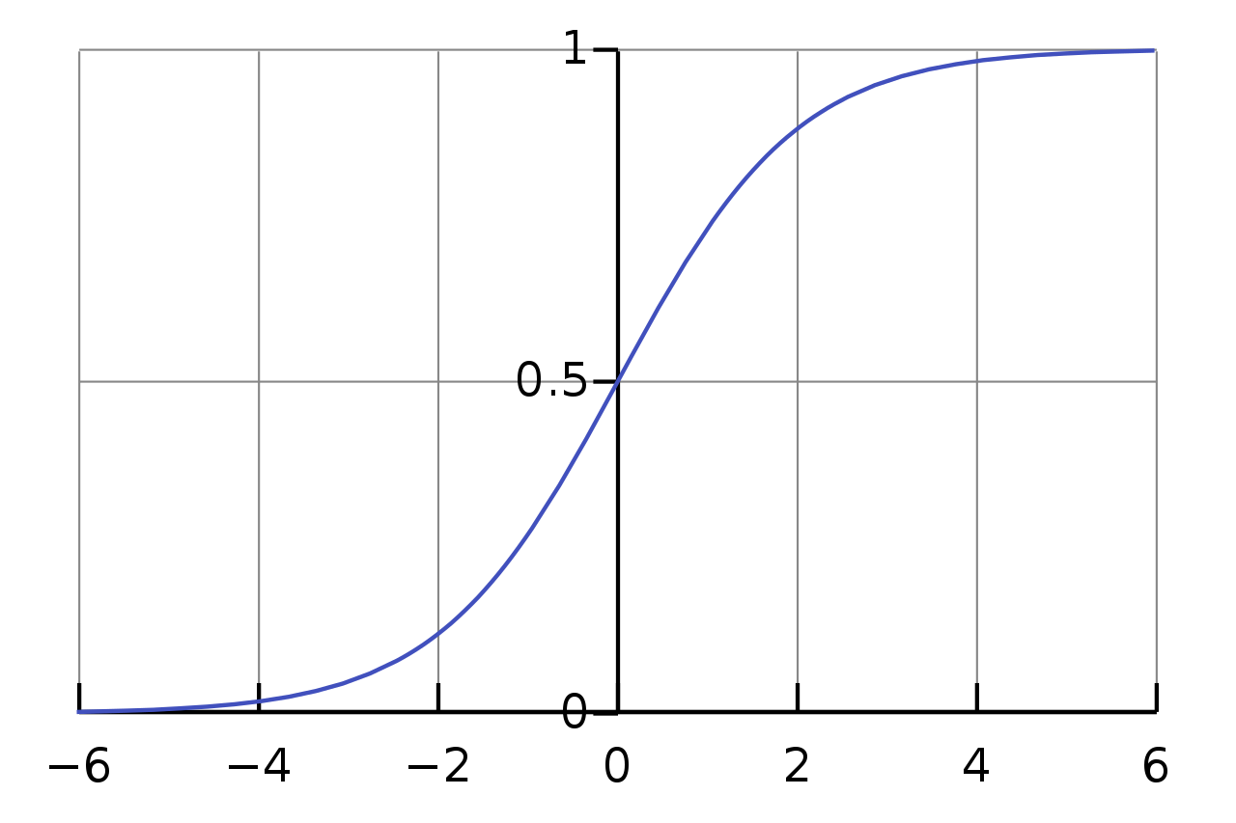
Activation function
Output activation
e = ~ 2.72
Input activation - a_{i}
The logistic function in useful in various ways.

Slide 17
Storing knowledge

Slide 18
Neural Network
-1
0.5

Slide 19

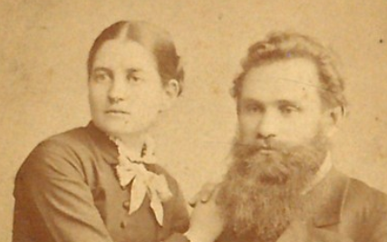
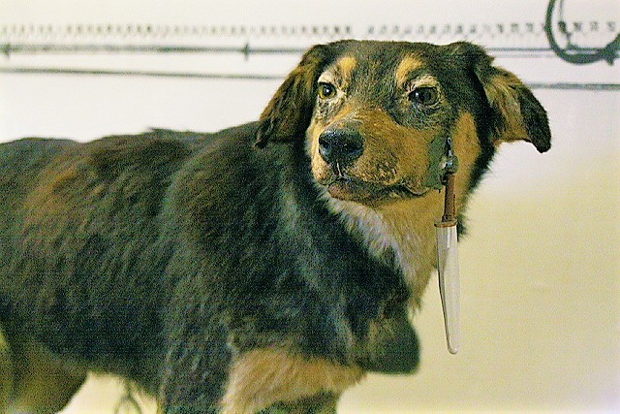
Neural Network
Bell
w_{B}
Food
Bell | Light | Food
1 | 0 | 1
1 | 1 | 0
w_{L}
Light
What should w_{B} and w_{L} be?

Slide 20
Learning

Slide 21
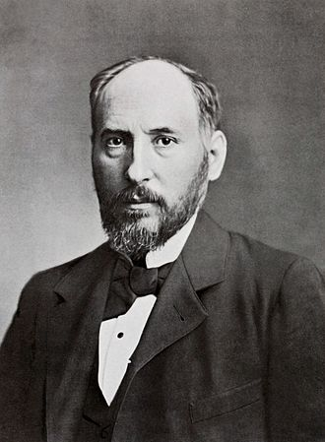
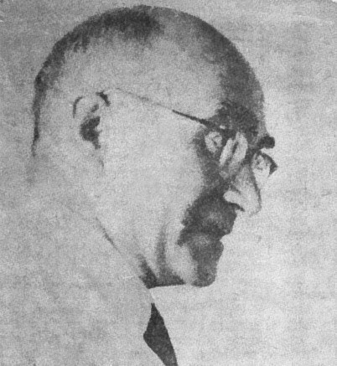
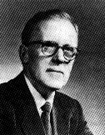
Learning
Cajal
Spain, 1894
Konorski
Russia, 1948
Hebb
USA, 1949

Slide 22
Hebbian Learning
A
B
"When an axon of cell A is near enough to excite cell B and repeatedly or persistently takes part in firing it, some growth process or metabolic change takes place in one or both cells such that A's efficiency, as one of the cells firing B, is increased”
Hebb
Neurons that fire together wire together

Slide 23
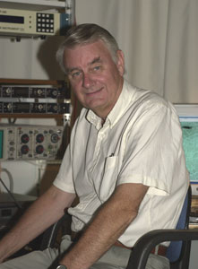
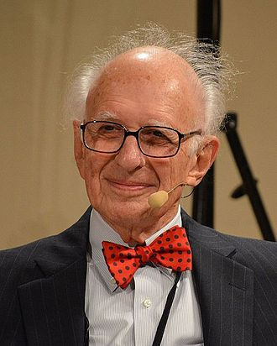
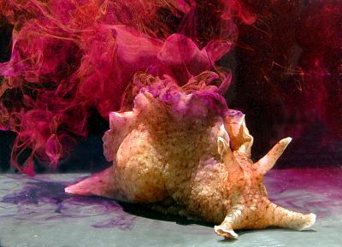
Long-term potentiation
Neurons that fire together wire together
Terje Lømo
Eric Kandel
Aplysia Californica

Slide 24
Hebbian Learning
Neurons that fire together wire together
1
2
Δw₁₂ = G . a₁ . a₂

Slide 25
Hebbian Learning
Neurons that fire together wire together
Trial | Bell | Food | Δw | w
1 | 1 | 1 | .1 | .1
2 | 1 | 1 | .1 | .2
3... | 1 | 1 | .1 | .3
...1000 | 1 | 1 | .1 | 10 (!)
0
Bell
Food
Δw_{BF} = G . a_{B} . a_{F G= 0.1}

Slide 26
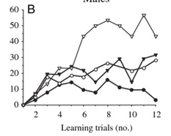
Acquisition
Learning tends to slow as it proceeds.

Slide 27
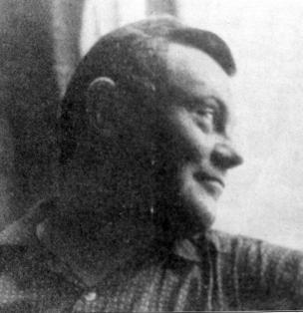
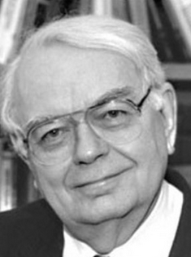
Bush-Mosteller
The more you know, the less you learn.
1
2
Δw₁₂ = G(t – a₁w₁₂ )a₁
Bush
Mosteller
Teacher
Student prediction

Slide 28
Bush-Mosteller
The more you know, the less you learn.
Trial | Bell (a₁) | Food (t) | Δw | w
1 | 1 | 1 | .1 x (1-0x1) = .1 | .1
2 | 1 | 1 | .1 x (1-.1x1) = .09 | .19
3... | 1 | 1 | .1 x (1-.19) = .081 | .271
...1000 | 1 | 1 | .1 x (1-1) = 0 | 1
0
Bell
Food
Δw₁₂ = G(t – a₁w₁₂ )a₁
_{G= 0.1}

Slide 29
Delta rule

Slide 30
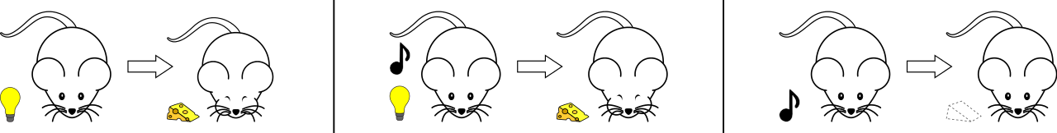
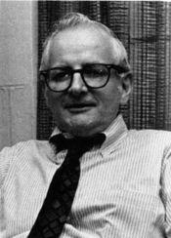
Blocking (Kamin, 1969)
?
1. Tone → Food
2. Tone + Light → Food
3. Light → ?
Kamin

Slide 31
Bush-Mosteller (Blocking)
0
Light
0
Food
Tone

Slide 32
Bush-Mosteller (Blocking)
1
Light
0
Food
Tone

Slide 33
Bush-Mosteller (Blocking)
1
Light
1
Food
Tone

Slide 34
Blocking (Kamin, 1969)
1. Light → Food
2. Tone + Light → Food
3. Tone → Little salivation

Slide 35
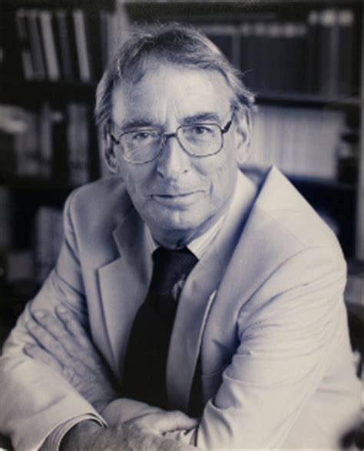






Why blocking?

Slide 36
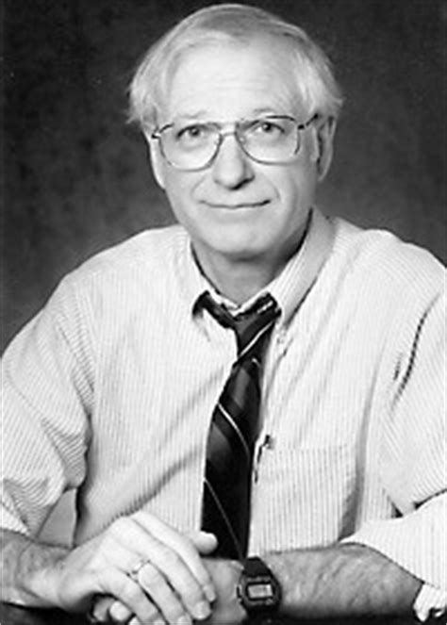

Rescorla-Wagner (1972)
Rescorla
Wagner

Slide 37
Bush-Mosteller
1
3
2
1
L
Δw₁₃ = G(t – a₁w_{1,2} )a₁
F
T
1
Teacher
Teacher
Student prediction
Student prediction

Slide 38
Bush-Mosteller → Rescorla-Wagner
1
3
2
Δw₁₃ = G(t – a₁w_{1,2} )a₁
Δw₁₃ = G(t – Σaw )a₁
Teacher
Teacher
Teacher
Teacher
Teacher
Teacher
Teacher
Student prediction
Teacher
Student prediction
Student prediction
Student prediction
Student prediction
Student prediction
Student prediction
Student prediction

Slide 39
Stage 1: Light → Food
0
Trial | Light (a_{L}) | Food (t) | Δw_{LF} | w_{LF}
1 | 1 | 1 | .1 x (1-0) = .1 | .1
2 | 1 | 1 | .1 x (1-.1) = .09 | .19
3... | 1 | 1 | .1 x (1-.19) = .081 | .271
...1000 | 1 | 1 | .1 x (1-1) = 0 | 1
L
F
T
0
Δw_{LF} = G(t – Σaw )a_{L}
_{G= 0.1}

Slide 40
Stage 2: Light + Tone → Food
1
Trial | Tone (a_{T}) | Food (t) | Δw_{TF} | w_{TF}
1 | 1 | 1 | .1 x (1-1) = 0 | 0
2 | 1 | 1 | .1 x (1-1) = 0 | 0
3... | 1 | 1 | .1 x (1-1) = 0 | 0
...1000 | 1 | 1 | .1 x (1-1) = 0 | 0
L
F
T
0
Δw_{TF} = G(t – Σaw )a_{T}
_{G= 0.1}

Slide 41
Stage 3: Tone → ?
1
L
F
T
0

Slide 42
AI: Convergence rule
Mathematical proof: anything that can be learned by a single-layer network will be learned by the delta rule.
1
3
2

Slide 43
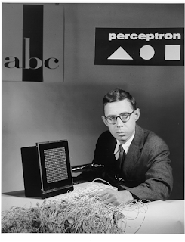
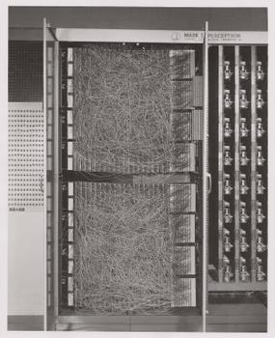
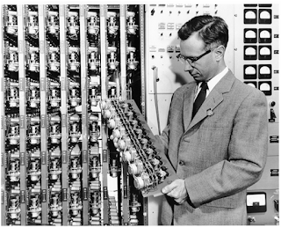
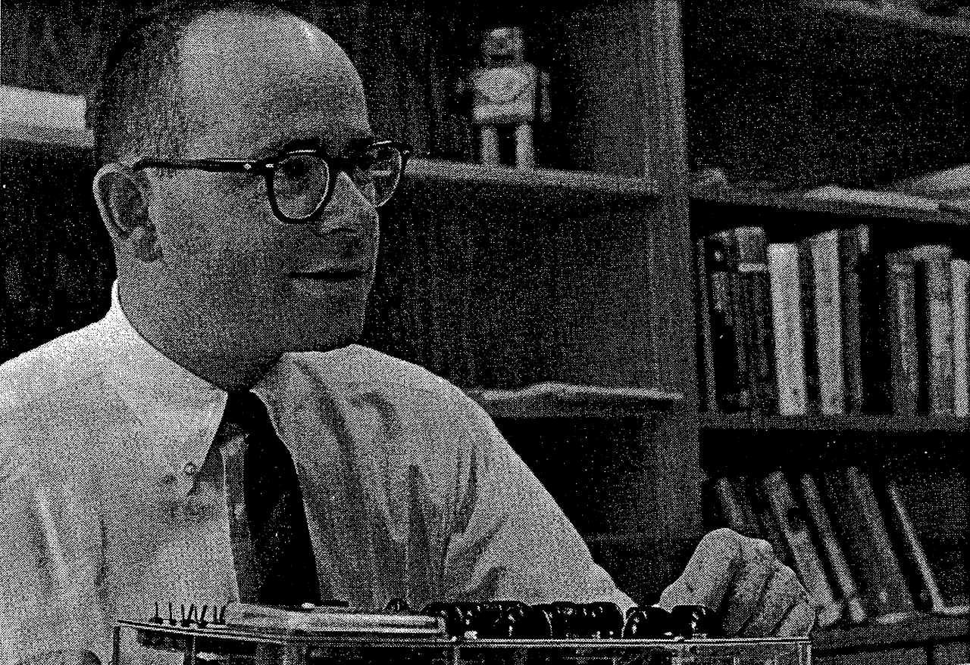
1958-1969: AI optimism
"the embryo of an electronic computer that [the Navy] expects will be able to walk, talk, see, write, reproduce itself and be conscious of its existence."

Slide 44
First AI Winter

Slide 45
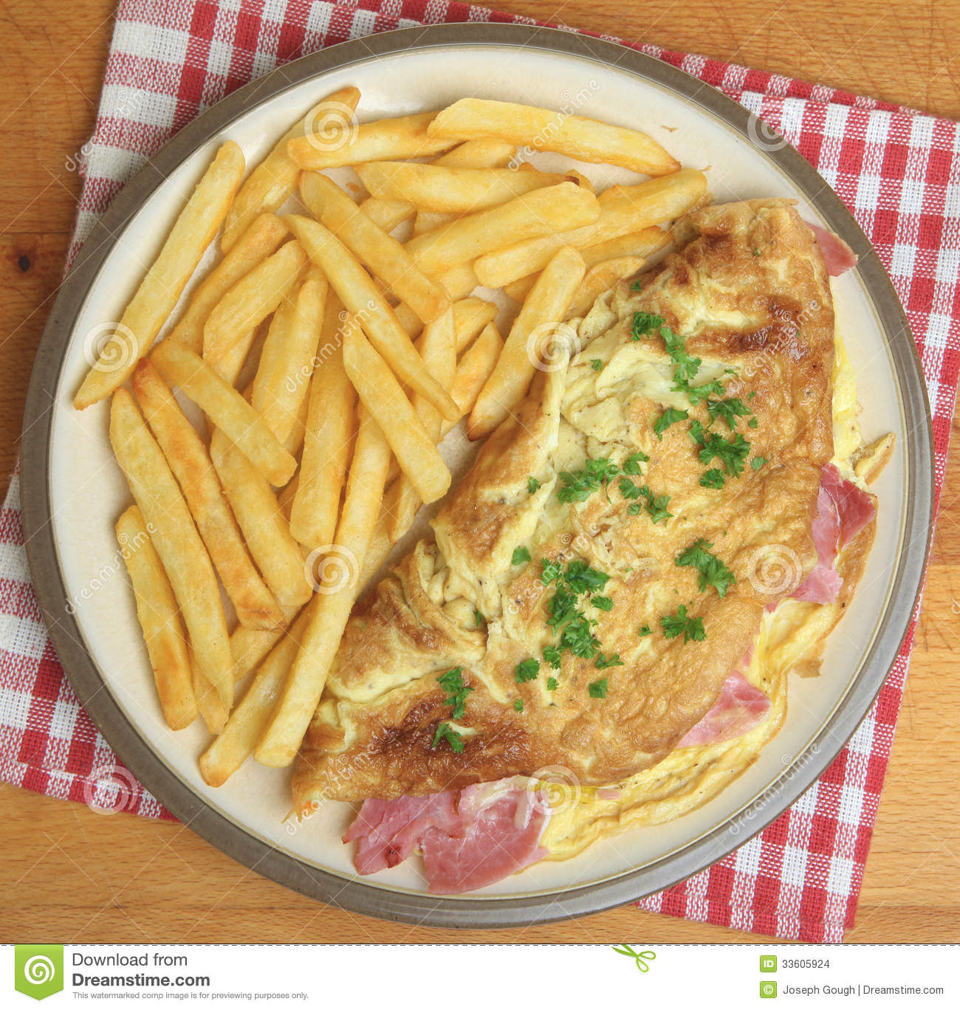
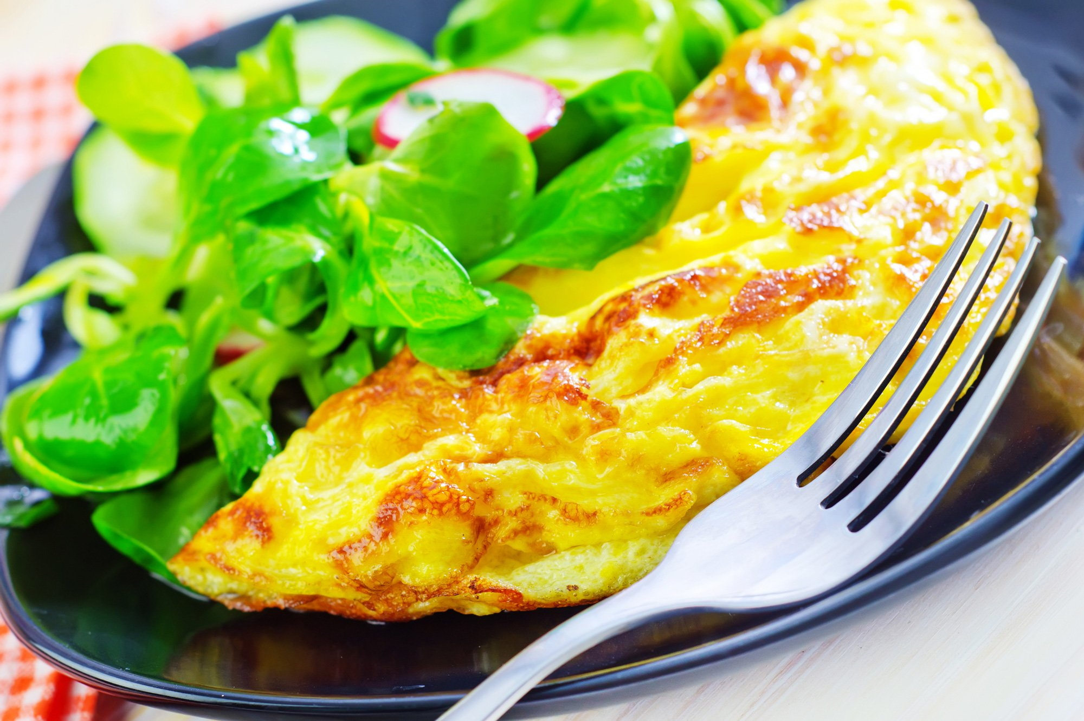
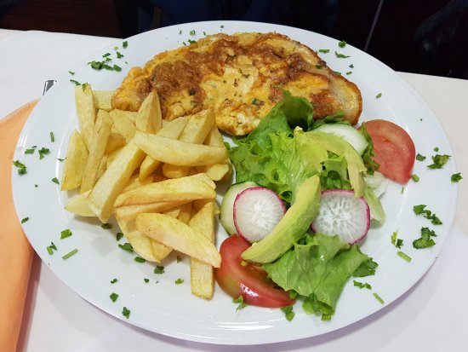
XOR
“Omelette, with chips or salad”

Slide 46


XOR
“Omelette, with chips or salad”

Slide 47
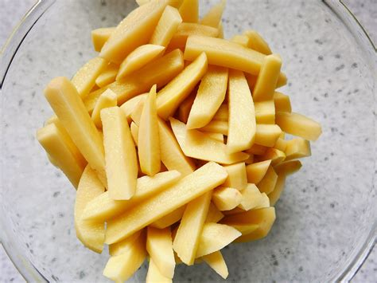
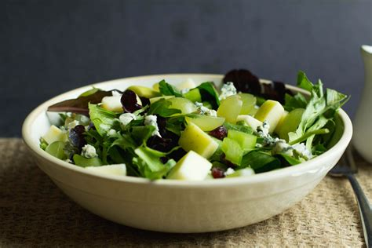
Limitations of single-layer nets
1
C
OK
S
1

Slide 48
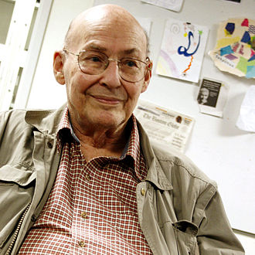
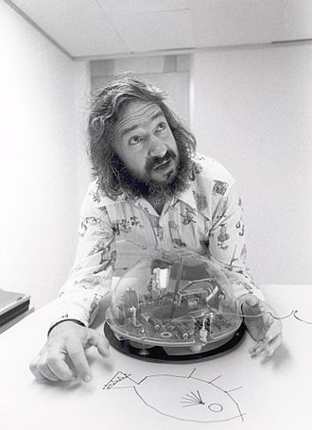
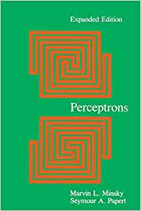
Perceptrons (1969)
Minksy
Papert

Slide 49
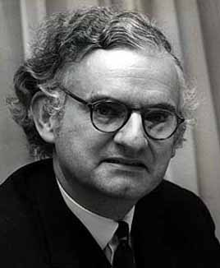
1st AI winter (1974-1980)
"In no part of the field have the discoveries made so far produced the major impact that was then promised"
- Lighthill report (1974)
Lighthill

Slide 50
Solving XOR

Slide 51
Solving XOR
C
Threshold activation
If in < T, out = 0
Otherwise, out = in
OK
S

Slide 52
Solving XOR
1
C
1
Threshold activation
If in < T, out = 0
Otherwise, out = in
-1
1.5
OK
1
1
S

Slide 53
1+0 = 1
Out = 0
1
1
C
1
-1
1.5
OK
1
1
0
S
1+0+0 = 1
Output: 1

Slide 54
1+1 = 2
Output: 2
1
1
C
1
-1
1.5
OK
1
1
1
S
1+1-2 = 0
Output: 0

Slide 55
Backprop

Slide 56
Backpropagation of error
1
3
Δw₁₃ = G(t – Σaw )a₁
2
Teacher
Teacher
Teacher
Teacher
Student prediction
Student prediction
Student prediction
Student prediction

Slide 57
Defining error
Δw₁₃ = G(t – Σaw )a₁
Teacher
Teacher
Teacher
Teacher
Student prediction
Student prediction
Student prediction
Student prediction
E₃ = (t – Σaw )
Δw₁₃ = G.E_{3.}a₁

Slide 58
Input = .5+.5 = 1
Error = ?
1
1
1
.5
0
-1
H
OK
.5
1
Input = 1+1-1 = 1
Error = 0 – 1 = -1
1
2

Slide 59
Input = .5+.5 = 1
Error = ?
1
1
1
.5
0
-1
H
OK
.5
1
Input = 1+1-1 = 1
Error = 0 – 1 = -1
1
2

Slide 60
Input = .5+.5 = 1
Error = -1 x -1 = 1
1
1
1
.5
0
-1
H
OK
.5
1
Input = 1+1-1 = 1
Error = 0 – 1 = -1
1
2

Slide 61
Input = .6+.6 = 1.2
1
1
1
.6
0
-1
H
OK
.6
1
Input = 1+1-1.2 = .8
Error = 0 – .8 = -.8
1
2

Slide 62
History of backprop

Slide 63
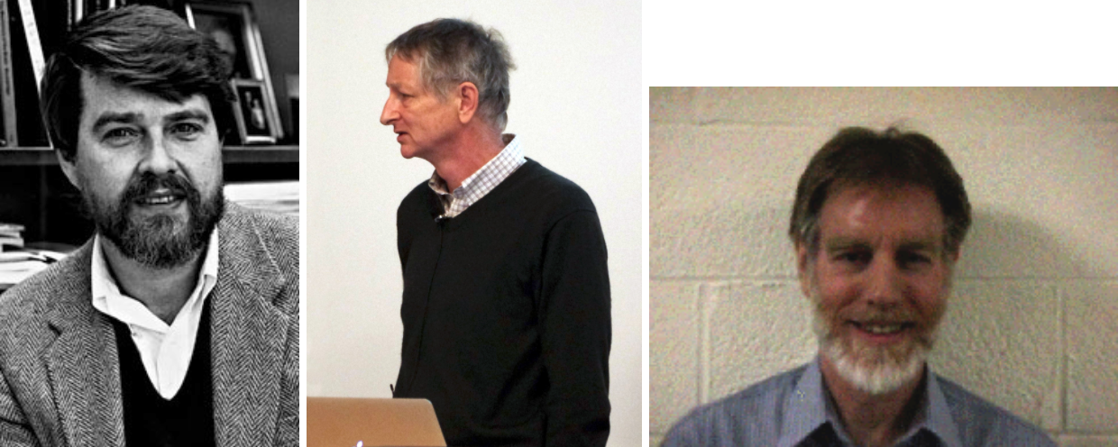
Standard story
Rumelhart, Hinton & Williams (1986)

Slide 64
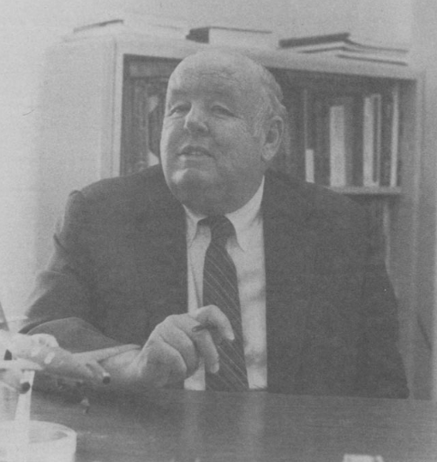
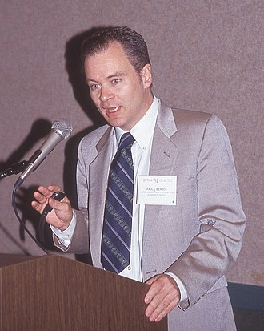
Invention of backprop
Kelley (1960)
Werbos (1974)

Slide 65
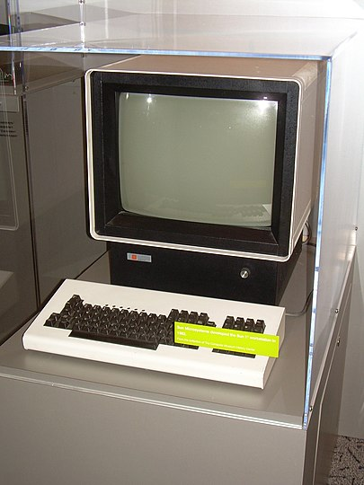
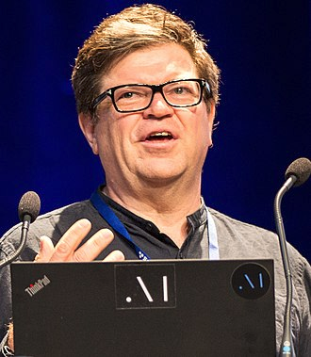
Invention of backprop
Yann LeCun
Sun-1 (1983)
£24,000 in today’s money

Slide 66
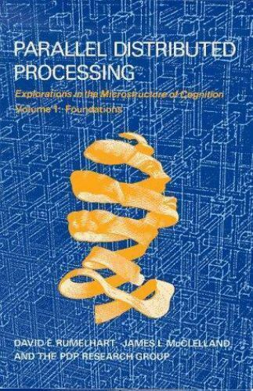
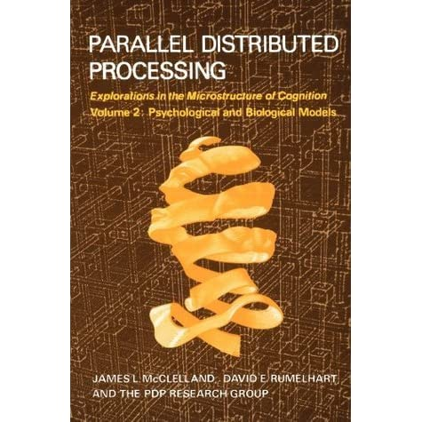
Connectionism

Slide 67
Power and limitations of backprop

Slide 68
Universal approximators
A multilayer feedforward network, with sufficient hidden units can represent any deterministic mapping between its inputs and its outputs
- Hornik, Stinchcombe & White (1989)

Slide 69
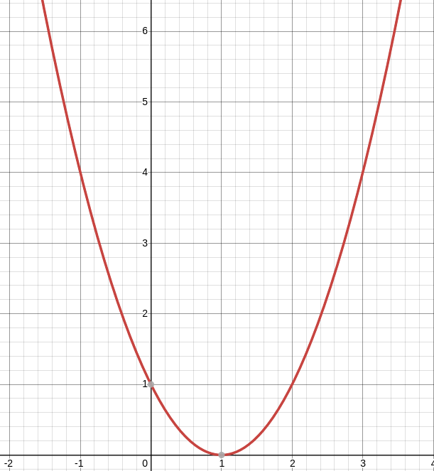
Error surface
Error
1
Bell
Food
weight

Slide 70
Error surface
Error
1
Bell
Food
weight

Slide 71
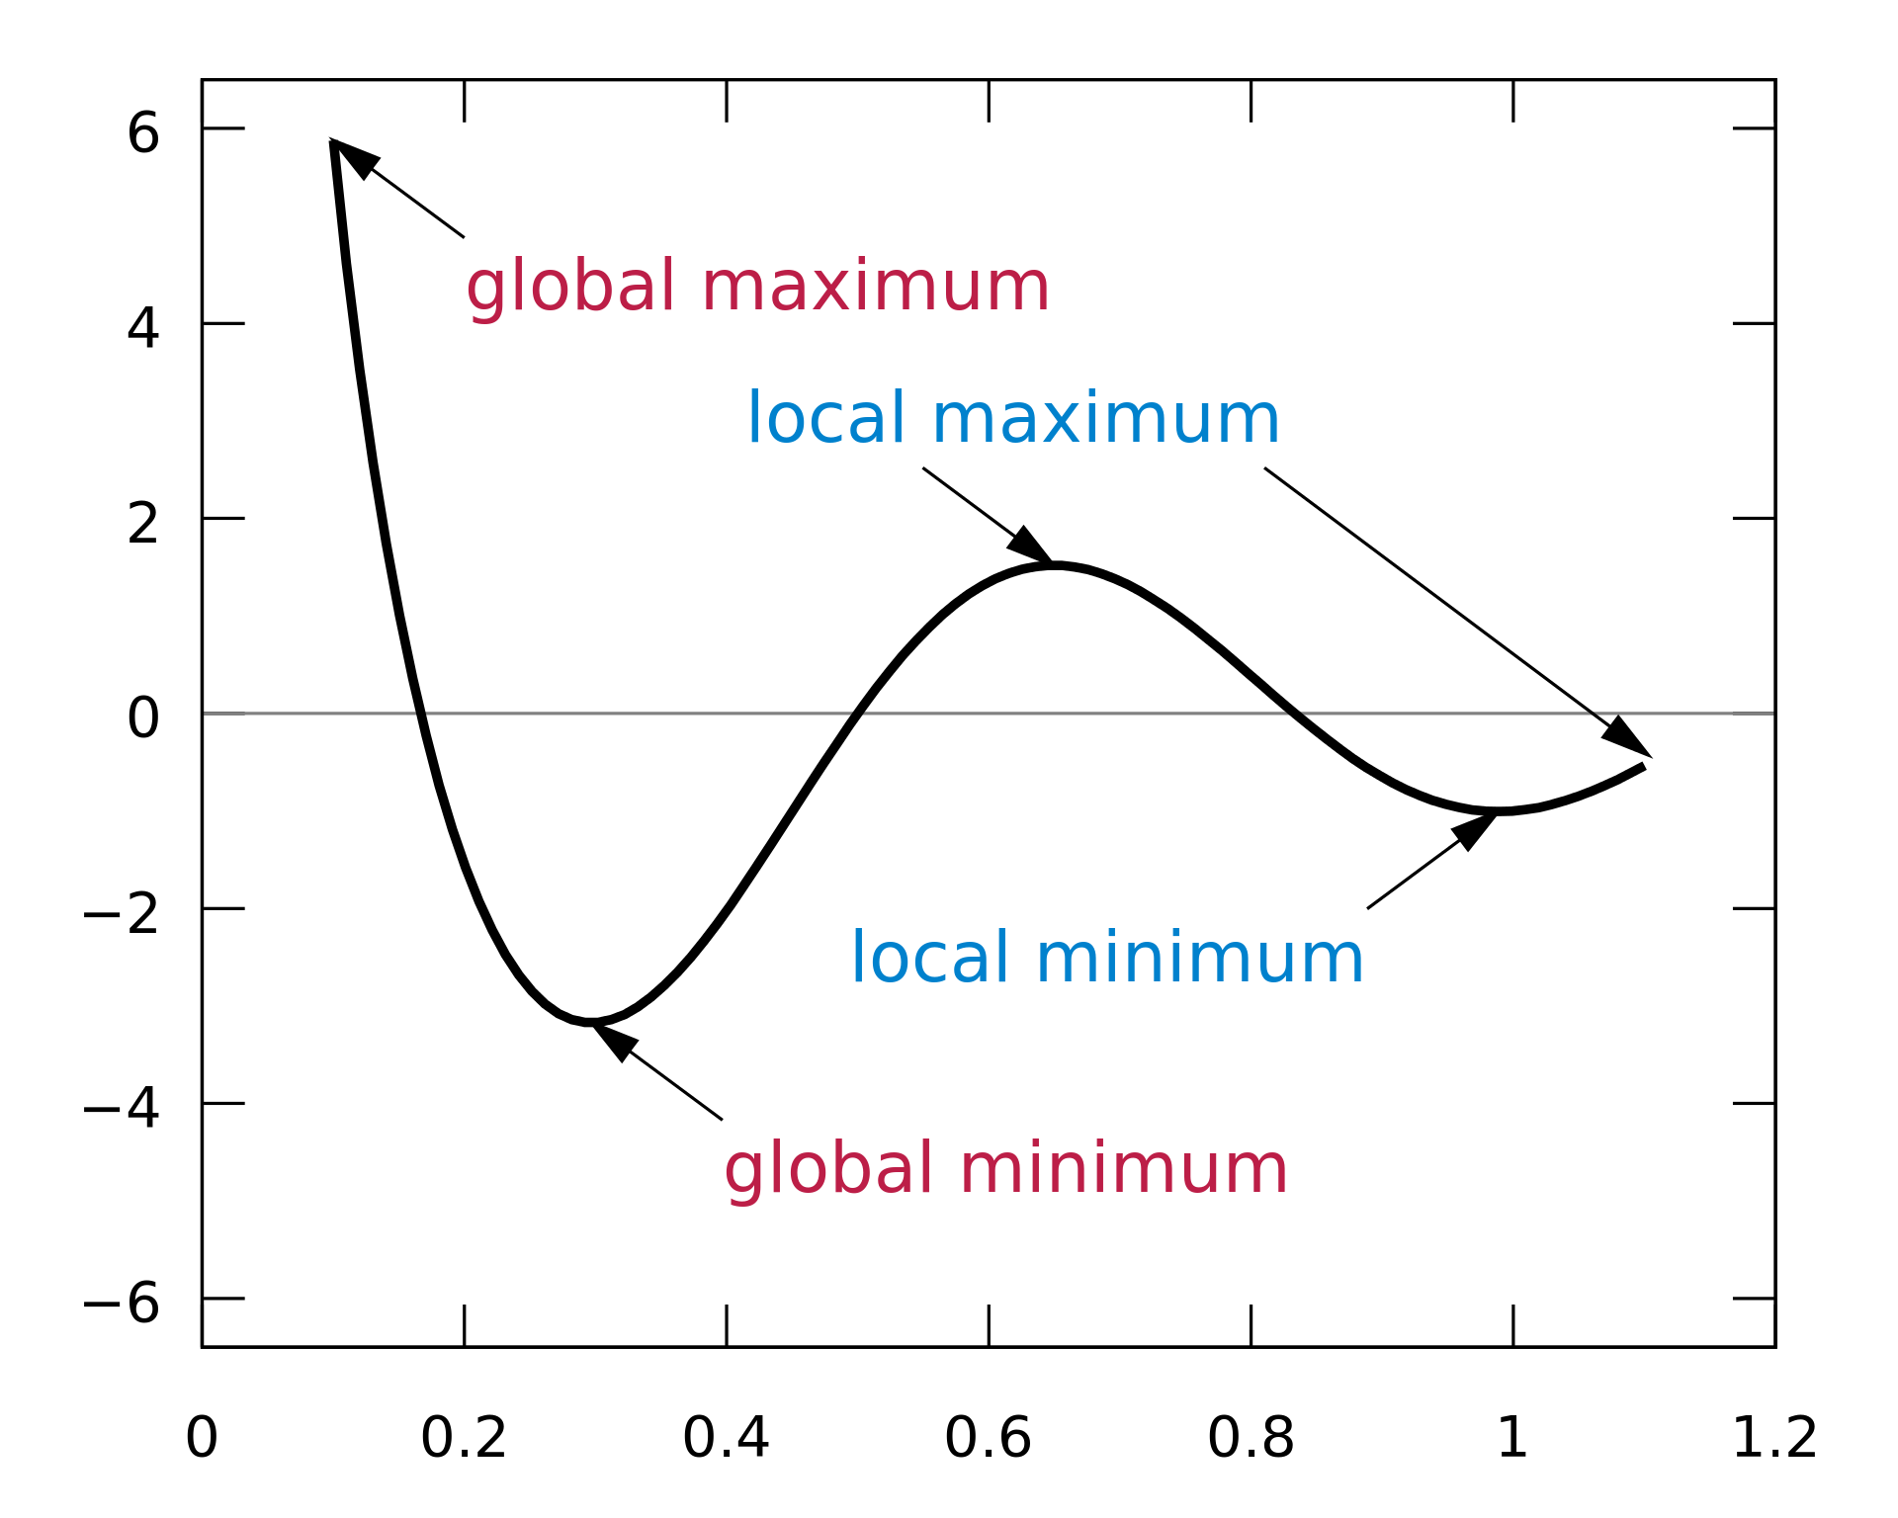
Error surface
Error
weight

Slide 72
Error surface
Error
weight

Slide 73
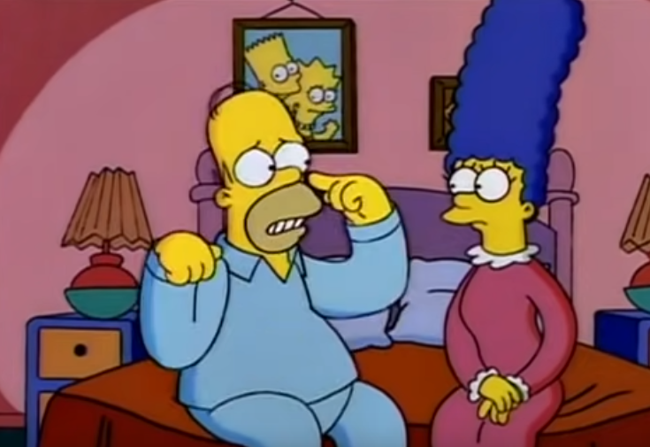
Interference
“Every time I learn something new, it pushes some old stuff out of my brain”
- Homer Simpson

Slide 74

People: Retroactive Interference
Retroactive interference
Barnes & Underwood (1959)
List 1 (A-B)
dax – regal
…
List 2 (A-C)
dax – cabbage
...

Slide 75

Backprop: Catastrophic Interference
Catastrophic interference
McCloskey & Cohen (1989)
List 1 (A-B)
dax – regal
…
List 2 (A-C)
dax – cabbage
...

Slide 76

Neural plausibility

Slide 77
Summary

