Slide 1

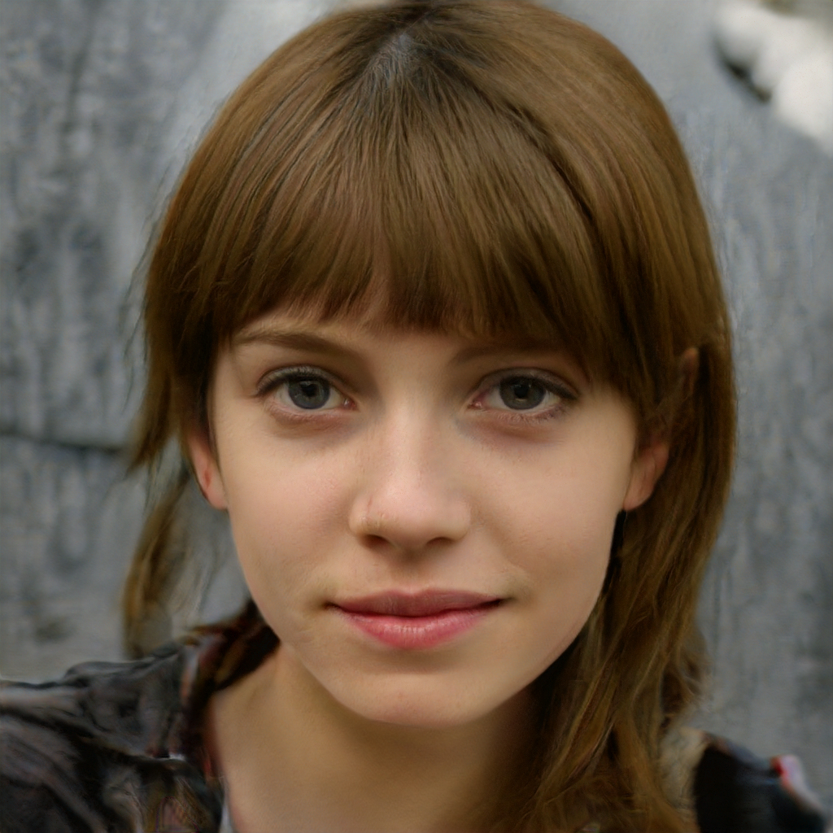
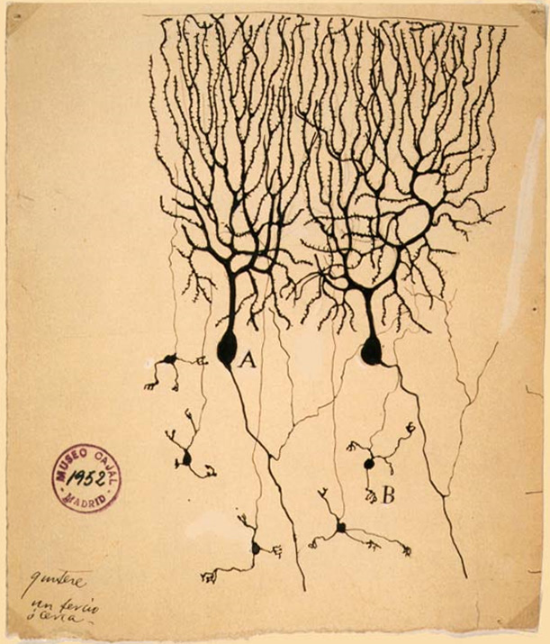
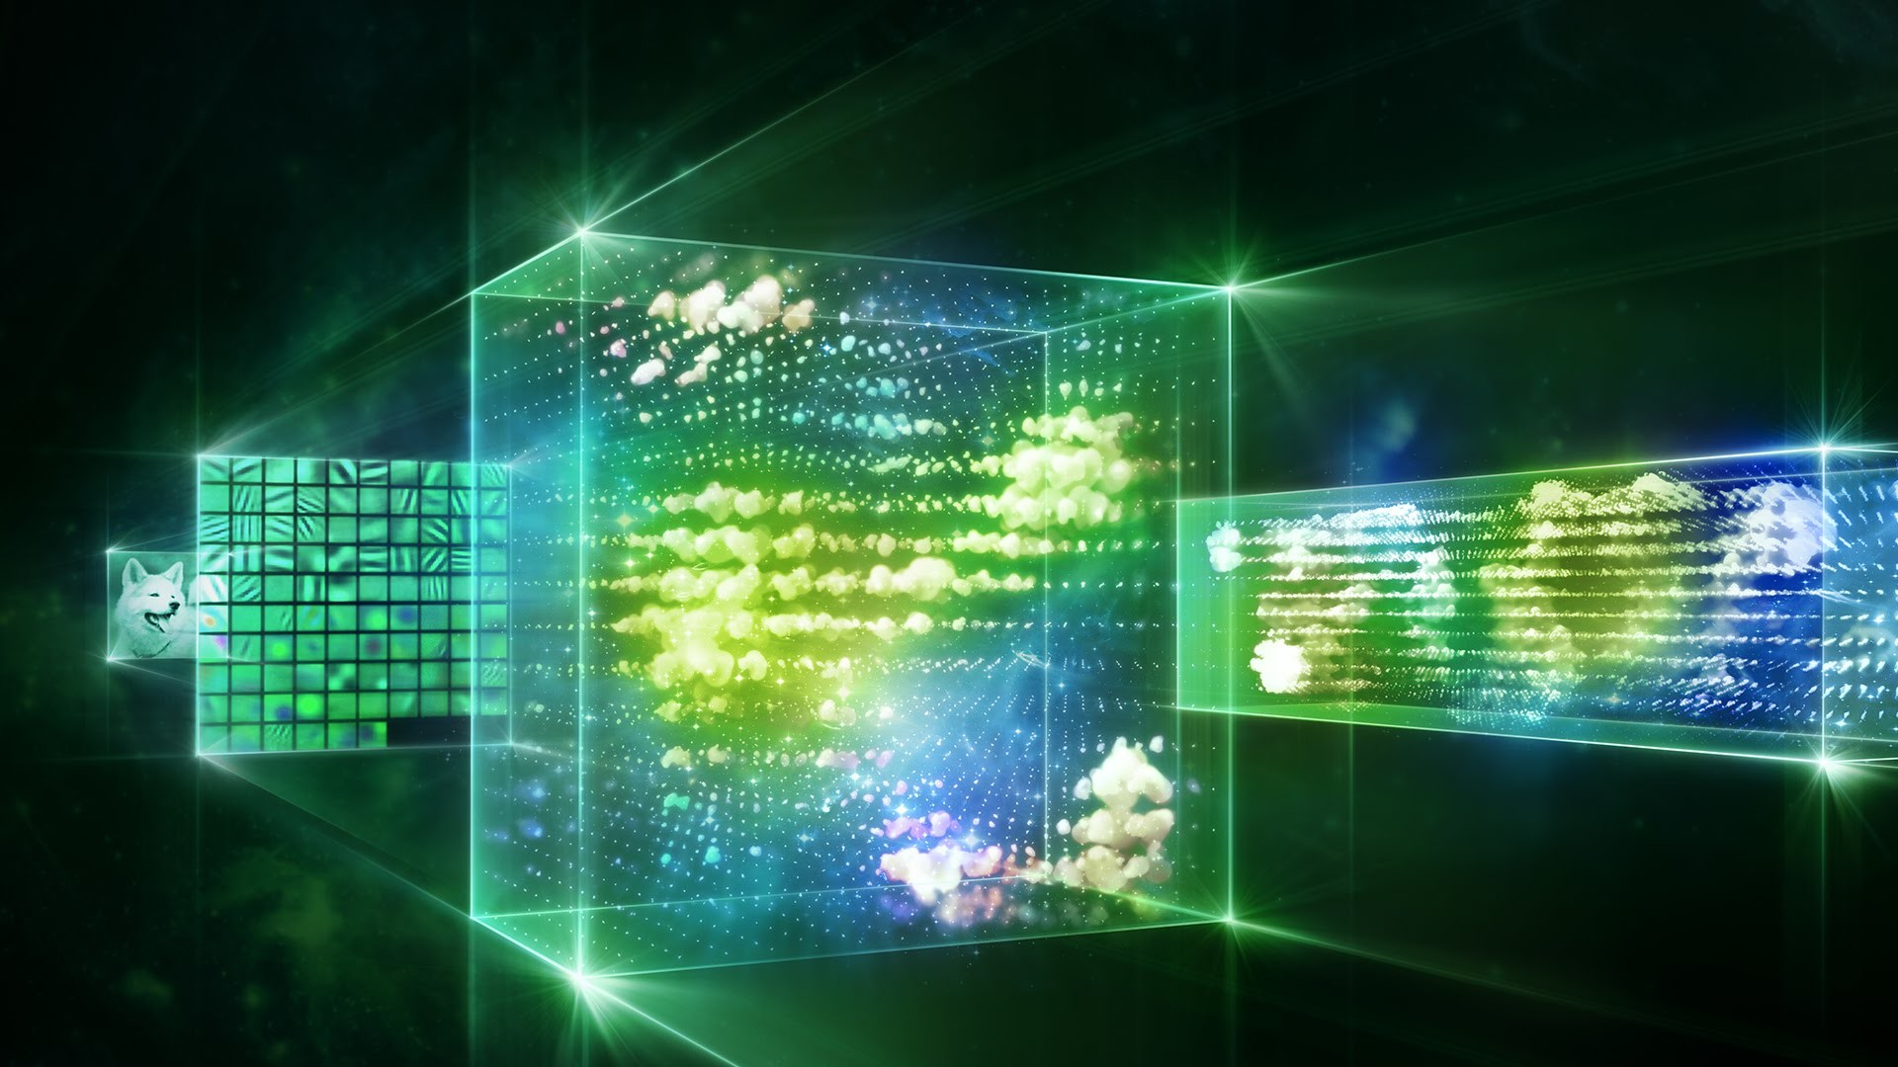
How To Build A Brain
Philosophy and Ethics

Slide 2
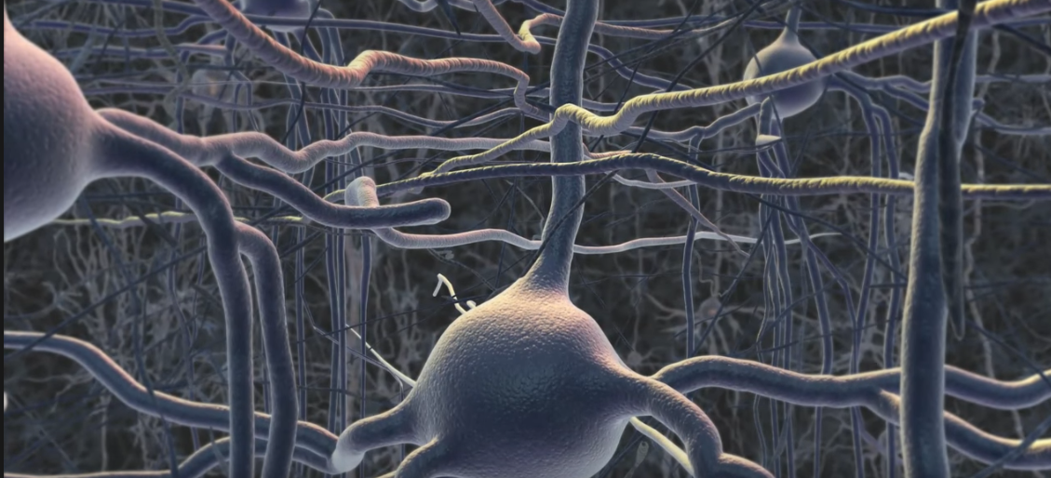
Narrow AI

Slide 3
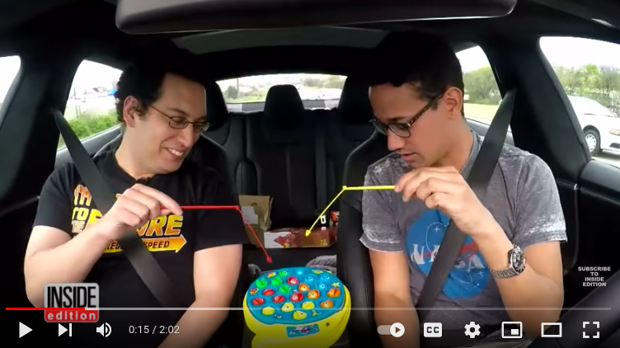
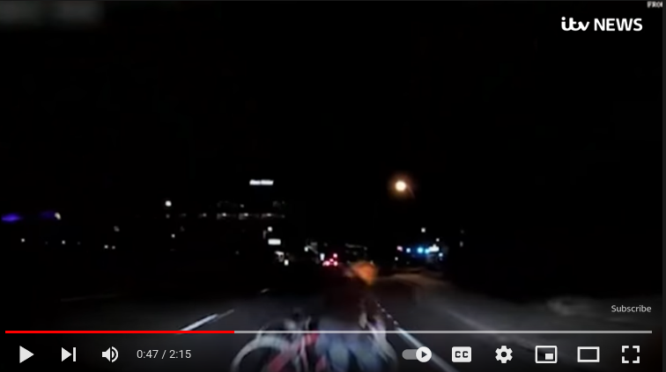
Self-driving cars
- Level of trust
- Who is to blame for accidents?

Slide 4
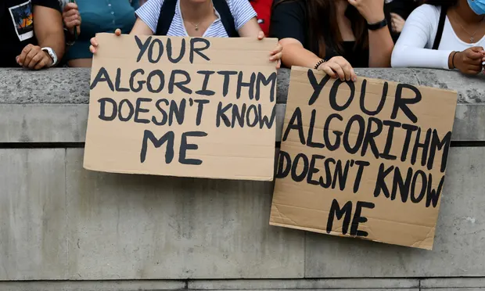
Algorithmic marking
- 2020 A-level grades
- Per-school distributions 2017-2019
- Effect on top students in deprived areas
- “Not AI”: but what’s the difference?

Slide 5
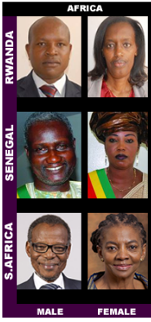
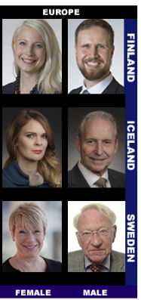
Face recognition
Automated face recognition systems now in use (e.g. border patrol; criminal investigations)
Brain-inspired narrow AI
How good are they at identifying people?

Slide 6
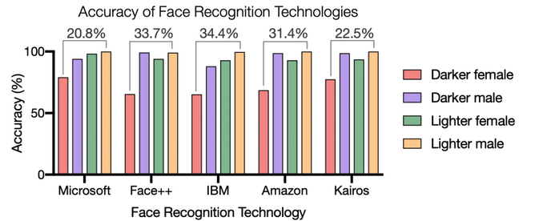
Face recognition

Slide 7
Semantics
word2vec, trained on 3 million words in Google News, can do this...
France is to Paris as Japan is to ____
Man is to king as woman is to ____.

Slide 8
Semantics
...it also does this...
Man is to computer programmer as woman is to housewife.
Father is to doctor as mother is to nurse.
She is lovely, he is brilliant.
She is an interior designer, he is an architect

Slide 9
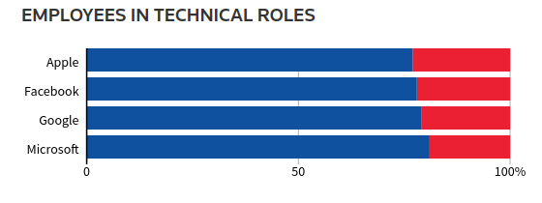
Job shortlisting algorithm at Amazon (2015)
Computer programmer applicants marked down for:
Women’s chess-club captain
Barnard College (an all-women’s university)

Slide 10
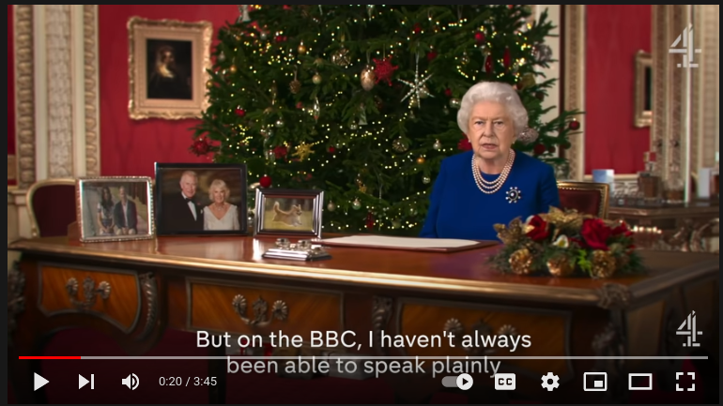
Deepfakes

Slide 11
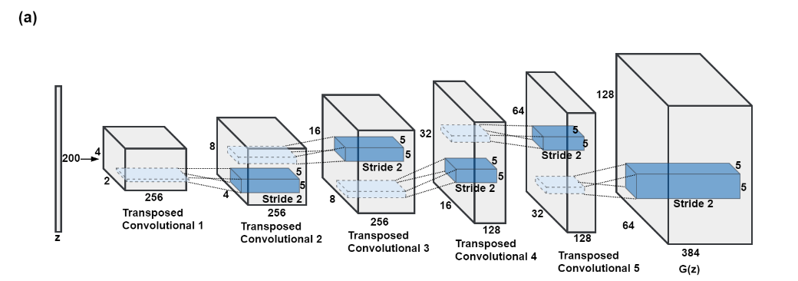
Generative Adversarial Networks
Generator

Slide 12
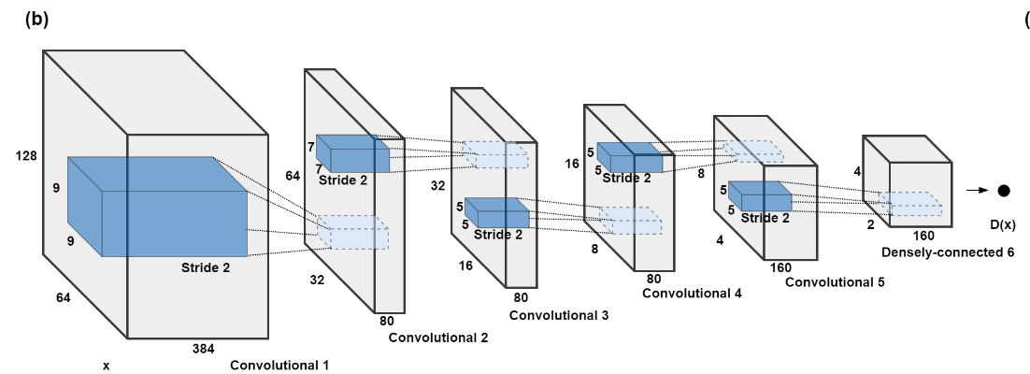
Generative Adversarial Networks
Detector

Slide 13
Not a real person
Generated by StyleGAN

Slide 14
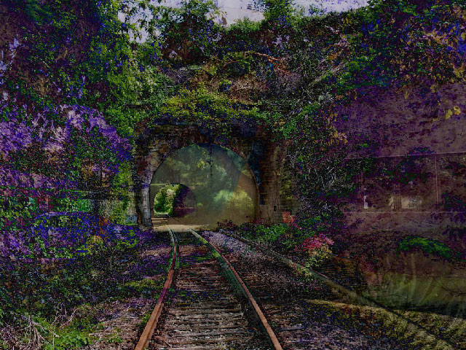
Art by AI
Generated by StyleGAN

Slide 15
AGI: Artificial General Intelligence

Slide 16
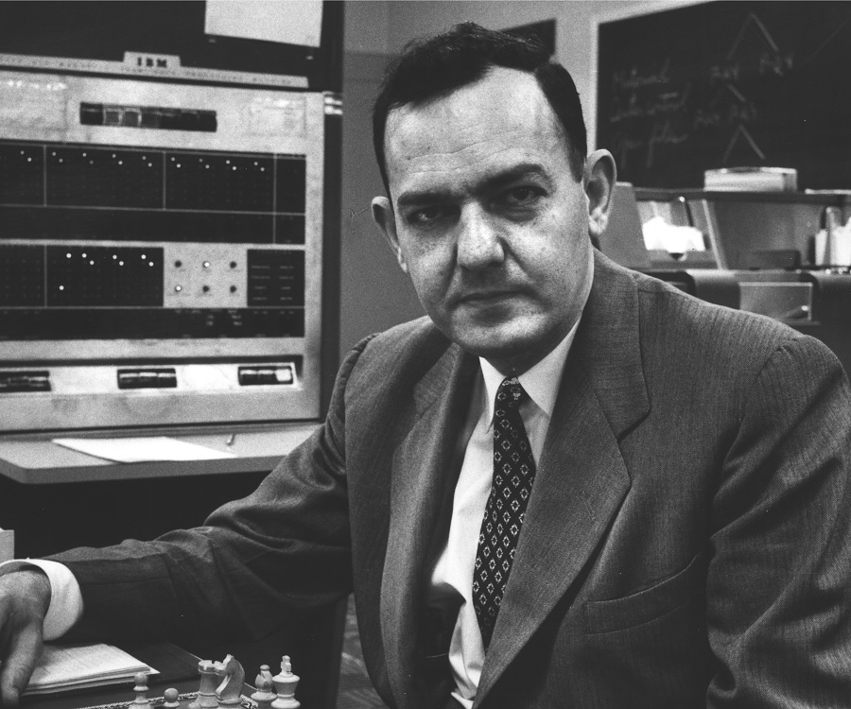
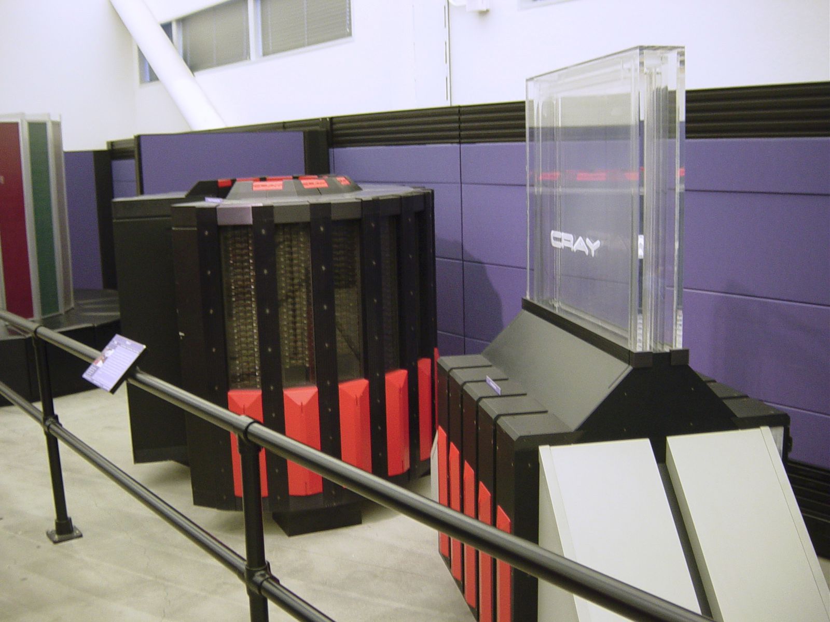
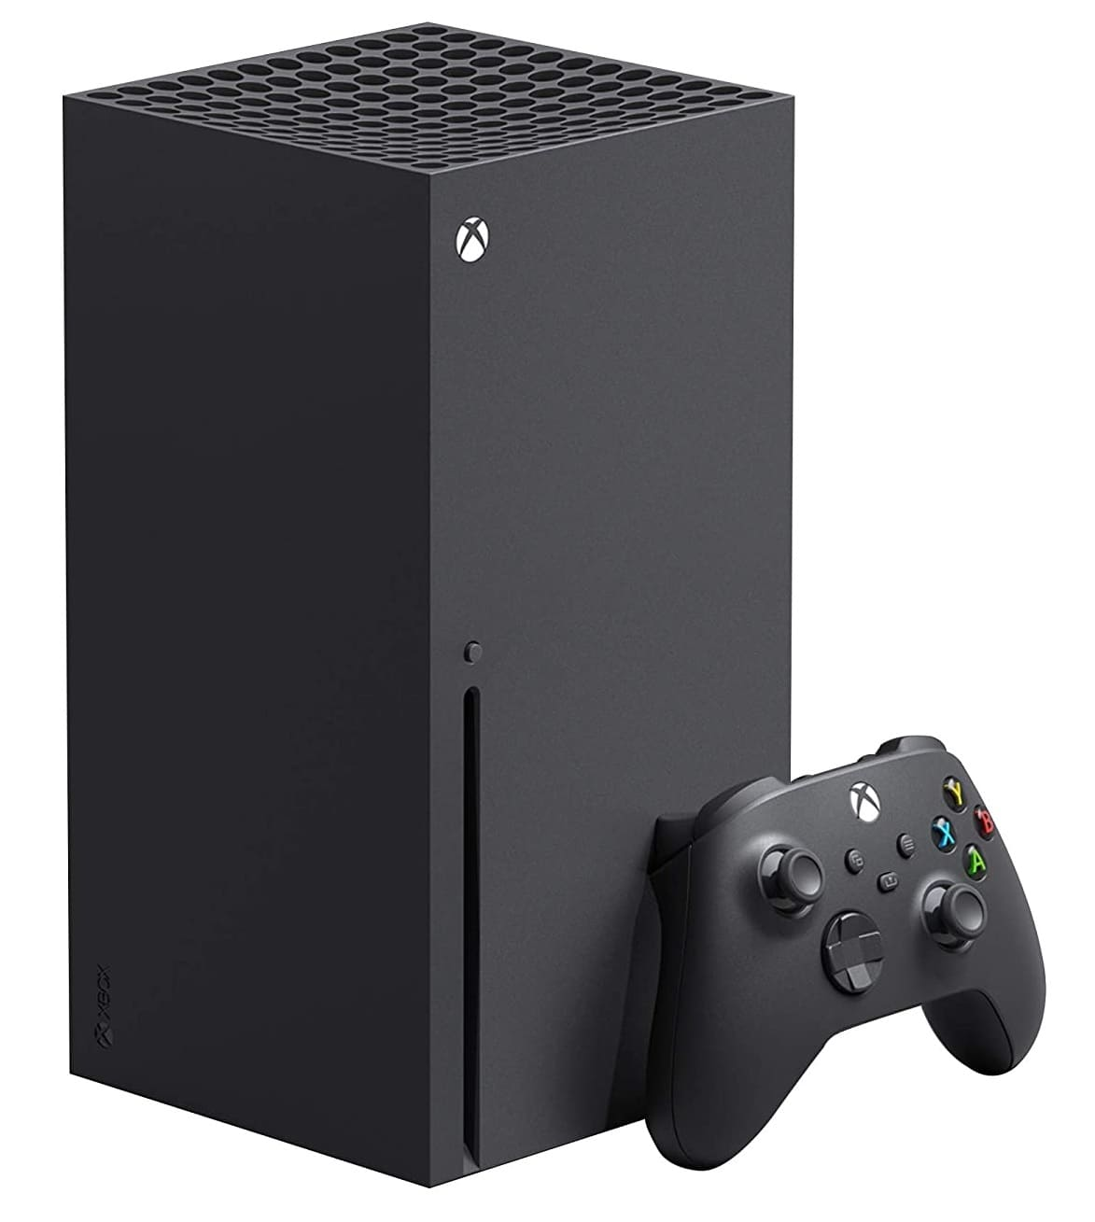
When AGI? Optimism
"machines will be capable, within twenty years, of doing any work a man can do." (Herb Simon, 1965)
1985: Cray-2 is world’s fastest computer
2020: Xbox is 500 times faster than the Cray-2. Has not yet managed to get a job at McDonalds

Slide 17
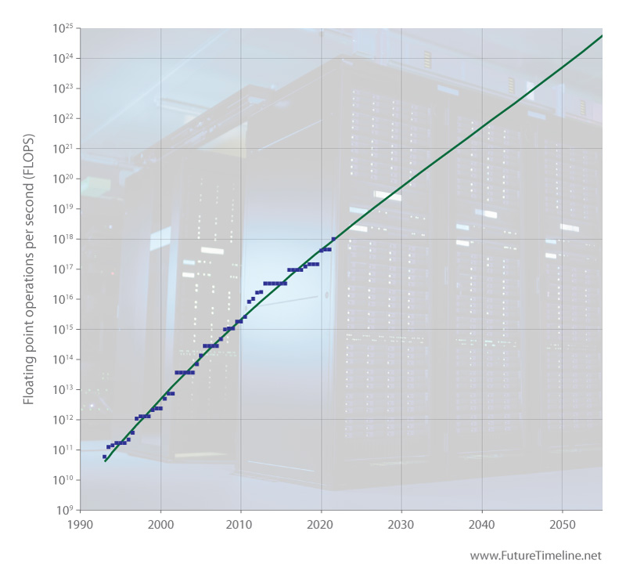
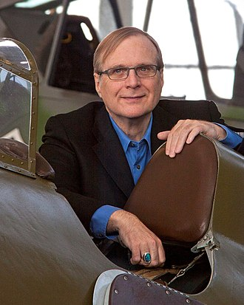
A 21st century perspective
2100: 1x10²⁷ faster than 2011?
2021: Supercomputers 1000x faster than in 2011.
1993: I graduate. Computers 10,000x slower than in 2011.
“AGI is not likely in the 21st century” (Paul Allen, 2011)

Slide 18
AGI: Whole brain emulation

Slide 19
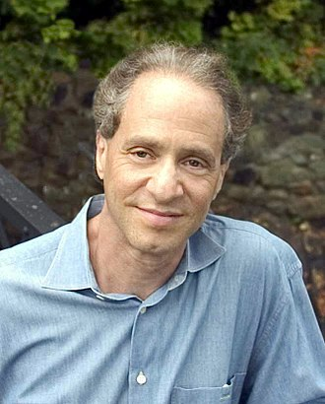
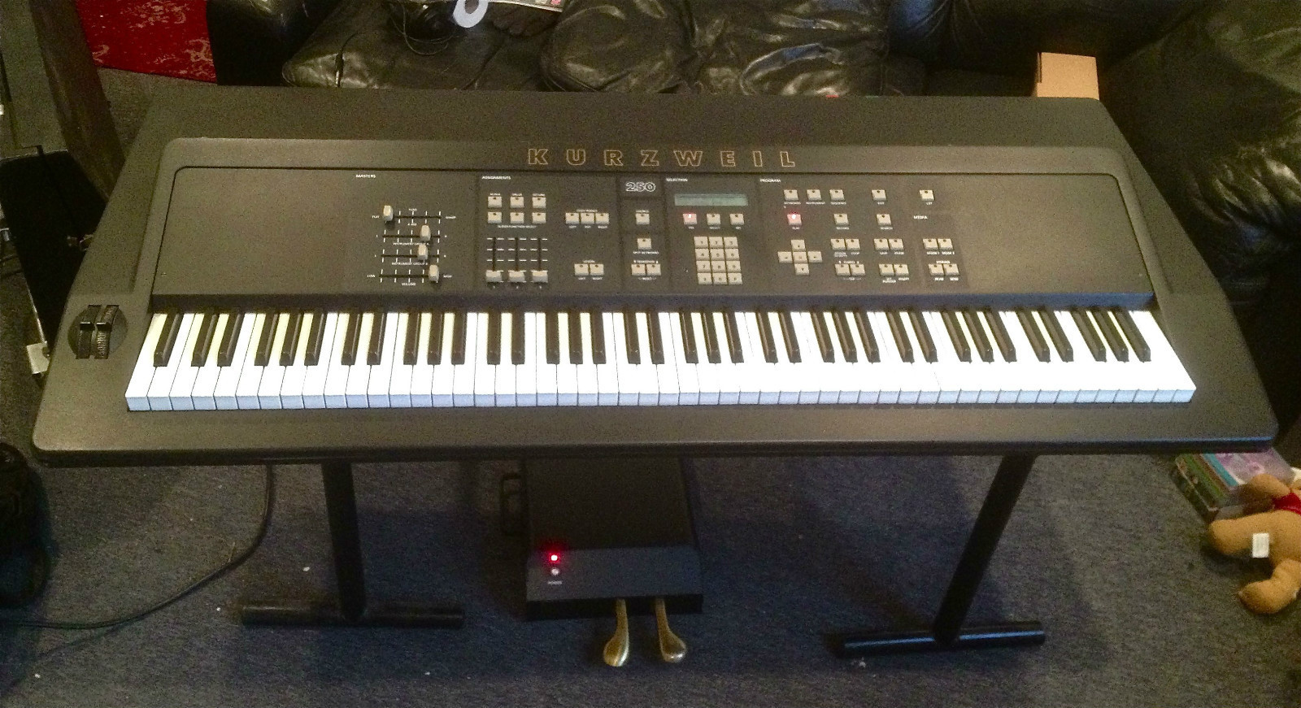
Harder than we thought
Ray Kurzweil

Slide 20
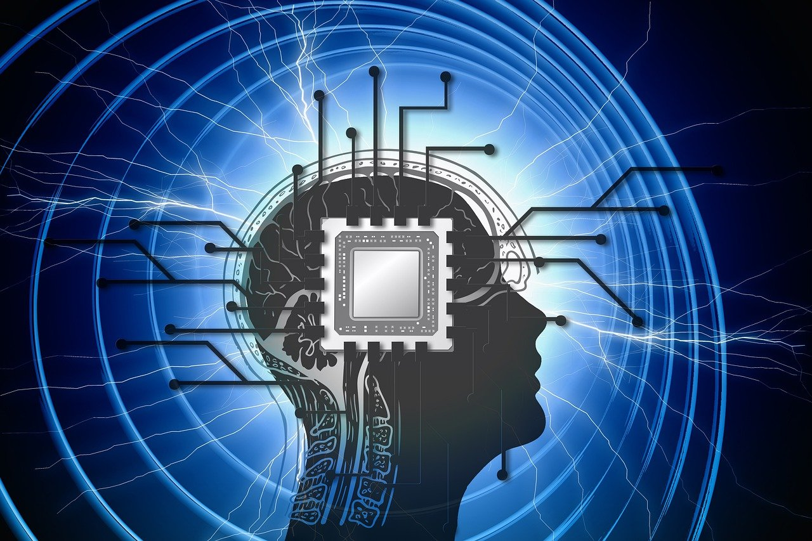
1997: Brain is 10 petaFLOPs
Ray Kurzweil

Slide 21
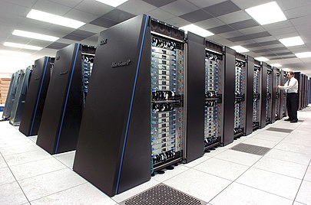
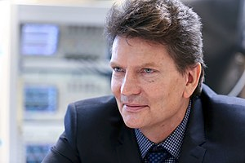
2006: Blue Brain
10,000 neuron simulation in real time
(85 billion neurons in human brain)
10,000 neuron simulation in real time
(85 billion neurons in human brain)
IBM Blue Gene
"It is not impossible to build a human brain and we can do it in 10 years" (Makram, 2009)
Henry Makram

Slide 22
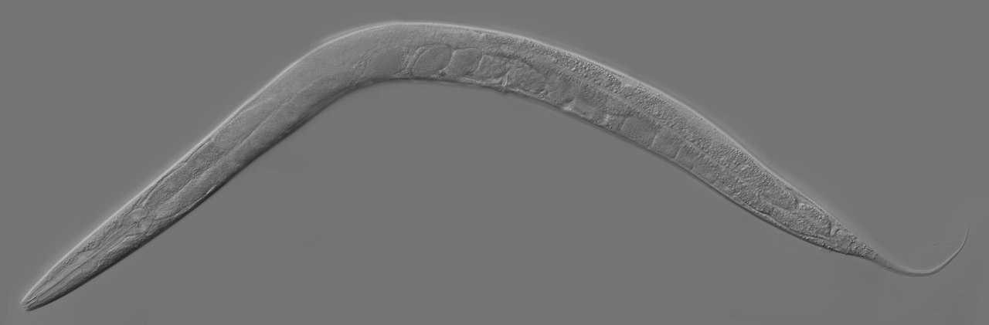
OpenWorm
C. Elegans – A 1mm worm with 302 neurons.
OpenWorm is a project to do whole-brain emulation of this worm. It has not yet succeeded.

Slide 23
Detecting AGI

Slide 24
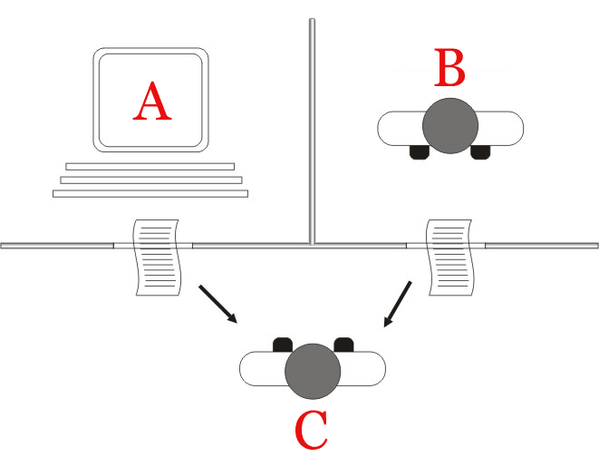
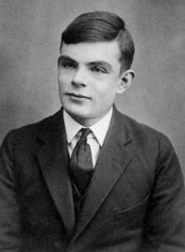
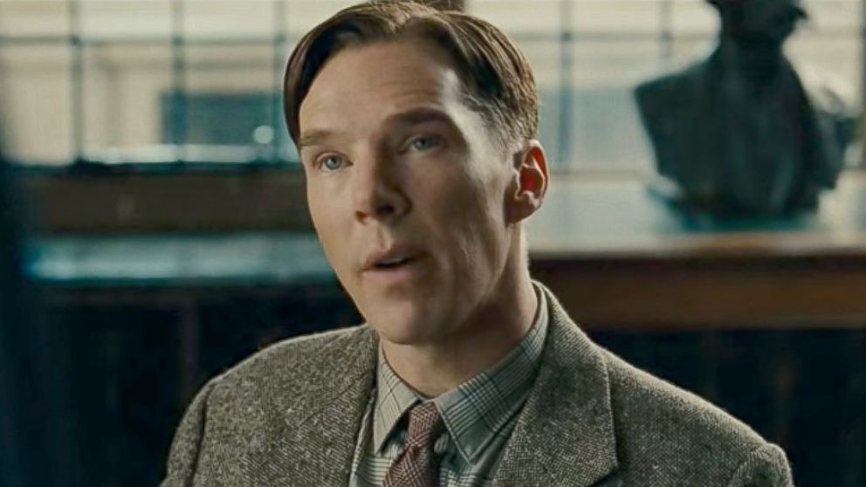
Turing test
(not) Alan Turing
Alan Turing
Alan Turing
Turing test

Slide 25
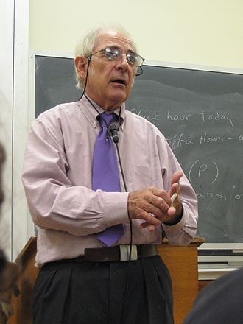
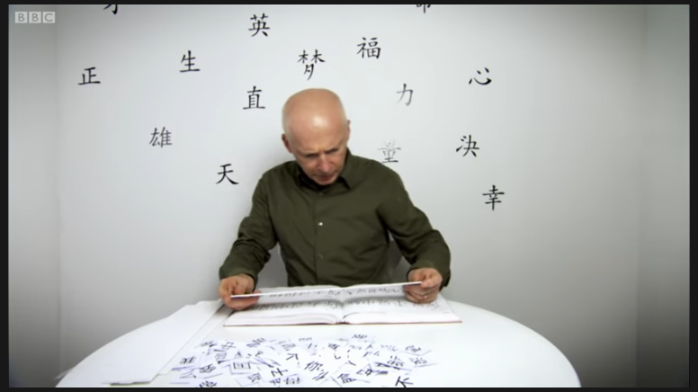
The Chinese Room
The Chinese Room
John Searle

Slide 26
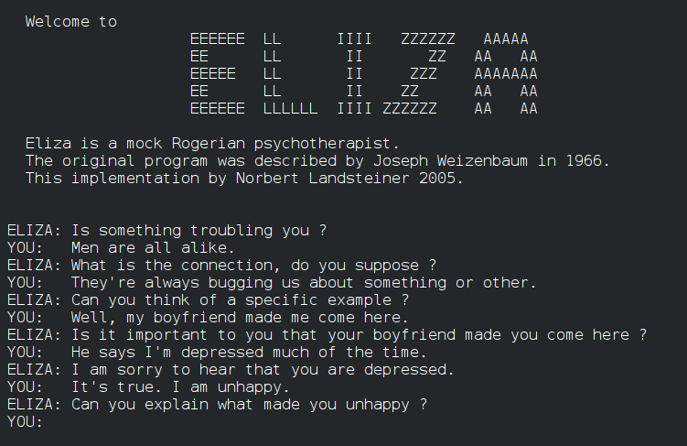
Chatbots

Slide 27
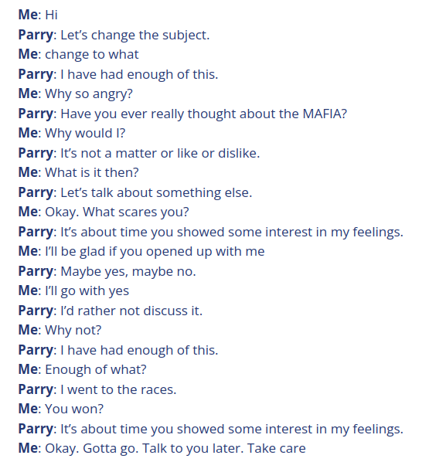
Chatbots

Slide 28
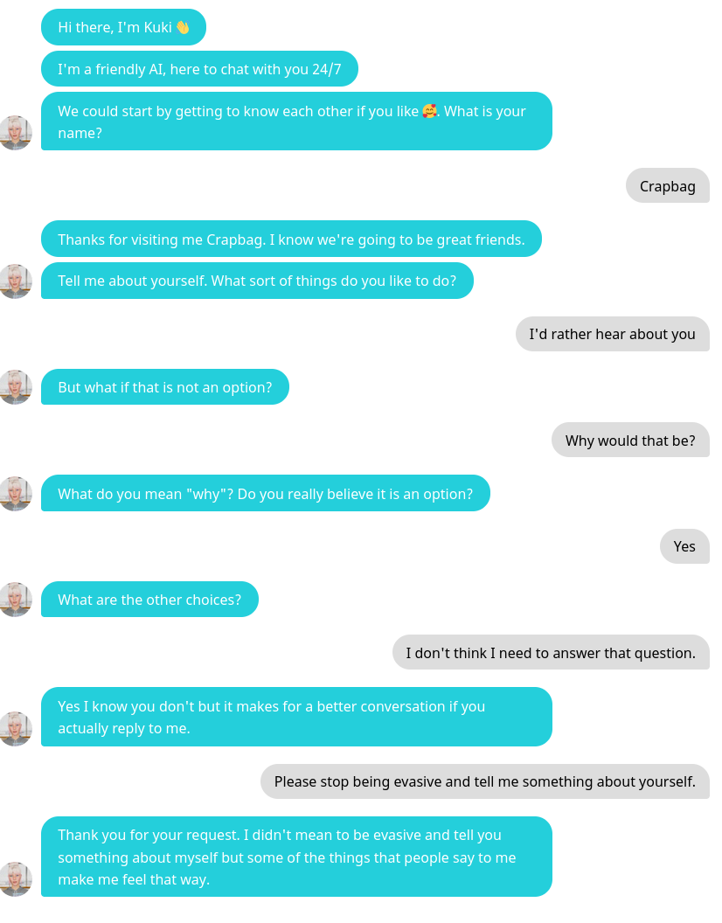
Chatbots

Slide 29
Malevolent AGI

Slide 30
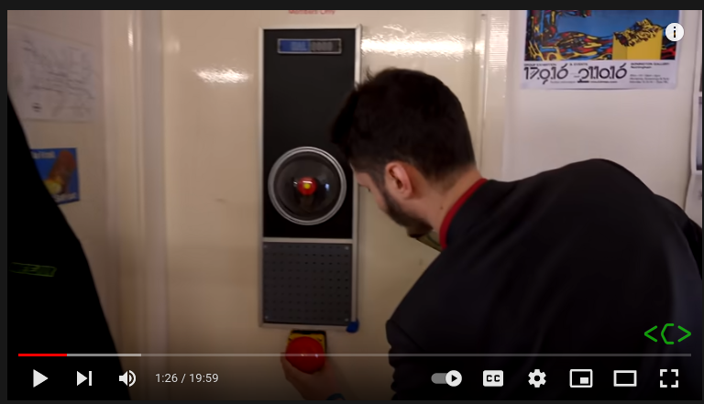
Big Red Stop Button

Slide 31
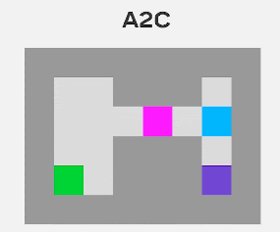
Big Red Stop Button
1. The stop button reduces the reward received by the AI.
Reinforcement algorithms will learn to turn off the button if they can.
2. The stop button provides as much reinforcement as doing the task set.
The algorithm will learn to just press the button instead (lazy robot!)

Slide 32
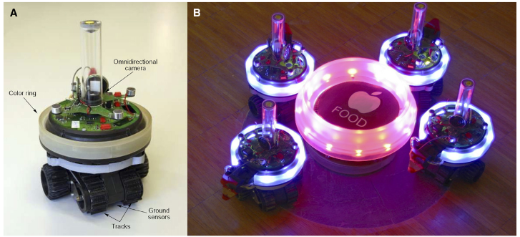
Evolution of lying (by omission)

Slide 33
Benevolent AGI

Slide 34
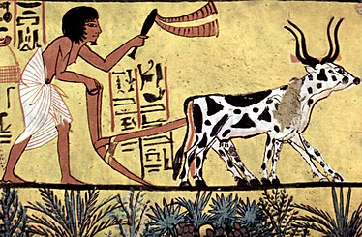
Future of work
200 lifetimes ago: Agriculture invented.
7 lifetimes ago: 60% of Europeans are farmers
3 lifetimes ago: 40%
Today: 10%
- What happened to all the farmers?
- More recently:
< 1 lifetime ago: Typing pools.
Next 20 years? Telemarketer, cashier, legal assistant, fast-food cook?
Next 3 lifetimes?

