Slide 1

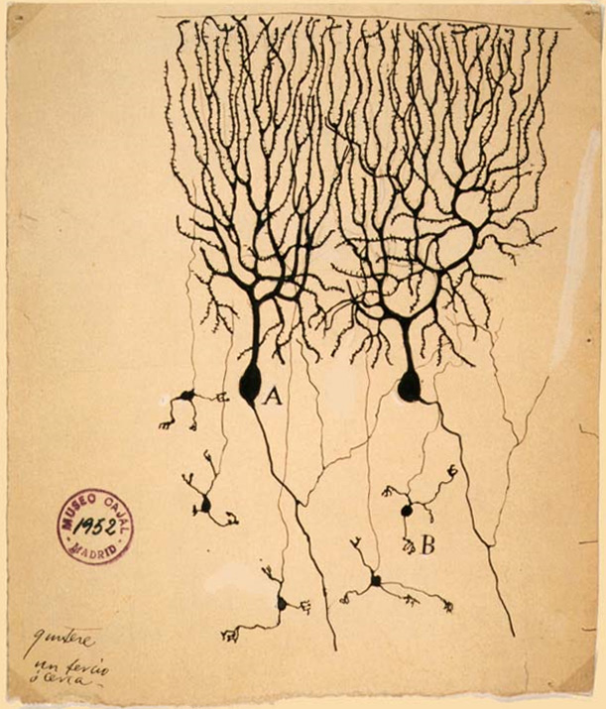
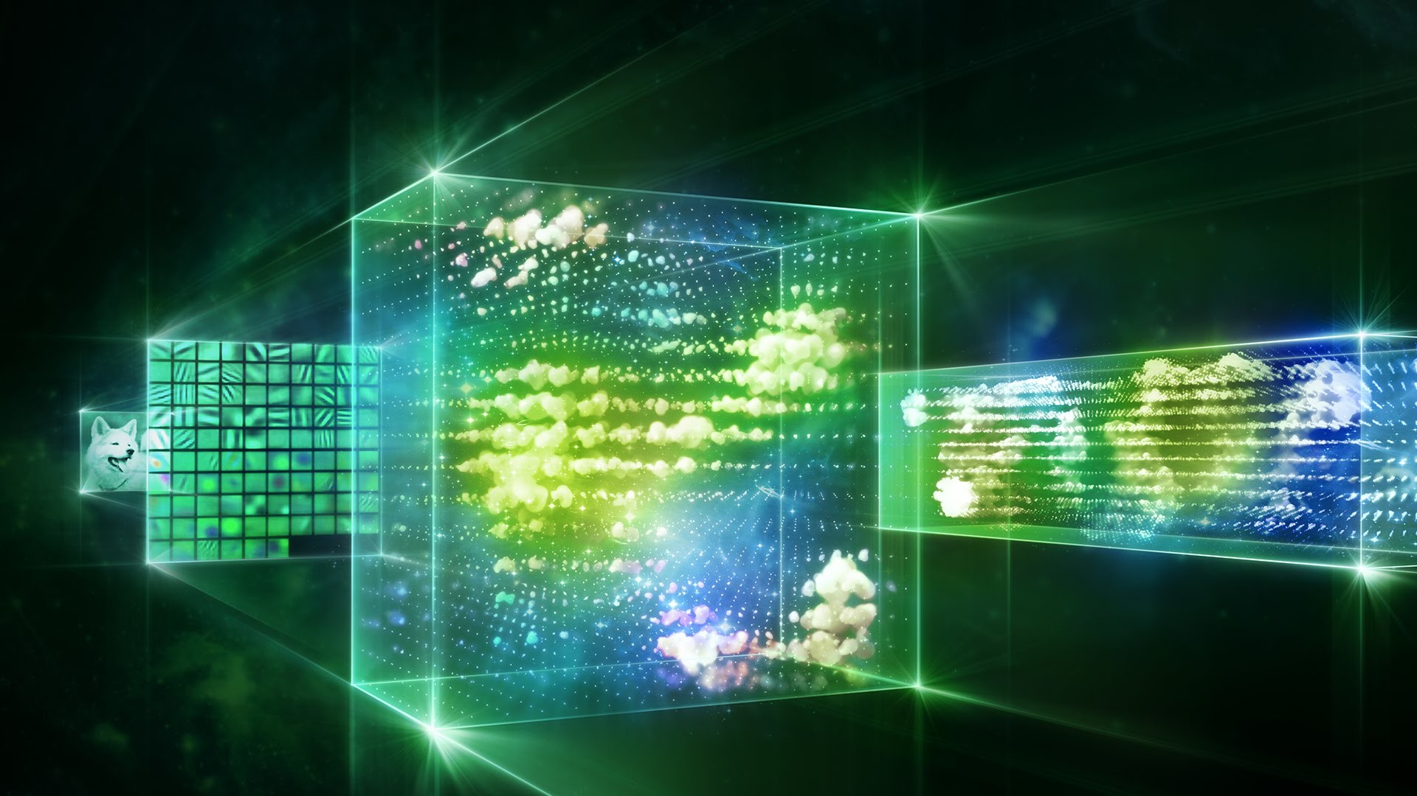
How To Build A Brain
Perception

Slide 2
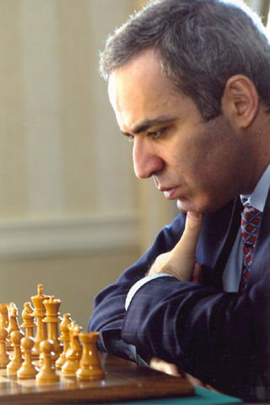
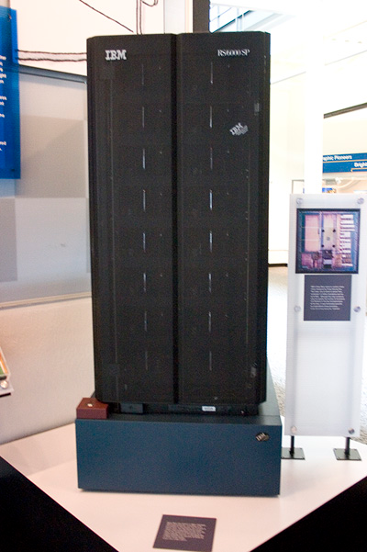
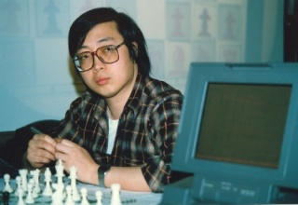
Beating humans
Gary Kasparov
Deep Blue
Feng-Hsiung Hsu
1997: Deep Blue beats Gary Kasparov at chess.

Slide 3
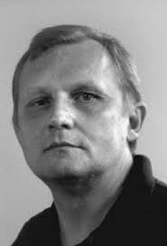
Moravec’s paradox (1988)
"It is comparatively easy to make computers exhibit adult level performance on intelligence tests or playing checkers, and difficult or impossible to give them the skills of a one-year-old when it comes to perception and mobility"

Slide 4
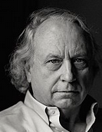
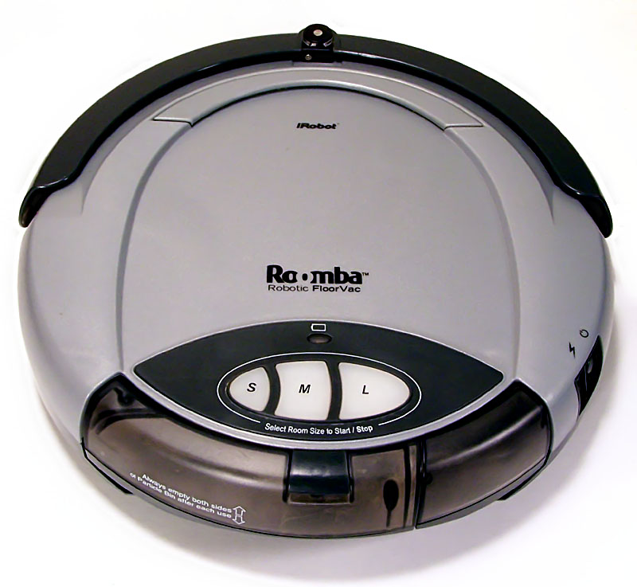
Rodney Brooks
In early AI research, intelligence was characterized as
“the things that highly-educated male scientists found challenging”
while
"things that children of four or five years could do effortlessly, such as visually distinguishing between a coffee cup and a chair...were not thought of as activities requiring intelligence"

Slide 5
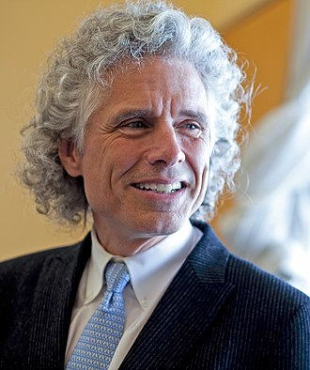
Stephen Pinker (1994)
“The main lesson of thirty-five years of AI research is that the hard problems are easy and the easy problems are hard”

Slide 6
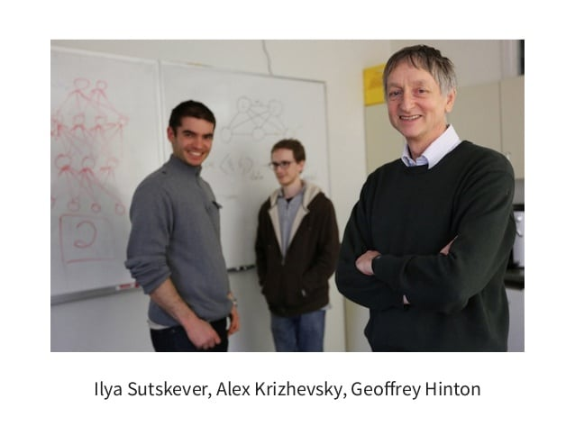
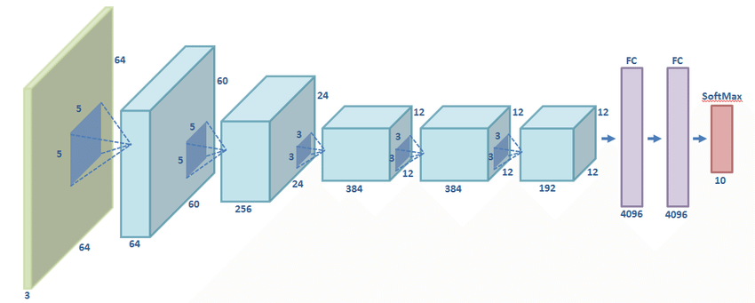
AlexNet (2012)

Slide 7
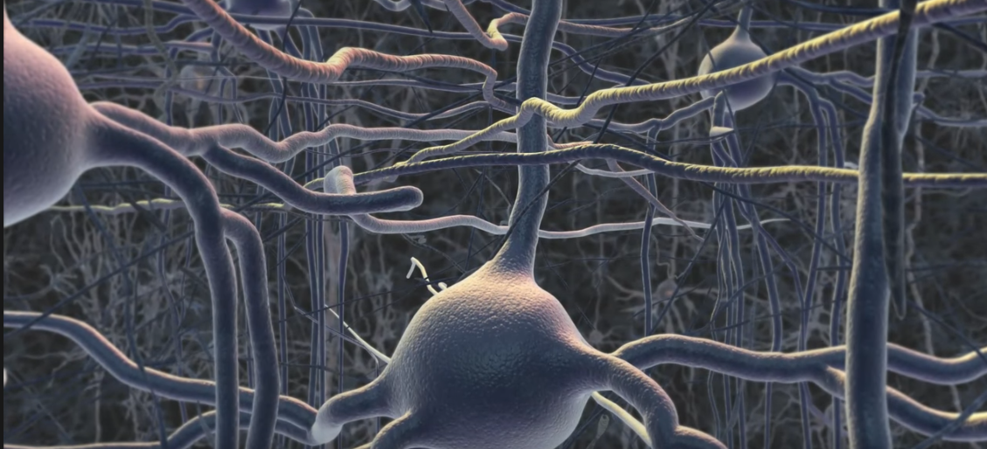
Visual Neuroscience

Slide 8
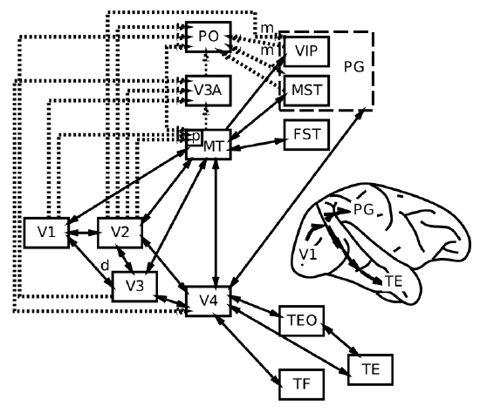
Deeper

Slide 9
More sparse

Slide 10
Receptive fields
Receptive field
Visual field

Slide 11
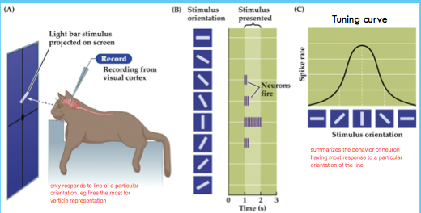
Neural tuning

Slide 12
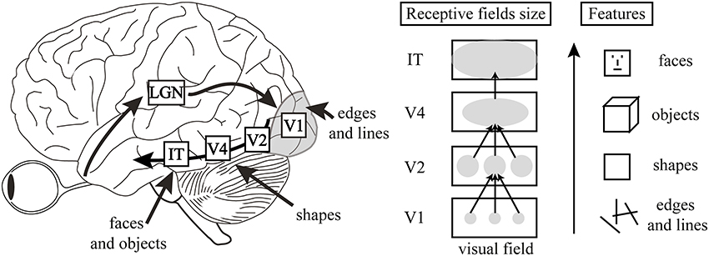
Simple to complex

Slide 13
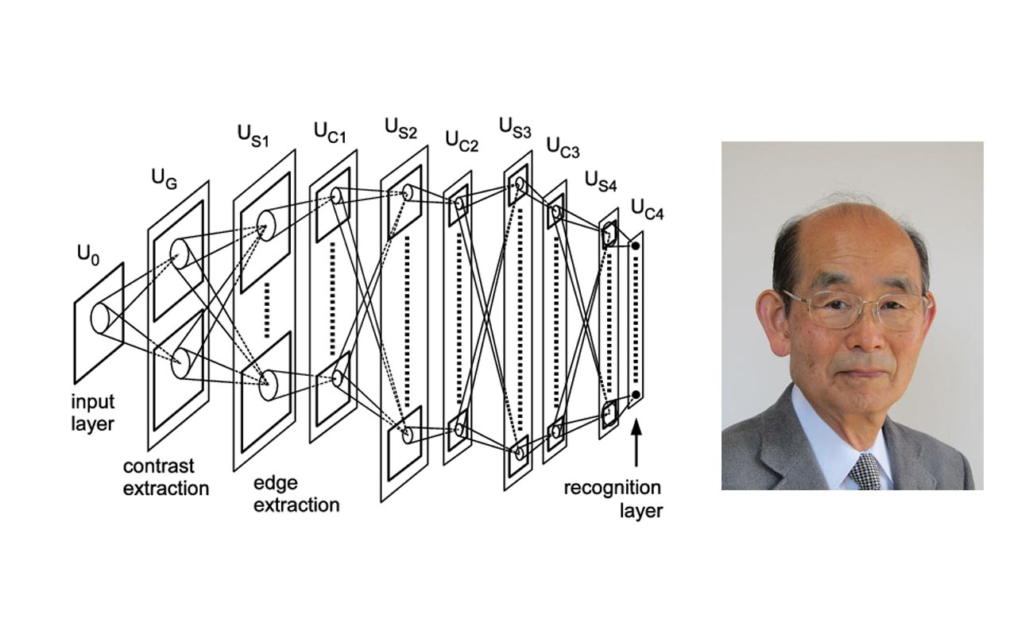
Neocognitron
Kunihiko Fukushima

Slide 14
LeNet (1989)

Slide 15
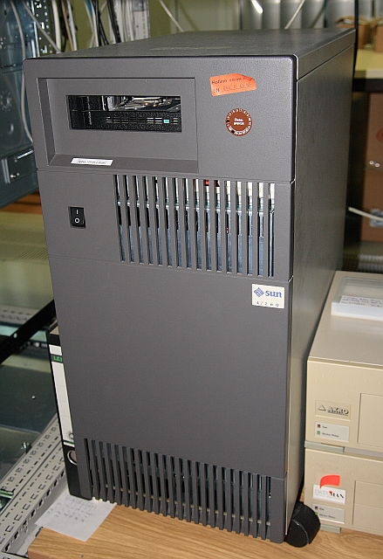
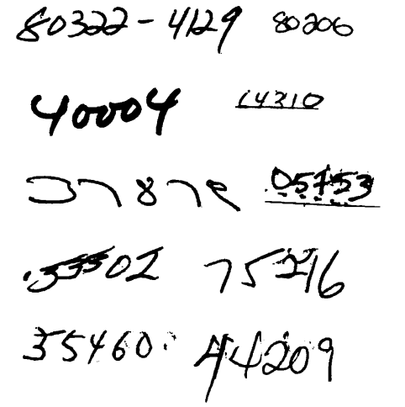
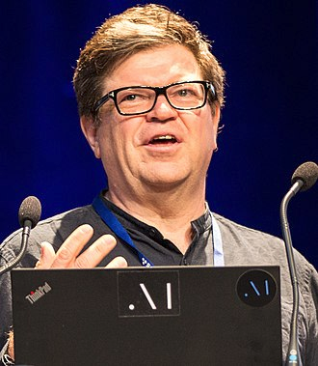
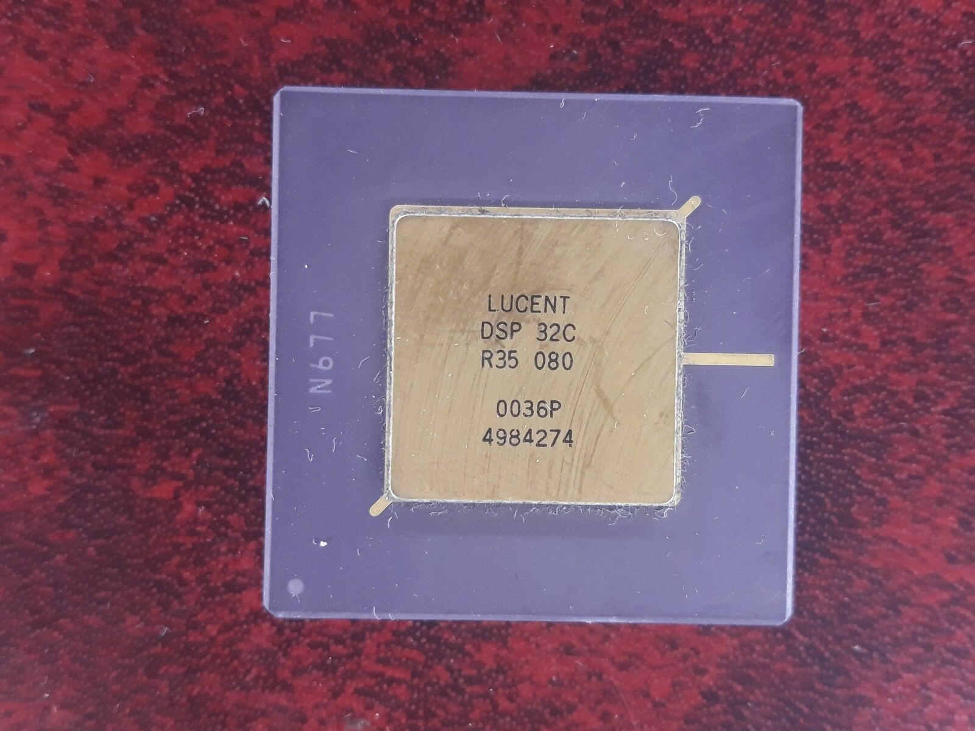
Recognition of handwritten digits
SUN-4/260
Yann LeCun
AT&T DSP 32C

Slide 16

Convolutional filter

Slide 17
Input
Weights
Multiply
Add
Output
0 | 1 | 0
0 | 1 | 0
0 | 1 | 0
0 | 1 | -1
-1 | 1 | -1
-1 | 1 | 0
0 | 1 | 0
0 | 1 | 0
0 | 1 | 0
3
3
1 | 0 | 0
0 | 1 | 0
0 | 0 | 1
0 | 1 | -1
-1 | 1 | -1
-1 | 1 | 0
0 | 0 | 0
0 | 1 | 0
0 | 0 | 0
1
1
1 | 1 | 1
1 | 1 | 1
1 | 1 | 1
0 | 1 | -1
-1 | 1 | -1
0 | 1 | 0
0 | 1 | -1
-1 | 1 | -1
-1 | 1 | 0
-1
0

Slide 18
Convolutional filter
Filter applied to top-left of image

Slide 19
Convolutional filter
Next filter overlaps.

Slide 20
Convolutional filter
The filter is applied a total of 64 times across the image
(8 examples shown here).
...and produces output activations for 64 hidden units, in an 8x8 grid.
Weights: 25
(vs. a dense network: 16,384!)

Slide 21
Convolutional filter
size: 8 x 8
conv: 5 x 5
stride: 2
weights: 25
size: 16 x 16

Slide 22
Filter Bank
size: 16 x 16
size: 8 x 8 x 12
conv: 5 x 5
stride: 2
weights: 300

Slide 23
2nd Filter Bank
The 2nd filter is applied a total of 16 times across the 1st filter
(4 examples shown here).
...and produces output activations for 16 hidden units, in an 4x4 grid.

Slide 24
3D convolutional filter
The 3D filter has 5 x 5 x 12 = 300 weights

Slide 25
First Three Layers
Image
2D filters
3D filters

Slide 26
Last two layers
Dense
Dense
3D filters
Hidden layer
Output layer
Image

Slide 27
LeNet
Conv
Conv
Dense
Dense
Image
2D filters
3D filters
Hidden
Output

Slide 28
LeNet
Trained with backprop
7,291 digits, 23 times each
(167,693 trials).
5% errors on a test set.
10 digits/second

Slide 29
AlexNet (2012)

Slide 30
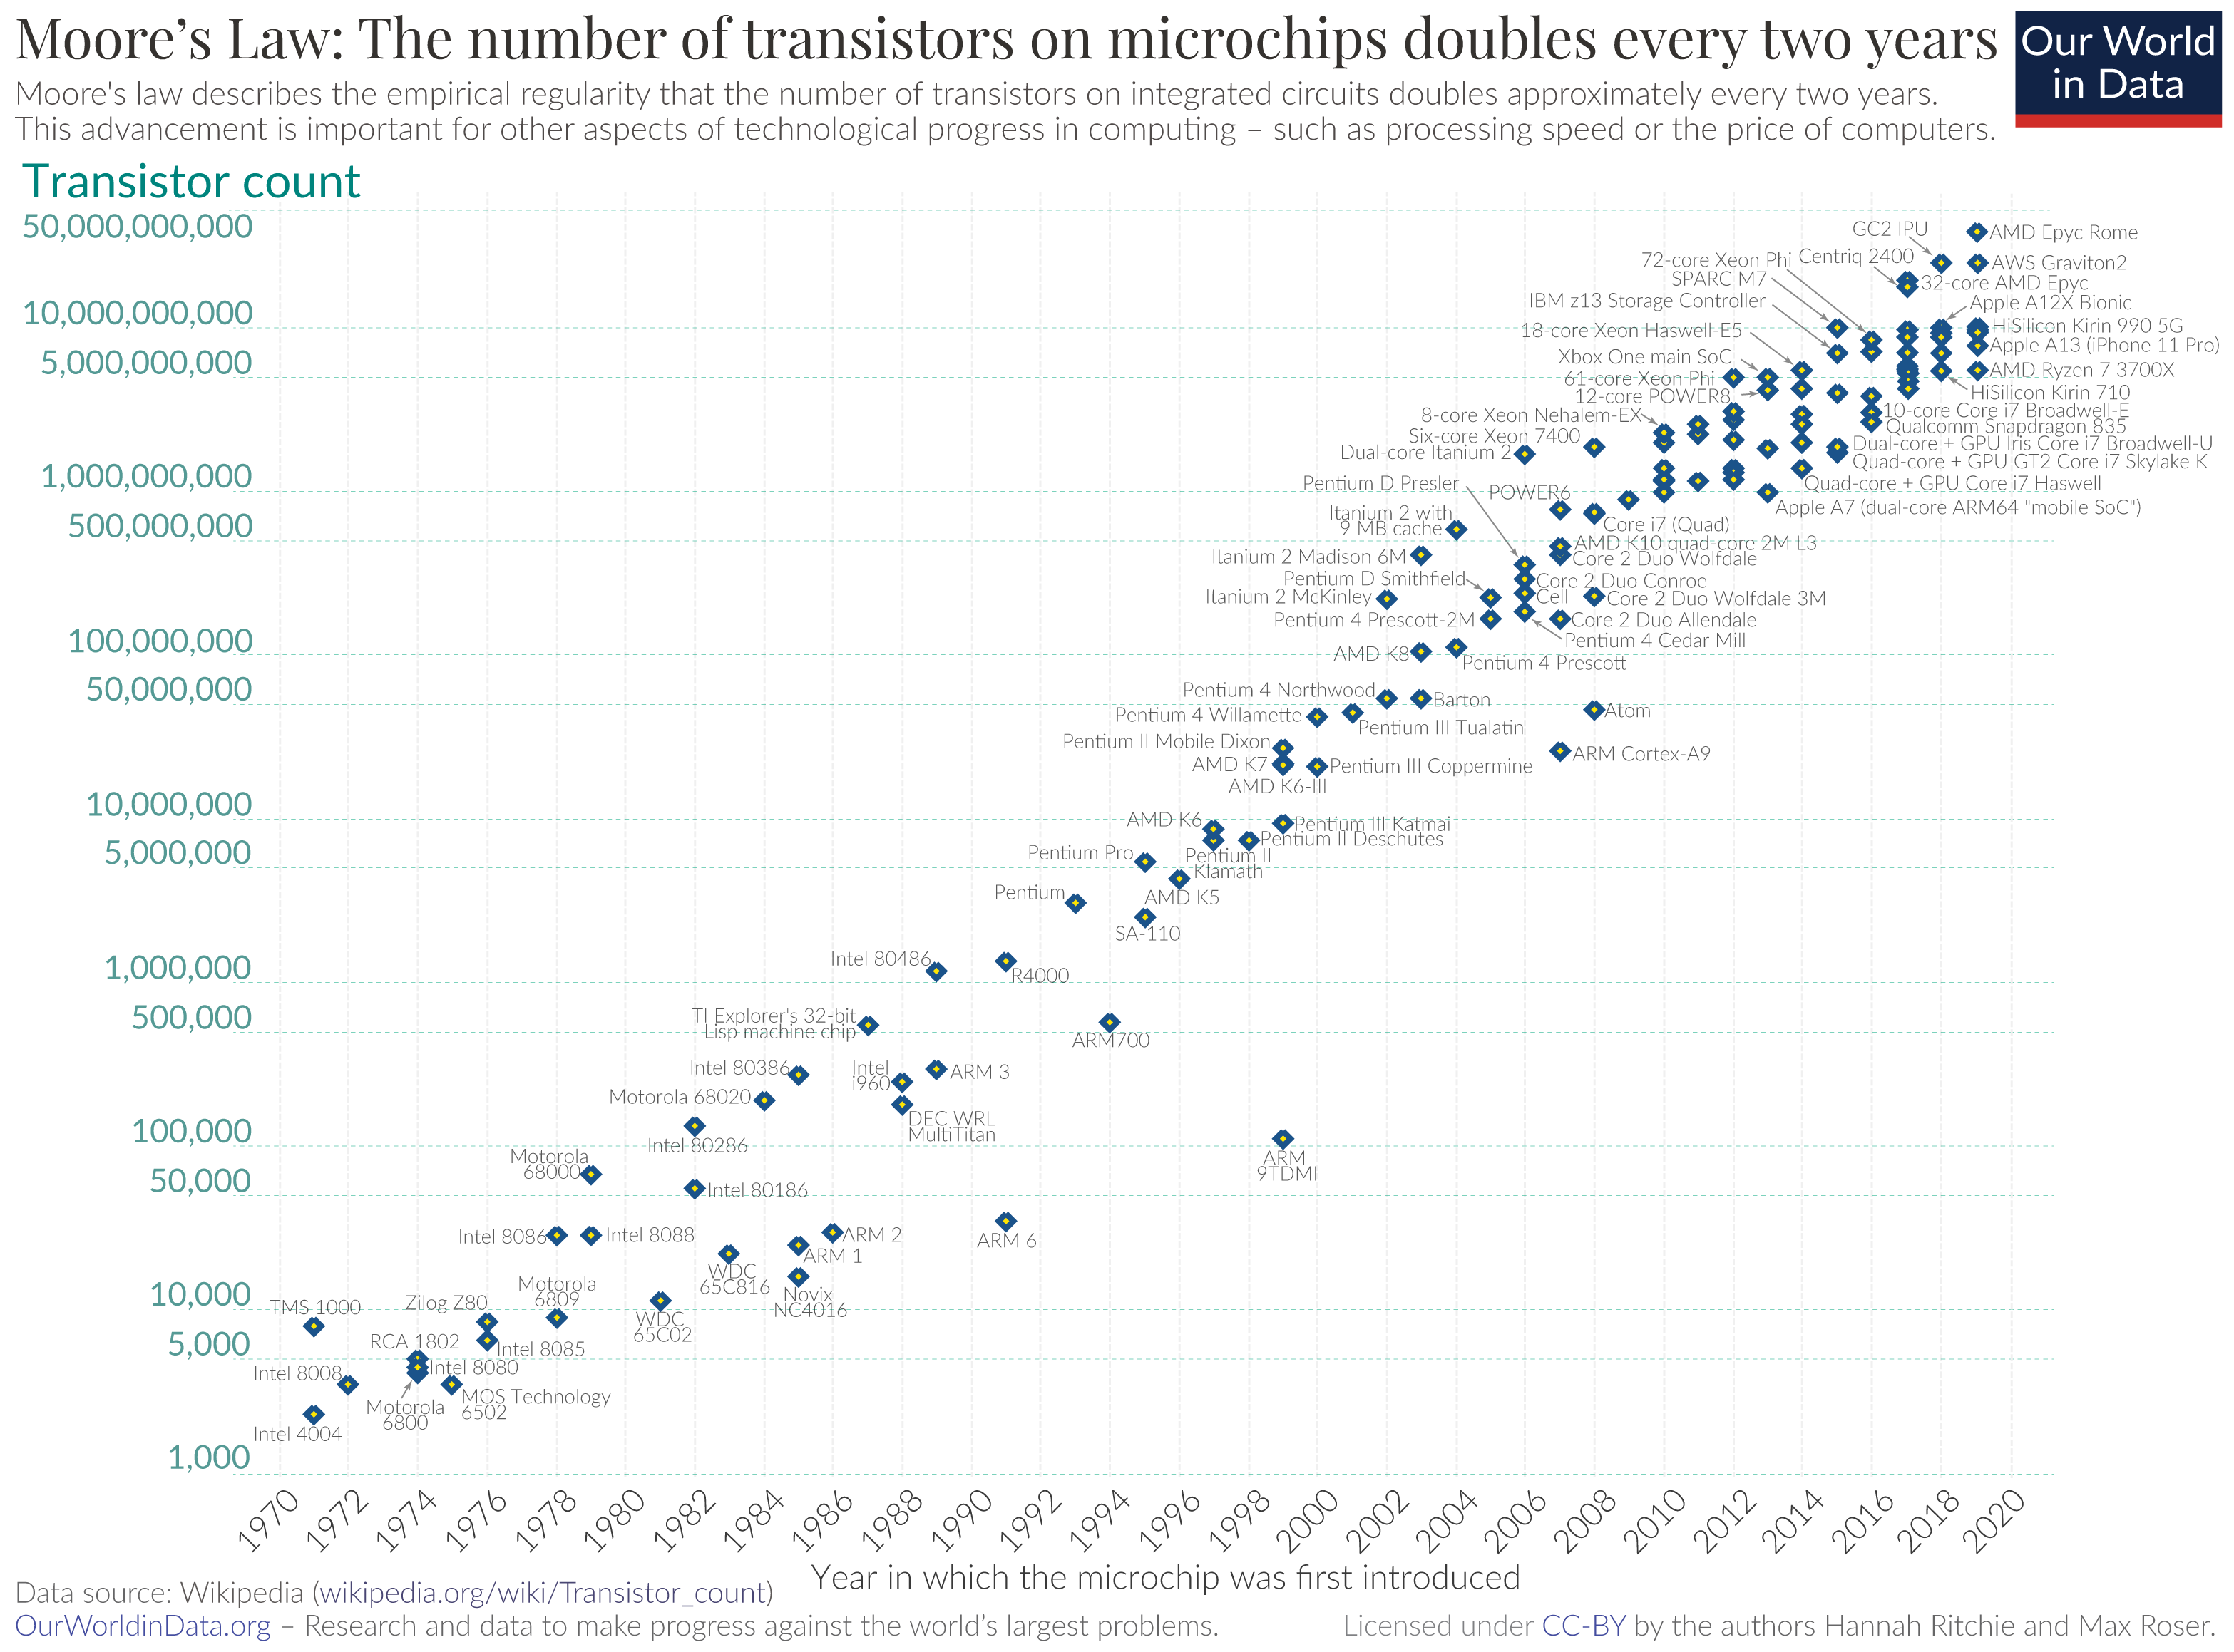
Note: log scale.
Doubles every 2 years.

Slide 31
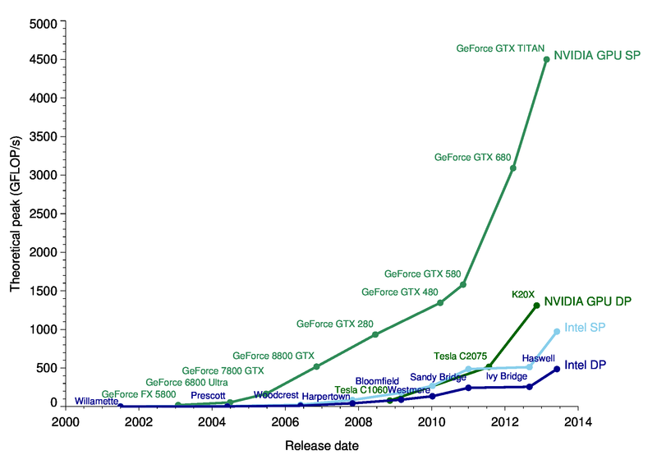
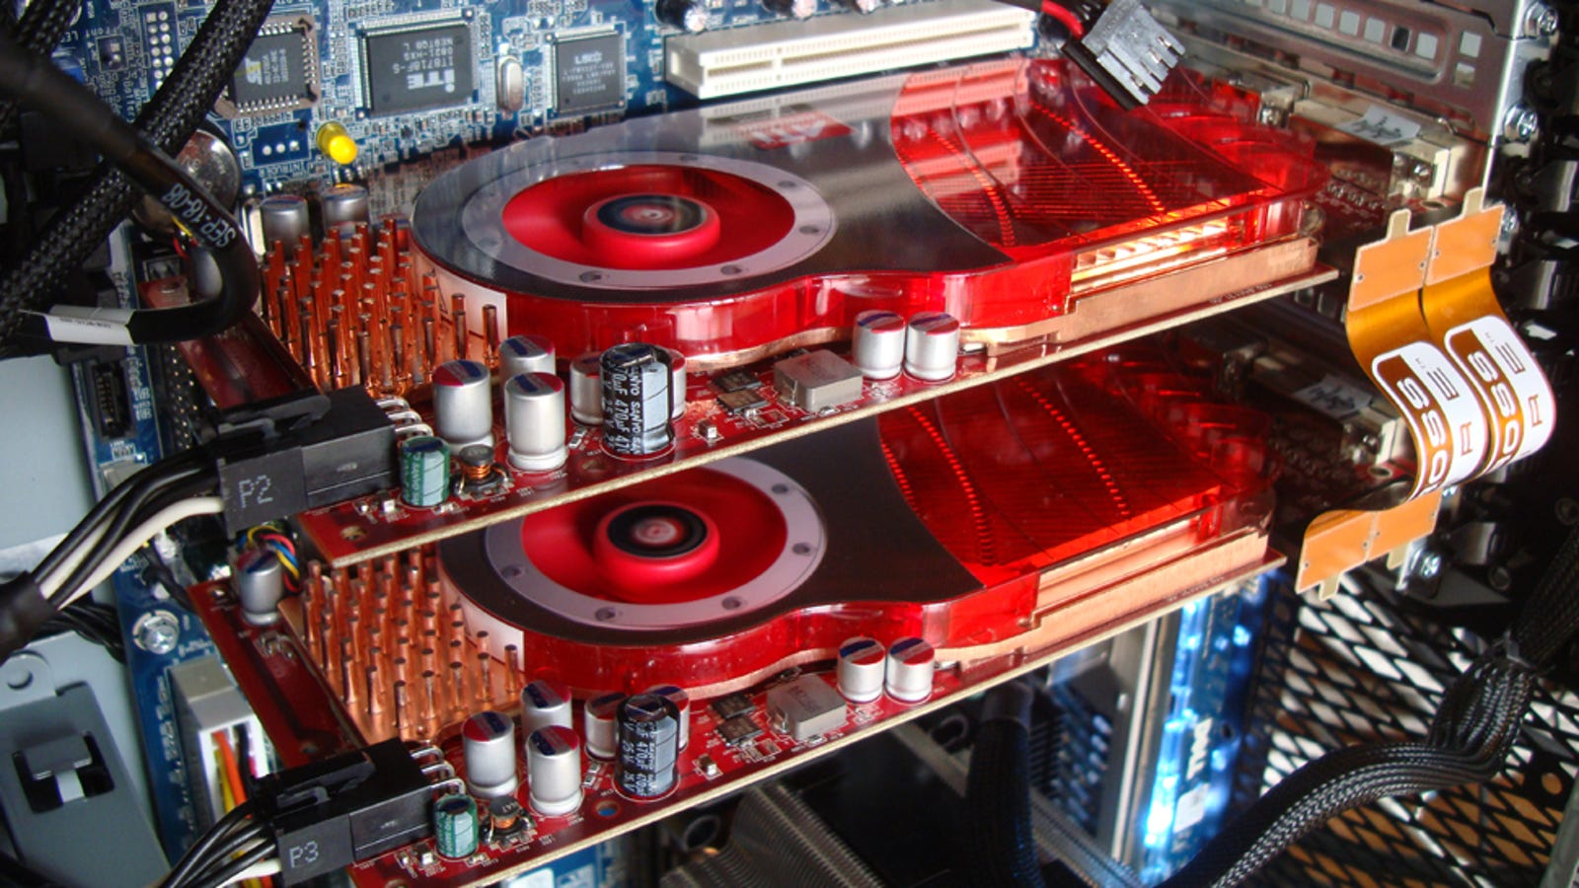
GPUs and CPUs.
Note: linear scale.
Doubles every 2 years.

Slide 32
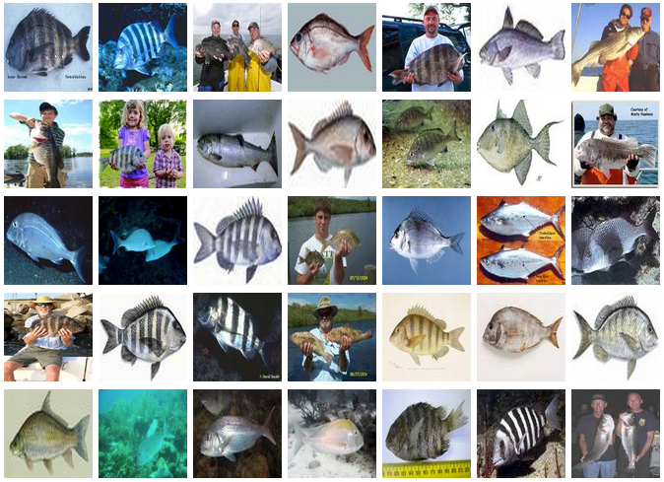
Imagenet (2009-)
14 million images
20,000 categories
100s examples per category
Some of the fish pictures in ImageNet

Slide 33
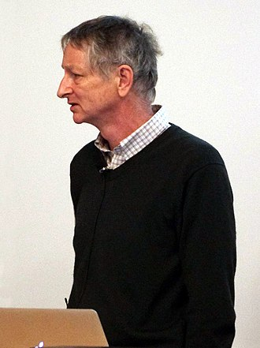
Legacy of AlexNet
100,000+ citations
Acquired by Google
Big Tech headhunts brain-inspired AI academics
Yann LeCun
Now @ facebook
Geoff Hinton
Now @ Google

Slide 34

Higher-res, and colour
AlexNet
LeNet
size: 16 x 16
size: 256 x 256 x 3

Slide 35
LeNet
AlexNet
Deeper
Image
Conv
Image
Conv
Conv
Conv
Conv
Conv
Dense
Conv
Dense
Dense
Category
Dense
Dense
Category

Slide 36
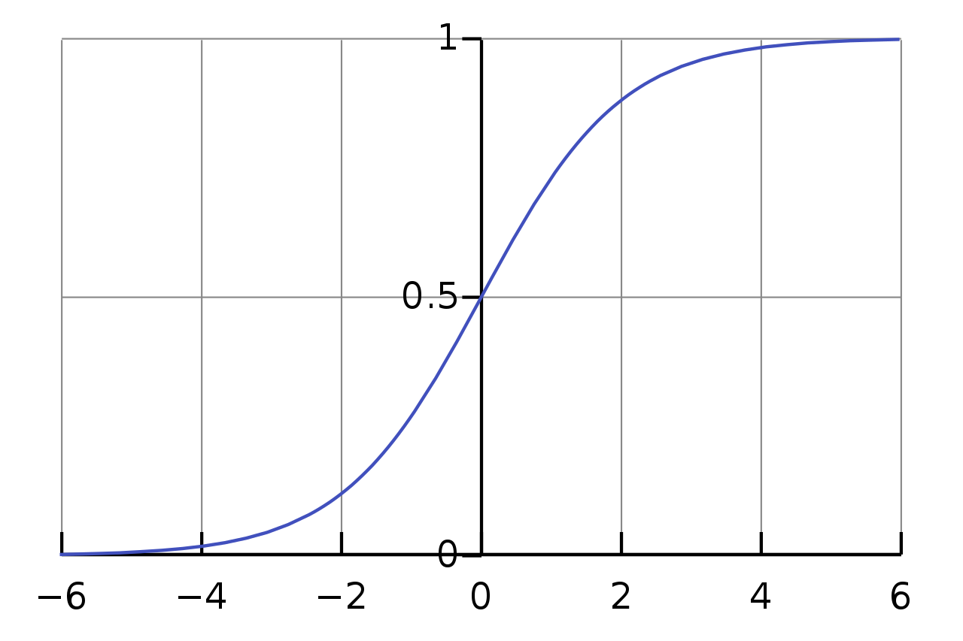
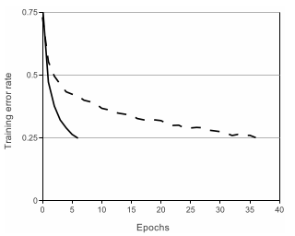
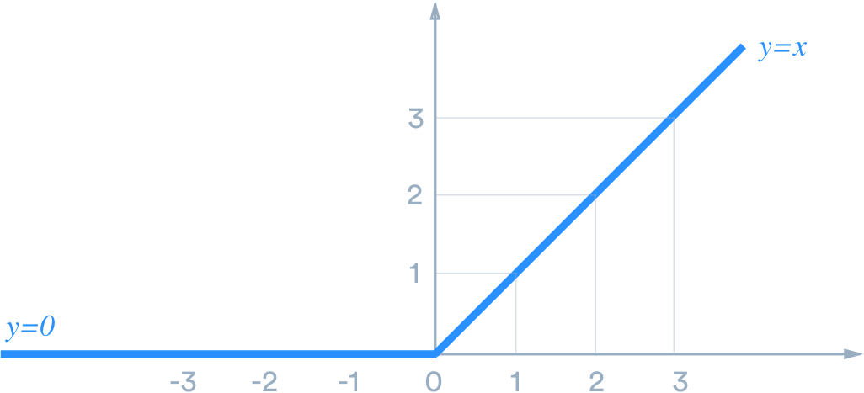
ReLU

Slide 37
Grouping
Image
Image
Category
Conv
Conv
Conv
Conv
Conv
Image
Category
Dense
Dense
Dense
Category

Slide 38
Dropout

Slide 39
ResNet (2016)

Slide 40
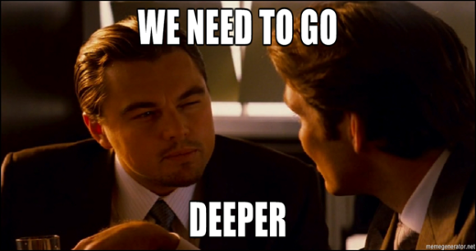
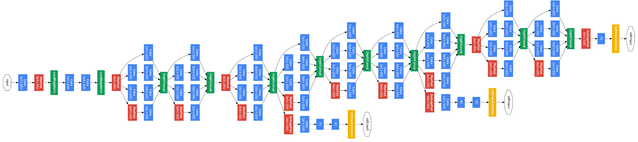
LeNet
AlexNet
VGG
Inception

Slide 41
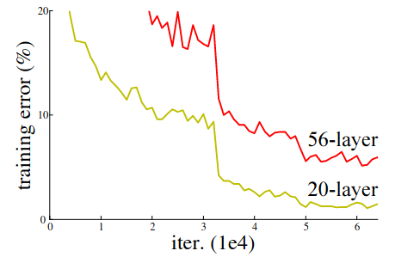

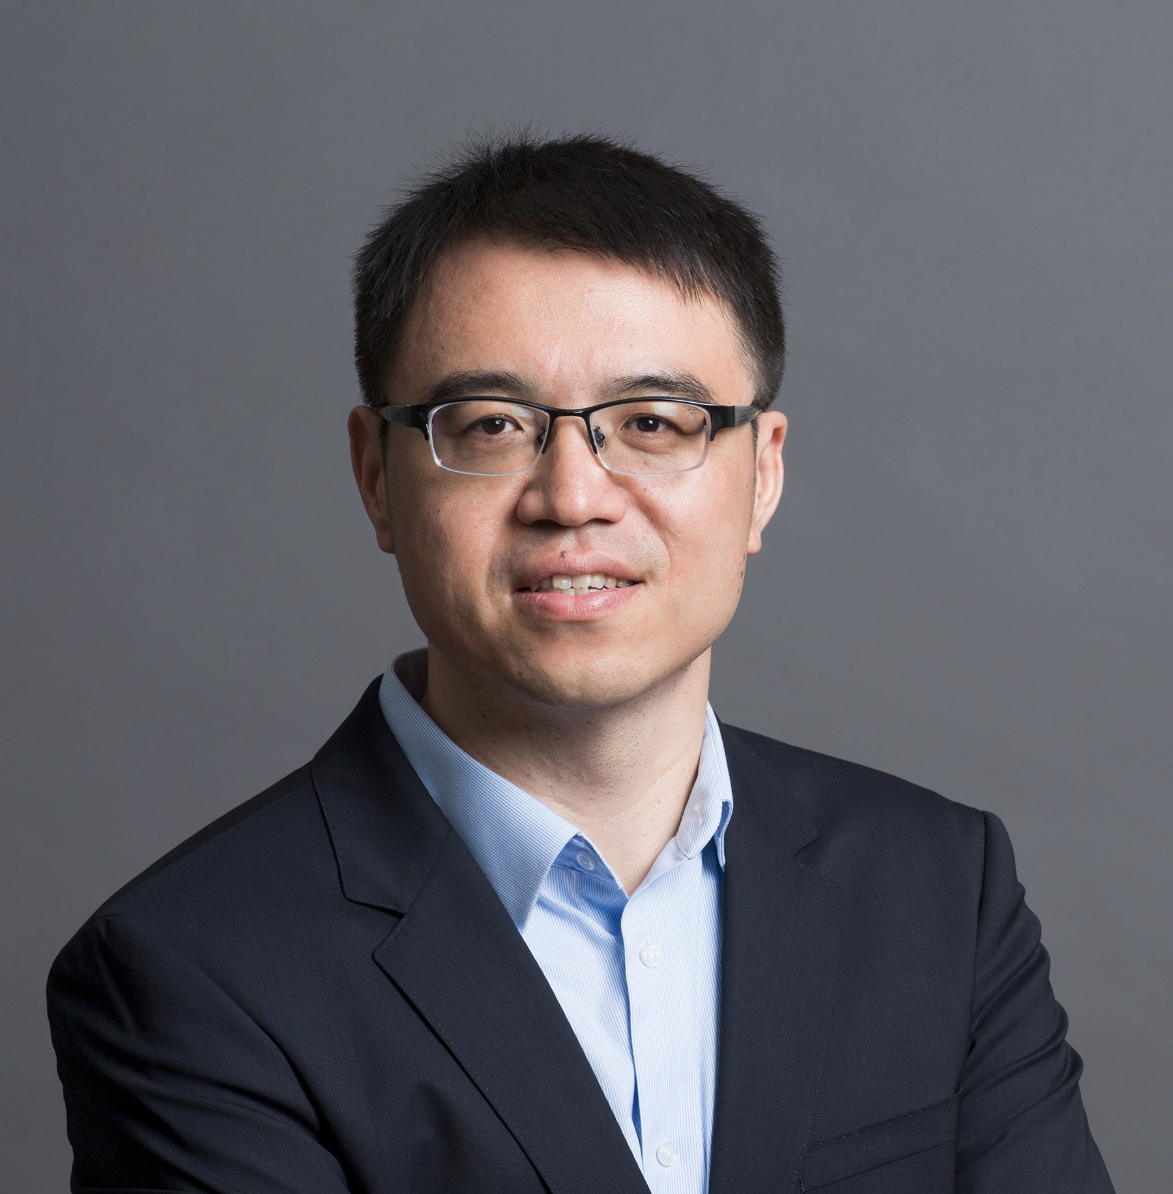
Network degradation
Kaiming He
Jian Sun

Slide 42
Network degradation
Identity

Slide 43
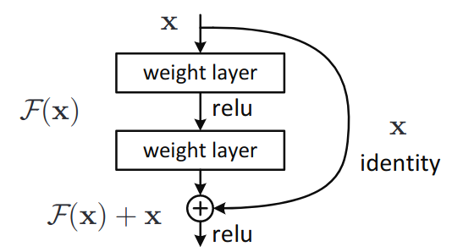
Residual Block

Slide 44
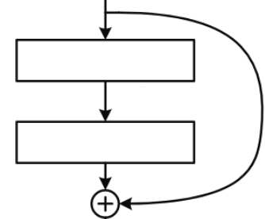
ResNet 34

Slide 45
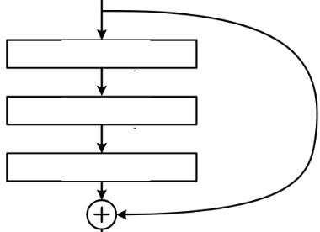
ResNet 152
ResNet152 with ResNet 34 for scale
(zoom in to slide for detail)

Slide 46
Applications

Slide 47
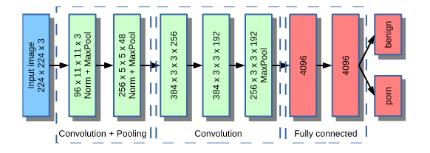
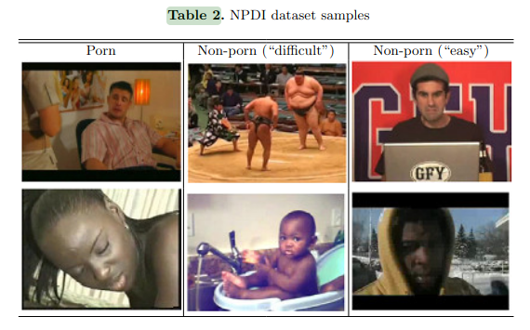
Content moderation
Mohammed Moustafa (2015)

Slide 48
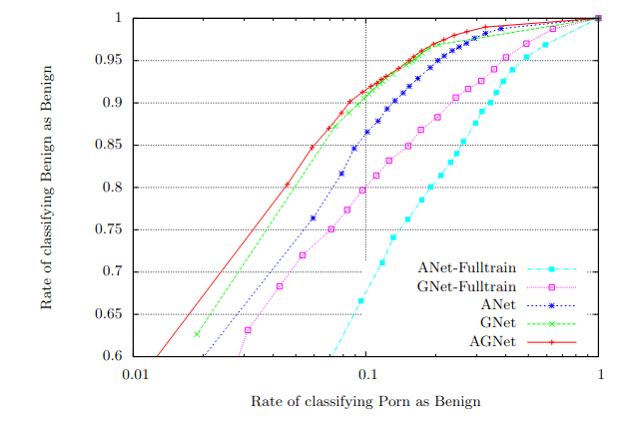
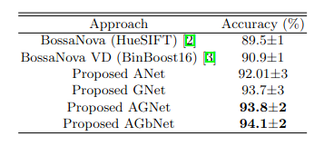
Content moderation
Videos
Stills

Slide 49
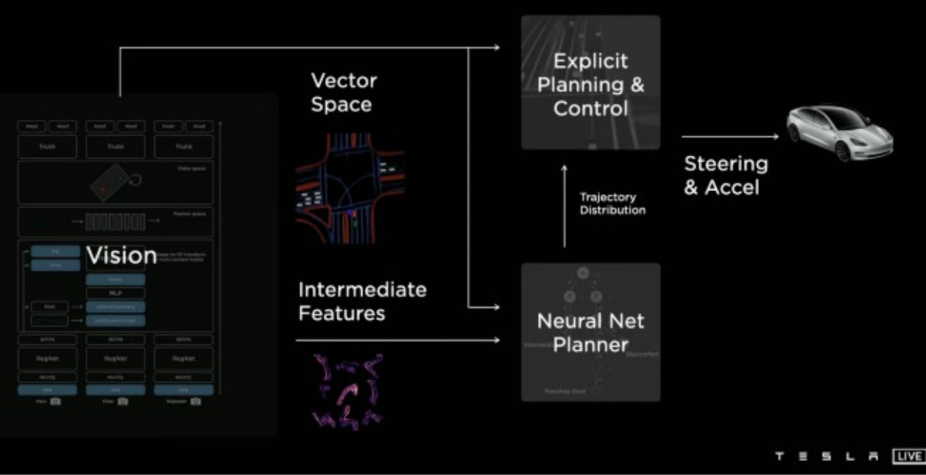
Tesla AutoPilot

Slide 50
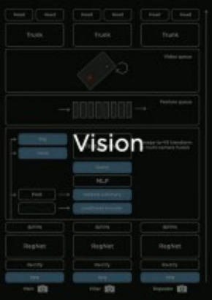
Tesla AutoPilot
Autopilot is a complex system.
...but nearly the first thing that happens to the data from each of the 8 cameras is that it’s passed through a RegNet. This is a development of the ResNet system.

Slide 51
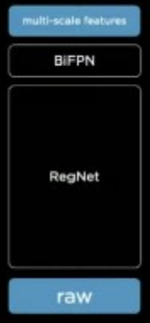
Tesla AutoPilot
Autopilot is a complex system.
...but nearly the first thing that happens to the data from each of the 8 cameras is that it’s passed through a RegNet. This is a development of the ResNet system.

Slide 52
Why so deep?

Slide 53
The paradox
A multilayer feedforward network, with sufficient hidden units can represent any deterministic mapping between its inputs and its outputs - Hornik, Stinchcombe & White (1989)
ResNet152 (!)

Slide 54
Lower complexity
2-layer dense network
150,000 inputs
75,000 hidden
1,000 outputs
= 11 billion connections
50-layer ResNet
150,000 inputs
1,000 outputs
24 million connections
400 times simpler

Slide 55
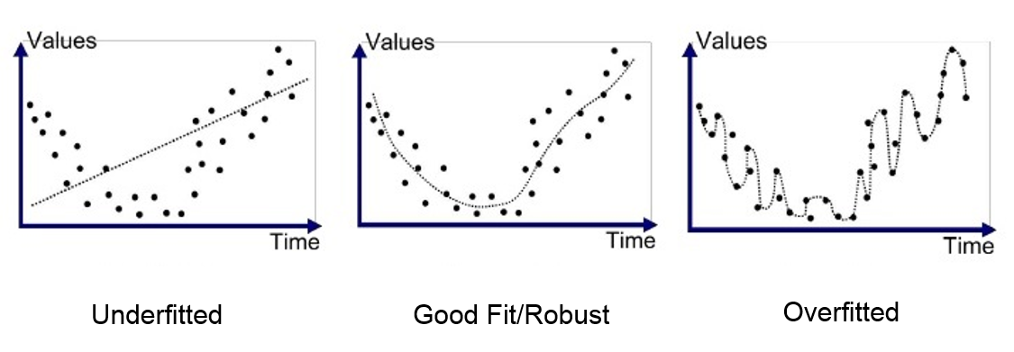
Overfitting

Slide 56
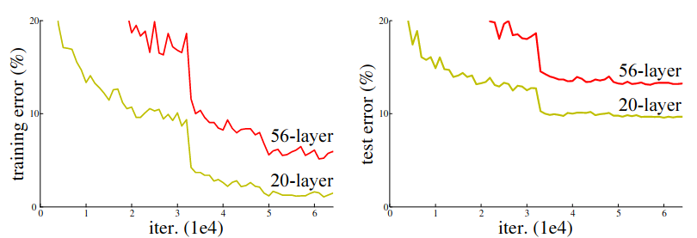
Overfitting

Slide 57
The State Of The Art

Slide 58
How good are they?
“recent advances from machine learning led to the discovery of hierarchical neural network models that achieved near-human-level performance level on challenging object categorization tasks”
- Yamins & DiCarlo (2016)

Slide 59
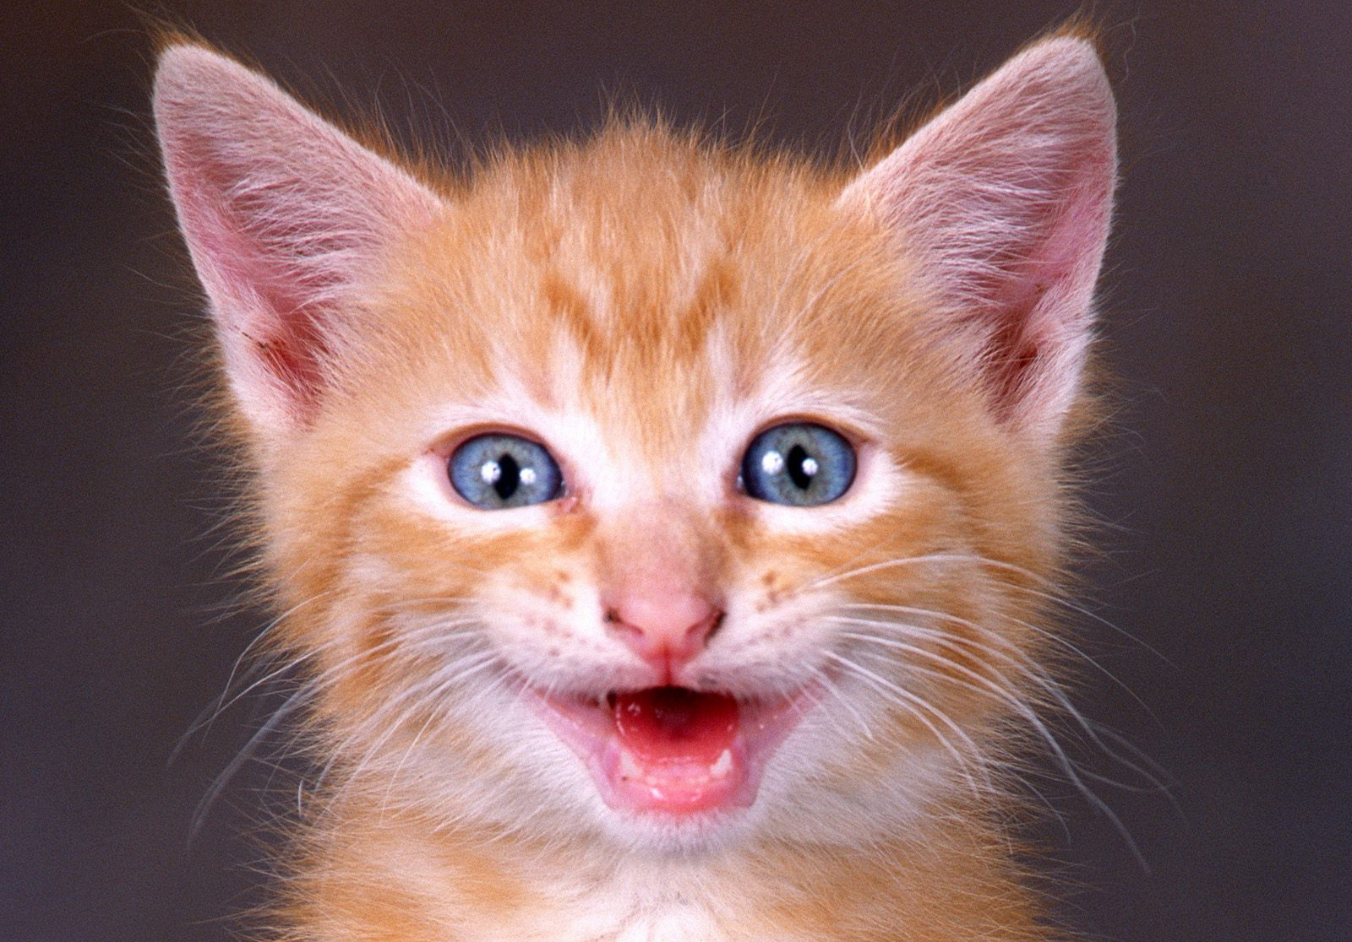
Can you be more specific?
PNASNet:
  - 96.2% Top-5 accuracy on ImageNet (Liu et al., 2018)
  (1) Hatstand
  (2) Orange
  (3) Battleship
  (4) Dandelion
  (5) Cat

Slide 60
How about a sensible answer?
PNASNet:
  ~73% Top-1 accuracy on ~300 ImageNet categories
  (Barbu et al., 2019)
  (1) Cat
  (2) Orange
  (3) Battleship
  (4) Dandelion
  (5) Hatstand

Slide 61
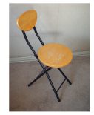
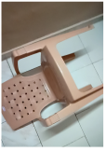
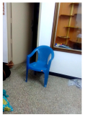
Barbu et al. (2019)
Internet objects
72% correct
Objects in the real world
30 % correct

Slide 62
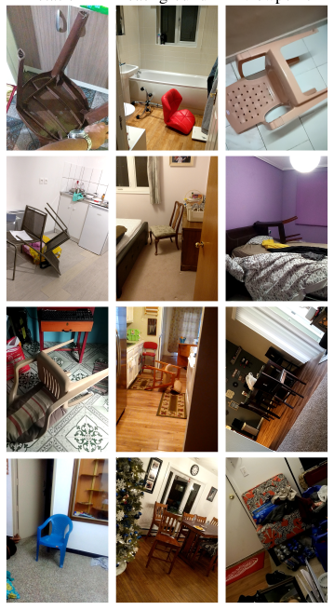
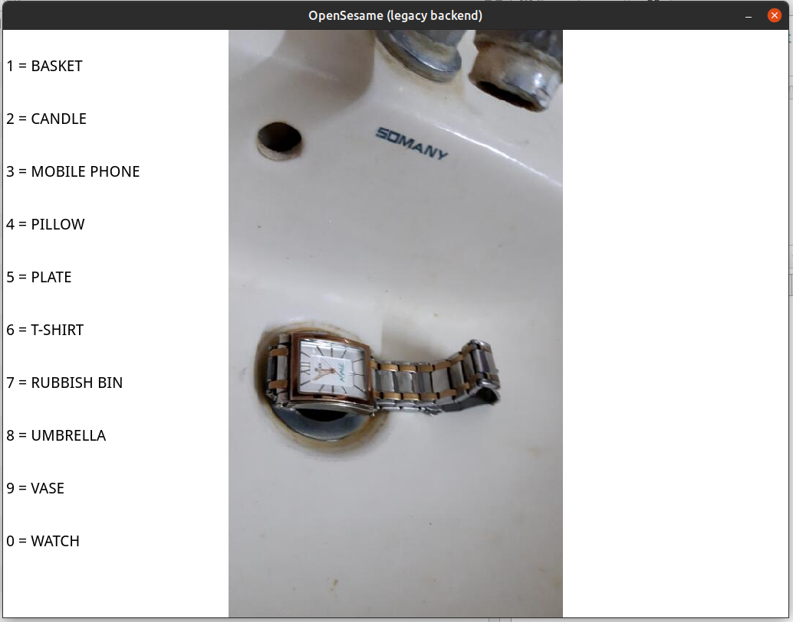
How good are people?

Slide 63

Results

Slide 64
How To Improve?

Slide 65


Insufficiently sensitive to shape
Baker et al. (2018)

Slide 66


Overly sensitive to tiny local features
Malhorta et al. (2020)

Slide 67

Evans et al. (2022)

Slide 68


Evans et al. (2022)

Slide 69
Summary

