Slide 1
On Esteem:
Rewarding Reproducible Science
Andy J. Wills
Plymouth University
14th June 2019
CC-BY-SA 4.0

Slide 2
Norms of esteem
Hiring
Promotion
Introducing a visiting speaker
Writing a self-bio
Deciding where to submit a paper
Congratulating others on success
Criticising or gossiping about others
Deciding which papers to cite

Slide 3
Number of publications
“Prof. Esteem has published over 200 papers...”
“One paper per year of your Ph.D.”
“50 papers for a Chair”

Slide 4
Issues with N
Very easy to “game” with co-authors
A measure of persistence
A measure of wealth
A measure of social network size

Slide 5
Location of publications
Journal | Esteem | Impact Factor
Psychological Review Psychological Science JEP: Gen | “It’s a 4* journal” | 7.2 6.1 4.1
JEP:LMC QJEP JEP:ALC | “It’s a 3* journal” | 2.2 2.1 1.8
Learning & Behavior | “It’s a 2-3* journal” | 1.4
Impact Factor of journal X: Mean number of times a paper in journal X is cited in the first two years of publication.

Slide 6
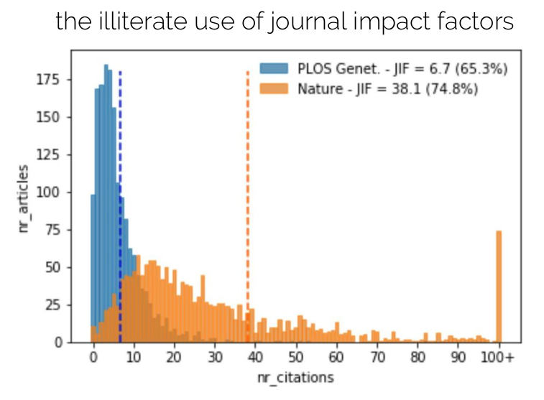
Impact Factor is unrepresentative
https://osf.io/n3yfz/ - Paola Masuzzo

Slide 7
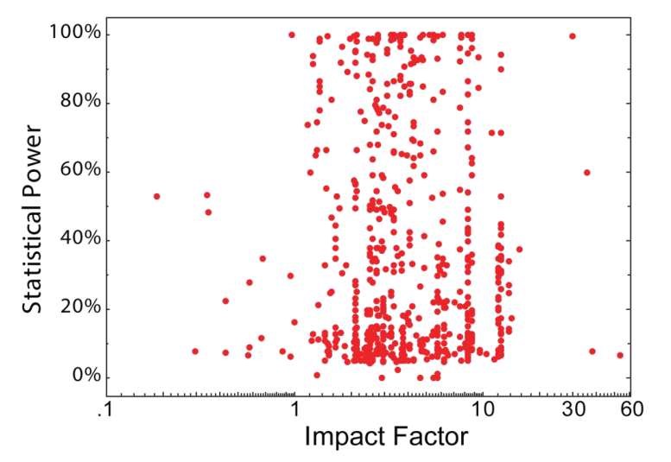
Impact Factor uncorrelated with quality
http://bjoern.brembs.net/2016/01/even-without-retractions-top-journals-publish-the-least-reliable-science/

Slide 8
Number of citations
Negative citations are rare, perhaps 3%
Citation practices differ
h-index
  Gaming the h-index
  No good for junior hires
https://www.pnas.org/content/112/45/13823
https://www.psychologicalscience.org/observer/citation-based-indices-of-scholarly-impact-databases-and-norms

Slide 9
Read the damm thing!
Speaker introduction
“Jackie’s paper on elaborated instrusion theory made me think differently about how to reduce obesity”
Hiring, promotion
“List your three best publications”
Issues for hiring and promotion
1. Time
2. Author contribution.
3. Hypercompetition

Slide 10
Grant income
“Prof. Esteem has received over
£2m in grant income”
Promotion:
“Talk to me once you get a £300k grant”
Hiring:
“Sustained track record of grant income”

Slide 11
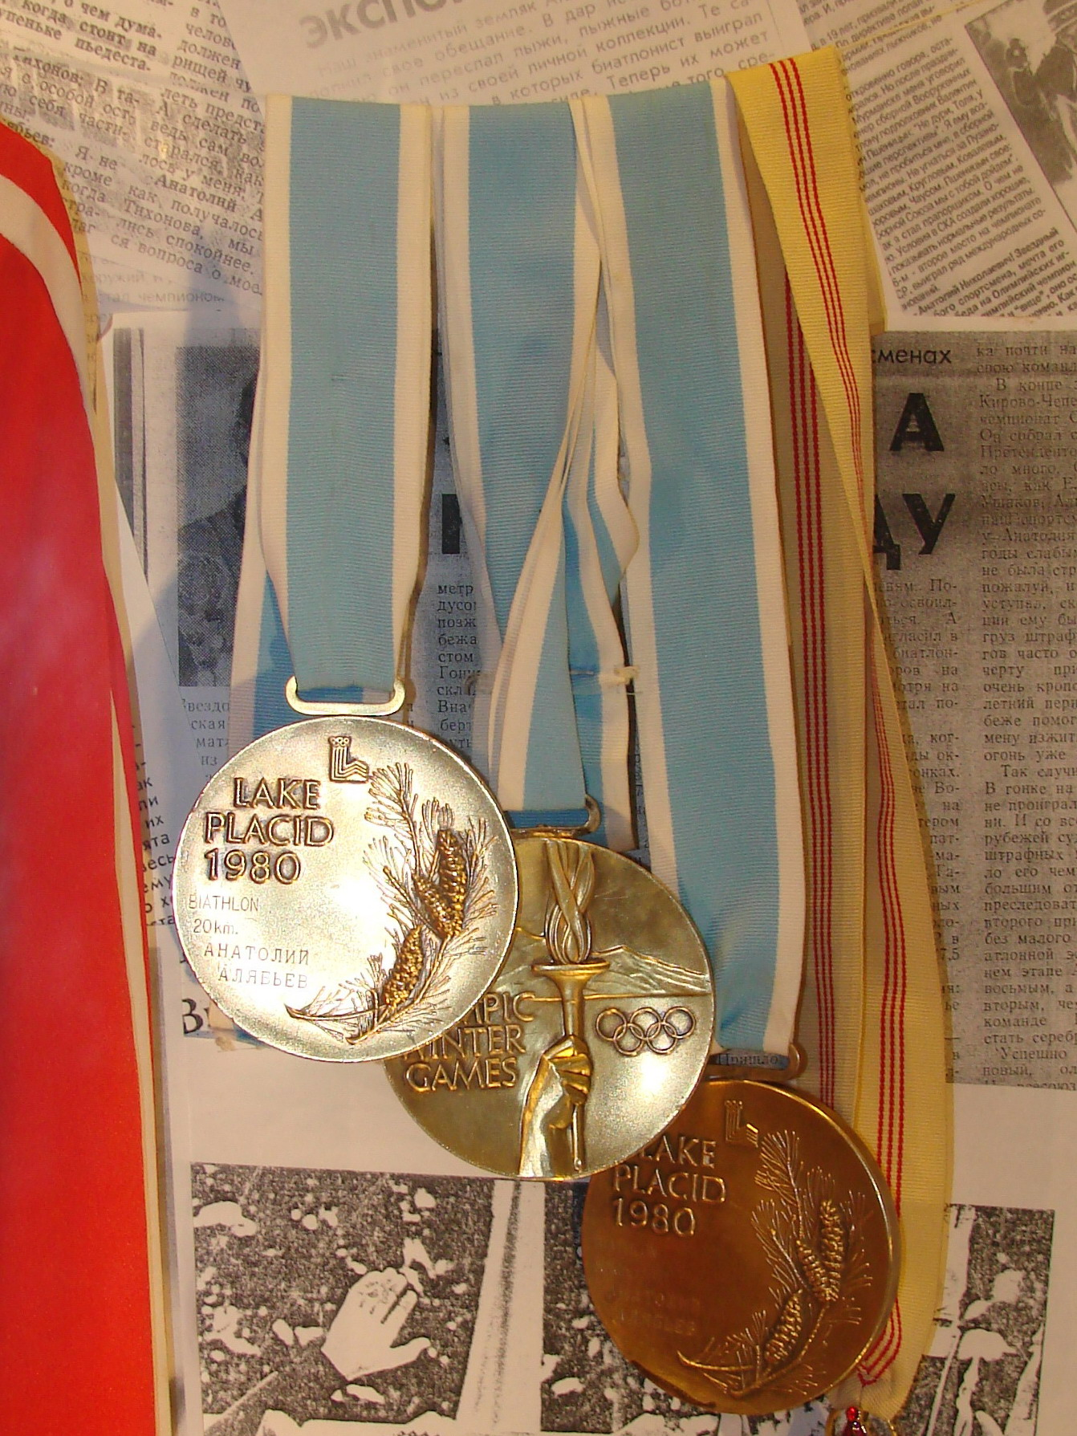
Esteem and reproducible science
Don’t use:
  Number of publications
  Impact Factor
  Grant income
Sometimes OK:
  Citation counts
  H-index
Do use:
  Reading their best work
By Sergeev Pavel - museum exhibition, Public Domain, https://commons.wikimedia.org/w/index.php?curid=11891066

