Slide 1
The synthesis of integral dimensions
Andy J. Wills – University of Plymouth
C.E.R. Edmunds – Queen Mary University
Fraser Milton – University of Exeter

Slide 2

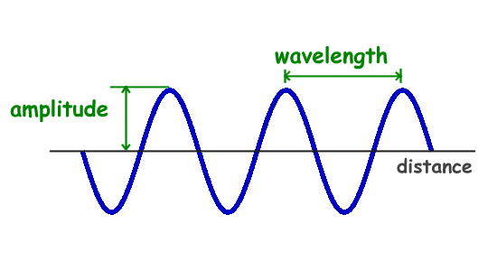
Stimuli have multiple attributes

Slide 3
Classes of theories of classification
Differentiation Theory
  Lockhead (1972), et seq.
Combination Theory
  Neisser (1967), et seq.

Slide 4
Differentiation Theory
Size
Brightness
“Unanalyzed whole”

Slide 5
Widespread assumption of Differentiation Theory
Use of terms “analytic” and “nonanalytic” (or “holistic”) to describe modes of thought.
Example: Hypothesis that Western Educated Industrialised Rich Democratic (WEIRD) populations have an unusually analytic mode of thought
  Heinrich et al. (2010)

Slide 6
Differentiation Theory is wrong
For example:
  Milton, Longmore & Wills (2008): time pressure, concurrent load
  Milton, Wills & Hodgson (2009): fMRI
  Wills et al. (2009): pigeon / squirrel / human comparisons
  Wills et al. (2013): concurrent load, instructions, working memory capacity
  Wills, Inkster & Milton (2015): time pressure, concurrent load, incidental training.
  Wills, Ellett, Milton, Croft & Beesley (2020): pretraining, concurrent load.

Slide 7
Combination Theory
Size
Brightness
“Unanalyzed whole”
Size
Brightness
“Synthesized whole”

Slide 8
Combination Theory
Predicts the effects of time pressure, cognitive load, incidental training, instructions … on the classification of a variety of stimuli in a variety of procedures.
Basically: The less time or mental resources we have to apply to a classification the fewer stimulus attributes we use.

Slide 9



Breaking Combination Theory?
Separable versus integral stimuli (Garner, 1976)
Separable stimulus set:
Integral stimulus set:

Slide 10
Predictions
Combination Theory: With sufficiently high time pressure, people will classify integral stimuli on the basis of a single attribute, because the attributes have not yet been combined.
Differentiation Theory: Classification on the basis of a single attribute will be more likely as time pressure reduces.

Slide 11
Experiment
IV: stimulus presentation time
  100 ms vs. 2000 ms (between-subjects)
Stimuli
  Red hue squares varying in saturation and brightness
Procedure
  “Triad” (restricted classification) task

Slide 12



Slide 13
Odd one out?

Slide 14
Brightness
Saturation

Slide 15
Brightness
Saturation

Slide 16
Brightness
Saturation

Slide 17
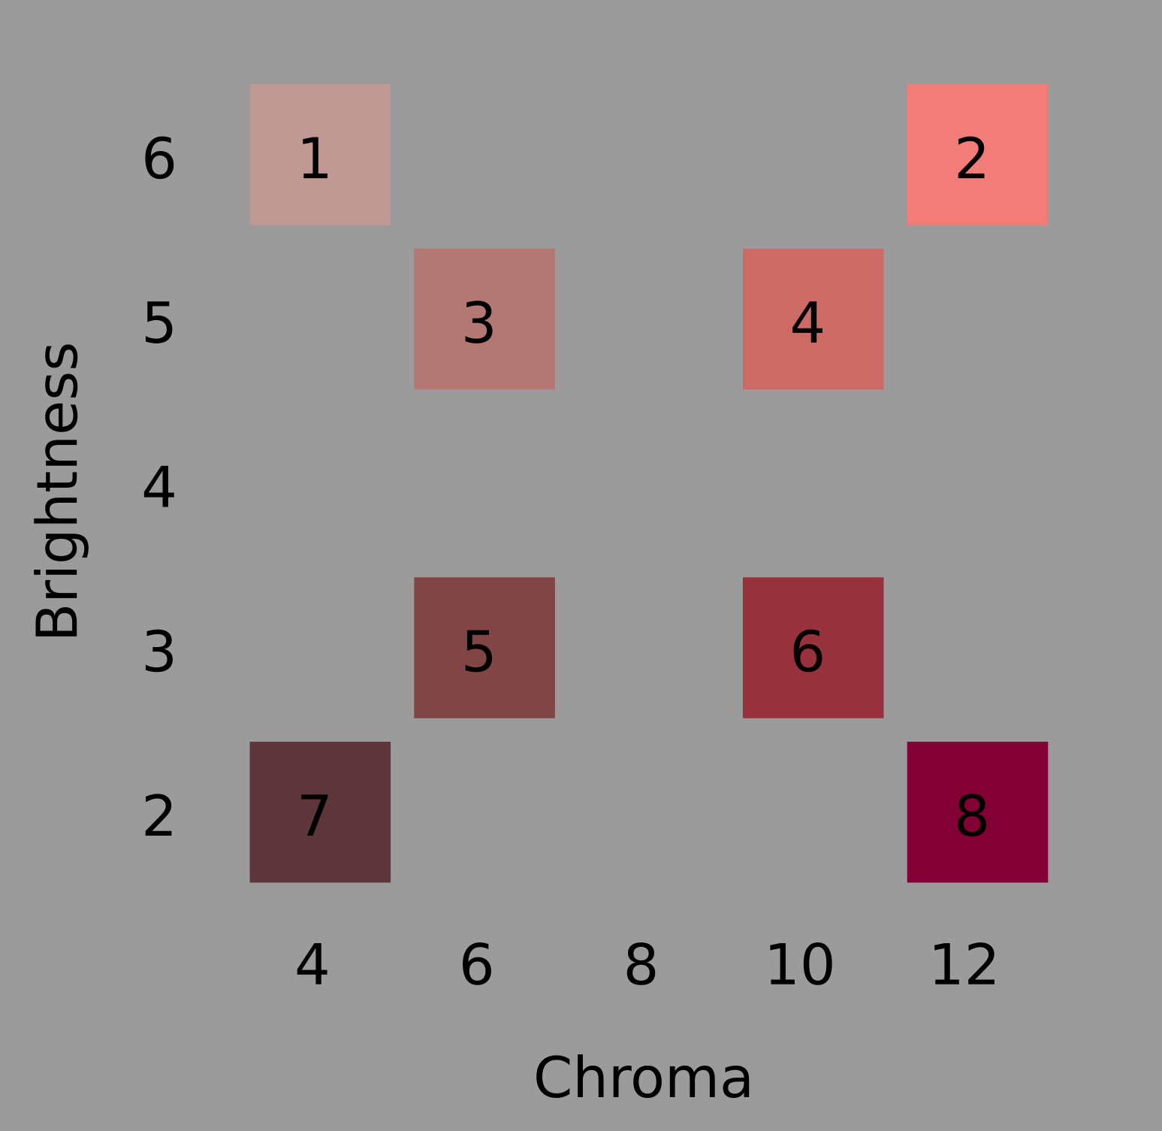

Slide 18
Overall similarity
Identity
Single dimension

Slide 19
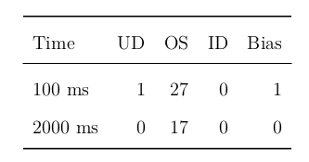
Results
BF₁₀ = 0.14

Slide 20
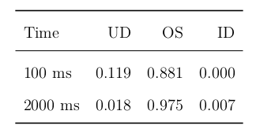
Exploratory analysis
BF₁₀ = 4.92

Slide 21
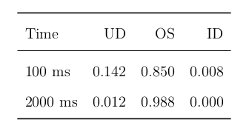
Direct replication
BF₁₀ = 1047

Slide 22
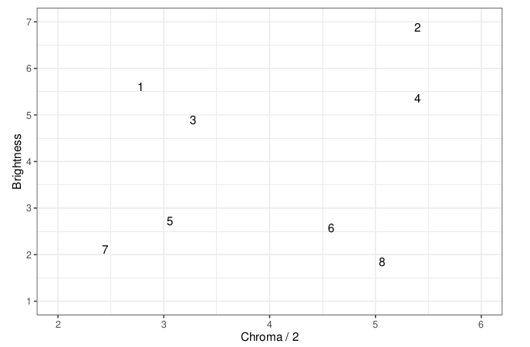
Multidimensional scaling

Slide 23
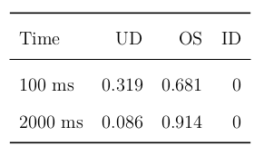
Final analysis
BF₁₀ = 892

Slide 24
Summary
Size
Differentiation Theory 👎
Brightness
“Unanalyzed whole”
Size
Combination Theory 👍
Brightness
“Synthesized whole”

Slide 25

Our cognitive chemists do not analyze mysterious compounds, they synthesize stimuli from their components.

Slide 26
Questions?

