Slide 1
PSYC003: Psychological Influences on Health & Behaviour
Exercise & Physical Activity
School of Psychology, University of Plymouth
Dr Rob Heirene
April 2023
Notes:
https://www.mentimeter.com/app/presentation/altr8mkxrkmrcrsuuk954u2jxs71uapy/v597cedctrfp/edit

Slide 2
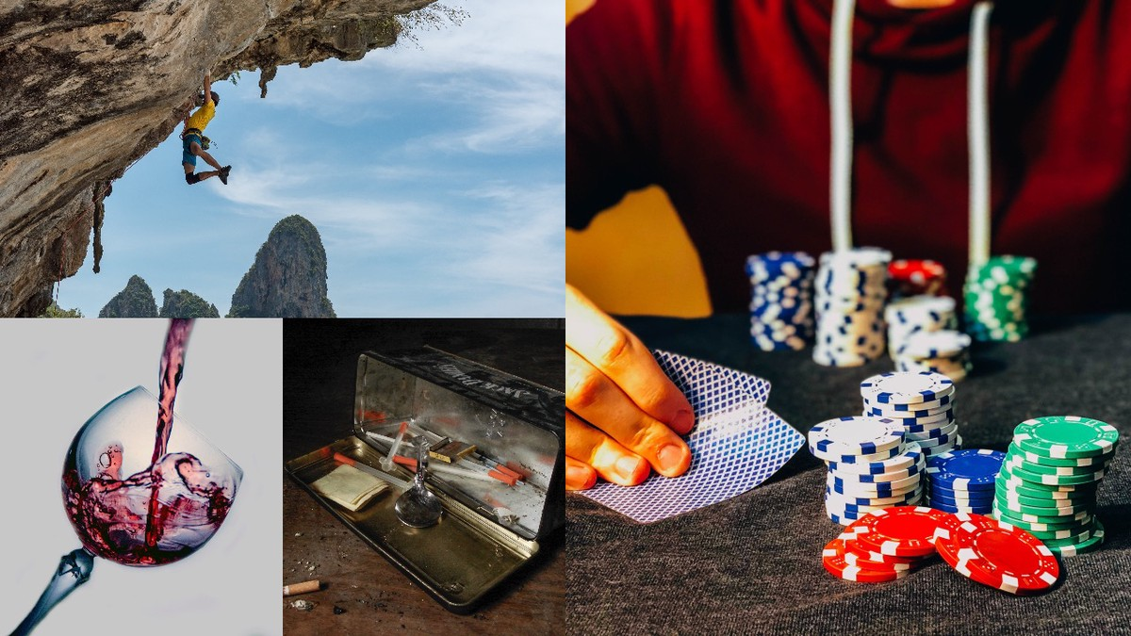
About me
Name: Dr Rob Heirene
Office: A210 Portland Square
Email: Rob.Heirene@Plymouth.ac.uk

Slide 3

Recap quiz: Stress & Coping
Interactive task
Please go to the following site & enter this number:
2497 0442
2-question MCQ on diet and weight management from our last lecture:
Login to Menti and add your answers
https://www.menti.com/

Slide 4

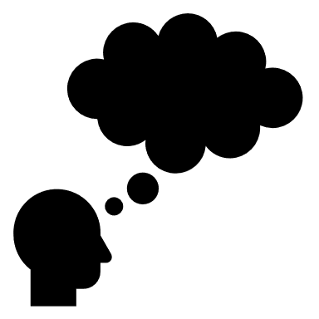


About today’s class
Block 1
Healthspan
Importance of physical activity
Levels of activity
Burden of disease caused by physical inactivity
Physical (in)activity and mental health
Why is exercise good for us?
Who is (not) exercising?
Interactive task: How much are we exercising?
~10-minute break
Block 2
How can we increase physical activity?
Why do people (not) exercise?
Interventions to improve activity levels
Physical activity as an intervention
Depression
Addiction
Activity: prescribing exercise?
~5-minute break

Slide 5
Block 1 Importance of physical activity

Slide 6
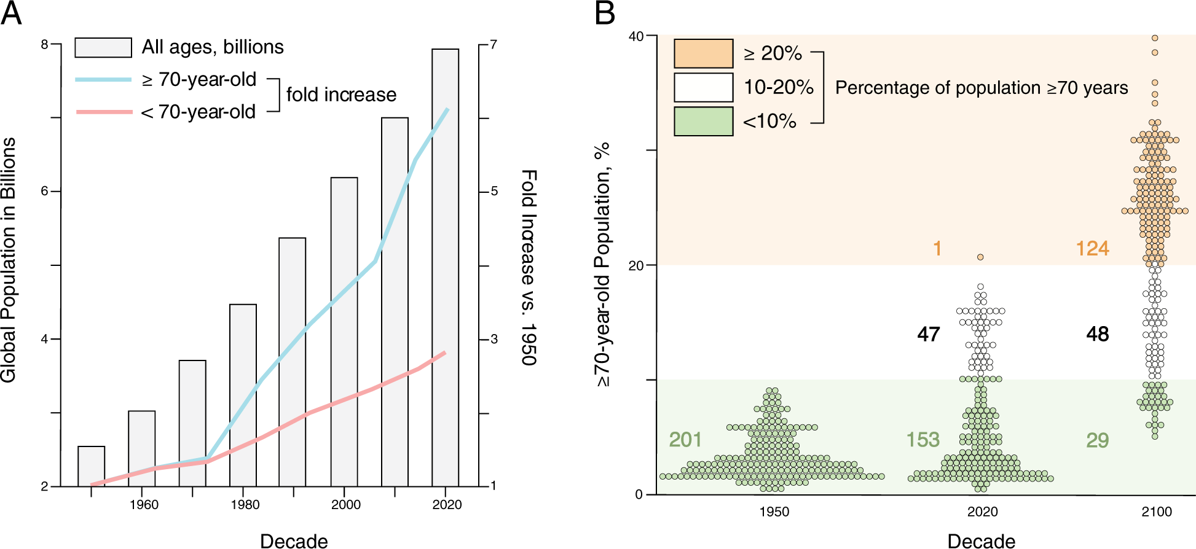
Healthspan
Garmany et al. (2021): Society is getting older
Notes:
PANEL A
Since 1950, the world’s population has increased from 2.9 billion to 7.8 in 2020.
On 15 November 2022, the world's population reached 8 billion people
Over that same period, average life expectancy has increased from 47 to 73 years of age -- a 26 year expansion in seven decades!
- Largely attributable to reductions in childhood disease and death
Hailed as one of humanity’s greatest achievements, although is starting to level off
PANEL B
This has led to an increasing proportion of the population being older.
In 1950, less than 10% of all countries populations were above the age 70,
By 2020, in 47 countries people over the age of 70 that made up between 10 and 20%of the total population and in one country, more than 20% of the population is over 70.
This is projected to substantially increase by 2100.

Slide 7
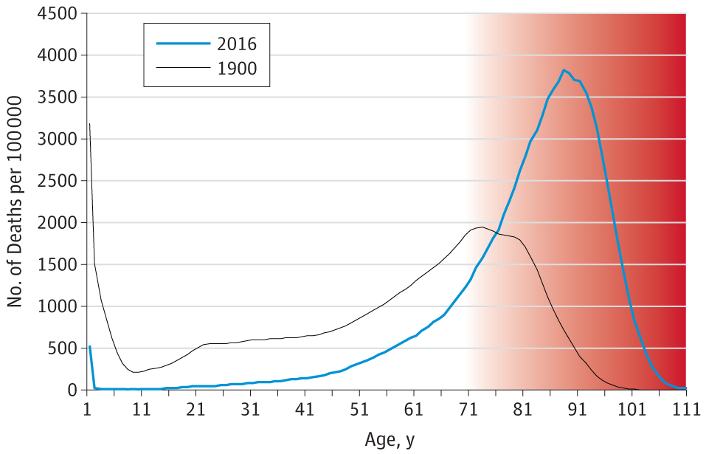
Healthspan
Olshansky (2018): Substantial increases in maximum lifespan are now unlikely:
“The inescapable conclusion from these observations is that life extension should no longer be the primary goal of medicine when applied to people older than 65 years of age. The principal outcome and most important metric of success should be the extension of healthspan.”
Notes:
The problem with this ageing population is that after a certain age we reach the red-zone:
The red zone represents a period in life are the risk of frailty and disability begins to increase rapidly
We are living for longer in this zone
Olshansky has argued that the gains in combating diseases and preventing childhood
mortality have increased our lifespan to the point where we’re unlikely to make any more substantial gains in the average number of years lived and so we should be less focused on making people live longer.
Instead… (next page)
----
Figure. Age Distribution of Life Table Deaths for Women in the United States, per 100 000 People, 1900 and 2016

Slide 8
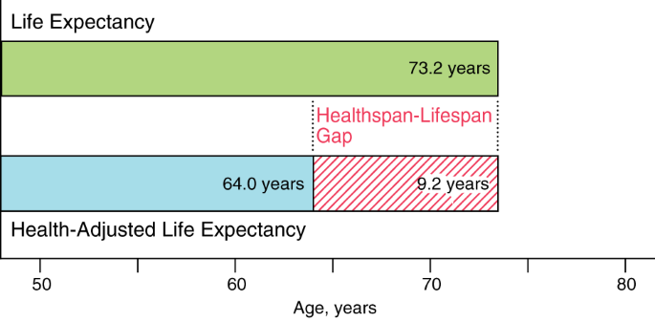
Healthspan
Lifespan: the total life lived
Health span: the period of life free from disease
Garmany et al. (2021)
Notes:
We should be focused on increasing the number of years people spend in their life healthy and free from the disease.
This is what is referred to as health span.
It’s currently estimated that, on average, the gap between lifespan and health span is 9.2 years, as around 63/64 is when the onset of many major diseases starts to occur, on average.
This red shaded area is where people start to be plagued by heart disease, cancers, strokes, dementias, and diabetes.
So, basically we need to change the goalposts and think less about just extending people’s number of absolute years, and more about extending the number of years they spend living healthily.
---
https://publichealth.wustl.edu/heatlhspan-is-more-important-than-lifespan-so-why-dont-more-people-know-about-it/

Slide 9
Healthspan
Garmany et al. (2021):
“addressing modifiable risk factors, namely excess weight, physical inactivity, smoking, and poor diet, would prevent 80% of deaths from non-communicable diseases, corresponding to 57% of all deaths”
Citing Choksi & Farley (2014) [Citation error?!?!]
Health risk behaviours: Behaviours that are thought to be damaging to our health
Also referred to as “behavioural pathogens”
Health protective behaviours: Behaviours that benefit our health and protect against illness
Also referred to as “behavioural immunogens”
Notes:
This is what brings us to today’s topic. How can we live a healthier life with the limited number of years that we’re currently restricted too.
As we learnt in our last lecture, whilst we can be genetically more or less at risk of certain diseases, our health is very much a product of our lifestyle and our day-to-day behaviours!
We can behave in ways that place our health at risk: health risk behaviours
Or in ways that are protective of our health: health protective behaviours
Quote: searched the article cited and I couldn’t find this 57% figure anywhere!
- Use as an example warning to students not to blindly trust the literature

Slide 10
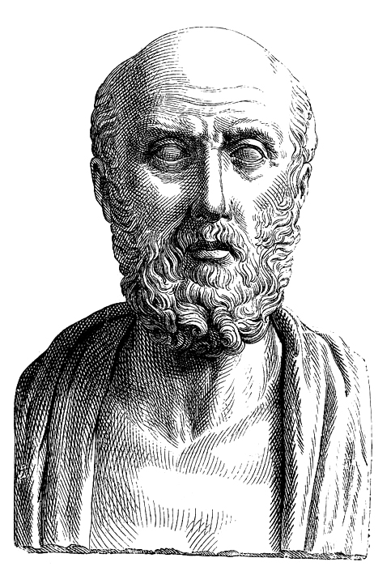
Importance of physical activity
Tipton (2014)
2007: American College of Sports Medicine:
Exercise Is Medicine: We should promote exercise to prevent, reduce, manage or treat diseases that impact health and the quality of life in humans
Hippocrates (460-370 BC):
I say then, that this question [regimen] is a most excellent one and allied to many others, some of the most vital importance in the art [medicine], for that it can contribute much to the recovery of the sick, and to the preservation of health in case of those gymnastic[athletic] exercises, and is useful to whatever one wish to apply it.
“what is old is new again.”
Source: Wiki
Notes:
The importance of exercise for health has been really pushed over the last twenty years, often under the phrase: EIM
“Ancient physicians—including those from China in 2600 BC and Hippocrates around 400 BC—believed in the value of physical activity for health. By the twentieth century, however, a diametrically opposite view—that exercise was dangerous—prevailed instead. During the early twentieth century, complete bed rest was prescribed for patients with acute myocardial infarction”
https://www.ncbi.nlm.nih.gov/pmc/articles/PMC3645500/pdf/nihms385288.pdf

Slide 11
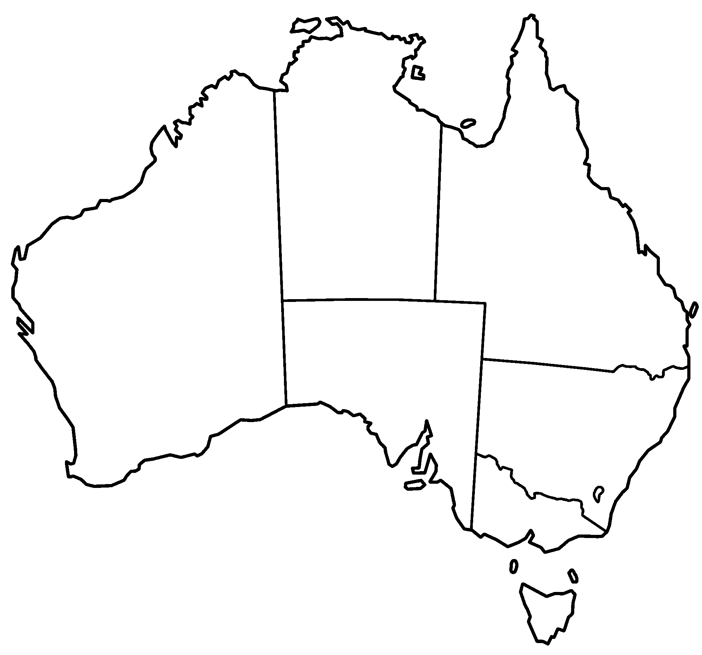
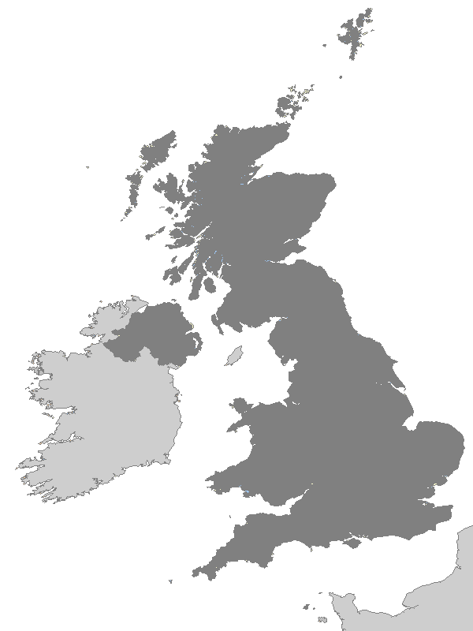
Importance of physical activity
Levels of activity
Australia
Each week, adults should do either:
2.5 to 5 hours of moderate intensity physical activity – such as a brisk walk, golf, mowing the lawn or swimming
1.25 to 2.5 hours of vigorous intensity physical activity – such as jogging, aerobics, fast cycling, soccer or netball
an equivalent combination of moderate and vigorous activities.
Include muscle-strengthening activities as part of your daily physical activity on at least 2 days each week.
United Kingdom
Each week, adults should do:
at least 150 minutes moderate intensity activity, 75 minutes’ vigorous activity, or a mixture of both
strengthening activities on two days
reduce extended periods of sitting
Children?
Sedentary behaviour: Being inactive, either sitting or lying down for long periods (strongly tied to screen-time in modern life)
Physical inactivity: Not meeting physical activity guidelines
Notes:
How much should we be doing?
Australian government recommends for adults aged 18 to 65 that people are active most days but preferably every day
CHILDREN: in Australia, it is recommended that children aged 5 to 17 do at least 60 minutes of moderate vigorous physical activity each day! And strengthening exercises at least three times a week, but that includes things like swinging on monkey bars and climbing.
- It’s also recommended that they have less than two hours of sedentary recreational screen time per day, other than that for schoolwork.
For younger children, it seems a bit more difficult to provide concrete recommendations for exercise durations, but the government seems to just simply recommend they are very active throughout the day and include some more intense exercise for children aged 3 to 5 (running, playing active games, skipping etc.)
Overall, there’s a reason these guidelines are the same – these are globally recommended standards by the WHO

Slide 12
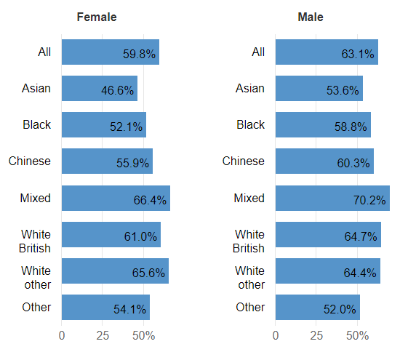
Importance of physical activity
Levels of activity
How active are the British?
UK government report: Physical activity (2022)
Data from November 2022 November 2021:
61.4% of people aged 16 or over are physically active
38.6% physically inactive
Children: UK Gov Physical activity tool data (2020/21):
47.2% of people aged under 16 physically active
70.1% of 15-year-olds with a mean daily sedentary time of more than seven hours!
Notes:
Figure on the right shows the number of people aged 16 years and over classed as physically active (i.e., active for more than 150 minutes per week)
UK adult figures -- these are actually better than Australia, where it’s estimated that less than 50% of adults are physically active.

Slide 13

Importance of physical activity
Levels of activity
Clayton & Clayton (2022):
50% of UK adults know look at screens for 11 hours or more a day
Hedderson et al. (2023):
In young children aged 4-12 years, pre-pandemic screen time was 4.4 hours per day (average)
This increased to 6.15 hours per day during the first lockdown (average).
Higher screen time levels have remained since public health precautions were lifted.
Notes:
Physical inactivity a particular concern now due to high screen use combined with the pandemic.
Clayton & Clayton provide a short policy document that raises the alarm about UK adults’ use of screen time, discussing research that shows a steep rise during and post-covid and that many people think it’s having a negative impact on their health
Hedderson study done in the US

Slide 14

Importance of physical activity
Burden of disease caused by physical activity
Why does it matter whether we’re active?
Leet et al. (2012):
6-10% of noncommunicable diseases can be attributed to physical inactivity
Responsible for 9% of premature mortality (5.3 million deaths in 2008)
Average lifespan gain of 0.7 years if activity levels achieved (2-4 years?)
Katzmarzyk et al. (2022):
8% of noncommunicable diseases attributable to physical inactivity
What about the economic cost of inactivity (Ding et al., 2016)?
53.8 billion in healthcare costs (31.2 paid for by the public sector) in 2013 alone
13.7 billion in productivity losses
13.4 million DALYs
Notes:
Lee et al.: Used data from the World Health Organisation collected in 2008 (latest available)
Noncommunicable diseases included this coronary heart disease, type 2 diabetes, and breast and colon cancers
They also estimated that if everyone was to meet physical activity guidelines then the average increase in life would be 0.7 years
This doesn’t seem much, but when you consider that this is an average across all people, including those already active, it is quite a substantial gain
The findings of other studies focused on just those who are inactive led the authors to conclude that for those who are inactive the expected gain in life expectancy would be closer to 2 to 4 years
They concluded that inactivity is comparable to smoking and obesity as a risk factor for disease and death
Katzmarzyk et al. (2022): more recent data from the same team
Data from 1.9 million people across 168 countries
“to contextualise our results, the 7% global PAR for all-cause mortality associated with physical inactivity compares with an estimated global PAR of 8.7% for global tobacco use,¹⁷ 1.2% for global sugar-sweetened beverage consumption,¹⁸ 10% in women and 11% in men for obesity in Europe¹⁹ and between 3% and 15% for obesity in the USA.”
Economic cost: Direct health-care costs and DALYs were estimated ONLY coronary heart disease, stroke, type 2 diabetes, breast cancer, and colon cancer attributable to physical inactivity
They state that these are highly likely to be conservative estimates
Paradoxically, high-income countries were found to bear a larger proportion of economic burden (80·8% of health-care costs and 60·4% of indirect costs), whereas low-income and middle-income countries have a larger proportion of the disease burden (75·0% of DALYs).
Underestimate: One study puts the Aus costs at 80billion! Need to confirm whether annual or total over a period

Slide 15
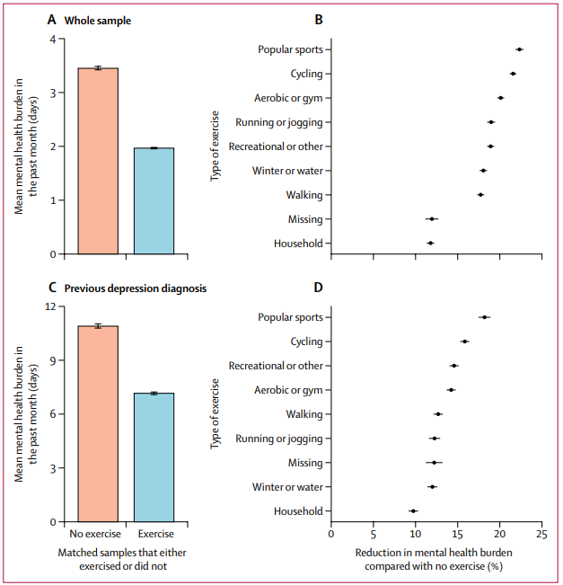
Importance of physical activity
Physical (in)activity & mental health
What about our mental health?
Chekroud et al. (2018): People who were physically active had a 43% reduction in the number of poor mental health days in the last month
Higher physical activity during the first year of the Covid 19 pandemic associated with higher self-reported well-being, quality-of-life, and lower symptoms of anxiety, depression, and stress (Marconcin et al., 2022)
Physical activity and happiness (Zhang & Chen, 2019):
Observational studies show consistent association between exercise levels and happiness
RCTs indicate improved happiness following exercise
Checkroud et al (2018)
Notes:
Some key findings in this area – CAUSE AND EFFECT????
(Chekroud et al., 2018)
In this cross-sectional study, we analysed data from 1,237,194 people aged 18 years or older
in the USA from the 2011, 2013, and 2015 Centers for Disease Control and Prevention Behavioral Risk Factors Surveillance System survey.
We compared the number of days of bad self-reported mental health between individuals who exercised and those who did not,
balancing the two groups in terms of age, race, gender, marital status, income, education level, body-mass index category, self-reported physical health, and previous diagnosis of depression
Individuals who exercised had 1·49 (43·2%) fewer days of poor mental health in the past month than individuals who did not exercise but were otherwise matched
All types of exercise are associated with a lower mental health burden, with the largest seem for popular team sports, cycling, aerobic, and gym activities
Large associations were also seen with exercise duration is a 45 minutes and frequencies 3 to 5 times per week
(Marconcin et al., 2022)
Systematic review of 31 studies from five continents
Concluded that its physical activity appeared to mitigate the effects of the stay-at-home orders on mental health
(Zhang & Chen, 2019)
Systematic review of 15 observational studies and six RCTs
All the observational studies reported positive associations between physical activity and happiness.
As little as 10-min physical activity per week or 1 day of doing exercise per week might result in increased levels of happiness.
Mediation effects were examined in two studies indicating the positive relationship between physical activity and happiness might be mediated by health and social functioning.
The randomized controlled trials mostly focused on older adults and cancer survivors, and suggested that both aerobic exercise and stretching/balancing exercise were effective in improving happiness.
The authors do, however, suggest caution as there are a limited number of high quality randomized controlled trials.

Slide 16
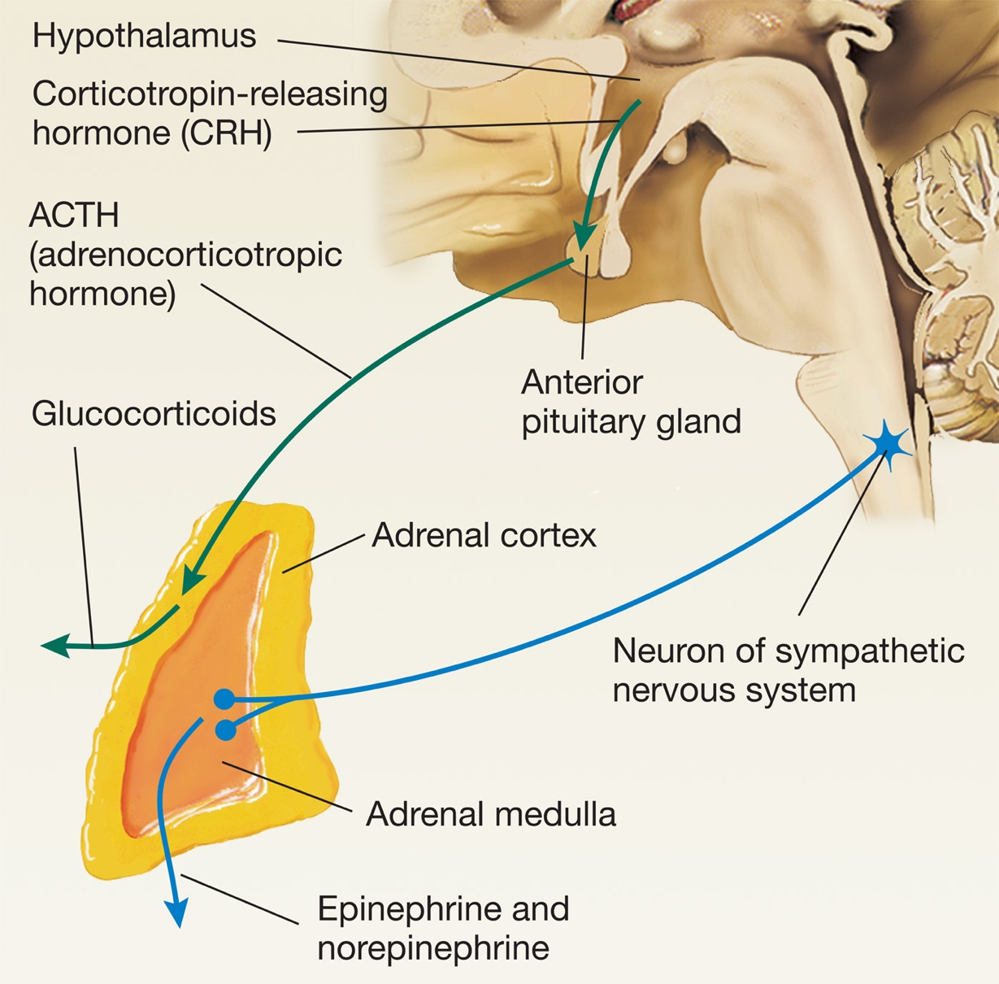
Importance of physical activity
Why is exercise good for us?
Physical health
(Morrison et al., pg. 116; Warburton et al., 2006)
Strengthens heart muscles
Increased cardiac & respiratory efficiency
Improved endothelial function
Lowered blood pressure
Reduced visceral & sub-cutaneous fat
Reduced inflammation
Increased bone density (Hong & Kim, 2018)
Increased strength & balance
Mental health
Increased catecholamines (Kruk et al., 2020)
Dopamine release (Basso et al., 2017)
Beta-endorphin release (Basso et al., 2017)
Increased neurogenesis in the hippocampus (Schoenfeld & Swanson, 2021)
Dampens stress response (Caplin et al., 2021)
Improved body satisfaction (Fuller-Tyszkiewicz et al., 2013; LePage, & Crowther, 2010)
Notes:
Lifting weights is thought to be particularly beneficial for bone density
Endothelial function
The endothelium is a thin membrane that lines the inside of the heart and blood vessels. Endothelial cells release substances that control vascular relaxation and contraction as well as enzymes that control blood clotting, immune function and platelet adhesion.
Inflammation: Recent RCTs have shown that exercise training may cause marked reductions in C-reactive protein levels (involved in mediating the inflammatory response).
Increase strength and balance reduces incidence of falls and injuries. More than 37 millions falls each year needing medical attention in those over 60, resulting in 17 million DALYs! (https://www.ncbi.nlm.nih.gov/pmc/articles/PMC8646839/#:~:text=Globally%2C%20approximately%20684%20000%20people,income%20and%20middle%2Dincome%20countries.&text=Worldwide%20every%20year%2C%2037%C2%B73,life%2Dyears%20(DALYs).)
- 648,000 die from falls
Each of these factors may explain directly or indirectly the reduced incidence of chronic disease and premature death among people who engage in routine physical activity.
Catecholamines (adrenaline and noradrenaline)
Exercise induces increased catecholamine concentrations
Adrenaline and noradrenaline are the main hormones whose levels increase substantially during exercise
Management of physiological response
Increased energy
Dopamine release – thought to be involved in motivating further physically active behaviour
Beta endorphins thought to play a role in hippocampal neurogenesis
Neurotransmitter and hormone
Endogenous opioid that binds to the same receptors as opioid drugs
Analgesics – reduced pain
Inhibits pain during acute stress
Interacts with dopamine and be involved in reward processes
Moderates stress response
Many of the cognitive benefits of physical activity have been associated with increased hippocampal neurogenesis
- Hippocampus is one of only two broad areas of the brain that continue to produce new neuronal cells in adulthood (the other is 2 areas related to smell)
Caplin, A., Chen, F. S., Beauchamp, M. R. & Puterman, E. (2021):
Eighty-three healthy men were randomly assigned to exercise on a treadmill at either 30%, 50% or 70% of their heart rate reserve (HRR) for 30 min and then underwent the Trier Social Stress Test 45 min later.
Salivary cortisol was measured repeatedly throughout and following the exercise bout and stressor task.
Trier Social Stress test: involves telling somebody suddenly that they had five minutes to prepare for a job interview that will last five minutes long and be in front of three judges who are instructed to maintain a very blank, indifferent presentation. After the presentation they have to count backwards, typically in bouts of 13 from 1022
When following vigorous exercise, HPA reactivity to a stressor is dampened compared to when following moderate/light activity.
When following moderate exercise, HPA reactivity to a stressor is dampened compared to when following light activity.
Improved body satisfaction: Yes, but people who are motivated by weight and appearance may experience less of the positive impact on body satisfaction after exercise compared to people focused on fitness.
A lot of individual differences in determining the impact on body size selection
OVERALL POINT: As with most things, there is a limit to the amount of exercise which is associated with positive changes in physical or mental health. There is a mostly linear relationship up to a point when diminishing returns are observed and even impaired health can occur.

Slide 17
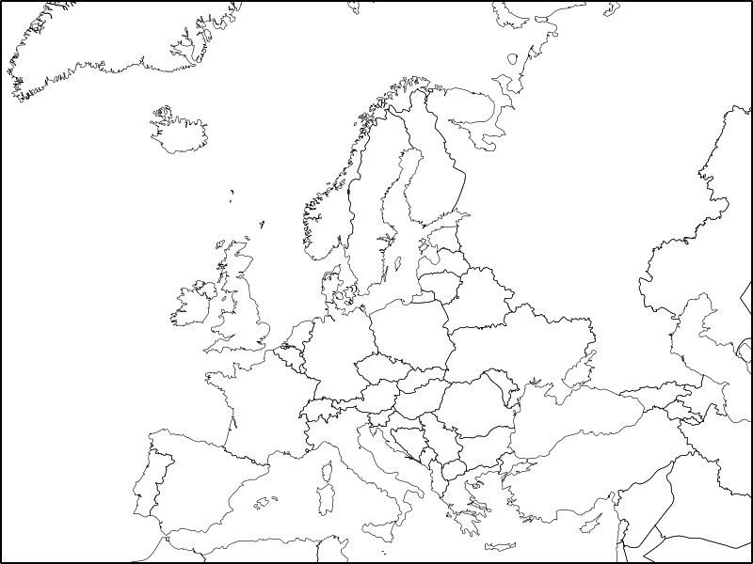
Importance of physical activity
Who is (not) exercising?
Correlates of physical activity: Can you guess the direction of effects?
Sex/gender
Age
Life satisfaction
Socio-economic status
Physical activity levels appear to be higher in (Nikitara et al., 2021):
Men
Younger people
Higher life satisfaction
Higher socio-economic status
Notes:
Nikitara, et al., 2021: study of over 1000 respondents from 28 different European countries in 2017.
Focused on people aged 18 to 64 years
Found one in three were physically inactive, with substantial cross-country differences
Most studies find men are more physically active typically across the board, although the gap between men and women decreases in more developed and wealthy countries where there are more opportunities for them to engage in physical activity
Life satisfaction: this relationship seems to be bidirectional. Inadequate physical activities associated with low-life satisfaction; they both influence each other, potentially
Interestingly, they found physical activity was highest in northern European countries like Sweden, Germany, the Netherlands, Estonia
And it was lowest in southern countries like Malta, Italy, Portugal and Cyprus

Slide 18
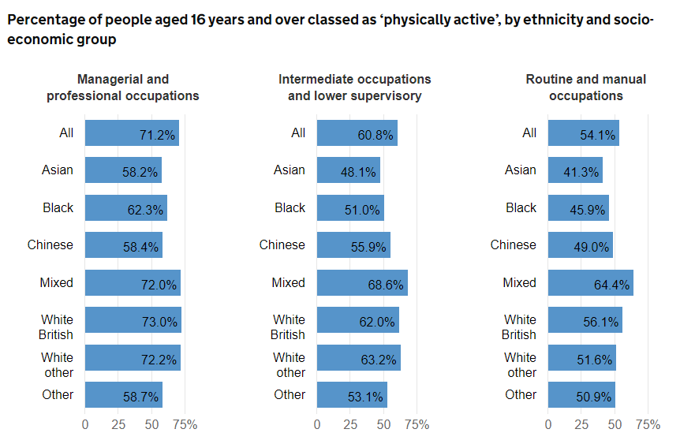
Importance of physical activity
Who is (not) exercising?
Notes:
https://www.ethnicity-facts-figures.service.gov.uk/health/diet-and-exercise/physical-activity/latest
Numbers were substantially lower for those unemployed and were in between the top two social economic groups for students or those unclassified.

Slide 19
Importance of physical activity
Interactive task
Please go to the following site & enter this number:
2497 0442
How much did you exercise last week?
Login to Menti and respond to each question
Class discussion
What’s stopping you from exercising more frequently?
Go back to Menti and jot down your thoughts
Class discussion
https://www.menti.com/

Slide 20
Block 2 How can we increase physical activity?

Slide 21

How can we increase physical activity?
Why do people (not) exercise?
Personally, I exercise (or might exercise)….
To stay slim
To avoid ill health
Because it makes me feel good
To help me look younger
To show my worth to others
To give me space to think
To have a healthy body
To build up my strength
Because I enjoy the feeling of exerting myself
To spend time with friends
Because my doctor advised me to exercise
Because I like trying to win in physical activities
This day/become more agile
To give me goals to work towards
To lose weight
To prevent health problems
Because I find exercise invigorating
To have a good body
To compare my abilities with other peoples’
Because it helps to reduce tension
Exercise motivation inventory-2 (EMI-2; Markland & Ingledew, 1997):
Stress management
Revitalisation
Enjoyment
Challenge
Social recognition
Affiliation
Competition
Health pressures
Ill-health avoidance
Positive health
Weight management
Appearance
Strength & endurance
Nimbleness
Notes:
If we want to know how to increase people’s activity levels, the first thing we need to know is why people bother to exercising in the first place
Most of the studies in this domain tend to be older, with more recent studies focusing on very specific populations like those with early psychosis or multiple sclerosis
A good starting point for reasons why people exercise is to look at scale that measure motivations:
Original exercise motivations inventory developed in 1993 with 44 items
This version potentially excluded people who weren’t exercising at the time and failed to account for obvious fitness reasons for exercising (strength, endurance et cetera)
Revised in 1997 and now has 51 items!
Just taken a snapshot of the first 20 here to show you how these are assessed
People are asked to rate their agreement with each of these statements along a Likert scale from 0 (not at all true for me) to 5 (very true for me)

Slide 22
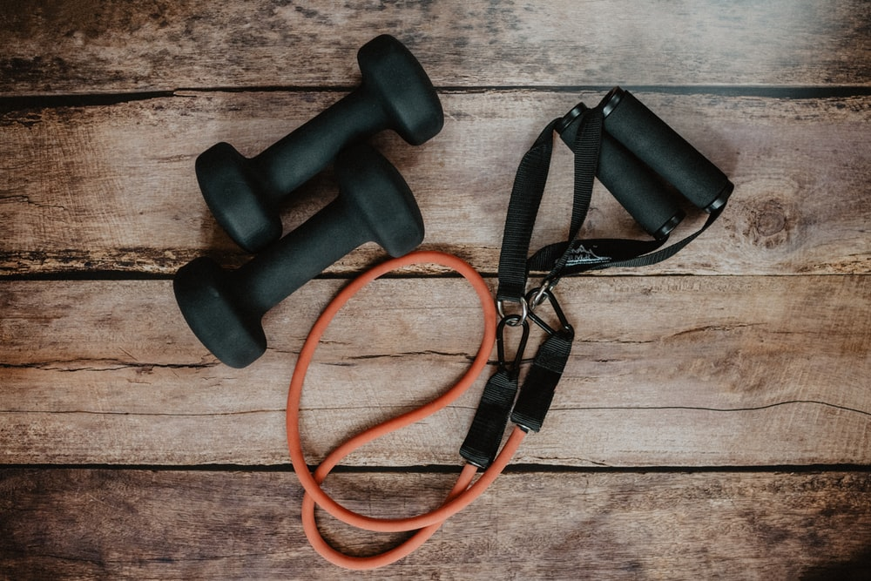
How can we increase physical activity?
Why do people (not) exercise?
Commonly reported barriers to exercise (Baxter et al., 2015; Gómez-López Et al., 2010; Lovell et al., 2010; Johs et al., 2019):
Lack of time
Physical exertion
Not seeing its practicality or usefulness
Lacking confidence in the activity (self-efficacy)
Lack of social support
Work or study related stress
Fear of safety (population specific)
Health-related challenges (population specific)
Notes:
Next, we probably want to know why people are not exercising in the first place
Again, of the studies in this domain tend to be older, with more recent studies focusing on very specific populations like people with rheumatoid arthritis or recovering from strokes
People with rheumatoid arthritis it was found that people had a general fear of the unknown including the safety level of the exercise type, and a fear of their safety while exercise (Baxter et al., 2016)
In men with HIV, their physical health was said to be a barrier to exercise

Slide 23

How can we increase physical activity?
Why do people (not) exercise?
Cultural differences: Perceived barriers among regional indigenous Australians (Sushames et al., 2017):
Sorry business
Transport
Having to travel away from community
Lack of community infrastructure
Personal & societal factors affecting exercise levels (Bauman et al., 2012):
Self-efficacy
Perceived behavioural control
Perceived access to recreation facilities
Density of exercise facilities
Policy that facilitates exercise
Individual factors
Ecological factors
Notes:
Sushames et al. (2017) interviewed 12 rural and 22 regional indigenous Australians
Sorry business – term used by indigenous Australians the refers to a time of mourning in the community, following the death of the person. Can take an extended period of time
Having to leave the community; indigenous populations tend to be more mobile as they need to leave their homes to access medical services or for cultural obligations like attending funerals; or even to find employment in larger, more urban areas
Bauman – large review study
Policy like that in the Netherlands that facilitates cycling as a mode of transport was positively associated with physical activity level
“Research into correlates (factors associated with activity) or determinants (those with a causal relationship) has burgeoned in the past two decades, but has mostly focused on individual-level factors in high-income countries. It has shown that age, sex, health status, self-efficacy, and motivation are associated with physical activity. Ecological models take a broad view of health behaviour causation, with the social and physical environment included as contributors to physical inactivity, particularly those outside the health sector, such as urban planning, transportation systems, and parks and trails.”

Slide 24
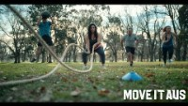
How can we increase physical activity?
Interventions to improve activity levels
Mass media campaigns: Are they effective?
Abioye et al. (2013):
Improved walking levels
Reduce sedentary behaviour
Achieve recommended levels of physical activity
Notes:
Move it Aus was a campaign released in 2018/2019 that involved a number of different advertisements promoting physical activity levels
- No real evidence on the effect of the campaign adverts, but they were combined with funding grants to develop community schemes to promote physical activity and sport and they seem to have shown some efficacy based on surveys and focus groups (chrome-extension://efaidnbmnnnibpcajpcglclefindmkaj/https://www.clearinghouseforsport.gov.au/__data/assets/pdf_file/0004/1042339/Move-It-AUS-Participation-grants-evaluation-executive-summary-1.pdf)
Systematic review of nine prospective studies that followed people before, during and after mass media campaigns aimed to increase physical activity levels
studies followed-up 27,601 people over 8 weeks to 3 years
Some of the interventions appeared to increase levels of walking quite substantially, but none led to participants achieving the recommended levels of physical activity
- There was only 1 study of questionable rigour that led to the view that these campaigns reduce sedentary behaviour, and removing this there was no effect.
Media campaigns based on social norms were more likely to lead to reduction in sedentary behaviour compared to those using celebrities or based on risk messaging
There is some evidence from other reviews that mass media campaigns can be more effective when they are linked to specific community programs that work in tandem to promote and facilitate exercise (Heath et al., 2012)

Slide 25
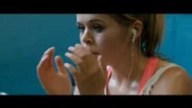
How can we increase physical activity?
Interventions to improve activity levels
This Girl Can (TGC) campaigns
(2015-2012)
Manifesto: “Woman come in all shapes and sizes and all levels of ability. It doesn’t matter if you’re rubbish or an expert. The brilliant thing is you’re a woman and you’re doing something”.
Huge increases in participation – why so effective?
Directly targeted perceived barriers to exercise!
Notes:
This girl can was a media campaign run by sport England starting in 2015 which has ran on and off all the way up to 2021
It was motivated by the gender gap in physical activity across the UK – despite overall increasing levels of physical activity, women were still persistently less active than men.
After studying the barriers women were experiencing to exercise, they noticed a common theme amongst many of them: the fear of judgement.
It’s unclear exactly how they measured success in their report, but it seems they did a survey and then extrapolated their findings.
Anyway, using this unclear methodology, the estimated 2.8 million women aged 14 to 40 were more active (e.g. tried a new type of exercise, or increased the amount of time spent exercising) as a result of seeing the campaign.
• Of those, 1.6 million started or restarted exercise (e.g. got back into exercise after a break) as a result of seeing the campaign.
- And of the 2.8 million,, 250,000 started being physically active or playing sport at least once per week regularly.
https://sportengland-production-files.s3.eu-west-2.amazonaws.com/s3fs-public/2022-05/TGC%20Campaign%20summary%202021_0.pdf?VersionId=8j5WaQWXjRZy95JkiyT8s_8efCG.8llF

Slide 26
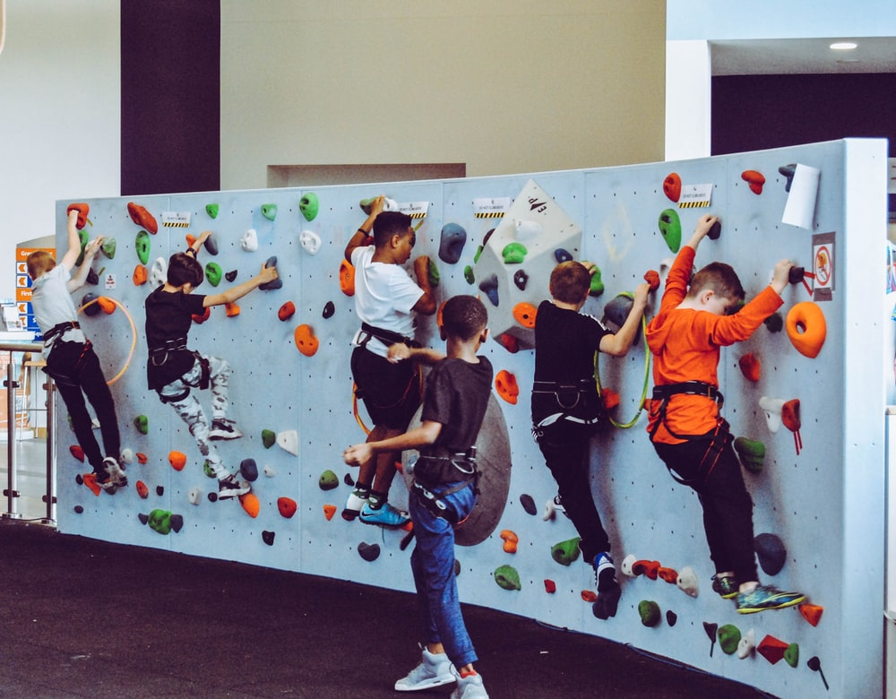
How can we increase physical activity?
Interventions to improve activity levels
Craike et al. (2018): Improving physical activity in disadvantaged groups
Preschool children
Parent focused family-based interventions in community settings
Intensive interventions with many contacts over a long period
High levels of parental engagement
Use of behaviour change techniques such as goal setting
Focus on skill building not just knowledge acquisition
Primary-school-aged children
School-based interventions
Embedded into school curriculum
Provide additional opportunities for physical activity
Embed school-based physical activity into policy
Notes:
An umbrella review of 17 systematic reviews looking at interventions for improving physical activity levels among socio-economically disadvantaged groups
Looked at what components of interventions appear to be effective at different age groups
PRESCHOOL;
Behaviour change techniques: goal setting; environmental restructuring; time management
Skills like actually teaching people how to exercise.
PRIMARY SCHOOL:
Strong evidence for the effectiveness of school-based interventions
School-based intervention is more likely to be effective when they are embedded into the curriculum, include enhancements to physical education like requiring students to undertake it as part of the schooling
Many countries have policies on physical activity in schools although evidence indicates that not all schools are meeting these recommendations
A recent study of Australian primary schools found 30% did not meet the mandated hours of planned physical activity each week

Slide 27
How can we increase physical activity?
Interventions to improve activity levels
Craike et al. (2018): Improving physical activity in disadvantaged groups
Adolescents
Limited evidence of intervention effectiveness
Recommendations to involve adolescents & family
Adults
Mixed evidence of effectiveness
Group based interventions
Focus on physical activity only
Issues with this literature
Poor reporting standards
Use of non-validated physical activity measures
High probability of selection bias
Low proportion of eligible participants agreeing to participate
High attrition rates
Lack of long-term follow-up
Notes:
Group based intervention is ineffective at improving excise levels among adolescents
Recommendations to involve adolescents in the development and delivery of interventions and involve family
Group based interventions seem to be effective for adults, although the overall evidence was poor and there was very few studies that measured long-term outcomes.
The social support provided in group settings is expected to at least partially explain their effectiveness
In general, they note that interventions that target multiple health behaviours tend to be less successful than single behaviour interventions
Individuals may find it hard to change multiple behaviours together
May be less focused on each individual behaviour
Although, there being few direct comparisons of individual versus multi-behaviour interventions within a single study. Instead, reviews have compared the overall effectiveness of individual studies of each type.
In general, the methodological quality of many of the studies, particularly among children and adolescent participants, is thought to be quite poor.
Poor reporting standards – insufficient description of interventions and outcomes
Use of non-validated physical activity measures – makes it difficult to compare across studies and know how useful the measure of physical activity is
High probability of selection bias
Low proportion of eligible participants agreeing to participate
High attrition rates
Lack of long-term follow-up - most never looked beyond six months

Slide 28
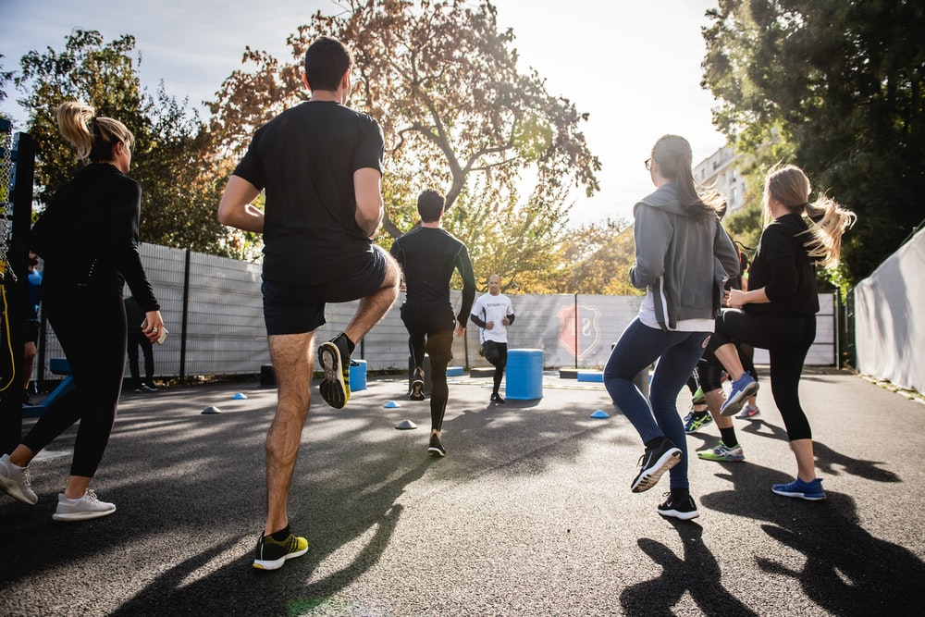
Physical activity as an intervention
Depression
Is exercise an effective intervention for depression?
Large scale meta-analyses indicate that exercise-based interventions have a beneficial effect on depressive symptoms across a wide age range (Hu et al., 2020)
Poor study quality may inflate effects (Krogh et al., 2017)
Bouldering/rock climbing as a treatment for depression?
Bouldering psychotherapy (BPT) shows initial promise (Luttenberger et al., 2015)
BPT effects last or 12 months (Schwarz et al., 2019)
BPT more effective than exercise alone (Karg et al., 2020)
Notes:
Hu et al., 2020:
Most studies focus on exercise after people experience depression but there is a smaller number that indicates that exercise actually prevents the onset of depression
Krogh, et al. (2017): the effects seem to be limited when studies or poor quality are removed indicating it may not be quite as effective as we initially thought.
Bouldering psychotherapy: combination of bouldering with psychotherapy.
Each session focuses on a specific subject like self-efficacy, anxiety, or trust
Usually the session starts with a mindfulness exercise then free bouldering and then ends again with a mindfulness exercise that sums up the acquired capabilities and how they could be useful for day-to-day life.
Luttenberger et al. (2015) – initial pilot with a small sample suggest that it has a very large effect on depression symptoms relative to a waitlist control.
Schwarz et al. (2019) – once a week over eight weeks compared to a waitlist control – effect maintained after 12 months
Karg, N., Dorscht, L., Kornhuber, J. & Luttenberger, K. (2020):
more recent randomised controlled trial compared a bouldering psychotherapy group with the home-based exercise program
Found the bouldering group significantly decreased their depression and anxiety, and improve their body image and self-esteem relative to the exercise only group.

Slide 29
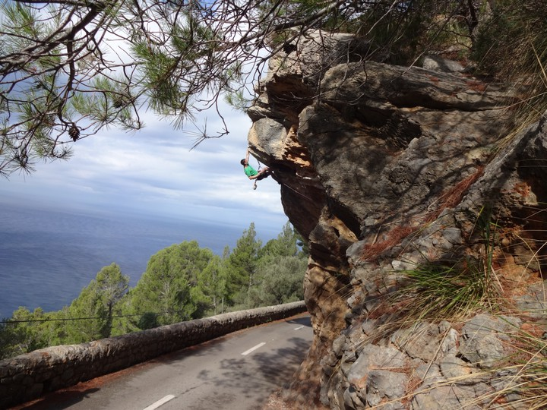
Physical activity as an intervention
Addiction
Can physical activity be used to help those with addictions?
Exercise can target many of the risk factors for relapse in those with SUDs (Weinstock et al., 2017)
Limited but promising evidence that exercise is a useful adjunct to SUD treatments (e.g., Brown et al., 2014)
Limited evidence that sport-based interventions can prevent excessive alcohol use (e.g., Werch et al., 2003)
Extreme Sports & Addiction(?)
Heirene et al. (2016): Could extreme sports act as a “substitute” for drug use?
Anaheim Lighthouse: sobriety and extreme sports
Notes:
Exercise can potentially improve comorbid psychiatric conditions ( e.g., depression) which are common in those with SUDs
Exercise also has a positive impact on risk factors related to relapse
It has been shown to reduce cravings for alcohol,
induces positive mood
Increase the ability to deal with stressful situations
There is some promising studies in this area but most have been small and had only a short-term follow up
Sport and addiction: The limited evidence in this area and mostly low quality studies.
Anaheim Lighthouse: they phrase it as putting the excitement in recovery
Replace the euphoric feeling of drug use of the different kind of rush!

Slide 30
Physical activity as an intervention
Interactive task
Please go to the following site & enter this number:
2497 0442
Should doctors prescribe physical activity?
Login to Menti and add your thoughts
Do some research – what does the scientific literature say about this strategy?
Class discussion
https://www.menti.com/
Notes:
Support:
Most people visit their GP every year
Prevents rather than responds
Will assist in improving all areas of mental health
Arguments against:
potentially can’t be universally applied
Some people don’t like it! (Does that matter?)
time barriers
physical barriers
Adherence issues
More nuanced: Yes, but in combination with policy factors that facilitate access to exercise/ sporting facilities

Slide 31
Next week: Alcohol & Addictive Behaviours

Slide 32
Credits & Sources
If an image in this slideshow does not have a link to the source posted below it, then I have either taken the picture myself or taken it from the site www.unsplash.com and clicking the image will take you to the original source on unsplash.

Slide 33
References
Abioye, A. I., Hajifathalian, K. & Danaei, G. (2013). Do mass media campaigns improve physical activity? a systematic review and meta-analysis. Archives of Public Health, 71(1), 20. https://doi.org/10.1186/0778-7367-71-20
Basso, J. C. & Suzuki, W. A. (2017). The Effects of Acute Exercise on Mood, Cognition, Neurophysiology, and Neurochemical Pathways: A Review. Brain Plasticity, 2(2), 127–152. https://doi.org/10.3233/bpl-160040
Bauman, A. E., Reis, R. S., Sallis, J. F., Wells, J. C., Loos, R. J., Martin, B. W. & Group, for the L. P. A. S. W. (2012). Correlates of physical activity: why are some people physically active and others not? The Lancet, 380(9838), 258–271. https://doi.org/10.1016/s0140-6736(12)60735-1
Baxter, S., Smith, C., Treharne, G., Stebbings, S. & Hale, L. (2015). What are the perceived barriers, facilitators and attitudes to exercise for women with rheumatoid arthritis? A qualitative study. Disability and Rehabilitation, 38(8), 773–780. https://doi.org/10.3109/09638288.2015.1061602
Braun, V. & Clarke, V. (2006). Using thematic analysis in psychology. Qualitative Research in Psychology, 3(2), 77–101. https://doi.org/10.1191/1478088706qp063oa
Brown, R. A., Abrantes, A. M., Minami, H., Read, J. P., Marcus, B. H., Jakicic, J. M., Strong, D. R., Dubreuil, M. E., Gordon, A. A., Ramsey, S. E., Kahler, C. W. & Stuart, G. L. (2014). A preliminary, randomized trial of aerobic exercise for alcohol dependence. Journal of Substance Abuse Treatment, 47(1), 1–9. https://doi.org/10.1016/j.jsat.2014.02.004
Caplin, A., Chen, F. S., Beauchamp, M. R. & Puterman, E. (2021). The effects of exercise intensity on the cortisol response to a subsequent acute psychosocial stressor. Psychoneuroendocrinology, 131, 105336. https://doi.org/10.1016/j.psyneuen.2021.105336

Slide 34
References
Chekroud, S. R., Gueorguieva, R., Zheutlin, A. B., Paulus, M., Krumholz, H. M., Krystal, J. H. & Chekroud, A. M. (2018). Association between physical exercise and mental health in 1·2 million individuals in the USA between 2011 and 2015: a cross-sectional study. The Lancet Psychiatry, 5(9), 739–746. https://doi.org/10.1016/s2215-0366(18)30227-x
Chokshi, D. A. & Farley, T. A. (2014). Changing behaviors to prevent noncommunicable diseases. Science 345, 1243-1244. DOI:10.1126/science.1259809
Clayton, R. & Clayton, C. (2022). UK Screen use in 2022: A need for guidance. University of Leeds. https://eprints.whiterose.ac.uk/184618/1/PolicyLeeds-Brief9_UK-screen-use-in-2022.pdf
Craike, M., Wiesner, G., Hilland, T. A. & Bengoechea, E. G. (2018). Interventions to improve physical activity among socioeconomically disadvantaged groups: an umbrella review. The International Journal of Behavioral Nutrition and Physical Activity, 15(1), 43. https://doi.org/10.1186/s12966-018-0676-2
Ding, D., Lawson, K. D., Kolbe-Alexander, T. L., Finkelstein, E. A., Katzmarzyk, P. T., Mechelen, W. van, Pratt, M. & Committee, L. P. A. S. 2 E. (2016). The economic burden of physical inactivity: a global analysis of major non-communicable diseases. The Lancet, 388(10051), 1311–1324. https://doi.org/10.1016/s0140-6736(16)30383-x
Fuller-Tyszkiewicz, M., Skouteris, H. & Mccabe, M. (2013). A re-examination of the benefits of exercise for state body satisfaction: Consideration of individual difference factors. Journal of Sports Sciences, 31(7), 706–713. https://doi.org/10.1080/02640414.2012.746723
Garmany, A., Yamada, S. & Terzic, A. Longevity leap: mind the healthspan gap. npj Regen Med. 6, 57 (2021). https://doi.org/10.1038/s41536-021-00169-5

Slide 35
References
Gómez-López, M., Gallegos, A. G. & Extremera, A. B. (2010). Perceived barriers by university students in the practice of physical activities. Journal of Sports Science & Medicine, 9(3), 374–381.
Hammarberg, K., Kirkman, M. & Lacey, S. de. (2016). Qualitative research methods: when to use them and how to judge them. Human Reproduction, 31(3), 498–501. https://doi.org/10.1093/humrep/dev334
Heath, G. W., Parra, D. C., Sarmiento, O. L., Andersen, L. B., Owen, N., Goenka, S., Montes, F., Brownson, R. C. & Group, for the L. P. A. S. W. (2012). Evidence-based intervention in physical activity: lessons from around the world. The Lancet, 380(9838), 272–281. https://doi.org/10.1016/s0140-6736(12)60816-2
Heirene, R. M., Shearer, D., Roderique-Davies, G. & Mellalieu, S. D. (2016). Addiction in Extreme Sports: An Exploration of Withdrawal States in Rock Climbers. Journal of Behavioral Addictions, 5(2), 332–341. https://doi.org/10.1556/2006.5.2016.039
Hong, A. R. & Kim, S. W. (2018). Effects of Resistance Exercise on Bone Health. Endocrinology and Metabolism, 33(4), 435–444. https://doi.org/10.3803/enm.2018.33.4.435
Hu, M. X., Turner, D., Generaal, E., Bos, D., Ikram, M. K., Ikram, M. A., Cuijpers, P. & Penninx, B. W. J. H. (2020). Exercise interventions for the prevention of depression: a systematic review of meta-analyses. BMC Public Health, 20(1), 1255. https://doi.org/10.1186/s12889-020-09323-y
Johs, N. A., Kellar-Guenther, Y., Jankowski, C. M., Neff, H. & Erlandson, K. M. (2019). A qualitative focus group study of perceived barriers and benefits to exercise by self-described exercise status among older adults living with HIV. BMJ Open, 9(3), e026294. https://doi.org/10.1136/bmjopen-2018-026294

Slide 36
References
Karg, N., Dorscht, L., Kornhuber, J. & Luttenberger, K. (2020). Bouldering psychotherapy is more effective in the treatment of depression than physical exercise alone: results of a multicentre randomised controlled intervention study. BMC Psychiatry, 20(1), 116. https://doi.org/10.1186/s12888-020-02518-y
Katzmarzyk, P. T., Friedenreich, C., Shiroma, E. J. & Lee, I.-M. (2022). Physical inactivity and non-communicable disease burden in low-income, middle-income and high-income countries. British Journal of Sports Medicine, 56(2), 101–106. https://doi.org/10.1136/bjsports-2020-103640
Krogh, J., Hjorthøj, C., Speyer, H., Gluud, C. & Nordentoft, M. (2017). Exercise for patients with major depression: a systematic review with meta-analysis and trial sequential analysis. BMJ Open, 7(9), e014820. https://doi.org/10.1136/bmjopen-2016-014820
Kruk, J., Kotarska, K. & Aboul-Enein, B. H. (2020). Physical exercise and catecholamines response: benefits and health risk: possible mechanisms. Free Radical Research, 54(2–3), 1–21. https://doi.org/10.1080/10715762.2020.1726343
LePage, M. L. & Crowther, J. H. (2010). The effects of exercise on body satisfaction and affect. Body Image, 7(2), 124–130. https://doi.org/10.1016/j.bodyim.2009.12.002
Lee, I.-M., Shiroma, E. J., Lobelo, F., Puska, P., Blair, S. N., Katzmarzyk, P. T. & Group, for the L. P. A. S. W. (2012). Effect of physical inactivity on major non-communicable diseases worldwide: an analysis of burden of disease and life expectancy. The Lancet, 380(9838), 219–229. https://doi.org/10.1016/s0140-6736(12)61031-9
Luttenberger, K., Stelzer, E.-M., Först, S., Schopper, M., Kornhuber, J. & Book, S. (2015). Indoor rock climbing (bouldering) as a new treatment for depression: study design of a waitlist-controlled randomized group pilot study and the first results. BMC Psychiatry, 15(1), 201. https://doi.org/10.1186/s12888-015-0585-8

Slide 37
References
Lovell, G. P., Ansari, W. E. & Parker, J. K. (2010). Perceived Exercise Benefits and Barriers of Non-Exercising Female University Students in the United Kingdom. International Journal of Environmental Research and Public Health, 7(3), 784–798. https://doi.org/10.3390/ijerph7030784
Marconcin, P., Werneck, A. O., Peralta, M., Ihle, A., Gouveia, É. R., Ferrari, G., Sarmento, H. & Marques, A. (2022). The association between physical activity and mental health during the first year of the COVID-19 pandemic: a systematic review. BMC Public Health, 22(1), 209. https://doi.org/10.1186/s12889-022-12590-6
Morrison, V., Bennett, P., Butow, P., Mullan, B., & Sharp, L. (2019). Introduction to Health Psychology in Australia, 3rd Edition. Pearson.
Nikitara, K., Odani, S., Demenagas, N., Rachiotis, G., Symvoulakis, E. & Vardavas, C. (2021). Prevalence and correlates of physical inactivity in adults across 28 European countries. European Journal of Public Health, 31(4), ckab067-. https://doi.org/10.1093/eurpub/ckab067
Olshansky SJ. From Lifespan to Healthspan. JAMA. 2018;320(13):1323–1324. doi:10.1001/jama.2018.12621
Schoenfeld, T. J. & Swanson, C. (2021). A Runner’s High for New Neurons? Potential Role for Endorphins in Exercise Effects on Adult Neurogenesis. Biomolecules, 11(8), 1077. https://doi.org/10.3390/biom11081077
Schwarz, L., Dorscht, L., Book, S., Stelzer, E.-M., Kornhuber, J. & Luttenberger, K. (2019). Long-term effects of bouldering psychotherapy on depression: benefits can be maintained across a 12-month follow-up. Heliyon, 5(12), e02929. https://doi.org/10.1016/j.heliyon.2019.e02929

Slide 38
References
Sushames, A., Engelberg, T. & Gebel, K. (2017). Perceived barriers and enablers to participation in a community-tailored physical activity program with Indigenous Australians in a regional and rural setting: a qualitative study. International Journal for Equity in Health, 16(1), 172. https://doi.org/10.1186/s12939-017-0664-1
Warburton, D. E. R., Nicol, C. W. & Bredin, S. S. D. (2006). Health benefits of physical activity: the evidence. Canadian Medical Association Journal, 174(6), 801–809. https://doi.org/10.1503/cmaj.051351
Weinstock, J., Farney, M. R., Elrod, N. M., Henderson, C. E. & Weiss, E. P. (2017). Exercise as an Adjunctive Treatment for Substance Use Disorders: Rationale and Intervention Description. Journal of Substance Abuse Treatment, 72, 40–47. https://doi.org/10.1016/j.jsat.2016.09.002
Werch, C. (Chad), Moore, M., DiClemente, C. C., Owen, D. M., Jobli, E. & Bledsoe, R. (2003). A Sport-Based Intervention for Preventing Alcohol Use and Promoting Physical Activity Among Adolescents. Journal of School Health, 73(10), 380–388. https://doi.org/10.1111/j.1746-1561.2003.tb04181.x
Zhang, Z. & Chen, W. (2019). A Systematic Review of the Relationship Between Physical Activity and Happiness. Journal of Happiness Studies, 20(4), 1305–1322. https://doi.org/10.1007/s10902-018-9976-0

