Slide 1

Psychometrics

Slide 2
The power of large samples
E.g. Sir Francis Galton’s “wisdom of the crowd”
https://www.youtube.com/watch?v=uz5AeHqUtRs

Slide 3
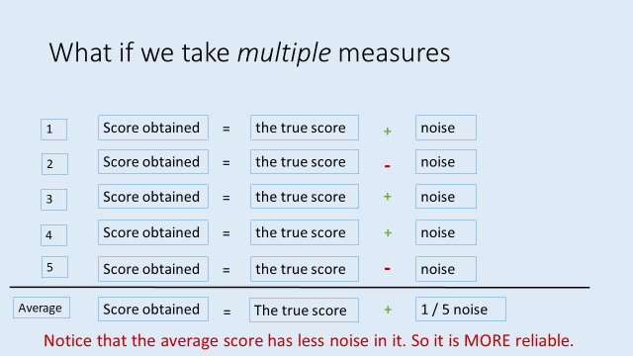
Wisdom of the (large) crowd
In the jelly bean example (or the original Cow example from Galton), the average is taken over a LARGE sample (160 in this case), and the result is a quite accurate average.
This implies that all people have some accuracy buried in lots of noise.
Averaging a crowd gets rid of the noise, and reveals the underlying estimate.

Slide 4
Wisdom of the (large) crowd
Another example comes from gambling / bookmaker’s odds.
One way of predict who will win a race (or an election) is to follow the money.
Each person might make a poor prediction, but the results of LOTS of bets can be quite accurate.
Bookmakers odds reflect where the money is placed.

Slide 5
Validity
Is the extent to which a measure, measures what it is supposed to.
i.e. that a thermometer measures temperature
that an extraversion test measures extraversion
that a spatial skill test measures spatial skill

Slide 6
Four kinds of validity (only 2 can be tested)
1: Face validity
Does the measure look right?
e.g. does a spatial skill measure have questions that test spatial ability rather than other kinds of ability.

Slide 7
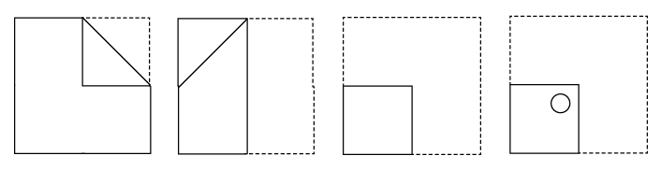
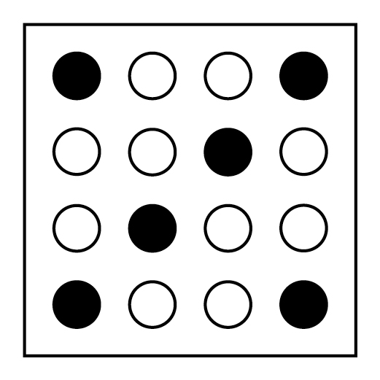
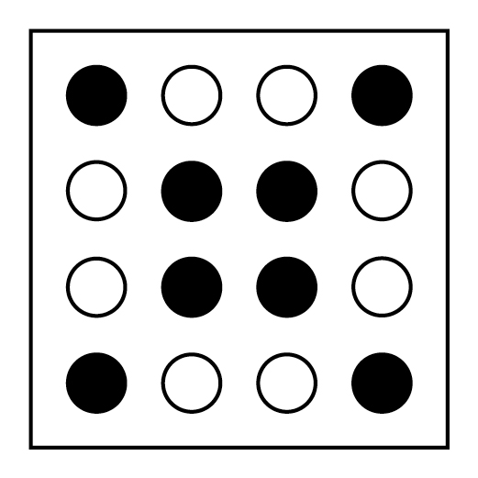
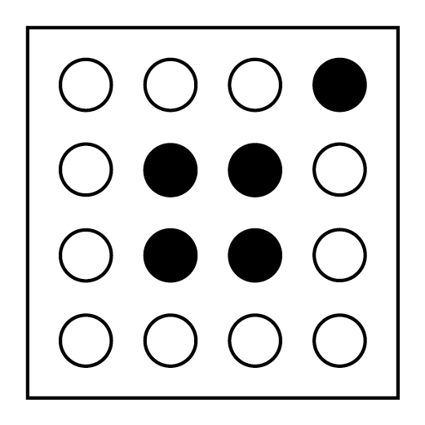
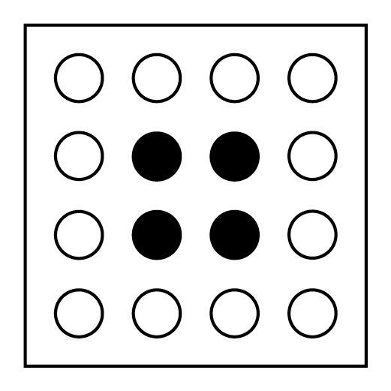
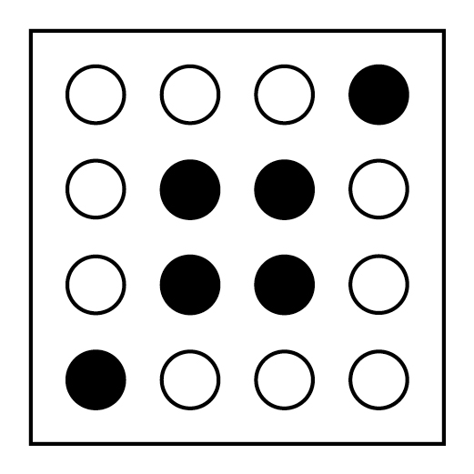
Imagine a paper is folded, then a hole punched through.
When unfolded, what will the pattern of holes look like (shaded dark below)

Slide 8
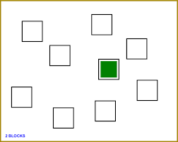
Four kinds of validity (only 2 can be tested)
2: Content validity
Does the measure sample all aspects of the construct?
e.g. for spatial skill, it might involve:
paper folding
mental rotation
spatial working memory capacity
remembering routes (etc)

Slide 9
Four kinds of validity (only 2 can be tested)
3: Predictive validity
Does the measure predict outcomes that are expected
e.g. a valid measure of spatial skill, should predict:
performance on other tests of spatial skill
differences between people we expect to vary in spatial skill (e.g. architects vs non-architects)

Slide 10
Four kinds of validity (only 2 can be tested)
4: Discriminant validity
Is the measure insensitive to factors that are unrelated to the construct being measured.
e.g. a valid measure of spatial skill, should NOT be related
to performance on a verbal reasoning task
should not relate to extraversion / introversion

Slide 11
Convergent and discriminant validity
Are measures of the correlation between the test and other measures.
Correlations that should be observed (convergent validity)
Correlations that should not be observed (discriminant validity)

Slide 12
Improving validity
Imagine you had a 4 measures of a construct (Measures 1-4).
You correlate each score with the average of the remainder.
i.e. correlate Score 1 with the average of 2,3 and 4
correlate Score 2 with the average or 1, 3 and 4
etc.

Slide 13
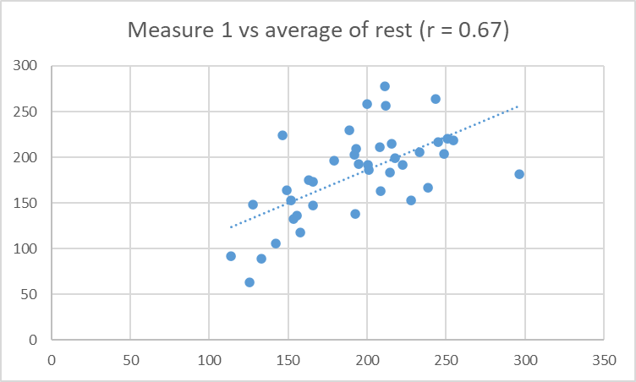
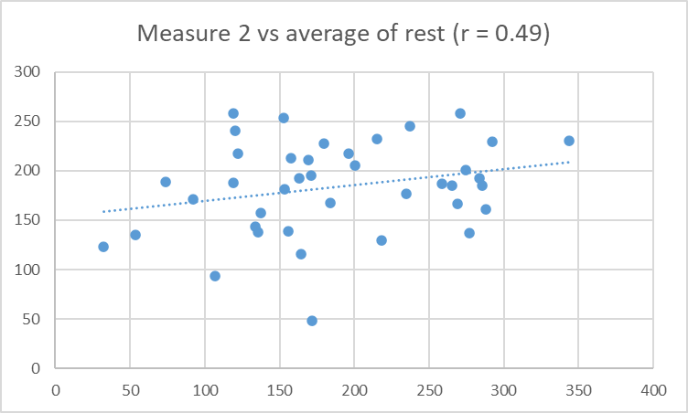
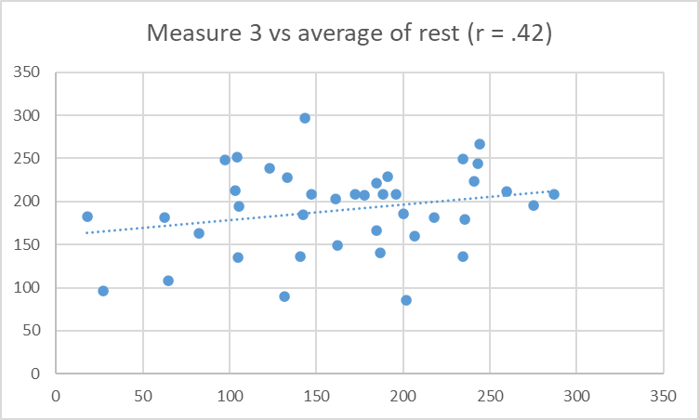
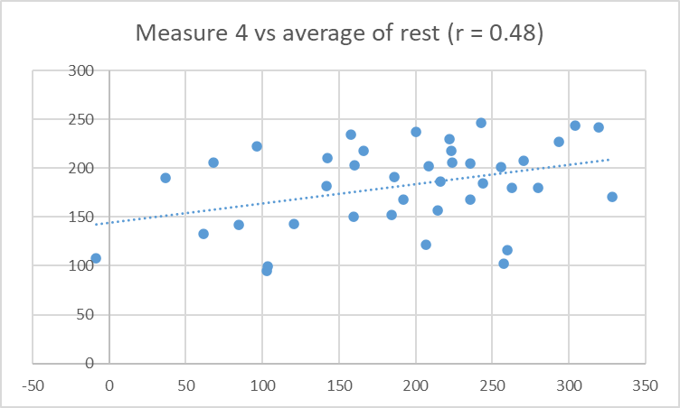
Imagine this was the outcome: Which is the best measure?

Slide 14
Imagine this was the outcome: Which is the best measure?
Measure 1 correlates (= predicts) the average of the remainder, better than any other measure does. It is the “best” measure of these 4 scores of whatever these tests share.

Slide 15
Personality

Slide 16
Psychometrics of personality tests
Woodworth Personal Data Sheet (1919)
Myers-Briggs (1944)
NEO (1985, 1992, 2005)
Available online: https://bigfive-test.com
Good reliability
Less poor validity

Slide 17
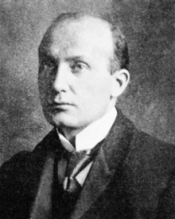
Psychometrics of personality tests
Woodworth Personal Data Sheet (1919)
Where it all began
Example items
1. Do you usually feel well and strong? (reverse scored) Yes
4. Are you troubled with dreams about your work? No
25. Have you ever fainted away? No
110. Has any of your family committed suicide? No
116. Do you like outdoor life? (reverse scored) Yes

Slide 18
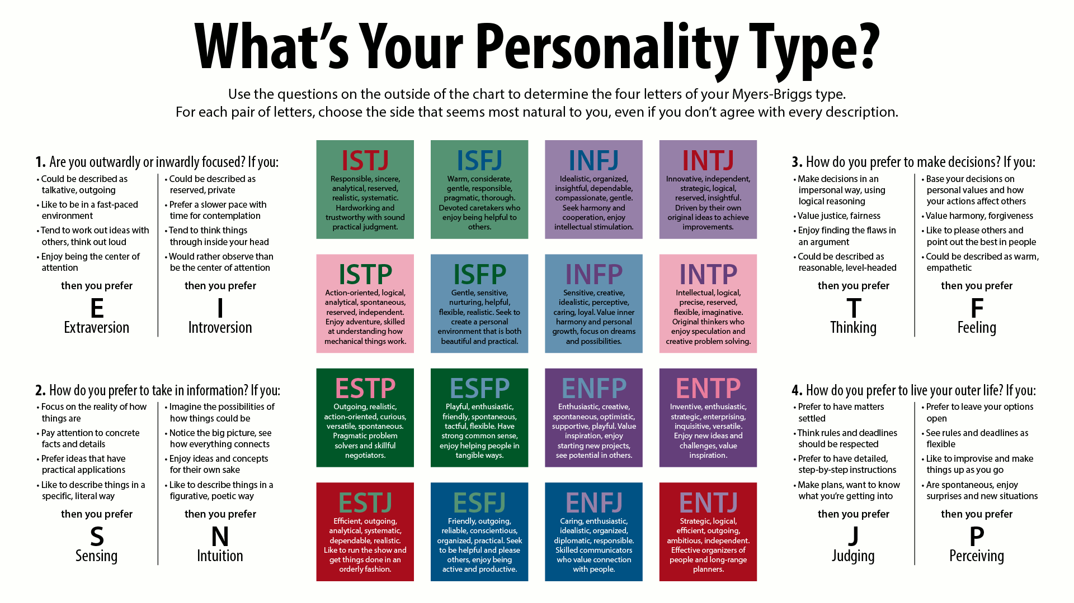
Psychometrics of personality
- Myers-Briggs
Myers-Briggs
Popular online
Poor reliability
Poor validity
Personality is not dichotomous!

Slide 19

Psychometrics of personality tests
NEO (1985, 1992, 2005)
Available online: https://bigfive-test.com
Based on the now-standard Five Factor model
Good reliability
Less poor validity
Openness to experience
Conscientiousness
Extraversion
Agreeableness
Neuroticism

Slide 20
Psychometrics of almost anything!
There are good, free, tests for almost anything: https://ipip.ori.org
This alphabetical lit might be particularly helpful:
https://ipip.ori.org/newIndexofScaleLabels.htm

Slide 21
Experiments

Slide 22
Topic of this lecture: Experimental research
Research Methods in Psychology, Chapter 5 & Chapter 8

Slide 23
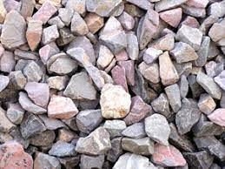
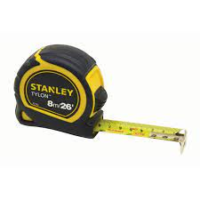
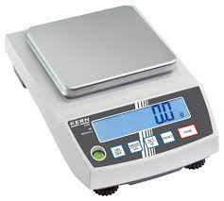
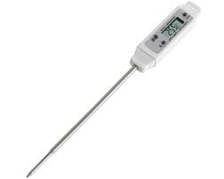
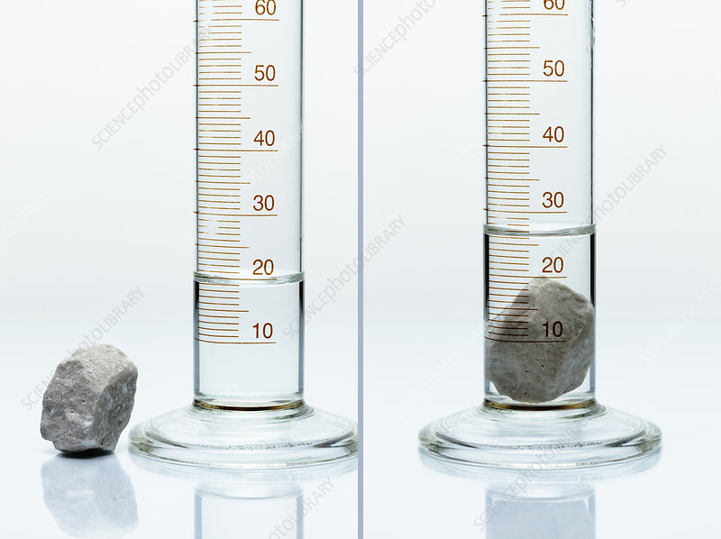
Remember this?
Q: How could you find out which is the largest stone by volume?
These are tools for converting physical properties of the stones into a numerical value that can be used to distinguish between them.

Slide 24
What if we wanted to know what affects the volume of water?
e.g. Is the volume of water affected by temperature?
How could we find out?

Slide 25
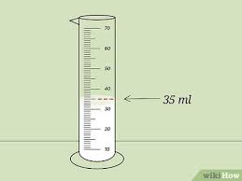
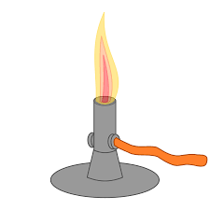
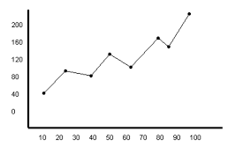
Essential steps in an experiment
1: Take a sample (or set of samples)
We don’t test all the water in the world, just a sample.
2: Manipulate something
These have to be systematic (controlled, careful…)
3: Measure the outcome(s)
3: Relate the manipulation (2) to the outcome (3)
We observe the relationship between our manipulation and the outcome(s).

Slide 26
What if we wanted to know what affects the happiness of people?
e.g. Is happiness affected by ambient temperature?
How could we find out?

Slide 27

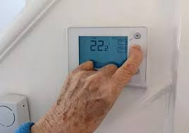
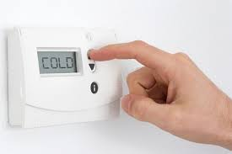


Essential steps in an Psychology experiment
1: Take a sample (or set of samples)
We don’t test everyone in the world, just a sample. But people vary a lot, so larger samples needed.
2: Manipulate something
These have to be systematic (controlled, careful…). But people are reactive, so it is tricky.
3: Measure the outcome(s)
3: Relate the manipulation (2) to the outcome (3)
We can (statistically) test the relationship between our manipulation and the outcome(s).

Slide 28
Some terminology
The thing we manipulate in an experiment is called
The independent variable.
(Variations in this are independent of everything other than the manipulation).
The outcome we measure is called:
The dependent variable
(Scores on this measure depend upon the manipulation)

Slide 29
Independent variables
Can be binary (Hot vs cold, drug vs control, eyes closed vs eyes open), or can have multiple levels
e.g. Hot vs warm vs cold
1st test vs 2nd test vs 3rd test
etc.
In each case, the manipulation of an independent variable leads to different experimental conditions.
e.g. the “hot” “warm” and “cold” conditions.

Slide 30
Variables (Measures) come in different forms
A categorical variable is one which different outcomes can be distinguished, without specifying a rank order.
e.g. for an independent variable: Drug A vs Drug B
e.g. for dependent variable: Will vote for Party A vs Party B vs Party C

Slide 31
Variables (Measures) come in different forms
An ordinal variable (or scale) is one in which it is possible to specify the rank order, but the differences between steps may not be equal.
e.g. For an independent variable: whether an interview is conducted by someone who is unfriendly, neutral, or friendly.
e.g. For a dependent variable: ratings like this:
Unfriendly 1 2 3 4 5 6 7 Friendly
The difference between 1 and 2 may not be the same as between 2 and 3, or between 4 and 5.

Slide 32
Variables (Measures) come in different forms
An interval scale is one on which it is possible to say that the steps are of equal size, but there is no zero point
e.g. for an independent variable: 10 vs 20 vs 30 degrees centigrade.
Here the steps are 10 degrees, but 20 degrees centigrade isn’t twice as hot as 10 degrees centigrade.

Slide 33
Variables (Measures) come in different forms
An ratio scale variable is one on which it is possible to say that the steps are of equal size, and there is zero point
e.g. for an independent variable: 0 vs 1 vs 2 cups of coffee.
Here 2 cups is twice 1 cup.
e.g. for a dependent variable:
number of errors on a test, time spent studying (in seconds), number of people supporting outcome X etc
– i.e. anything that can be counted, where there is a true zero point.

Slide 34
Why is this important?
The nature of the variables influences what kinds of statistics are appropriate.
For now, it influences the conclusions that can be drawn.
Key point: you can’t draw “ratio” (or relative) conclusions from non-ratio data.

Slide 35
Imagine we’d collected 40 ratings of friendliness of two experimenters (E1 and E2).
Unfriendly 1 2 3 4 5 6 7 Friendly
E1 6 10 14 8 2 0 0
E2 0 0 1 8 10 12 9
What can we conclude about who is friendliest?
How much friendlier?
Average ratings for E1 = 2.75, and E2 = 5.5.
So is E2 twice as friendly as E1?

Slide 36
Imagine we’d collected 40 ratings of friendliness of two experimenters (E1 and E2).
Unfriendly 1 2 3 4 5 6 7 Friendly
E1 6 10 14 8 2 0 0
E2 0 0 1 8 10 12 9
Average ratings for E1 = 2.75, and E2 = 5.5.
So is E2 twice as friendly as E1?
NO: because this assumes that the difference between ratings 1 and 2 is the same as 3 and 4 (etc). That is how an average is calculated.

Slide 37
What can we do? – Convert to a ratio scale.
Unfriendly 1 2 3 4 5 6 7 Friendly
E1 6 10 14 8 2 0 0
E2 0 0 1 8 10 12 9
Number of people giving a rating of 4 or above:
E1 10 E2 39
We can conclude that E2 was 3.9 times more likely to receive a rating of 4 or above. (Or 15.5 times more likely to receive a rating of 5 or above).
This is because frequency counts are on a ratio scale.

Slide 38
Creating experiments
The aim of an experiment is to establish a causal relationship between a change we make (called the independent variable), and an outcome we observe (called the dependent variable).
To do this, we need to remove all other possible differences other than the change we make, or those that are truly random.

Slide 39
A “true” experimental design involves
1: A deliberate manipulation of one or more independent variable(s) while holding other potential variables constant.
2: Measurement of one or more dependent variable(s).

Slide 40
More from previous lecture
Any test score obtained consists of two components
Score obtained
=
the true score
+/-
noise
Other factors that might influence the outcome
e.g. motivation, attention, understanding instructions etc.
The underlying construct being measured.

Slide 41
Strictly, this should be
Any test score obtained in a particular set of conditions consists of two components
Score obtained
=
the true score
+/-
noise
Other factors that might influence the outcome
e.g. motivation, attention, understanding instructions etc.
The underlying construct being measured.

Slide 42
If the conditions vary then
Score obtained
=
the true score
+/-
noise
+/-
bias
The underlying construct being measured.
Other factors that might randomly influence the outcome
e.g. motivation, attention, understanding instructions etc.
Factors systematically associated with the conditions that can influence the outcome.

Slide 43
If the conditions vary then
Score obtained
=
the true score
+/-
noise
+/-
bias
The underlying construct being measured.
Other factors that might randomly influence the outcome
e.g. motivation, attention, understanding instructions etc.
Factors systematically associated with the conditions that can influence the outcome.
Extraneous variables

Slide 44
When we compare two conditions
Difference obtained
the true difference
=
+/-
noise
+/-
bias
Difference in the underlying construct caused by the difference in conditions
Other factors that might randomly influence the outcome
e.g. motivation, attention, understanding instructions etc.
Difference caused by factors that are systematically associated with the different conditions
Smaller because noise is roughly equal across conditions if the sample is big enough.
Evidence for a causal effect.
Confounding variables that offer an alternate explanation for the difference.

Slide 45
The logic of an experiment
Score Condition 1 = baseline + effect of IV in condition 1 + noise + bias
Score Condition 2 = baseline + effect of IV in condition 2 + noise + bias
Difference = 0 + difference in IV (c1-c2) + 0(ish) 0 (?)
i.e. the difference between conditions is due solely to the impact of the manipulation (the I.V.).
This is only zero if there is nothing else that changes between Condition 1 and Condition 2, other than the I.V.

Slide 46
Common confounding variables
Selection of participants
Materials
Order
Experimenter / instructional effects
Demand / expectancy effects
Experimental context
(Experimenter bias)

Slide 47
The first fundamental choice
Between-subjects vs within-subjects designs.
A within-subjects (between-group) design looks like this:
Condition 1 Condition 2
Participant 1 Participant 1
Participant 2 Participant 2
Participant 3 Participant 3
etc.

Slide 48
The first fundamental choice
Between-subjects vs within-subjects designs.
A between-subjects design looks like this:
Condition 1 Condition 2
Participant 1 Participant 2
Participant 3 Participant 4
Participant 5 Participant 6
etc. etc.

Slide 49
When we compare two conditions
Difference obtained
the true difference
=
+/-
noise
+/-
bias
Other factors that might randomly influence the outcome
e.g. motivation, attention, understanding instructions etc.
Between-subjects designs increase noise, because there are individual differences between the two groups involved.
Within-subjects designs reduce noise, because there are no individual differences - it is the same people in each condition

Slide 50
When we compare two conditions
Difference obtained
the true difference
=
+/-
noise
+/-
bias
Factors systematically associated with the conditions that can influence the outcome.
Between-subjects designs can help reduce some bias, because the two conditions can be run identically. But selection issues can increase bias.
Within-subjects designs risk increasing bias because the conditions cannot be the same (e.g. the order in which they are undertaken).

Slide 51
Common confounding variables
Selection of participants
Is not an issue for within-subjects designs.
For between-subjects designs the allocation of participants to conditions should be unrelated to any aspect of the individuals involved.
e.g. their time of availability
their preference for a particular condition
their friendliness, ability, cognitive style, personality
etc.
The best solution is to randomly (pre)allocate participants to conditions.

Slide 52
Common confounding variables
Materials
Is not an issue for between-subjects designs, as long as the same materials are allocated to each condition.
For within-subjects designs, the materials (often) should not be the same across both conditions.
e.g. you can’t do the same test (in the same format) twice, because of practice (or order) effects.

