Slide 1

Coin flips

Slide 2
I’m going to start by dividing you into 2 groups
Half will be Group A, half Group B

Slide 3
I want you to take part in a betting game…
But the rules will be slightly different for Group A and B.
I’ll show you the rules on the next slides, so in a moment I’ll ask you all to close your eyes, and then open them to read your set of rules.

Slide 4
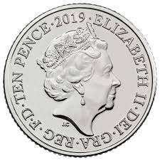
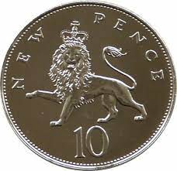
The betting game is whether the coin will be Heads or Tails?

Slide 5
Everyone close your eyes

Slide 6
Group A open your eyes

Slide 7
Group A: In this bet, the following rules apply.
If it is Heads, you win £2.
If it is Tails, you lose £1.

Slide 8
Everyone close your eyes

Slide 9
Group B open your eyes

Slide 10
Group B: In this bet, the following rules apply.
If it is Heads, you win 2 pence.
If it is Tails, you lose 1 pence.

Slide 11
Everyone stand up.
If you want to have a go at the bet, please remain standing

Slide 12
Heads or tails?

Slide 13
We’re now going to do the same again
If you want to have a go at the bet, please remain standing.
If you don’t want to continue in the game, sit down.

Slide 14
Heads or tails?

Slide 15
We’re now going to do the same again
If you want to have a go at the bet, please remain standing.
If you don’t want to continue in the game, sit down.

Slide 16
Heads or tails?

Slide 17
We’re now going to do the same again
If you want to have a go at the bet, please remain standing.
If you don’t want to continue in the game, sit down.

Slide 18
Heads or tails?

Slide 19
We’re now going to do the same again
If you want to have a go at the bet, please remain standing.
If you don’t want to continue in the game, sit down.

Slide 20
Heads or tails?

Slide 21
We’re now going to do the same again
If you want to have a go at the bet, please remain standing.
If you don’t want to continue in the game, sit down.

Slide 22
Heads or tails?

