Slide 1
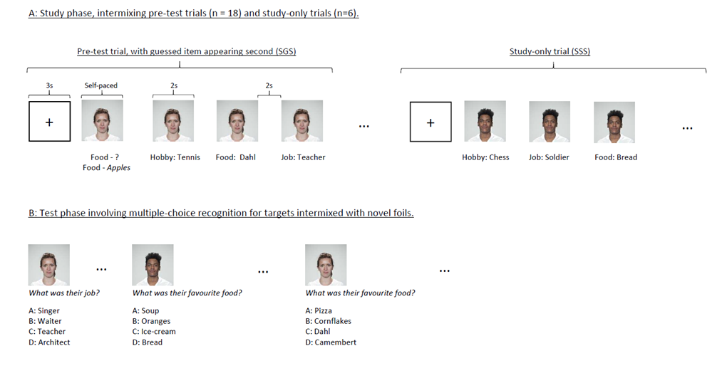
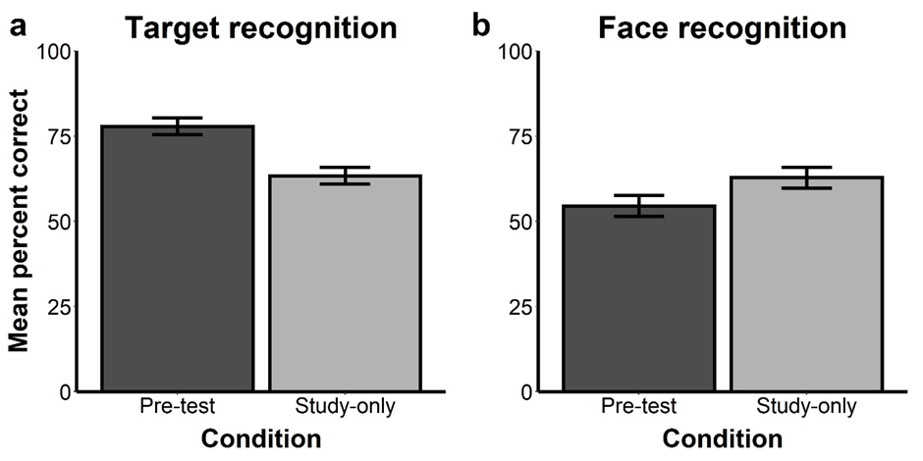

Pre-testing Effects Are Target-Specific and Are Not Driven by a Generalised State of Curiosity
Tim Hollins, Tina Seabrooke, Angus Inkster, Andy Wills & Chris Mitchell
Guessing an answer to an unfamiliar question prior to seeing the answer leads to better memory than studying alone (the pre-testing effect), which some theories attribute to increased curiosity. A similar effect occurs in general knowledge learning: people are more likely to recall information that they were initially curious to learn.
Gruber and Ranganath (2019) argued that unanswered questions can cause a state of curiosity during which encoding is enhanced for the missing answer, but also for incidental information presented at the time. If pre-testing similarly induces curiosity, then it too should produce better memory for incidental information.
We tested this idea in 3 experiments that varied the order, nature and timing of the incidental material presented within a pre-testing context. In each experiment we examined both the memory for the answer presented as feedback, and also memory for a face associated with that question.
Our hypothesis was that if curiosity drives the pre-testing effect, then guesses should be associated with better memory for the answers and the faces.
Method
Discussion
Introduction
Participants: In each experiment, we tested 32 undergraduate volunteers, who participated for course credit.
Procedure: Participants completed a series of trials, as illustrated below.
In three experiments, we demonstrated the benefits of a pre-test on subsequent recognition of the target of a guess, relative to study alone.
Experiment 1 used arbitrary facts associated with faces, while Experiments 2 and 3 used the meanings of unfamiliar rare English words. These experiments therefore add to a growing literature demonstrating that pre-testing boosts subsequent recognition memory for targets, regardless of any pre-existing semantic association (Seabrooke, Hollins et al., 2019, Seabrooke, Mitchell et al., 2019).
However, there was no evidence to suggest that the beneficial effect of guessing generalises to the incidentally presented material (faces) encountered prior to the feedback, as predicted by a curiosity-state hypothesis (Gruber & Ranganath, 2019). That is, none of our studies showed a pre-testing effect for the faces.
Put the details of the analysis here.
Results
Our results therefore suggest that the pre-testing effect is not driven by a generalised state of curiosity.
Our hypothesis was that if curiosity drives the pre-testing effect, then guesses should be associated with better memory for the answers and the faces.

Slide 2

Pre-testing Effects Are Target-Specific and Are Not Driven by a Generalised State of Curiosity
Tim Hollins, Tina Seabrooke, Angus Inkster, Andy Wills & Chris Mitchell
Guessing an answer to an unfamiliar question prior to seeing the answer leads to better memory than studying alone (the pre-testing effect), which some theories attribute to increased curiosity. A similar effect occurs in general knowledge learning: people are more likely to recall information that they were initially curious to learn.
Gruber and Ranganath (2019) argued that unanswered questions can cause a state of curiosity during which encoding is enhanced for the missing answer, but also for incidental information presented at the time. If pre-testing similarly induces curiosity, then it too should produce better memory for incidental information.
We tested this idea in 3 experiments that varied the order, nature and timing of the incidental material presented within a pre-testing context. In each experiment we examined both the memory for the answer presented as feedback, and also memory for a face associated with that question.
Our hypothesis was that if curiosity drives the pre-testing effect, then guesses should be associated with better memory for the answers and the faces.
Method
Discussion
Introduction
Participants: In each experiment, we tested 32 undergraduate volunteers, who participated for course credit.
Procedure: Participants completed a series of trials, as illustrated below.
In three experiments, we demonstrated the benefits of a pre-test on subsequent recognition of the target of a guess, relative to study alone.
Experiment 1 used arbitrary facts associated with faces, while Experiments 2 and 3 used the meanings of unfamiliar rare English words. These experiments therefore add to a growing literature demonstrating that pre-testing boosts subsequent recognition memory for targets, regardless of any pre-existing semantic association (Seabrooke, Hollins et al., 2019, Seabrooke, Mitchell et al., 2019).
However, there was no evidence to suggest that the beneficial effect of guessing generalises to the incidentally presented material (faces) encountered prior to the feedback, as predicted by a curiosity-state hypothesis (Gruber & Ranganath, 2019). That is, none of our studies showed a pre-testing effect for the faces.
Results
Figure 1 shows memory performance for the target facts (a) and faces (b) in Experiment 1.
Put the details of the analysis here.
Our conclusion is therefore that the pre-testing effect is not driven by a generalised state of curiosity.
Our hypothesis was that if curiosity drives the pre-testing effect, then guesses should be associated with better memory for the answers and the faces.

