Slide 1

Experiments and Statistics

Slide 2
Experiments

Slide 3
From last time … Common confounding variables
Selection of participants
Materials
Order
Experimenter / instructional effects
Demand / expectancy effects
Experimental context
(Experimenter bias)

Slide 4
Common confounding variables
Order
This is a common issue in within-subject designs, where each participant completes two (or more) conditions.
This can be overcome, by either randomisation, or (in more simple cases) counterbalancing.

Slide 5
Counterbalancing
With two conditions (A, B).
Participant 1 completes A, then B
Participant 2 completes B, then A
Etc.
To be “fully” counterbalanced requires the sample size to be a multiple of 2.
Notice here, that if there is a difference between A and B, it can’t be because of what was done first (vs second)

Slide 6
Counterbalancing
With three conditions (A, B, C).
To be “fully” counterbalanced requires the sample size to be a multiple of 6 (= 3 x 2).
i.e. test 6, 12, 18 (etc) participants.
Notice here, that if there is a difference between A, B, and C it can’t be because of what was done first (vs second vs third)

Slide 7
More conditions
4 conditions requires multiples of 4 x 3 x 2 = 24
5 conditions requires multiples of 5 x 4 x 3 x 2 = 120
6 conditions requires multiples of 6 x 5 x 4 x 3 x 2 = 720
With more conditions full counterbalancing may require more participants than can be tested.
One solution is to randomise the order differently for each participant.

Slide 8
Randomisation
Difference obtained
the true difference
=
+/-
noise
+/-
bias
Other factors that might randomly influence the outcome
e.g. motivation, attention, understanding instructions etc.
Factors systematically associated with the conditions that can influence the outcome.
Relative to full counterbalancing, randomisation may increase noise. However, if it is truly random, it is not a source of systematic bias.

Slide 9
Common confounding variables
Experimenter / instructional effects
Differences can arise between conditions if they are associated with different people running them.
e.g. Different ways of presenting the instructions.
Different ways of scoring the data
Different non-verbal behaviours
These can be unconscious and subtle, but still have an effect.

Slide 10
Example of experimenter effect
Clark, Marshall & Rosenthal (2009).
Witnesses saw lineups that did not contain the true perpetrator.
If the administrator said nothing: 37% false IDs.
If the administrator said “take your time”: 56% false IDs.

Slide 11
Common confounding variables
Demand / expectancy effects
These can affect both within- and between-participant designs.
A variant of experimenter effects is when participants know (or expect) a particular outcome associated with the conditions.
e.g. telling participants which condition leads to “best performance” in advance may change their motivation.
This could come from experimenter body language, but also from the instructions, or even from the recruitment materials or informed consent paperwork.

Slide 12
Common confounding variables
Experimental context
Aspects of the environment in which the experiment takes place. (You can’t test everyone at the same time and place).
Is not an issue for within-subjects designs where the context is the same across conditions.
For between subjects the environmental variations should be unrelated to the experimental conditions, either by counterbalancing, or randomising (see previous slide).
e.g. Time of day at which the experiment is run.
Room in which the test takes place.

Slide 13
Common confounding variables
Experimenter bias.
This is an influence of the experimenter’s beliefs on the outcome of the experiment.
This can be during the experiment (see Experimenter effects)
But it can also happen after the data is collected, e.g. when ambiguous data are scored.
This can affect both within- and between-participant designs.

Slide 14
Back to variables

Slide 15
Manipulation of independent variables
Can be direct
e.g. Setting the room temperature at 2 different levels
Giving people drug A vs drug B.
Can be indirect (or instructional)
e.g. Asking people to imagine something vs no instructions.
Asking for quick responses vs accurate responses.

Slide 16
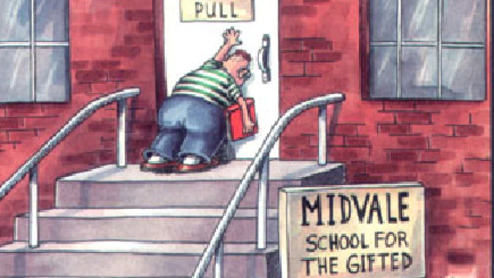
A problem with instructional manipulations
Participants don’t always follow instructions!
If an experiment finds no effect it could be that:
There is no effect to find.
Or
People didn’t follow the instructions

Slide 17
Solutions to the problem of instructional manipulations
Measure understanding of the instructions (at beginning and end of the experiment).
This shows participants at least knew what they were supposed to do.
Ask for compliance with instructions
This shows participants say that they tried to do what they were supposed to do. (Or that they lied about it).
Include a manipulation check
This shows that some aspect of behaviour was changed by the manipulation (just not the main one).

Slide 18
Example of manipulation checks
You want to know whether people’s presentations are rated higher if they are told to smile a lot (vs no instructions).
Independent variable: Instruction for to smile (vs no instruction)
Dependent variable: Rated quality of presentation (by judges).
Possible manipulation checks:
Independent observers count number of smiles (or time spent smiling)

Slide 19
What about the “ish”?
Score Condition 1 = baseline + effect of IV in condition 1 + noise + bias
Score Condition 2 = baseline + effect of IV in condition 2 + noise + bias
Difference = 0 + difference in IV (c1-c2) + 0(ish) + 0
i.e. the difference between conditions is due solely to the impact of the manipulation (the I.V.).
This is only true if there is nothing else that changes between Condition 1 and Condition 2, other than the I.V.

Slide 20
We can make the “ish” small by reducing the impact of noise in general
Score Condition 1 = baseline + effect of IV in condition 1 + noise + bias
Score Condition 2 = baseline + effect of IV in condition 2 + noise + bias
Difference = 0 + difference in IV (c1-c2) + 0(ish) + 0
The less noise in each condition, the smaller the difference between them.

Slide 21
Reducing random noise
One way of reducing noise is to reduce variability between people.
e.g. imagine an experiment looking at the effect of a poster campaign (vs nothing) on political attitudes in:
A random sample of the general public
A random neurotypical sample of Psychology undergraduates, who are white, female, heterosexual, aged 19-21, with no political affiliation, and come from Devon.
Which sample would be more variable (i.e. noisier)?

Slide 22
Noise vs generality
The downside of less noise is that the sample is less representative of the general population.
i.e. you are more likely to find an effect in a less noisy population.
But you are less able to draw conclusions about the general population.

Slide 23
Q: Why is the following not a true experiment?
The experimenter wants to know whether beer-drinkers vs wine-drinkers differ in their liking of rock music.
They recruit participants who self-identify as beer-drinkers or wine-drinkers and ask them to rate their enjoyment of a selection of rock-music samples.

Slide 24
Clue 1: Remember a true experiment
Score Condition 1 = baseline + effect of IV in condition 1 + noise + bias
Score Condition 2 = baseline + effect of IV in condition 2 + noise + bias
Difference = 0 + difference in IV (c1-c2) + 0(ish) + 0(?)
i.e. the difference between conditions is due solely to the impact of the manipulation (the I.V.).
This is only true if there is nothing else that changes between Condition 1 and Condition 2, other than the I.V.

Slide 25
Clue 2
Q: What is being manipulated by the experimenter in this experiment?
A: Nothing
Without a experimenter-controlled manipulation, it isn’t a true experiment.

Slide 26
In this example
The observation of any difference between beer-drinkers and wine-drinkers may be because of their drinking preferences.
But, it could also be due to many other factors that differ between these two groups.
e.g. Social class, educational background, parental tastes in music (etc).
This is an example of a quasi-experimental design.

Slide 27
Quasi-experimental designs
Can be run under conditions of a “true” experiment, but cannot attribute any difference to the independent variable, because this is not manipulated.
i.e. we don’t manipulate drinking preference in the experiment. We can’t know if any differences are due to other factors that are associated with preference.

Slide 28
Quasi-experimental designs involve
Comparison of any pre-existing groups (or materials) based upon an attribute.
e.g. Personality, ability
Age / Gender / Sexual orientation
Left vs right-handedness
Coffee drinkers vs non-coffee drinkers
Football fans vs cricket fans
etc.
In all cases, these are not true experiments because we cannot manipulate that attribute (to see what happens).

Slide 29
Quasi-experimental designs
Can tell you that a difference exists.
E.g. that beer-drinkers prefer rock music.
But it doesn’t provide evidence of a causal effect.
i.e. it doesn’t show that getting wine drinkers to drink more beer will make them like rock music.

Slide 30
Quasi-experimental designs can also involve contrasts of pre-existing materials.
e.g. we get participants to rate their appreciation of samples of rock music vs classical music.
If we find a difference, we know that a difference exists in this sample, using these materials.
What we can’t know is what causes this difference.
It could be the instruments, the volume, the presence of drums etc.
It could be prior experience / familiarity
etc.

Slide 31
Experimental design: data issues

Slide 32
Back to this to discuss data issues:
Score obtained
=
the true score
+/-
noise
+/-
bias
The underlying construct being measured.
Other factors that might randomly influence the outcome
e.g. motivation, attention, understanding instructions etc.
Factors systematically associated with the conditions that can influence the outcome.
All of this assumes that our measuring instrument is able to accurately measure differences in the outcome. This may not always be true (for all values).

Slide 33
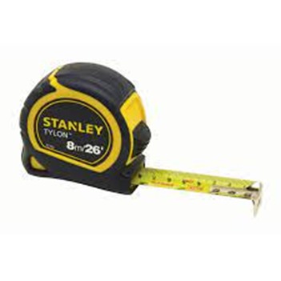
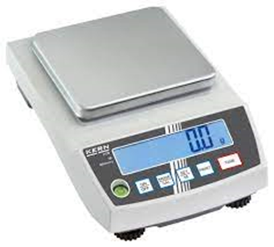
When valid measures become invalid…
This is a valid measure of weight, but can’t accurately distinguish between the weights of two different planets
This is a valid measure of length, but can’t accurately distinguish between lengths of .00002 and .00001cm.

Slide 34
Ceiling and floor effects
Whether or not we can detect a difference between two conditions is also subject to the same constraints.
e.g. If I want to know whether doing exercise boosts memory, I would not find a difference if:
The memory test was so easy, that everyone would score 100% regardless of exercise ( = a “ceiling” effect)
The memory test was so difficult that everyone would score zero, regardless of exercise. ( = a “floor” effect)

Slide 35
Ceiling and floor effects
Don’t just happen when everyone hits floor / ceiling.
The impact of these factors is related to the proportion of your sample that is scoring at the maximum (or minimum).

Slide 36
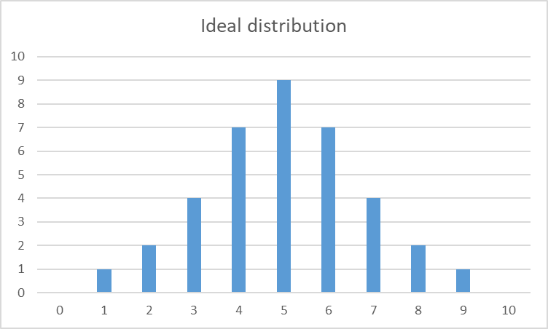
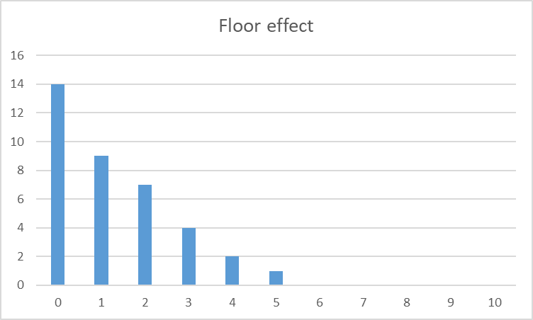
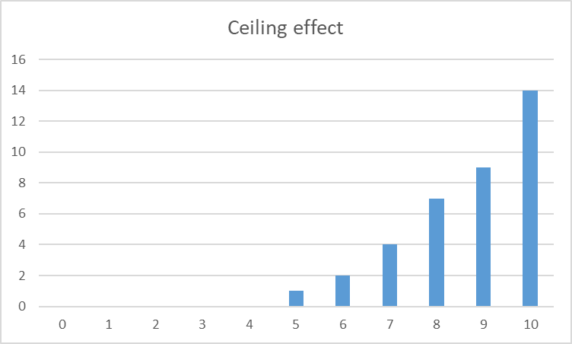

Slide 37
If the test had been easier, and all scores were 4 points higher:
Scores of 6 and above all reach the maximum value (10).
We have lost some of the variability in our scores, because of a
CEILING EFFECT.

Slide 38
If the test had been harder, and all scores were 4 points lower:
Scores of 4 and above all reach the minimum value (zero)
We have lost some of the variability in our scores, because of a
FLOOR EFFECT.

Slide 39
Statistics

Slide 40
Statistics
A demonstration…

Slide 41
Two observations so far
1: You made decisions whether or not to continue, with evidence that was uncertain.
2: The two groups made different decisions about continuing, even though the evidence was the same.

Slide 42
Statistics as a way of dealing with uncertainty.
If a coin is fair, then the outcome of a flip is random.
The chance of a Head is 50%, or 0.5, or 1 in 2.
The chance of a Tail is 50% , or 0.5, or 1 in 2.
If we flip a coin multiple times, then these probabilities multiply.

Slide 43
Likelihoods of different numbers of Heads (or Tails) in multiple coin-flips.
Two flips of a coin can result in the following outcomes
H H
H T
T H
T T
i.e. there are four possible outcomes, which are all equally likely, so the chances of getting two Tails in a row is 1 / 4.
Another way of saying this, is probability of one tail (0.5) multiplied by the probability of another tail (0.5), which is 0.5 x 0.5 = 0.25.

Slide 44
For higher numbers of coin-flips
3 flips: 8 possibilities
THH TTH
HTH THT
HHH HHT HTT TTT
The chance of 3 Tails in a row is 1/8, or 12.5%.

Slide 45
4 flips: 16 possibilities
TTHH
THTH
THHH THHT HTTT
HTHH HTTH THTT
HHTH HTHT TTHT
HHHH HHHT HHTT TTTH TTTT
The chance of 4 Tails in a row is 1/16, or 6.25%.

Slide 46
With more observations, the likelihood of all the coins landing tails becomes less-likely.
5 flips: 1/32 = 3.1%
6 flips: 1/64 = 1.56%
7 flips: 1/128 = 0.8%
8 flips: 1/256 = 0.4%
etc

Slide 47
We don’t have to just look at all responses being identical.
TTHH
THTH
THHH THHT HTTT
HTHH HTTH THTT
HHTH HTHT TTHT
HHHH HHHT HHTT TTTH TTTT
Here for 4 flips of a coin, the chance of getting 3 Tails or more is 5 / 16, or 31.3%.

Slide 48
We can do this for different cut-off points, and different numbers of observations
e.g.
Possibility of 5 or more Heads in 6 coin tosses = 10.9%
Possibility of 6 or more Heads in 7 coin tosses = 6.3%
Possibility of 7 or more Heads in 8 coin tosses = 3.5%.

Slide 49
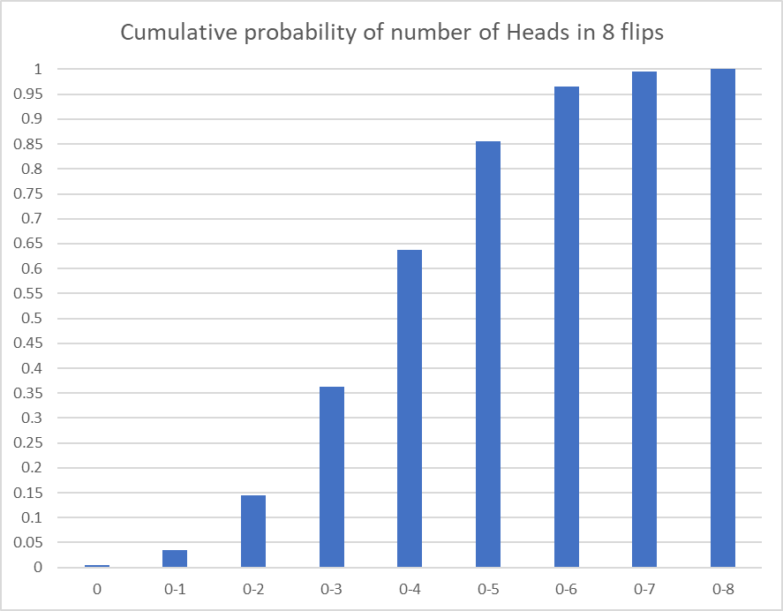
For the case of 8 coin flips
Getting 3 or fewer Heads (i.e. 5 or more Tails) is expected to happen around 35% of the time.
Getting 1 or fewer Heads (i.e. 7 or more Tails) is expected to happen around 3% of the time.

Slide 50
Making decisions based on evidence that involves uncertainty.
The real state of the world
No difference
There is a difference
Correctly conclude no difference
Falsely conclude there is no difference
No difference
The conclusion you reached based upon the evidence you have collected
Falsely conclude there is a difference
Correctly conclude there is a difference
There is a difference

Slide 51
Making decisions based on evidence that involves uncertainty.
The real state of the world
No difference
There is a difference
Falsely conclude there is no difference
A “Type 2 error”
A false negative
No difference
The conclusion you reached based upon the evidence you have collected
Falsely conclude there is a difference
A “Type 1” error
There is a difference
A false positive

Slide 52
Making decisions based on evidence that involves uncertainty.
The real state of the world
No difference
There is a difference
Falsely conclude there is no difference
A “Type 2 error”
The conclusions we draw depend upon how we view risks associated with each error
No difference
The conclusion you reached based upon the evidence you have collected
Falsely conclude there is a difference
A “Type 1” error
There is a difference

Slide 53
Making decisions based on evidence that involves uncertainty.
The real state of the world
No difference
There is a difference
Falsely conclude there is no difference
A “Type 2 error”
The conclusions we draw depend upon how we view risks associated with each error
No difference
The conclusion you reached based upon the evidence you have collected
Falsely conclude there is a difference
A “Type 1” error
There is a difference
If we draw positive conclusions on less evidence, we increase the risk of a Type 1 error (and reduce the risk of a Type 2 error).

Slide 54
In terms of our demonstration
Group A
If it is Heads, you win £2.
If it is Tails, you lose £1.
Group B
If it is Heads, you win 2 pence.
If it is Tails, you lose 1 pence.
Because Group A had the potential for bigger losses, they were more likely to conclude that the coin-flip exercise was not fair earlier.
i.e. there was enough evidence for them to stop betting after fewer flips of the coin.

Slide 55
Group A and B had the same evidence!
The decision to continue to bet (or not) was not entirely related to the evidence you had.
It was also driven by the perceived risks associated with:
Potentially missing out on a good bet (if the coin is really fair)
Vs
Potentially losing out from a bad bet (if the coin is really unfair).

Slide 56
Summary of first key statistical principle.
When evaluating evidence that involves uncertainty, there is always the probability of drawing a false conclusion.
Because the evidence involves uncertainty, it does not “prove” anything absolutely.
Any decision we make carries the risk of 2 kinds of error:
Type 1 – a false positive
Type 2 – a false negative.

Slide 57
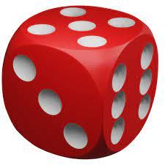
A new example – rolling a dice
Chance of throwing a 6 in one roll: 1/6 = .17
Chance of NOT getting a 6 in one roll: 5/6 = .83
Two sixes in a row: 1/6 x 1/6 = .03
NOT getting a 6 twice in a row 5/6 x 5/6 = .69
A six followed by not a six: 1/6 x 5/6 = .14
NOT a six, followed by a six 5/6 x 1/6 = .14

Slide 58
A new example – rolling a dice
Chance of throwing a 6 in one roll: 1/6 = .17
Chance of NOT getting a 6 in one roll: 5/6 = .83
Two sixes in a row: 1/6 x 1/6 = .03
NOT getting a 6 twice in a row 5/6 x 5/6 = .69
A six followed by not a six: 1/6 x 5/6 = .14
NOT a six, followed by a six 5/6 x 1/6 = .14
At least ONE six in two throws: .03 + .14 + .14 = 0.31

Slide 59
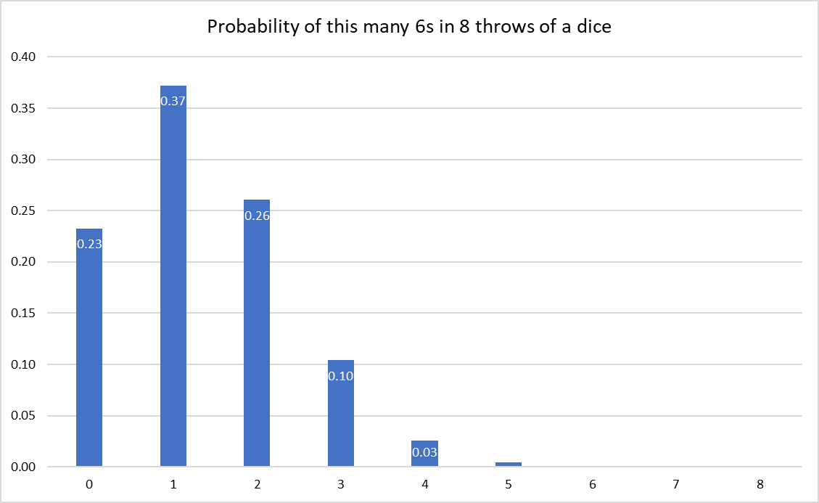
We can draw a distribution of possibilities for this example also.
This tells us the likelihood of getting this exact number of sixes.
But to know whether our dice is giving us more than a “fair” number of sixes, we need to know the probability of at least that many sixes.

Slide 60
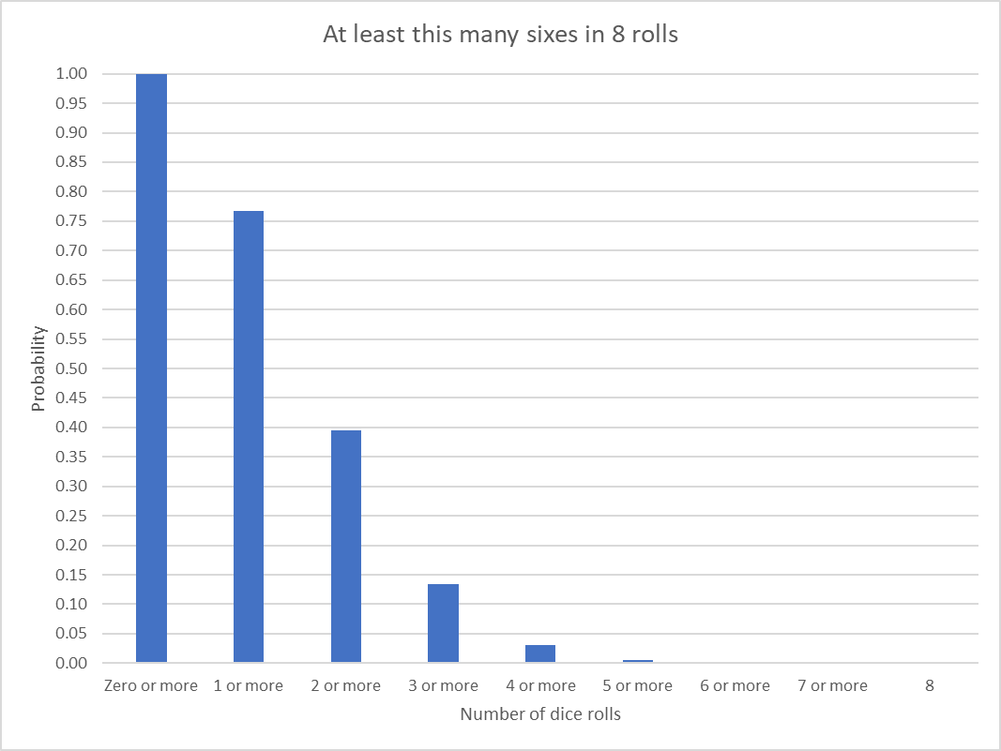
A cumulative probability function
Here we can see that there is a 13% chance of getting 3 or more sixes in 8 rolls.
And there is a 3% chance of getting 4 or more 6s in 8 rolls

Slide 61
Just as with the coin example
There is a likelihood of every possible outcome happening by chance.
Thus, for any observed outcome, we can ask,
“How likely is this to have happened by chance”?

Slide 62
Second statistical principle
We can set the criterion for accepting that a particular outcome is unlikely by chance.
(Just as you did with the coin-flip example).
In science, it is conventional to use a criterion of 5% as the level at which we start to question whether the outcome occurred through chance. This is called the significance level.

Slide 63

The concept of significance
In this example, the chance of getting 4 or more sixes in eight rolls of a fair dice is 3%.
This is less than the criterion of 5%, so we would conclude that the observation is significant.
So, if we roll a dice 8 times, and get 4 (or more) sixes, we haven’t proved that the dice is “unfair”.
Instead we have shown that this outcome would be unlikely to have happened with a fair dice. i.e. we would expect it to happen only 3% of the time.
In this case, then it suggests that the dice isn’t “fair.”

Slide 64
Take care!
What we are talking about here is P(data | fair_coin ),
i.e. the probability of observing this result or a more extreme one, if the coin is fair.
That is NOT the same as P(fair_coin | data)
e.g. P(car_won’t_start | battery dead ) = 1,
P( battery_dead | car_won’t_start ) < 1

Slide 65
Moving from coins / dice to people.
Imagine a within-participant design, in which participants take a test under two conditions (A and B). Our hypothesis is that A > B.
What is the likelihood that the difference in the scores between Test A and Test B occurred by chance?

Slide 66
What would we expect by chance if there were NO differences between Test A and B?
If we simply look at which score is higher (vs lower), then by chance we would expect A to be higher half the time, and B to be higher half the time (roughly).
This is like saying we would expect Heads vs Tails on a coin to be equally likely (roughly).

Slide 67
In our example
A is highest on 7 out of 8 comparisons (and the reverse is true only once).
This is like getting 7 heads out of 8.
By chance, we would expect this to happen only 3% of the time.
We would conclude – on the basis of this statistical test – that this is a significant effect.

Slide 68
Take care!
What we are talking about here is P(data | H₀ ),
i.e. the probability of observing this result or a more extreme one, if the two groups are the same (null hypothesis, H₀)
That is NOT the same as P(H₀ | data)
What we are generally interested in is P(H₀ | data), but it’s not what we calculate!
Bayesian analysis solves this problem (see later Stages).
For now, just remember to never say :
“p < .05 so the chance of there being no difference is less than 5%”
You’ll hear that a lot from psychologists, but it’s wrong.

Slide 69
Two almost identical examples
Notice here that our statistical comparison (which direction is the difference in) is IDENTICAL in both Scenarios, and wo we would DRAW THE IDENTICAL CONCLUSION that Scores on Test A tend to be higher than scores on Test B.
This is true, despite the fact that:
Scenario 1: Average of B < Average of A,
Scenario 2: Average of B > Average of A

Slide 70
Third Statistical principle
The conclusions that can be drawn depend upon the assumptions in the statistical test being used.

Slide 71
Third Statistical principle
The conclusions that can be drawn depend upon the assumptions in the statistical test is being used.
In our statistical test, we are testing an assumption about the DIRECTION of any difference, not the SIZE of any difference.
There are (other) statistical tests that can be used to test assumptions about the size of any difference: you will cover these later in the UG programme.

Slide 72
Notice in these examples
In both cases it is TRUE that MOST PEOPLE (7 out of 8) do better at Test A.
Out statistical test is about the DIRECTION of the differences, and so this pattern (7/8 in one direction) is unlikely to have occurred by chance.
Our statistical test is not about SIZE of the DIFFERENCE, and so it doesn’t apply to the AVERAGE SCORE on each test.

Slide 73
The example I’ve used is called the Sign-Test
So far we have used a small example (8 people), but it is possible to extend this test to any sample size.
In all cases, the logic is identical. If we have N pairs of scores, we expect one of the scores to be higher on around half the observations.
The more the differences deviate from a 50:50 pattern, the less likely this is to be by chance.
We use computers to calculate the probability for us.

