Slide 1

Experiments

Slide 2
Topic of this lecture: Experimental research
Research Methods in Psychology, Chapter 5 & Chapter 8

Slide 3

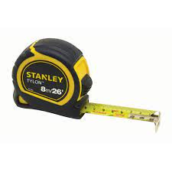
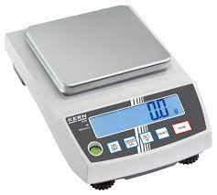
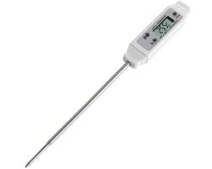
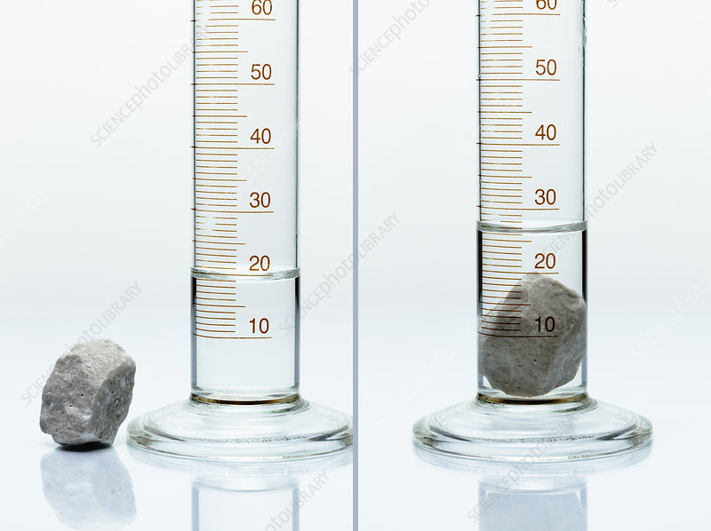
Remember this?
Q: How could you find out which is the largest stone by volume?
These are tools for converting physical properties of the stones into a numerical value that can be used to distinguish between them.

Slide 4
What if we wanted to know what affects the volume of a stone?
e.g. Is the volume of water affected by temperature?
How could we find out?

Slide 5
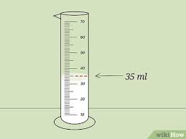
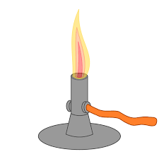
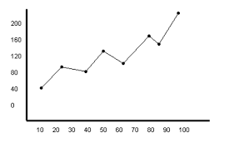
Essential steps in an experiment
1: Take a sample (or set of samples)
We don’t test all the stones in the world, just a sample.
2: Manipulate something
These have to be systematic (controlled, careful…)
3: Measure the outcome(s)
3: Relate the manipulation (2) to the outcome (3)
We can (statistically) test the relationship between our manipulation and the outcome(s).

Slide 6
What if we wanted to know what affects the happiness of people?
e.g. Is happiness affected by ambient temperature?
How could we find out?

Slide 7

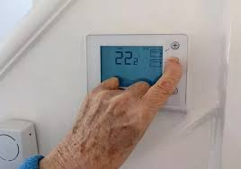
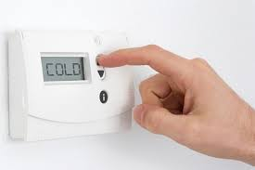


Essential steps in an Psychology experiment
1: Take a sample (or set of samples)
We don’t test everyone in the world, just a sample. But people vary a lot, so larger samples needed.
2: Manipulate something
These have to be systematic (controlled, careful…). But people are reactive, so it is tricky.
3: Measure the outcome(s)
3: Relate the manipulation (2) to the outcome (3)
We can (statistically) test the relationship between our manipulation and the outcome(s).

Slide 8
Some terminology
The thing we manipulate in an experiment is called
The independent variable.
(Variations in this are independent of everything other than the manipulation).
The outcome we measure is called:
The dependent variable
(Scores on this measure depend upon the manipulation)

Slide 9
Independent variables
Can be binary (Hot vs cold, drug vs control, eyes closed vs eyes open), or can have multiple levels
e.g. Hot vs warm vs cold
1st test vs 2nd test vs 3rd test
etc.
In each case, the manipulation of an independent variable leads to different experimental conditions.
e.g. the “hot” “warm” and “cold” conditions.

Slide 10
Variables (Measures) come in different forms
A categorical variable is one which different outcomes can be distinguished, without specifying a rank order.
e.g. for an independent variable: Drug A vs Drug B
e.g. for dependent variable: Will vote for Party A vs Party B vs Party C

Slide 11
Variables (Measures) come in different forms
An ordinal variable (or scale) is one in which it is possible to specify the rank order, but the differences between steps may not be equal.
e.g. For an independent variable: whether an interview is conducted by someone who is unfriendly, neutral, or friendly.
e.g. For a dependent variable: ratings like this:
Unfriendly 1 2 3 4 5 6 7 Friendly
The difference between 1 and 2 may not be the same as between 2 and 3, or between 4 and 5.

Slide 12
Variables (Measures) come in different forms
An interval scale is one on which it is possible to say that the steps are of equal size, but there is no zero point
e.g. for an independent variable: 10 vs 20 vs 30 degrees centigrade.
Here the steps are 10 degrees, but 20 degrees centigrade isn’t twice as hot as 10 degrees centigrade.

Slide 13
Variables (Measures) come in different forms
An ratio scale variable is one on which it is possible to say that the steps are of equal size, and there is zero point
e.g. for an independent variable: 0 vs 1 vs 2 cups of coffee.
Here 2 cups is twice 1 cup.
e.g. for a dependent variable:
number of errors on a test, time spent studying (in seconds), number of people supporting outcome X etc
– i.e. anything that can be counted, where there is a true zero point.

Slide 14
Why is this important?
The nature of the variables influences what kinds of statistics are appropriate.
For now, it influences the conclusions that can be drawn.
Key point: you can’t draw “ratio” (or relative) conclusions from non-ratio data.

Slide 15
Imagine we’d collected 40 ratings of friendliness of two experimenters (E1 and E2).
Unfriendly 1 2 3 4 5 6 7 Friendly
E1 6 10 14 8 2 0 0
E2 0 0 1 8 10 12 9
What can we conclude about who is friendliest?
How much friendlier?
Average ratings for E1 = 2.75, and E2 = 5.5.
So is E2 twice as friendly as E1?

Slide 16
Imagine we’d collected 40 ratings of friendliness of two experimenters (E1 and E2).
Unfriendly 1 2 3 4 5 6 7 Friendly
E1 6 10 14 8 2 0 0
E2 0 0 1 8 10 12 9
Average ratings for E1 = 2.75, and E2 = 5.5.
So is E2 twice as friendly as E1?
NO: because this assumes that the difference between ratings 1 and 2 is the same as 3 and 4 (etc). That is how an average is calculated.

Slide 17
What can we do? – Convert to a ratio scale.
Unfriendly 1 2 3 4 5 6 7 Friendly
E1 6 10 14 8 2 0 0
E2 0 0 1 8 10 12 9
Number of people giving a rating of 4 or above:
E1 10 E2 39
We can conclude that E2 was 3.9 times more likely to receive a rating of 4 or above. (Or 15.5 times more likely to receive a rating of 5 or above).
This is because frequency counts are on a ratio scale.

Slide 18
Creating experiments
The aim of an experiment is to establish a causal relationship between a change we make (called the independent variable), and an outcome we observe (called the dependent variable).
To do this, we need to remove all other possible differences other than the change we make, or those that are truly random.

Slide 19
A “true” experimental design involves
1: A deliberate manipulation of one or more independent variable(s) while holding other potential variables constant.
2: Measurement of one or more dependent variable(s).

Slide 20
More from previous lecture
Any test score obtained consists of two components
Score obtained
=
the true score
+/-
noise
Other factors that might influence the outcome
e.g. motivation, attention, understanding instructions etc.
The underlying construct being measured.

Slide 21
Strictly, this should be
Any test score obtained in a particular set of conditions consists of two components
Score obtained
=
the true score
+/-
noise
Other factors that might influence the outcome
e.g. motivation, attention, understanding instructions etc.
The underlying construct being measured.

Slide 22
If the conditions vary then
Score obtained
=
the true score
+/-
noise
+/-
bias
The underlying construct being measured.
Other factors that might randomly influence the outcome
e.g. motivation, attention, understanding instructions etc.
Factors systematically associated with the conditions that can influence the outcome.

Slide 23
If the conditions vary then
Score obtained
=
the true score
+/-
noise
+/-
bias
The underlying construct being measured.
Other factors that might randomly influence the outcome
e.g. motivation, attention, understanding instructions etc.
Factors systematically associated with the conditions that can influence the outcome.
Extraneous variables

Slide 24
When we compare two conditions
Difference obtained
the true difference
=
+/-
noise
+/-
bias
Difference in the underlying construct caused by the difference in conditions
Other factors that might randomly influence the outcome
e.g. motivation, attention, understanding instructions etc.
Difference caused by factors that are systematically associated with the different conditions
Smaller because noise is roughly equal across conditions if the sample is big enough.
Evidence for a causal effect.
Confounding variables that offer an alternate explanation for the difference.

Slide 25
The logic of an experiment
Score Condition 1 = baseline + effect of IV in condition 1 + noise + bias
Score Condition 2 = baseline + effect of IV in condition 2 + noise + bias
Difference = 0 + difference in IV (c1-c2) + 0(ish) 0 (?)
i.e. the difference between conditions is due solely to the impact of the manipulation (the I.V.).
This is only zero if there is nothing else that changes between Condition 1 and Condition 2, other than the I.V.

Slide 26
Common confounding variables
Selection of participants
Materials
Order
Experimenter / instructional effects
Demand / expectancy effects
Experimental context
(Experimenter bias)

Slide 27
The first fundamental choice
Between-subjects vs within-subjects designs.
A within-subjects (between-group) design looks like this:
Condition 1 Condition 2
Participant 1 Participant 1
Participant 2 Participant 2
Participant 3 Participant 3
etc.

Slide 28
The first fundamental choice
Between-subjects vs within-subjects designs.
A between-subjects design looks like this:
Condition 1 Condition 2
Participant 1 Participant 2
Participant 3 Participant 4
Participant 5 Participant 6
etc. etc.

Slide 29
When we compare two conditions
Difference obtained
the true difference
=
+/-
noise
+/-
bias
Other factors that might randomly influence the outcome
e.g. motivation, attention, understanding instructions etc.
Between-subjects designs increase noise, because there are individual differences between the two groups involved.
Within-subjects designs reduce noise, because there are no individual differences - it is the same people in each condition

Slide 30
When we compare two conditions
Difference obtained
the true difference
=
+/-
noise
+/-
bias
Factors systematically associated with the conditions that can influence the outcome.
Between-subjects designs can help reduce some bias, because the two conditions can be run identically. But selection issues can increase bias.
Within-subjects designs risk increasing bias because the conditions cannot be the same (e.g. the order in which they are undertaken).

Slide 31
Common confounding variables
Selection of participants
Is not an issue for within-subjects designs.
For between-subjects designs the allocation of participants to conditions should be unrelated to any aspect of the individuals involved.
e.g. their time of availability
their preference for a particular condition
their friendliness, ability, cognitive style, personality
etc.
The best solution is to randomly (pre)allocate participants to conditions.

Slide 32
Common confounding variables
Materials
Is not an issue for between-subjects designs, as long as the same materials are allocated to each condition.
For within-subjects designs, the materials (often) should not be the same across both conditions.
e.g. you can’t do the same test (in the same format) twice, because of practice (or order) effects.

Slide 33
Common confounding variables
Order
This is a common issue in within-subject designs, where each participant completes two (or more) conditions.
This can be overcome, by either randomisation, or (in more simple cases) counterbalancing.

Slide 34
Counterbalancing
With two conditions (A, B).
Participant 1 completes A, then B
Participant 2 completes B, then A
Etc.
To be “fully” counterbalanced requires the sample size to be a multiple of 2.
Notice here, that if there is a difference between A and B, it can’t be because of what was done first (vs second)

Slide 35
Counterbalancing
With three conditions (A, B, C).
To be “fully” counterbalanced requires the sample size to be a multiple of 6 (= 3 x 2).
i.e. test 6, 12, 18 (etc) participants.
Notice here, that if there is a difference between A, B, and C it can’t be because of what was done first (vs second vs third)

Slide 36
More conditions
4 conditions requires multiples of 4 x 3 x 2 = 24
5 conditions requires multiples of 5 x 4 x 3 x 2 = 120
6 conditions requires multiples of 6 x 5 x 4 x 3 x 2 = 720
With more conditions full counterbalancing may require more participants than can be tested.
One solution is to randomise the order differently for each participant.

Slide 37
Randomisation
Difference obtained
the true difference
=
+/-
noise
+/-
bias
Other factors that might randomly influence the outcome
e.g. motivation, attention, understanding instructions etc.
Factors systematically associated with the conditions that can influence the outcome.
Relative to full counterbalancing, randomisation may increase noise. However, if it is truly random, it is not a source of systematic bias.

Slide 38
Common confounding variables
Experimenter / instructional effects
Differences can arise between conditions if they are associated with different people running them.
e.g. Different ways of presenting the instructions.
Different ways of scoring the data
Different non-verbal behaviours
These can be unconscious and subtle, but still have an effect.

Slide 39
Example of experimenter effect
Clark, Marshall & Rosenthal (2009).
Witnesses saw lineups that did not contain the true perpetrator.
If the administrator said nothing: 37% false IDs.
If the administrator said “take your time”: 56% false IDs.

Slide 40
Common confounding variables
Demand / expectancy effects
These can affect both within- and between-participant designs.
A variant of experimenter effects is when participants know (or expect) a particular outcome associated with the conditions.
e.g. telling participants which condition leads to “best performance” in advance may change their motivation.
This could come from experimenter body language, but also from the instructions, or even from the recruitment materials or informed consent paperwork.

Slide 41
Common confounding variables
Experimental context
Aspects of the environment in which the experiment takes place. (You can’t test everyone at the same time and place).
Is not an issue for within-subjects designs where the context is the same across conditions.
For between subjects the environmental variations should be unrelated to the experimental conditions, either by counterbalancing, or randomising (see previous slide).
e.g. Time of day at which the experiment is run.
Room in which the test takes place.

Slide 42
Common confounding variables
Experimenter bias.
This is an influence of the experimenter’s beliefs on the outcome of the experiment.
This can be during the experiment (see Experimenter effects)
But it can also happen after the data is collected, e.g. when ambiguous data are scored.
This can affect both within- and between-participant designs.

Slide 43
Back to variables

Slide 44
Manipulation of independent variables
Can be direct
e.g. Setting the room temperature at 2 different levels
Giving people drug A vs drug B.
Can be indirect (or instructional)
e.g. Asking people to imagine something vs no instructions.
Asking for quick responses vs accurate responses.

Slide 45
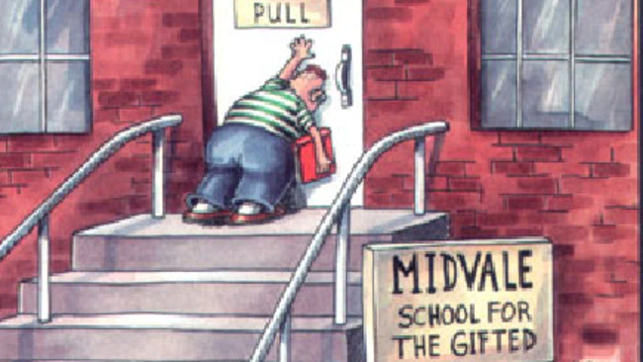
A problem with instructional manipulations
Participants don’t always follow instructions!
If an experiment finds no effect it could be that:
There is no effect to find.
Or
People didn’t follow the instructions

Slide 46
Solutions to the problem of instructional manipulations
Measure understanding of the instructions (at beginning and end of the experiment).
This shows participants at least knew what they were supposed to do.
Ask for compliance with instructions
This shows participants say that they tried to do what they were supposed to do. (Or that they lied about it).
Include a manipulation check
This shows that some aspect of behaviour was changed by the manipulation (just not the main one).

Slide 47
Example of manipulation checks
You want to know whether people’s presentations are rated higher if they are told to smile a lot (vs no instructions).
Independent variable: Instruction for to smile (vs no instruction)
Dependent variable: Rated quality of presentation (by judges).
Possible manipulation checks:
Independent observers count number of smiles (or time spent smiling)

