Slide 1
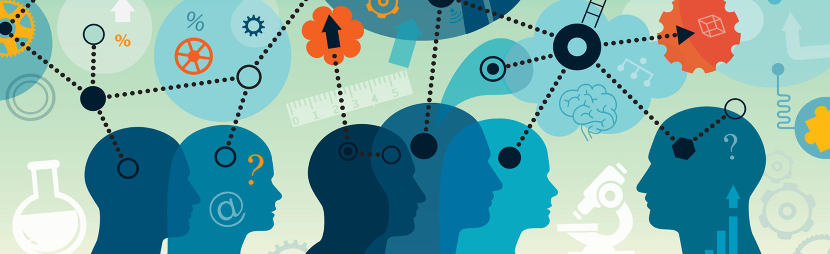
Science, Truth, and Honesty
Prof. Andy Wills
https://calendly.com/andy-wills/15-min-office-hour-appointment

Slide 2
Module overview
Delivery
11 x 2-hour lectures
10 x 1 hour workshops
3 x 1 hour tutorials

Slide 3
Aims
Psychological Knowledge:
To introduce some key concepts and methods in psychological research.
To explore how biological, cognitive and social variables interact with decision-making and behaviour / health.
Research Skills:
To develop new research and numeracy skills by designing, conducting, and disseminating a small psychological experiment.

Slide 4
This lecture covers two broad topics
Psychology as a science
Research ethics in Psychology

Slide 5
Reading associated with this lecture
Research Methods in Psychology, 4th Edition
https://kpu.pressbooks.pub/psychmethods4e/
Chapters 1 and 3

Slide 6
What is science?
What words come to mind to describe science?
How scientific are these subjects?
Physics
Geography
Psychology
Music

Slide 7
How do we acquire “knowledge” (and how do we know if it is “true”?)
1: Authority
We rely on accepting “facts” from others – particularly those we trust (including experts).
e.g. information from parents, friends, the media, textbooks, experts…
But this doesn’t guarantee truth.

Slide 8
How do we acquire “knowledge” (and how do we know if it is true?)
2: Logic / Reasoning
Formal logic and reasoning can lead to conclusions that are valid,
if the premises are true, and
if the logical rules are applied appropriately.
However, humans often make reasoning errors.

Slide 9
Formal logic
If a person is a heavy drinker they will damage their liver
This person has liver damage
Therefore this person is a heavy drinker? TRUE / FALSE

Slide 10

Logical example
e.g. (1) “If the election is fair, I will win”
“I did not win the election”
Therefore?
The election was not fair. TRUE / FALSE

Slide 11
Formal logic
If a person is a heavy drinker they will damage their liver
This person has liver damage
Therefore this person is a heavy drinker? TRUE / FALSE
This does not logically follow: there are other causes of liver disease.

Slide 12
This example is logically identical to…
My theory predicts that X will happen
My experiment shows that X happens
Therefore this proves my theory?
NO: This does not logically follow: there may be other explanations.
(e.g. other theories make the same prediction, there are other causes of X).
So, finding evidence consistent with a theory does not PROVE a theory.

Slide 13
Informal reasoning
Which of these two animals eats most food in day? (kg of food)
Elephant
Robin
Which city is further north?
London, England
Montreal, Canada

Slide 14
Reasoning informally
We often reason informally, by applying rules of thumb (“heuristics”)

Slide 15
Reasoning errors
We often reason informally, by applying rules of thumb.
e.g. larger animals eat more food.
e.g. places that are colder (more snowy) are further north
This kind of heuristic reasoning doesn’t guarantee truth.

Slide 16
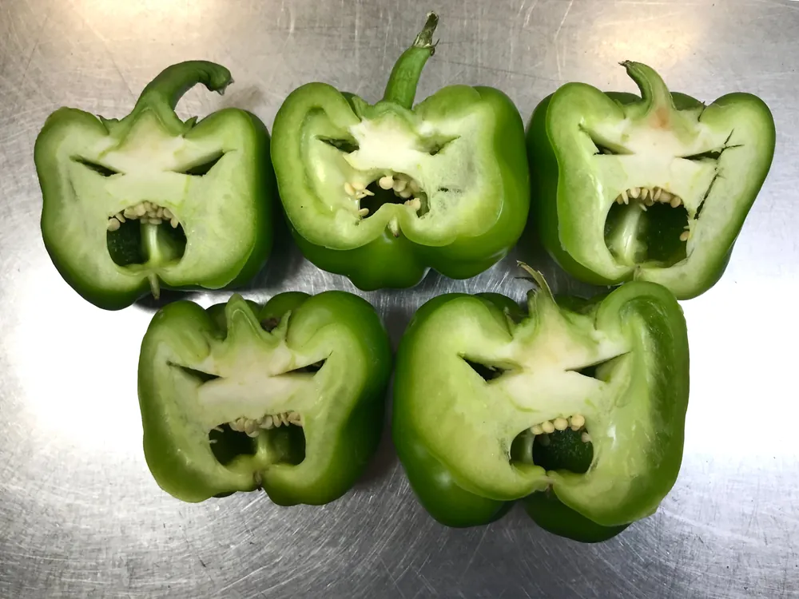
How do we acquire “knowledge” (and how do we know if it is true?)
3: Observation
People learn from observing the world all the time.
e.g. Head-butting the wall hurts.
Iron is heavier than water.
But often people “see” patterns that go beyond the data.
e.g. superstitious behaviours
The link between MMR and Autism
Faces in everyday objects

Slide 17
How do we acquire “knowledge” (and how do we know if it is true?)
4: The scientific method
This involves reasoning, logic and observations, but does so in a systematic, objective (and so replicable) fashion.
It has 3 key elements.

Slide 18

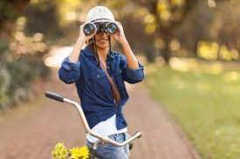


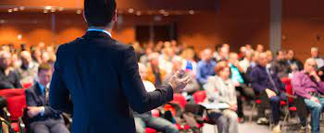
What is the scientific method?
Systematic observations
Empirical questions
Dissemination

Slide 19
What is the scientific method?
Systematic observations
Empirical questions
Dissemination
e.g. “People who prepare their own packed lunch tend to use an alarm clock”
e.g. If I run a survey on frequency of packed lunches, and use of alarm clocks, I will find a positive relationship.
e.g. I tell the world what I found.

Slide 20
What is the scientific method?
Systematic observations
Empirical questions
Dissemination
e.g. “Some children do worse than expected at school”
e.g. I have a theory that child-parent attachment problems could cause some children to be socially anxious. This could cause them to struggle at school, and in other social settings.
e.g. I tell the world what I found about my findings and my theory.
Notice here, a theory does 2 things:
Explains prior observations
Makes novel predictions (that can be tested)

Slide 21
Dissemination and Scientific progress
Without dissemination, knowledge is not shared.
Sharing leads other scientists developing new empirical tests that can confirm / disconfirm previous observations / theories.
This potentially provides a self-correcting aspect to the scientific method. Errors / misconduct are discovered by later scientists.

Slide 22
What the scientific method can (vs. can’t) do
It can be used to test measurable predictions about the world.
e.g. if we burn carbon fuels, the global climate will heat up.
Drug X can help people sleep.
Drivers under the age of 25 cause most traffic accidents
It cannot be used to make moral or value judgements.
e.g. Climate change is a bad thing
Drugging people to sleep is unhealthy.
Young people shouldn’t be allowed to drive.

Slide 23
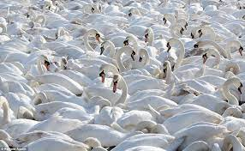
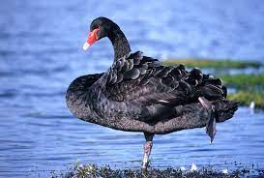
Testing theories
Observations can support (be consistent with) a theory, but they do not prove it.
e.g. the theory: All swans are white:
But observations can disprove a theory.

Slide 24
A scientific theory
Must be potentially refutable.
Not all theories can be disproved.

Slide 25
Are facts established by science actually “true”?
One criticism is that science isn’t truly objective. There are biases in
The questions asked
The methods used
The interpretations made
Another criticism is that scientific facts are only true until they are disproved by an advance in our understanding.

Slide 26
Think of science as delivering answers that are less wrong.
An answer that is less wrong is more useful.
i.e. we can make better predictions about the world.
predictions that are more accurate (precision)
predictions that apply in more circumstances (generalisation)

Slide 27
Theories can be more or less accurate
e.g. You observe an outcome (in a psychological experiment) that is consistent with Theory A, but not Theory B.
For this outcome, Theory A is better than Theory B.
Theory A is less wrong than Theory B (in this instance).

Slide 28
Psychology as a science
Human behaviours can be observed.
Predictions about human behaviour can be tested.
The results can be disseminated
(Theories can be developed).
i.e. Psychological knowledge is the result of the scientific method.

Slide 29
Some questions (answer ’yes’ or ‘no’)
Sometimes I feel happy
Sometimes I feel sad
Intelligent people are good at problem solving
Some people are prejudiced
Memory tends to get worse as you get old
People often shout when they are angry
It's hard to concentrate when you are bored

Slide 30
Psychological constructs
You just made a series of judgements about common psychological constructs:
Happiness
Sadness
Intelligence
Prejudice
Memory
Anger
Concentration / boredom
You didn’t have difficulty in accepting these constructs exist.
But none of them exist in the physical world.
i.e. they can’t be directly measured.

Slide 31
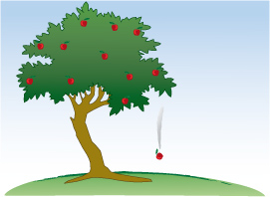

This is a common approach in science
= “Gravity”
These are both observations of the effects of the underlying construct.
We can’t “see” time or gravity.
= “Time”

Slide 32
The nature of Psychological evidence
1: Psychological constructs are not measured directly.
2: For any psychological construct we expect people to vary.
3: Variations in psychological constructs are often caused by many things.
4: Measurements of psychological constructs are often “reactive”.

Slide 33
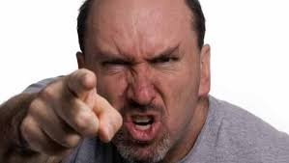
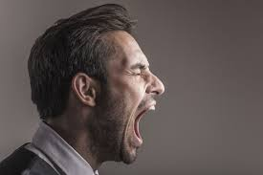
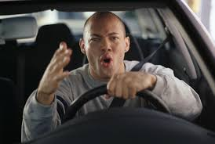
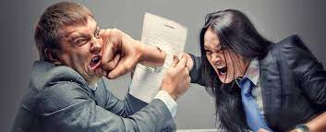
The nature of evidence in Psychology (1).
Psychological constructs are inferred from observable behaviours
Aggression

Slide 34

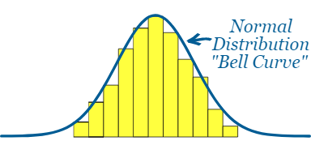
The nature of evidence in Psychology (2)
Imagine you measured the weight of each member of a set of objects to the nearest kg.
Set 1 is 1-litre bottles of water. Set 2 is people.
Water
People

Slide 35
People differ on psychological constructs.
In fact, variation occurs both:
Across people.
e.g. some people are generally more aggressive than others.
2) Within the same people.
e.g. Sometimes I am happier than usual, and sometimes less.
Happiness
Aggression
Hours of sleep per night
Spatial navigation skills
Verbal skills
Ability at basketball
Love of pets
etc

Slide 36
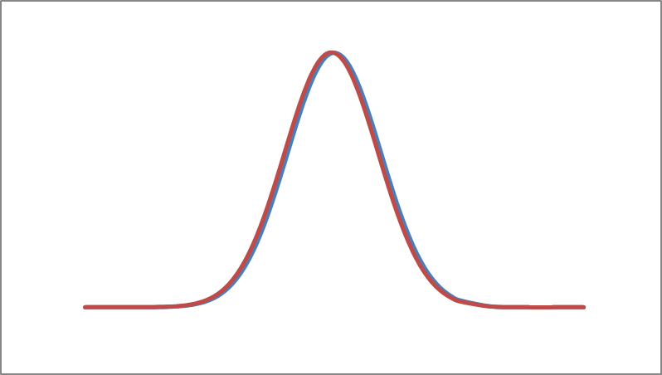
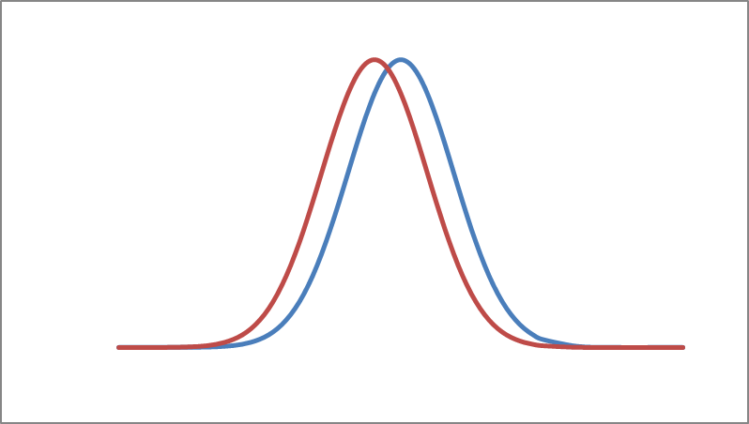
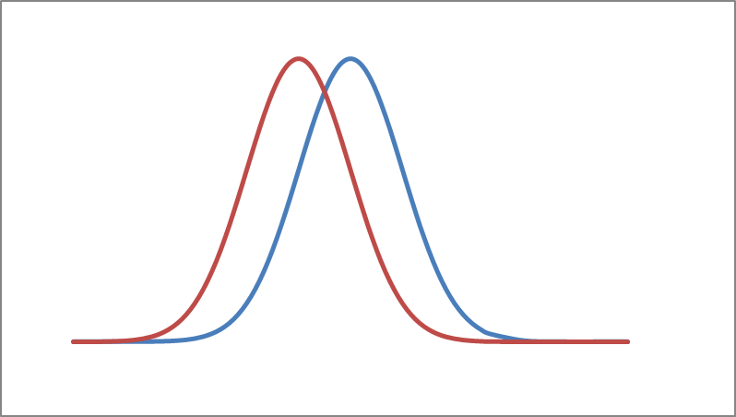
e.g. how talkative are men vs women?
Here, while men and women both vary in talkativeness, this shows no sex difference at all.
Here, men and women both vary in talkativeness, but men are slightly more talkative. But the two distributions overlap substantially.
Here, men and women both vary in talkativeness, but men are more than slightly more talkative. But the two distributions still overlap a lot

Slide 37
The nature of evidence in Psychology (2)
The evidence is probabilistic, not absolute.
e.g. the average man is taller than the average woman, but…
some women are taller than some men.
Caffeine tends to increase alertness overall, but…
some people may be more alert without caffeine than others with caffeine.
Swans are more likely to be white than Robins, even though…
not all swans are white!

Slide 38
The nature of evidence in Psychology (3).
Any particular underlying construct can be determined by many factors
Concentration
Personality
Environmental distraction
Time of day
Caffeine
Task difficulty

Slide 39
The nature of evidence in Psychology (4).
Human participants are not passive “subjects” of an experiment – they react to being tested.
Creativity
Motivation
Experimenter effects
Cheating
Willingness to please
Strategy

Slide 40

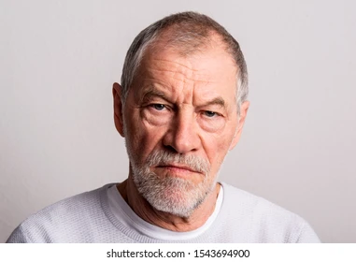
Reactive effects
How stressed do you feel right now?

Slide 41
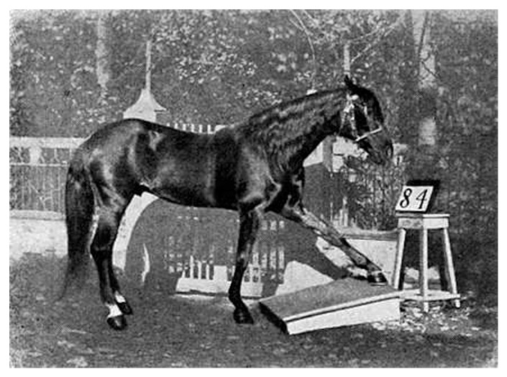
Clever Hans – the thinking horse (1904)

Slide 42
Implications for psychological evidence
Choose measure(s) carefully (base on prior research if possible)
Use carefully controlled conditions (and report them).
Avoid obvious biases that could influence the outcome.
Expect people to vary.

Slide 43
Part 2: Ethical issues in running Psychological research
Risk / Benefit analysis
Acting with integrity
Acting fairly / justly
Showing respect

Slide 44
Discussion: Risk vs benefits
Social problem: there is an ongoing dispute as to whether therapy can create false memories of childhood trauma.
A researcher decides to try to get people to “recover” a memory that is known to be false, using methods reported by therapists, such as guided imagination.
What are the risks vs benefits of this kind of research?
What would decrease the risk?
What would increase the benefit?

Slide 45
Discussion 2: Respect
For the purposes of research, is it ever justified to lie or otherwise deceive participants?
Hint: Think about different levels or degrees of deception

Slide 46
From principles to guidelines
Experiments involving human (or animal) participants require ethical approval (by a suitably appointed ethics committee).
For your group project, you will have to get ethical approval, before you recruit anyone to take part in your research.

Slide 47
The ethics form should detail:
what will happen to the participants
and where necessary, to justify these (i.e. Benefit vs risk).
the level of anticipated harm / risk
and what steps taken to reduce these
How participant’s rights are protected
Informed consent
Treated with respect (including not being deceived unnecessarily)
Right to withdraw
Anonymity
Brief and Debrief

Slide 48
Ethical process for your group projects
Your ethics approval request should detail
Confirmation of who your sample will be
An outline of your research procedure
Explanation of how you have considered and dealt with potential ethical concerns
The nature of the data you plan to collect
A copy of the Brief and Debrief you plan to show participants
A consent form.

Slide 49
Informed consent
Participants should the necessary information to judge whether they wish to participate.
What will happen to them?
What is expected of them?
What are the potential harms / risks?
What are their rights? (more later)
What rewards (if any) are on offer?
Note: the level of information needs to be balanced against the aims of the experiment (i.e. the potential benefits)

Slide 50
Treated with respect
The language used with the participant should be appropriate.
The experimenter should not be judgmental / authoritarian (etc).

Slide 51
Right to withdraw
A participant has the right to withdraw their consent at any point.
i.e. even having signed a consent form, they can stop.
They can even request their data not be used after the end of the experiment.

Slide 52
Right to Anonymity
Participants have the right to remain anonymous in all aspects of the research, in particular
During dissemination of the results.
On digital records.
In fact under GDPR legislation, there are serious penalties if identifying information is recorded without permission, or stored / shared inappropriately.

Slide 53
Brief
The aim of the brief is to tell participants what is going to happen here possible, why), so that they can give informed consent.
There is a balance between giving enough information, and giving information that may affect the outcome of the study.

Slide 54
Debrief
The aim of the debrief is to tell participants the purpose of the experiment once it is over.
Remember, if there are multiple conditions, they may not have experienced all of them.

