Slide 1

PSYC003: Psychological influences on Health and Behaviour: Lecture 3
Prof Tim Hollins
PSQ A219
Office hours: Fridays 10-1pm
https://dle.plymouth.ac.uk/mod/scheduler/view.php?id=1402630

Slide 2
Reading for this lecture
Research Methods in Psychology, Chapter 4

Slide 3
Psychometrics
Psycho = “of the mind” (mental) + metric = “measurement”
Psychometrics is concerned with measurement of mental constructs, and theories that explain the pattern of findings.
Measurement is a systematic procedure by which numerical scores are assigned to a set of objects, where these scores represent the characteristic of interest.

Slide 4
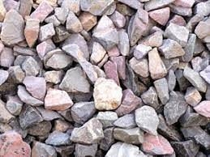
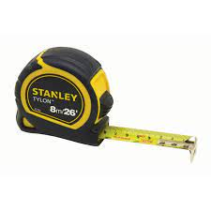
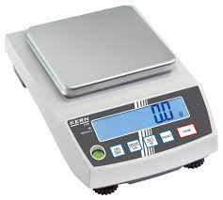
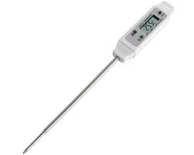
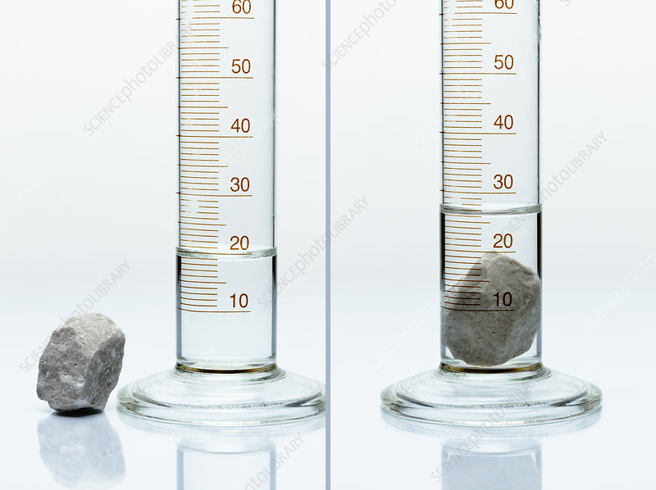
Measurement
Q: How could you find out which is the largest stone by volume?
These are tools for converting physical properties of the stones into a numerical value that can be used to distinguish between them.

Slide 5
Two key properties tools need to be useful.
Reliability
They give the same answer when used twice.
They give the same answer if two different versions of the tool are used.
Validity
They accurately measure the right physical property.
i.e. if you want to measure volume, they measure volume, not weight, or temperature.

Slide 6
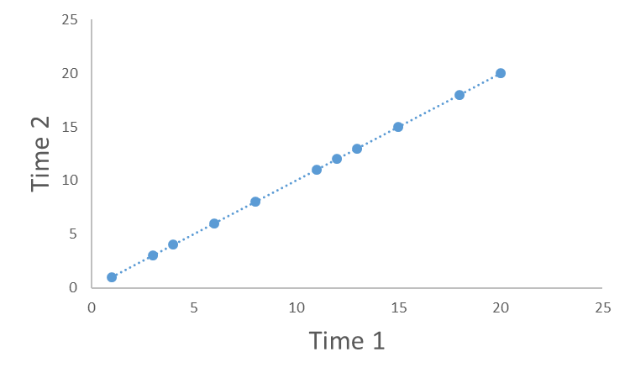
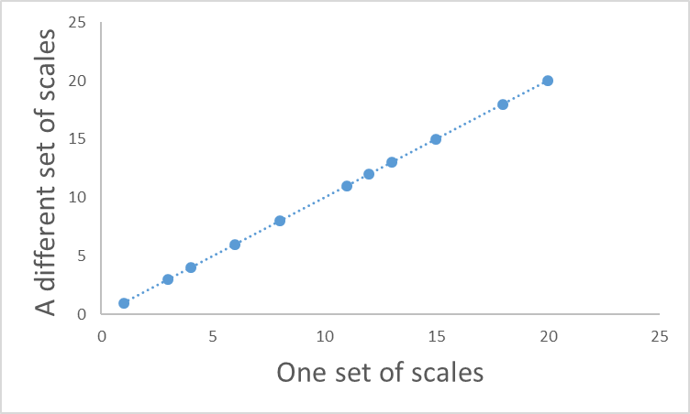
What would reliability look like?
Test – retest reliability
Parallel forms

Slide 7
A crucial point about reliability and validity.
A measure can be reliable without be valid.
e.g. scales measure weight accurately, but this does not make them a good measure of temperature.
A measure that is not reliable is not valid.
If a measure gives a different answer each time (is unreliable), then the reading you get can’t be a valid measure of anything
i.e. a faulty set of scales does not a valid measure of weight.

Slide 8
Psychometrics is commonly concerned with relatively stable constructs that people vary on (called “traits”).
e.g. Personality (e.g. extraversion, openness to experience etc).
Ability (e.g. verbal abilities, musical ability, general intelligence)
Beliefs / Attitudes (e.g. political orientation, spirituality)
But it can also measure more temporary “states”
e.g. Mood, stress

Slide 9
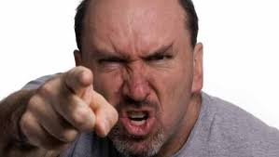
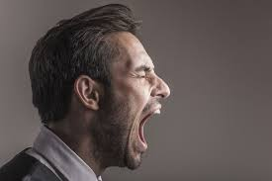
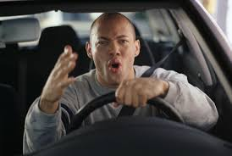
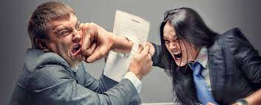
Remember this slide from Lecture 1?
Psychological constructs are inferred from observable behaviours
Aggression

Slide 10
How could we develop a tool that provided a reliable measure of aggression?
Behavioural observation of the behaviours we think are caused by aggression
Self-report of those behaviours

Slide 11
But how do we know if it reliable and valid?
1: Reliability
Getting the same score twice.

Slide 12
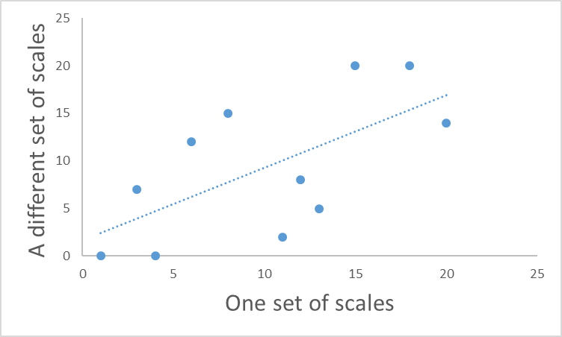
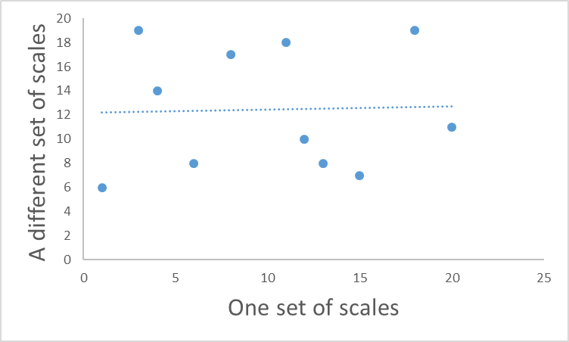
Back to reliability
Perfect reliability
One score is exactly the same as the other.
Knowing one score tells you exactly what the other score will be.
Zero reliability
One score is completely unrelated to the other.
Knowing one score tells you nothing about what the other will be
?

Slide 13
Reliability
Another way of expressing the concept of reliability, is predictability.
Here, one score perfectly predicts what the other score will be.

Slide 14
Scatterplots and correlations
A scatter plot is the figure you get when you plot the value of two observations against each other.

Slide 15
Scatterplots and correlations
The blue dotted line represents the best “fit” between the observations.
Notice that this line goes up.
(Has a positive slope)
This means that as one measure goes up, so does the other one.

Slide 16
Scatterplots and correlations
The “fit” of the line is how far away the dots fall from the best possible line.
Here we can measure how far away each point is (the red lines), and add them up.
The smaller the total, the closer on average the dots are to the line.
If the dots fell exactly on the line, the total would be zero – a perfect correlation.

Slide 17
Correlation values
Value | Interpretation
1 > r > 0.6 | A strong positive correlation: as one variable increases, so does the other.
0.6 > r > 0.4 | A moderate positive correlation
0.4 > r > 0.2 | A weak positive correlation
-0.2 < r < 0.2 | Weak to non-existent correlation
-0.4 < r < -0.2 | A weak negative correlation
-0.6 < r < -0.4 | A moderate negative correlation
-1 < r < -0.6 | A strong negative correlation: as one variable increases, the other decreases.

Slide 18
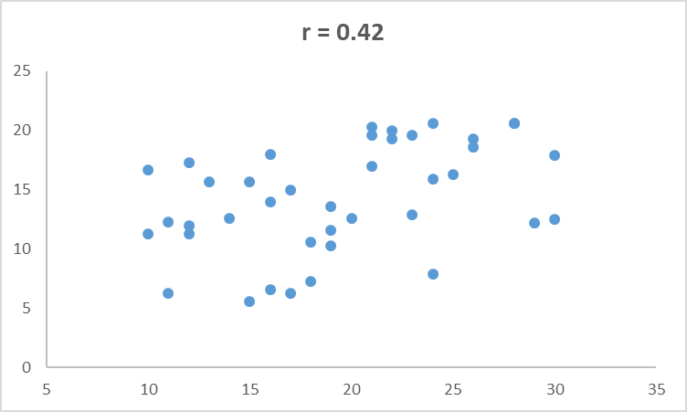
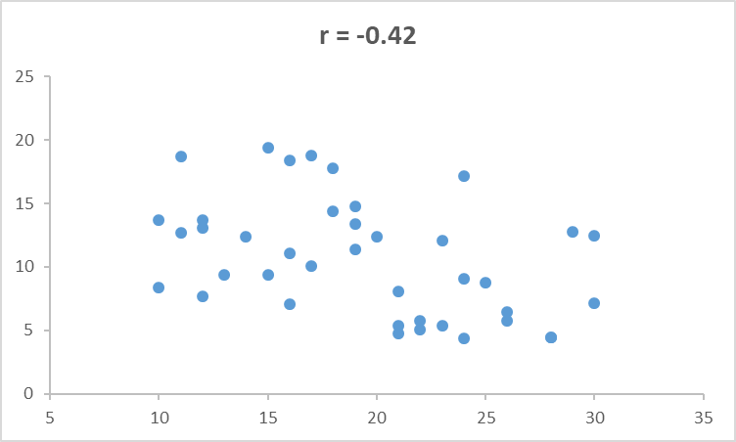
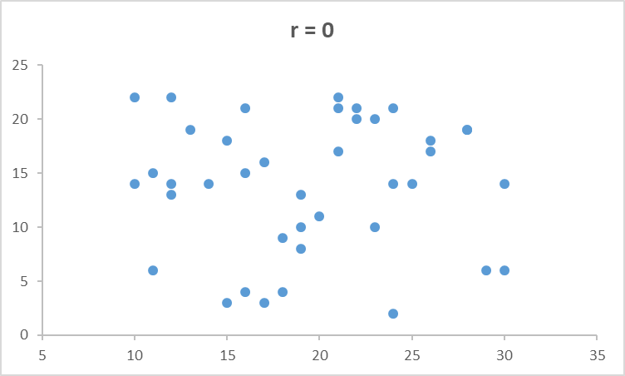
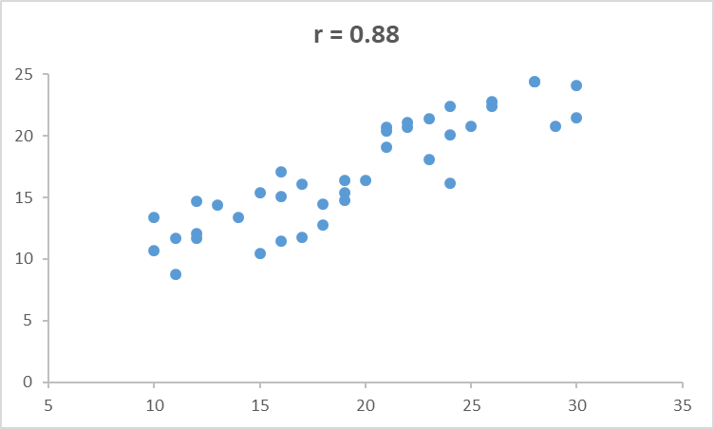
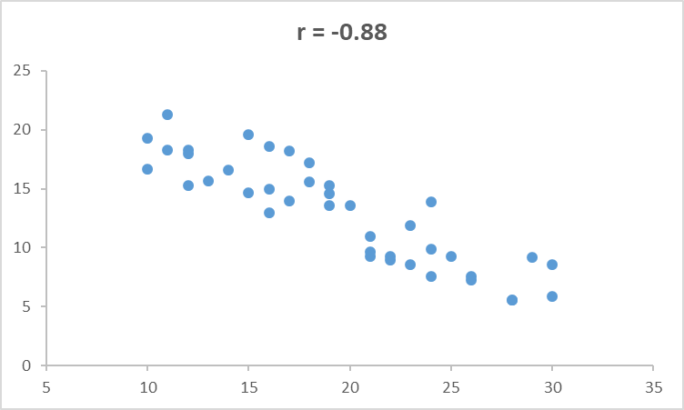
Positive vs negative correlations:

Slide 19
Some limitations of (simple) correlations
1: They only measure the linear relationship between two variables.
2: Their value depends upon the variation in each variable
- this is related to the sample you measure
3: They require that each variable is (roughly) normally distributed
- they are affected by extreme values.

Slide 20
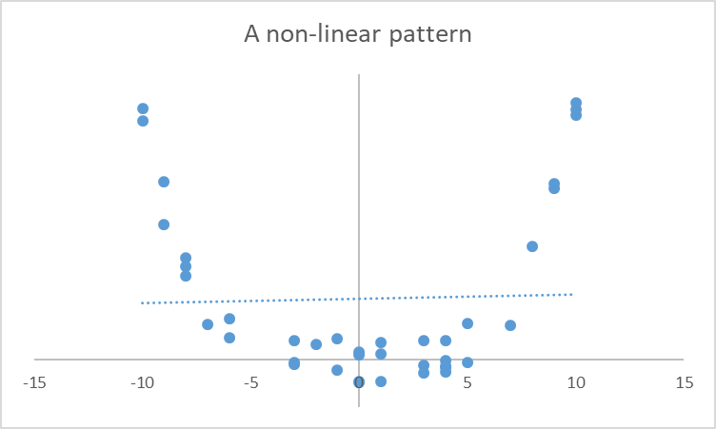
Correlations only measure linear relationships
Here there is a clear relationship between the two variables – just not a linear one.
Consequenly a single straight line will never “fit” the data very well – the correlation is nearly zero here.

Slide 21
The effect of restrictions of range
r = - 0.2
A restricted range
Here the whole sample shows a moderately
positive correlation.
But if we restrict the range (to only high-scorers on the
Test), the correlation value reduces. This is because there
isn’t so much variation in the test scores in this sample.

Slide 22
The effect of restrictions of range
r = - 0.16
Here the whole sample shows a moderately
positive correlation.
The same happens if we only look at the low scorers.

Slide 23
The effect of extreme values
r = 0.61
Here the whole sample shows a moderately
positive correlation.
Picking only the highest and lowest scores
increases the correlation. This is because the extreme
scores don’t overlap as much as those in the middle.

Slide 24
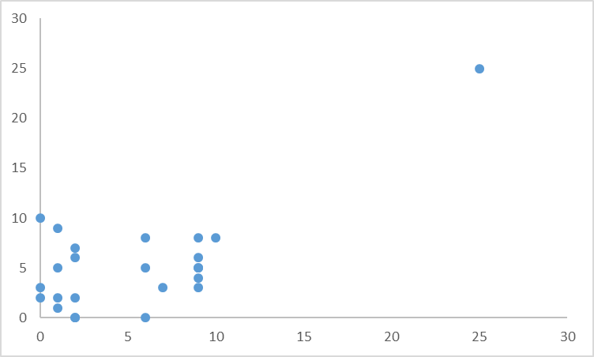
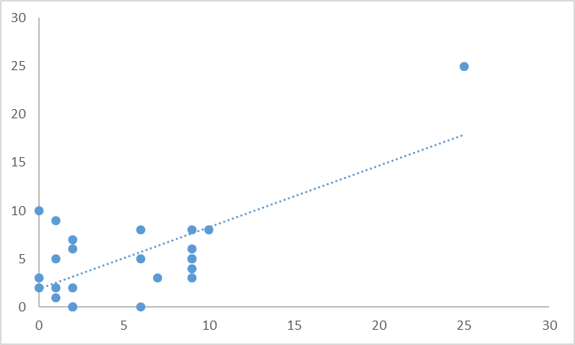
The effects of extreme values
r = 0.01
r = 0.61
This set of points represents a near zero correlation.
Adding a single extreme value increases the correlation value.

Slide 25
Reliability of multiple-item scales.
So, we have focused on two (overall) scores
Either time 1 vs time 2 (test-retest reliability)
Or test 1 vs test 2 (parallel form reliability).
We can extend this to multiple measures and use the results to increase reliability (and also validity – see later).

Slide 26
Increasing the reliability of a measure.
Any test score obtained consists of two components
Score obtained
=
the true score
+/-
noise
Other factors that might influence the outcome
e.g. motivation, attention, understanding instructions etc.
The underlying construct being measured.

Slide 27
Increasing the reliability of a measure.
Any test score obtained consists of two components
Score obtained
=
the true score
+/-
noise
Other factors that might influence the outcome
e.g. motivation, attention, understanding instructions etc.
The underlying construct being measured.
If the score obtained is mostly the true score, with little noise, then the score obtained will be reliable!

Slide 28
Increasing the reliability of a measure.
Any test score obtained consists of two components
Score obtained
=
the true score
+/-
noise
Other factors that might influence the outcome
e.g. motivation, attention, understanding instructions etc.
The underlying construct being measured.
If the score obtained is mostly noise, then the score will be unreliable!

Slide 29
Increasing the reliability of a measure.
Any test score obtained consists of two components
Score obtained
=
the true score
+/-
noise
Other factors that might influence the outcome
e.g. motivation, attention, understanding instructions etc.
The underlying construct being measured.

Slide 30
What if we take multiple measures
1
Score obtained
=
the true score
+
noise
2
Score obtained
=
the true score
-
noise
3
Score obtained
=
the true score
+
noise
4
Score obtained
=
the true score
+
noise
5
Score obtained
=
the true score
-
noise
Average
Score obtained
=
The true score
+
1 / 5 noise
Notice that the average score has less noise in it. So it is MORE reliable.

Slide 31
Therefore
Multiple measures (of the same thing) give you a more reliable measure.
This is why most scales and tests contain multiple items to measure the thing they are interested in.
e.g. personality tests, ability tests etc.

Slide 32
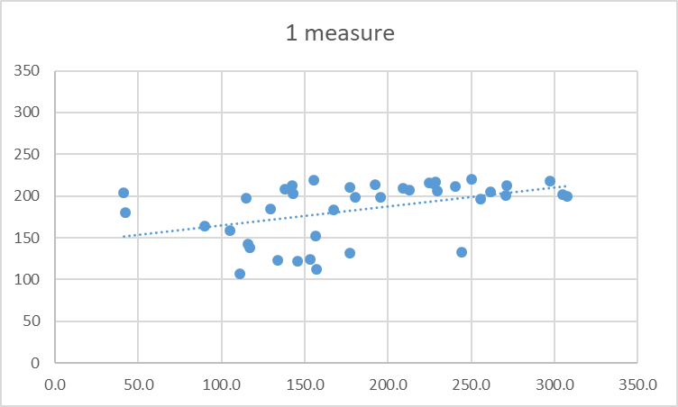
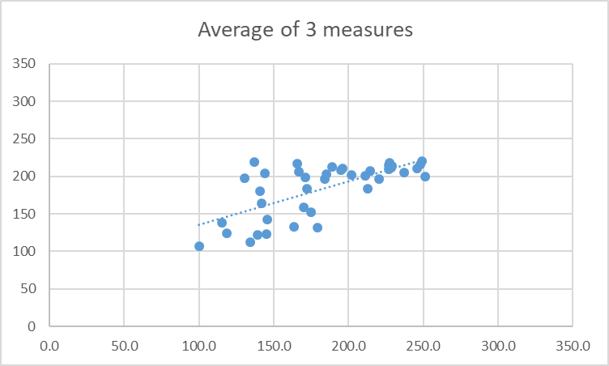
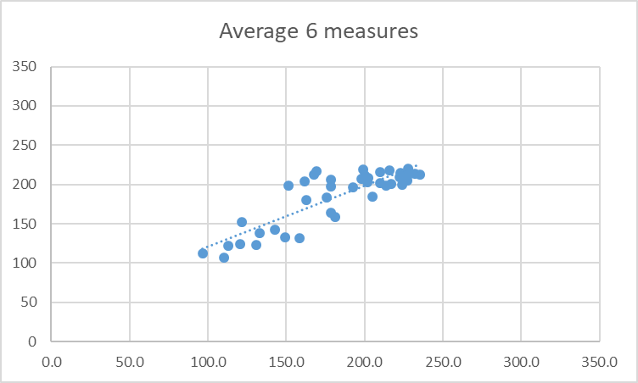
If you have enough measures, you can get an accurate reading, even if each individual measure is noisy.
r = 0.43
r = 0.68
r = 0.85
True score
True score
True score
One moderately reliable measure
Average of 3 moderately reliable measures
Average of 6 moderately reliable measures
Notice, by adding (or averaging) multiple measures, as well as higher correlations, there are fewer outliers, and the slope becomes more accurate.

Slide 33
The effect of averaging across more predictors is an example of the law of small numbers.
The “law of small numbers” is the false belief that small samples provide a good representation of the population they come from.
Examples:
…that restaurant is rubbish because my friend had a bad experience.
…this course will be boring because the first lecture was dull.
…University X will be great, because their Open Day was great.
ALL THESE EXAMPLES HAVE A SAMPLE SIZE OF 1.

Slide 34
These examples are NOT necessarily true.
Small samples result in averages that are more likely to be further away from the true (population) average than averages from larger samples.
Because small samples are noisier measures!

Slide 35
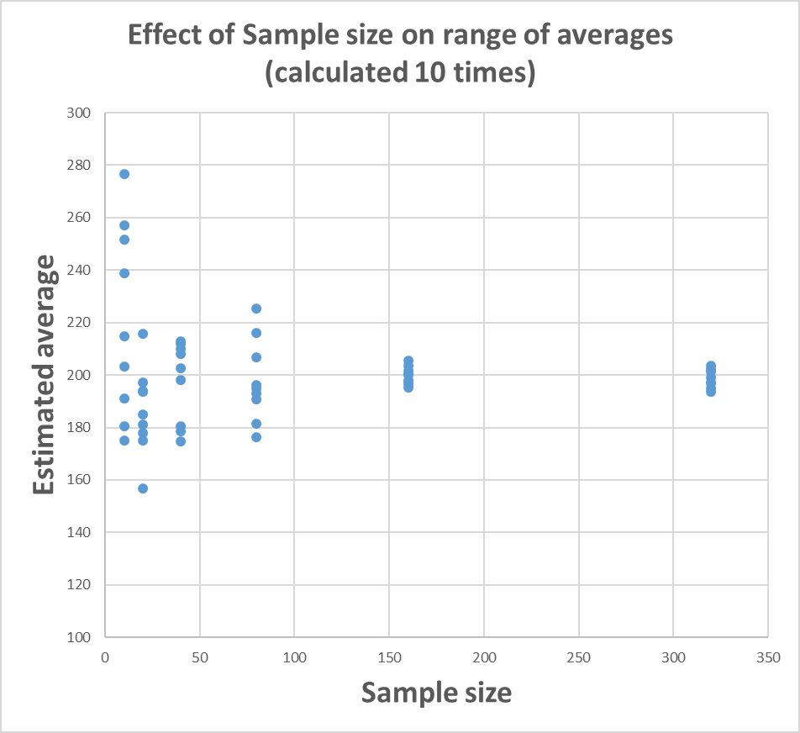
Small samples likely to give more extreme estimates of true average
10 estimates from small samples (n = 10)
10 estimates from large samples (n = 320)
True average = 200

Slide 36
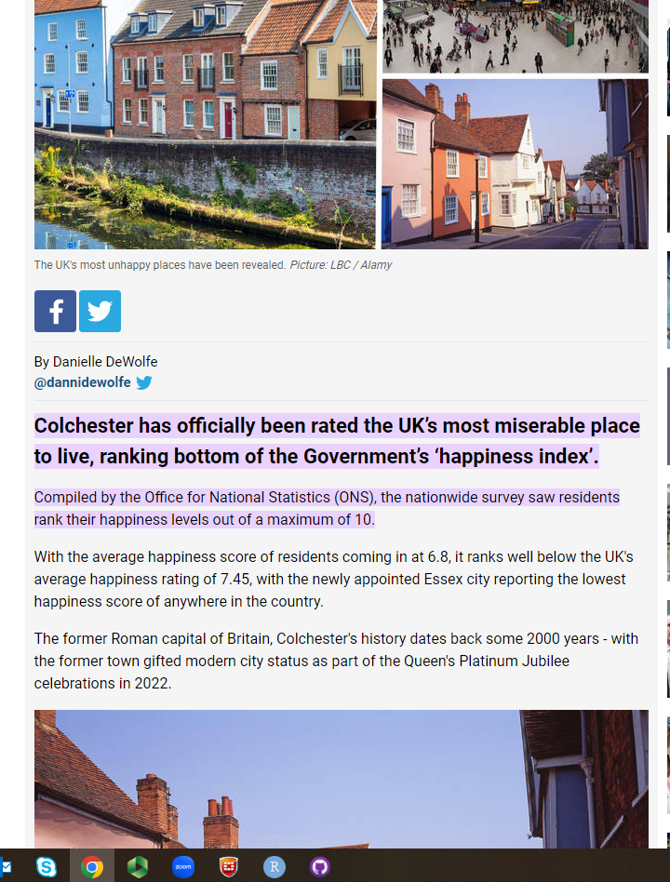
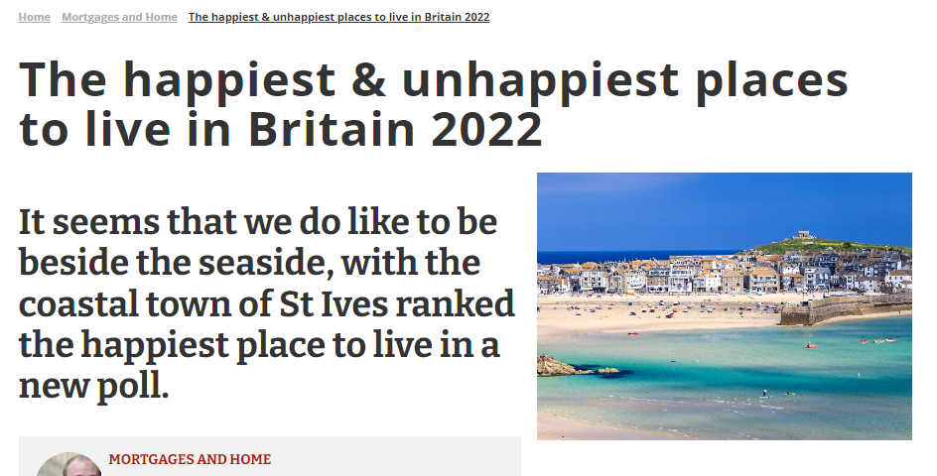
This is why we should be wary of media reports like this:
The “extreme” scores are most likely to come from SMALL samples. i.e. towns like St Ives and Colchester, not cities like Manchester or Birmingham.

Slide 37
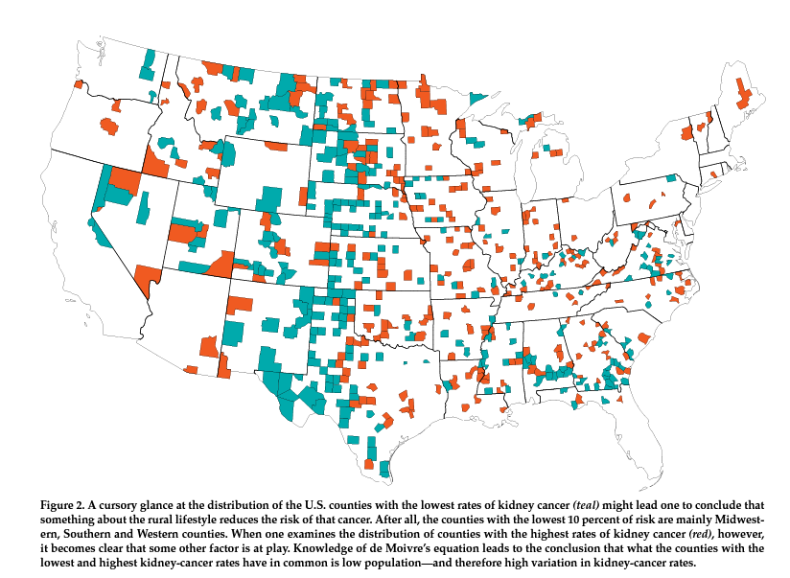
Another (more serious) example
Map of kidney cancer rates in the States.
Blue (teal) shows the areas with particularly low rates of kidney cancer.
Why might this be?
Red shows the areas with particularly high rates of kidney cancer.
What do you conclude now?

Slide 38
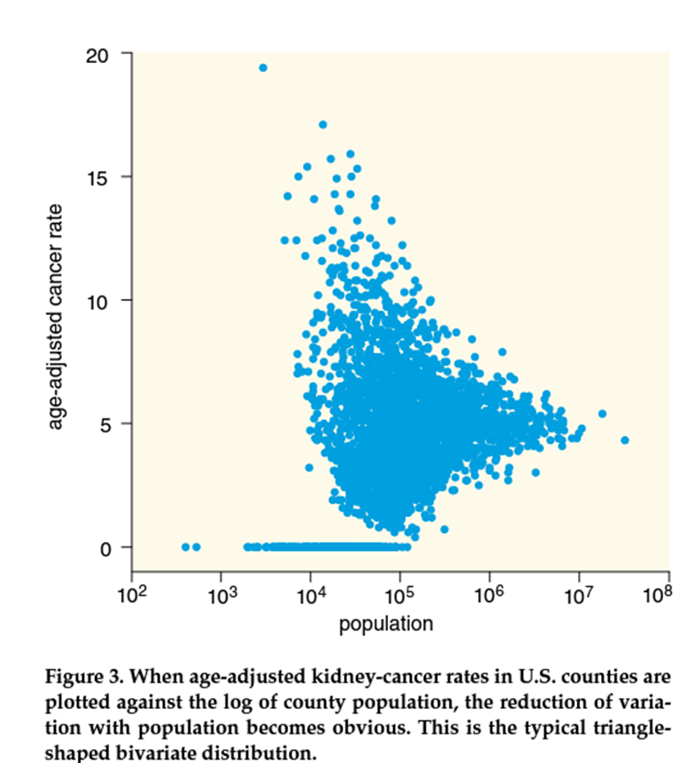
Plot of rates of cancer, based on population.
Here you can see that larger populations give more accurate estimates.
So areas within the same state show the highest AND the lowest rates of cancer, because those states have the lowest populations.

Slide 39
The opposite is to believe in larger samples.
E.g. Sir Francis Galton’s “wisdom of the crowd”
https://youtu.be/iOucwX7Z1HU
From 1:06

Slide 40
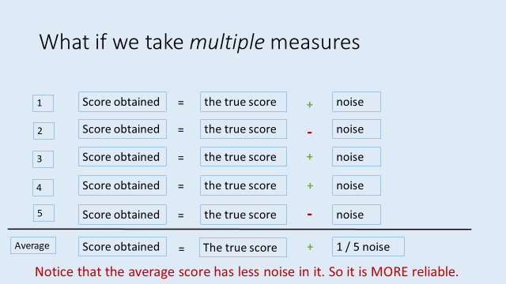
Wisdom of the (large) crowd
In the jelly bean example (or the original Cow example from Galton), the average is taken over a LARGE sample (160 in this case), and the result is a quite accurate average.
This implies that all people have some accuracy buried in lots of noise.
Averaging a crowd gets rid of the noise, and reveals the underlying estimate.

Slide 41
Wisdom of the (large) crowd
Another example comes from gambling / bookmaker’s odds.
One way of predict who will win a race (or an election) is to follow the money.
Each person might make a poor prediction, but the results of LOTS of bets can be quite accurate.
Bookmakers odds reflect where the money is placed.

Slide 42
Validity
Is the extent to which a measure, measures what it is supposed to.
i.e. that a thermometer measures temperature
that a extraversion test measures extraversion
that a spatial skill test measures spatial skill

Slide 43
Four kinds of validity (only 2 can be tested)
1: Face validity
Does the measure look right?
e.g. does a spatial skill measure have questions that test spatial ability rather than other kinds of ability.

Slide 44
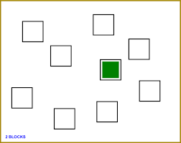
Four kinds of validity (only 2 can be tested)
2: Content validity
Does the measure sample all aspects of the construct?
e.g. for spatial skill, it might involve:
paper folding
mental rotation
spatial working memory capacity
remembering routes (etc)

Slide 45
Four kinds of validity (only 2 can be tested)
3: Predictive validity
Does the measure predict outcomes that are expected
e.g. a valid measure of spatial skill, should predict:
performance on other tests of spatial skill
differences between people we expect to vary in spatial skill (e.g. architects vs non-architects)

Slide 46
Four kinds of validity (only 2 can be tested)
4: Discriminant validity
Is the measure insensitive to factors that are unrelated to the construct being measured.
e.g. a valid measure of spatial skill, should NOT be related
to performance on a verbal reasoning task
should not relate to extraversion / introversion

Slide 47
Convergent and discriminant validity
Are measures of the correlation between the test and other measures.
Correlations that should be observed (convergent validity)
Correlations that should not be observed (discriminant validity)

Slide 48
Improving validity
Imagine you had a 4 measures of a construct (Measures 1-4).
You correlate each score with the average of the remainder.
i.e. correlate Score 1 with the average of 2,3 and 4
correlate Score 2 with the average or 1, 3 and 4
etc.

Slide 49
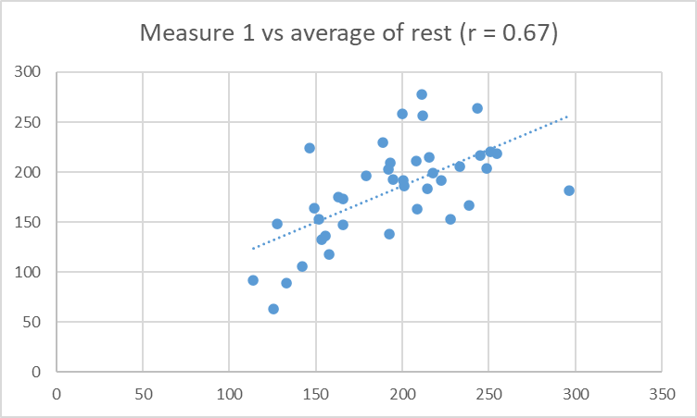
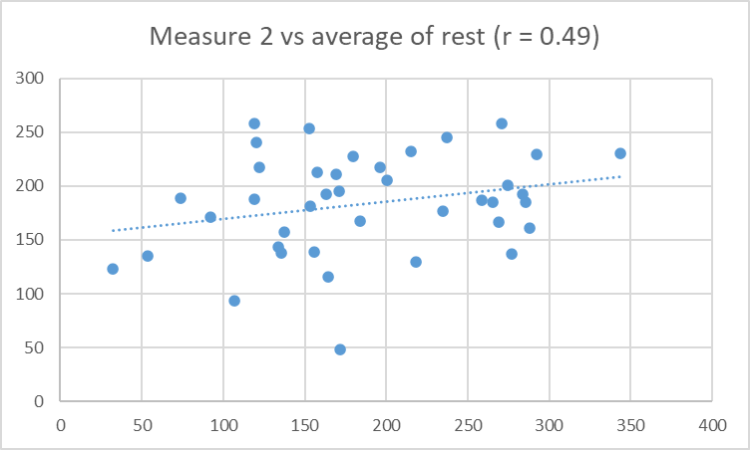
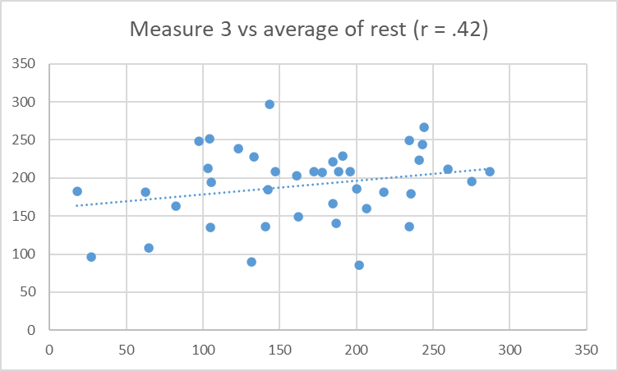
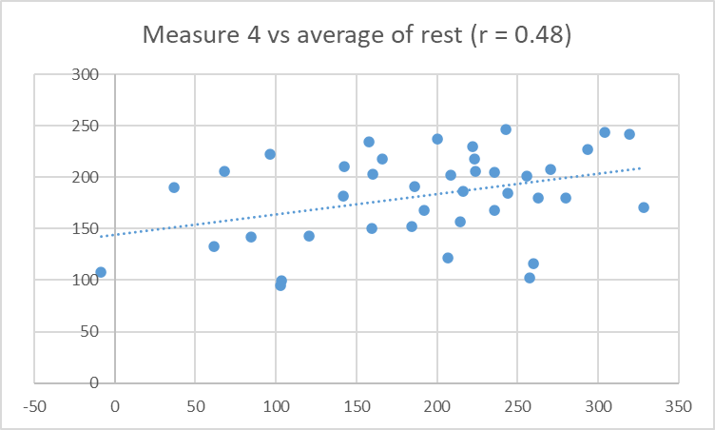
Imagine this was the outcome: Which is the best measure?

Slide 50
Imagine this was the outcome: Which is the best measure?
Measure 1 correlates (= predicts) the average of the remainder, better than any other measure does. It is the “best” measure of these 4 scores of whatever these tests share.

Slide 51
The use of psychometric tests in (job) selection
A very common use of psychometric tests is in job selection.
The assumption is that a job has a particular set of demands, and that the organisation wants to employ people who are “high” on those criteria.
e.g. ability: language / reasoning / spatial / problem-solving
personality: social skills / motivation / teamworking

Slide 52
Psychometric tests used in selection
In order to be successful, these tests need to be reliable, and valid.
A problem that organisations have is in defining what leads to success in a particular role. (i.e. how to define validity).

Slide 53
Psychometric tests used in selection
Problem 1: success may come from many different attributes.
e.g. A successful architect has to have spatial skills
but also
Ability to work with colleagues
Conscientiousness / drive
To be able to understand the needs of clients
Numerical ability
Cetc.

Slide 54
Psychometric tests used in selection
Problem 2: Defining validity from current (successful) employees might not work.
Did not apply for job
Employed by company
Applied for job but rejected
Knowing that current employees are successful doesn’t tell you whether those who were rejected, or those who didn’t apply could have been even better.

Slide 55
Psychometric tests used in selection
Problem 3: The predictive validity of different scales vary, in relation to their breadth / generality.
Specific ability scales are good predictors of similar skills.
e.g. mental rotation and ability to
General scales (such as personality measures) are less predictive.
e.g. motivation (to do what?)

Slide 56
The benefit of psychometric tests
For companies is their ability to reject unsuitable candidates.
For the employer, they don’t mind if they reject some good candidates, as long as they end up with a good employee.
What they don’t want is to employ someone bad at the job.

Slide 57
Selection issues with tests that vary in validity
Job
Performance
Psychometric test

Slide 58
Selection issues: a highly valid test
Low test score / high job performance
High test score / high job performance
The applicants perspective
If they are likely to be good at the job, most do well on the test.
The recruiter’s perspective
Too many people pass the test – we can’t interview all those.
Job
Performance
Psychometric test
Low test score / poor job performance

Slide 59
Selection issues: A high validity test, with higher selection criterion
Low test score / high job performance
High test score / high job performance
The applicants perspective
Lots of people who are could be good at the job don’t get interviewed. This isn’t “fair”.
The recruiter’s perspective
Only have to interview a few people.
All of them will be good at the job.
Job
Performance
Psychometric test
Low test score / poor job performance

Slide 60
Selection issues: A moderately valid test
Low test score / high job performance
High test score / high job performance
The applicants perspective
Quite a few who could do the job well don’t pass the test
The recruiter’s perspective
Too many people pass the test – we can’t interview all those.
The test only slightly improves the chance of getting someone good at the job
Job
Performance
Low test score / poor job performance
Psychometric test
High test score / low job performance

Slide 61
Selection issues: A moderate selection criterion and a high criterion
Low test score / high job performance
High test score / high job performance
The applicants perspective
Lots of people who are could be good at the job don’t get interviewed. This isn’t “fair”.
The recruiter’s perspective
Only have to interview a few people.
Quite a few will be bad at the job.
Job
Performance
Low test score / poor job performance
Psychometric test
High test score / low job performance

