Slide 1
PSYC003: Psychological Influences on Health & Behaviour
Exercise & Physical Activity
School of Psychology, University of Plymouth
Dr Rob Heirene
April 2023

Slide 2
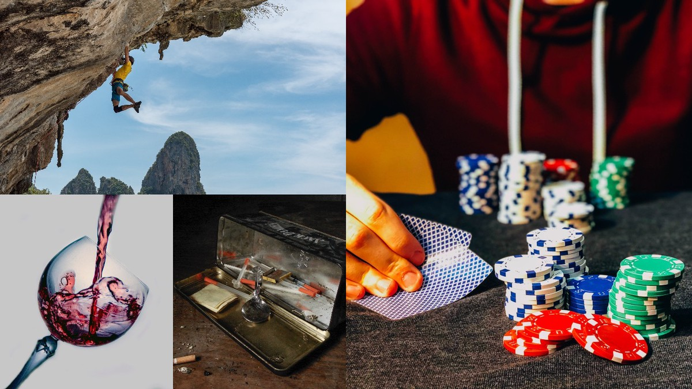
About me
Name: Dr Rob Heirene
Office: A210 Portland Square
Email: Rob.Heirene@Plymouth.ac.uk

Slide 3




About today’s class
Block 1
Healthspan
Importance of physical activity
Levels of activity
Burden of disease caused by physical inactivity
Physical (in)activity and mental health
Why is exercise good for us?
Who is (not) exercising?
Interactive task: How much are we exercising?
~10-minute break
Block 2
How can we increase physical activity?
Why do people (not) exercise?
Interventions to improve activity levels
Physical activity as an intervention
Depression
Addiction
Interactive task: prescribing exercise?
~5-minute break

Slide 4
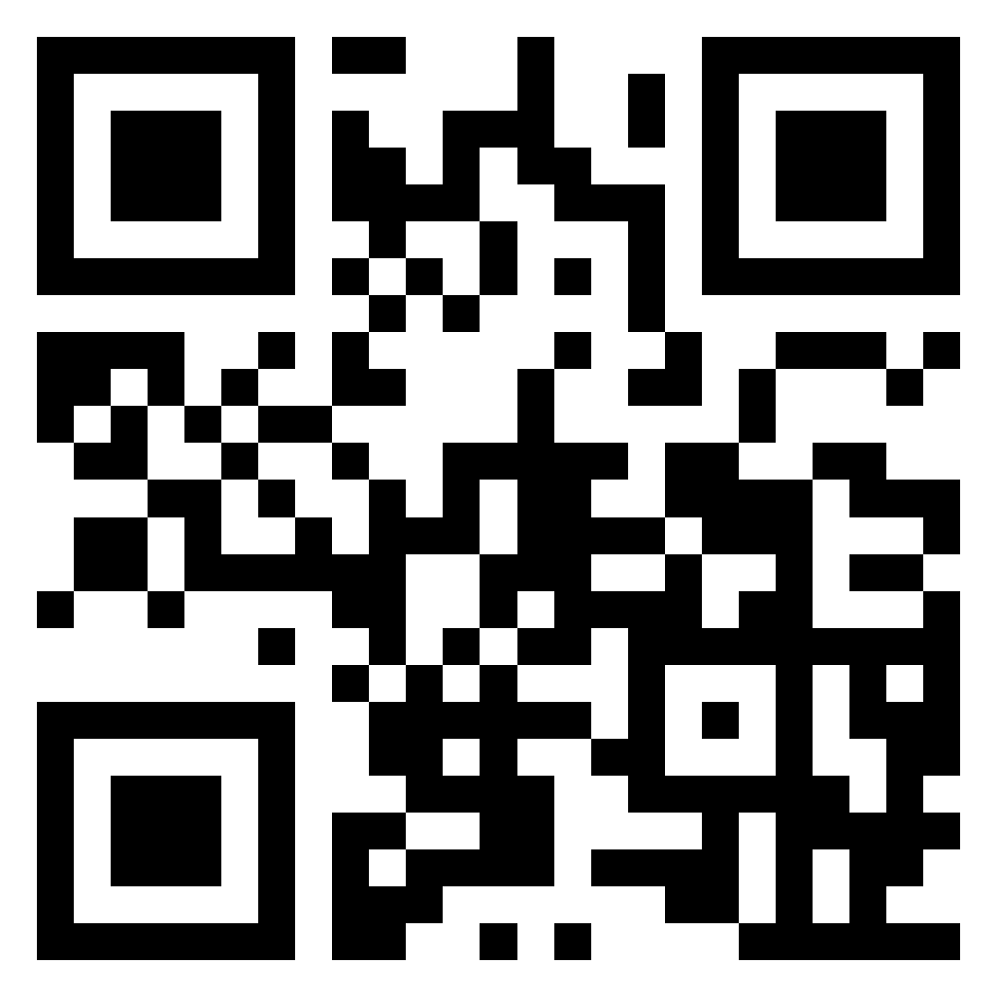
Recap quiz: Stress & Coping
Interactive task
Please go to the following site & enter this number:
TBC
2-question MCQ on diet and weight management from our last lecture:
Login to Menti and add your answers
https://www.menti.com/

Slide 5
Block 1 Importance of physical activity

Slide 6
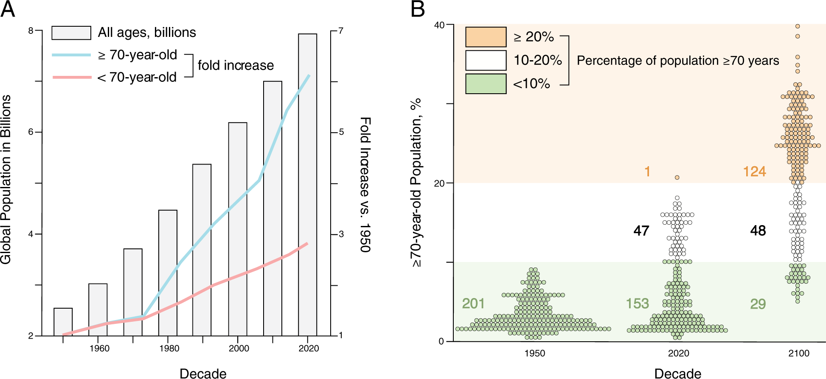
Healthspan
Garmany et al. (2021): Society is getting older

Slide 7
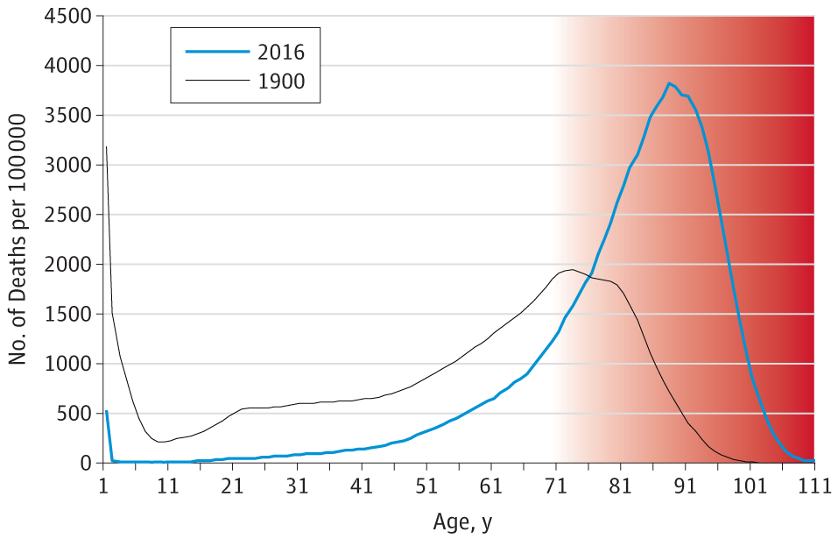
Healthspan
Olshansky (2018): Substantial increases in maximum lifespan are now unlikely:
“The inescapable conclusion from these observations is that life extension should no longer be the primary goal of medicine when applied to people older than 65 years of age. The principal outcome and most important metric of success should be the extension of healthspan.”

Slide 8
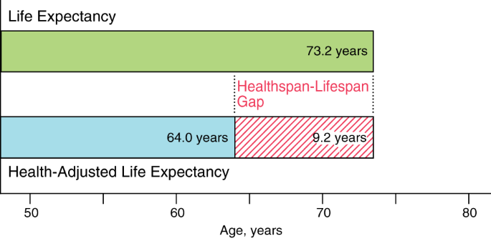
Healthspan
Lifespan: the total life lived
Health span: the period of life free from disease
Garmany et al. (2021)

Slide 9
Healthspan
Garmany et al. (2021):
“addressing modifiable risk factors, namely excess weight, physical inactivity, smoaking, and poor diet, would prevent 80% of deaths from non-communicable diseases, corresponding to 57% of all deaths”
Citing Choksi & Farley (2014) [Citation error?!?!]
Health risk behaviours: Behaviours that are thought to be damaging to our health
Also referred to as “behavioural pathogens”
Health protective behaviours: Behaviours that benefit our health and protect against illness
Also referred to as “behavioural immunogens”

Slide 10
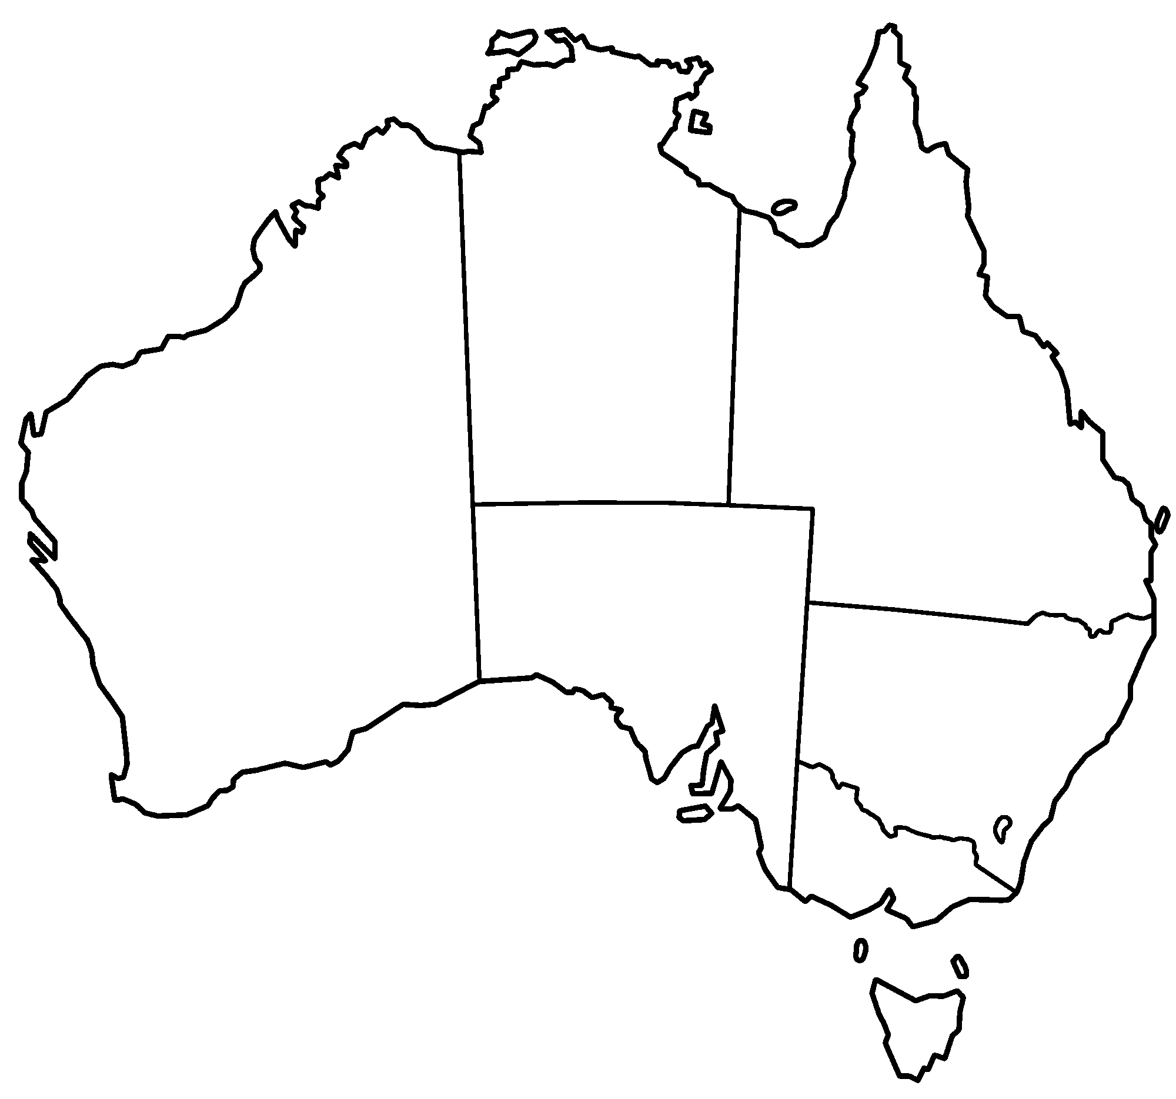
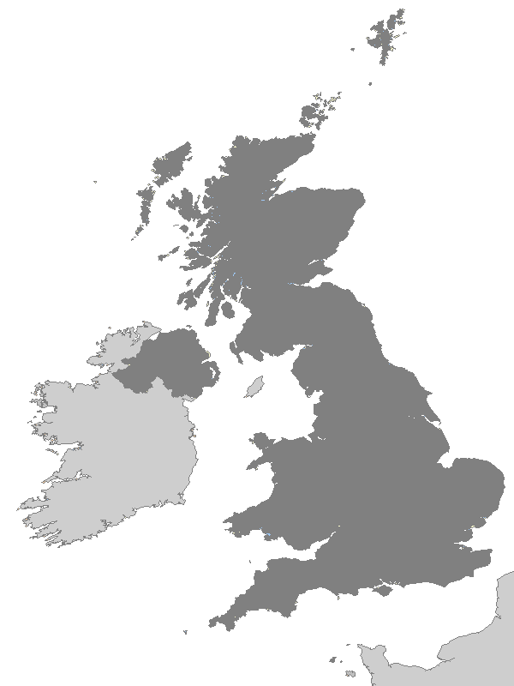
Importance of physical activity
Levels of activity
Australia
Each week, adults should do either:
2.5 to 5 hours of moderate intensity physical activity – such as a brisk walk, golf, mowing the lawn or swimming
1.25 to 2.5 hours of vigorous intensity physical activity – such as jogging, aerobics, fast cycling, soccer or netball
an equivalent combination of moderate and vigorous activities.
Include muscle-strengthening activities as part of your daily physical activity on at least 2 days each week.
United Kingdom
Each week, adults should do:
at least 150 minutes moderate intensity activity, 75 minutes’ vigorous activity, or a mixture of both
strengthening activities on two days
reduce extended periods of sitting
Sedentary behaviour: Being inactive, either sitting or lying down for long periods (strongly tied to screen-time in modern life)
Physical inactivity: Not meeting physical activity guidelines

Slide 11
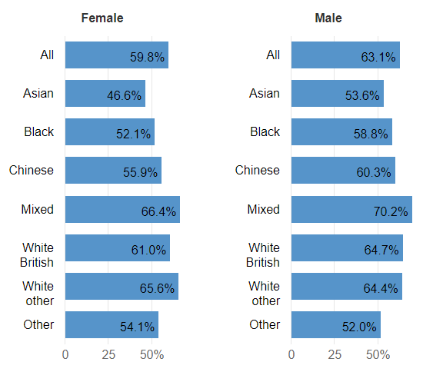
Importance of physical activity
Levels of activity
How active are the British?
UK government report: Physical activity (2022)
Data from November 2022 November 2021:
61.4% of people aged 16 or over work life is physically active
38.6% physically inactive
UK Gov Physical activity tool data (2020/21):
47.2% of people aged under 16 physically active
70.1% of 15-year-olds with a mean daily sedentary time of more than seven hours!

Slide 12

Importance of physical activity
Levels of activity
Clayton & Clayton (2022):
50% of UK adults know look at screens for 11 hours or more a day
Hedderson et al. (2023):
In young children aged 4-12 years, pre-pandemic screen time was 4.4 hours per day (average)
This increased to 6.15 hours per day during the first lockdown (average).
Higher screen time levels have remained since public health precautions were lifted.

Slide 13

Importance of physical activity
Burden of disease caused by physical activity
Why does it matter whether we’re active?
Leet et al. (2012):
6-10% of noncommunicable diseases can be attributed to physical inactivity
Responsible for 9% of premature mortality (5.3 million deaths in 2008)
Katzmarzyk et al. (2022):
8% of noncommunicable diseases attributable to physical inactivity
What about the economic cost of inactivity (Ding et al., 2016)?
53.8 billion in healthcare costs (31.2 paid for by the public sector)
13.7 billion in productivity losses
13.4 million DALYs

Slide 14
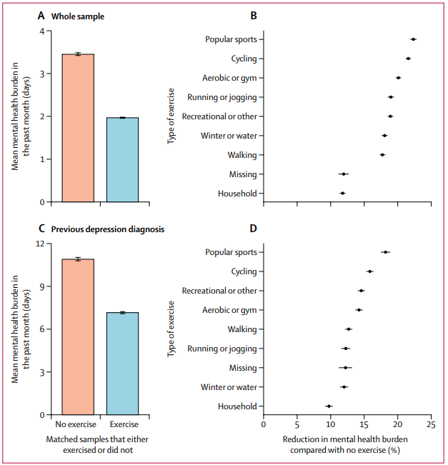
Importance of physical activity
Physical (in)activity & mental health
What about our mental health?
Chekroud et al. (2018): People who were physically active had a 43% reduction in the number of poor mental health days in the last month
Higher physical activity during the first year of the Covid 19 pandemic associated with higher self-reported well-being, quality-of-life, and lower symptoms of anxiety, depression, and stress (Marconcin et al., 2022)
Physical activity and happiness (Zhang & Chen, 2019):
Observational studies show consistent association between exercise levels and happiness
RCTs indicate improved happiness following exercise
Checkroud et al (2018)

Slide 15
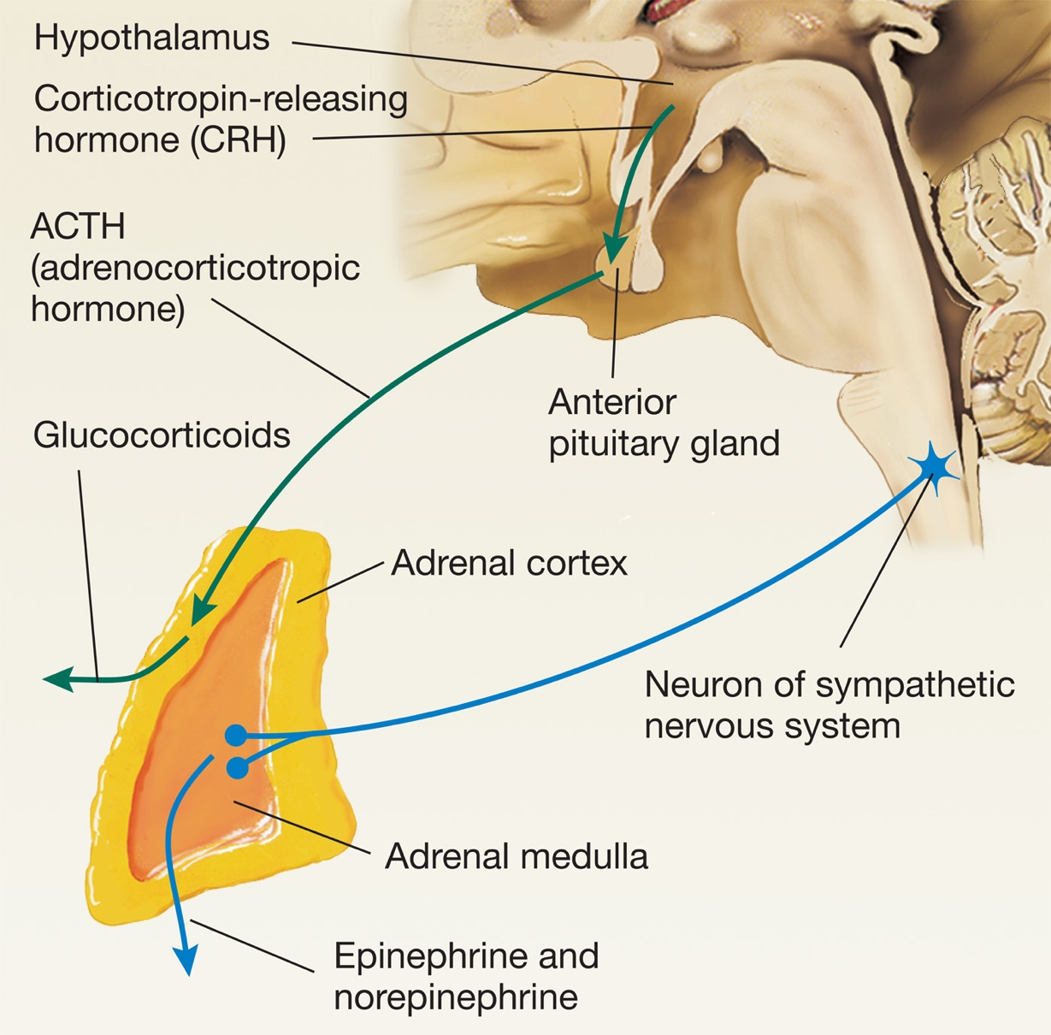
Importance of physical activity
Why is exercise good for us?
Physical health
(Morrison et al., pg. 116; Warburton et al., 2006)
Strengthens heart muscles
Increased cardiac & respiratory efficiency
Improved endothelial function
Lowered blood pressure
Reduced visceral & sub-cutaneous fat
Reduced inflammation
Increased bone density (Hong & Kim, 2018)
Increased strength & balance
Mental health
Increased catecholamines (Kruk et al., 2020)
Dopamine release (Basso et al., 2017)
Beta-endorphin release (Basso et al., 2017)
Increased neurogenesis in the hippocampus (Schoenfeld & Swanson, 2021)
Dampens stress response (Caplin et al., 2021)
Improved body satisfaction (Fuller-Tyszkiewicz et al., 2013; LePage, & Crowther, 2010)

Slide 16
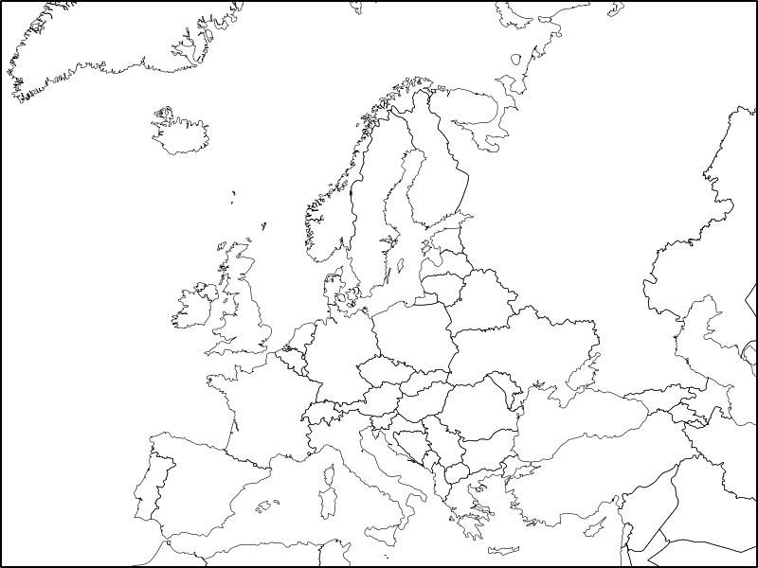
Importance of physical activity
Who is (not) exercising?
Correlates of physical activity: Can you guess the direction of effects?
Sex/gender
Age
Life satisfaction
Socio-economic status
Physical activity levels appear to be higher in (Nikitara et al., 2021):
Men
Younger people
Higher life satisfaction
Higher socio-economic status

Slide 17
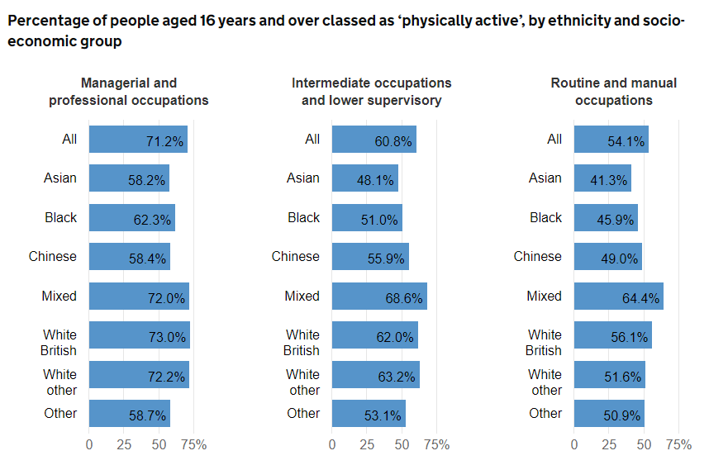
Importance of physical activity
Who is (not) exercising?

Slide 18
Importance of physical activity
Interactive task
Please go to the following site & enter this number:
TBC
How much did you exercise last week?
Login to Menti and respond to each question
Class discussion
What’s stopping you from exercising more frequently?
Go back to Menti and jot down your thoughts
Class discussion
https://www.menti.com/

Slide 19
Block 2 How can we increase physical activity?

Slide 20

How can we increase physical activity?
Why do people (not) exercise?
Personally, I exercise (or might exercise)….
To stay slim
To avoid ill health
Because it makes me feel good
To help me look younger
To show my worth to others
To give me space to think
To have a healthy body
To build up my strength
Because I enjoy the feeling of exerting myself
To spend time with friends
Because my doctor advised me to exercise
Because I like trying to win in physical activities
This day/become more agile
To give me goals to work towards
To lose weight
To prevent health problems
Because I find exercise invigorating
To have a good body
To compare my abilities with other peoples’
Because it helps to reduce tension
Exercise motivation inventory-2 (EMI-2; Markland & Ingledew, 1997):
Stress management
Revitalisation
Enjoyment
Challenge
Social recognition
Affiliation
Competition
Health pressures
Ill-health avoidance
Positive health
Weight management
Appearance
Strength & endurance
Nimbleness

Slide 21
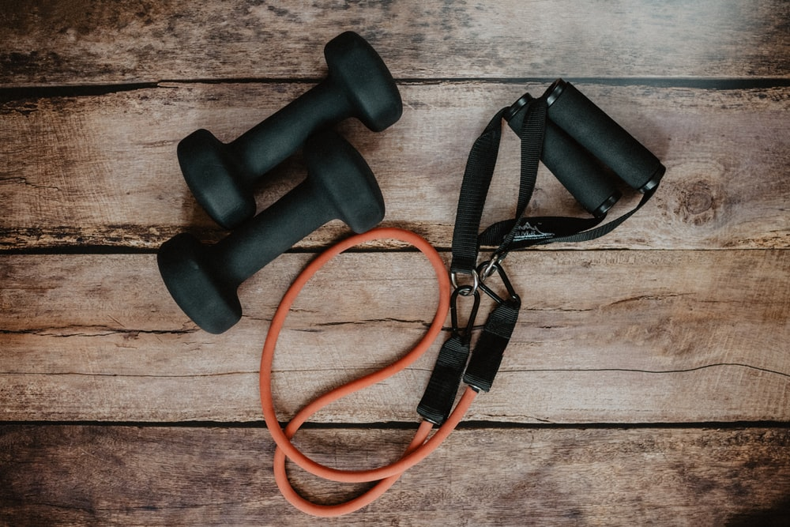
How can we increase physical activity?
Why do people (not) exercise?
Commonly reported barriers to exercise (Baxter et al., 2015; Gómez-López Et al., 2010; Lovell et al., 2010; Johs et al., 2019):
Lack of time
Physical exertion
Not seeing its practicality or usefulness
Lacking confidence in the activity (self-efficacy)
Lack of social support
Work or study related stress
Fear of safety (population specific)
Health-related challenges (population specific)

Slide 22

How can we increase physical activity?
Why do people (not) exercise?
Cultural differences: Perceived barriers among regional indigenous Australians (Sushames et al., 2017):
Sorry business
Transport
Having to travel away from community
Lack of community infrastructure
Personal & societal factors affecting exercise levels (Bauman et al., 2012):
Self-efficacy
Perceived behavioural control
Perceived access to recreation facilities
Density of exercise facilities
Policy that facilitates exercise

Slide 23
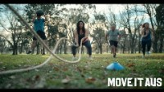
How can we increase physical activity?
Interventions to improve activity levels
Mass media campaigns: Are they effective?
Abioye et al. (2013):
Improved walking levels
Reduce sedentary behaviour
Achieve recommended levels of physical activity

Slide 24
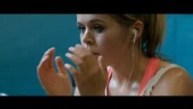
How can we increase physical activity?
Interventions to improve activity levels
This Girl Can (TGC) campaigns
(2015-2012)
Manifesto: “Woman come in all shapes and sizes and all levels of ability. It doesn’t matter if you’re rubbish or an expert. The brilliant thing is you’re a woman and you’re doing something”.
Huge increases in participation– why so effective?
Directly targeted perceived barriers to exercise!

Slide 25
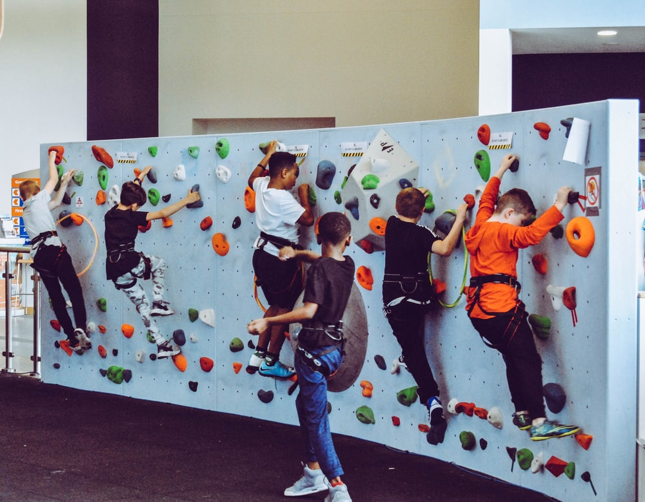
How can we increase physical activity?
Interventions to improve activity levels
Craike et al. (2018): Improving physical activity in disadvantaged groups
Preschool children
Parent focused family-based interventions in community settings
Intensive interventions with many contacts over a long period
High levels of parental engagement
Use of behaviour change techniques such as goal setting
Focus on skill building not just knowledge acquisition
Primary-school-aged children
School-based interventions
Embedded into school curriculum
Provide additional opportunities for physical activity
Embed school-based physical activity into policy

Slide 26
How can we increase physical activity?
Interventions to improve activity levels
Craike et al. (2018): Improving physical activity in disadvantaged groups
Adolescents
Limited evidence of intervention effectiveness
Recommendations to involve adolescents & family
Adults
Mixed evidence of effectiveness
Group based interventions
Focus on physical activity only
Issues with this literature
Poor reporting standards
Use of non-validated physical activity measures
High probability of selection bias
Low proportion of eligible participants agreeing to participate
High attrition rates
Lack of long-term follow-up

Slide 27
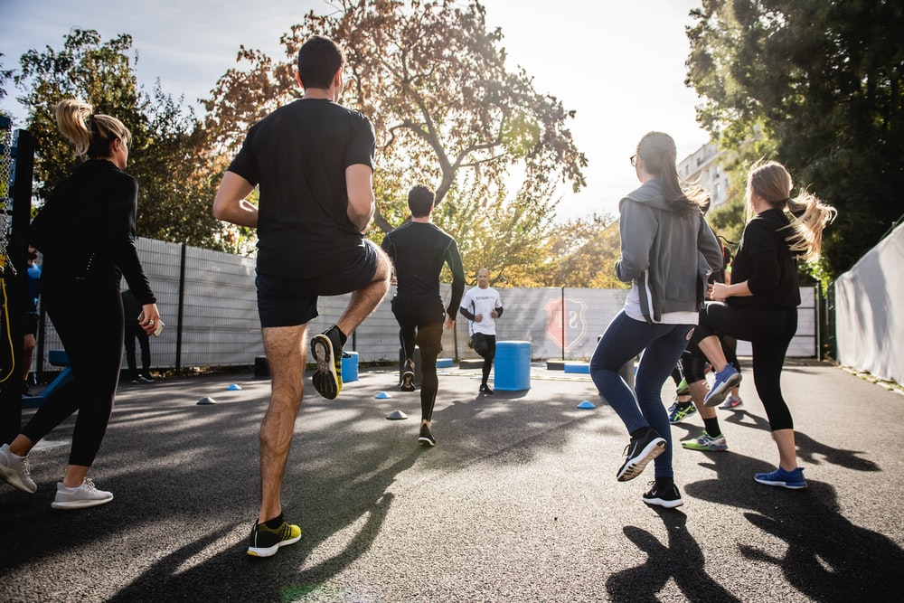
Physical activity as an intervention
Depression
Is exercise an effective intervention for depression?
Large scale meta-analyses indicate that exercise-based interventions have a beneficial effect on depressive symptoms across a wide age range (Hu et al., 2020)
Poor study quality may inflate effects (Krogh et al., 2017)
Bouldering/rock climbing as a treatment for depression?
Bouldering psychotherapy (BPT) shows initial promise (Luttenberger et al., 2015)
BPT effects last or 12 months (Schwarz et al., 2019)
BPT more effective than exercise alone (Karg et al., 2020)

Slide 28
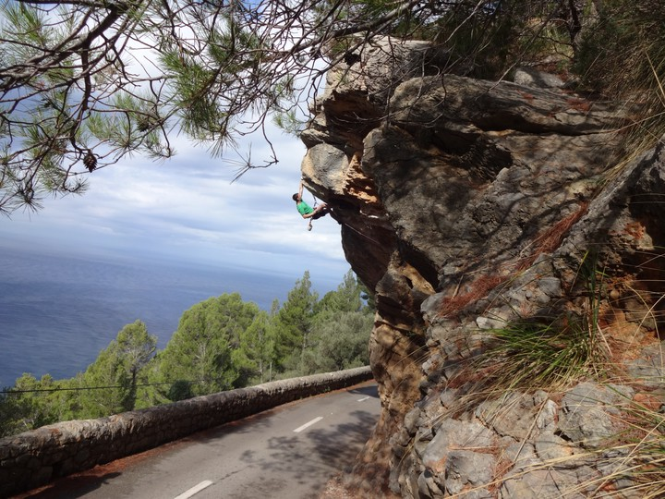
Physical activity as an intervention
Addiction
Can physical activity be used to help those with addictions?
Exercise can target many of the risk factors for relapse in those with SUDs (Weinstock et al., 2017)
Limited but promising evidence that exercise is a useful adjunct to SUD treatments (e.g., Brown et al., 2014)
Limited evidence that sport-based interventions can prevent excessive alcohol use (e.g., Werch et al., 2003)
Extreme Sports & Addiction(?)
Heirene et al. (2016): Could extreme sports act as a “substitute” for drug use?
Anaheim Lighthouse: sobriety and extreme sports

Slide 29
Physical activity as an intervention
Interactive task
Please go to the following site & enter this number:
TBC
Should doctors prescribe physical activity?
Login to Menti and add your thoughts
Do some research – what does the scientific literature say about this strategy?
Class discussion
https://www.menti.com/

Slide 30
Next week: Alcohol & Addictive Behaviours

Slide 31
Credits & Sources
If an image in this slideshow does not have a link to the source posted below it, then I have either taken the picture myself or taken it from the site www.unsplash.com and clicking the image will take you to the original source on unsplash.

Slide 32
References
Abioye, A. I., Hajifathalian, K. & Danaei, G. (2013). Do mass media campaigns improve physical activity? a systematic review and meta-analysis. Archives of Public Health, 71(1), 20. https://doi.org/10.1186/0778-7367-71-20
Basso, J. C. & Suzuki, W. A. (2017). The Effects of Acute Exercise on Mood, Cognition, Neurophysiology, and Neurochemical Pathways: A Review. Brain Plasticity, 2(2), 127–152. https://doi.org/10.3233/bpl-160040
Bauman, A. E., Reis, R. S., Sallis, J. F., Wells, J. C., Loos, R. J., Martin, B. W. & Group, for the L. P. A. S. W. (2012). Correlates of physical activity: why are some people physically active and others not? The Lancet, 380(9838), 258–271. https://doi.org/10.1016/s0140-6736(12)60735-1
Baxter, S., Smith, C., Treharne, G., Stebbings, S. & Hale, L. (2015). What are the perceived barriers, facilitators and attitudes to exercise for women with rheumatoid arthritis? A qualitative study. Disability and Rehabilitation, 38(8), 773–780. https://doi.org/10.3109/09638288.2015.1061602
Braun, V. & Clarke, V. (2006). Using thematic analysis in psychology. Qualitative Research in Psychology, 3(2), 77–101. https://doi.org/10.1191/1478088706qp063oa
Brown, R. A., Abrantes, A. M., Minami, H., Read, J. P., Marcus, B. H., Jakicic, J. M., Strong, D. R., Dubreuil, M. E., Gordon, A. A., Ramsey, S. E., Kahler, C. W. & Stuart, G. L. (2014). A preliminary, randomized trial of aerobic exercise for alcohol dependence. Journal of Substance Abuse Treatment, 47(1), 1–9. https://doi.org/10.1016/j.jsat.2014.02.004
Caplin, A., Chen, F. S., Beauchamp, M. R. & Puterman, E. (2021). The effects of exercise intensity on the cortisol response to a subsequent acute psychosocial stressor. Psychoneuroendocrinology, 131, 105336. https://doi.org/10.1016/j.psyneuen.2021.105336

Slide 33
References
Chekroud, S. R., Gueorguieva, R., Zheutlin, A. B., Paulus, M., Krumholz, H. M., Krystal, J. H. & Chekroud, A. M. (2018). Association between physical exercise and mental health in 1·2 million individuals in the USA between 2011 and 2015: a cross-sectional study. The Lancet Psychiatry, 5(9), 739–746. https://doi.org/10.1016/s2215-0366(18)30227-x
Chokshi, D. A. & Farley, T. A. (2014). Changing behaviors to prevent noncommunicable diseases. Science 345, 1243-1244. DOI:10.1126/science.1259809
Clayton, R. & Clayton, C. (2022). UK Screen use in 2022: A need for guidance. University of Leeds. https://eprints.whiterose.ac.uk/184618/1/PolicyLeeds-Brief9_UK-screen-use-in-2022.pdf
Craike, M., Wiesner, G., Hilland, T. A. & Bengoechea, E. G. (2018). Interventions to improve physical activity among socioeconomically disadvantaged groups: an umbrella review. The International Journal of Behavioral Nutrition and Physical Activity, 15(1), 43. https://doi.org/10.1186/s12966-018-0676-2
Ding, D., Lawson, K. D., Kolbe-Alexander, T. L., Finkelstein, E. A., Katzmarzyk, P. T., Mechelen, W. van, Pratt, M. & Committee, L. P. A. S. 2 E. (2016). The economic burden of physical inactivity: a global analysis of major non-communicable diseases. The Lancet, 388(10051), 1311–1324. https://doi.org/10.1016/s0140-6736(16)30383-x
Fuller-Tyszkiewicz, M., Skouteris, H. & Mccabe, M. (2013). A re-examination of the benefits of exercise for state body satisfaction: Consideration of individual difference factors. Journal of Sports Sciences, 31(7), 706–713. https://doi.org/10.1080/02640414.2012.746723
Garmany, A., Yamada, S. & Terzic, A. Longevity leap: mind the healthspan gap. npj Regen Med. 6, 57 (2021). https://doi.org/10.1038/s41536-021-00169-5

Slide 34
References
Gómez-López, M., Gallegos, A. G. & Extremera, A. B. (2010). Perceived barriers by university students in the practice of physical activities. Journal of Sports Science & Medicine, 9(3), 374–381.
Hammarberg, K., Kirkman, M. & Lacey, S. de. (2016). Qualitative research methods: when to use them and how to judge them. Human Reproduction, 31(3), 498–501. https://doi.org/10.1093/humrep/dev334
Heath, G. W., Parra, D. C., Sarmiento, O. L., Andersen, L. B., Owen, N., Goenka, S., Montes, F., Brownson, R. C. & Group, for the L. P. A. S. W. (2012). Evidence-based intervention in physical activity: lessons from around the world. The Lancet, 380(9838), 272–281. https://doi.org/10.1016/s0140-6736(12)60816-2
Heirene, R. M., Shearer, D., Roderique-Davies, G. & Mellalieu, S. D. (2016). Addiction in Extreme Sports: An Exploration of Withdrawal States in Rock Climbers. Journal of Behavioral Addictions, 5(2), 332–341. https://doi.org/10.1556/2006.5.2016.039
Hong, A. R. & Kim, S. W. (2018). Effects of Resistance Exercise on Bone Health. Endocrinology and Metabolism, 33(4), 435–444. https://doi.org/10.3803/enm.2018.33.4.435
Hu, M. X., Turner, D., Generaal, E., Bos, D., Ikram, M. K., Ikram, M. A., Cuijpers, P. & Penninx, B. W. J. H. (2020). Exercise interventions for the prevention of depression: a systematic review of meta-analyses. BMC Public Health, 20(1), 1255. https://doi.org/10.1186/s12889-020-09323-y
Johs, N. A., Kellar-Guenther, Y., Jankowski, C. M., Neff, H. & Erlandson, K. M. (2019). A qualitative focus group study of perceived barriers and benefits to exercise by self-described exercise status among older adults living with HIV. BMJ Open, 9(3), e026294. https://doi.org/10.1136/bmjopen-2018-026294

Slide 35
References
Karg, N., Dorscht, L., Kornhuber, J. & Luttenberger, K. (2020). Bouldering psychotherapy is more effective in the treatment of depression than physical exercise alone: results of a multicentre randomised controlled intervention study. BMC Psychiatry, 20(1), 116. https://doi.org/10.1186/s12888-020-02518-y
Katzmarzyk, P. T., Friedenreich, C., Shiroma, E. J. & Lee, I.-M. (2022). Physical inactivity and non-communicable disease burden in low-income, middle-income and high-income countries. British Journal of Sports Medicine, 56(2), 101–106. https://doi.org/10.1136/bjsports-2020-103640
Krogh, J., Hjorthøj, C., Speyer, H., Gluud, C. & Nordentoft, M. (2017). Exercise for patients with major depression: a systematic review with meta-analysis and trial sequential analysis. BMJ Open, 7(9), e014820. https://doi.org/10.1136/bmjopen-2016-014820
Kruk, J., Kotarska, K. & Aboul-Enein, B. H. (2020). Physical exercise and catecholamines response: benefits and health risk: possible mechanisms. Free Radical Research, 54(2–3), 1–21. https://doi.org/10.1080/10715762.2020.1726343
LePage, M. L. & Crowther, J. H. (2010). The effects of exercise on body satisfaction and affect. Body Image, 7(2), 124–130. https://doi.org/10.1016/j.bodyim.2009.12.002
Lee, I.-M., Shiroma, E. J., Lobelo, F., Puska, P., Blair, S. N., Katzmarzyk, P. T. & Group, for the L. P. A. S. W. (2012). Effect of physical inactivity on major non-communicable diseases worldwide: an analysis of burden of disease and life expectancy. The Lancet, 380(9838), 219–229. https://doi.org/10.1016/s0140-6736(12)61031-9
Luttenberger, K., Stelzer, E.-M., Först, S., Schopper, M., Kornhuber, J. & Book, S. (2015). Indoor rock climbing (bouldering) as a new treatment for depression: study design of a waitlist-controlled randomized group pilot study and the first results. BMC Psychiatry, 15(1), 201. https://doi.org/10.1186/s12888-015-0585-8

Slide 36
References
Lovell, G. P., Ansari, W. E. & Parker, J. K. (2010). Perceived Exercise Benefits and Barriers of Non-Exercising Female University Students in the United Kingdom. International Journal of Environmental Research and Public Health, 7(3), 784–798. https://doi.org/10.3390/ijerph7030784
Marconcin, P., Werneck, A. O., Peralta, M., Ihle, A., Gouveia, É. R., Ferrari, G., Sarmento, H. & Marques, A. (2022). The association between physical activity and mental health during the first year of the COVID-19 pandemic: a systematic review. BMC Public Health, 22(1), 209. https://doi.org/10.1186/s12889-022-12590-6
Morrison, V., Bennett, P., Butow, P., Mullan, B., & Sharp, L. (2019). Introduction to Health Psychology in Australia, 3rd Edition. Pearson.
Nikitara, K., Odani, S., Demenagas, N., Rachiotis, G., Symvoulakis, E. & Vardavas, C. (2021). Prevalence and correlates of physical inactivity in adults across 28 European countries. European Journal of Public Health, 31(4), ckab067-. https://doi.org/10.1093/eurpub/ckab067
Olshansky SJ. From Lifespan to Healthspan. JAMA. 2018;320(13):1323–1324. doi:10.1001/jama.2018.12621
Schoenfeld, T. J. & Swanson, C. (2021). A Runner’s High for New Neurons? Potential Role for Endorphins in Exercise Effects on Adult Neurogenesis. Biomolecules, 11(8), 1077. https://doi.org/10.3390/biom11081077
Schwarz, L., Dorscht, L., Book, S., Stelzer, E.-M., Kornhuber, J. & Luttenberger, K. (2019). Long-term effects of bouldering psychotherapy on depression: benefits can be maintained across a 12-month follow-up. Heliyon, 5(12), e02929. https://doi.org/10.1016/j.heliyon.2019.e02929

Slide 37
References
Sushames, A., Engelberg, T. & Gebel, K. (2017). Perceived barriers and enablers to participation in a community-tailored physical activity program with Indigenous Australians in a regional and rural setting: a qualitative study. International Journal for Equity in Health, 16(1), 172. https://doi.org/10.1186/s12939-017-0664-1
Warburton, D. E. R., Nicol, C. W. & Bredin, S. S. D. (2006). Health benefits of physical activity: the evidence. Canadian Medical Association Journal, 174(6), 801–809. https://doi.org/10.1503/cmaj.051351
Weinstock, J., Farney, M. R., Elrod, N. M., Henderson, C. E. & Weiss, E. P. (2017). Exercise as an Adjunctive Treatment for Substance Use Disorders: Rationale and Intervention Description. Journal of Substance Abuse Treatment, 72, 40–47. https://doi.org/10.1016/j.jsat.2016.09.002
Werch, C. (Chad), Moore, M., DiClemente, C. C., Owen, D. M., Jobli, E. & Bledsoe, R. (2003). A Sport-Based Intervention for Preventing Alcohol Use and Promoting Physical Activity Among Adolescents. Journal of School Health, 73(10), 380–388. https://doi.org/10.1111/j.1746-1561.2003.tb04181.x
Zhang, Z. & Chen, W. (2019). A Systematic Review of the Relationship Between Physical Activity and Happiness. Journal of Happiness Studies, 20(4), 1305–1322. https://doi.org/10.1007/s10902-018-9976-0

