Slide 1

Experiments and Data
Prof. Andy Wills

Slide 2
Topic of this lecture: Experimental research
Research Methods in Psychology, Chapter 5 & Chapter 8

Slide 3
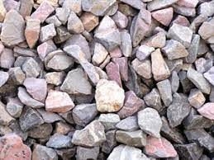
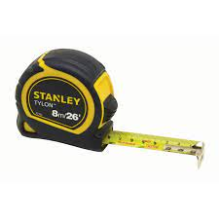
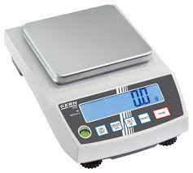
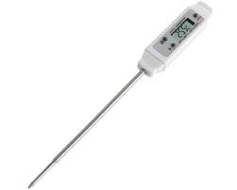
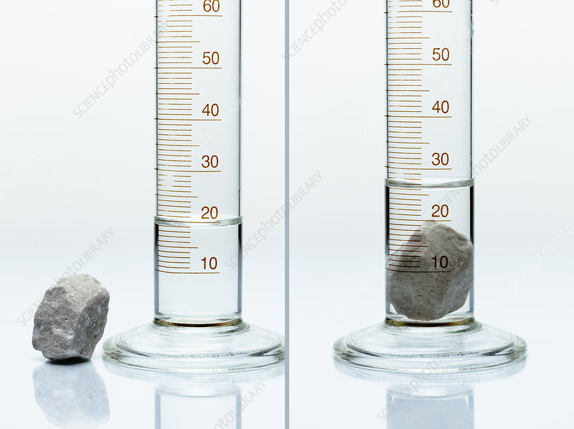
Remember this from Lecture 3
Q: How could you find out which is the largest stone by volume?
These are tools for converting physical properties of the stones into a numerical value that can be used to distinguish between them.

Slide 4
What if we wanted to know what affects the volume of a stone?
e.g. Is the volume of a stone (or set of stones) affected by temperature?
How could we find out?

Slide 5

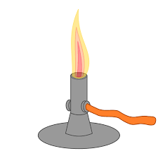

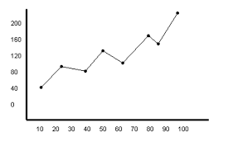
Essential steps in an experiment
1: Take a sample (or set of samples)
We don’t test all the stones in the world, just a sample.
2: Manipulate something
These have to be systematic (controlled, careful…)
3: Measure the outcome(s)
3: Relate the manipulation (2) to the outcome (3)
We can (statistically) test the relationship between our manipulation and the outcome(s).

Slide 6
What if we wanted to know what affects the happiness of people?
e.g. Is happiness affected by ambient temperature?
How could we find out?

Slide 7


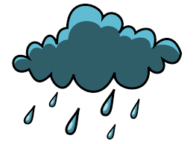

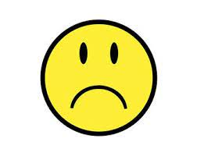
Essential steps in an Psychology experiment
1: Take a sample (or set of samples)
We don’t test everyone in the world, just a sample. But people vary a lot, so larger samples needed.
2: Manipulate something
These have to be systematic (controlled, careful…). But people are reactive, so it is tricky.
3: Measure the outcome(s)
3: Relate the manipulation (2) to the outcome (3)
We can (statistically) test the relationship between our manipulation and the outcome(s).

Slide 8
Some terminology
The thing we manipulate in an experiment is called
The independent variable.
(Variations in this are independent of everything other than the manipulation).
The outcome we measure is called:
The dependent variable
(Scores on this measure depend upon the manipulation)

Slide 9
Independent variables
Can be binary (Hot vs cold, drug vs control, eyes closed vs eyes open), or can have multiple levels
e.g. Hot vs warm vs cold
1st test vs 2nd test vs 3rd test
etc.
In each case, the manipulation of an independent variable leads to different experimental conditions.
e.g. the “hot” “warm” and “cold” conditions.

Slide 10
Variables (Measures) come in different forms
A categorical variable is one which different outcomes can be distinguished, without specifying a rank order.
e.g. for an independent variable: Drug A vs Drug B
e.g. for dependent variable: Will vote for Party A vs Party B vs Party C

Slide 11
Variables (Measures) come in different forms
An ordinal variable (or scale) is one in which it is possible to specify the rank order, but the differences between steps may not be equal.
e.g. For an independent variable: whether an interview is conducted by someone who is unfriendly, neutral, or friendly.
e.g. For a dependent variable: ratings like this:
Unfriendly 1 2 3 4 5 6 7 Friendly
The difference between 1 and 2 may not be the same as between 2 and 3, or between 4 and 5.

Slide 12
Variables (Measures) come in different forms
An interval scale is one on which it is possible to say that the steps are of equal size, but there is no zero point
e.g. for an independent variable: 10 vs 20 vs 30 degrees centigrade.
Here the steps are 10 degrees, but 20 degrees centigrade isn’t twice as hot as 10 degrees centigrade.
e.g. for a dependent variable: temperature (in centigrade) or normatively determined test score (e.g. IQ score)

Slide 13
Variables (Measures) come in different forms
An ratio scale variable is one on which it is possible to say that the steps are of equal size, and there is zero point
e.g. for an independent variable: 0 vs 1 vs 2 cups of coffee.
Here 2 cups is twice 1 cup.
e.g. for a dependent variable:
number of errors on a test, time spent studying (in seconds), number of people supporting outcome X etc
– i.e. anything that can be counted, where zero is a valid outcome.

Slide 14
Why is this important?
The nature of the variables influences what kinds of statistics are appropriate.
For now, it influences the conclusions that can be drawn.
Key point: you can’t draw “ratio” (or relative) conclusions from non-ratio data.

Slide 15
Creating experiments
The aim of an experiment is to establish a causal relationship between a change we make (called the independent variable), and an outcome we observe (called the dependent variable).
To do this, we need to remove all other possible differences other than the change we make, or those that are truly random.

Slide 16
A “true” experimental design involves
1: A deliberate manipulation of one or more independent variable(s) while holding other potential variables constant.
2: Measurement of one or more dependent variable(s).

Slide 17
More from Lecture 3
Any test score obtained consists of two components
Score obtained
=
the true score
+/-
noise
Other factors that might influence the outcome
e.g. motivation, attention, understanding instructions etc.
The underlying construct being measured.

Slide 18
Strictly, this should be
Any test score obtained in a particular set of conditions consists of two components
Score obtained
=
the true score
+/-
noise
Other factors that might influence the outcome
e.g. motivation, attention, understanding instructions etc.
The underlying construct being measured.

Slide 19
If the conditions vary then
Score obtained
=
the true score
+/-
noise
+/-
bias
The underlying construct being measured.
Other factors that might randomly influence the outcome
e.g. motivation, attention, understanding instructions etc.
Factors systematically associated with the conditions that can influence the outcome.

Slide 20
If the conditions vary then
Score obtained
=
the true score
+/-
noise
+/-
bias
The underlying construct being measured.
Other factors that might randomly influence the outcome
e.g. motivation, attention, understanding instructions etc.
Factors systematically associated with the conditions that can influence the outcome.
Extraneous variables

Slide 21
When we compare two conditions
Difference obtained
the true difference
=
+/-
noise
+/-
bias
Difference in the underlying construct caused by the difference in conditions
Other factors that might randomly influence the outcome
e.g. motivation, attention, understanding instructions etc.
Difference caused by factors that are systematically associated with the different conditions
Smaller because noise is roughly equal across conditions if the sample is big enough.
Evidence for a causal effect.
Confounding variables that offer an alternate explanation for the difference.

Slide 22
The logic of an experiment
Score Condition 1 = baseline + effect of IV in condition 1 + noise + bias
Score Condition 2 = baseline + effect of IV in condition 2 + noise + bias
Difference = 0 + difference in IV (c1-c2) + 0(ish) 0 (?)
i.e. the difference between conditions is due solely to the impact of the manipulation (the I.V.).
This is only zero if there is nothing else that changes between Condition 1 and Condition 2, other than the I.V.

Slide 23
Common confounding variables
Selection of participants
Materials
Order
Experimenter / instructional effects
Demand / expectancy effects
Experimental context
(Experimenter bias)

Slide 24
The first fundamental choice
Between-subjects vs within-subjects designs.
A within-subjects (between-group) design looks like this:
Condition 1 Condition 2
Participant 1 Participant 1
Participant 2 Participant 2
Participant 3 Participant 3
etc

Slide 25
The first fundamental choice
Between-subjects vs within-subjects designs.
A between-subjects design looks like this:
Condition 1 Condition 2
Participant 1 Participant 2
Participant 3 Participant 4
Participant 5 Participant 6
etc etc

Slide 26
When we compare two conditions
Difference obtained
the true difference
=
+/-
noise
+/-
bias
Other factors that might randomly influence the outcome
e.g. motivation, attention, understanding instructions etc.
Between subjects designs increase noise, because there are individual differences between the two groups involved.
Within subjects designs reduce noise, because there are no individual differences - it is the same people in each condition

Slide 27
When we compare two conditions
Difference obtained
the true difference
=
+/-
noise
+/-
bias
Factors systematically associated with the conditions that can influence the outcome.
Between subjects designs can help reduce some bias, because the two conditions can be run identically. But selection issues can increase bias.
Within subjects designs risk increasing bias because the conditions cannot be the same (e.g. the order in which they are undertaken).

Slide 28
Common confounding variables
Selection of participants
Is not an issue for within-subjects designs.
For between subjects designs the allocation of participants to conditions should be unrelated to any aspect of the individuals involved.
e.g. their time of availability
their preference for a particular condition
their friendliness, ability, cognitive style, personality
etc.
The best solution is to randomly (pre)allocate participants to conditions.

Slide 29
Common confounding variables
Materials
Is not an issue for between-subjects designs, as long as the same materials are allocated to each condition.
For within-subjects designs, the materials (often) should not be the same across both conditions.
e.g. you can’t do the same test (in the same format) twice, because of practice (or order) effects.

Slide 30
Common confounding variables
Order
This is a common issue in within-subject designs, where each participant completes two (or more) conditions.
This can be overcome, by either randomisation, or (in more simple cases) counterbalancing.

Slide 31
Counterbalancing
With two conditions (A, B).
Participant 1 completes A, then B
Participant 2 completes B, then A
Etc.
To be “fully” counterbalanced requires the sample size to be a multiple of 2.
Notice here, that if there is a difference between A and B, it can’t be because of what was done first (vs second)

Slide 32
Counterbalancing
With three conditions (A, B, C).
To be “fully” counterbalanced requires the sample size to be a multiple of 6 (= 3 x 2).
i.e. test 6, 12, 18 (etc) participants.
Notice here, that if there is a difference between A, B, and C it can’t be because of what was done first (vs second vs third)

Slide 33
More conditions
4 conditions requires multiples of 4 x 3 x 2 = 24
5 conditions requires multiples of 5 x 4 x 3 x 2 = 120
6 conditions requires multiples of 6 x 5 x 4 x 3 x 2 = 720
With more conditions full counterbalancing may require more participants than can be tested.
One solution is to randomise the order differently for each participant.

Slide 34
Randomisation
Difference obtained
the true difference
=
+/-
noise
+/-
bias
Other factors that might randomly influence the outcome
e.g. motivation, attention, understanding instructions etc.
Factors systematically associated with the conditions that can influence the outcome.
Relative to full counterbalancing, randomisation may increase noise. However, if it is truly random, it is not a source of systematic bias.

Slide 35
Back to counterbalancing for a moment
Hidden in this design are some other comparisons we can make:
We can look at whether order is important (regardless of list) by comparing 1st test vs 2nd test (i.e. blue vs red shading).

Slide 36
Back to counterbalancing for a moment
There are also 2 between subject designs here (A vs B on List 1 and A vs B on list 2).
This is actually a form of design called a 2-factor design, in which we can look at Test (A vs B) and Order (1st vs 2nd) at the same time.
You will cover this later in the UG programme.

Slide 37
Common confounding variables
Experimenter / instructional effects
Differences can arise between conditions if they are associated with different people running them.
e.g. Different ways of presenting the instructions.
Different ways of scoring the data
Different non-verbal behaviours
These can be unconscious and subtle, but still have an effect.

Slide 38
Examples of experimenter effects
Administrator bias in police lineups.
e.g. Haw & Fisher (2004) had witnesses take a lineup, run by an administrator, who falsely thought the lineup contained the perpetrator.
Half the time, the administrator just observed.
Half the time, the administrator conducted the lineup.
Observation condition: 7% errors.
Conducting condition: 30% errors.

Slide 39
Another lineup example.
Clark, Marshall & Rosenthal (2009).
Witnesses saw lineups that did not contain the true perpetrator.
If the administrator said nothing: 37% false IDs.
If the administrator said “take your time”: 56% false IDs.

Slide 40
Common confounding variables
Demand / expectancy effects
These can effect both within- and between participant designs.
A variant of experimenter effects is when participants know (or expect) a particular outcome associated with the conditions.
e.g. telling participants which condition leads to “best performance” in advance may change their motivation.
This could come from experimenter body language, but also from the instructions, or even from the recruitment materials or informed consent paperwork.

Slide 41
Common confounding variables
Experimental context
Aspects of the environment in which the experiment takes place. (You can’t test everyone at the same time and place).
Is not an issue for within-subjects designs where the context is the same across conditions.
For between subjects the environmental variations should be unrelated to the experimental conditions, either by counterbalancing, or randomising (see previous slide).
e.g. Time of day at which the experiment is run.
Room in which the test takes place.

Slide 42
Common confounding variables
Experimenter bias.
This is an influence of the experimenter’s beliefs on the outcome of the experiment.
This can be during the experiment (see Experimenter effects)
But it can also happen after the data is collected, e.g. when ambiguous data are scored.
This can affect both within- and between-participant designs.

Slide 43
Back to variables

Slide 44
Manipulation of independent variables
Can be direct
e.g. Setting the room temperature at 2 different levels
Giving people drug A vs drug B.
Can be indirect (or instructional)
e.g. Asking people to imagine something vs no instructions.
Asking for quick responses vs accurate responses.

Slide 45
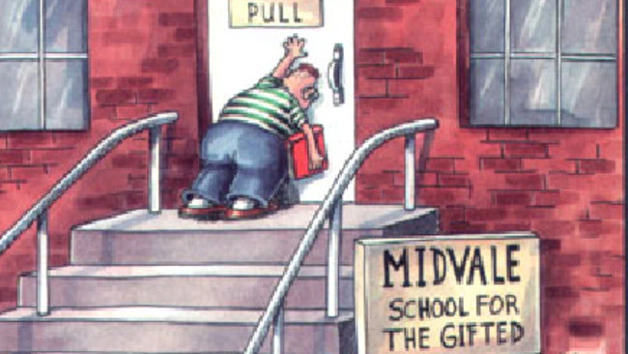
A problem with instructional manipulations
Participants don’t always follow instructions!
If an experiment finds no effect it could be that:
There is no effect to find.
Or
People didn’t follow the instructions

Slide 46
Solutions to the problem of instructional manipulations
Measure understanding of the instructions (at beginning and end of the experiment).
This shows participants at least knew what they were supposed to do.
Ask for compliance with instructions
This shows participants say that they tried to do what they were supposed to do. (Or that they lied about it).
Include a manipulation check
This shows that some aspect of behaviour was changed by the manipulation (just not the main one).

Slide 47
Examples of manipulation checks.
e.g. (1) You want to know whether 1 week of aerobic exercise boosts mood.
Independent variable: Instructions to exercise (vs not)
Dependent variable: Mood questionnaire 1 week later.
Possible manipulation checks:
Fit-bit record of heart rate over the week
Log of attendances at gym
Map-my-run logs showing routes taken.

Slide 48
Examples of manipulation checks
E.g.(2). You want to know whether people’s presentations are rated higher if they are told to smile a lot (vs no instructions).
Independent variable: Instruction for to smile (vs no instruction)
Dependent variable: Rated quality of presentation (by judges).
Possible manipulation checks:
Independent observers count number of smiles (or time spent smiling)

Slide 49
What about the “ish”?
Score Condition 1 = baseline + effect of IV in condition 1 + noise + bias
Score Condition 2 = baseline + effect of IV in condition 2 + noise + bias
Difference = 0 + difference in IV (c1-c2) + 0(ish) + 0
i.e. the difference between conditions is due solely to the impact of the manipulation (the I.V.).
This is only true if there is nothing else that changes between Condition 1 and Condition 2, other than the I.V.

Slide 50
What about the “ish”?
Because there is ALWAYS variability, we can’t assume the effects of noise are exactly zero.
This is why we need statistics!
We use statistics to tell us whether the difference we observe is in line with what we would expect through random variation, or whether it is greater than we would expect. (More in next week’s lecture).

Slide 51
We can make the “ish” small by reducing the impact of noise in general
Score Condition 1 = baseline + effect of IV in condition 1 + noise + bias
Score Condition 2 = baseline + effect of IV in condition 2 + noise + bias
Difference = 0 + difference in IV (c1-c2) + 0(ish) + 0
The less noise in each condition, the smaller the difference between them.

Slide 52
Reducing random noise
One way of reducing noise is to reduce variability between people.
e.g. imagine an experiment looking at the effect of a poster campaign (vs nothing) on political attitudes in:
A random sample of the general public
A random neurotypical sample of Psychology undergraduates, who are white, female, heterosexual, aged 19-21, with no political affiliation, and come from Devon.
Which sample would be more variable (i.e. noisier)?

Slide 53
Noise vs generality
The downside of less noise is that the sample is less representative of the general population.
i.e. you are more likely to find an effect in a less noisy population.
But you are less able to draw conclusions about the general population.

Slide 54
Q: Why is the following not a true experiment?
The experimenter wants to know whether beer-drinkers vs wine-drinkers differ in their liking of rock music.
They recruit participants who self-identify as beer-drinkers or wine-drinkers and ask them to rate their enjoyment of a selection of rock-music samples.

Slide 55
Clue 1: Remember a true experiment
Score Condition 1 = baseline + effect of IV in condition 1 + noise + bias
Score Condition 2 = baseline + effect of IV in condition 2 + noise + bias
Difference = 0 + difference in IV (c1-c2) + 0(ish) + 0(?)
i.e. the difference between conditions is due solely to the impact of the manipulation (the I.V.).
This is only true if there is nothing else that changes between Condition 1 and Condition 2, other than the I.V.

Slide 56
Clue 2
Q: What is being manipulated by the experimenter in this experiment?
A: Nothing
Without a experimenter-controlled manipulation, it isn’t a true experiment.

Slide 57
In this example
The observation of any difference between beer-drinkers and wine-drinkers may be because of their drinking preferences.
But, it could also be due to many other factors that differ between these two groups.
e.g. Social class, educational background, parental tastes in music (etc).
This is an example of a quasi-experimental design.

Slide 58
Quasi-experimental designs
Can be run under conditions of a “true” experiment, but cannot attribute any difference to the independent variable, because this is not manipulated.
i.e. we don’t manipulate drinking preference in the experiment. We can’t know if any differences are due to other factors that are associated with preference.

Slide 59
Quasi-experimental designs involve
Comparison of any pre-existing groups (or materials) based upon an attribute.
e.g. Personality, ability
Age / Gender / Sexual orientation
Left vs right-handedness
Coffee drinkers vs non-coffee drinkers
Football fans vs cricket fans
etc.
In all cases, these are not true experiments because we cannot manipulate that attribute (to see what happens).

Slide 60
Quasi-experimental designs
Can tell you that a difference exists.
E.g. that beer-drinkers prefer rock music.
But it doesn’t provide evidence of a causal effect.
i.e. it doesn’t show that getting wine drinkers to drink more beer will make them like rock music.

Slide 61
Quasi-experimental designs can also involve contrasts of pre-existing materials.
e.g. we get participants to rate their appreciation of samples of rock music vs classical music.
If we find a difference, we know that a difference exists in this sample, using these materials.
What we can’t know is what causes this difference.
It could be the instruments, the volume, the presence of drums etc.
It could be prior experience / familiarity
etc.

Slide 62
Experimental design: data issues

Slide 63
Back to this to discuss data issues:
Score obtained
=
the true score
+/-
noise
+/-
bias
The underlying construct being measured.
Other factors that might randomly influence the outcome
e.g. motivation, attention, understanding instructions etc.
Factors systematically associated with the conditions that can influence the outcome.
All of this assumes that our measuring instrument is able to accurately measure differences in the outcome. This may not always be true (for all values).

Slide 64


When valid measures become invalid…
This is a valid measure of weight, but can’t accurately distinguish between the weights of two different planets
This is a valid measure of length, but can’t accurately distinguish between lengths of .00002 and .00001cm.

Slide 65
Ceiling and floor effects
Whether or not we can detect a difference between two conditions is also subject to the same constraints.
e.g. If I want to know whether doing exercise boosts memory, I would not find a difference if:
The memory test was so easy, that everyone would score 100% regardless of exercise ( = a “ceiling” effect)
The memory test was so difficult that everyone would score zero, regardless of exercise. ( = a “floor” effect)

Slide 66
Ceiling and floor effects
Don’t just happen when everyone hits floor / ceiling.
The impact of these factors is related to the proportion of your sample that is scoring at the maximum (or minimum).

Slide 67
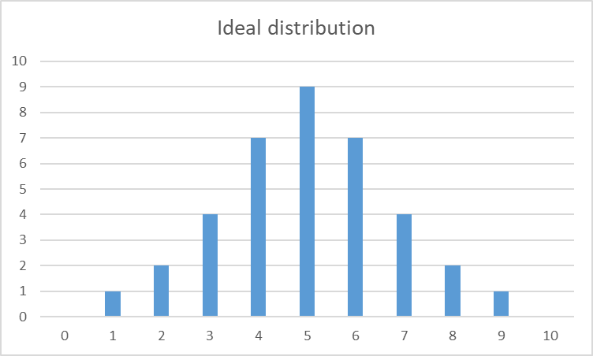
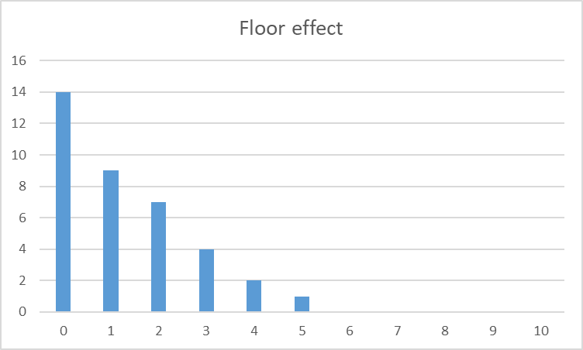
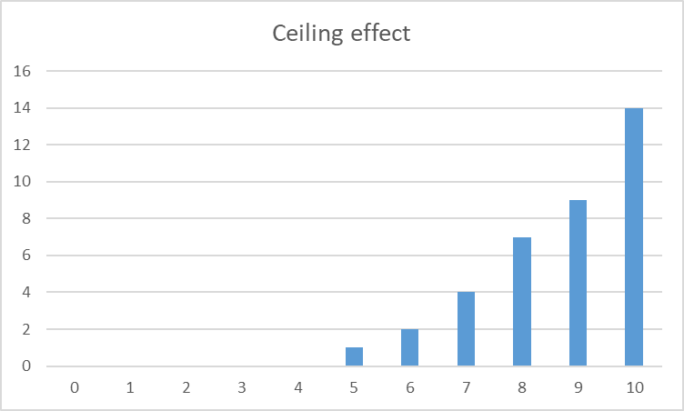

Slide 68
If the test had been easier, and all scores were 4 points higher:
Scores of 6 and above all reach the maximum value (10).
We have lost some of the variability in our scores, because of a
CEILING EFFECT.

Slide 69
If the test had been harder, and all scores were 4 points lower:
Scores of 4 and above all reach the minimum value (zero)
We have lost some of the variability in our scores, because of a
FLOOR EFFECT.

