Slide 1

Statistical Inference
Prof. Andy Wills

Slide 2
Statistics
Aim of today’s lecture is to understand the fundamental principles behind statistical analysis.

Slide 3
Two observations so far
1: You made decisions whether or not to continue, with evidence that was uncertain.
2: The two groups made different decisions about continuing, even though the evidence was the same.

Slide 4
Statistics as a way of dealing with uncertainty.
If a coin is fair, then the outcome of a flip is random.
The chance of a Head is 50%, or 0.5, or 1 in 2.
The chance of a Tail is 50% , or 0.5, or 1 in 2.
If we flip a coin multiple times, then these probabilities multiply.

Slide 5
Likelihoods of different numbers of Heads (or Tails) in multiple coin-flips.
Two flips of a coin can result in the following outcomes
H H
H T
T H
T T
i.e. there are four possible outcomes, which are all equally likely, so the chances of getting two Tails in a row is 1 / 4.
Another way of saying this, is probability of one tail (0.5) multiplied by the probability of another tail (0.5), which is 0.5 x 0.5 = 0.25.

Slide 6
For higher numbers of coin-flips
3 flips: 8 possibilities
THH TTH
HTH THT
HHH HHT HTT TTT
The chance of 3 Tails in a row is 1/8, or 12.5%.

Slide 7
4 flips: 16 possibilities
TTHH
THTH
THHH THHT HTTT
HTHH HTTH THTT
HHTH HTHT TTHT
HHHH HHHT HHTT TTTH TTTT
The chance of 4 Tails in a row is 1/16, or 6.25%.

Slide 8
With more observations, the likelihood of all the coins landing tails becomes less-likely.
5 flips: 1/32 = 3.1%
6 flips: 1/64 = 1.56%
7 flips: 1/128 = 0.8%
8 flips: 1/256 = 0.4%
etc

Slide 9
We don’t have to just look at all responses being identical.
TTHH
THTH
THHH THHT HTTT
HTHH HTTH THTT
HHTH HTHT TTHT
HHHH HHHT HHTT TTTH TTTT
Here for 4 flips of a coin, the chance of getting 3 Tails or more is 5 / 16, or 31.3%.

Slide 10
We can do this for different cut-off points, and different numbers of observations
e.g.
Possibility of 5 or more Heads in 6 coin tosses = 10.9%
Possibility of 6 or more Heads in 7 coin tosses = 6.3%
Possibility of 7 or more Heads in 8 coin tosses = 3.5%.

Slide 11
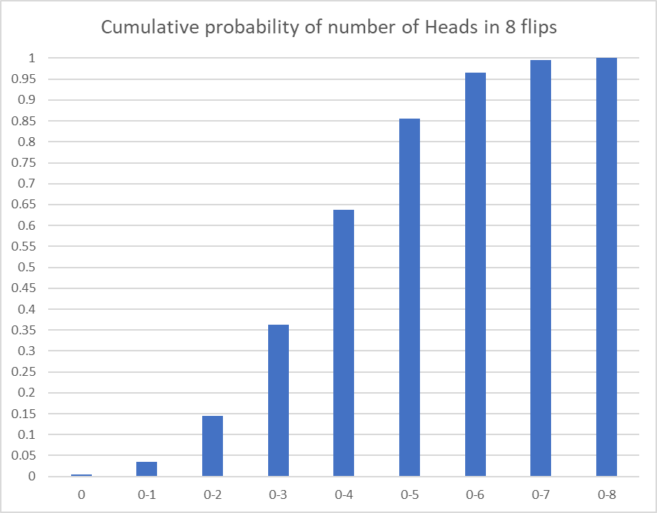
For the case of 8 coin flips
Getting 3 or fewer Heads (i.e. 5 or more Tails) is expected to happen around 35% of the time.
Getting 1 or fewer Heads (i.e. 7 or more Tails) is expected to happen around 3% of the time.

Slide 12
Making decisions based on evidence that involves uncertainty.
The real state of the world
No difference
There is a difference
Correctly conclude no difference
Falsely conclude there is no difference
No difference
The conclusion you reached based upon the evidence you have collected
Falsely conclude there is a difference
Correctly conclude there is a difference
There is a difference

Slide 13
Making decisions based on evidence that involves uncertainty.
The real state of the world
No difference
There is a difference
Falsely conclude there is no difference
A “Type 2 error”
A false negative
No difference
The conclusion you reached based upon the evidence you have collected
Falsely conclude there is a difference
A “Type 1” error
There is a difference
A false positive

Slide 14
Making decisions based on evidence that involves uncertainty.
The real state of the world
No difference
There is a difference
Falsely conclude there is no difference
A “Type 2 error”
The conclusions we draw depend upon how we view risks associated with each error
No difference
The conclusion you reached based upon the evidence you have collected
Falsely conclude there is a difference
A “Type 1” error
There is a difference

Slide 15
Making decisions based on evidence that involves uncertainty.
The real state of the world
No difference
There is a difference
Falsely conclude there is no difference
A “Type 2 error”
The conclusions we draw depend upon how we view risks associated with each error
No difference
The conclusion you reached based upon the evidence you have collected
Falsely conclude there is a difference
A “Type 1” error
There is a difference
If we draw positive conclusions on less evidence, we increase the risk of a Type 1 error (and reduce the risk of a Type 2 error).

Slide 16
In terms of our demonstration
Group A
If it is Heads, you win 10 pence.
If it is Tails, you lose 9 pence.
Group B
If it is Heads, you win 10 pence.
If it is Tails, you lose 1 pence.
Because Group A had the potential for bigger losses, they were more likely to conclude that the coin-flip exercise was not fair earlier.
i.e. there was enough evidence for them to stop betting after fewer flips of the coin.

Slide 17
Group A and B had the same evidence!
The decision to continue to bet (or not) was not entirely related to the evidence you had.
It was also driven by the perceived risks associated with:
Potentially missing out on a good bet (if the coin is really fair)
Vs
Potentially losing out from a bad bet (if the coin is really unfair).

Slide 18
Summary of first key statistical principle.
When evaluating evidence that involves uncertainty, there is always the probability of drawing a false conclusion.
Because the evidence involves uncertainty, it does not “prove” anything absolutely.
Any decision we make carries the risk of 2 kinds of error:
Type 1 – a false positive
Type 2 – a false negative.

Slide 19
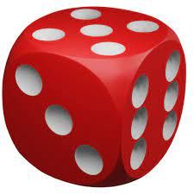
A new example – rolling a dice
Chance of throwing a 6 in one roll: 1/6 = .17
Chance of NOT getting a 6 in one roll: 5/6 = .83
Two sixes in a row: 1/6 x 1/6 = .03
NOT getting a 6 twice in a row 5/6 x 5/6 = .69
A six followed by not a six: 1/6 x 5/6 = .14
NOT a six, followed by a six 5/6 x 1/6 = .14

Slide 20
A new example – rolling a dice
Chance of throwing a 6 in one roll: 1/6 = .17
Chance of NOT getting a 6 in one roll: 5/6 = .83
Two sixes in a row: 1/6 x 1/6 = .03
NOT getting a 6 twice in a row 5/6 x 5/6 = .69
A six followed by not a six: 1/6 x 5/6 = .14
NOT a six, followed by a six 5/6 x 1/6 = .14
At least ONE six in two throws: .03 + .14 + .14 = 0.31

Slide 21
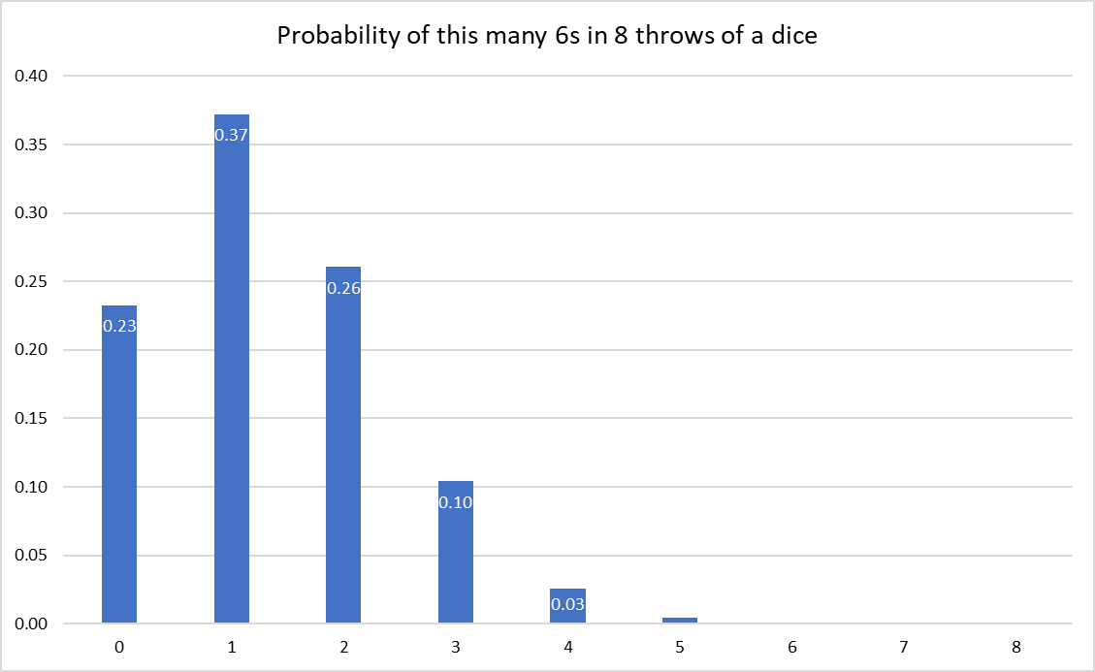
We can draw a distribution of possibilities for this example also.
This tells us the likelihood of getting this exact number of sixes.
But to know whether our dice is giving us more than a “fair” number of sixes, we need to know the probability of at least that many sixes.

Slide 22
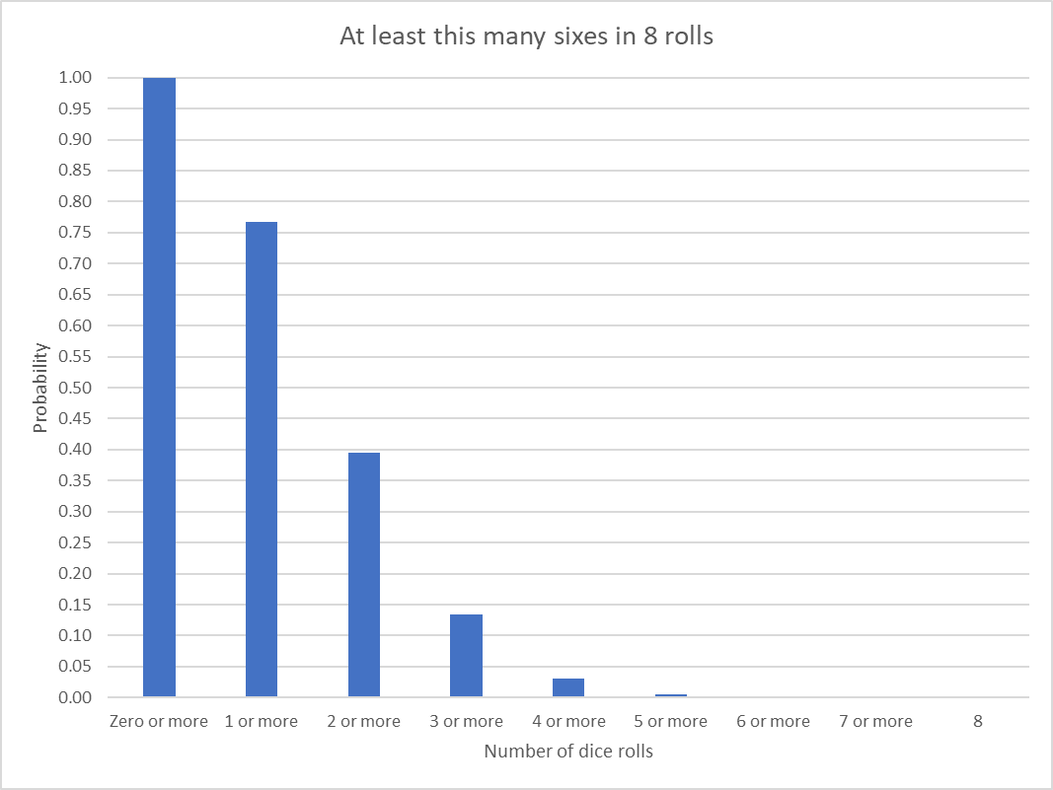
A cumulative probability function
Here we can see that there is a 13% chance of getting 3 or more sixes in 8 rolls.
And there is a 3% chance of getting 4 or more 6s in 8 rolls

Slide 23
Just as with the coin example
There is a likelihood of every possible outcome happening by chance.
Thus, for any observed outcome, we can ask,
“How likely is this to have happened by chance”?

Slide 24
Second statistical principle
We can set the criterion for accepting that a particular outcome is unlikely by chance.
(Just as you did with the coin-flip example).
In science, it is conventional to use a criterion of 5% as the level at which we start to question whether the outcome occurred through chance. This is called the significance level.

Slide 25

The concept of significance
In this example, the chance of getting 4 or more sixes in eight rolls of a fair dice is 3%.
This is less than the criterion of 5%, so we would conclude that the observation is significant.
So, if we roll a dice 8 times, and get 4 (or more) sixes, we haven’t proved that the dice is “unfair”.
Instead we have shown that this outcome would be unlikely to have happened with a fair dice. i.e. we would expect it to happen only 3% of the time.
In this case, then it suggests that the dice isn’t “fair.”

Slide 26
Moving from coins / dice to people.
Imagine a within-participant design, in which participants take a test under two conditions (A and B). Our hypothesis is that A > B.
What is the likelihood that the difference in the averages between Test A and Test B occurred by chance?

Slide 27
What would we expect by chance if there were NO differences between Test A and B?
If we simply look at which score is higher (vs lower), then by chance we would expect A to be higher half the time, and B to be higher half the time (roughly).
This is like saying we would expect Heads vs Tails on a coin to be equally likely (roughly).

Slide 28
In our example
A is highest on 7 out of 8 comparisons (and the reverse is true only once).
This is like getting 7 heads out of 8.
By chance, we would expect this to happen only 3% of the time.
We would conclude – on the basis of this statistical test – that this is a significant effect.

Slide 29
Two almost identical examples
Notice here that our statistical comparison (which direction is the difference in) is IDENTICAL in both Scenarios, and wo we would DRAW THE IDENTICAL CONCLUSION that Scores on Test A tend to be higher than scores on Test B.
This is true, despite the fact that:
Scenario 1: Average of B < Average of A,
Scenario 2: Average of B > Average of A

Slide 30
Third Statistical principle
The conclusions that can be drawn depend upon the assumptions in the statistical test being used.

Slide 31
Third Statistical principle
The conclusions that can be drawn depend upon the assumptions in the statistical test is being used.
In our statistical test, we are testing an assumption about the DIRECTION of any difference, not the SIZE of any difference.
There are (other) statistical tests that can be used to test assumptions about the size of any difference: you will cover these later in the UG programme.

Slide 32
Notice in these examples
In both cases it is TRUE that MOST PEOPLE (7 out of 8) do better at Test A.
Out statistical test is about the DIRECTION of the differences, and so this pattern (7/8 in one direction) is unlikely to have occurred by chance.
Our statistical test is not about SIZE of the DIFFERENCE, and so it doesn’t apply to the AVERAGE SCORE on each test.

Slide 33
The example I’ve used is called the Sign-Test
So far we have used a small example (8 people), but it is possible to extend this test to any sample size.
In all cases, the logic is identical. If we have N pairs of scores, we expect one of the scores to he higher on around half the observations.
The more the differences deviate from a 50:50 pattern, the less likely this is to be by chance. We don’t have to calculate the likelihood by chance – statistics programmes (or Excel) will do this for us.

Slide 34
Another example using a between-participant design.
In this example, we have Test A and Test B taken by different people, so we can’t look at the direction of a difference for each person.
So, we start with a different assumption.
If Test A and B are (roughly) the same then the highest (vs lowest) scores should be spread out equally across both conditions.

Slide 35
The case with 4 participants.
We have 1 score per person (with half the sample doing each test).
Score Condition
Person 1 10 A
Person 2 5 B
Person 3 8 A
Person 4 4 B
Here the two HIGHEST scores are in A, and the two LOWEST scores are in B.
What is the probability that this happened by chance?

Slide 36
For our simple example, there are 24 possible rank orders (of Person 1, 2, 3 and 4).
1st 2nd 3rd 4th
1 1 2 3 4
2 1 2 4 3
3 1 3 2 4
4 1 3 4 2
5 1 4 2 3
6 1 4 3 2
7 2 1 3 4
8 2 1 4 3
9 2 3 1 4
10 2 3 4 1
11 2 4 1 3
12 2 4 3 1
1st 2nd 3rd 4th
13 3 1 2 4
14 3 1 4 2
15 3 2 1 4
16 3 2 4 1
17 3 4 1 2
18 3 4 2 1
19 4 1 2 3
20 4 1 3 2
21 4 2 1 3
22 4 2 3 1
23 4 3 1 2
24 4 3 2 1

Slide 37
How many of these have Person 1 and 2 in the highest rank positions?
1st 2nd 3rd 4th
1 1 2 3 4
2 1 2 4 3
3 1 3 2 4
4 1 3 4 2
5 1 4 2 3
6 1 4 3 2
7 2 1 3 4
8 2 1 4 3
9 2 3 1 4
10 2 3 4 1
11 2 4 1 3
12 2 4 3 1
1st 2nd 3rd 4th
13 3 1 2 4
14 3 1 4 2
15 3 2 1 4
16 3 2 4 1
17 3 4 1 2
18 3 4 2 1
19 4 1 2 3
20 4 1 3 2
21 4 2 1 3
22 4 2 3 1
23 4 3 1 2
24 4 3 2 1
i.e. By chance we would expect Person 1 and 2 to be the highest 2 scoring people 4 times out of 24 = 16.7% of the time.

Slide 38
This too can be extended
For any set of scores, we can calculate the probability that any rank order would be generated by chance, and then check the probability of that distribution of rank orders across our conditions.
In this example, the highest score is 16, which gets a rank of 1, the next highest score is 14, which gets a rank of 2, and so on down to 2, which gets a rank of 8.
We see that 3 out of 4 top scores are for Test A, and 3 of the 4 lowest scores are for Test B.

Slide 39
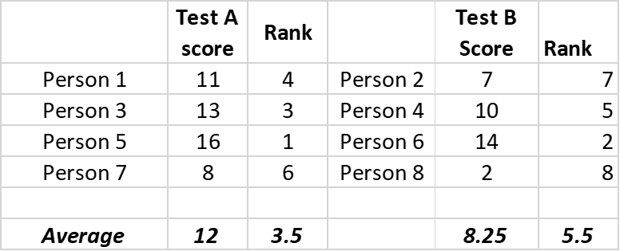
This is the Mann-Whitney (or rank-sum) test
Fortunately, you don’t have to calculate the probabilities by hand. This can be done with statistics packages, or Excel.
Notice however, that because we are looking at RANK ORDER of the scores, we are not basing our statistical test on the SIZE of the difference. Like the Sign test, this statistical test tells us about the distribution of scores, not their means.

Slide 40
The conclusions depend upon the assumptions!
Scenario 1
Scenario 2
Just as with the Sign-Test, we can get situations where the rank-orders may not reflect the direction of the means. See the two examples above. They have the same rank orders, but the means show opposite patterns.
And, just as with the Sign test, our statistical analysis tells us about the distribution of scores, not their absolute size (i.e. which test gives the highest average).

Slide 41
If your group projects involve a comparison of scores across two conditions:
For within-subjects designs (participants do both conditions) you should use a Sign Test.
For between-participant designs (participants do one condition only) you should use the Mann-Whitney test.
In both cases, the test will tell you the likelihood of observing the distribution of scores that you obtained. It will not tell you about the size of the difference between the averages.

Slide 42
Doing the statistical analysis for your project
I will supply an Excel spreadsheet for you to enter your values into.
It will then automatically calculate the statistical value(s) necessary and significance of your test.
For your poster, you should include the necessary statistics, and (for the assessment) be able to explain what they mean.
(I’ll come onto correlational designs later)

Slide 43
Predictions can be specific (one directional) or general (two-directional)
In the example earlier, I spoke specifically about looking for 3 Tails in a row:
3 flips: 8 possibilities
THH TTH
HTH THT
HHH HHT HTT TTT
The chance of 3 Tails in a row is 1/8, or 12.5%.

Slide 44
Predictions can be specific (one directional) or general (two-directional)
What if I am just looking to see if the coin is generally biased towards one face or the other.
3 flips: 8 possibilities
THH TTH
HTH THT
HHH HHT HTT TTT
The chance of 3 outcomes that are the same = 2/8 = 25%

Slide 45
Predictions about experiments can be directional (one-tailed) or non-directional (two-tailed).
When we run an experiment, we can either make a specific prediction:
Test A > Test B.
Or we can ask is there a difference between Test and Test B:
Test A > Test B or Test B > Test A

Slide 46
A one- vs two-tailed test
In a two-tailed test, you have twice as many outcomes that could occur by chance in favour of a difference. (A > B, B > A).
To prevent us from making too many false positives (a Type 1 error), we require stronger evidence (in either direction) before we conclude there is a difference.

Slide 47
For example: remember I said the odds of all Tails was:
All Tails on a coin
5 flips: 1/32 = 3.1%
6 flips: 1/64 = 1.56%
7 flips: 1/128 = 0.8%
8 flips: 1/256 = 0.4%

Slide 48
The same probabilities apply to Heads (and then you can add both up)
All Tails on a coin All Heads All the same (H or T)
5 flips: 1/32 = 3.1% 3.1% 6.2%
6 flips: 1/64 = 1.56% 1.56% 3.1%
7 flips: 1/128 = 0.8% 0.8% 1.56%
8 flips: 1/256 = 0.4% 0.4% 0.8%

Slide 49
If I’m looking for a coin biased towards Tails
All Tails on a coin All Heads All the same (H or T)
5 flips: 1/32 = 3.1% 3.1% 6.2%
6 flips: 1/64 = 1.56% 1.56% 3.1%
7 flips: 1/128 = 0.8% 0.8% 1.56%
8 flips: 1/256 = 0.4% 0.4% 0.8%
If you predict that the coin will come up tails, then a probability of <5% is reached after 5 tails in a row.

Slide 50
If I’m looking for a biased coin (in either direction)
All Tails on a coin All Heads All the same (H or T)
5 flips: 1/32 = 3.1% 3.1% 6.2%
6 flips: 1/64 = 1.56% 1.56% 3.1%
7 flips: 1/128 = 0.8% 0.8% 1.56%
8 flips: 1/256 = 0.4% 0.4% 0.8%
If you predict that the coin will be the same each time, then a probability of <5% is reached only after 6 identical outcomes in a row.

Slide 51
Statistical principle 4
Your statistical test is influenced by the hypothesis you are testing.
If your prediction is more specific then fewer outcomes are consistent with it by chance.
If your prediction is less specific (e.g. “a difference”), then more outcomes are consistent with this by chance.
The evidence must always be interpreted in terms of the hypothesis you start with.
(And not one you might finish with after you have collected the data!).

Slide 52
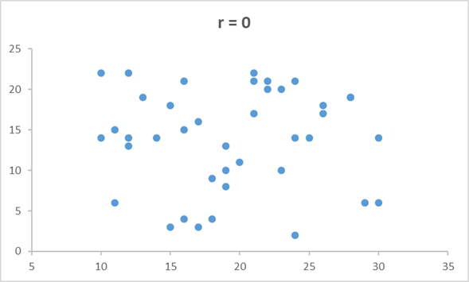
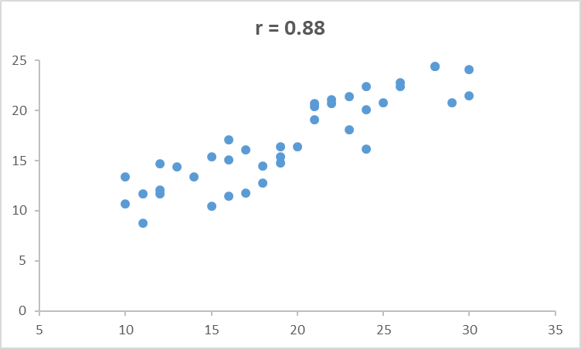
Analysis of correlational data for your project
The statistical principals behind testing the significance of a correlation are (largely) the same, but the maths is trickier.
For any pair of values that each vary, we can how much association we would expect to see between them by chance.

Slide 53
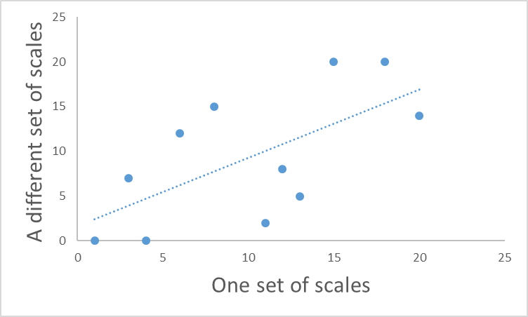
For any scatterplot
By chance, we would expect the points to be randomly scattered across the graph (with no obvious pattern).
However, randomly, we might observe a degree of correlation.
As with our tests for differences across groups, we can ask how likely our observed pattern is if the relationship was just chance.
And, as with out previous examples, we set a criterion (5%) for accepting that our outcome was unlikely by chance.
(The mathematics is trickier, so I won’t explain it here).

Slide 54
For projects based on correlations
I will supply an Excel spreadsheet for you to enter your values into.
It will then automatically calculate the statistical value(s) necessary and significance of your test, as well as plotting the scatterplot, and distributions of each variable.
For your poster, you should include the necessary statistics, and (for the assessment) be able to explain what they mean.

