Slide 1
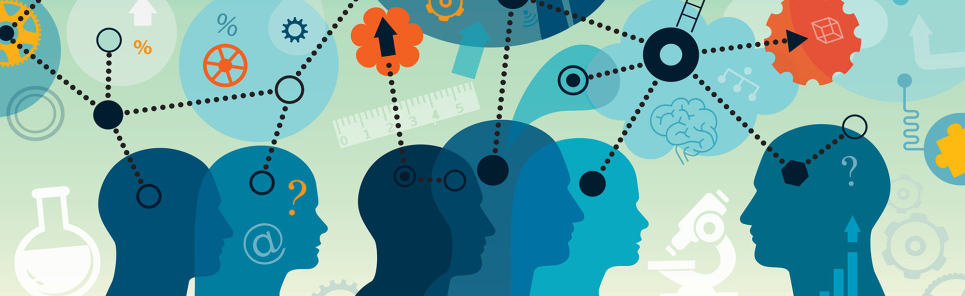
Ethics and Psychometrics

Slide 2
Reading for this lecture
Research methods in Psychology, Chapters 3 and 4

Slide 3
Ethics

Slide 4
Ethical issues in running Psychological research
Risk / Benefit analysis
Acting with integrity
Acting fairly / justly
Showing respect

Slide 5
Discussion: Risk vs benefits
Social problem: there is an ongoing dispute as to whether therapy can create false memories of childhood trauma.
A researcher decides to try to get people to “recover” a memory that is known to be false, using methods reported by therapists, such as guided imagination.
What are the risks vs benefits of this kind of research?
What would decrease the risk?
What would increase the benefit?

Slide 6
Discussion: Respect
For the purposes of research, is it ever justified to lie or otherwise deceive participants?

Slide 7
From principles to guidelines
Experiments involving human (or animal) participants require ethical approval (by a suitably appointed ethics committee).
For your group project, you will have to get ethical approval, before you recruit anyone to take part in your research.

Slide 8
The ethics form should detail:
what will happen to the participants
and where necessary, to justify these (i.e. benefit vs risk).
the level of anticipated harm / risk
and what steps taken to reduce these
How participant’s rights are protected
Informed consent
Treated with respect (including not being deceived unnecessarily)
Right to withdraw
Anonymity
Brief and Debrief

Slide 9
Ethical process for your group projects
Your ethics approval request should detail
Confirmation of who your sample will be
An outline of your research procedure
Explanation of how you have considered and dealt with potential ethical concerns
The nature of the data you plan to collect
A copy of the Brief and Debrief you plan to show participants
A consent form.

Slide 10
Informed consent
Participants should have the necessary information to judge whether they wish to participate.
What will happen to them?
What is expected of them?
What are the potential harms / risks?
What are their rights? (more later)
What rewards (if any) are on offer?
Note: the level of information needs to be balanced against the aims of the experiment (i.e. the potential benefits)

Slide 11
Treated with respect
The language used with the participant should be appropriate.
The experimenter should not be judgmental / authoritarian (etc).

Slide 12
Right to withdraw
A participant has the right to withdraw their consent at any point.
i.e. even having signed a consent form, they can stop.
They can even request their data not be used after the end of the experiment.

Slide 13
Right to Anonymity
Participants have the right to remain anonymous in all aspects of the research, in particular
During dissemination of the results.
On digital records.
Under GDPR legislation, there are serious penalties if identifying information is recorded without permission or stored / shared inappropriately.

Slide 14
Brief
The aim of the brief is to tell participants what is going to happen (and, where possible, why), so that they can give informed consent.
There is a balance between giving enough information, and giving information that may affect the outcome of the study.

Slide 15
Debrief
The aim of the debrief is to tell participants the purpose of the experiment once it is over.
Remember, if there are multiple conditions, they may not have experienced all of them.

Slide 16
Psychometrics

Slide 17
Psychometrics
Psycho = “of the mind” (mental) + metric = “measurement”
Psychometrics is concerned with measurement of mental constructs, and theories that explain the pattern of findings.
Measurement is a systematic procedure by which numerical scores are assigned to a set of objects, where these scores represent the characteristic of interest.

Slide 18
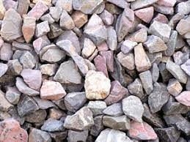
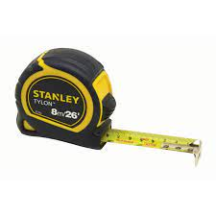
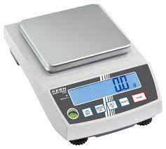
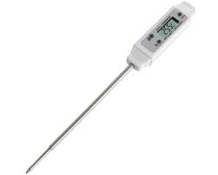
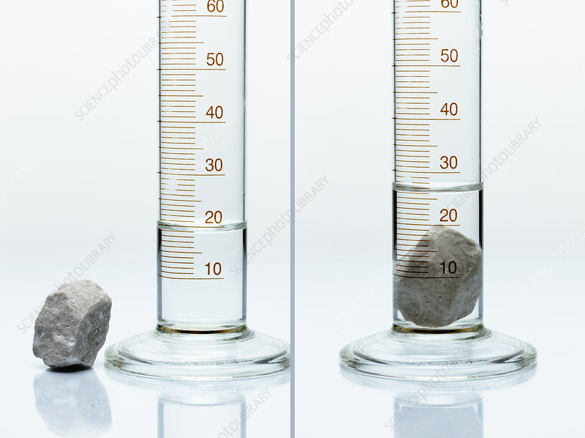
Measurement
Q: How could you find out which is the largest stone by volume?
These are tools for converting physical properties of the stones into a numerical value that can be used to distinguish between them.

Slide 19
Two key properties tools need to be useful.
Reliability
They give the same answer when used twice.
They give the same answer if two different versions of the tool are used.
Validity
They accurately measure the right physical property.
i.e. if you want to measure volume, they measure volume, not weight, or temperature.

Slide 20
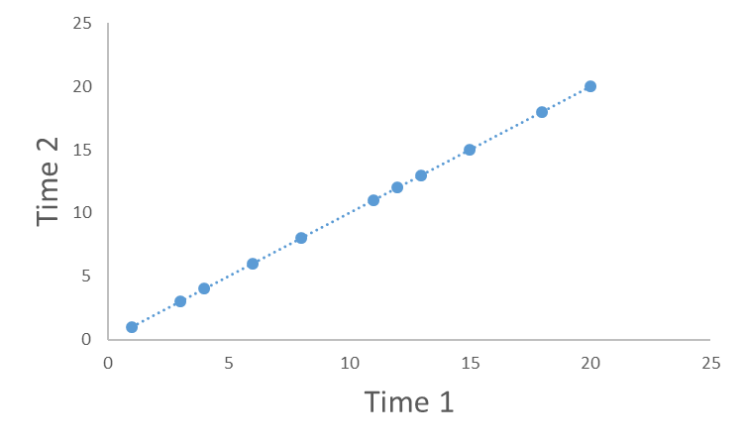
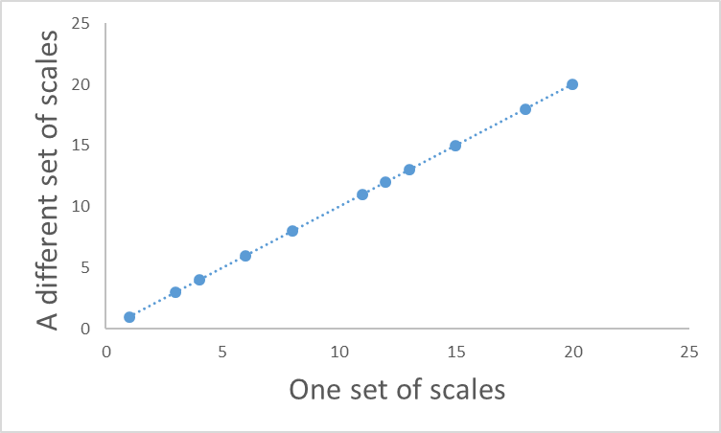
What would reliability look like?
Test – retest reliability
Parallel forms

Slide 21
A crucial point about reliability and validity.
A measure can be reliable without be valid.
e.g. scales measure weight accurately, but this does not make them a good measure of temperature.
A measure that is not reliable is not valid.
If a measure gives a different answer each time (is unreliable), then the reading you get can’t be a valid measure of anything
i.e. a faulty set of scales does not a valid measure of weight.

Slide 22
Psychometrics is commonly concerned with relatively stable constructs that people vary on (called “traits”).
e.g. Personality (e.g. extraversion, openness to experience etc).
Ability (e.g. verbal abilities, musical ability, general intelligence)
Beliefs / Attitudes (e.g. political orientation, spirituality)
But it can also measure more temporary “states”
e.g. Mood, stress

Slide 23
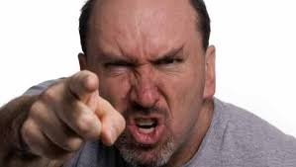
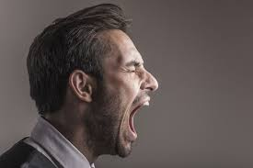
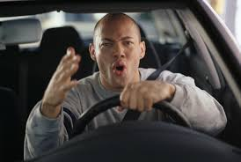
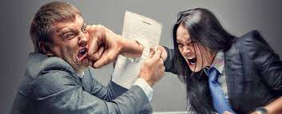
Remember this slide?
Psychological constructs are inferred from observable behaviours
Aggression

Slide 24
How could we develop a tool that provided a reliable measure of aggression?
Behavioural observation of the behaviours we think are caused by aggression
Self-report of those behaviours

Slide 25
But how do we know if it reliable and valid?
1: Reliability
Getting the same score twice.

Slide 26
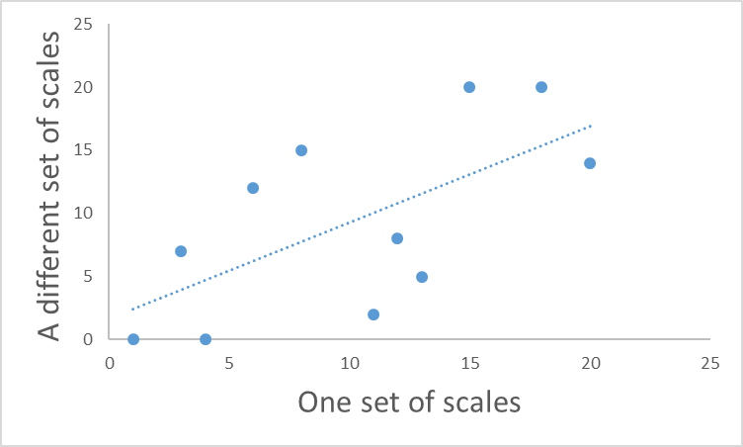
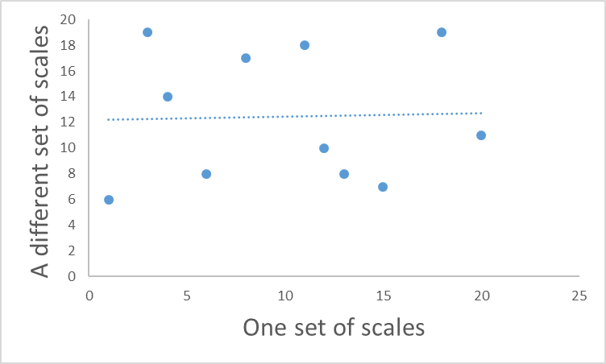
Back to reliability
Perfect reliability
One score is exactly the same as the other.
Knowing one score tells you exactly what the other score will be.
Zero reliability
One score is completely unrelated to the other.
Knowing one score tells you nothing about what the other will be
?

Slide 27
Reliability
Another way of expressing the concept of reliability, is predictability.
Here, one score perfectly predicts what the other score will be.

Slide 28
Scatterplots and correlations
A scatter plot is the figure you get when you plot the value of two observations against each other.

Slide 29
Scatterplots and correlations
The blue dotted line represents the best “fit” between the observations.
Notice that this line goes up.
(Has a positive slope)
This means that as one measure goes up, so does the other one.

Slide 30
Scatterplots and correlations
The “fit” of the line is how far away the dots fall from the best possible line.
Here we can measure how far away each point is (the red lines) and add them up.
The smaller the total, the closer on average the dots are to the line.
If the dots fell exactly on the line, the total would be zero – a perfect correlation.

Slide 31
Correlation values
Value | Interpretation
1 > r > 0.6 | A strong positive correlation: as one variable increases, so does the other.
0.6 > r > 0.4 | A moderate positive correlation
0.4 > r > 0.2 | A weak positive correlation
-0.2 < r < 0.2 | Weak to non-existent correlation
-0.4 < r < -0.2 | A weak negative correlation
-0.6 < r < -0.4 | A moderate negative correlation
-1 < r < -0.6 | A strong negative correlation: as one variable increases, the other decreases.

Slide 32
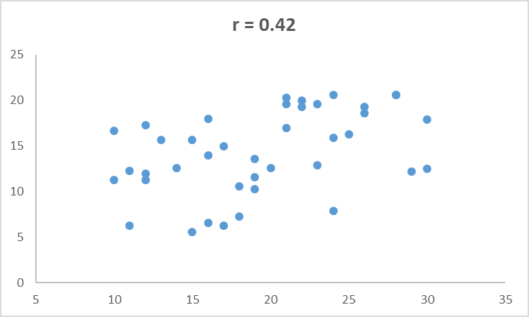
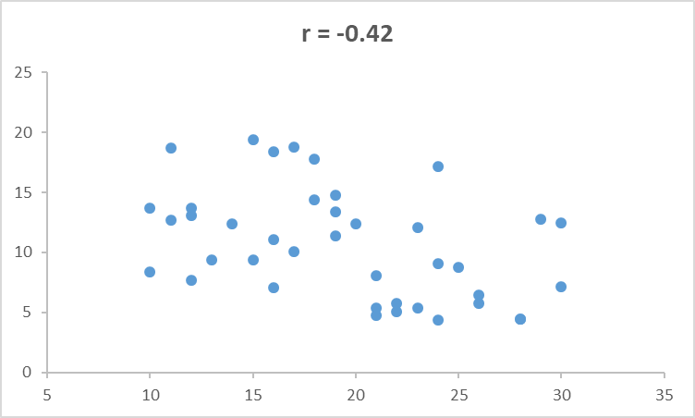
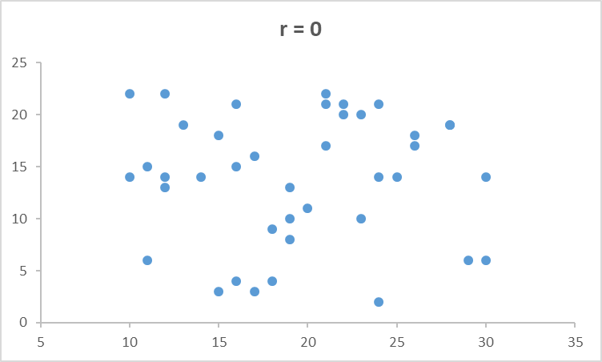
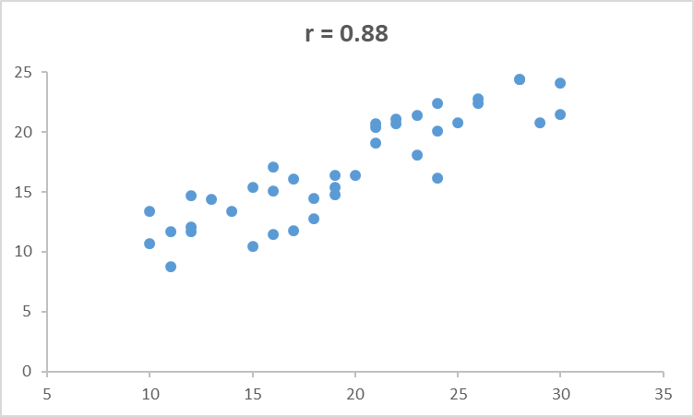
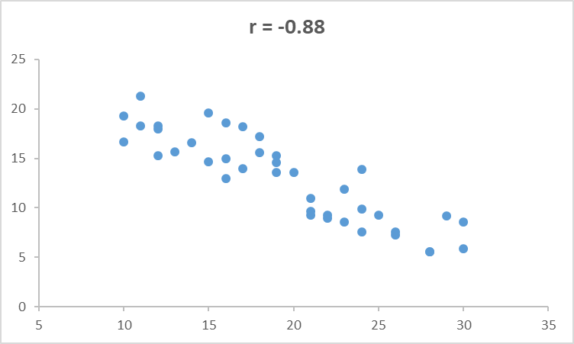
Positive vs negative correlations:

Slide 33
Some limitations of (simple) correlations
1: They only measure the linear relationship between two variables.
2: Their value depends upon the variation in each variable
- this is related to the sample you measure
3: They require that each variable is (roughly) normally distributed
- they are affected by extreme values.

Slide 34
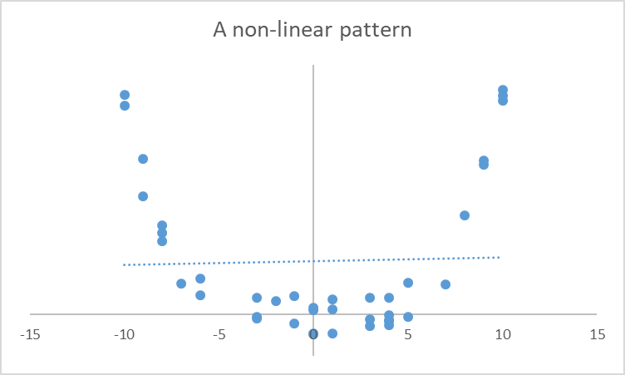
Correlations only measure linear relationships
Here there is a clear relationship between the two variables – just not a linear one.
Consequently a single straight line will never “fit” the data very well – the correlation is nearly zero here.

Slide 35
The effect of restrictions of range
r = - 0.2
A restricted range
Here the whole sample shows a moderately
positive correlation.
But if we restrict the range (to only high-scorers on the
Test), the correlation value reduces. This is because there
isn’t so much variation in the test scores in this sample.

Slide 36
The effect of restrictions of range
r = - 0.16
Here the whole sample shows a moderately
positive correlation.
The same happens if we only look at the low scorers.

Slide 37
The effect of extreme values
r = 0.61
Here the whole sample shows a moderately
positive correlation.
Picking only the highest and lowest scores
increases the correlation. This is because the extreme
scores don’t overlap as much as those in the middle.

Slide 38
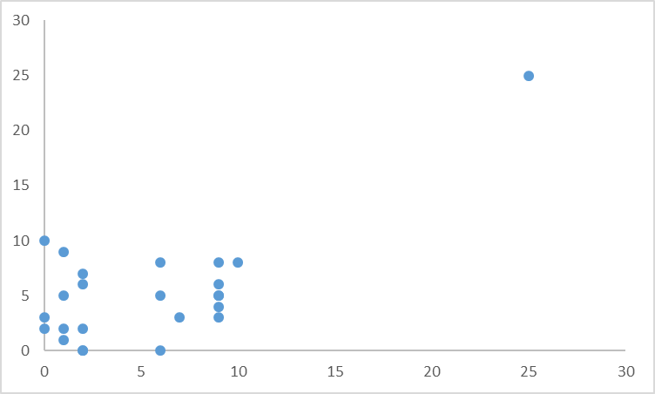
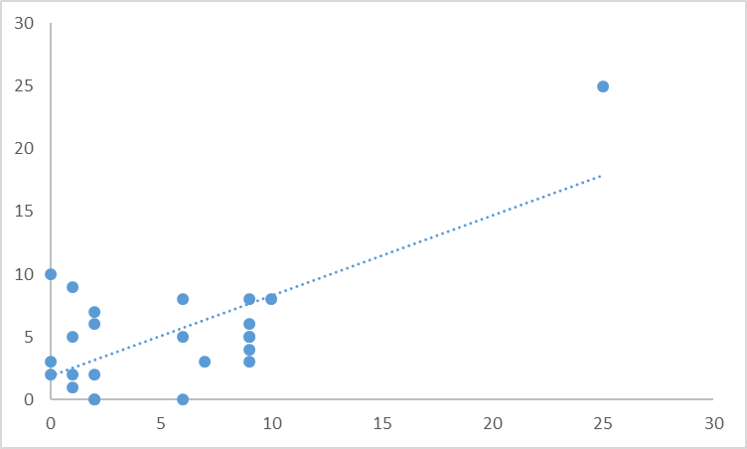
The effects of extreme values
r = 0.01
r = 0.61
This set of points represents a near zero correlation.
Adding a single extreme value increases the correlation value.

Slide 39
Reliability of multiple-item scales.
So, we have focused on two (overall) scores
Either time 1 vs time 2 (test-retest reliability)
Or test 1 vs test 2 (parallel form reliability).
We can extend this to multiple measures and use the results to increase reliability.

Slide 40
Increasing the reliability of a measure.
Any test score obtained consists of two components
Score obtained
=
the true score
+/-
noise
Other factors that might influence the outcome
e.g. motivation, attention, understanding instructions etc.
The underlying construct being measured.

Slide 41
Increasing the reliability of a measure.
Any test score obtained consists of two components
Score obtained
=
the true score
+/-
noise
Other factors that might influence the outcome
e.g. motivation, attention, understanding instructions etc.
The underlying construct being measured.
If the score obtained is mostly the true score, with little noise, then the score obtained will be reliable!

Slide 42
Increasing the reliability of a measure.
Any test score obtained consists of two components
Score obtained
=
the true score
+/-
noise
Other factors that might influence the outcome
e.g. motivation, attention, understanding instructions etc.
The underlying construct being measured.
If the score obtained is mostly noise, then the score will be unreliable!

Slide 43
What if we take multiple measures
1
Score obtained
=
the true score
+
noise
2
Score obtained
=
the true score
-
noise
3
Score obtained
=
the true score
+
noise
4
Score obtained
=
the true score
+
noise
5
Score obtained
=
the true score
-
noise
Average
Score obtained
=
The true score
+
1 / 5 noise
Notice that the average score has less noise in it. So it is MORE reliable.

Slide 44
Therefore
Multiple measures (of the same thing) give you a more reliable measure.
This is why most scales and tests contain multiple items to measure the thing they are interested in.
e.g. personality tests, ability tests etc.

Slide 45
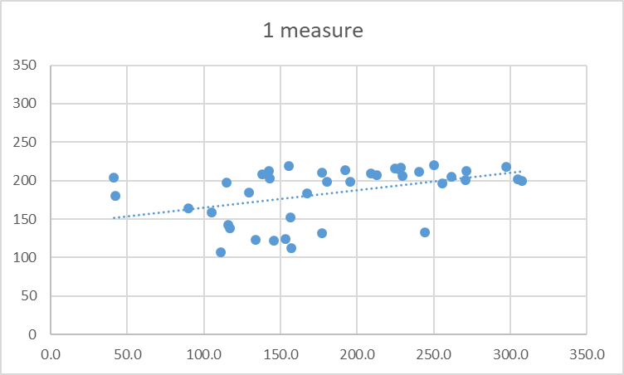
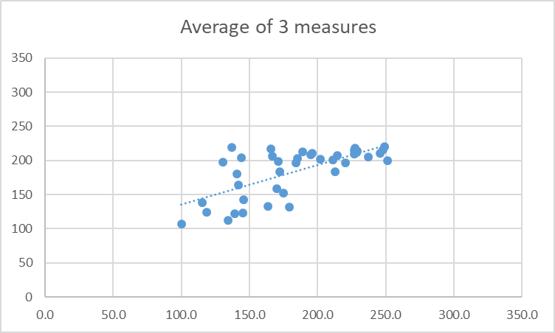
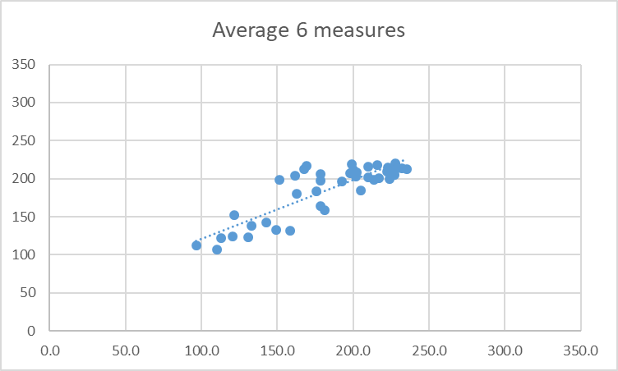
If you have enough measures, you can get an accurate reading, even if each individual measure is noisy.
r = 0.43
r = 0.68
r = 0.85
True score
True score
True score
One moderately reliable measure
Average of 3 moderately reliable measures
Average of 6 moderately reliable measures
Notice, by adding (or averaging) multiple measures, as well as higher correlations, there are fewer outliers, and the slope becomes more accurate.

Slide 46
The effect of averaging across more predictors is an example of the law of small numbers.
The “law of small numbers” is the false belief that small samples provide a good representation of the population they come from.
Examples:
…that restaurant is rubbish because my friend had a bad experience.
…this course will be boring because the first lecture was dull.
…University X will be great, because their Open Day was great.
ALL THESE EXAMPLES HAVE A SAMPLE SIZE OF 1.

Slide 47
These examples are NOT necessarily true.
Small samples result in averages that are more likely to be further away from the true (population) average than averages from larger samples.
Because small samples are noisier measures!

Slide 48
In the example on the next slide.
In the next figure, I randomly generated guesses that were normally distributed (bell-curve) with a true average of 200, ranging from -100 to +500.
I then took averages of 10, 20, 40, 80, 160 or 320 guesses.
I did this 10 times to see how variable the averages were.

Slide 49
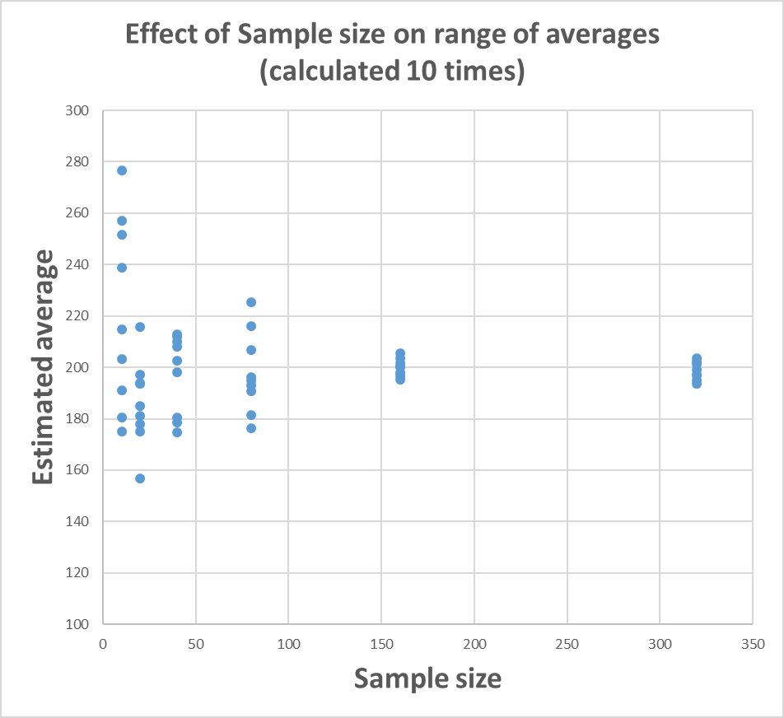
Small samples likely to give more extreme estimates of true average
10 estimates from small samples (n = 10)
10 estimates from large samples (n = 320)
True average = 200

Slide 50
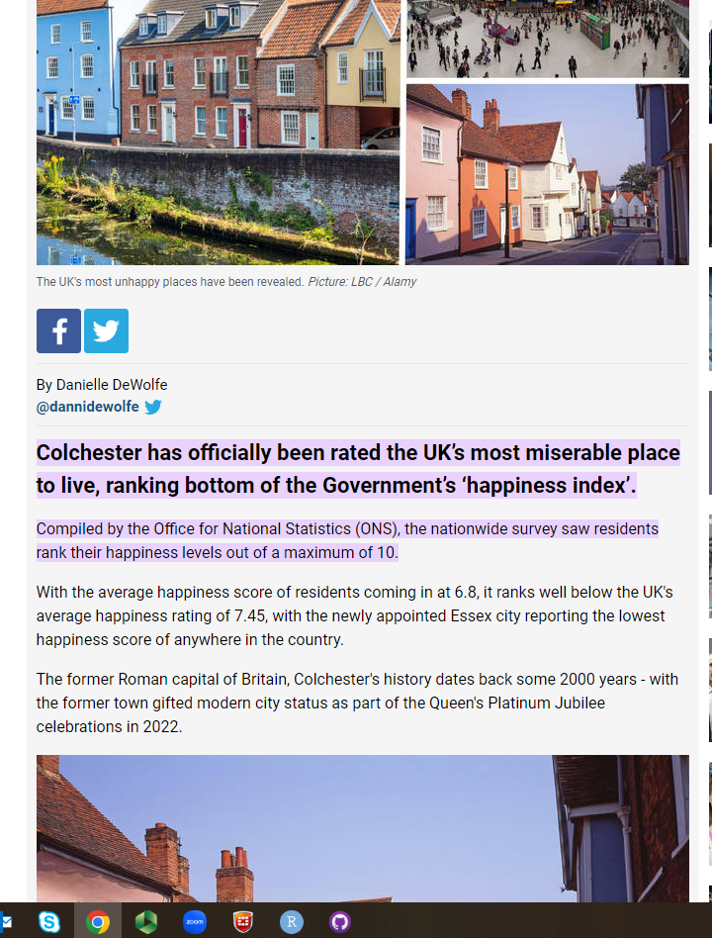
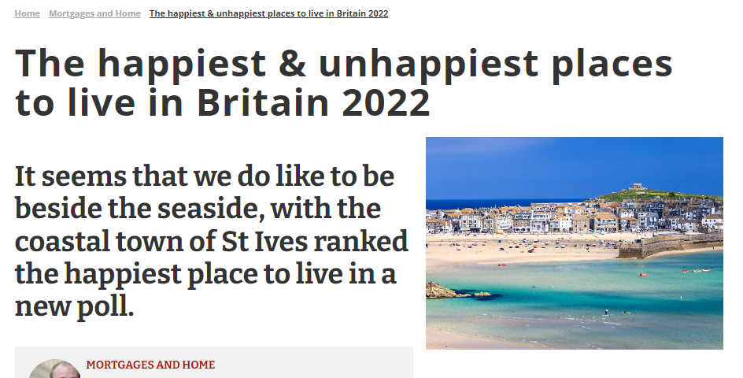
This is why we should be wary of media reports like this:
The “extreme” scores are most likely to come from SMALL samples. i.e. towns like St Ives and Colchester, not cities like Manchester or Birmingham.

Slide 51
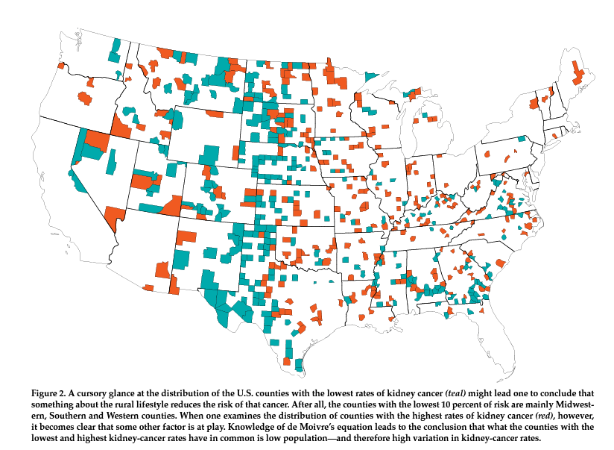
Another (more serious) example
Map of kidney cancer rates in the States.
Blue (teal) shows the areas with particularly low rates of kidney cancer.
Why might this be?
Red shows the areas with particularly high rates of kidney cancer.
What do you conclude now?

Slide 52
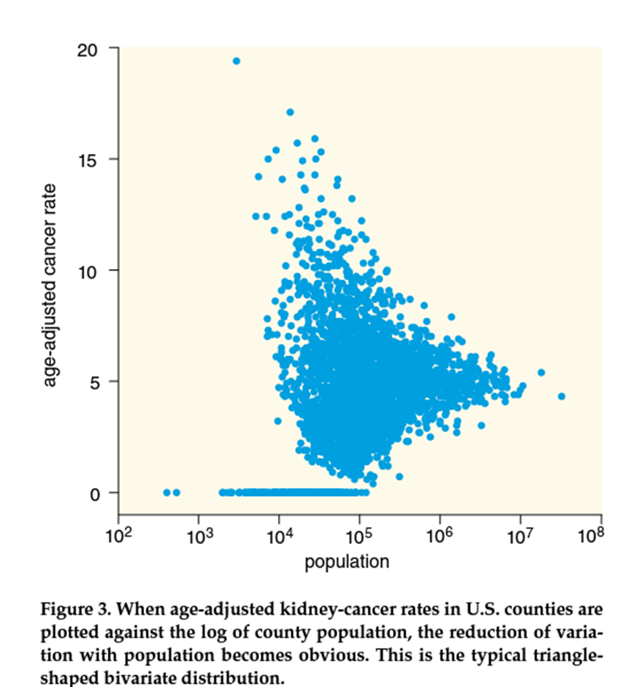
Plot of rates of cancer, based on population.
Here you can see that larger populations give more accurate estimates.
So areas within the same state show the highest AND the lowest rates of cancer, because those states have the lowest populations.

Slide 53
The opposite is to believe in larger samples.
E.g. Sir Francis Galton’s “wisdom of the crowd”
https://www.youtube.com/watch?v=uz5AeHqUtRs

Slide 54
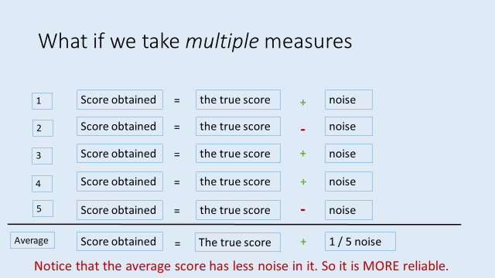
Wisdom of the (large) crowd
In the jelly bean example (or the original Cow example from Galton), the average is taken over a LARGE sample (160 in this case), and the result is a quite accurate average.
This implies that all people have some accuracy buried in lots of noise.
Averaging a crowd gets rid of the noise, and reveals the underlying estimate.

