Slide 1

Learning from failure?
Olivia Flack,
Tessa Guest,
Stephen Mackintosh,
Nick Monsell,
Jenni Plaisted,
Kate Rodd

Slide 2
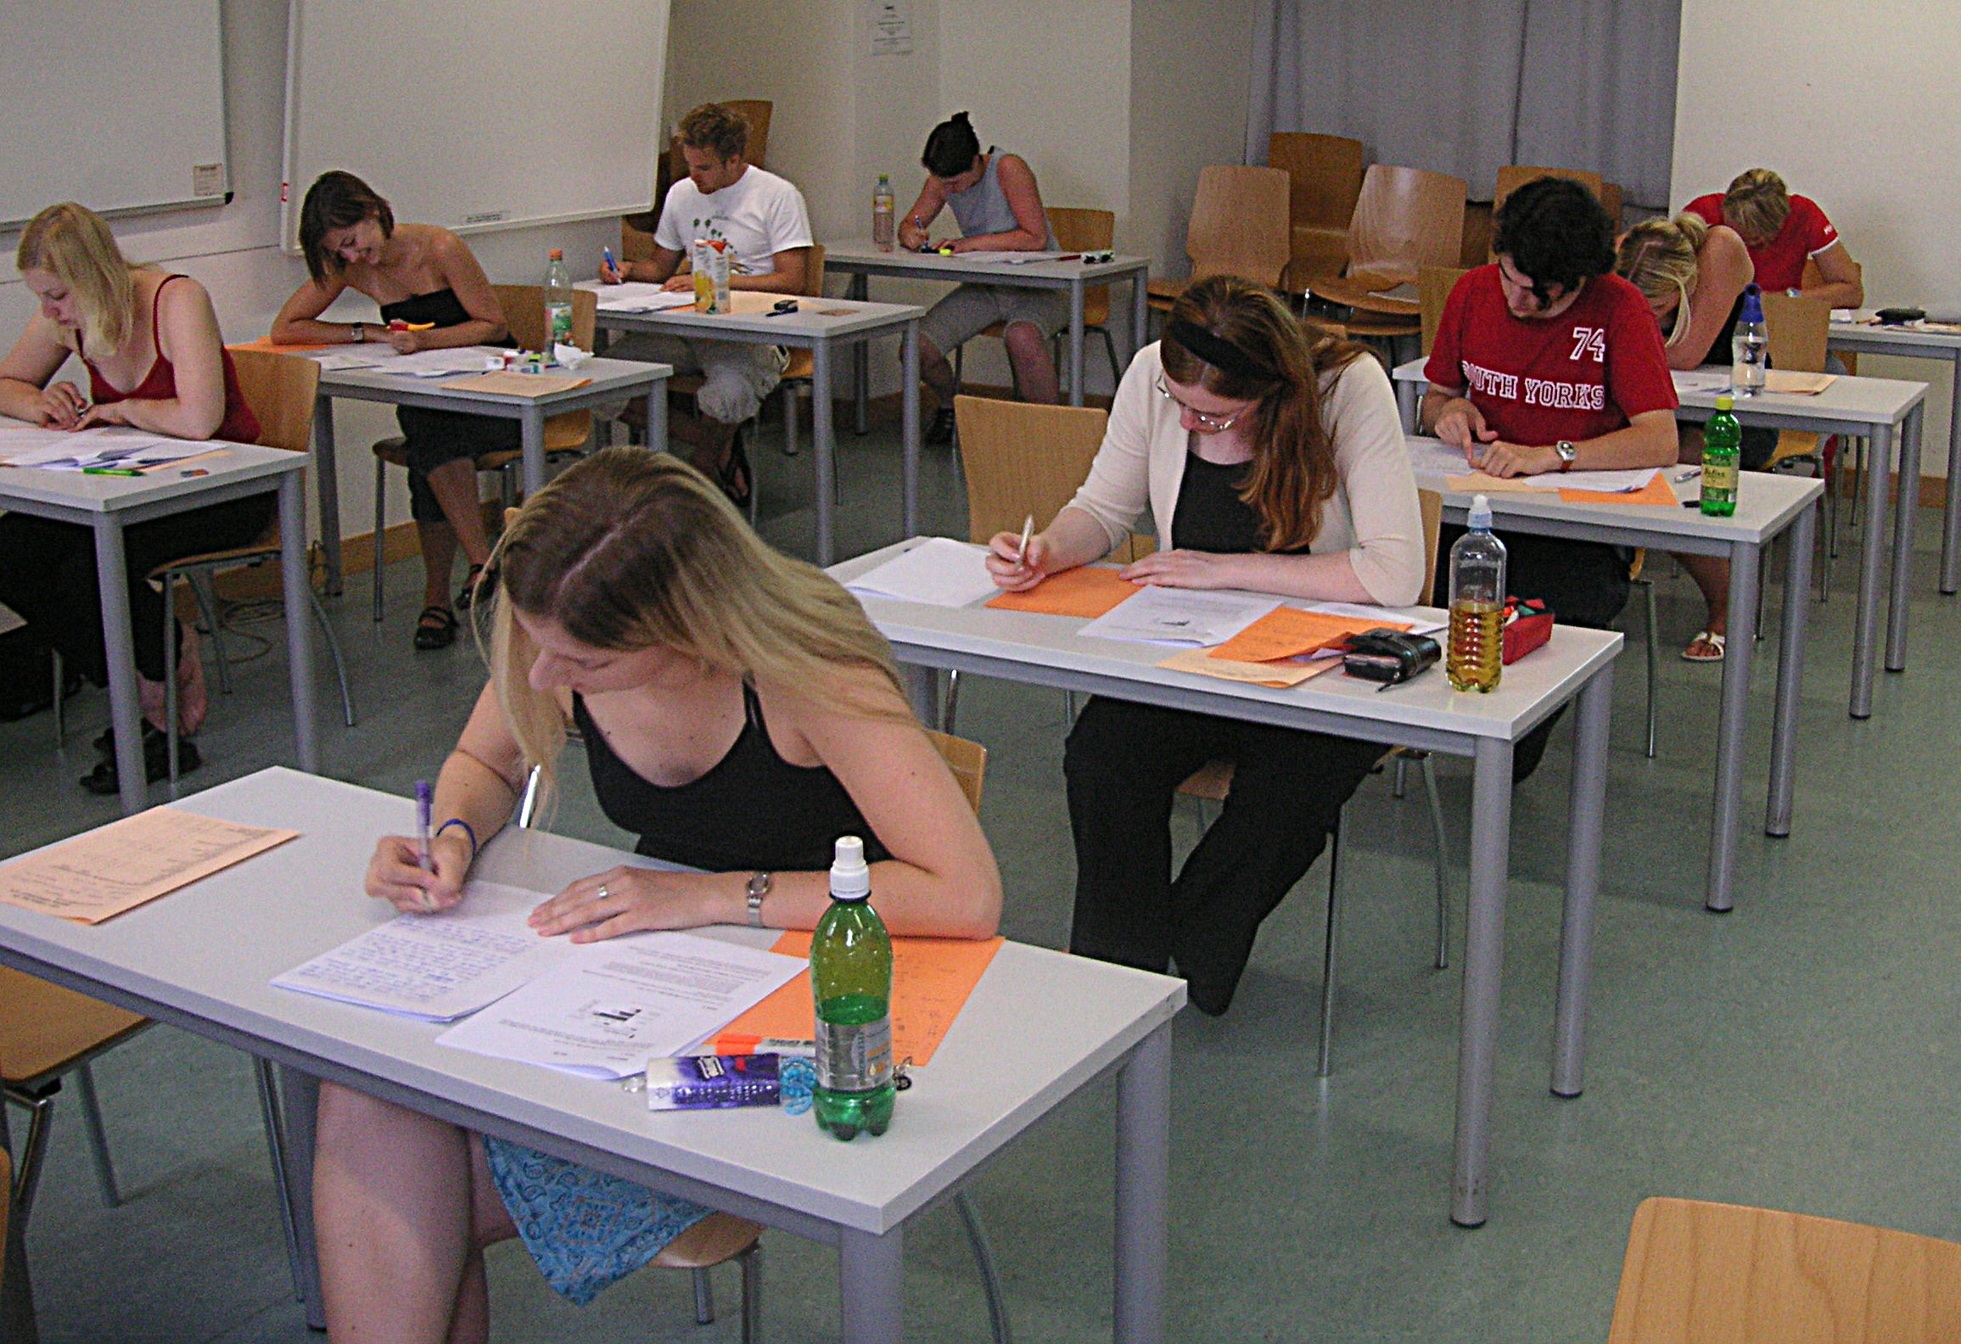
Learning and testing
Optimising learning is important for both students and educators.
The testing effect (Roediger & Karpicke, 2006)
Tests seem to help even when performance is poor (Kornell et al. 2009) ...
… and even for arbitrary pairings such as vocabulary learning (Potts & Shanks, 2014).

Slide 3
Potts & Shanks (2014)
Generate: roke - ? / roke – man / roke – mist
Study: roke – mist
Test:
‘roke’ means: lament threat mist loud
RESULT: Generate better than Study.

Slide 4
Our question
Would the Potts & Shanks result generalise to a more challenging type of test? (i.e. recall rather than recognition)

Slide 5
Method
52 participants (2 lost due to technical errors)
Within-subjects factor: Generate vs. Study
Between-subjects factor: Test difficulty
15 word pairs per condition (e.g. gadoid = fish)
Generate:
  10 seconds: cue (gadoid) and guess
  7 seconds: pair (gadoid – fish)
Study:
  17 seconds: gadoid – fish
Recall test: All cues at end (hard test), cues at end of each condition (easy test)
  What does this word mean? gadoid

Slide 6
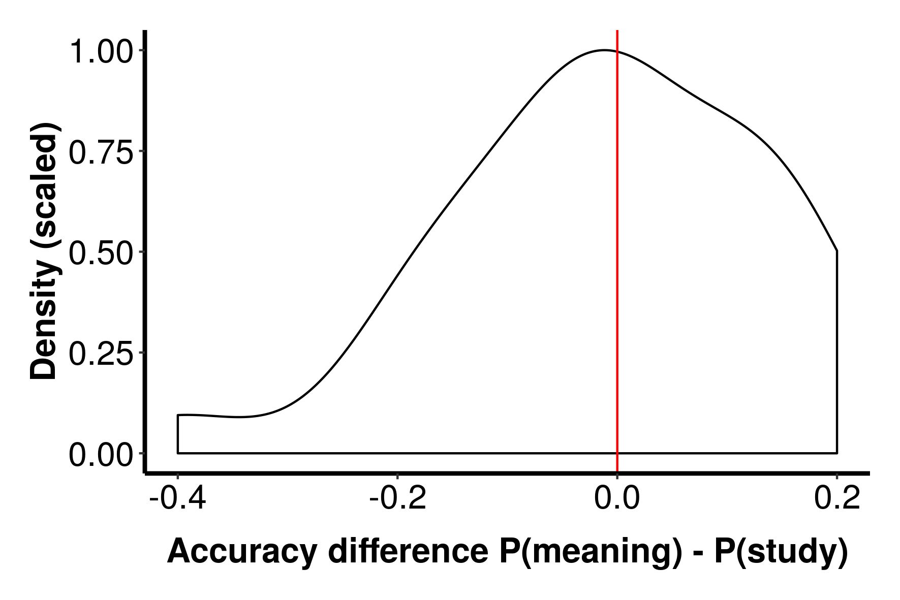
Results – Hard test
Meaning: 0.13
Study: 0.14
BF = 0.30
No effect of study type in a cued recall test.

Slide 7
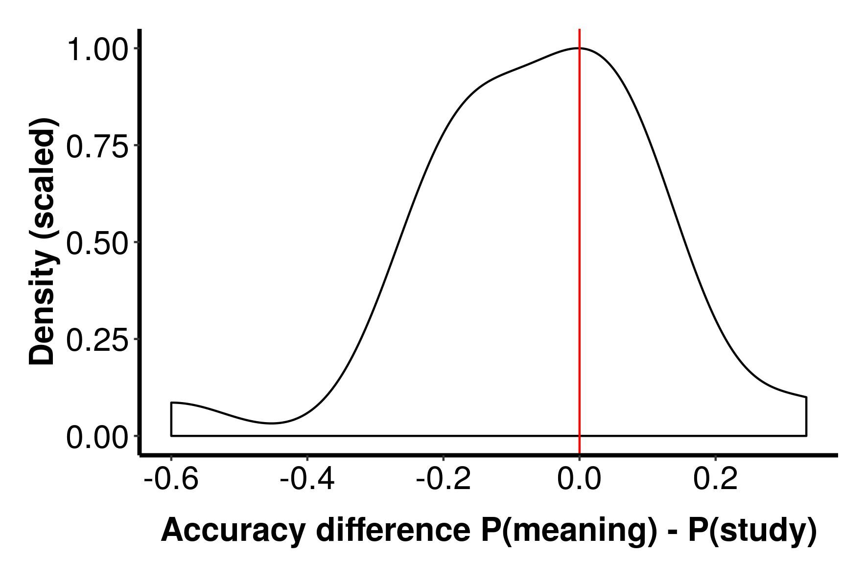
Results – Easy test
Meaning: 0.29
Study: 0.35
BF = 0.86
Inconclusive results.

Slide 8
Results – Comparison of conditions
Hard test was harder, BF = 3605
Main effect of encoding condition inconclusive, BF = 0.39
Evidence for an interaction inconclusive, BF = 0.38.

Slide 9
Discussion
Different result to Potts & Shanks.
Difference is likely due to use of cued recall.
Perhaps errorful generation boosts familiarity rather than associative learning?

Slide 10
Next steps
Re-run easier task with larger sample size.
Equate stimulus presentatin time.
Any questions?
All images from Wikimedia Commons

