Slide 1
Face Processing And Recognition Projects
Notes:
Two topics to look at:
Holistic processing of faces and the composite face effect.
Unfamiliar face recognition and the influence of images used.

Slide 2
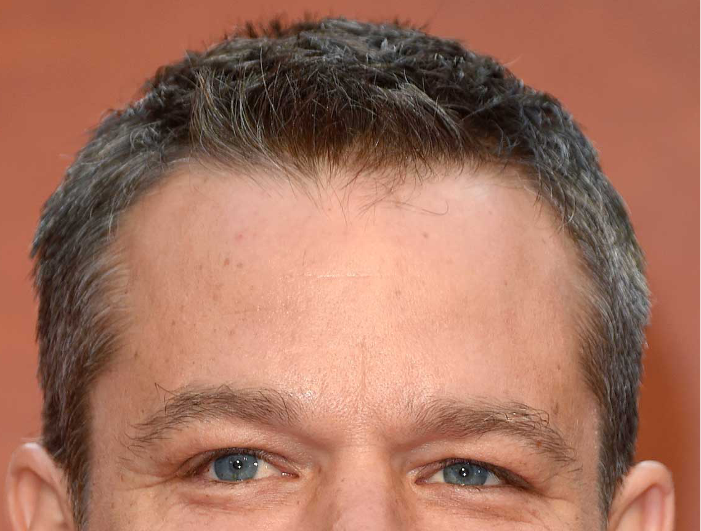
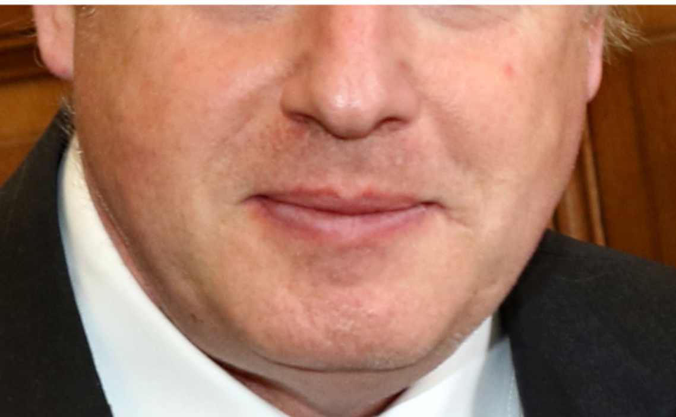
Holistic processing of faces and the composite face effect
Notes:
The composite face effect is one half of one persons faces combined with the another half of another person’s face. This, as in the example on this slide is the top half of one person’s face (from the top of the head to the midpoint on the nose) combined with the bottom half (from the middle of the nose to the bottom of the chin) of another person’s face. When the two halves are aligned like this people find it had to name the top or bottom half. However, when the two halves are mis-aligned people find this task easier.
Class activity: Get the students to try to name the top half and then the bottom half. Face recognition ability is quite variable in the population so some may be able to do this task, others will struggle. Advance the slide and the two halves will separate. For those that identified the halves previously, see if they are still sure of this. For those who could not identify the faces, see if they can now do it.
The top half is Matt Damon, the bottom half is Boris Johnson.

Slide 3
Holistic processing of faces and the composite face effect
Why do people find it hard to identify the halves when they are aligned?
It seems to be because faces are processed holistically (i.e. as a single object) rather than individual parts. Combing the two halves creates a new representation of a face
In the class example this seems to affect familiar face identity processing
The papers in the resource list suggest other aspects of face processing that might also be processed holistically. What other aspects of face processing can be investigated by this effect?
Notes:
The composite face effect can be easily explained as follows: it is thought that faces are processed not as individual features but rather as wholes. When the two halves of the face are aligned a brand new holistic representation is perceived and processed instead of two individual halves. This holistic representation does not match any known face resulting is a difficulty in trying to determine which half belongs to which person. When the two halves are mis-aligned however no such new representation is formed leaving observers to process each half as best they can. Without the interference of a (misleading) holistic representation, people find this condition easier.
The papers listed in the resource list look at three different effects using the composite face:
Gender
Unfamiliar face matching
Social categories
All three papers report that holistic processing underlies the effect they were looking at. Thus gender appears to be processed holistically, as do unfamiliar faces. The final paper reveals that the strength of holistic processing (as shown by the composite face effect) can be modified by the social category of the face. Students can look at other aspects (perhaps expressions, identity with different expressions in each half and so on).

Slide 4
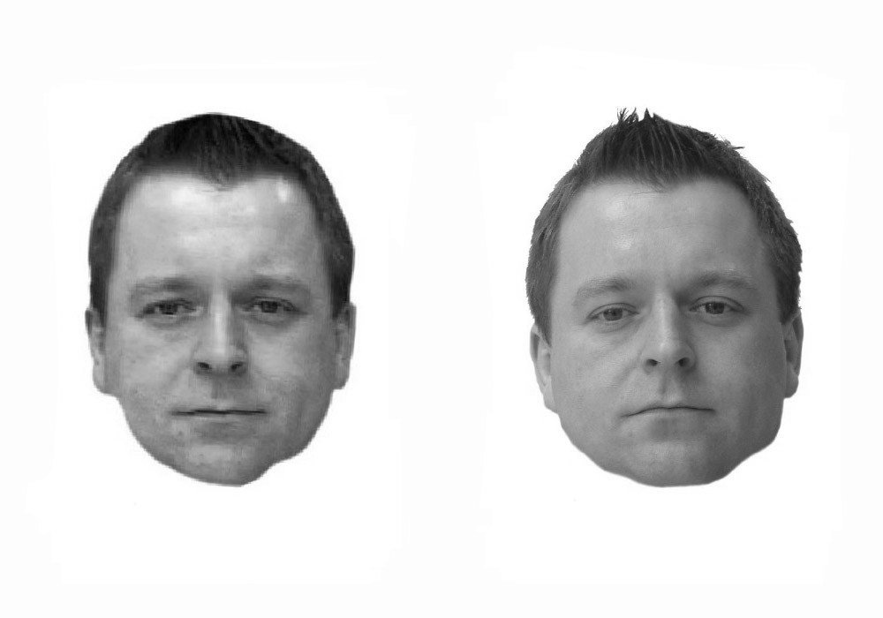
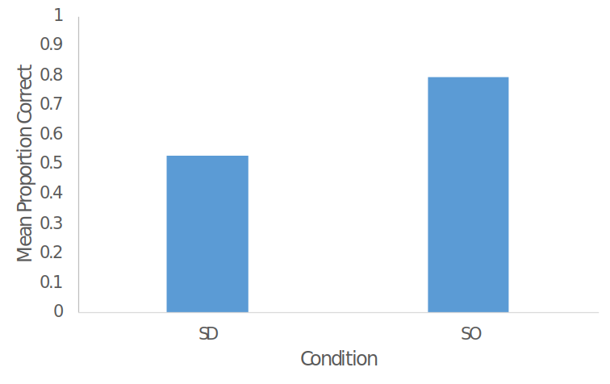
Image-dependency of unfamiliar face recognition and matching
Notes:
Unfamiliar face recognition is considered to be image-bound. That is, recognition of an unfamiliar face is somewhat poor unless the image of that person remains unchanged. If the image is changed, recognition performance falls. Consider the example of this slide. The two images on the left are two different images of one man. If the left hand image of the pair is presented for study and then at test the participant is shown the same picture their recognition tends to be quite good. Present the right image of the pair at test however recognition performance falls.
Class activity: ask the students if the faces look familiar. Have they seen them before? In fact, these images and this procedure was a PsycEL activity the students completed in PSYC412. The results of this activity from this group of students are shown in the graph on the right. SD = a different picture shown during test and SO = the same picture shown at both study and test. So even with these highly similar pictures, any small change seems to affect recognition.

Slide 5
Image-dependency of unfamiliar face recognition and matching
Why are unfamiliar faces hard to recognise?
Pictorial coding systems seem to underlie unfamiliar face recognition. Changing the picture between study and test decreases recognition
The main change in the previous example was that a different camera was used – the two images were actually taken very close together.
Can we find more transformations that adversely affect the recognition of unfamiliar faces?
Notes:
Pictorial coding means the same thing as image-bound. Pictorial codes are tied to properties of the image studied and are unique to that image (e.g. a patch of light here, a darker areas here and so on). In fact, some suggest that pictorial codes do not accurately reflect face recognition (although that is an argument well beyond PSYC520). It would be interesting to examine the limits of generalisation from pictorial codes. The resource papers identify ways in which pictorial code recognition can be foiled:
Blurring
Pixilation
Viewpoint
Perhaps there are other transformations that affect unfamiliar face recognition? Note that the first paper uses a procedure that cannot be used with OpenSesame. However the principle of blurring should still hold. The last paper employed both recognition memory and face matching paradigms. Both are easily implemented in OpenSesame but they should only use one technique.
Final note for all face projects: if famous faces are involved then the students will have to source their own. We will be able to provide images of unfamiliar faces – these will be available from their project leader.

