Slide 1
Compilation(Synthesis)
            Suvarna P Biliki

Slide 2
Contents
Compilation Phases
Intermediate code generation
Intermediate Representation.
Three Address code.
Machine Independent Code Optimization
Code Optimization
Machine Dependent Code Optimization

Slide 3
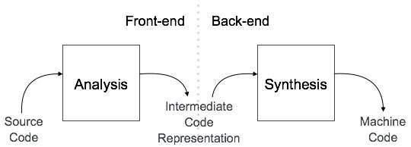
Compilation phases

Slide 4
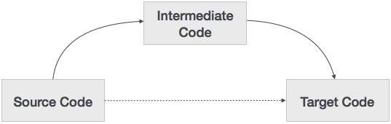
Intermediate Code Generation
Intermediate code is in between the high-level language and the machine language.
This intermediate code should be generated in such a way that it makes it easier to be translated into the target machine code.

Slide 5
Why intermediate code generation ?
If a compiler translates the source language to its target machine language without having the option for generating intermediate code,then for each new machine,a full native compiler is required.
Intermediate code eliminates the need of a new full compiler for every unique machine by keeping the analysis portion for all the compiler.
It becomes easier to apply source code modification to improve code performance by applying code optimization technique on the intermediate code.

Slide 6
Intermediate Representation
High Level IR
High level IR is very close to source language.
It can be easily Generated from the source code and we can easily apply code modification to enhance performance.
Low Level IR
Low Level IR is close to target machine which makes it suitable for register and memory allocation,instruction set selection.
It is Good for machine dependent Optimization.

Slide 7
Three Address Code
A Three address code has at most three address locations to calculate the expression,it can be represented in two forms.
Quadruples
Triples

Slide 8
Quadruples
Each instructions in Quadruples presentation is divided into 4 fields operator,arg1,arg2,and Result.
Ex:a = b + c * d;
Generator will divide this expression into sub expression and generate corresponding code.
t1 = c * d;
t2 = b + t1;
t3 = t2 + t1;
a =t3;
where t1, t2, t3 being used as temporary variables.

Slide 9
Quadruples Representation
operator | argument1 | argument2 | result
* | c | d | t1
+ | b | t1 | t2
+ | t2 | t1 | t3
= | t3 |  | a

Slide 10
Triples Representation
Each instruction in Triples presentation has three fields:Operator, argument1, argument2.
The Result of respective sub-expression are denoted by the position Of expression.

Slide 11
Triples Representation
Operator | argument1 | argument2 | Position
* | c | d | (0)
+ | b | (0) | (1)
+ | (1) | (0) | (2)
= | (2)

Slide 12
Code Optimization
Optimization is a program transformation technique, which tries to improve the code by making it consume less resources (ie., CPU, Memory) and deliver high speed.
There are two types of Code Optimization
Machine Independent Optimization.
Machine Dependent Optimization.

Slide 13
Cont….
Machine Independent Code Optimization
  - Global Common sub – expression Elimination
  - Copy Propagation
  - Loop Invariant Code Motion
  - Function In lining
Machine Dependent Code Optimization
  - Dead Code Elimination
  - Flow Control

Slide 14
Machine Independent Optimizations
In this optimization, the compiler takes the intermediate code and transforms a part of the code that does not involve any CPU registers and/or absolute memory locations.
Ex:
do
{
item = 10;
value = value + item;
}while(value<100);
item = 10;
do
{
value = value + item;
}while(value<100);

Slide 15
Peep hole optimization
Definition
It removes unnecessary code lines, and arranges the sequence statements in order to speed up the program execution without wasting resources (CPU, memory).

Slide 16
Redundant instruction elimination
int add_ten(int x) { int y, z; y = 10; z = x + y; return z; } | int add_ten(int x) { int y; y = 10; y = x + y; return y; } | int add_ten(int x) { int y = 10; return x+y; } | int add_ten(int x) { return x+10; }

Slide 17
Code Generation
Basic blocks comprises of sequence of three address instructions. Code generator takes these instructions as input.
It should consider following things to generate the code:
Target Language
Selection of Instruction
Register Allocation
Optimized intermediate code is converted to assembly language.

Slide 18

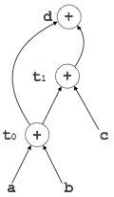
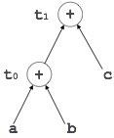
t0 =a + b;
t1 =t0 + c;
t2 =t1 + t0;
d = t2;

Slide 19
Machine dependent optimizations
Types
Control Flow.
Dead Code Elimination.

Slide 20
Flow of control optimization
MOV R1, R2
GOTO L1
---------
---------
---------
---------
L1 : GOTO L2
L2 : INC R1
After:-
MOV R1, R2
GOTO L2
------------
------------
------------
L2 : INC R1

Slide 21
Dead code elimination
Instructions that compute a value never used is called a dead code which is eliminated.
Ex: LD R0, a
  LD R1,b
  LD R2, #6
  add R0, R1
  ST R0, c

