Slide 1
Virtual File System
presented by Jyothi

Slide 2
Contents
Introduction
VFS Data Structures

Slide 3
Introduction
A VFS is a kernel software layer that handles all system calls related to a standard UNIX filesystem
VFS was first designed by Sun microsystems in 1986, then UNIX included VFS
Later Linux also used the same and now it supports various filesystem
Main strength – to provide common interface to several kinds of filesystems
$cp /floppy/test /temp/test

Slide 4
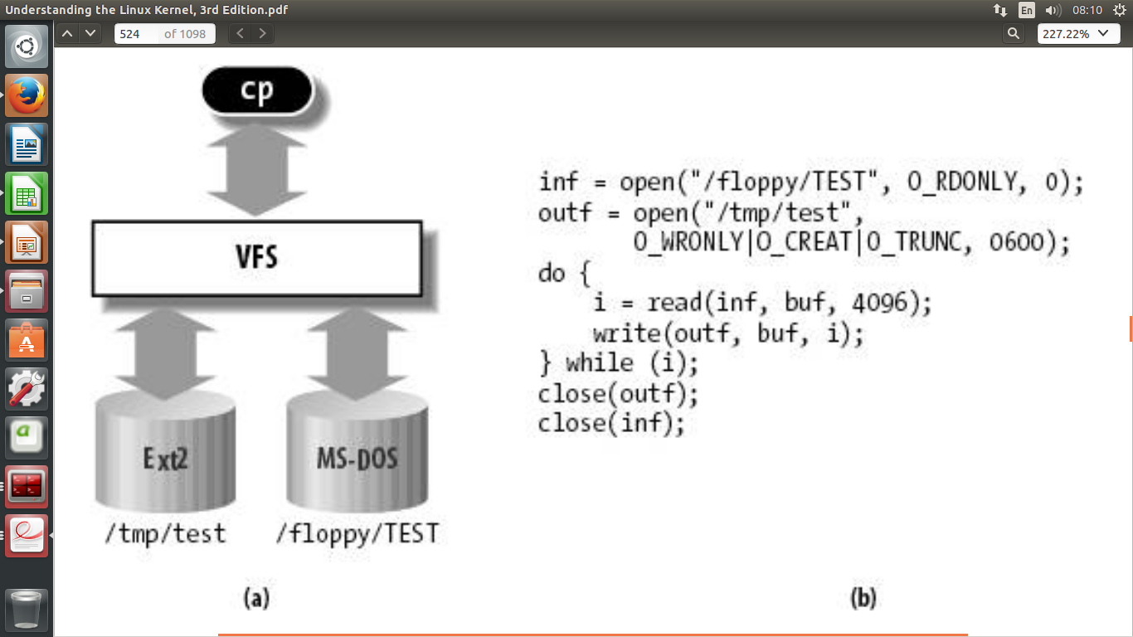

Slide 5
VFS Data Structures
Superblock object
Inode object
Dentry object
File object

Slide 6
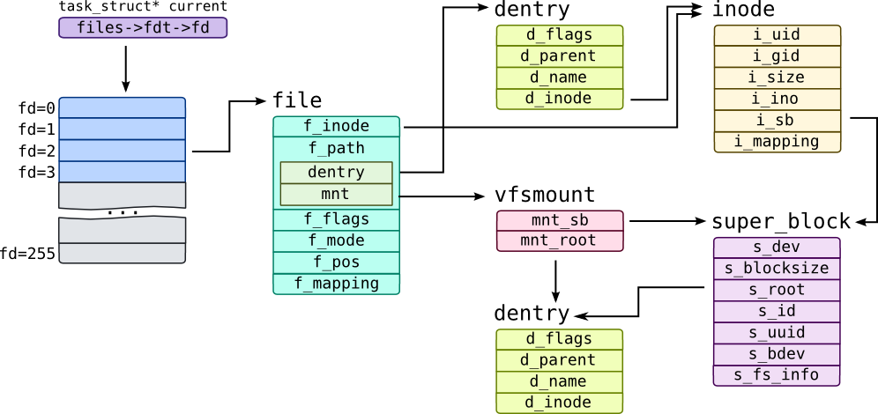

Slide 7
Superblock Object
Implemented by each filesystem, and is used to store information describing that specific filesystem
The superblock object is represented by struct super_block
The superblock operations table is represented by struct super_operations

Slide 8
Inode Object
The inode object represents all the information needed by the kernel to manipulate a file or directory
The inode object is represented by struct inode
The inode operations table is represented by struct inode_operations

Slide 9
Dentry Object
VFS employs the concept of a directory entry (dentry)
A dentry is a specific component in a path
Dentry objects are represented by struct dentry
The dentry_operations structure specifies the methods that the VFS invokes on directory entries on a given filesystem

Slide 10
File Object
The file object is used to represent a file opened by a process
The file object is represented by struct file
The file object methods are specified in file_operations

Slide 11
References
GLMS videos
Linux Kernel Development by Robert Love
Understanding the Linux Kernel by Bovet

Slide 12
Any Queries ?

Slide 13
Feedback

