Slide 1
SPI and V4L2
Jyothi A.

Slide 2
Contents
SPI
  Introduction
  Separate slave line
  Single slave line
  Programming in SPI
  Advantages of SPI
  Disadvantages of SPI

Slide 3
Cont...
V4L2
    Introduction
    Data Structures
    Input / Output
    Capturing Video

Slide 4
Serial Peripheral Interface
(SPI)

Slide 5
Introduction
SPI is an interface bus commonly used to send data between microcontrollers and small peripherals such as
- shift registers
- sensors
- SD cards
SPI developed by motorola to provide full duplex synchronous serial communication.

Slide 6
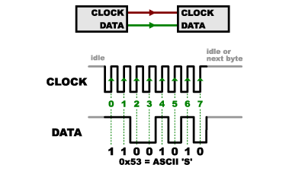
Cont...
SPI has synchronous solution to receive data.

Slide 7
Cont...
SPI has four pins:
  SCK / CLK : generates clock signal.
  MOSI : data sent from master to slave, Master Out Slave In
  MISO : data sent from slave to master, Master In Slave Out
  SS : used to select the required slave

Slide 8
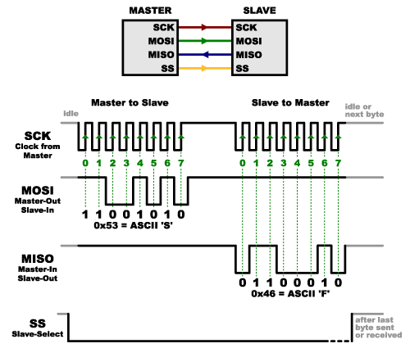
Cont...

Slide 9
Cont...
Multiple slaves : 2 ways
  separate slave lines
  single SS line (daisy chain configuration)

Slide 10
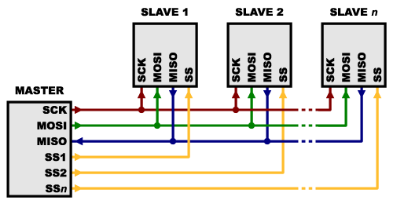
Separate Slave Lines

Slide 11
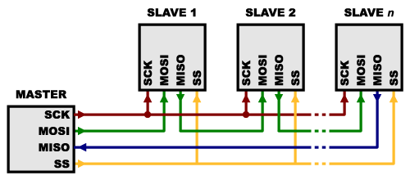
Single SS line

Slide 12
Cont...
SPI transfer example
  when master wants to initiate transfer, it must pull SS signal low for the slave it wants to communicate with
  once SS signal is low, that slave will be listening on the bus
  master is free to start sending data

Slide 13
Cont...
There are 4 different types of SCK signal. The four modes are categorized into two:
  CPOL (clock polarity) : value low/high will decide the idle state of bus
  CPHA (clock phase) : sampling of data during rising or falling edge of the clock

Slide 14
Cont...
SPI mode | Clock Polarity (CPOL) | Clock Phase (CPHA) | Clock Edge
0 | 0 | 0 | 1
1 | 0 | 1 | 0
2 | 1 | 0 | 1
3 | 1 | 1 | 0

Slide 15
Programming in SPI
The programming interface is structured around two kinds of driver
  Controller driver
  Protocol driver

Slide 16
Cont...
struct spi_master{
  struct device dev;
  u16 num_chipselect;
  size_t (*)(struct spi_device *spi) max_transfer_size;
  int (*)(struct spi_device *spi,struct spi_message *mesg) transfer;
  void (*)(struct spi_device *spi) cleanup;
  …
  ...
};

Slide 17
Cont...
struct spi_device{
  struct device dev;
  struct spi_master *master;
  u8 chip_select;
  void *controller_state;
  void *controller_data;
  ...
  ...
};

Slide 18
Cont...
struct spi_board_info {
const void * platform_data;
void * controller_data;
u16 chip_select;
u16 mode;
  ...
  ...
};

Slide 19
Cont...
struct spi_driver {
  const struct spi_device_id * id_table;
  int (* probe) (struct spi_device *spi);
  int (* remove) (struct spi_device *spi);
  void (* shutdown) (struct spi_device *spi);
  struct device_driver driver;
};

Slide 20
Cont...
struct spi_message {
  struct spi_device * spi;
unsigned frame_length;
unsigned actual_length;
int status;
...
  ...
};

Slide 21
Cont...
struct spi_transfer {
  unsigned tx_nbits:3;
  unsigned rx_nbits:3;
  u8 bits_per_word;
  u16 delay_usecs;
  u32 speed_hz;
  ...
  ...
};

Slide 22
Advantages of SPI
It’s faster than asynchronous serial
The receive hardware can be a simple shift register
It supports multiple slaves

Slide 23
Disadvantages of SPI
It requires more signal lines (wires) than other communications methods
The communications must be well-defined in advance
The master must control all communications
It usually requires separate SS lines to each slave, which can be problematic if numerous slaves are needed

Slide 24
Video 4 Linux 2
(V4L2)

Slide 25
Introduction
V4L is a collection of device drivers and an API for supporting real time video capture on Linux system.
Programming a V4L2 device consists of below steps:
  Opening the device - open()
  Changing device properties, selecting a video and audio output, video standard, picture brightness - ioctl()
  Negotiating a data format - ioctl()
  Negotiating an input/output method - ioctl()
  The actual input/output method – ioctl()
  Closing the device - close()

Slide 26
Cont...
V4L2 drivers are implemented as kernel modules.
Driver modules plug into the “video-dev” kernel module
Each driver has major number – 81, minor number ranges from 0 – 255
The module options to select minor numbers are named after the device special file with a "_nr" suffix
Ex: "video_nr" for /dev/video video capture devices

Slide 27
Data Structures
struct v4l2_capability
{
__u32 capabilities; /* Device capabilities */
...
} cap ;

Slide 28
Cont...
struct v4l2_format
{
enum v4l2_buf_type type;
union
{
struct v4l2_pix_format pix;
...
} fmt;
} fmt ;

Slide 29
Input/Output
Read / Write
Streaming
  Memory mapping : Map buffers in device memory into
  the application’s address space
  User Pointer : Buffers are allocated by the application itself. The driver must be switched into user pointer I/O mode with desired buffer type

Slide 30
Capturing Video
open_device( )
fd = open ( “/dev/video0”, O_RDONLY ) ;
init_device ( )
ioctl ( fd ,VIDIOC_QUERYCAP, &cap ) ;
/* Select video input, video standard and format */
ioctl ( fd, VIDIOC_ENUM_FMT, &fmt ) ;
start_capturing ( )
ioctl ( fd, VIDIOC_STREAMON, &type ) ;

Slide 31
Cont...
read_frame ( )
ioctl ( fd, VIDIOC_DQBUF, &buf ) ;
ioctl ( fd, VIDIOC_QBUF, &buf ) ;
process_image ( )
/* Application Dependent */

Slide 32
Cont...
stop_capturing ( )
ioctl ( fd, VIDIOC_STREAMOFF, &type ) ;
uninit_device( )
free ( ) ;
close_device ( )
close ( fd ) ;

Slide 33


