Slide 1
Basics of Shell Scripting
Shubham Talekar
Jyothi A.

Slide 2
Contents
Introduction
User Input
Bash Control Structures
Repetition Constructs
Shell Functions
Debugging Shell Program
Applications
Limitations

Slide 3
1. Introduction
What is shell scripting ?
Why we require shell scripting ?
To run :
# make executable: $ chmod +x <script_filename>
$ ./<script_filename>
# To run in command line:
$ sh <script_filename>

Slide 4
2. User Input
Shell allows you to prompt for user input.
Syntax:
        read varname1, [varname2, .. ]
        example
              echo “Enter your name: \c”
              read my_name

Slide 5
3. Bash Control Structures
if-then-else
case
loops
for
while
until
select

Slide 6
3.1 Simple if Statement
General Syntax:
if command
then
statements
fi
statements are executed only if command succeeds, i.e. has return status “0”

Slide 7
3.2 if-then–else Statement
General syntax:
if [ condition ];
then
statements-1
else
statements-2
fi
executes statements-1 if condition is true
executes statements-2 if condition is false

Slide 8
3.3 If-then-elif-then-else Statement
General syntax:
if [ condition ]; then
statements
elif [ condition ]; then
statement
else
statements
fi
The word elif stands for “else if”
It is part of the if statement and cannot be used by itself

Slide 9
3.4 Relational Operators
Meaning | Numeric | String
Greater than | -gt | -
Greater than or equal | -ge | -
Less than | -lt | -
Less than or equal | -le | -
Equal | -eq | = or ==
Not equal | -ne | !=

Slide 10
Meaning | Numeric | String
str1 is less than str2 | - | str1 < str2
str1 is greater str2 | - | str1 > str2
String length is greater than zero | - | -n str
String length is zero | - | -z str

Slide 11
3.5 File Testing
Options | Meaning
-d | True if file is a directory
-f | True if file is a ordinary file
-r | True if file is readable
-w | True if file is writable
-x | True if file is executable
-s | True if length of file is non - zero

Slide 12
3.6 case Statement
use the case statement for a decision that is based on multiple choices
General syntax:
case word in
pattern1) command-list1
;;
pattern2) command-list2
;;
patternN) command-listN
;;
esac

Slide 13
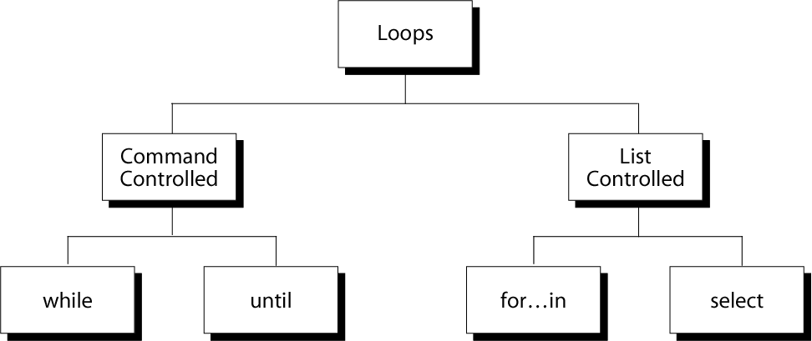
4. Repetition Constructs

Slide 14
4.1 while Loop
To execute commands in “command-list” as long as “expression” evaluates to true
General syntax:
while [ expression ]
do
command-list
done

Slide 15
4.2 The until Loop
To execute commands in “command-list” as long as “expression” evaluates to false
General syntax:
until [ expression ]
do
command-list
done

Slide 16
4.3 The for Loop
To execute commands as many times as the number of words in the “argument-list”
General Syntax:
for variable in argument-list
do
commands
done

Slide 17
4.4 select Command
Constructs simple menu from word list
Allows user to enter a number instead of a word
User enters sequence number corresponding to the word
General Syntax:
select WORD in LIST
do
RESPECTIVE-COMMANDS
done
Loops until end of input, i.e. ^d (or ^c)

Slide 18
4.5 break and continue
Interrupt for, while or until loop
The break statement
transfer control to the statement AFTER the done statement
terminate execution of the loop
The continue statement
transfer control to the statement TO the done statement
skip the test statements for the current iteration
continues execution of the loop

Slide 19
5. Shell Functions
A shell function is similar to a shell script
stores a series of commands for execution later
shell stores functions in memory
shell executes a shell function in the same shell that called it
Where to define
In .profile
In your script
Or on the command line

Slide 20
General Syntax:
function-name () {
statements
}
must be defined before they can be referenced
usually placed at the beginning of the script
Remove a function
Use unset built-in

Slide 21
5.1 Function Parameters
Need not be declared
Arguments provided via function call are accessible inside function as $1, $2, $3, …
$# reflects number of parameters
$0 still contains name of script (not name of function)

Slide 22
5.2 Local Variables in Function
Variables defined within functions are global, i.e. their values are known throughout the entire shell program
Keyword “local” inside a function definition makes referenced variables “local” to that function

Slide 23
6. Debugging Shell Programs
Debugging is troubleshooting errors that may occur during the execution of a program/script
The following two commands can help you debug a bash shell script:
echo - use explicit output statements to trace execution
set

Slide 24
6.1 Debugging Using “set”
The “set” command is a shell built-in command has options to allow flow of execution
–v option prints each line as it is read
–x option displays the command and its arguments
–n checks for syntax errors

Slide 25
options can turned on or off
To turn on the option: set -xv
To turn off the options: set +xv
Options can also be set via she-bang line
#! /bin/bash -xv

Slide 26
7. Applications
You can write a script which installs prequisites
To kill or start multiple applications together
To observe large database of files and find some patterns out of it
So in general to automate the process and the list goes on

Slide 27
8. Limitations
Inadvertent typing errors such as rm -rf * / (instead of the intended rm -rf */)
need to launch a new process for almost every shell command executed, slow execution speed

Slide 28
References
Beginning the Shell Scripting

Slide 29


