Slide 2
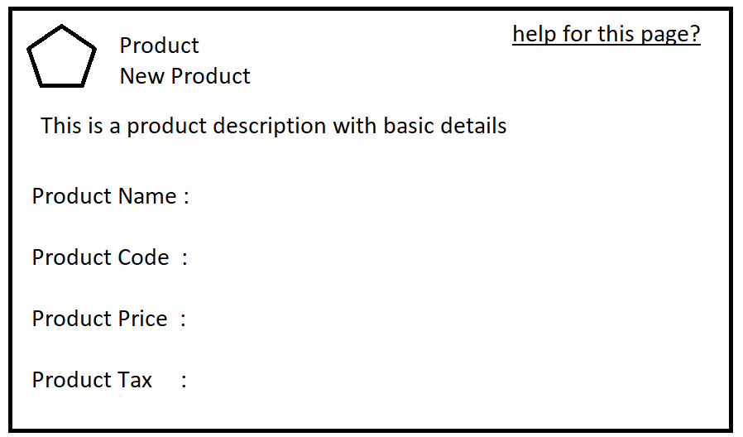
Section Header Example -1

Slide 3
<apex:page>
<apex:sectionHeader title=“Product” subtitle=“newProduct” help=“/apex/apex_page”
descriptin =“This is a product description using basic details “ />
Product Name : <br/><br/>
Product Code : <br/><br/>
Product Price:<br/><br/>
Product Tax :
</apex:page>

Slide 4
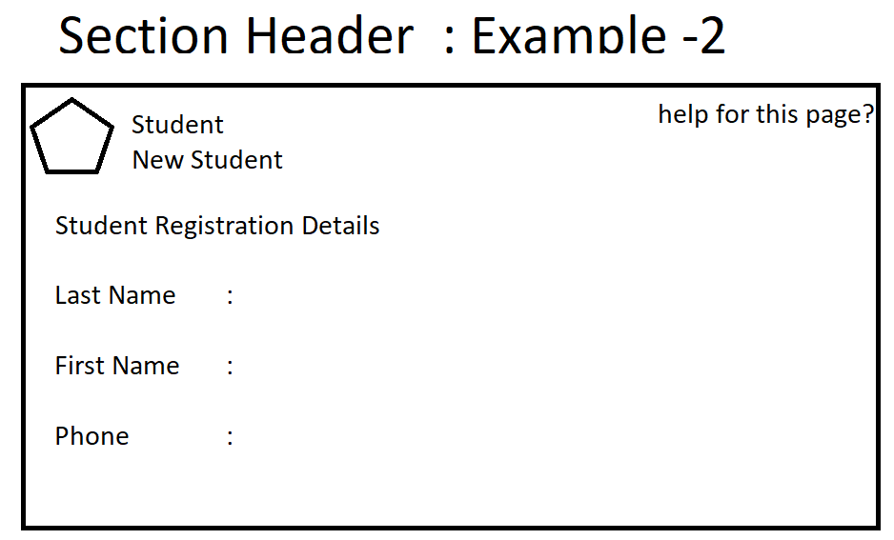

Slide 5
Apex:pageBlock :
This will create block on the page .
Atributes :
1.Title :
a. This is a string value .
b. This will be displayed on the left corner of the pageBlock Header
2. tabStyle :
a. This is subject name
b. Tab style of the given subject will be applied for pageBlock
3. helpTitle :
a. This is a string value .
b. This will be displayed as link on the right corner of the pageBlock header
4. helpUrl
a. This will take the url of the page
b. When we click on the help title which page should be opened is defined by helpUrl
5. rendered :
a. This is a Boolean value
b. When set as true ,content of the component will be displayed.
6. mode :
a. This will specify the mode of the pageBlock
b. Possible values are Edit ,Detail ,MainDetail

Slide 6
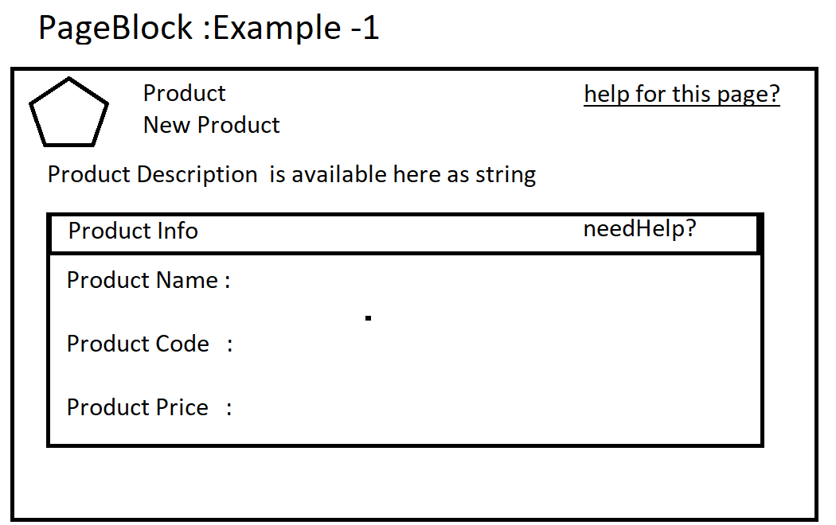

Slide 7
<apex:page>
<apex:sectionHeader title=“Product” subtitle=“New Product”
help=“/apex/apex_help”
description=“Production descriptios is given here as string “ />
<apex:pageBlock title=“ProductInfo” helpTitle=“needHelp?”
helpUrl=“/apex/apex_help” >
Product Name : <br/><br/>
Product Code : <br/><br/>
Product Price :<br/> <br/>
</apex:pageBlock>
</apex:page>

