Slide 1

Aligning Facilities, Enrollment, & Educational Opportunities
Part 2
November 4, 2026
Notes:
Prepared for the HUUSD Board meeting on September 9, 2026.

Slide 2
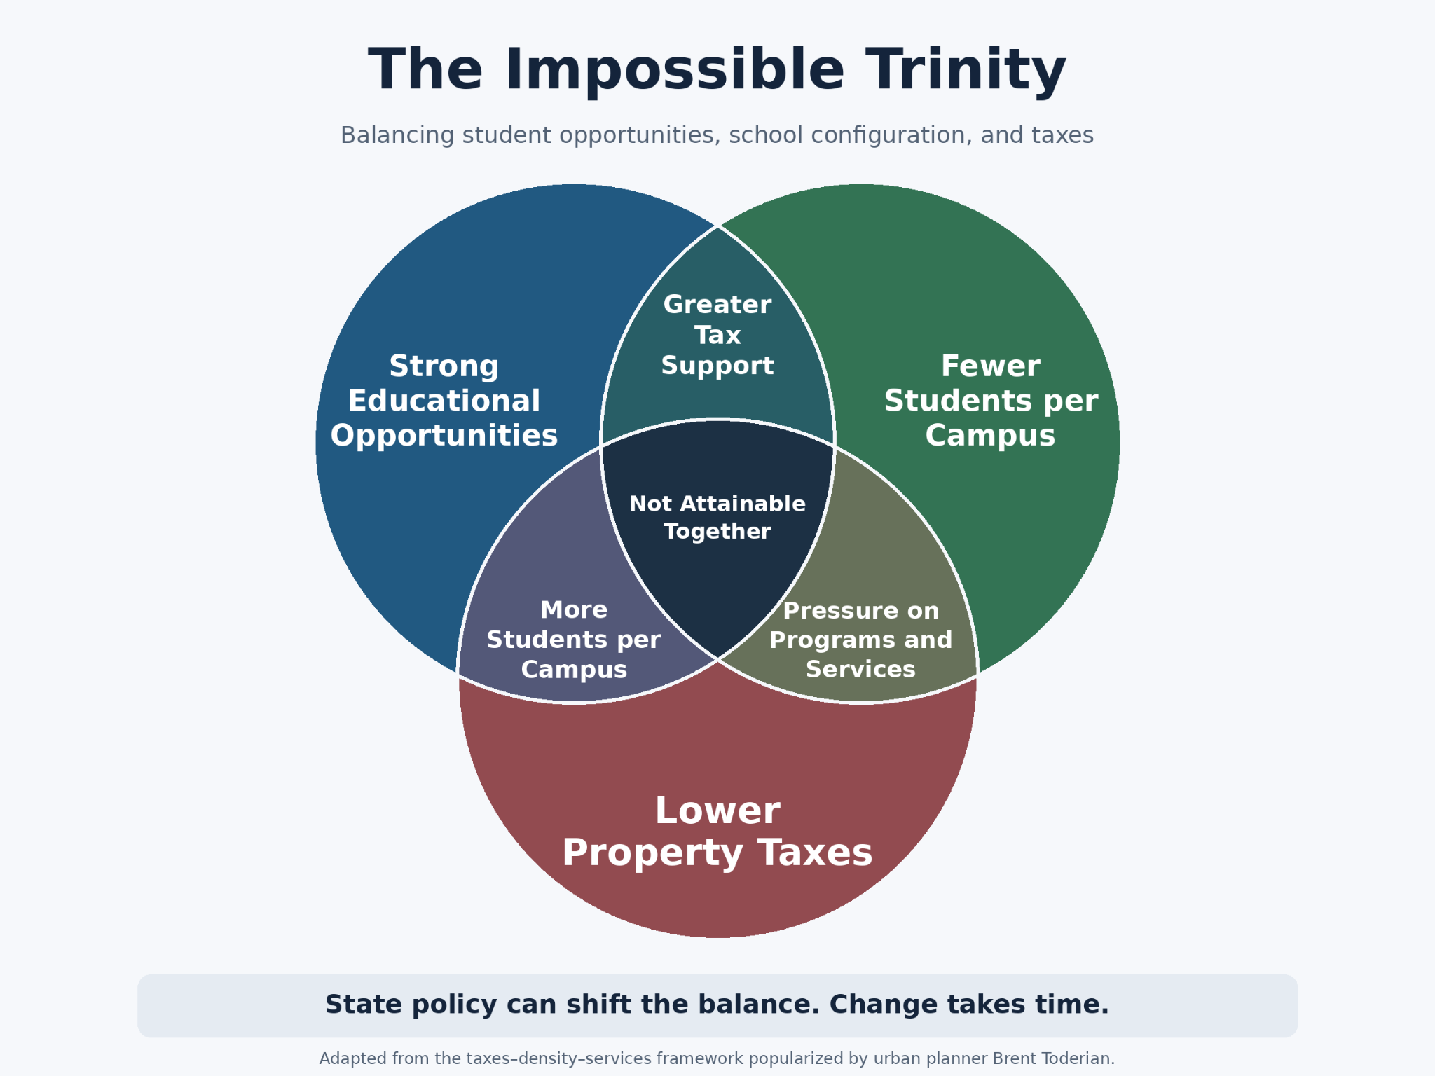

Slide 3

FINANCIAL OVERVIEW & THRESHOLDS
Revised FY28 Proposed Budget Impacts with Health Care Cost 2.5%
Level service budget, projected inflation rates, and Level funded (not to exceed excess spending threshold [EST])
Level Service
$54,924,120
+5.858% Year over Year north
Exceeds EST by $962.81 per pupil
Adjusted cost per pupil $18,487.62
EXCESS SPENDING PENALTY
$2,469,605
IMPACT ON TAXPAYERS
Projected Inflation
$53,285,738
+2.70% Year over Year north
Required Cut: $1,2938,382
Exceeds EST by $172
EXCESS SPENDING PENALTY
$445,340
IMPACT ON TAXPAYERS
Level Funded (Cap EST)
$51,884,847
0% Year over Year
Required Cut: $3,339,273 south
Does Not Exceed EST
($220.67) corrected to remove debt exclusion
$(25.67)
UNDER THRESHOLD PER PUPIL
FY28 EST Threshold: $16,562 • Proposed Per Pupil Exceeds Threshold by $962.81 • Target Cut Needed: $3,339,273

Slide 4
District Planning Framework
Guiding Principles
Core criteria for evaluating school consolidation scenarios and future budget options.
school
01
meeting_room
02
account_balance
03
Grade Alignment
Ensure consistent grade structures across district schools to support curriculum continuity and student development.
Facility Fit
Available Classrooms
Match student enrollment with available classroom capacity and specialized learning spaces.
Financial Framework
Align with state spending threshold caps (EST) and achieve long-term fiscal sustainability.

Slide 5
District Planning
Agreements
Core criteria for evaluating school consolidation scenarios and future budget options.
01 school
Kindergarten Classrooms
Trigger Threshold
18+ Students
Regular Ed Para Added
If there are 18 or more students in a kindergarten classroom, a regular education para will be added.
02 child_care
PreK Guidelines
1 Section
Up to 15 students
Shared Classrooms
2 PreK sections can share a class
30 PreK Students
Equals 1 full classroom
03 verified
EQS
Educational Quality Standards
Average Class-Size Maximums:
GRADES
K – 3
MAX SIZE
20
GRADES
4 – 6
MAX SIZE
25

Slide 6
DISTRICT RESOURCE ALLOCATION
Elementary Classrooms & Current Classroom Teacher Counts
Side-by-side comparison of physical classroom spaces and current classroom teacher staffing across district schools.
FAYSTON
MORETOWN
WAITSFIELD
WARREN
BROOKSIDE
CLASSROOMS
9
CLASSROOMS
11
CLASSROOMS
11
CLASSROOMS
14
CLASSROOMS
24
TEACHERS
7
TEACHERS
9
TEACHERS
7
TEACHERS
8.4
TEACHERS
17

Slide 7
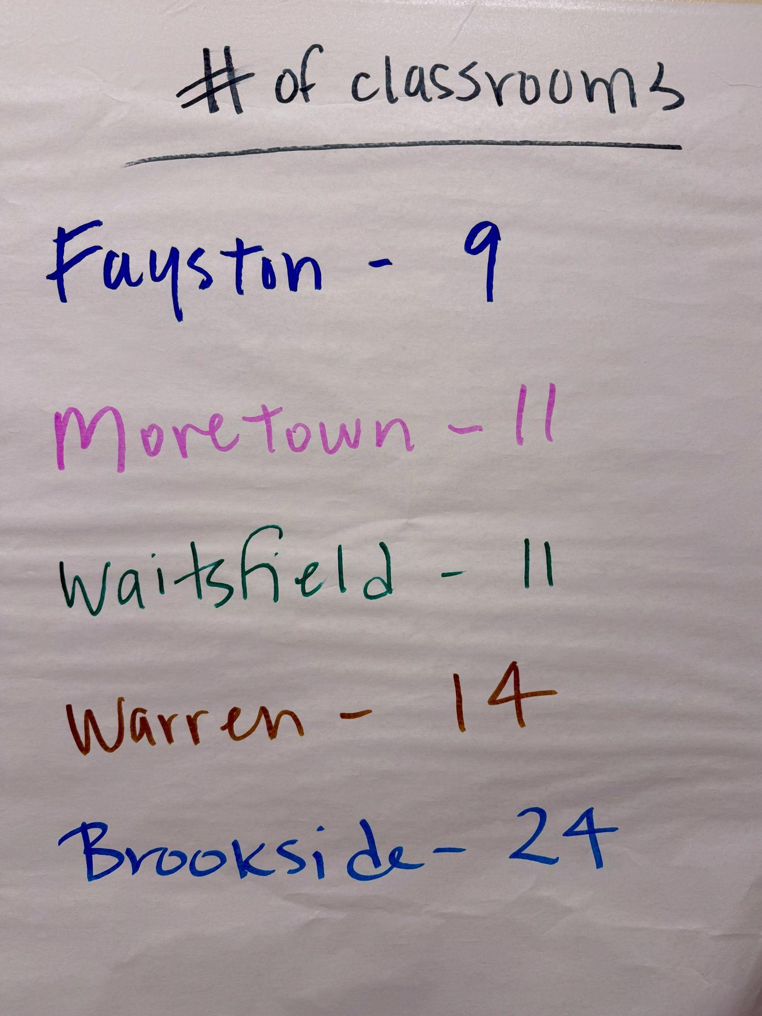

Slide 8
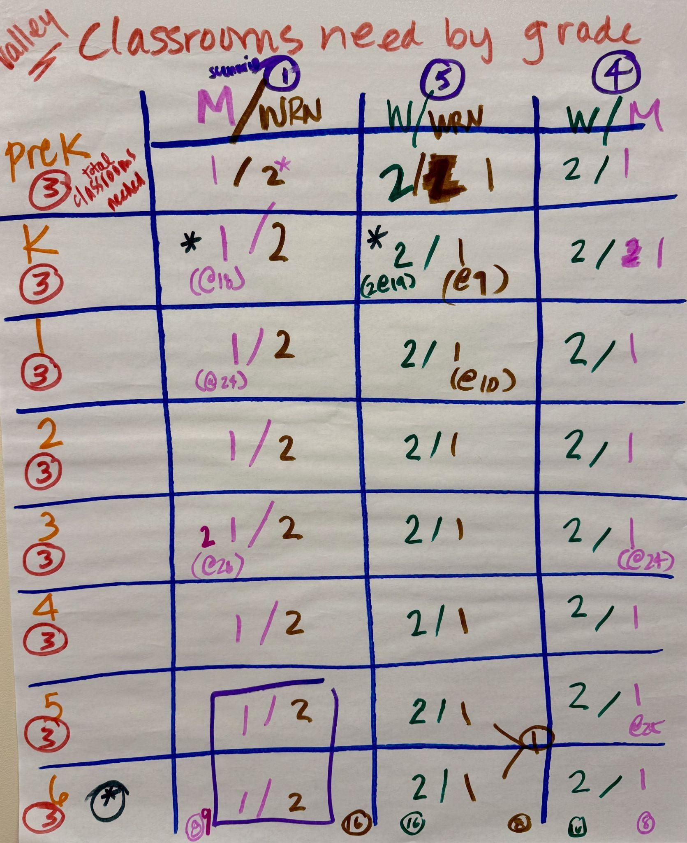
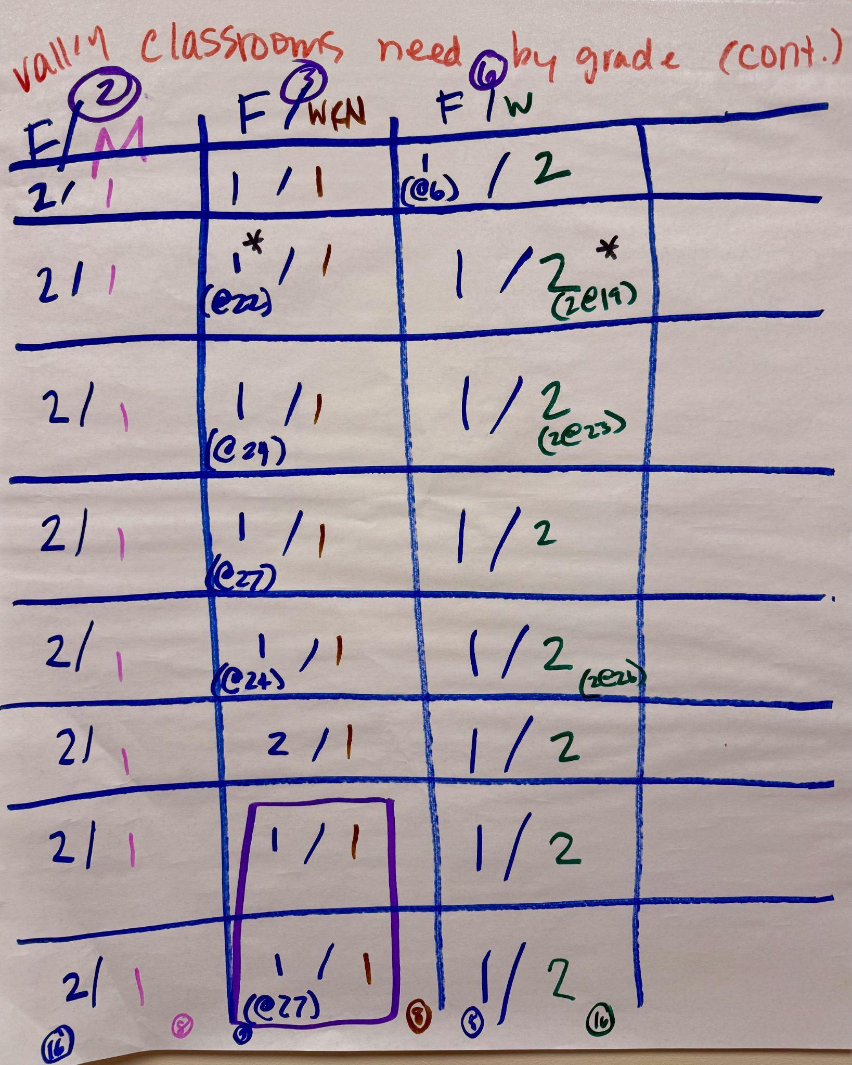

Slide 9
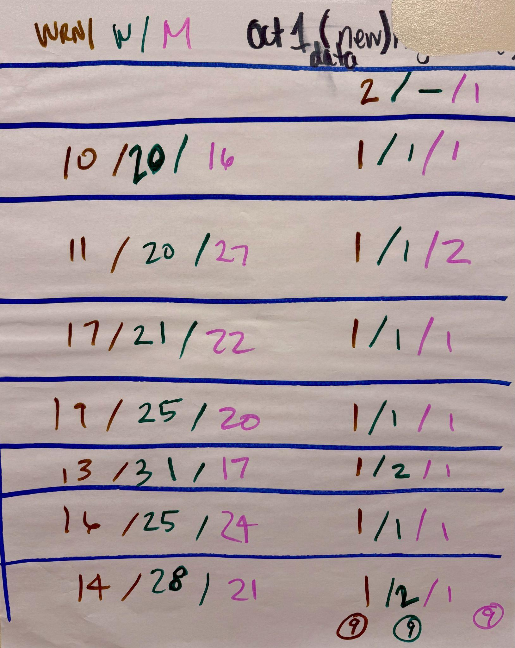

Slide 10
HUUSD RECONFIGURATION ANALYSIS · FINANCIAL & OPERATIONAL IMPACTS
Valley Elementary Consolidation (4 to 3 Schools) Keeping Valley PK–6th Grade
PROPOSAL SCOPE
4 Schools ➔ 3 Schools
FINANCIAL IMPACT & OPERATING EFFICIENCIES FOR FY28
MIDDLE SCHOOL MERGER & CBMS IMPACTS
ESTIMATED ANNUAL OPERATING SAVINGS
~$2,304,281
KEY CONSIDERATION: LIMITED STRUCTURAL GAINS
Closing only one valley elementary school significantly reduces potential savings while limiting staffing efficiencies and building utilization. We capture considerably less of the financial benefit required for long-term fiscal challenges.
SAVINGS REDUCTION OUTCOME
Projected savings decrease from $3,929,469 — a net loss of $1,625,188 in savings from consolidating only 1 valley school.
KEY OUTCOME: CBMS & STAFFING IMPLICATIONS
Without moving valley 5th & 6th grade students to CBMS:
Dual Staffing Required: Must maintain additional staffing at both CBMS and valley elementary schools.
Low Enrollment: Leaves only 131 students in grades 5 and 6 at CBMS.
Facility Underutilization: Results in significant underutilization of CBMS while still incurring full operational costs.
warning
Excess Spending Penalty
$165,324
Incurred penalty increasing taxpayer burden.
account_balance
Projected Y over Y Budget
$52,619,839
Represents a 1.42% budget increase.

Slide 11
HUUSD RECONFIGURATION ANALYSIS · FINANCIAL & OPERATIONAL IMPACTS
Valley Elementary Consolidation (4 to 3 Schools) Keeping Valley PK–6th Grade
FINANCIAL IMPACT ANALYSIS
FY29 Budget Projections
SCENARIO A: LEVEL-FUNDED BUDGET
Excess Spending Penalty
$325,299
Projected Tax Penalty
trending_up
Cost Per Pupil Impact
+$128.62
Above the state excess spending threshold.
Under level funding, the district immediately triggers severe financial penalties, significantly escalating taxpayer costs without service additions.
SCENARIO B: PENALTY AVOIDANCE
Required Budget Cuts
~$350,000
Minimum YoY Budget Reduction
warning_amber
Remaining Buffer
Only $10
Margin below the excess spending threshold.
Even after cutting $350k year-over-year, the district is left with virtually zero financial flexibility to handle unforeseen cost variations.
STRATEGIC IMPLICATIONS
Fiscal Flexibility Risk
account_balance_wallet
Zero Operational Cushion
Illustrates how little room exists to absorb inflationary or unexpected cost growth.
Years of Prior Cuts: Previous budget reductions have exhausted operational redundancies.
Taxpayer Pressure: Maintaining level services continues to place intense strain on district taxpayers.
Structural Action Needed: Reconfiguration is vital to avoid continuous cycle of deep operational cuts.

Slide 12
HUUSD RECONFIGURATION ANALYSIS · SCENARIO OPTION
6th Grade Relocation to HUMS: Space & Facility Impacts
CONFIGURATION PROPOSAL
2 Valley Schools + BPS (PK–5) & HUMS (6–8)
COHORT INFLOW REQUIREMENT
Space for 6 Classrooms
130
Students Total
warning FACILITY FEASIBILITY ALERT
No Available Room at HUMS
CROSSETT BROOK (CBMS)
3-Teacher Team
63 Students
VALLEY ELEMENTARY
3 Teachers
67 Students
Site administration confirms zero unallocated classroom capacity to absorb incoming sections.
CRITICAL OPERATIONAL & FINANCIAL IMPACTS
domain_disabled
Facilities Maxed
Every room actively utilized.
palette
Specials Demand
More dedicated FTE and rooms needed.
badge
Licensing & Teams
Educator Licenses k–6, 5–8 or 7–12
Unclear how to team students
account_balance_wallet
Fiscal Trade-off
Lower net consolidation savings overall

Slide 13
Grade Alignment: One Student Pathway, Stronger Opportunities
Grade alignment means students follow consistent grade bands, learning expectations, and transitions across HUUSD
ONE COORDINATED PATHWAY
Illustrative grade bands under discussion
PK–4
5–6
7–8
9–12
ELEMENTARY
UPPER GRADES
MIDDLE GRADES
HIGH SCHOOL
WHY IT MATTERS FOR STUDENTS
WHAT IT MEANS FOR COMMUNITIES
1
Fairer access
1
A clearer family pathway
Specialists, enrichment, and student supports.
Know when school transitions are expected.
2
Consistent learning
2
A unified HUUSD identity
Aligned curriculum, expectations.
Shared pride, connections, and belonging across towns.
3
Stronger peer groups
3
Sustainable programs
More same-grade connections and coordinated teams.
Organize staff and resources around student needs.
COMMUNITY COMMITMENT
Plan carefully for community engagement, school traditions, and local identity.
The goal is a stronger student experience — not simply a different arrangement of buildings.
Notes:
Presenter notes — Grade Alignment
Definition: Grade alignment is the intentional organization of grade spans and teaching pathways across HUUSD, so students in the same grade have comparable access and coordinated experiences. The pathway shown is illustrative, not a final Board-approved placement plan.
Talking points:
1. Student opportunity: A common grade structure can make it easier to schedule specialized instruction, enrichment, electives and peer experiences equitably, and coordinate teachers and student-support teams.
2. Curriculum continuity: Alignment facilitates a shared curriculum sequence, common expectations and purposeful transition planning.
3. Community and unified district identity: Families can plan around a clear pathway; students can make connections across HUUSD towns. Shared learning experiences can cultivate one HUUSD identity, a sense of districtwide pride, belonging, and responsibility for all students. This is additive: a unified district identity should celebrate, not erase, the distinct traditions and character of each town and school. However, community schools are centers of local identity and relationships. Families will rightly ask about school identity, travel time, after-school participation, siblings and traditions. Those concerns must be addressed in design and implementation, not dismissed.
4. Important nuance: Grade configuration alone does not guarantee academic benefits; research is mixed and school-to-school transitions can create challenges without careful support. Present these as design goals, not proven outcomes.
Sources for background: University of Minnesota Center for Applied Research and Educational Improvement, Review of Literature on Grade Configuration and School Transitions (https://carei.umn.edu/review-literature-grade-configuration-and-school-transitions); NEASC, Curriculum Alignment, 2024 (https://www.neasc.org/sites/default/files/2024-01/neasc-cis%20-%20MANUAL%20school%20improvement%20-%20r2024-01_final.pdf); National Rural Education Association rural consolidation overview (https://eric.ed.gov/?id=EJ783851).

Slide 14
SCHOOL LEVEL LEADERSHIP UPDATE
Message from the PreK-12 Principals

Slide 15

HUUSD / BUILDING UNITY
OUR STRENGTH IS IN
OUR CONNECTIONS.
Unity does not diminish what makes each town special. It brings those strengths together for every student.
CONNECTED COMMUNITIES • SHARED PURPOSE
FAYSTON
DUXBURY
MORETOWN
SIX DISTINCT
COMMUNITIES.
EVERY
STUDENT
ONE SHARED
COMMITMENT.
WAITSFIELD
WATERBURY
WARREN
STRONGER TOGETHER • FOR ALL OUR STUDENTS

Slide 16
The Charge
Key financial and operational models under evaluation for budget development
payments
school
Budget Cap Threshold
Per Pupil Spending Limit
Elementary & Middle Schools Consolidation
4 Elem ➔ 2 Elem | 7th & 8th merge with HUMH
EVALUATION QUESTION
What reductions would be necessary to achieve a budget not to exceed the per pupil projected spending threshold?
EVALUATION QUESTION
What are the cost efficiencies if we were to consolidate 4 valley elementary schools into 2 elementary schools and merge 2 middle schools into 1 middle school?
KEY FOCUS
Targeted expenditure reductions
KEY FOCUS
Valley elementary & middle school consolidation

Slide 17
Budget Cap Threshold Summary
Total High Impact Reductions
CUMULATIVE BUDGET REDUCTION TARGET
Combined cuts across transportation, academics, athletics, and student programs
$3,339,273
Transportation & Routes
$1,360,000
Daily routes, field travel, tech school transportation
Athletics & Co-Curriculars
$312,757 (70% cut)
Sports coaches, officials, theater, music & student clubs
Special Programming
$583,516
Farm to School, outdoor ed & learning center supports
Pre-K Tuition-Only Model
$517,000
Eliminates in-district public Pre-K slots & limits capacity
Academic & Behavioral Staff
$456,000
Reduces interventionists, paras & tier 2/3 student support
Electives & Technology
$110,000
Reduces course offerings, software & hardware tools
DEVASTATING IMPACT ON STUDENTS & COMMUNITIES
Access & Equity: Severe transportation & Pre-K barriers disproportionately affect vulnerable families.
Student Development: Widespread loss of sports, arts, electives, hands-on learning, and intervention support.
School Community: Eroded support structures, strained classroom environments, and loss of shared traditions.

Slide 18
Valley Elementary Consolidation
Financial evaluation and outcomes of restructuring elementary school facilities
PROPOSAL SCOPE: 4 SCHOOLS ➜ 2 SCHOOLS
Educational Efficiencies
EVALUATION QUESTION
What educational and financial efficiencies could result from consolidating 4 valley elementary schools into 2?
KEY EDUCATIONAL OUTCOMES
More flexible staff and scheduling across grade levels
Greater opportunities for peer interaction and collaborative learning
More consistent access to specialized instruction, interventions, and support
Elimination of shared staff and travel time across buildings
Full time nurse at each location
More robust educational experiences
FINANCIAL IMPACT & EFFICIENCIES
We would achieve consolidation cost efficiencies of:
~$1,826,527
ESTIMATED ANNUAL OPERATING SAVINGS
A REDUCTION OF -16 FTE*
KEY OUTCOME
Significant annual operating savings redirected to educational quality and staff retention.
*FTE = Full-Time Equivalent (i.e. one person)

Slide 19
Middle Schools Merger
Middle Schools Merger
7th & 8th graders merge with HUMH 5th & 6th remain at CB
EVALUATION QUESTION
What are the cost efficiencies if we were to consolidate 2 middle schools into 1 middle school?
KEY EDUCATIONAL OUTCOMES
Expanded academic electives, athletics, and extracurricular offerings
Dedicated grade-level teacher teams and enhanced peer collaboration
Consolidated special education, counseling, and intervention support
More equitable access to advanced coursework and specialized facilities
FINANCIAL IMPACT & EFFICIENCIES
We would achieve consolidation cost efficiencies of:
~$2,102,942
ESTIMATED ANNUAL OPERATING SAVINGS
-16.5 FTEs
KEY OUTCOME
Significant annual operating savings redirected to educational quality and staff retention.

Slide 20
Combined School Consolidation Impact
Comprehensive educational outcomes and combined financial efficiencies from facility restructuring
Elementary Consolidation
4 Schools ➜ 2 Schools
EVALUATION QUESTION
What efficiencies result from consolidating 4 valley elementary schools into 2?
KEY EDUCATIONAL OUTCOMES
More flexible staff & scheduling across grades
Greater peer interaction & collaborative learning
Consistent access to specialized instruction
Elimination of shared staff travel time
Increased nursing staff & support
SUBTOTAL SAVINGS
~$1,826,527
-16 FTEs
Middle Schools Merger
7th & 8th graders merge with HUMH 5th & 6th remain at CB
EVALUATION QUESTION
What cost efficiencies exist by consolidating 2 middle schools into 1?
KEY EDUCATIONAL OUTCOMES
Expanded electives, athletics & extracurriculars
Dedicated grade-level teacher teams
Consolidated special education & counseling
Equitable access to advanced coursework
SUBTOTAL SAVINGS
~$2,102,942
-16.5 FTEs
TOTAL POTENTIAL IMPACT
Combined Annual Operating Savings
~$3,929,469
ESTIMATED ANNUAL OPERATING SAVINGS
A REDUCTION OF -32.5 FTEs
KEY STRATEGIC OUTCOME
Substantial long-term budget sustainability with savings directly redirected to educational quality, student support, and staff retention.

Slide 21
FINANCIAL OVERVIEW & THRESHOLDS
Review Of FY28 Proposed Budget Impact
Elementary & Middle Schools Consolidation
PROJECTED BUDGET
$51,294,651
-1.138% arrow_downward Budget Change
PROJECTED PER PUPIL VARIANCE AS OF 11-4-2026
($255.76)
Below the excess spending threshold
FY28 EST THRESHOLD
$16,562
PROJECTED PER PUPIL
$16,306.24
THRESHOLD STATUS
Below Threshold Limit

Slide 22
ELEMENTARY CONSOLIDATION · BOARD EVALUATION RESULTS
Evaluation of Six Elementary Consolidation Scenarios
Composite scores from 14 School Board member evaluations across 4 feasibility categories (1=Poor to 5=Strong fit)
TOP OVERALL RANKING
Waitsfield + Warren
Score: 248 pts (Avg 17.71 / 25) · Kitchen 4.57
BEST ENROLLMENT & BALANCED FIT
Moretown + Warren
Score: 241 pts (Avg 17.21) · Highest Enrollment 3.79
EMERGING BOARD CONSENSUS
Top 3 vs. Bottom 3 Divide
Top tier averages 17.0 pts vs. 12.4 pts for Fayston pairs
Rank | Scenario (Schools Open) | Total Pts | Mean / 25 | Enrollment | Building | Kitchen | Wastewater | Feasibility Assessment
#1 | Waitsfield + Warren | 248 | 17.71 | 3.21 | 3.43 | 4.57 | 2.86 | Top overall score; exceptional kitchen/meal ops
#2 | Moretown + Warren | 241 | 17.21 | 3.79 | 3.50 | 2.50 | 3.71 | Highest enrollment & wastewater rating
#3 | Moretown + Waitsfield | 223 | 15.93 | 3.00 | 3.50 | 2.64 | 3.57 | Balanced fit; strong facility/wastewater viability
#4 | Fayston + Warren | 180 | 12.86 | 2.29 | 1.57 | 3.64 | 3.36 | Severe building condition & enrollment barriers
#5 | Fayston + Waitsfield | 175 | 12.50 | 2.00 | 2.07 | 4.14 | 2.29 | Strong kitchen; limited capacity & capital concerns
#6 | Moretown + Fayston | 165 | 11.79 | 2.07 | 2.00 | 2.14 | 3.36 | Lowest composite score; multiple operational hurdles
The link to the dashboard results can be found here

Slide 23
HUUSD CONSOLIDATION GANTT CHART
October 2026 – August 2027 | Decision milestones, planning, and implementation
Note: A Gantt chart is a visual bar chart that illustrates a project schedule, showing tasks, start and end dates, durations, and how activities depend on one another across a timeline.
MILESTONE / WORKSTREAM
Oct
Nov
Dec
Jan
Feb
Mar
Apr
May
Jun
Jul
Aug
Board direction: Path A or Path B
Feasibility proposals due
Board reviews data / identifies options
Select RFP firm(s), if applicable
December 1 tax letter / projected yield
Budget Overviews 2 & 3
Community engagement meetings on school closings
RFP / statutory notice process (confirm)
Board vote on school closures (listed date)
Announced tuition due (confirm date)
Common Level of Appraisal published (confirm)
Final budget, warning & articles
Administrator contract notifications
Interdistrict choice deadline (confirm)
HUUSD annual report
Budget informational hearing
Town Meeting Day
Preliminary school assignments
Teacher contracts / LOIs / RIF planning
Union staff contracts
Teacher contracts due back (confirm)
Non-union contracts
Union staff contracts due back (confirm)
Financial year-end close
Prepare for possible school closings
Plan receiving-school readiness / reopening
School openings
WORKING DRAFT

Slide 24

HUUSD FY28 Budget Development Timeline Process & Milestones
Key board decisions and budget-development milestones from October through Town Meeting Day
01
02
03
04
05
06
07
08
Oct. 14, 2026
Oct. 28, 2026
Nov. 4, 2026
Nov. 18, 2026
Dec. 2 & 16 2026
Jan 6 & 13, 2027
Mar 1, 2027
Mar. 2, 2027
BOARD MEETING
Budget Impact Presentation #1 Level Service
Consolidation of Middle Schools & Valley Elementary
BOARD MEETING
Budget Impact Presentation #2
Review Enrollment Projections
BOARD MEETING
Building Analysis Chart
FY28 Finalize Board Budget Priorities
BOARD MEETING
Budget Overview #1
Enrollment & Staffing
BOARD MEETING
December 2:
Budget Overview #2
December 16:
Budget Overview #3
BOARD MEETING
January 6:
Budget Recap Receive CLA from VT Dept of Taxes
January 13:
Final Budget Approve Warning & Articles
BOARD MEETING
Budget Informational Hearing
VOTE
Town Meeting Day
***Addition meeting January 20, 2027 if necessary for budget adoption

Slide 25
BOARD DIRECTION & TIMELINE DIRECTIVES
Board Direction: Decision Path A or Path B & Next Steps
PATH A
PATH B
High Impact Budget Reductions
District-wide budget reductions without school consolidation.
Valley Consolidation & Middle School Merger
What schools the board is considering maintaining
IF PATH B: STATUTORY PUBLIC HEARING & VOTING TIMELINE
NOVEMBER 18
LATE NOV & DECEMBER
DEC 16 → JAN 6 VOTE
Schedule Public Hearings
Leadership to bring back 3 scheduled hearing dates to be held between Nov 18 - Dec 16.
Community Meetings
Convene three public meetings for community presentation and feedback. At least one must be held in each town/ school(s) proposed to close.
Closure Warning & Vote
If closing schools, must issue warning notice on Dec 16 for the Jan 6 vote meeting.
GOVERNANCE MANDATE: Board decisions guide administrative compliance with statutory public hearing timelines and warnings.

Slide 26

COMMUNITY FEEDBACK
Questions & Discussion
We welcome your feedback, thoughts, and community questions regarding the district plans.
?
HUUSD Board
huusd.org/board
Access board meeting schedules, agendas, and policy updates.
language
Public Input
Comments & Inquiries
Submit community feedback & share perspectives with district leadership.
forum
HARWOOD UNIFIED UNION SCHOOL DISTRICT

