Slide 1

Aligning Facilities, Enrollment, & Educational Opportunities
Dr. Mike Leichliter, Superintendent of Schools
Lisa Estler, Chief Financial Officer

Slide 2


PRESENTATION ROADMAP
01
The Challenge & Demographic Reality
Birth rate trends and long-term enrollment projections across towns.
Today's Agenda
Key topics for evaluating HUUSD's structural future and financial sustainability.
02
The Cost of Status Quo / Budget Cap: Not Exceeding Excess Spending Threshold
Excess spending penalties and required $3.3M program reductions.
03
Proactive Consolidation Models
Evaluating Valley Elementary (4 to 2) and Middle School (2 to 1) mergers.
04
Roadmap & Transition Timeline
HUUSD Board Meeting
Implementation milestones, board decision points, and community engagement.

Slide 3

Vermont is growing, but our student pipeline is shrinking.
+3.2%
Vermont Population Growth (2009–2025).
The state is gaining residents, creating the illusion of future school growth.
2009
Vermont Live Births (2009–2024).
We are gaining adults, but experiencing a severe, sustained collapse in infant populations.
-17.8%

Slide 4


Without structural intervention, the contraction will accelerate.
2,000
-140 additional
students
(Projected decline from 2025 to 2032).
1,940
1,900
1,800
1,700
1,567
-489
total students lost
A 25.2% total district contraction from 2009 to 2032.
1,600
1,451
1,500
2009-10
2010-11
2011-12
2012-13
2013-14
2014-15
2015-16
2016-17
2017-18
2018-19
2019-20
2020-21
2021-22
2022-23
2023-24
2024-25
2025-26
2026-27
2027-28
2028-29
2029-30
2030-31
2031-32
Because the incoming cohorts are already born, the enrollment pipeline is projected to decline

Slide 5
DEMOGRAPHIC ANALYSIS & PLANNING
The Demographic Reality of HUUSD
Understanding the structural shifts driving enrollment decline and the need for strategic consolidation
STRUCTURAL SHIFTS
Enrollment Decline
Long-term demographic trends and birth rate shifts are directly reducing student cohorts across district campuses.
Shrinking incoming grade levels
Graduating classes outstripping entry numbers
Underutilized facility capacities
STRATEGIC IMPERATIVE
Strategic Consolidation
A mathematical necessity to realign operational footprints, ensure fiscal responsibility, and protect educational quality.
Optimizing district resource allocation
Avoiding unsustainable budget cuts
Sustaining rich academic programming

Slide 6
Structural Shifts Require Structural Solutions
“Student Pipeline”
-17.8%
Structural Deficit
(Graduates > Incoming Students)
Projected Enrollment
-25% Decline
warningKEY TAKEAWAY
Sustaining educational quality requires thoughtful alignment of our facilities with enrollment trends and the financial framework established by state policy.
STATE PRESSURE
Legislature pressure to realign district operating scale closer to state formula funding model

Slide 7
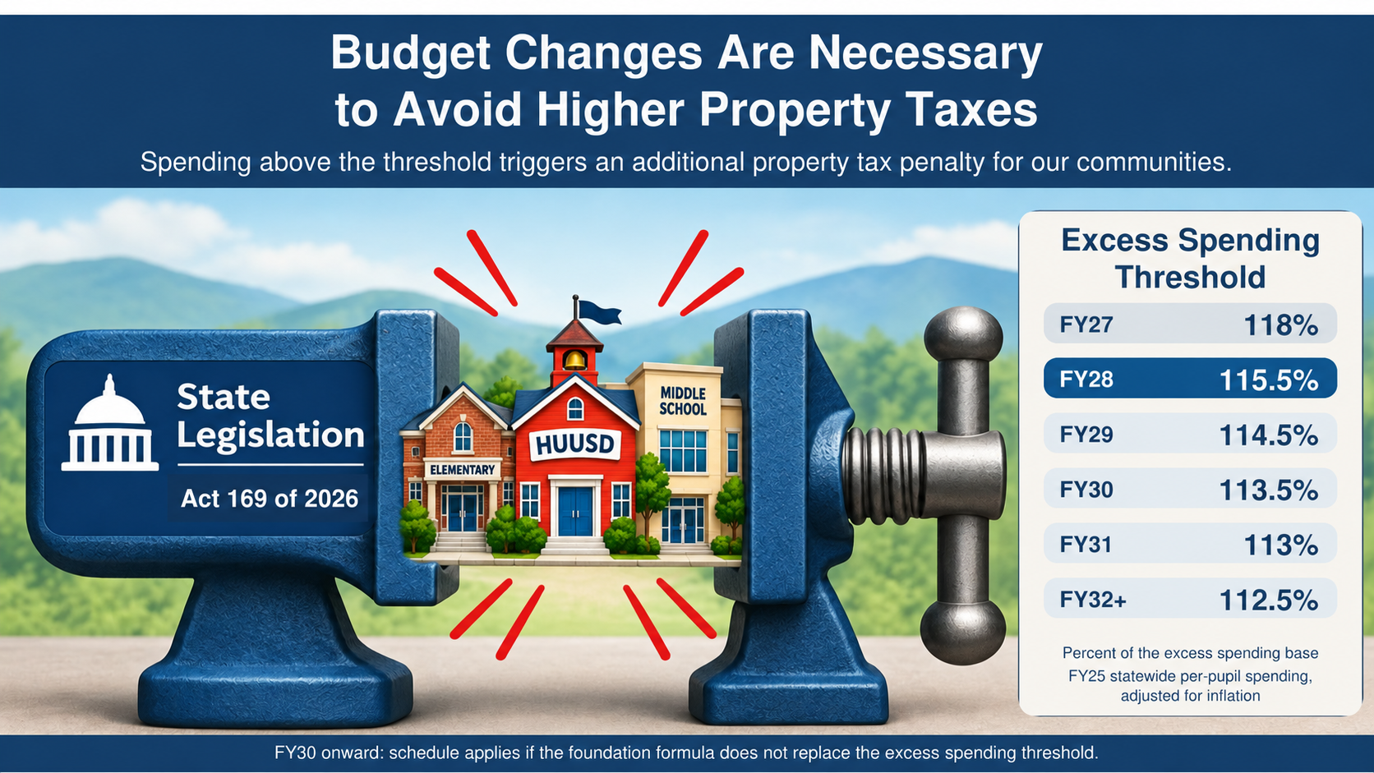
Converging Challenges & Sustaining Strong Student Programs
Spending above the threshold triggers an additional property tax penalty for our communities.
Excess Spending
Threshold
FY27
118%
FY28
115.5%
FY29
114.5%
Act 169 of 2026
FY30
113.5%
FY31
113%
FY32+
112.5%
Percent of the excess spending base
FY25 statewide per-pupil spending,
adjusted for inflation
FY30 onward: schedule applies if the foundation formula does not replace the excess spending threshold.
Notes:
Source: Vermont Act 169 of 2026, sections 6–7 and 15. https://legislature.vermont.gov/Documents/2026/Docs/ACTS/ACT169/ACT169%20As%20Enacted.pdf
Section 7 sets FY28 at 115.5%, FY29 at 114.5%, FY30 at 113.5%, FY31 at 113%, FY32 at 112.5%. Section 6 establishes the inflation-adjusted FY25 spending base and ongoing 112.5% threshold. FY26 and FY27 remain at 118%. Agency of Education corroboration and foundation formula contingency: https://education.vermont.gov/schools/school-governance/education-transformation
FY27 is 118%, rather than the 115.5% initially supplied. FY28 is the first reduction. Original user-supplied PDF artwork retained. Updated act label, schedule and explanatory text are editable.

Slide 8
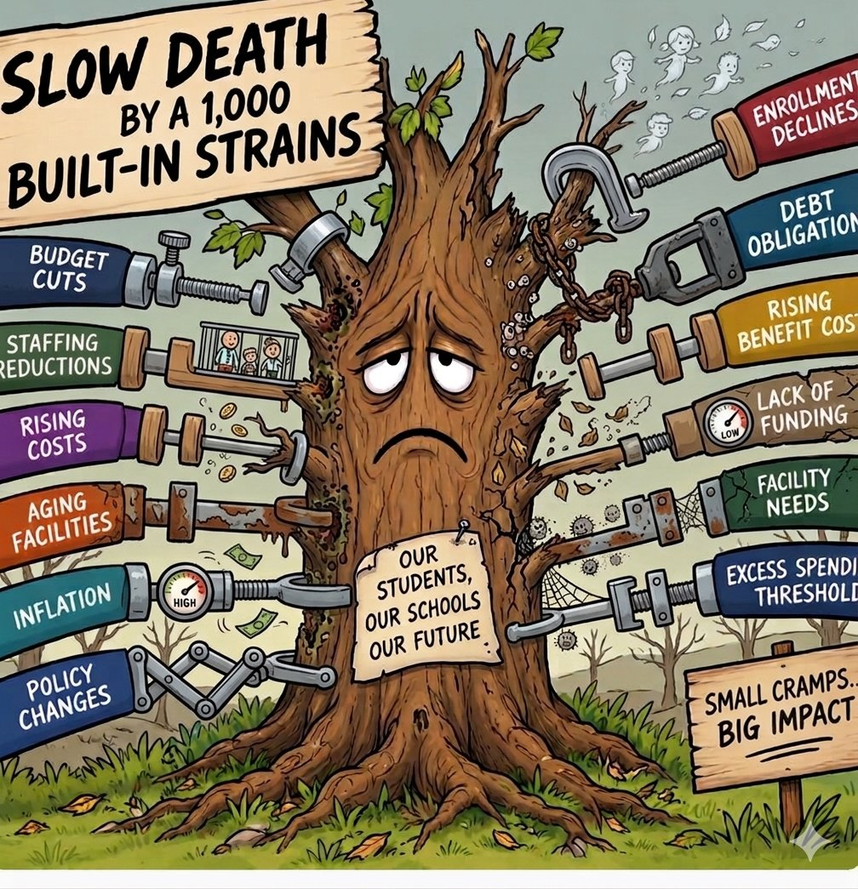
Defining Choice
Tonight, we face a critical question regarding the future of our school district.
OPTION 1: INCREMENTAL CUTS
Continue making incremental reductions year after year, further limiting student opportunities, placing greater demands on staff, and shifting burdens onto families.
OPTION 2: PROACTIVE EXAMINATION
Take a hard look at a new district structure to concentrate resources where they matter most: in our classrooms, supporting students, and protecting quality.
THE QUESTION BEFORE US
What decisions will best support strong educational opportunities for our students while ensuring our district’s long-term financial sustainability?

Slide 9
We cannot keep cutting our way forward without changing how we operate.
THE CHALLENGE
Beyond Preserving Structures
Our responsibility is to ensure that our facilities support strong educational opportunities for students and a financially sustainable future for our district.
OUR RESPONSIBILITY
Sustainable Education
Together, our collective community can plan for changing enrollment while making thoughtful use of our building footprint and human resources to meet students’ needs.

Slide 10
FINANCIAL OVERVIEW & THRESHOLDS
Review Of FY28 Proposed Budget Impacts
Level service budget, projected inflation rates, and Level funded (not to exceed excess spending threshold [EST])
Level Service
$55,224,120
+6.436% Year over Yearnorth
Exceeds EST by $1,081 per pupil
EXCESS SPENDING PENALTY
$2,773,267
IMPACT ON TAXPAYERS
Projected Inflation
$53,285,738
+2.70% Year over Year north
Required Cut: $1,2938,382
Exceeds EST by $172
EXCESS SPENDING PENALTY
$445,340
IMPACT ON TAXPAYERS
Level Funded (Cap EST)
$51,884,847
0% Year over Year
Required Cut: $3,339,273south
Does Not Exceed EST
$(25.67)
UNDER THRESHOLD PER PUPIL
($220.67) was corrected to remove the debt exclusion
Adjusted cost per pupil $18,724.39
FY28 EST Threshold: $16,562•Proposed Per Pupil Exceeds Threshold by $1,081•Target Cut Needed: $3,339,273

Slide 11
What consolidation means
THE CORE PURPOSE
Beyond Closing Buildings
Consolidation is not simply about closing school buildings or cutting costs.
It is about making difficult, long-term decisions to protect the quality of education we can provide.
THE STRATEGIC CHOICE
Two Possible Paths Forward
Proactive Restructuring
Restructure our district to sustain student opportunities and educational quality.
Reactive Status Quo
Continue decisions that risk diminishing the student experience across all schools.

Slide 12
The Charge
Key financial and operational models under evaluation for budget development
payments
school
Budget Cap Threshold
Per Pupil Spending Limit
Elementary & Middle Schools Consolidation
4 Elem ➔ 2 Elem | 7th & 8th merge with HUMH
EVALUATION QUESTION
What reductions would be necessary to achieve a budget not to exceed the per pupil projected spending threshold?
EVALUATION QUESTION
What are the cost efficiencies if we were to consolidate 4 valley elementary schools into 2 elementary schools and merge 2 middle schools into 1 middle school?
KEY FOCUS
Targeted expenditure reductions
KEY FOCUS
Valley elementary & middle school consolidation

Slide 13
Budget Cap Threshold Summary
Total High Impact Reductions
CUMULATIVE BUDGET REDUCTION TARGET
Combined cuts across transportation, academics, athletics, and student programs
$3,339,273
Transportation & Routes
$1,360,000
Daily routes, field travel, tech school transportation
Athletics & Co-Curriculars
$312,757 (70% cut)
Sports coaches, officials, theater, music & student clubs
Special Programming
$583,516
Farm to School, outdoor ed & learning center supports
Pre-K Tuition-Only Model
$517,000
Eliminates in-district public Pre-K slots & limits capacity
Academic & Behavioral Staff
$456,000
Reduces interventionists, paras & tier 2/3 student support
Electives & Technology
$110,000
Reduces course offerings, software & hardware tools
DEVASTATING IMPACT ON STUDENTS & COMMUNITIES
Access & Equity: Severe transportation & Pre-K barriers disproportionately affect vulnerable families.
Student Development: Widespread loss of sports, arts, electives, hands-on learning, and intervention support.
School Community: Eroded support structures, strained classroom environments, and loss of shared traditions.

Slide 14
PROGRAMMATIC BENEFITS OF CONSOLIDATION
Educational Benefits:
How restructuring transforms operational efficiency into enhanced academic, social, and emotional learning environments.
groups
Expanded Student Cohorts
psychology
Dedicated Full-Time Staff
Grade levels spread across small schools restrict peer interactions and social-emotional growth.
Our four valley schools require sharing of staff for integrated arts and nurses each week.
Outcome: Larger peer groups, dynamic social learning, and balanced classrooms.
Outcome: On-site, full-time staff in the valley elementary schools.
auto_graph
Resource Allocation (see example)
diversity_3
Staff Collaboration
Specialized services and interventions can be provided in group settings, optimizing student support services.
Grade level alignment…..Isolated grade levels within each valley elementary leave teachers working without direct peer colleagues on-site.
Outcome: Optimization of student support
Outcome: Grade-level team teaching, shared lesson planning, and professional growth.

Slide 15

Rethinking Our School Structure to Strengthen Student Opportunities

Slide 16
PROGRAMMATIC BENEFITS OF CONSOLIDATION
What Scale Can Mean for Students
A practical example: specialized reading instruction for students with IEPs
IN SEPARATE SCHOOLS
IN A CONSOLIDATED SCHOOL
1 student + 3 students
4 students, both teachers retained
School A: One student works one-on-one with a teacher because no appropriate peers are available.
School B: Three students with similar reading needs work with a second teacher.
If reading levels and IEPs support grouping, one teacher teaches the four students together.
The other teacher extends support to different students who cannot currently access that additional help in either building.
WHY LEARNING WITH PEERS IS IMPORTANT
One-on-one instruction is sometimes necessary, but it is not always the best setting. An appropriate small group lets students practice together, learn from one another, and build confidence and belonging.
Each student’s IEP and instructional needs guide grouping and services.

Slide 17
Valley Elementary Consolidation
Financial evaluation and outcomes of restructuring elementary school facilities
PROPOSAL SCOPE: 4 SCHOOLS ➜ 2 SCHOOLS
Educational Efficiencies
EVALUATION QUESTION
What educational and financial efficiencies could result from consolidating 4 valley elementary schools into 2?
KEY EDUCATIONAL OUTCOMES
More flexible staff and scheduling across grade levels
Greater opportunities for peer interaction and collaborative learning
More consistent access to specialized instruction, interventions, and support
Elimination of shared staff and travel time across buildings
Full time nurse at each location
More robust educational experiences
FINANCIAL IMPACT & EFFICIENCIES
We would achieve consolidation cost efficiencies of:
~$1,826,527
ESTIMATED ANNUAL OPERATING SAVINGS
A REDUCTION OF -16 FTE*
KEY OUTCOME
Significant annual operating savings redirected to educational quality and staff retention.
*FTE = Full-Time Equivalent (i.e. one person)

Slide 18
Middle Schools Merger
Middle Schools Merger
7th & 8th graders merge with HUMH 5th & 6th remain at CB
EVALUATION QUESTION
What are the cost efficiencies if we were to consolidate 2 middle schools into 1 middle school?
KEY EDUCATIONAL OUTCOMES
Expanded academic electives, athletics, and extracurricular offerings
Dedicated grade-level teacher teams and enhanced peer collaboration
Consolidated special education, counseling, and intervention support
More equitable access to advanced coursework and specialized facilities
FINANCIAL IMPACT & EFFICIENCIES
We would achieve consolidation cost efficiencies of:
~$2,102,942
ESTIMATED ANNUAL OPERATING SAVINGS
-16.5 FTEs
KEY OUTCOME
Significant annual operating savings redirected to educational quality and staff retention.

Slide 19
Combined School Consolidation Impact
Comprehensive educational outcomes and combined financial efficiencies from facility restructuring
Elementary Consolidation
4 Schools ➜ 2 Schools
EVALUATION QUESTION
What efficiencies result from consolidating 4 valley elementary schools into 2?
KEY EDUCATIONAL OUTCOMES
More flexible staff & scheduling across grades
Greater peer interaction & collaborative learning
Consistent access to specialized instruction
Elimination of shared staff travel time
Increased nursing staff & support
SUBTOTAL SAVINGS
~$1,826,527
-16 FTEs
Middle Schools Merger
7th & 8th graders merge with HUMH 5th & 6th remain at CB
EVALUATION QUESTION
What cost efficiencies exist by consolidating 2 middle schools into 1?
KEY EDUCATIONAL OUTCOMES
Expanded electives, athletics & extracurriculars
Dedicated grade-level teacher teams
Consolidated special education & counseling
Equitable access to advanced coursework
SUBTOTAL SAVINGS
~$2,102,942
-16.5 FTEs
TOTAL POTENTIAL IMPACT
Combined Annual Operating Savings
~$3,929,469
ESTIMATED ANNUAL OPERATING SAVINGS
A REDUCTION OF -32.5 FTEs
KEY STRATEGIC OUTCOME
Substantial long-term budget sustainability with savings directly redirected to educational quality, student support, and staff retention.

Slide 20
FINANCIAL OVERVIEW & THRESHOLDS
Review Of FY28 Proposed Budget Impact
Elementary & Middle Schools Consolidation
PROJECTED BUDGET
$51,294,651
-1.138% arrow_downward Budget Change
PER PUPIL VARIANCE
($255.76)
Below the excess spending threshold
FY28 EST THRESHOLD
$16,562
PROJECTED PER PUPIL
$16,306.24
THRESHOLD STATUS
Below Threshold Limit

Slide 21
FY27 Fayston Elementary School Profile
Facility profile, student enrollment, and capital investment priorities
HUUSD Facility Profile
TOTAL STUDENT ENROLLMENT
DEFERRED MAINTENANCE (P1-3)
IMPENDING INVESTMENT
BUILDING FOOTPRINT
STAFFING & HEADCOUNT
84
$7,352,902
$756,375
20,528 sq ft
25.63 FTE
Grades K – 6
Priority 1: $985,516
Near-term critical repairs
9 Classrooms •Playgrounds and
Trails but no fields
Student Enrollment Distribution (FY27)
PK3
PK4
Kindergarten
Grade 1
Grade 2
Grade 3
Grade 4
Grade 5
Grade 6
Grade 7
Grade 8
TOTAL
12
13
11
11
18
9
13
-
-
84
Impending Capital Investment & Facilities
Facility & Environmental Specs
Priority Maintenance
Roof Replacement
Fire Panel Replacement
Water System Controls Replacement
Kitchen & Meal Production
Fully operational Kitchen
Cafeteria Seating
Gym is used as cafeteria
Property Metric | Specification
Wastewater Permitting Capacity | 250
Heat/Solar | Propane/No solar
Land Ownership | 7.0 Acres with two easements through property
Number of Classrooms | 9
Annual Operating Costs
$174,783 not including custodial salary and benefits

Slide 22
FY27 Moretown Elementary School Profile
Facility profile, student enrollment, and capital investment priorities
HUUSD Facility Profile
TOTAL STUDENT ENROLLMENT
DEFERRED MAINTENANCE (P1-3)
IMPENDING INVESTMENT
BUILDING FOOTPRINT
STAFFING & HEADCOUNT
137
$4,875,697
$200,000 ****
22,100 sq ft
28.05 FTE
Grades K – 6
Priority 1: $366,584
Near-term critical repairs
11 Classrooms • Playgrounds,
access to town fields and trails
Student Enrollment Distribution (FY27)
PK3
18
PK4
Kindergarten
Grade 1
Grade 2
Grade 3
Grade 4
Grade 5
Grade 6
Grade 7
Grade 8
TOTAL
14
16
25
19
20
14
23
20
-
-
169
Impending Capital Investment & Facilities
Facility & Environmental Specs
Priority Maintenance
Exterior siding repairs needed
Heat Controls need replacement
Annual Operating Costs
$185,868 not including custodial salary and benefits
Kitchen needs & Meal Production
Prep kitchen only, food has to be transported from Harwood to serve. Dishwasher is problematic and needs to be replaced to meet the demands. Estimated replacement cost of $92K included. Additional refrigeration will also be required ****
Cafeteria Seating
Limited
Property Metric | Specification
Wastewater Permitting # | 235
Heat/Solar | Propane/No Solar
Land Ownership | ~2.0 Acres
Number of classrooms | 11

Slide 23
FY27 Waitsfield Elementary School Profile
Facility profile, student enrollment, and capital investment priorities
HUUSD Facility Profile
TOTAL STUDENT ENROLLMENT
DEFERRED MAINTENANCE (P1-3)
IMPENDING INVESTMENT
BUILDING FOOTPRINT
STAFFING & HEADCOUNT
103
$4,840,026
$150,000
23,680 sq ft
23.25 FTE
Grades K – 6
Priority 1: $622,673
Near-term critical repairs
11 Classrooms • Playgrounds,
fields and access to Mad River Path Trail
Student Enrollment Distribution (FY27)
PK3
PK4
Kindergarten
Grade 1
Grade 2
Grade 3
Grade 4
Grade 5
Grade 6
Grade 7
Grade 8
TOTAL
11
12
14
15
17
14
20
-
-
103
Impending Capital Investment & Facilities
Facility & Environmental Specs
Priority Maintenance
Boiler replacement
Partial roof replacement
Kitchen & Meal Production
Fully operational Kitchen. No incoming meal transport; outgoing to Fayston.
Cafeteria Seating
Gym is used as the cafeteria
Property Metric | Specification
Wastewater Permitting capacity | 230* (admenable to 300)
Heat/Solar | Oil/Yes, net metering agreement with Town of Waitsfield
Land Ownership | 7.7 Acres
Number of Classrooms | 11
Annual Operating Costs
$196,038 not including custodial salary and benefits

Slide 24
FY27 Warren Elementary School Profile
Facility profile, student enrollment, and capital investment priorities
HUUSD Facility Profile
TOTAL STUDENT ENROLLMENT
DEFERRED MAINTENANCE (P1-3)
IMPENDING INVESTMENT
BUILDING FOOTPRINT
STAFFING & HEADCOUNT
87
$4,055,711
$0
29,738 sq ft
25.63 FTE
Grades K – 6
Priority 1: $1,451,300
Near-term critical repairs
14 Classrooms • Access to
playground, fields and trails
Student Enrollment Distribution (FY27)
PK3
13
PK4
Kindergarten
Grade 1
Grade 2
Grade 3
Grade 4
Grade 5
Grade 6
Grade 7
Grade 8
TOTAL
19
8
8
16
17
12
16
10
-
-
119
Annual Operating Costs
$183,521 not including custodial salary and benefits
Impending Capital Investment & Facilities
Facility & Environmental Specs
Priority Maintenance
Kitchen & Meal Production
Fully operational Kitchen. No incoming meal transport.
Cafeteria Seating
Limited
Property Metric | Specification
Wastewater Permitting Capacity | 237
Heat/Solar | Oil/Yes, net metering agreement with Town of Warren
Land Ownership | 0 Acres School has easement for school building on Town Land
Number of Classrooms | 14

Slide 25
FY27 Brookside Primary School Profile
Facility profile, student enrollment, and capital investment priorities
HUUSD Facility Profile
TOTAL STUDENT ENROLLMENT
DEFERRED MAINTENANCE (P1-3)
IMPENDING INVESTMENT
BUILDING FOOTPRINT
STAFFING & HEADCOUNT
284
$16,735,501
$50,000
60,000 sq ft
67.44 FTE
Grades K – 6
Priority 1: $2,686,994
Near-term critical repairs
24 Classrooms • Playgrouds
Access to town fields & trails
Student Enrollment Distribution (FY27)
PK3
29
PK4
Kindergarten
Grade 1
Grade 2
Grade 3
Grade 4
Grade 5
Grade 6
Grade 7
Grade 8
TOTAL
25
51
53
59
49
72
-
-
338
Impending Capital Investment & Facilities
Facility & Environmental Specs
Priority Maintenance
Entry door replacement (safety concern)
Basement egress repair
Kitchen & Meal Production
Full/partially operational kitchen
Cafeteria Seating
Limited
Property Metric | Specification
Occupancy | 480
Heat/Solar | Oil /Yes
Land Ownership | 10 Acres
Town sewer/town water Number of classrooms | 8,200 GPD allotted by town 24
Annual Operating Costs
$393,969 not including custodial salaries and benefits

Slide 26
FACILITY & GRADE STRUCTURE ASSESSMENT
Temporary Classrooms vs. Grade Relocation
Evaluating site feasibility, modular costs, and educational benefits for 5th & 6th graders
Temporary Classroom Feasibility
High financial cost and physical site limitations complicate modular options.
Rationale for Moving 5th & 6th Graders
Reallocating grade levels provides immediate structural and financial advantages.
LIMITED SITE CAPACITY
All four schools have limitations of physical infrastructure & land space:
~$600K–$700K for two units / two locations
(2 classrooms per unit)
1. Educational & Social Quality
Consolidates middle-grade peers into dedicated learning environments with better access to specialized instruction. Quality and alignment of grades.
Key Constraints & Costs:
2. Financial Stewardship
Avoids significant temporary construction expenditures, preserving taxpayers' capital for long-term investments.
Capital Outlay: Substantial unbudgeted capital outlay for short-term modular leasing.
3. Operational Stability
Solves district-wide capacity imbalances without multi-year construction disruptions, avoids capital outlay of a construction bond, or ongoing lease overhead for temporary classrooms.
Complex Permitting: Site preparation, electrical, plumbing, and wastewater permitting.

Slide 27
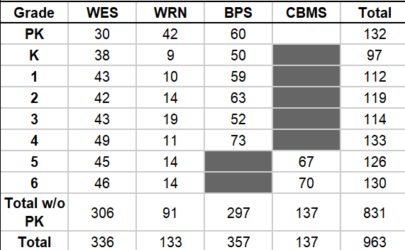
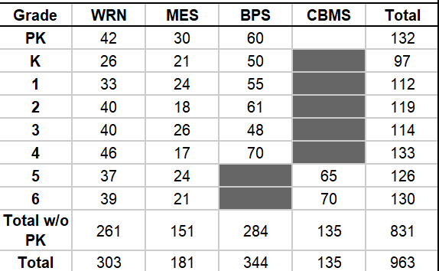
FACILITY & CAPACITY CONSTRAINTS
Impact of not moving valley 5th & 6th graders
Comparative evaluation of student enrollment distributions and facility capacity limits across schools. Based on home location to nearest school.
WAITSFIELD WOULD EXCEED WASTEWATER CAPACITY
WARREN WOULD EXCEED WASTEWATER CAPACITY
Exceeds
Exceeds
CRITICAL INFRASTRUCTURE FINDING
Wastewater capacity constraints mandate grade realignment to ensure sustainable facility operations across all sites.

Slide 28
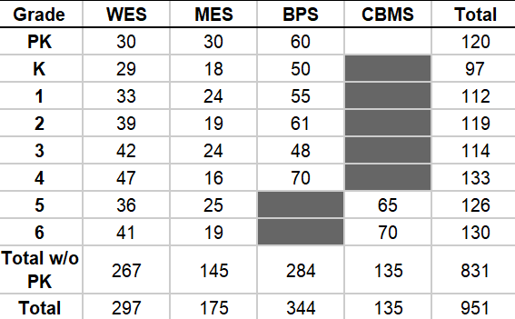
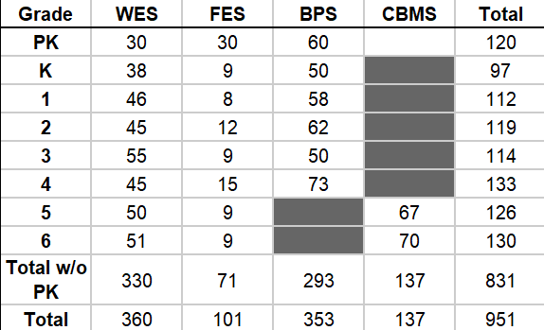
FACILITY & CAPACITY CONSTRAINTS
Impact of not moving valley 5th & 6th graders
Comparative evaluation of student enrollment distributions and facility capacity limits across schools. Based on home location to nearest school.
WAITSFIELD WOULD EXCEED WASTEWATER CAPACITY
WAITSFIELD EXCEEDS WASTEWATER CAPACITY
Exceeds
Exceeds
CRITICAL INFRASTRUCTURE FINDING
Wastewater capacity constraints mandate grade realignment to ensure sustainable facility operations across all sites.

Slide 29
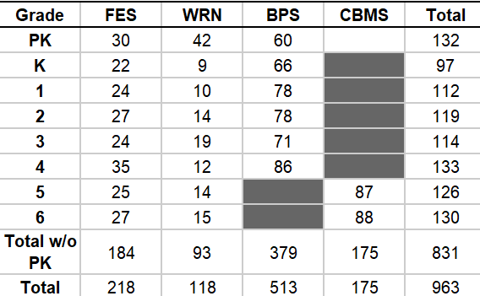
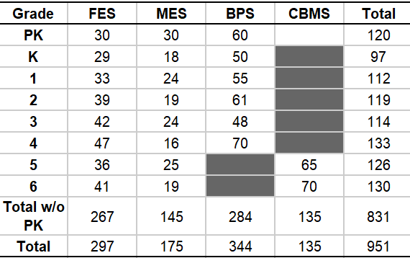
FACILITY & CAPACITY CONSTRAINTS
Impact of not moving valley 5th & 6th graders
Comparative evaluation of student enrollment distributions and facility capacity limits across schools. Based on home location to nearest school.
BROOKSIDE EXCEEDS WASTEWATER CAPACITY
FAYSTON EXCEEDS WASTEWATER CAPACITY
Max Occupancy is 480
Exceeds
CRITICAL INFRASTRUCTURE FINDING
Wastewater capacity constraints mandate grade realignment to ensure sustainable facility operations across all sites.

Slide 30
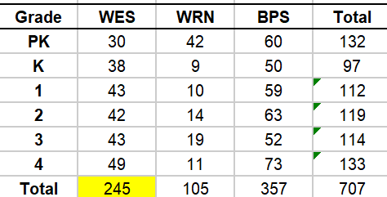
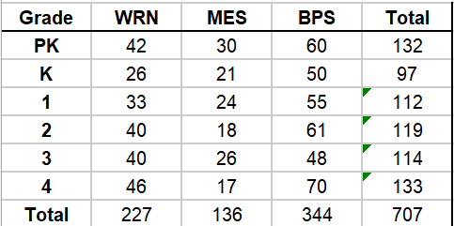
FACILITY & CAPACITY CONSTRAINTS
Impact of PK-4 grade
Comparative evaluation of student enrollment distributions and facility capacity limits across schools. Based on home location to nearest school.
WAITSFIELD WOULD EXCEED WASTEWATER CAPACITY
NO SCHOOL WOULD EXCEED WASTEWATER CAPACITY
Exceeds
CRITICAL INFRASTRUCTURE FINDING
Wastewater capacity constraints mandate grade realignment to ensure sustainable facility operations across all sites.

Slide 31
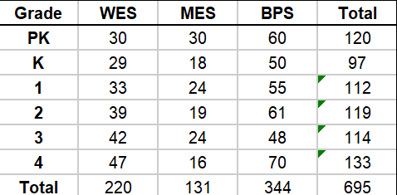
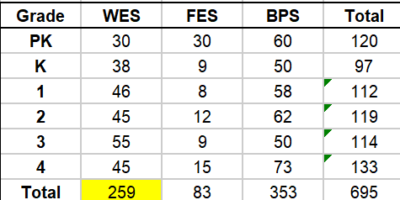
FACILITY & CAPACITY CONSTRAINTS
Impact of PK-4 grade
Comparative evaluation of student enrollment distributions and facility capacity limits across schools. Based on home location to nearest school.
NO SCHOOL WOULD NOT EXCEED WASTEWATER CAPACITY
WAITSFIELD EXCEEDS WASTEWATER CAPACITY
Exceeds
CRITICAL INFRASTRUCTURE FINDING
Wastewater capacity constraints mandate grade realignment to ensure sustainable facility operations across all sites.

Slide 32
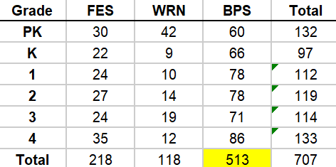
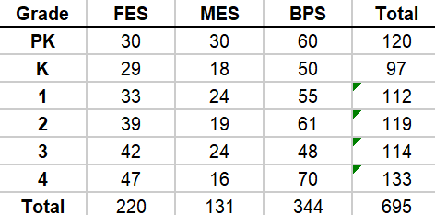
FACILITY & CAPACITY CONSTRAINTS
Impact of PK-4 grade
Comparative evaluation of student enrollment distributions and facility capacity limits across schools. Based on home location to nearest school.
BROOKSIDE EXCEEDS WASTEWATER CAPACITY
NO SCHOOL EXCEEDS WASTEWATER CAPACITY
Max Occupancy is 480
CRITICAL INFRASTRUCTURE FINDING
Wastewater capacity constraints mandate grade realignment to ensure sustainable facility operations across all sites.

Slide 33
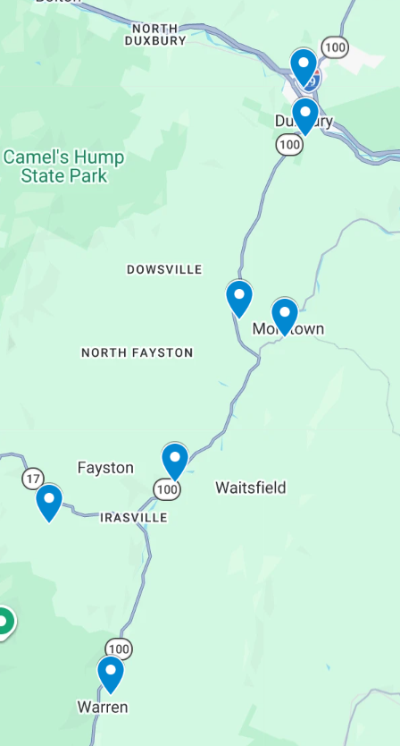
Brookside Primary
HUUSD SCHOOL LOCATIONS
Crossett Brook MS
HARWOOD UNION HIGH SCHOOL → CROSSETT BROOK MIDDLE SCHOOL
Approx. 5 miles
Approx. 7–10 minutes by car
Harwood HS
Moretown Elementary
SEVEN HUUSD SCHOOL LOCATIONS
Harwood Union High School
Crossett Brook Middle School
Brookside Primary School
Moretown Elementary School
Fayston Elementary
Waitsfield Elementary
Waitsfield Elementary School
Fayston Elementary School
Warren Elementary School
Warren Elementary
DISCUSSION POINT
We currently have students on Intradistrict Choice (IDC) attending CBMS from the Valley.
Map reference supplied by HUUSD • labels are editable

Slide 34
ELEMENTARY CONSOLIDATION: SIX POSSIBLE SCENARIOS
HOMEWORK FOR BOARD
Compare the six combinations, which schools are best equipped to serve students in a sustainable future configuration?
SCORING: 5 = Strong fit • 4 = Good fit • 3 = Adequate • 2 = Challenging • 1 = Poor fit
SCENARIO Schools staying open | Enrollment & receiving capacity | Building condition & capital needs | Kitchen & meal operations | Wastewater feasibility | Ranking of school combination | Total score
1 Moretown + Fayston | Score: ___ | Score: ___ | Score: ___ | Score: ___ | Score: ___ | Total: ___
2 Moretown + Waitsfield | Score: ___ | Score: ___ | Score: ___ | Score: ___ | Score: ___ | Total: ___
3 Moretown + Warren | Score: ___ | Score: ___ | Score: ___ | Score: ___ | Score: ___ | Total: ___
4 Fayston + Waitsfield | Score: ___ | Score: ___ | Score: ___ | Score: ___ | Score: ___ | Total: ___
5 Fayston + Warren | Score: ___ | Score: ___ | Score: ___ | Score: ___ | Score: ___ | Total: ___
6 Waitsfield + Warren | Score: ___ | Score: ___ | Score: ___ | Score: ___ | Score: ___ | Total: ___
BOARD QUESTIONS: Which two-school configuration can safely accommodate more students, support strong programs, and deliver sustainable net savings?

Slide 35
HUUSD CONSOLIDATION GANTT CHART
October 2026 – August 2027 | Decision milestones, planning, and implementation
Note: A Gantt chart is a visual bar chart that illustrates a project schedule, showing tasks, start and end dates, durations, and how activities depend on one another across a timeline.
MILESTONE / WORKSTREAM
Oct
Nov
Dec
Jan
Feb
Mar
Apr
May
Jun
Jul
Aug
Board direction: Path A or Path B
Feasibility proposals due
Board reviews data / identifies options
Select RFP firm(s), if applicable
December 1 tax letter / projected yield
Budget Overviews 2 & 3
Community engagement meetings on school closings
RFP / statutory notice process (confirm)
Board vote on school closures (listed date)
Announced tuition due (confirm date)
Common Level of Appraisal published (confirm)
Final budget, warning & articles
Administrator contract notifications
Interdistrict choice deadline (confirm)
HUUSD annual report
Budget informational hearing
Town Meeting Day
Preliminary school assignments
Teacher contracts / LOIs / RIF planning
Union staff contracts
Teacher contracts due back (confirm)
Non-union contracts
Union staff contracts due back (confirm)
Financial year-end close
Prepare for possible school closings
Plan receiving-school readiness / reopening
School openings
WORKING DRAFT

Slide 36

HUUSD FY28 Budget Development Timeline Process & Milestones
Key board decisions and budget-development milestones from October through Town Meeting Day
01
02
03
04
05
06
07
08
Oct. 14, 2026
Oct. 28, 2026
Nov. 4, 2026
Nov. 18, 2026
Dec. 2 & 16 2026
Jan 6 & 13, 2027
Mar 1, 2027
Mar. 2, 2027
BOARD MEETING
Budget Impact Presentation #1 Level Service
Consolidation of Middle Schools & Valley Elementary
BOARD MEETING
Budget Impact Presentation #2
Review Enrollment Projections
BOARD MEETING
Building Analysis Chart
FY28 Finalize Board Budget Priorities
BOARD MEETING
Budget Overview #1
Enrollment & Staffing
BOARD MEETING
December 2:
Budget Overview #2
December 16:
Budget Overview #3
BOARD MEETING
January 6:
Budget Recap Receive CLA from VT Dept of Taxes
January 13:
Final Budget Approve Warning & Articles
BOARD MEETING
Budget Informational Hearing
VOTE
Town Meeting Day
***Addition meeting January 20, 2027 if necessary for budget adoption

Slide 37
GOVERNANCE & RESTRUCTURING DIRECTIVES
Question for Board Direction
Path A or Path B?
UPCOMING MILESTONE
November 4th Meeting
Maintain 7 buildings and make high impact reductions
School Board Decision Point
A
Action Needed:
If Path A, determine services and programs to be eliminated and reduced
If Path B, use data provided to identify buildings for consolidation and subsequent meetings per the Articles of Agreement.
Valley Consolidation and Middle School Merger
B
Next Step Requirement: A: Identify programs and services to curtail. B: Identify buildings to accommodate additional students, then hold the three community meetings required by the Articles of Agreement before any official board action on school closure.
Notes:
Talk about what happens in Path A if a budget fails

Slide 38
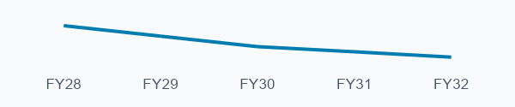
A REQUEST TO OUR LEGISLATORS
An Excess Spending Designation
Is Not a Diagnosis
Even with consolidation, HUUSD faces limited room for annual budget growth after FY28.
THE THRESHOLD PERCENTAGE KEEPS FALLING
THE DESIGNATION DOES NOT TELL US WHY
Percent of the inflation-adjusted excess spending base
The designation alone does not explain district geography, IEP service costs, regional teacher salary differences, or programs communities have added to enrich education.
115.5%
114.5%
113.5%
113.0%
112.5%
This policy pushes spending toward an average. Our schools, students and performance cannot be reduced to an average.
These are threshold percentages, not annual growth allowances.
The dollar base adjusts for inflation. FY30+ assumes this system continues.
FY28: WE WILL PLAN UNDER CURRENT RULES. THE REVIEW MUST BEGIN NOW.
For future budgets, examine these differences before treating higher spending as inefficiency. Protect affordability and the educational opportunities our communities value.
Notes:
Closing message for legislators: We are pursuing structural changes and affordability, but consolidation does not remove ongoing cost pressures or guarantee enough annual budget growth to sustain services after FY28. No district-specific growth percentage is asserted or calculated here. The threshold is a per-pupil tax mechanism, not a fixed annual district budget cap. Declining weighted enrollment can constrain total budget growth even as costs rise. Inflation adjusts the base while statute reduces the multiplier. The chart shows the multiplier, not the nominal dollar threshold, allowed annual growth, or projected HUUSD spending.
Current schedule: FY28 115.5%, FY29 114.5%, FY30 113.5%, FY31 113%, FY32 and thereafter 112.5%. FY30 onward applies if the current excess spending system remains in effect rather than being superseded by the contemplated foundation formula.
Sources: Vermont Agency of Education, Education Transformation, Excess Spending Timeline: https://education.vermont.gov/schools/school-governance/education-transformation ; Vermont Agency of Education, State Aid for School Construction, Excess Spending Threshold: https://education.vermont.gov/schools/construction/state-aid ; 32 V.S.A. §5401: https://legislature.vermont.gov/statutes/section/32/135/05401 . Accessed October 28, 2026.
Conceptual framing comes from the supplied October 2026 email exchange, including Mike Leichliter's feedback to Rebecca Holcombe. This slide paraphrases the concerns and uses the user's requested phrase, designation, not a diagnosis. It does not attribute that exact phrase to Holcombe. We will prepare FY28 under current rules and ask legislators to investigate future changes now. The designation alone is not a causal analysis of geographic size, actual IEP costs, regional teacher labor markets, or community-supported enrichment programs. Student weighting and other funding mechanisms may account for some differences. This slide does not claim that no part of the funding system recognizes student needs. The reference to performance is a statement that aggregate averages cannot describe a district, not a quantified comparison or a claim that HUUSD exceeds a particular performance benchmark.

Slide 39


?
Questions
?
We welcome your feedback, thoughts, and community questions regarding the district plans.
HUUSD Board
huusd.org/board
Public Input
Comments & Inquiries
HARWOOD UNIFIED UNION SCHOOL DISTRICT

Slide 40
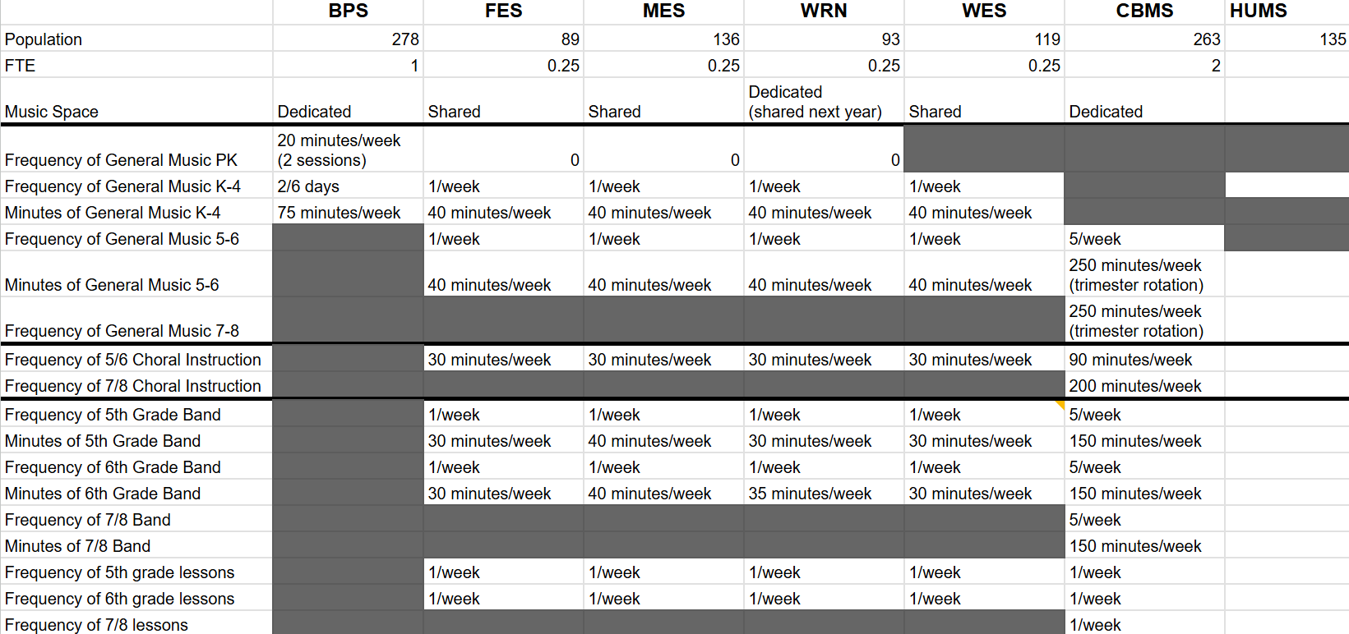
PROGRAMMATIC ANALYSIS & CURRICULUM
Education Benefits of Consolidation
Benefits of consolidation and economy of scale preserve quality programming across all district schools.
music_note
DISTRICT ALLOCATION MATRIX
Music & Arts Program Distribution Comparison
Programming
Economy of Scale
CORE OBJECTIVE
We will not continue to diminish programming across district facilities.
KEY ADVANTAGES
Consolidated staffing maximizes specialized FTE instruction.
Dedicated music spaces replace shared multi-purpose rooms.
Consistent weekly music, band, and choral scheduling.

