Slide 1


FY28 Budget
Development & Early Projections
event
9/23/2026
language
ONLINE RESOURCE
HARWOOD UNIFIED UNION
School Board Meeting
Budget information:
HUUSD.ORG/BUDGET
Notes:
The board sets district policy, hires and oversees the superintendent, and prepares and presents a proposed budget to voters.

Slide 2
Preliminary
Subject to Change
warning
update
Important Notice
The financial data, projections, and estimates presented in this document are initial drafts intended solely for discussion and planning purposes.
All figures remain subject to further revision based on updated state data, local board decisions, and upcoming legislative impacts.
Next Steps
Updated numbers and formal proposals will be presented in subsequent board meetings as state models finalize.
Please refer to the official district budget webpage for the most current documentation and timeline updates.

Slide 3

account_balance
Finance Overview
Quick Overview of Vermont Education Finance System and the Education Fund
Presentation Includes the Following
Overview of key agenda topics and structural modules covered in this session.
Pupils
Weighted pupils and pupil weighting factors breakdown
groups
settings_suggest
Process
Budget development process and planning framework
event_note
HUUSD Timeline
Budget time-line, key milestones & board actions
insights
Projections
Preliminary FY28 projections and financial outlook

Slide 4
Vermont’s Education Finance System
Couples Local and State Decisions
how_to_vote
calculate
account_balance
Local & State Level
Expenses are determined at the local and state level
Tax Rate Funding
Property tax rates are then set to fully fund those expenditures
Education Fund
All Education property taxes are dedicated to the statewide Education fund.

Slide 5

What is the Education Fund?
The Total Cost of Public Education in Vermont
Annually, local and State decisions determine total expenditures from the education fund.
how_to_vote
Local Decisions
account_balance
State Decisions
School districts build budgets that must be approved by voters
Certain appropriations and categorical aid
Policies that impact local budgets
location_city
Local spending decisions
gavel
State spending decisions
assignment
Total expenditures from the Education Fund
+
=

Slide 6
FY27 Education Fund Revenue Sources
Total Revenue Available: $2.433 Billion
Non-Homestead Property Tax 37.5% ($941.8M)
Education property tax paid on non-homestead property.
Other Revenue Sources
One-Time GF Transfer — 4.0%
$100.9M | One-time General Fund transfer for FY27.
Meals & Rooms Tax — 3.4%
$86.0M | Over one-quarter of revenue deposited under FY27 changes.
Purchase & Use Tax — 1.7%
$41.9M | Less than one-third of revenue deposited under FY27 changes.
Lottery — 1.3%
$33.4M | Lottery revenue transferred to Education Fund.
Medicaid & Other — 0.6%
$13.8M combined | Medicaid ($9.5M), wind/solar & interest ($4.3M).
Homestead Property Tax26.1% ($655.2M)
Education property tax paid on homestead property. FY27 gross homestead education property tax revenue is $789.4M, with a $134.2M property-tax credit reflected in the Education Fund calculation.
Sales & Use Tax25.5% ($640.9M)
All sales and use tax revenue is deposited into the Education Fund.

Slide 7

Education Finance Timeline
01
PHASE 1
02
DECEMBER 1
03
January
04
MARCH
Budget Prep
School boards begin preparing school district budgets.
December 1 Letter
Commissioner of Taxes publishes forecasting rates for the next fiscal year.
Budgets Warned
Boards prepare budgets and warn for voters, informed by the Dec 1 letter.
Voter Approval
Vermonters vote on school district budgets (usually at annual town meetings).
05
April/May
06
ON/BEFORE JUNE 30
07
LATE SUMMER/FALL
08
FALL & BEYOND
Yield Bill Set
General Assembly sets property taxes at level necessary to fund approved budgets.
Tax Rates Set
Department of Taxes sets spending-adjusted homestead tax rates for towns.
Administration
Town officials formally administer education property taxes to taxpayers.
Implementation
Taxpayers pay taxes, and school districts implement their operating budgets.

Slide 8

HUUSD Education Spending
BUDGET
APPROVED
BY VOTERS
OFFSETTING REVENUES
DISTRICT EDUCATION SPENDING
Once a budget is approved, the state is obligated to fund the district’s education spending from the Vermont Education Fund.
Offsetting Revenues
Local Revenues (i.e. tuition collected)
State & Federal Grants Such as:
  Special Education Reimbursement
  Merger Support Grant (formerly Small Schools Grant)
  Transportation Aid

Slide 9


Calculation for District Homestead Tax Rate
DISTRICT
EDUCATION
SPENDING
EDUCATION SPENDING PER LTW ADM
(Long Term Weighted Average Daily Membership)
DISTRICT LTW ADM
(Long Term Weighted Average Daily Membership)
EDUCATION SPENDING PER
LTW ADM
(Long Term Weighted Average Daily Membership)
STATE DOLLAR EQUIVALENT YIELD RATE
HUUSD HOMESTEAD TAX RATE
LTW ADM = Factors state assesses based upon cost to educate a student. For example a high school student has a higher factor since they are more expensive to educate than a graded school student.
Notes:
The District Education Spending is then divided by the number of LTW ADM. This number is the Education Spending per LTW ADM. This number is then divided by the State Dollar Equivalent Yield, which gives you the HHUSD Homestead Tax Rate.

Slide 10
What is the Yield?
DEFINITION
"The yield is the statewide benchmark used to translate a district's education spending per weighted pupil into a homestead education tax rate."
FY2027 BENCHMARK
$9,401
For FY2027, the property yield is $9,401.
VERMONT LAW DEFINITION
Vermont law defines the property yield as the amount of per-pupil education spending that would produce a $1.00 homestead tax rate per $100 of equalized education property value.
KEY EQUIVALENCE
$9,401 of education spending per weighted pupil = $1.00 tax rate
Notes:
Its basically a statewide checkbook so if Ed Spending statewide it growing more money is needed statewide and the yield is set accordingly. The yield is difficult to estimate as it is driven by the financial status of the education fund and other political factors but also by the Legislature’s management of the fund— including decisions to shift costs into the fund and whether to use reserves. The yield is the lever the legislature has to determine how much money comes into the education fund. When the Legislature lowers the yield, tax rates go up, and if it raises the yield, tax rates go down.

Slide 11
What is the Purpose of the Dollar Yield?
Purpose & Scope
Ensures there is enough money in the State Education Fund to fund all school district budgets (Education Spending portion).
Calculation
Calculated jointly by the Vermont Agency of Education working in coordination with the VT Department of Taxes.
Timeline
Dec 1: Commissioner announces estimated yield.
Final: Set by State Legislature once school budgets pass.
HOMESTEAD TAX RATE FORMULA
Education Spending
Per LTW ADM
÷
Dollar Yield
=
HUUSD Homestead
Tax Rate
Notes:
The VT Agency of Education and the VT Department of Taxes work together to determine how much all Vermont schools need from the Education Fund to fund their school budget(s) for the year. This is determined by estimated budget increases collected from all districts. A statewide budget increase is calculated and the Dollar Yield is announced by the Commissioner from the VT Department of Taxes. The Education Spending Per LTW ADM is divided by the Dollar Yield to equal the HUUSD Homestead Tax Rate.

Slide 12

The Multiple Components That Determine the Homestead Tax Rate and Town property Tax Rates
✓ IN OUR CONTROL
STATE FORMULA
1. District Spending
Proposed Expenditures: District operating budget
Estimated Revenues: Grants, tuition & local aid
Net result is District Education Spending
2. District LTWADM
Long Term Weighted Average Daily Membership
Weighted factors for grade levels & demographics
Determines spending per weighted student
LEGISLATURE SET
TOWN LEVEL
3. State Dollar Yield Rate
Set annually by the VT State Legislature
Statewide benchmark for yield rate
Establishes standard baseline tax rate
4. Common Level of Appraisal (CLA)
Calculated individually for each town
Adjusts for fair market property values
Directly determines Actual Tax Rate Increase
Homestead Tax Rate = (Net Education Spending ÷ LTWADM) ÷ State Yield Rate ÷ Town CLA
Notes:
Local control is expenditures and revenues.

Slide 13
Long Term Weighted Average Daily Membership (LTWADM)
What is LTWADM?
Why LTWADM Matters?
Student Count Adjusted for Need & Time
Tax-Capacity & Funding Formula Metric
Core Definition: LTWADM is essentially the district’s student count, averaged over a two-year period.
Weighting Factors: It is adjusted to account for the additional costs associated with serving specific student populations and demographics.
Beyond Headcount: LTWADM is not simply a raw enrollment number.
Financial Impact: It serves as a key tax-capacity and funding-formula metric that directly determines district spending capacity and property tax calculations.

Slide 14

Long Term Weighted Average Daily Membership (LTWADM)
Students who incur higher education costs are weighted to count for more.
Grade & Student Demographics
Sparsity & Small School Factors
EEE / PreK
Sparsity
< 36 pop/sq. mile
-0.54
0.15
Middle (6-8)
Sparsity
36 ≤ pop/sq. mile < 55
0.36
0.12
Secondary (9-12)
Sparsity
55 ≤ pop/sq. mile < 100
0.39
0.07
Poverty
Small School
≤ 55 pop/sq. mile, enrollment ≤ 100
1.03
0.21
English Language Learners (ELL)
Small School
≤ 55 pop/sq. mile, enrollment 101–250
2.49
0.07

Slide 15
Unfunded Mandates & Federal Requirements
A few Legislative acts and state/federal mandates impacting school district operations and budget.
Legislative Acts & Compliance Standards
Operational & District Mandates
• 2018 Act 11: Commission on Public School Employee Health Benefits.
• 2021-Act 172: Radon Testing
• 2022-Act 29: Access Control, Emergency Operations & Threat Assessment
• 2022-Act 127: Improving student equity by adjusting the school funding formula
• 2021-Act 72: Requirement to Employ a Facilities Director
• 2021-Act 74: PCB Testing and Remediation Program
• Act 35: Ban on Suspension or Expulsion for Under 8
• Hazing, Harassment and Bullying Legislation
• Title IX Requirements
• Act 166: Universal PreK
• Act 76: Child Care Contribution
• 3 Acre Storm Water Project (Clean Water Act 2015)
• Act 139: Evidence-based Literacy Instruction
• Act 64: Universal Meals
• Act 77: Flexible Pathways
• Act 66: Lead in Water Testing & Remediation
• Act 173: MTSS and Special Education Funding
• Act 114: Pension Costs (In Appropriations Bill)
• Act 66: Access to Menstrual Products
• Act 157: Access to Contraceptives
• Uniform Chart of Accounts
• Shared School District Data Management System
• Continuous Improvement Planning
• Resource Allocation Reviews (RAR)
• Requirement to Have a Food Service Director
• Shared District Administrative Reporting Standards
HARWOOD UNIFIED UNION SCHOOL DISTRICT
Notes:
Update the title of the slide and examples to fit your context.

Slide 16
How do town CLAs affect our town tax rates? Common Level of Appraisal (CLA) ensures each town pays its fair share of education property tax to the state's Education Fund.
Baseline Scenario
Sales Higher Than Assessed
Sales Lower Than Assessed
SALE AMOUNT $150,000
ASSESSED VALUE $150,000
CLA 100% TAX RATE Baseline
SALE AMOUNT $200,000
ASSESSED VALUE $150,000
CLA ⬇ Lower TAX RATE ⬆ Higher
SALE AMOUNT $150,000
ASSESSED VALUE $200,000
CLA ⬆ Higher TAX RATE ⬇ Lower
New Last Year: There is a statewide "adjustment" of X.XX% to your CLA. It inflates your CLA, thus decreasing your town's ESTIMATED tax rate.
HARWOOD UNIFIED UNION SCHOOL DISTRICT

Slide 17
Our Budget Planning Framework
Five questions guide the development of the budget and the decisions that shape it.
1
2
3
4
5
What do our students need?
Programs
Staffing
Services
What will it cost?
Wages & Benefits
Contracts
Operations
Special Education
Transportation
Utilities
What can we expect?
Tax Revenues
Educational Spending
Grant Funding
Other Revenues
What can we control?
Staffing
Programs
Contracts
Purchasing
What are the implications?
Tax Impact
Spending
Thresholds
Debt Service
The framework keeps the focus on both educational priorities and long-term financial sustainability.

Slide 18
What Drives the Budget?
Some factors are local decisions; others are influenced by contracts, markets, enrollment, or State policy.
PERSONNEL
STUDENT & PROGRAM NEEDS
OPERATIONS
CAPITAL & LONG-TERM
STATE & EXTERNAL
Wages & salaries
Collective bargaining
Health insurance
Retirement & benefits
Staffing levels
Enrollment
Special education
Student support
PreK
Transportation
Fuel & utilities
Technology
Maintenance
Insurance
Supplies & services
Operations of Buildings & grounds
Deferred maintenance
Vehicles/equipment
Debt
Capital reserves
Education funding formula
Property values / CLA
Spending thresholds
Inflation & economy
Under funded State Mandates
The budget reflects both decisions we make locally and financial factors outside the District’s direct control.

Slide 19
How We Build the Budget
School Board Sets Priorities & Guidelines
Student & Program Needs Enrollment & Financial Forecast
Enrollment & Financial Forecast
Board Review & Direction
Proposed Budget
Presentations
Community Vote
Budget Scenarios
SEP–OCT
FORECAST & ASSESS
School Board reviews priorities
SB sets guideline /targets
Enrollment projections
Revenue assumptions
Staffing & compensation
Program/service needs
OCT–NOV
BUILD & PRIORITIZE
School & dept. requests
Contracts & commitments
Capital & Operational. needs
Potential efficiencies
NOV–DEC
ANALYZE & REFINE
Budget scenarios
Program & staffing impacts
Tax implications
Multi-year projections
DEC–JAN
BOARD REVIEW
Major assumptions
Priorities & trade-offs
Financial outlook
Board reviews budget projections
JAN–FEB
FINALIZE
Tax & spending calcs
Finalize Budget
Community engagement
Warn the budget
Voter materials
MAR
VOTE
Annual meeting
Budget vote
Throughout the process: update assumptions • test scenarios • identify impacts • communicate changes

Slide 20
How We Build the Budget
The process moves from forecasting and information gathering to scenario development, Board direction, and a proposed budget.
SEP–OCT
FORECAST & ASSESS
School Board reviews priorities
SB sets guideline /targets
Enrollment projections
Revenue assumptions
Staffing & compensation
Program/service needs
OCT–NOV
BUILD & PRIORITIZE
School & dept. requests
Contracts & commitments
Capital & Operational. needs
Potential efficiencies
NOV–DEC
ANALYZE & REFINE
Budget scenarios
Program & staffing impacts
Tax implications
Multi-year projections
DEC–JAN
BOARD REVIEW
Major assumptions
Priorities & trade-offs
Financial outlook
Board reviews budget projections
JAN–FEB
FINALIZE
Tax & spending calcs
Finalize Budget
Community engagement
Warn the budget
Voter materials
MAR
VOTE
Annual meeting
Budget vote
Throughout the process: update assumptions • test scenarios • identify impacts • communicate changes

Slide 21
FY28 HUUSD Budget Development Timeline Process & Milestones
SEPTEMBER 2026
OCTOBER 2026
NOVEMBER 2026
DECEMBER 2026
Sep 23 School Board Meeting
Overview of education finance & budget development
Preliminary FY28 projections
Board direction & targets
Oct 14 Board Meeting
FY28 projections & impacts
Oct 28 Board Meeting
Targets, scenarios, enrollment
Oct 30 Feasibility Proposals
Proposals due
Nov 4 Board Mtg: Finalize Board direction
Wk of Nov 9: RFP Interviews
Nov 18 Board Mtg: 1st review FY28 expenditures
Nov 20: VEHI health estimate rates
Late Nov: Selection of RFP firms
Dec 1: VT Tax Comm. letter
Dec (est): Rates & inflation index
Dec 2 Board Mtg: 2nd review expenditures & revenues
Dec 16 Board Mtg: 3rd review of budget
Late Dec: RFP Notice to proceed
After Dec. 21: Spec Ed & Transp rev.
JANUARY 2027
FEBRUARY 2027
MARCH – MAY 2027
ONGOING / ADDITIONAL
Early Jan: LTWADMS shared
Jan 6 Board Mtg: Budget Recap, CLA & VEHI rate
Jan 13 Board Mtg: Calculation of Ed Spending and estimate of town tax rates, Finalize budget, approve Tuition, approve warning & articles
Jan 20: Extra mtg if needed
Feb Admin Report
FY26 Annual Report + Proposed FY28 Budget
Feb 3 Board Meeting
Feb 17 Board Meeting
Early Spring
Feasibility study completion
Mar 1: Annual Mtg Pres.
Mar 2: Town Mtg & Vote
Mar 10: Board Reorg
Apr 1: Teacher contracts / LOI
Apr 7 & 14: Board Mtgs
Apr 15: Union staff contracts
Apr 20 / May 1: Contracts due
VEHI Rate Info: Nov 20, 2026
RFP Selection: Nov–Dec 2026
LTWADMS: Jan 2027
Annual Report & FY28 Budget: Feb 2027
Feasibility Study: Early Spring 2027
Budget Prep: Throughout
FY28 HUUSD Budget Development Timeline

Slide 22
Why We Plan Beyond One Fiscal Year
A sustainable budget considers how today's decisions affect future years—not just whether the current year.
FY27
FY28
FY29
FY30
Long-Term
Student impact
How does the decision affect students and programs?
Educational impact
What changes to services, staffing, or opportunities result?
Operational impact
What does it mean for buildings, transportation, technology, and operations?
Financial impact
What does it mean for future budgets and reserves?
Taxpayer impact
What are the implications for local taxpayers and communities?
Sustainability
Can the District maintain the decision over time?
A budget for one year is only one part of a sustainable financial plan.

Slide 23
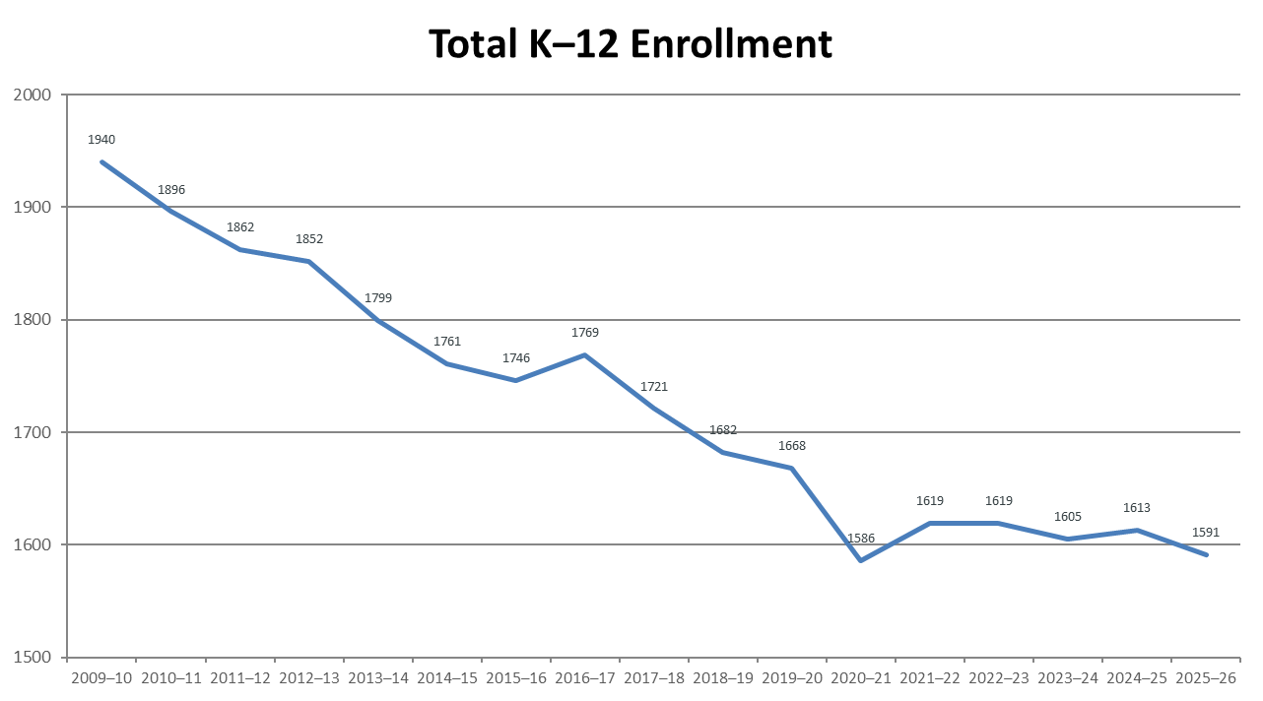
HUUSD K-12 Enrollment: 2009–10 to 2025–26
Total enrollment has declined by 349 students (18.0%) since 2009–10.
Overall Decline
18.0%
Representing 349 fewer students than the 2009–10 peak of 1,940.
Recent 10-Year Trend
-354
Net student decline from 2015–16 to 2025–26 (currently at 1,591).
Pattern: enrollment fell steadily through the 2010s, dropped notably in 2020–21, and has remained near 1,600 students since.

Slide 24
Enrollment Change by Campus: 2009–10 to 2025–26
Comparing campus-level shifts that contribute to the overall 18.0% district decline.
Campus | 2009–10 | 2025–26 | Enrollment Change | % Change
HUHS/MS | 780 | 604 | −176 | −22.6%
BPS | 343 | 285 | −58 | −16.9%
WAR | 148 | 93 | −55 | −37.2%
WES | 154 | 118 | −36 | −23.4%
FES | 112 | 91 | −21 | −18.8%
CBMS | 283 | 263 | −20 | −7.1%
MES | 120 | 137 | +17 | +14.2%
HUUSD Total | 1,940 | 1,591 | −349 | −18.0%
Only one campus (MES) saw positive growth, while others experienced declines of up to 37.2%.

Slide 25
Enrollment Summary & Projections
School Year | Grade K-12 | YOY Change +/- | School Year | Grade K-12 | YOY Change +/-
October 1, 2014 | 1761 | -38 | October 1, 2023 | 1605 | -14
October 1, 2015 | 1746 | -15 | October 1, 2024 | 1613 | +8
October 1, 2016 | 1769 | +23 | October 1, 2025 | 1591 | -22
October 1, 2017 | 1721 | -48 | October 1, 2026 | 1567 | -24
October 1, 2018 | 1682 | -39 | October 1, 2027 | 1539* | -22
October 1, 2019 | 1668 | -14 | October 1, 2028 | 1517* | -22
October 1, 2020 | 1586 | -82 | October 1, 2029 | 1495* | -22
October 1, 2021 | 1619 | +33 | October 1, 2030 | 1473* | -22
October 1, 2022 | 1619 | 0 | October 1, 2031 | 1451* | -22
* Based on the New England School Development Council (NESDEC) Enrollment Projection Report

Slide 26
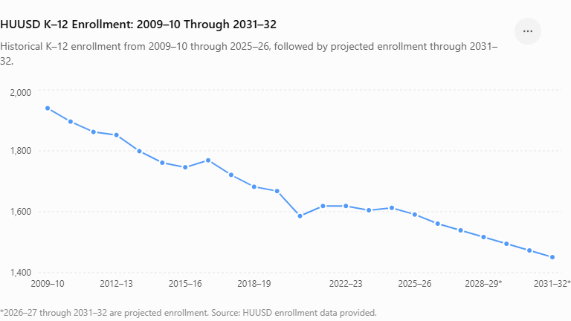
HUUSD K-12 Enrollment: 2009-10 to Projected 2031-32
An additional 140 - student projected decline from 2025-26 to 2031-32
-8.8%
Representing 349 fewer students than the 2009–10 peak of 1,940.
-489
Few students overall
From 2009-10 to the 2031-32 projection.
-25.2%
HUUSD Enrollment Has Declined 18% Since 2009-10 and Is Project to Decline Further

Slide 27

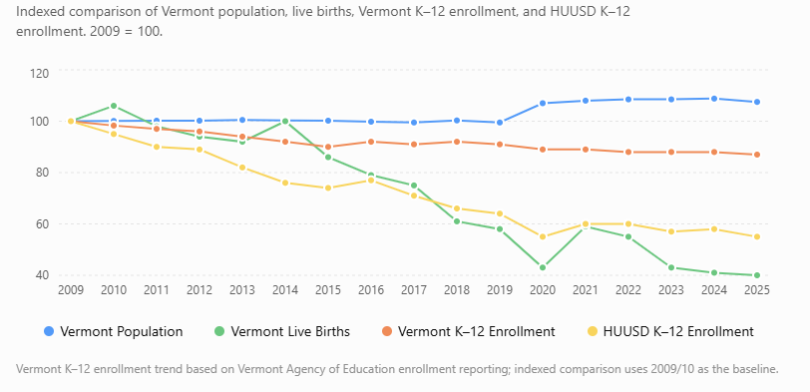
Vermont Demographic Trends & HUUSD Enrollment
Indexed to 2009 = 100 | Population, resident live births, and HUUSD K–12 enrollment
Key Trends
Vermont Population+3.2% (2009 to 2025)
Vermont Live Births-17.8% (2009 to 2024)
HUUSD Enrollment-18.0% (2009–10 to 2025–26)
Births have declined much faster than population, creating a smaller student pipeline.
*2025 Vermont birth data not yet included.
Sources: Vermont Department of Health, Vermont Vital Statistics Annual Report 2024; U.S. Census Bureau population estimates; HUUSD enrollment data.
Town births

Slide 28
Resident Births in HUUSD Communities
Historical live births in Duxbury, Fayston, Moretown, Waterbury, Warren, and Waitsfield (2020-2024)
Births by Town and Year
Key Observations
Waterbury Leads: Consistently records the highest birth numbers in the district, rising to 52 in 2024.
Declining Areas: Fayston and Warren saw notable decreases, dropping to just 4 and 1 births respectively in 2024.
Pipeline Impact: Highly localized birth variations directly influence future elementary school enrollment and class sizes.
Year | Fayston | Duxbury | Moretown | Waitsfield | Waterbury | Warren | Total
2026 | 7 | 10 | 9 | 9 | 34 | 4 | 73
2025 | 2 | 9 | 17 | 5 | 58 | 16 | 107
2024 | 4 | 14 | 23 | 13 | 52 | 1 | 107
2023 | 10 | 14 | 23 | 14 | 47 | 11 | 119
2022 | 7 | 8 | 21 | 13 | 41 | 8 | 98
2021 | 7 | 6 | 18 | 8 | 47 | 14 | 100
2020 | 10 | 8 | 18 | 10 | 43 | 6 | 95

Slide 29
Tracking Incoming PK to Graduates
Comparing resident birth cohorts with graduating senior class sizes to track long-term pipeline trends
Birth Year | Births | Grad Year | Seniors | Diff (+/-)
2020 | 95 | 2023 | 130 | -35
2021 | 100 | 2024 | 105 | -5
2022 | 98 | 2025 | 122 | -24
2023 | 119 | 2026 | 119 | 0
2024 | 107 | 2027 | — | —
2025 | 107 | 2028 | — | —
2026 | 73 | 2029 | — | —
Pipeline Analysis
Outflow Outpaces Inflow
Graduating classes have consistently been larger than incoming resident birth cohorts (average gap of ~16 students).
Future Enrollment Impact
As larger graduating classes leave the district, smaller incoming PK cohorts will create a net contraction in overall K–12 enrollment.
Key Takeaway
Planning must account for long-term class size structural adjustments across all campus levels.

Slide 30
How do we align our educational program, facilities, staffing, and resources with the number of students we are projected to serve?
THE CHALLENGE
What does this
mean for our
district?
STAFFING
How does declining enrollment affect staffing levels, class sizes, and the allocation of personnel across schools?
SEVEN CAMPUSES
What is the appropriate number and configuration of campuses to serve our projected student population?
FACILITIES
How should the district plan for buildings that may serve fewer students while continuing to carry fixed operating and maintenance costs?
BUDGET & AFFORDABILITY
How does maintaining our current structure affect the resources available for instruction and student services?
TRANSPORTATION
How do enrollment and geographic distribution affect routes, buses, travel times, and transportation costs?
STRATEGIC DIRECTIVE
Ensure absolute alignment of resources with enrollment realities to protect educational excellence.

Slide 31
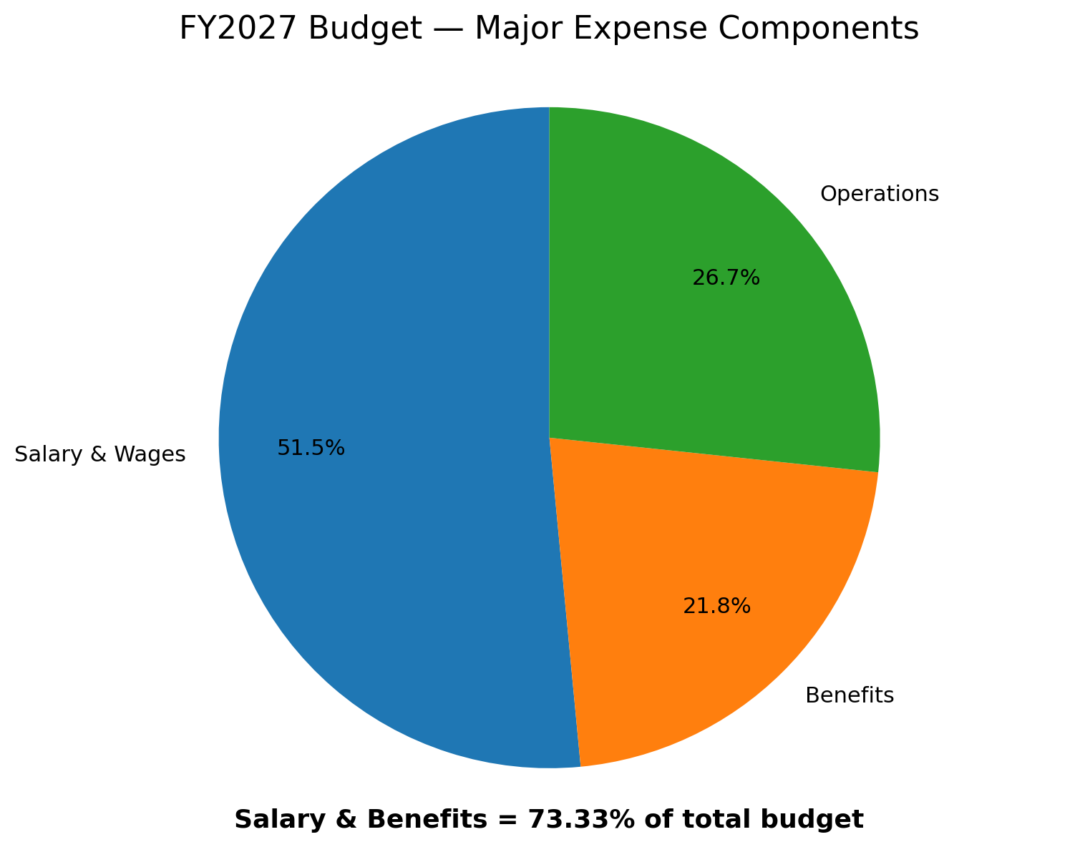
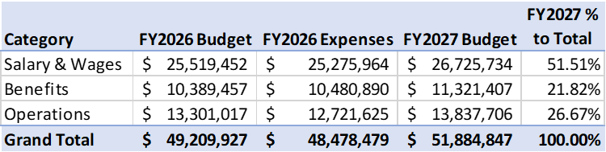
FY2027 Budget View
Nearly three-quarters of HUUSD budget is dedicated to salaries and employee benefits
Key Insights:
• Salary & Wages comprise the majority of the budget at 51.51%.
• Benefits make up 21.82%, leading to a combined 73.33% personnel investment.
Total FY2027 Proposed Budget: $51,884,847

Slide 32
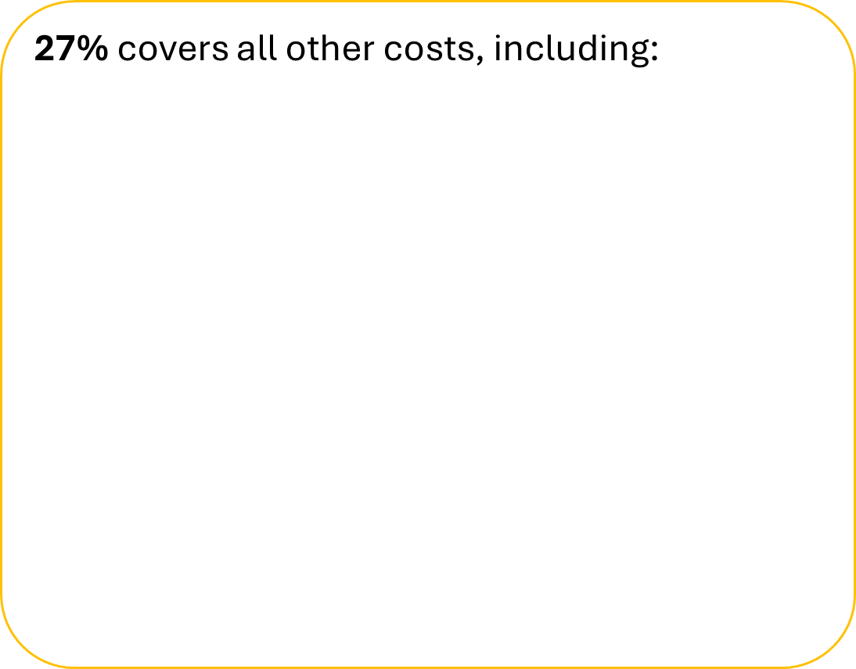
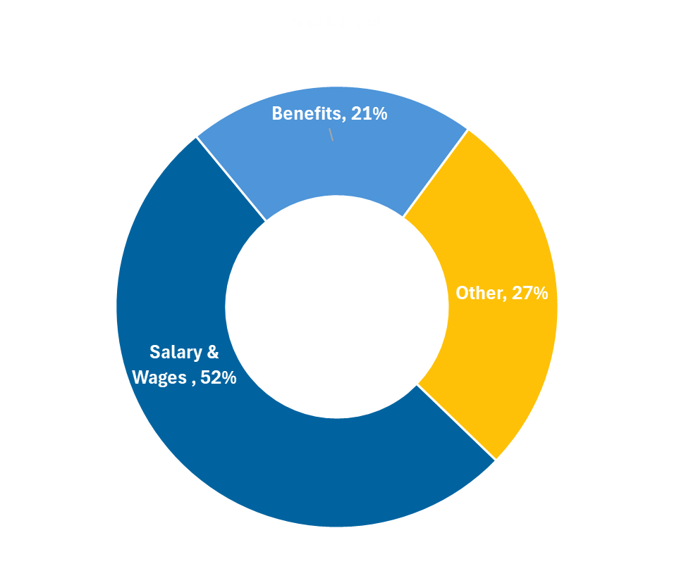
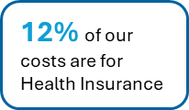
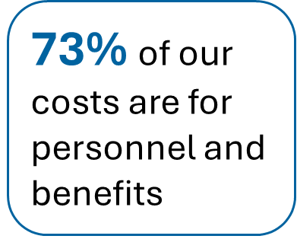
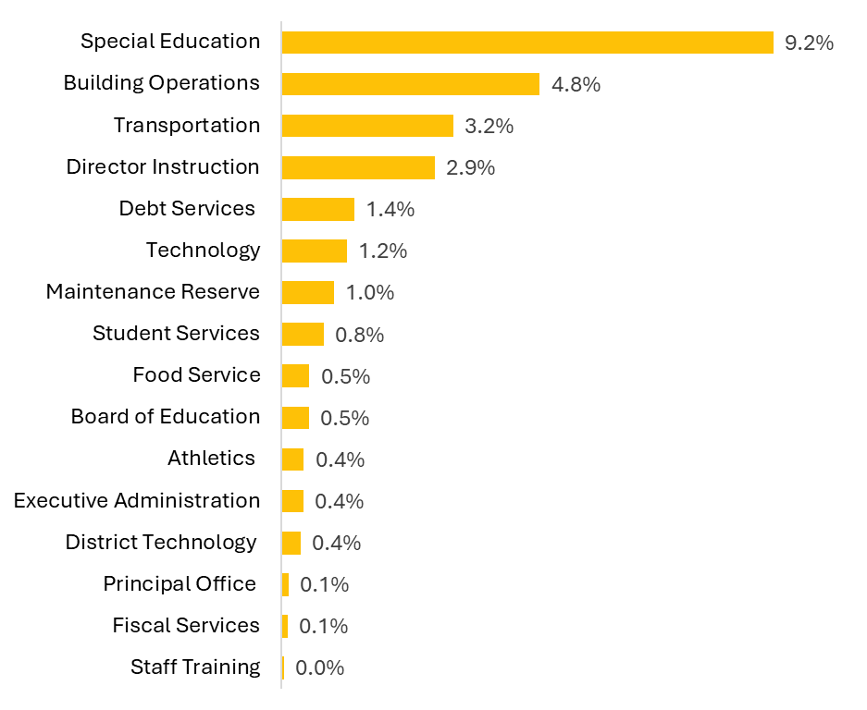
What is in our Budget

Slide 33

HUUSD – FY2027 School Budgets DISTRICT-WIDE SHOWN SEPARATELY
District-Wide Budget Highlight
Separated from individual school programs
$10,761,43720.7% of Total
Special Education: $5,114,708 (47.5%)
Salary & Wages: $1,899,090(17.6%)
Operations & Maintenance: $1,269,265 (11.8%)
Transportation: $1,132,558 (10.5%)
Employee Benefits: $845,827 (7.8%)
Maintenance Reserve: $500,000 (4.6%)
School / Program | Total Budget | % of Total
HUHS | $14,765,337 | 28.5%
Brookside Primary | $7,813,070 | 15.0%
CBMS | $6,490,488 | 12.5%
Moretown Elementary | $3,233,280 | 6.2%
Waitsfield Elementary | $2,990,160 | 5.8%
Warren Elementary | $2,883,758 | 5.6%
Fayston Elementary | $2,947,318 | 5.7%
School Programs Total | $41,123,410 | 79.3%
Total Budget by Expense Type
Overall FY2027 Budget: $51,884,847
Salary & Wages$26,725,734 (51.51%)
Employee Benefits$11,321,407 (21.82%)
Operations$13,837,706 (26.67%)
Personnel Investment: Salaries & Benefits make up 73.33% of the total budget.

Slide 34
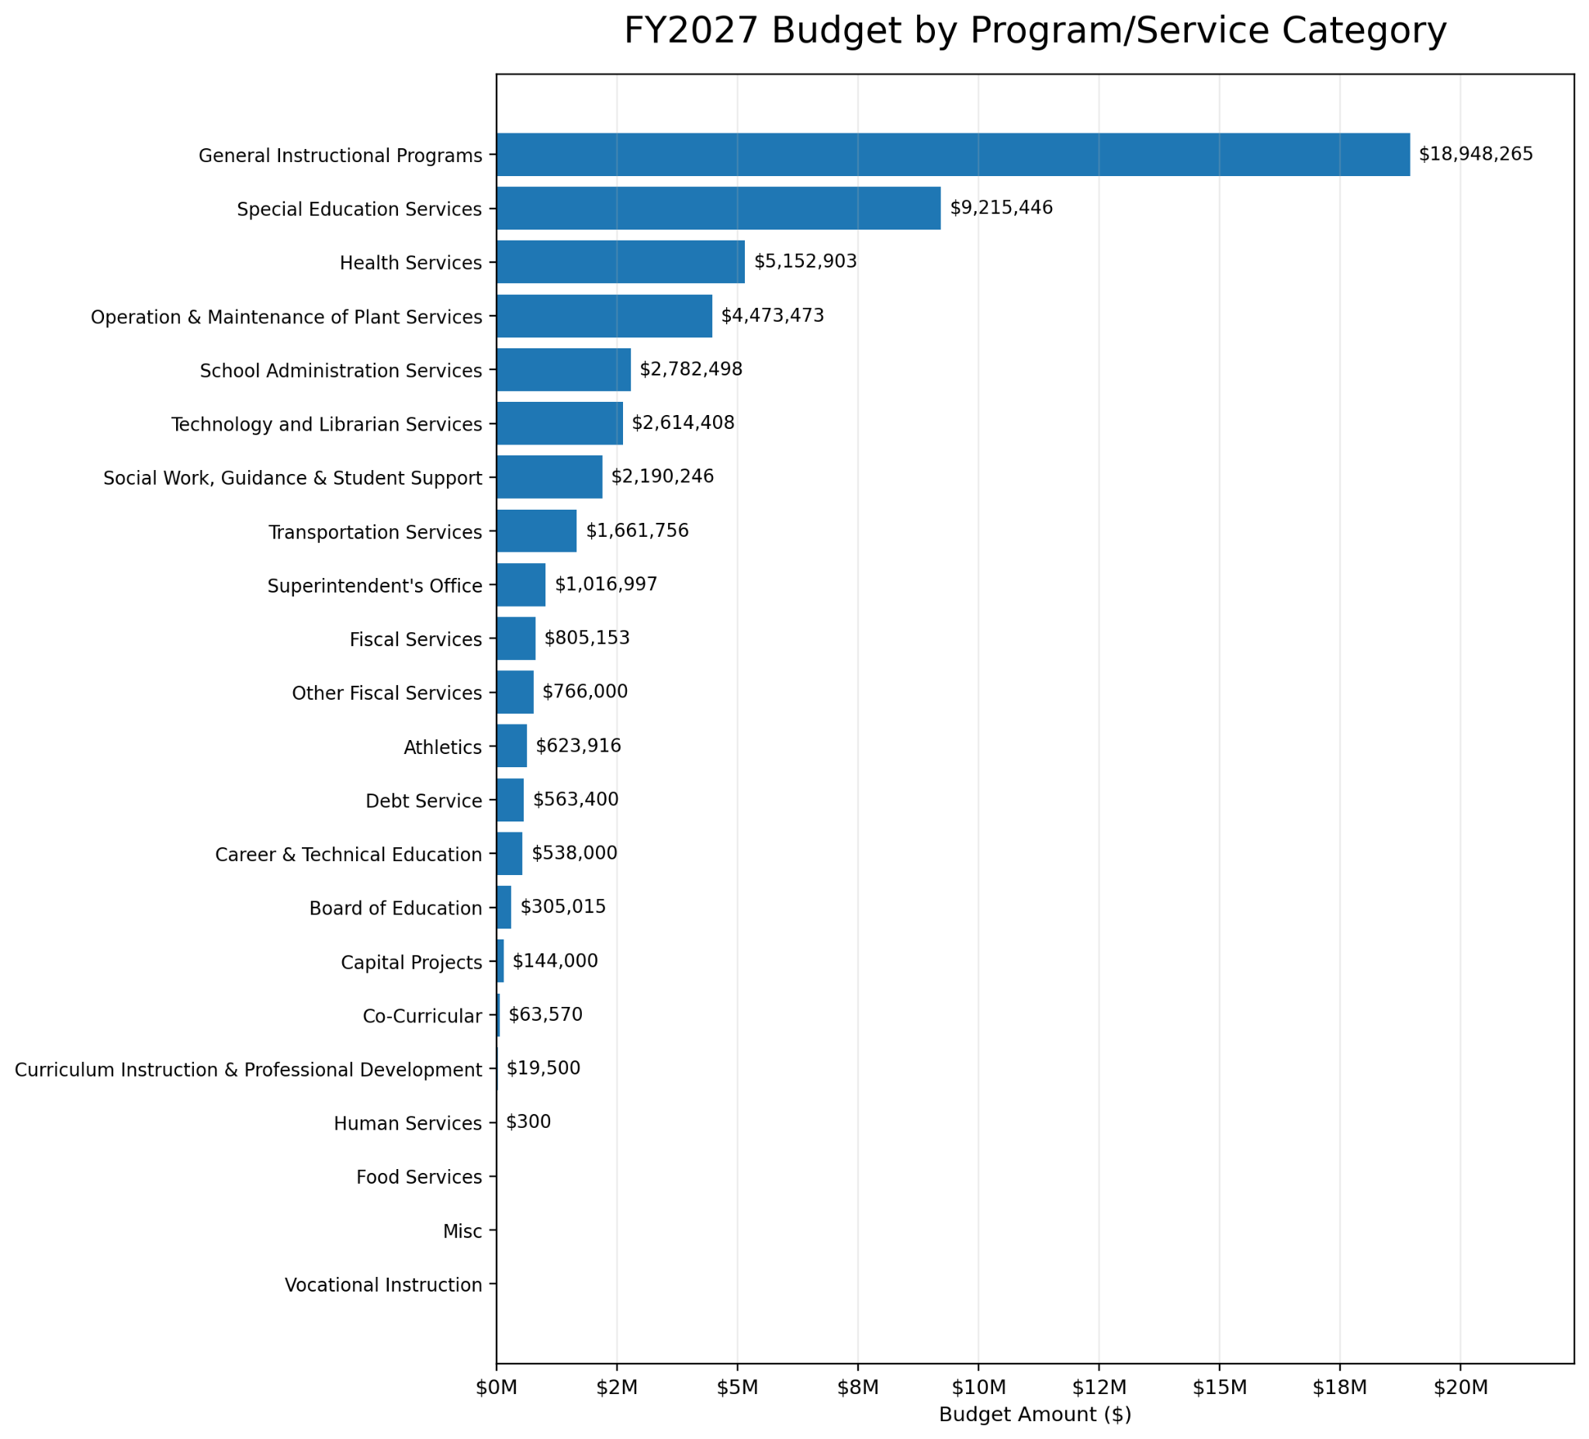
FY2027 Total Budget
Key Programs
General Instructional Programs | $18.95M
Special Education Services | $9.22M
Health Services | $5.15M
Operation & Maintenance | $4.47M
School Administration | $2.78M
Technology & Librarian Services | $2.61M
Student Support Services | $2.19M

Slide 35


Slide 36
Inflation Over the Years & Projected Future Rates
Historical inflation figures (2022–2026) alongside estimated projections through 2031
HISTORICAL RATES
PROJECTED ESTIMATES (EST.)
2022
6.5%
2023
3.4%
2024
2.9%
2025
2.7%
2026
2.8%
2027
(Est.)
2.4%
2028
(Est.)
2.7%
2029
(Est.)
2.6%
2030
(Est.)
2.5%
2031
(Est.)
2.5%
Key Takeaway: Inflation peaked at 6.5% in 2022 and is projected to stabilize between 2.4% and 2.7% long-term.
Notes:
Sean:

Slide 37
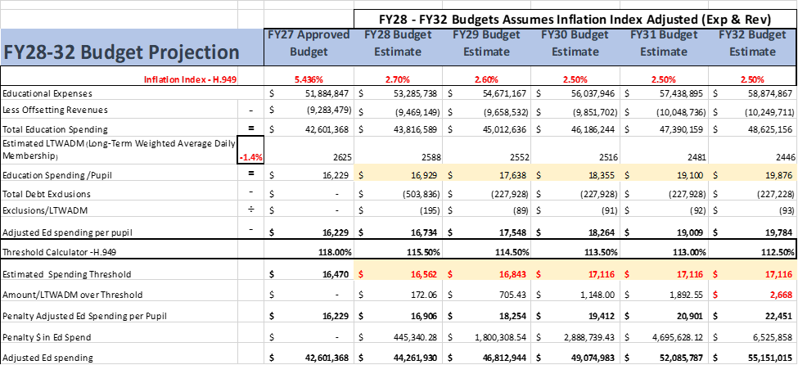

Slide 38
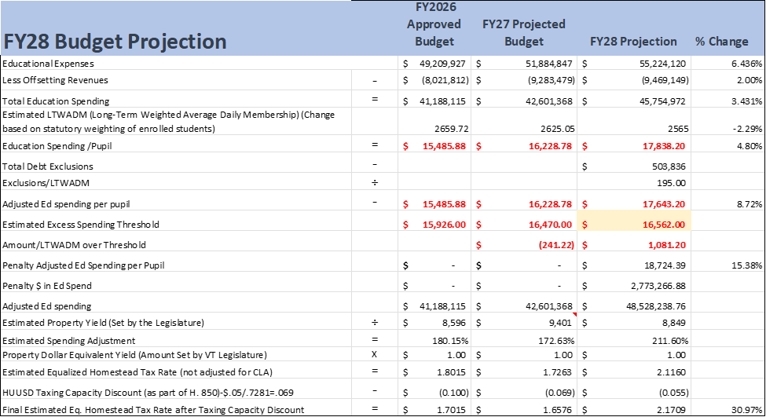

Slide 39
$51.9 million
Fiscal Year 2027 Approved Budget

Slide 40
$55.2 million
Fiscal Year 2028 Projected Budget

Slide 41
6.4%
Year over Year Projected Increase

Slide 42
$18,714
Projected Cost Per Pupil
$1,071 over the excess spending threshold

Slide 43
$2.7 million
Projected Spending Penalty

Slide 44

Preliminary Major Cost Drivers
FY27 to FY28 | Ranked by Dollar Increase
1.
District Wide Salaries
Negotiated agreements for Teachers, Support Staff and for non-unioned support staff
$2,114,801 7.8%
2.
Health Care Costs
HUUSD SCHOOL DISTRICT
$675,624 10%
3.
SPECIAL EDUCATION Costs (K-12)
# of IEP’s, increased costs
$407,122 8.0%
4.
Transportation (General Ed )
Rural community, limited options, alternative placements transportation, homeless transportation
$141,727 8.0%
Estimated increase: $3,339,273
6.436% overall growth

Slide 45
Preliminary FY28 HUUSD Budget
 | FY28 Proposed Budget | FY27 Budget | Difference | FY28 ESTIMATED HUUSD Homestead Tax Rate Increase
Total Budget | $55,224,120 | $51,884,847 | $3,339,273 | 6.436%
% Change
Education Spending Per LTW ADM | $17,623 | $16,229 | $1,395 | 8.59%

Slide 46

HUUSD Budget Growth
Approved Budgets through FY2027 • FY2028* projected
Budget Growth
FY2023 Budget
$42.66M
FY2027 Approved
$51.88M
FY2028 Projected
$55.22M
Overall Increase
+$12.57M
+29.5% Growth
55.0M
50.0M
45.0M
40.0M
FY2023
FY2024
FY2025
FY2026
FY2027
FY2028*
Year-over-Year Increase: 5.60% (FY24) • 6.50% (FY25) • 5.40% (FY26) • 2.75% (FY27) • 5.43% (FY28*) • 6.43% projected overall
Source: HUUSD budget data provided. *FY2028 is projected.

Slide 47
How did we get here?
Key historical and structural factors limiting the District's financial flexibility
Spending Threshold Limits
The last ten years of operating near the excess spending threshold have limited the District's financial flexibility.
Rising Cost of Education
The cost of education has continued to increase, particularly salaries, health insurance, transportation, facilities, and other operating costs.
External Cost Pressures
Many cost increases are outside the District's direct control, while opportunities to reduce costs without affecting students have become increasingly limited.
Significant Prior Reductions
HUUSD has already made significant reductions—approximately $7.2 million over three years and more than 53 positions.
Enrollment & Campus Infrastructure
Enrollment has declined and shifted among our communities, but the District continues to operate seven campus’ with substantial fixed costs.
Incremental reductions alone are no longer sufficient to address the underlying structural pressures.

Slide 48
What have we done to reduce expenses?
Summary of district financial and staffing adjustments over the past 3 years
Financial Impact
$7.2 M
Reduction in Expenses
Achieved over the last 3 fiscal years through operational, program, and service efficiency adjustments.
Personnel Impact
~53
Staff Positions Reduced
Reductions across classroom teachers, administrative leadership, interventionists, nurses and support staff.
Strategic Multi-Year Expense Management
Reductions were executed across consecutive budget cycles, targeting administrative efficiencies, program adjustments, class consolidation, and operational route optimizations.

Slide 49
Average Salary & Benefits
Position compensation analysis and targeted reductions to meet budget goals
Role / Position Avg. Salary & Benefits Positions to Cut
Reduction Planning
Target reductions depend on required expenditure targets across departments.
HIGHEST AVERAGE COST
$135,000
Teachers
LOWEST AVERAGE COST
$78,500
Food Service
Teachers $135,000 ?
Technology $119,400 ?
Custodian $106,500 ?
Administrative Assistant $93,400 ?
Instructional Assistant $80,250 ?
Food Service $78,500 ?

Slide 50
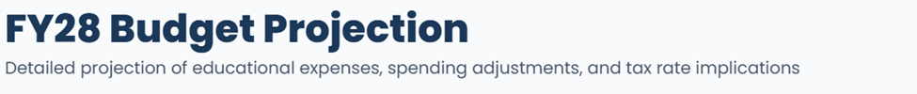
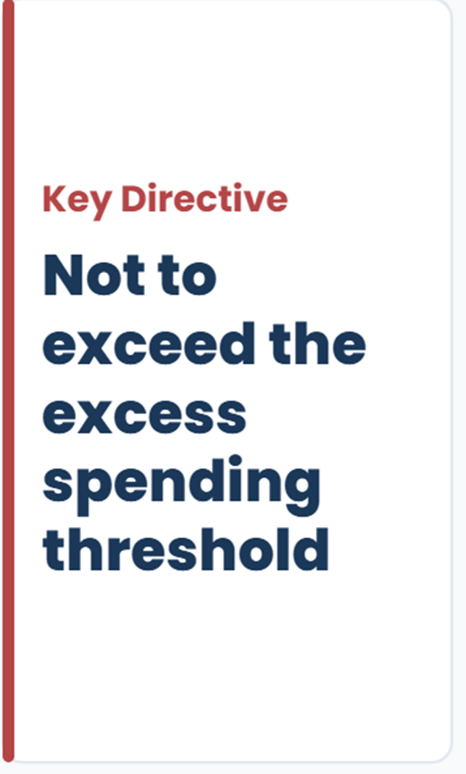
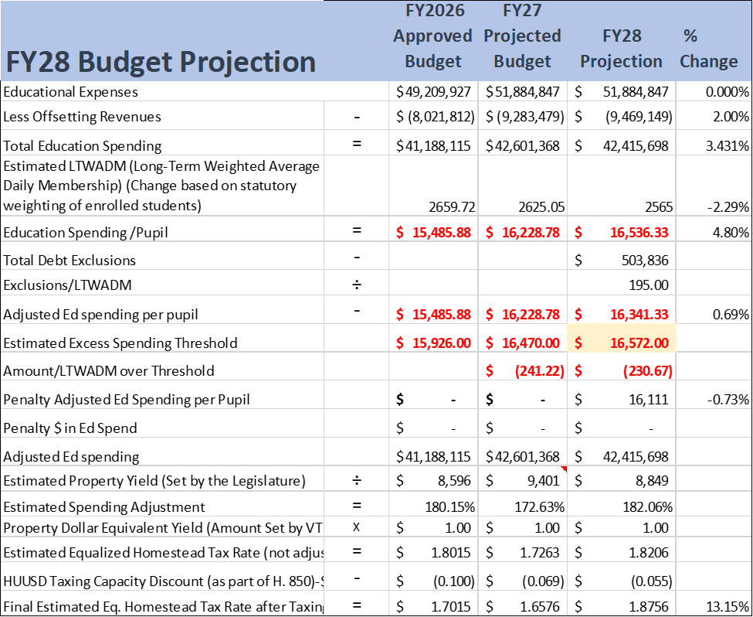
Requirement
Minimum $3.3M Cut
Required to stay under the spending threshold

Slide 51
Proposed Budget Impacts
Proposed Budget | Cost per Pupil | Excess over/(under) spending threshold | Penalty to Education Spending | Year over Year Increase % | Reduction in Expenses
$55.2M | $18,714 | $1,071 | $2.7M | 6.435% | (0)
$54.2M | $17,934 | $681 | $1.74M | 4.50% | ($1.0M)
$53.3M | $16,906 | $172 | $445K | 2.70% *(Projected Inflation) | ($1.9M)
$52.8M | $16,838 | $133 | $242K | 1.8% | ($2.7M)
$51.9M | $16,341 | ($221) | 0 | 0% | ($3.3M)

Slide 52
Board Priorities & Directions
Evaluating budget pathways and structural options for the upcoming fiscal year
Option A: Not to Exceed Spending Threshold
Would require -$3.3M Reduction in expenses
Option B: Alternative Path
Program Reductions
Transportation
Extra-Curricular
Field trips
Exceeds Spending Threshold
This direction represents the scenario where budget requirements exceed the state-mandated spending threshold to protect current educational programming levels.
Short-Term Considerations
Middle School consolidation
School Closure(s)
Efficencies of Scale
Long-Term Considerations
Long-term facility master planning
Consolidation
Structural realignment and footprint optimization

Slide 53

HARWOOD UNIFIED UNION SCHOOL DISTRICT

Slide 54

Questions
HARWOOD UNIFIED
UNION
SCHOOL DISTRICT

