Slide 1
Crypto Alert App
By Aditya Kumar

Slide 2


Uses
Crypto users often find themselves checking the prices of cryptocurrencies they have invested in or want to invest in.
This may be because they want to see if the coin is at a price worth selling/buying.
This alert application eliminates the need to check prices often.
Whenever a currency reaches the amount inputted by the user, they get a e-mail notification.

Slide 3
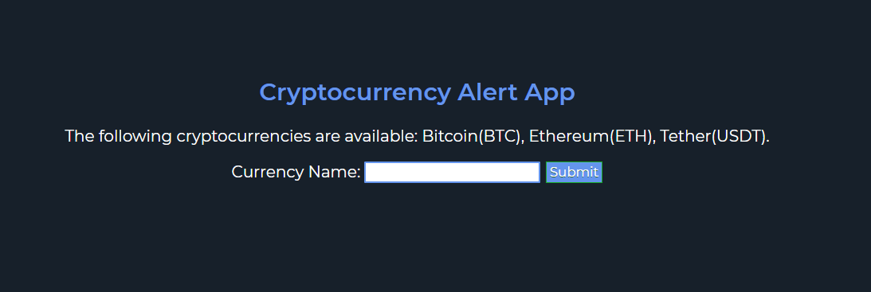
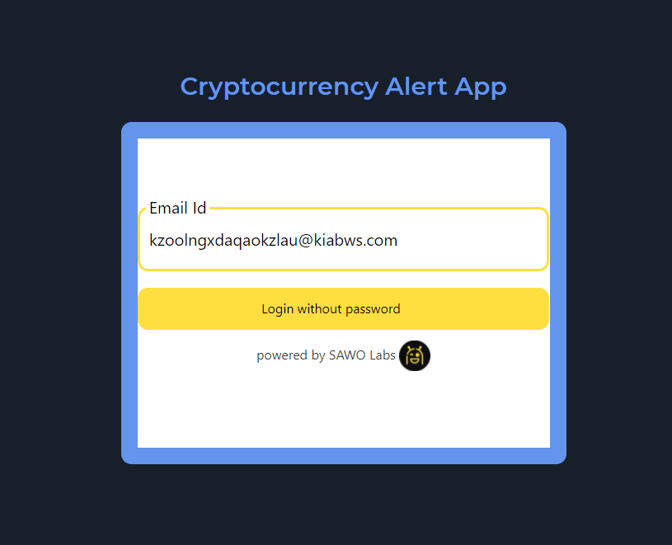
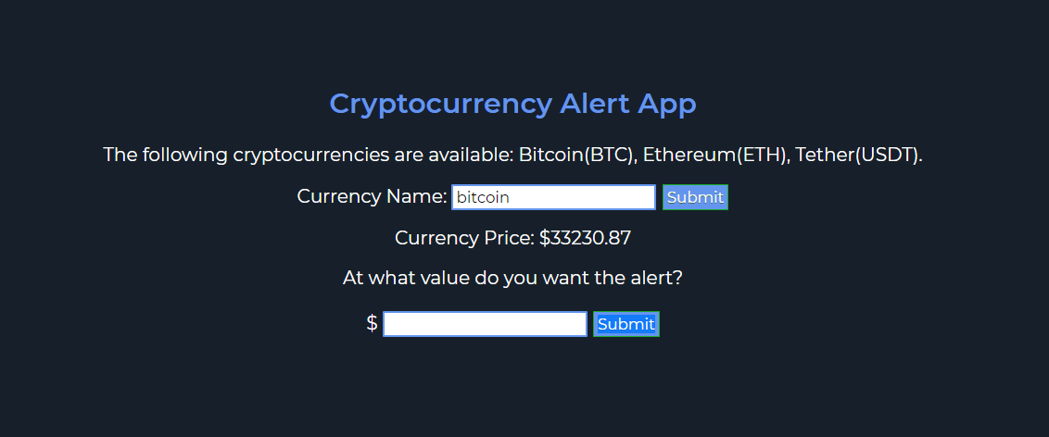
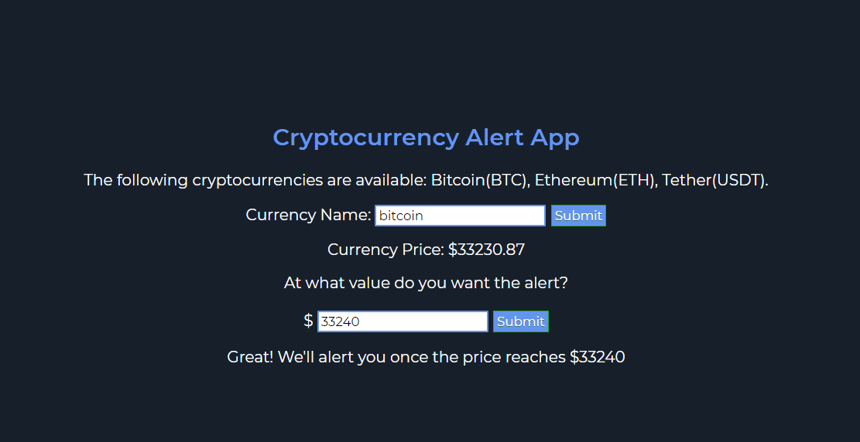
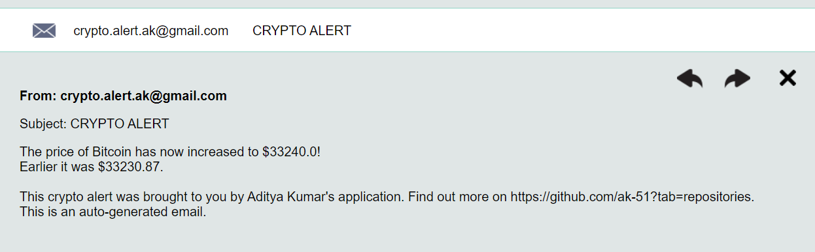
Showcase
In the beginning, SAWO Labs’ Auth API is used to authenticate the user.
The user inputs his e-mail ID and receives an OTP in the e-mail, which is inputted back in the site.
Now the user can choose from three coins – Bitcoin, Ethereum and Tether.
The current price of the coin is given and the user can choose at what value he wants to receive an alert.
Once the coin reaches that value, an alert is sent to the user’s e-mail ID.

Slide 4
How it was built
React Frontend
Node Backend
This projects uses React, Nodejs, Express, Python and SAWO Labs’ Authentication API.
The React sends the data given by the user to the back-end(Nodejs and Express) which then sends the data to a Python Script.
The libraries available in Python were substantially better compared to the ones offered in JavaScript when it came to getting cryptocurrency data and sending auto-generated e-mails. Due to this I chose Python for handling the e-mail service.
The auto-generated e-mails were sent using a Python library called smptlib which was quick and excellent for my purpose.
Python Script
Alert to User

Slide 5
Thank You

