Slide 1

project on
DTMF controlled robot
By:
Akanksha Bindal2K12/CO/008
Yamini Sharma 2K12/EC/195

Slide 2


What is a robot ?
A reprogrammable, multifunctional manipulator designed to move parts, tools or specialized devices through various programmed motions .

Slide 3
A robot must have the following essential characteristics:
Mobility: It possesses some form of mobility.
Programmability: It can be programmed to
accomplish a large variety of tasks. After
being programmed, it operates automatically.
Sensors: On or around the device that are able to
sense the environment and give useful feedback
to the device.
Mechanical capability: Enabling it to act on its
environment rather than merely function as a data
processing or computational device (a robot is a
machine); and
Flexibility: It can operate using a range of
programs and manipulates in a variety of ways.

Slide 4
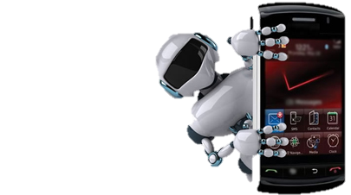
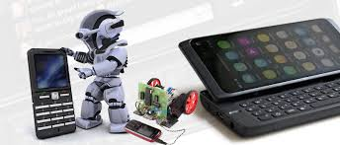
Aim
In this project we aim to design a robot that uses DTMF technology to perform motion

Slide 5

DTMF
Dual-tone multi-frequency signalling (DTMF) is used for telecommunication signalling over analog telephone lines in the voice-frequency band between telephone handsets and other communications devices and the switching centre. The version of DTMF that is used in push-button telephones for tone dialling is known as Touch-Tone.
Multi-frequency signalling (see also MF) is a group of signalling methods that use a mixture of two pure tone (pure sine wave) sounds.

Slide 6
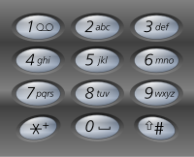
DTMF telephone keypad
The contemporary keypad is laid out in a 4×3 grid, although the original DTMF system in the new keypad had an additional column for four now-defunct menu selector keys. Most keypads have a star key or asterisk key on the bottom left and a hash key on the bottom right.
When used to dial a telephone number, pressing a single key will produce a dual-tone multi-frequency signalling pitch consisting of two simultaneous pure tone sinusoidal frequencies. The row in which the key appears determines the low frequency, and the column determines the high frequency. For example, pressing the '1' key will result in a sound composed of both a 697 and a 1209 hertz (Hz) tone.

Slide 7
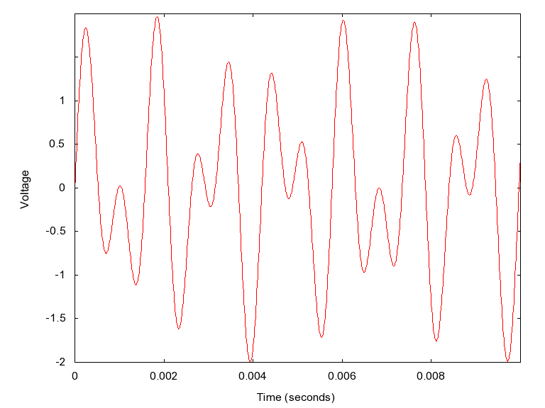


DTMF keypad frequencies
 | 1209 Hz | 1336 Hz | 1477 Hz | 1633 Hz
697 Hz | 1 | 2 | 3 | A
770 Hz | 4 | 5 | 6 | B
852 Hz | 7 | 8 | 9 | C
941 Hz | * | 0 | # | D
1209 Hz on 697 Hz to make the 1 tone

Slide 8

Why two tones in DTMF ?
There is always a possibility that a random sound will be on the similar frequency which will trip up the DTMF sounds system. It was recommended that if two tones were used to represent a digit, the probability of a false signal happening is ruled out, thus the name ‘Dual Tone’. This is the basis of using dual tone in DTMF communication.

Slide 9

Dtmf decoding
The circuit uses M-8870 DTMF decoder IC which decodes tone generated by the keypad of cell phone.
The decoder distinguishes the DTMF tones and produces the binary sequence equivalent to key pressed in a DTMF (Dual Tone Multi Frequency) keypad.
The signals from the microphone wire are processed by the DTMF decoder IC which generates an equivalent binary sequence as a parallel output like D3, D2, D1, and D0.

Slide 10
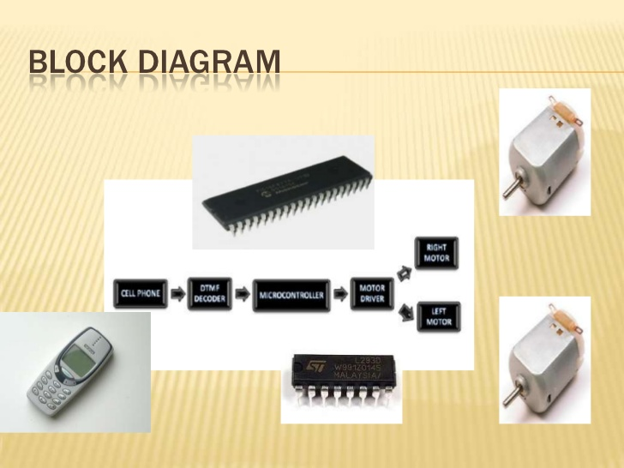

Slide 11
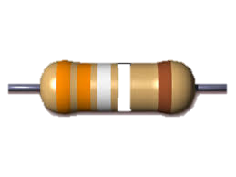
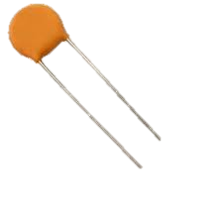
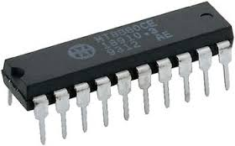
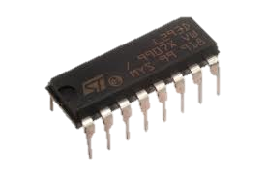
Components used:
Resistors
Capacitors
IC MT8870 (DTMF Decoder)
L293D (Motor H-bridge)
Atmega 16 (40 pin Microcontroller)

Slide 12
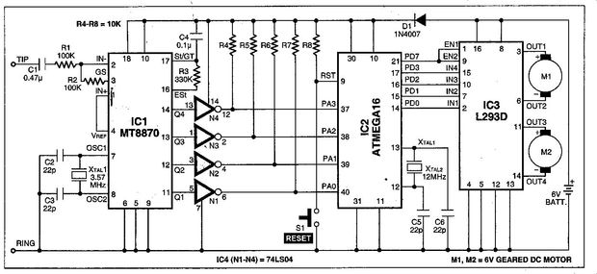
Circuit Diagram

Slide 13
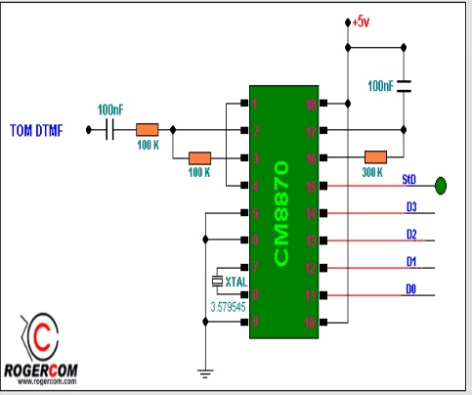
DTMF decoder IC

Slide 14
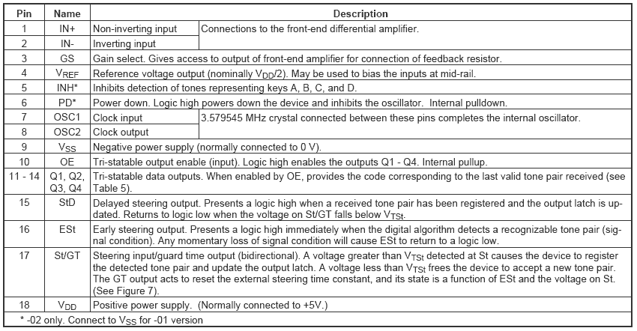
PIN DESCRIPTION

Slide 15
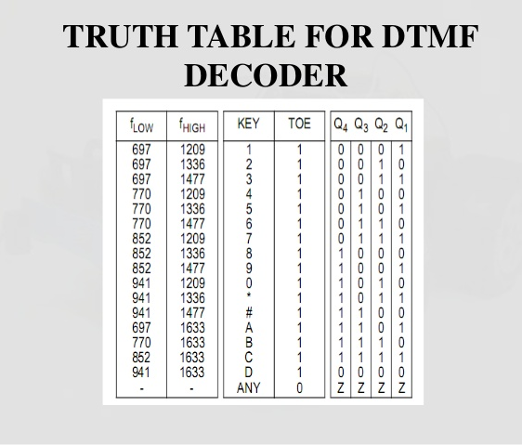

Slide 16
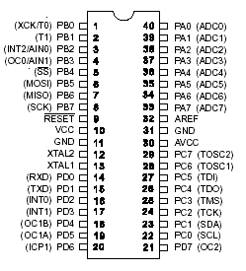
ATMEGA 16 datasheet

Slide 17
L293D
L293D contains two inbuilt H-bridge driver circuits. In its common mode of operation, two DC motors can be driven simultaneously, both in forward and reverse direction. The motor operations of two motors can be controlled by input logic at pins 2 & 7 and 10 & 15. Input logic 00 or 11 will stop the corresponding motor. Logic 01 and 10 will rotate it in clockwise and anticlockwise directions, respectively.
Enable pins 1 and 9 (corresponding to the two motors) must be high for motors to start operating. When an enable input is high, the associated driver gets enabled. As a result, the outputs become active and work in phase with their inputs. Similarly, when the enable input is low, that driver is disabled, and their outputs are off and in the high-impedance state.

Slide 18
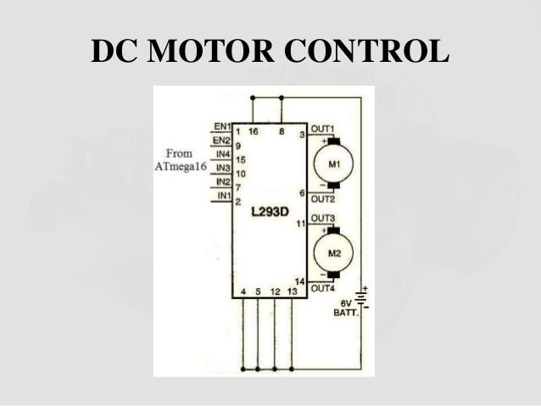
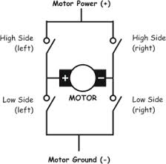
PIN
description
H bridge

Slide 19
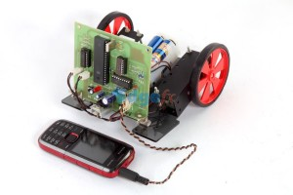
Final design

Slide 20
Avr studios -4 code
#include<avr/io.h>
void main()
{
int s=0;
DDRA=0b00000000;
DDRC=0b11111111;
while(1)
{
s=PINA&0b11110000;
if(s==0b00100000) //2
PORTC=0b10010000;
else if(s==0b01000000) //4
PORTC=0b10000000;
else if(s==0b01010000)//5
PORTC=0b00000000;
else if(s==0b01100000) //6
PORTC=0b00010000;
else if(s==0b10000000)//8
PORTC=0b01100000;
}
}

Slide 21
Action performed corresponding to the key pressed
Key pressed | Output of mt8870 decoder IC(D3D2D1D0) | Input to microcontroller (PIN A) | Output of microcontroller (PIN C) | Action of motors
2 | 0010 | 00100000 | 10010000 | forward
4 | 0100 | 01000000 | 10000000 | left
5 | 1010 | 10100000 | 00000000 | stop
6 | 0110 | 01100000 | 01100000 | right
8 | 1000 | 10000000 | 01100000 | backward

Slide 22
Advantages :
Wireless control
Makes use of mobile technology which present almost everywhere.
Surveillance system
DISADVANTAGES :
Mobile phone batteries drain out
Cost of project increases if cell phone cost
is included

Slide 23
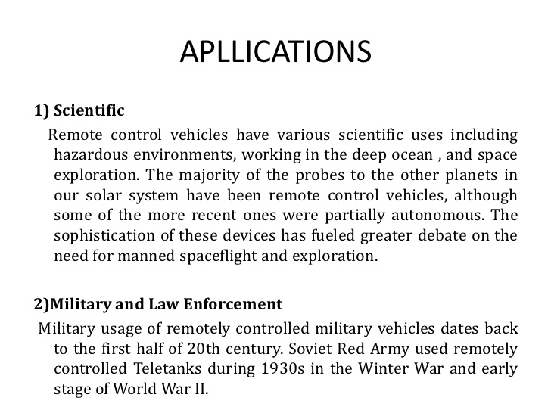
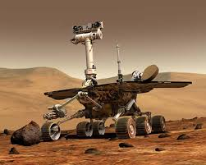
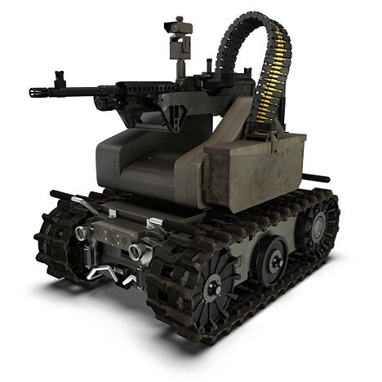

Slide 24
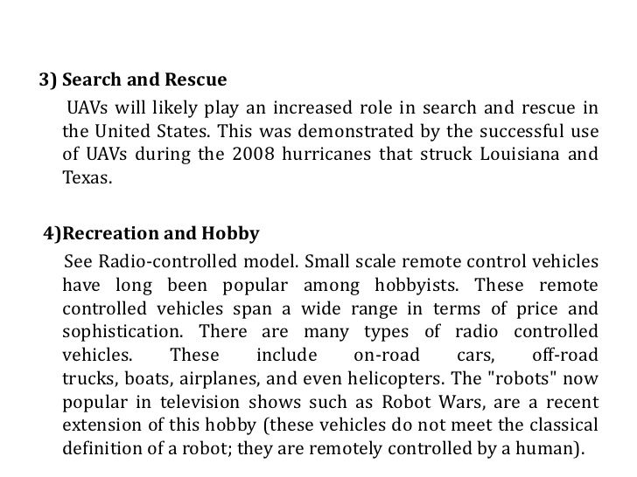
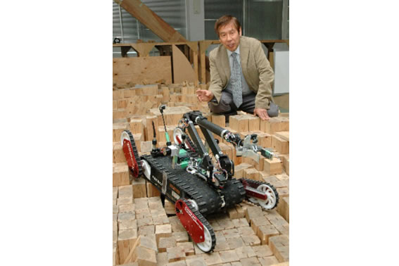
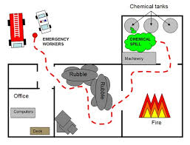

Slide 25
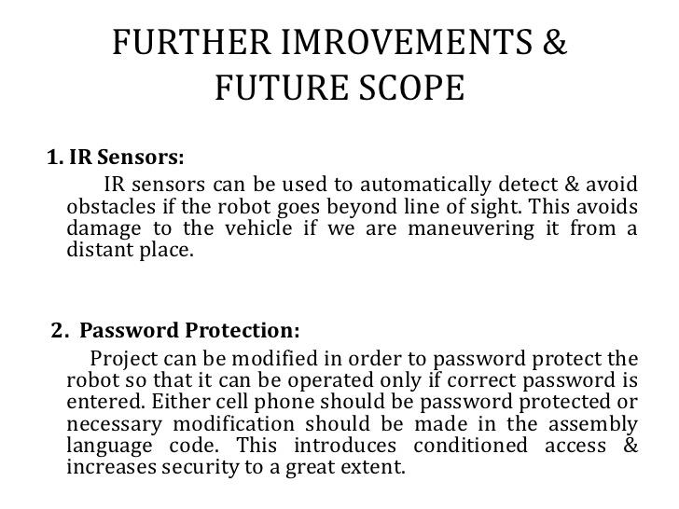

Slide 26
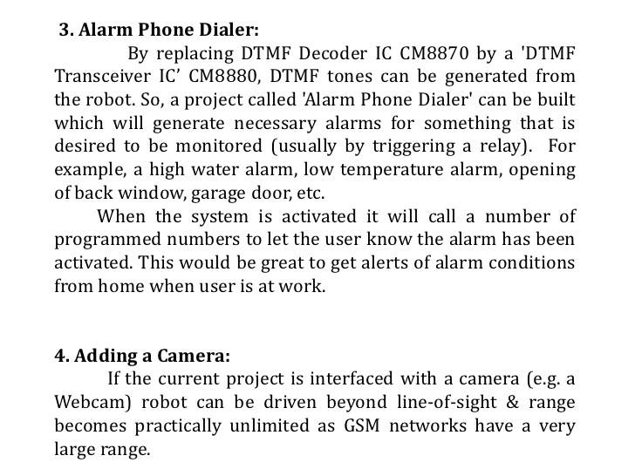
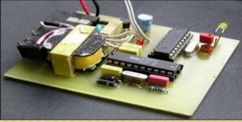
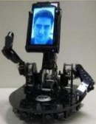

Slide 27
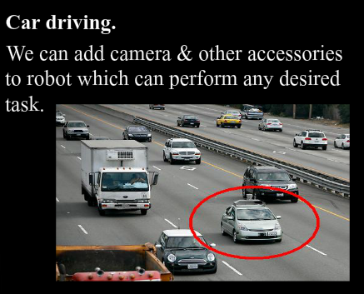
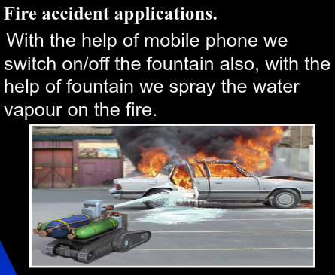

Slide 28
CONCLUSION
Thus we see that DTMF technology is easy to apply. The level of sophistication incorporated in this project is not high . Various peripherals can be added so as to cover a broad range of applications. It is up to us on how we extract and exploit this technology for the betterment of society.

