Slide 1
Flickr8k Image Captioning
Final Presentation Week 1–Week 4
ResNet50 Encoder + LSTM Decoder + Streamlit App
Deep Learning
Computer Vision
NLP
Goal: generate a short natural language caption from an uploaded image.
Flickr8k Image Captioning · 1/8

Slide 2
Problem and Solution
Why image captioning is a multimodal deep learning task
Problem
Solution
Computers can detect visual patterns, but they cannot describe an image in human language without a trained model.
Use a CNN encoder to extract visual features, then use an LSTM decoder to generate a caption word by word.
The model must connect two different data types: images and text.
CNN Encoder → LSTM Decoder
Image → 2048-D vector → “a man in…”
Flickr8k Image Captioning · 2/8

Slide 3
Dataset: Flickr8k
Images with human-written captions
40,455
8,091
≈5
image → text
caption rows
unique images
captions per image
task type
What the data contains
Why split by image name?
• image file name
• human-written caption
• multiple captions for the same image
• natural everyday scenes
Captions for the same image must not appear in both training and testing. This prevents data leakage and makes evaluation fair.
Train 80% · Validation 10% · Test 10%
Flickr8k Image Captioning · 3/8

Slide 4
Week 1–2: EDA, Preprocessing and Baseline
From raw captions to the first CNN-LSTM model
Week 1: EDA
Preprocessing
Baseline
• loaded captions file
• checked dataset shape
• analyzed caption length
• displayed images with captions
• lowercase text
• remove punctuation
• add <start> and <end>
• build vocabulary
• pad sequences
VGG16 + LSTM
First working captioning pipeline. It gave a comparison point for the improved model.
Flickr8k Image Captioning · 4/8

Slide 5
Week 3: Improved ResNet50 + LSTM Model
A stronger encoder and better training settings
Model architecture
Model settings
Input image
Model Feature LR Dropout
ResNet50 encoder
VGG16 + LSTM 4096 0.001 0.0
ResNet50 + LSTM 2048 0.0005 0.3
2048-D features
ResNet50 was selected because it is deeper and stronger than VGG16. Dropout was added to reduce overfitting risk, and a smaller learning rate was used for more stable training.
LSTM decoder
Generated caption
Flickr8k Image Captioning · 5/8

Slide 6
Outputs and Results
What the project produced after training and testing
Training outputs
Saved artifacts
Final app output
• train loss
• validation loss
• BLEU-1 and BLEU-2
• good / bad caption examples
resnet50_lstm_captioner.pt
“A man in a black shirt is a”
trained model checkpoint
vocab.json
word-to-index and index-to-word mappings
The caption is incomplete, but it proves the full pipeline works.
Interpretation
Loss shows learning progress, while BLEU and examples show caption quality.
These files allow the app to run inference without retraining.
Flickr8k Image Captioning · 6/8

Slide 7
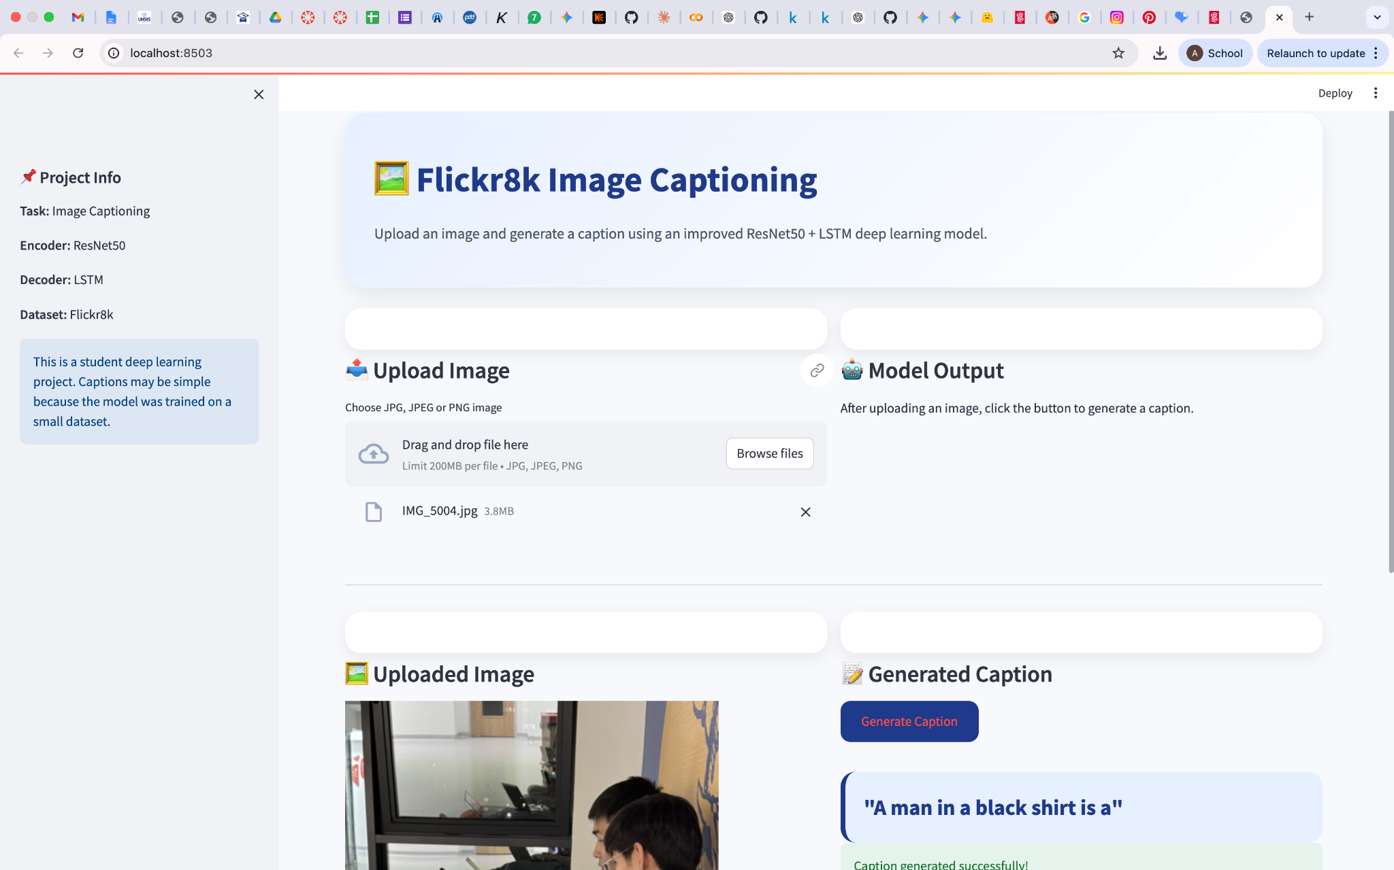
Week 4: Streamlit Mini Application
Interactive prototype for testing uploaded images
App features
• upload JPG, JPEG or PNG
• resize image to 224×224
• extract features with ResNet50
• generate caption with LSTM
• show the result in browser
Inference pipeline
uploaded image → preprocessing → ResNet50 → LSTM → caption
Flickr8k Image Captioning · 7/8

Slide 8
Conclusion and Future Work
Main outcome of the Week 1–Week 4 project
Final conclusion
Future work
The project completed the full deep learning pipeline: dataset loading, EDA, preprocessing, baseline model, improved model, evaluation, artifact saving and Streamlit deployment.
• train for more epochs
• use beam search instead of greedy decoding
• add attention mechanism
• test larger datasets like Flickr30k or MS COCO
• try Transformer-based captioning models
Main achievement
A working prototype that generates captions from uploaded images.
Key message
The result is not perfect, but it clearly demonstrates transfer learning, sequence modeling and deployment.
Flickr8k Image Captioning · 8/8

