Slide 1


Version Control with Git
Alaska INBRE is an Institutional Development Award (IDeA) from the National Institute of General Medical Sciences of the National Institute of Health (NIH) under grant number P20GM103395.

Slide 2
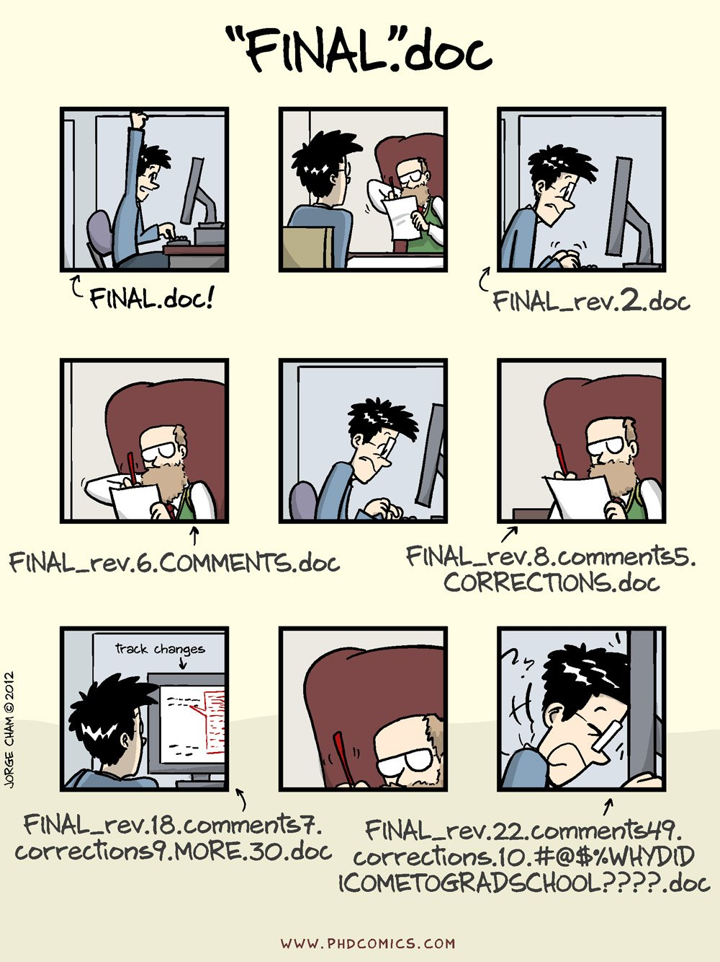
Version control helps avoid this →

Slide 3

What is Version Control?
Practice of controlling, organizing, and tracking different versions of computer files
Allows you to revert to specific versions later
Essential for software development, but useful for any evolving digital work (manuscripts, data, etc.)
“Ctrl+Z” on steroids, with a complete history

Slide 4
Version Control with Git
Developed in 2005 by Linus Torvalds, the creator of Linux
Every developer has a full copy of the repository
With a full history of all changes made to files in the repository!
Widely used in the industry and academia
Open source and free!
Notes:
How does Git do this?
Explanation: You start by making changes to your files.
Next, you choose which of those changes you want to include in your next save point. Think of this as selecting the important updates.
Then, you create a permanent snapshot of those selected changes, along with a message explaining what you did. This is like hitting "save" with a detailed note.
Finally, if you're working with others, you'll share your saved snapshots with a central location.
A simple flowchart illustrating the stages: "Your Files (Working)" -> "Preparing Changes" -> "Saving a Snapshot" -> "(Sharing if needed)". Use descriptive icons for each stage.

Slide 5
How does Git do this?
Working Directory: Local files you see and edit
Staging Area: A temporary area to prepare changes for the next commit
Repository (.git directory): The hidden folder where Git stores all the history and metadata for your project
Github Repository: A remote repository where you can push your committed data for sharing, collaborating, showcasing skills

Slide 6
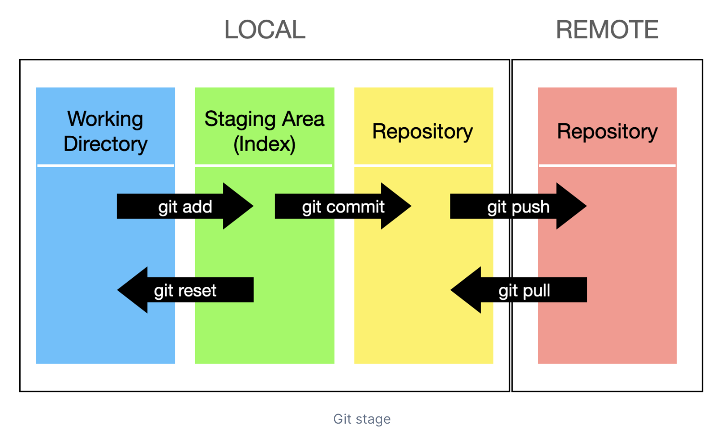
How do these structures interact?

Slide 7
Github!
Web-based platform built around Git
A remote location for your tracked files
Allows teams to collaborate on code, track changes, and revert to previous versions
Beyond Version Control: Also used for documentation, project management, and hosting websites (GitHub Pages)
Notes:
Part of Git’s infrastructure is something called branching and merging. Let’s say you are developing a new feature of a program. This has many intermediate steps that you really do not want to permanently save the history of

Slide 8
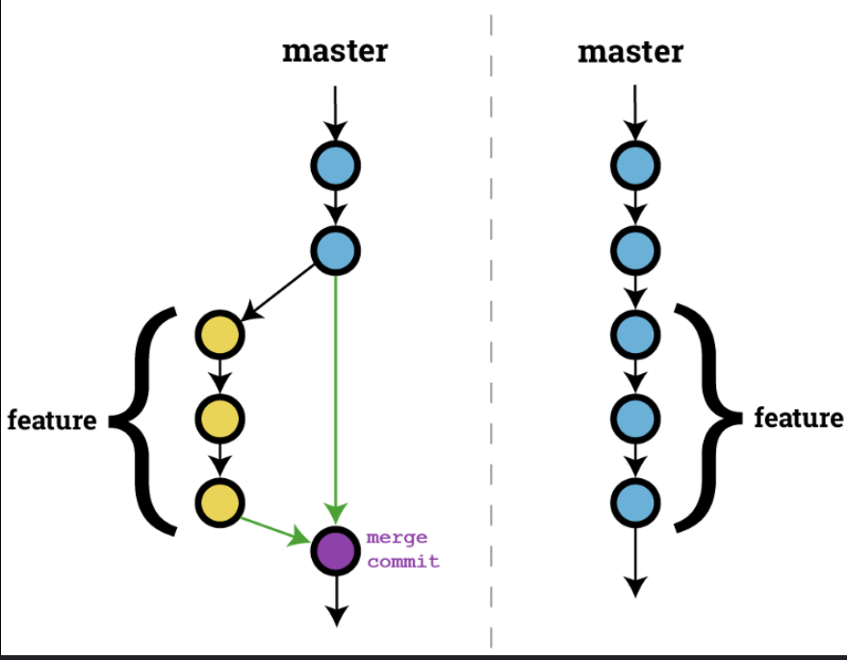
Branching & Merging with Git
Main branch
Main branch
Merge
Isolates development of new features from your main branch
Feature branch
https://haydar-ai.medium.com/learning-how-to-git-merging-branches-and-resolving-conflict-61652834d4b0

Slide 9
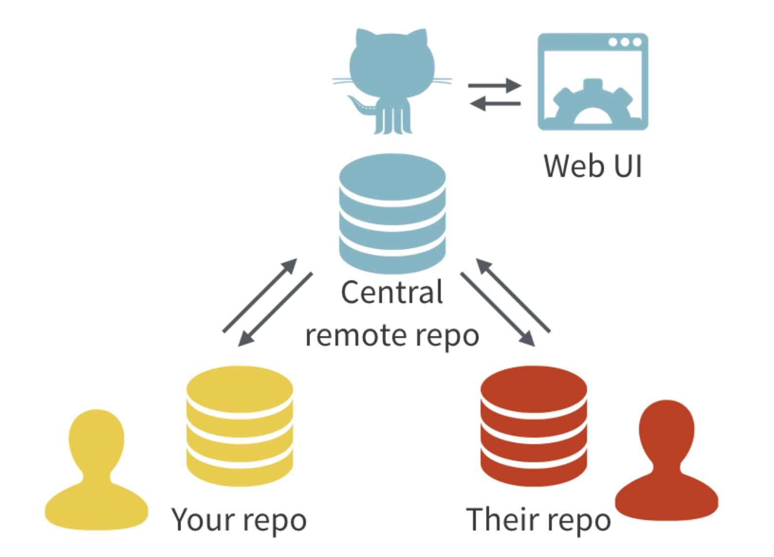

Collaborating on projects
All contributors have a local copy of the Git repository. These stay in sync through a central remote repository hosted on GitHub.

Slide 10
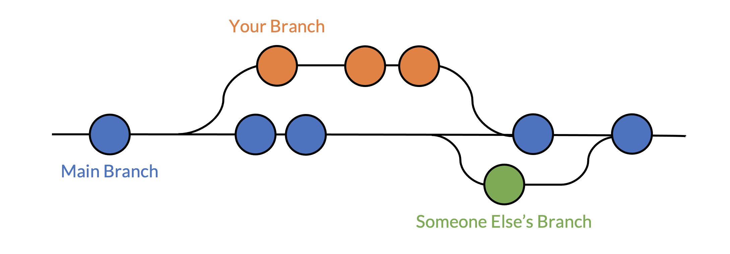
Collaborating through Branching & Merging
Branches let multiple collaborators make updates at the same time to later merge into the main branch.
https://cpske.github.io/ISP/git/branch-and-merge

Slide 11
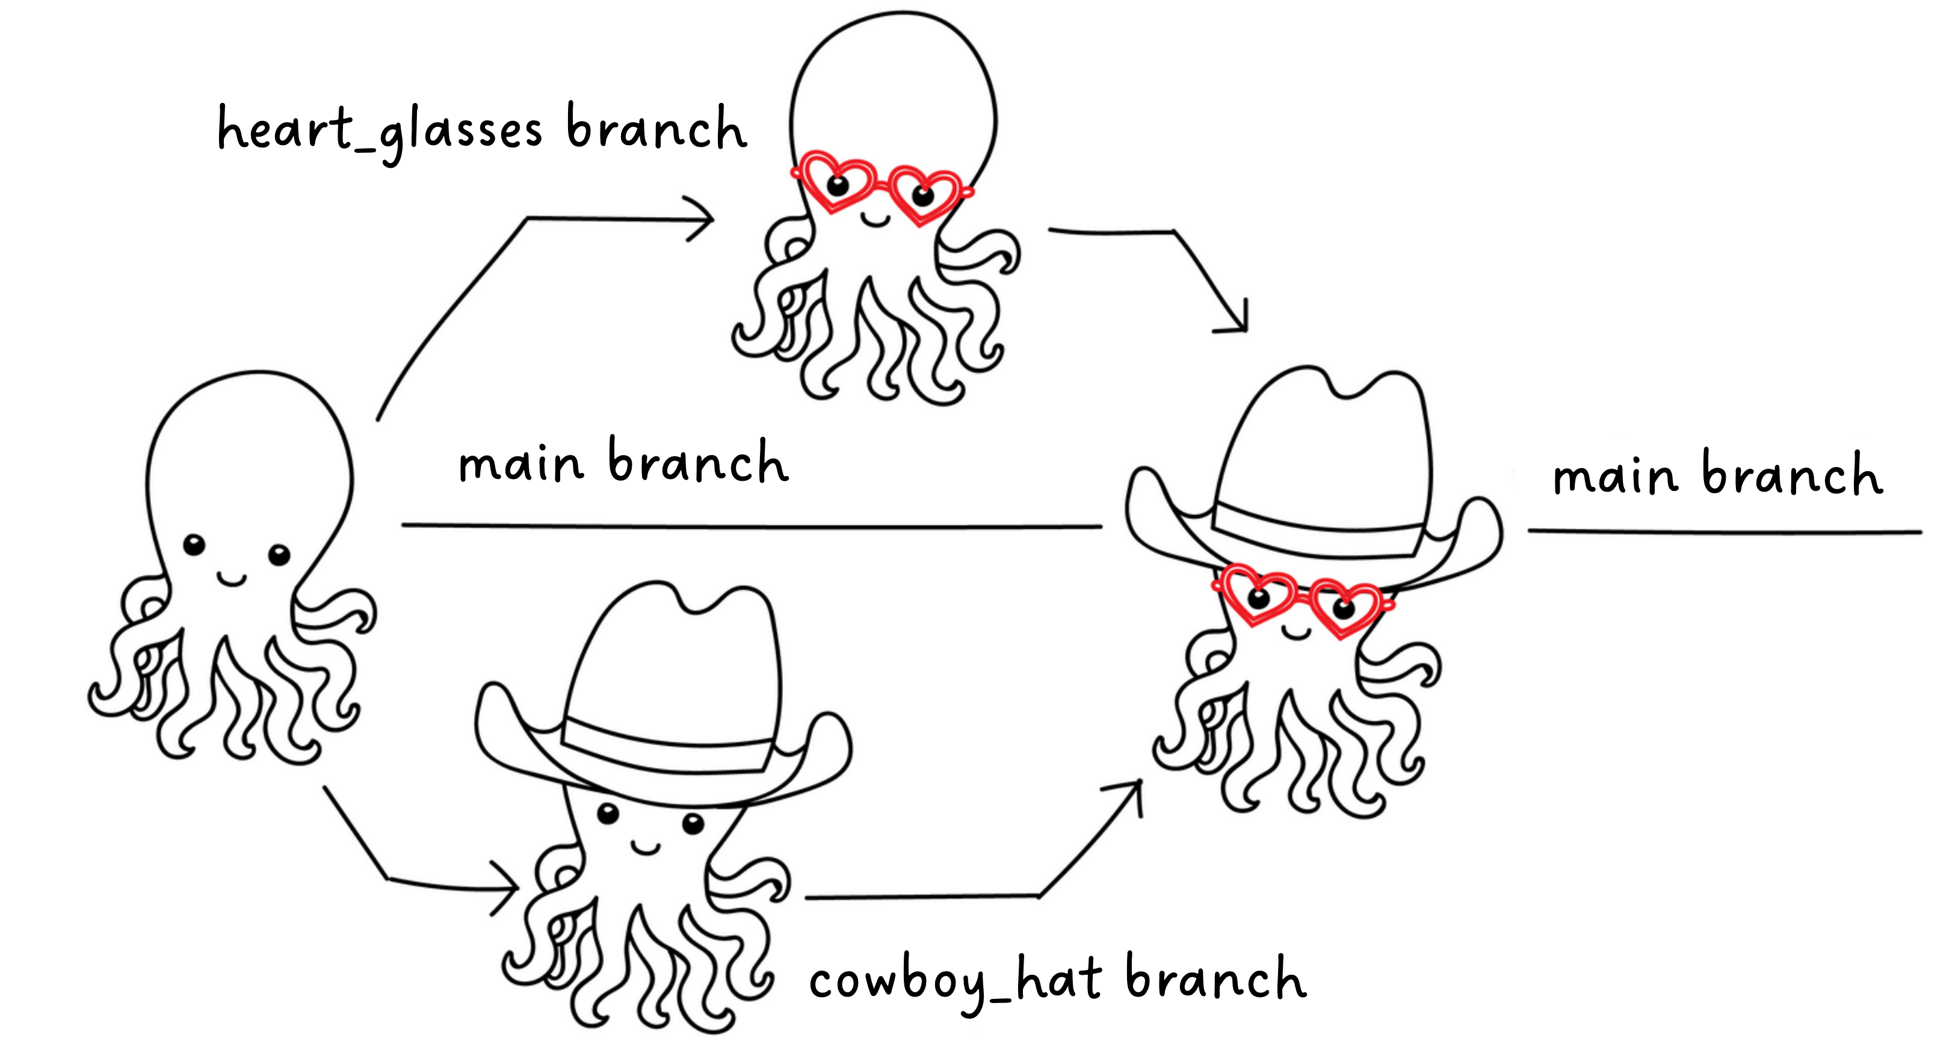
Collaborating through Branching & Merging
https://imperialcollegelondon.github.io/grad_school_git_course/l1-03-branching-merging/index.html

Slide 12
What we will work on today
Configuring Git on your instance
Git project management
Create a project
View the project history
Instruct Git what files to monitor and which to ignore
Connecting your local Git repository to a remote one (Github)
Create feature branches and merge edits with your main branch
Version control with Git in RStudio

Slide 13
Getting started
# Go to your home directory
cd ~
# Clone the workshop git repository
git clone https://github.com/drownlab/dsc_workshop_2025.git
# Move the folder Introduction-to-Git to your home directory
mv dsc_workshop_2025/notebooks/Introduction-to-Git/ ~/
Read the instructions well!

Slide 14
https://swcarpentry.github.io/git-novice/
https://coderefinery.github.io/git-intro/branches/
Using Git with Rstudio
https://swcarpentry.github.io/git-novice/14-supplemental-rstudio.html

Slide 16
Why Use Version Control? The Power of Knowing Your Past (and Working Together)
Track Changes: See exactly what was modified, when, and by whom.
Revert to Previous States: Easily undo mistakes or go back to a working version.
Collaboration: Multiple people can work on the same project simultaneously without chaos.
Branching and Merging: Experiment with new features without affecting the main codebase.
Understanding Project History: Learn how the project evolved and why certain decisions were made.
Notes:
Visual: A split image or icons representing individual work vs. collaboration.

