Slide 1

Reproducible Research Principles
Establishing trust, transparency, and continuity in science
Alaska INBRE is an Institutional Development Award (IDeA) from the National Institute of General Medical Sciences of the National Institute of Health (NIH) under grant number P20GM103395.

Slide 2

Core Definitions
Reproducibility: Ability to recompute results given the same data set and the analysis pipeline.
Replicability: The chance that an independent experiment on the same question produces a consistent result.
Beware: Definitions may be flipped depending on who is talking!

Slide 3
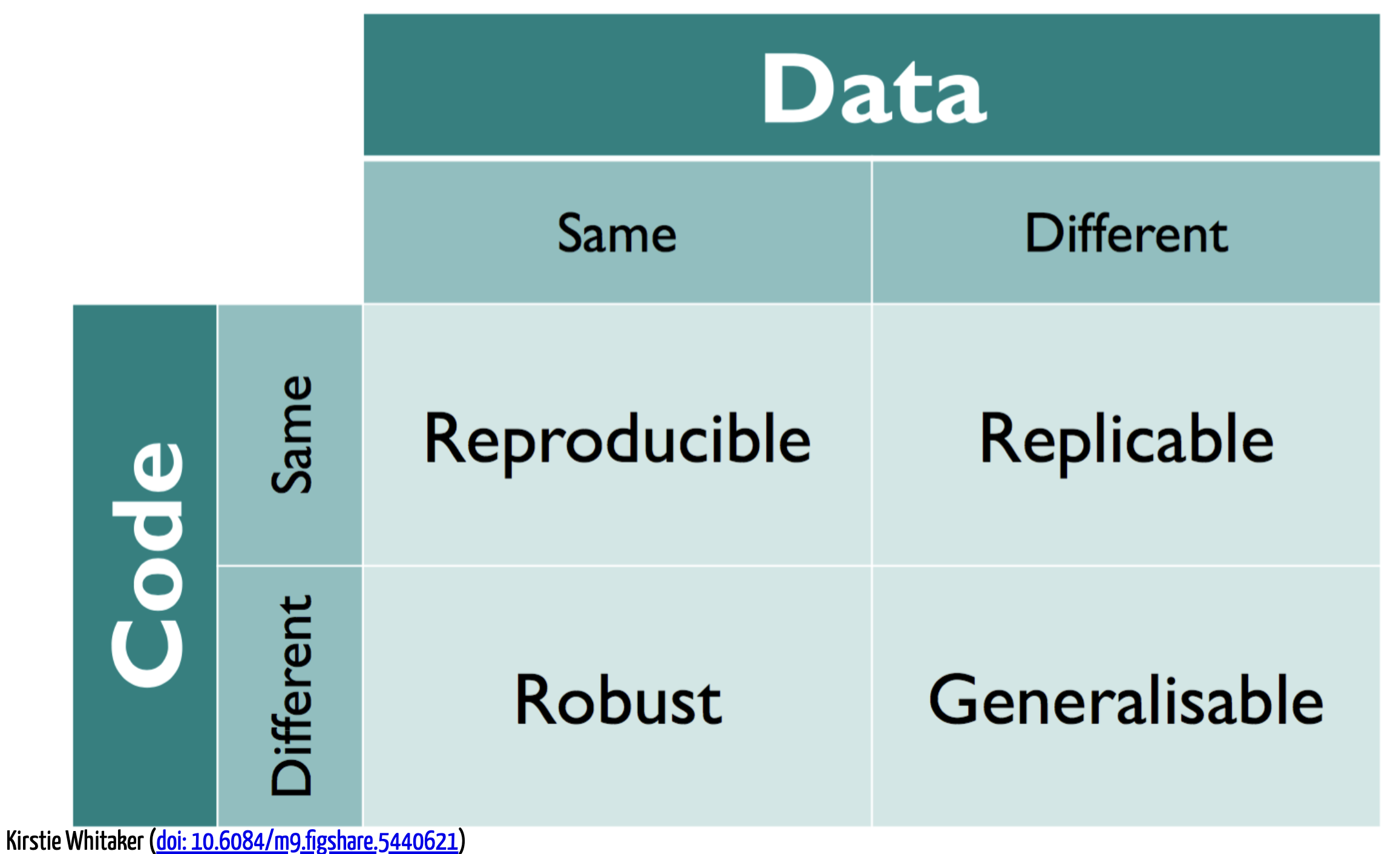

Slide 4
Why These Principles Matter?
Verify that results are correct and generalizable.
Allow others to build off earlier work.
Enable repurposing of materials and methods.

Slide 5
Pop quiz: Reproducibility or Replicability?
You download data from another lab, following their methods, you try to regenerate their results.
You rerun the mouse model that you ran in a previous paper but use a different strain.
Someone performs your study using a cohort of subjects in Korea.
A colleague asks for your raw data and any scripts you may have to repeat your earlier analysis.

Slide 6

Threats to Reproducibility
Data & Methods
Technical Rot
Data not public, incomplete methods, or "rabbit holes."
Operating system changes, URL rot, or software evolution.
Software Issues
Missing Details
Availability of software or "Custom Scripts" that aren't shared.
Protocols without enough detail or missing random seeds.

Slide 7
Threats to Replicability
Experimental Design
Biological variation
Poor design, overfitting, or selection bias.
Sex, age, genotype, or reagent differences.
Environment
Integrity
Storage conditions or confounding variables.
Sloppiness or scientific misconduct.

Slide 8
The Role of Version Control
Managing the "Code" and "Methods" pillars of reproducibility

Slide 9
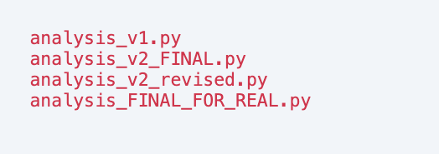
The Enemy: "Filename Versioning"
Which one produced your Figure 1?
Manual tracking is prone to error and difficult to audit

Slide 10

What is Version Control?
Practice of controlling, organizing, and tracking different versions of computer files
Allows you to revert to specific versions later
Essential for software development, but useful for any evolving digital work (manuscripts, data, etc.)
“Ctrl+Z” on steroids, with a complete history

Slide 11
Version Control with Git
Developed in 2005 by Linus Torvalds, the creator of Linux
Widely used in the industry and academia
Open source and free!

Slide 12

Git: A Research Time Machine
What is Git?
Free and open-source distributed version control system
Tracks every character change in your analysis code.
Allows you to revert to any working version instantly.
Provides a permanent record of your analysis evolution.

Slide 13
How does Git do this?
Working Directory: Local files you see and edit
Staging Area: A temporary area to prepare changes for the next commit
Local Repository (.git directory): The hidden folder where Git stores all the history and metadata for your project
Remote Repository: A remote repository where you can push your committed data for sharing, collaborating, showcasing skills

Slide 14
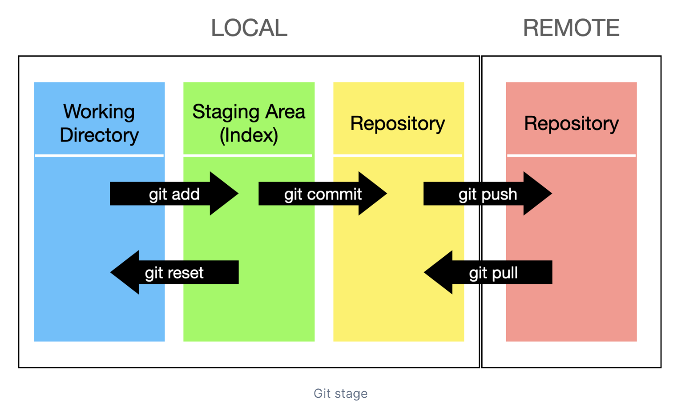
How do these structures interact?

Slide 15
The Power of the "Commit"
Snapshots
Attribution
Captures the state of your entire project at once.
Identifies who made which change → perfect for collaborations.
Documentation
Integrity
Commit messages explain the 'why' behind each adjustment.
Ensures history hasn't been tampered with or corrupted.

Slide 16
Reproducibility Best Practices
Make raw data and scripts accessible.
Document your software environment.
Use Version Control to track every step of the analysis pipeline.
Write meaningful commit messages for your "future self” and collaborators.

Slide 17
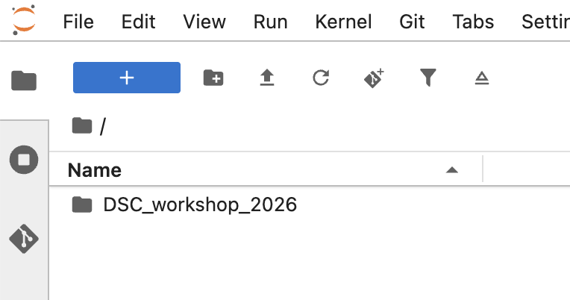
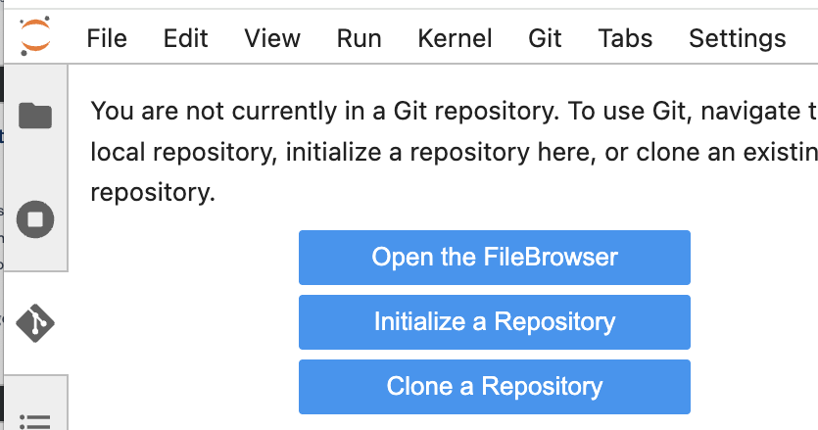
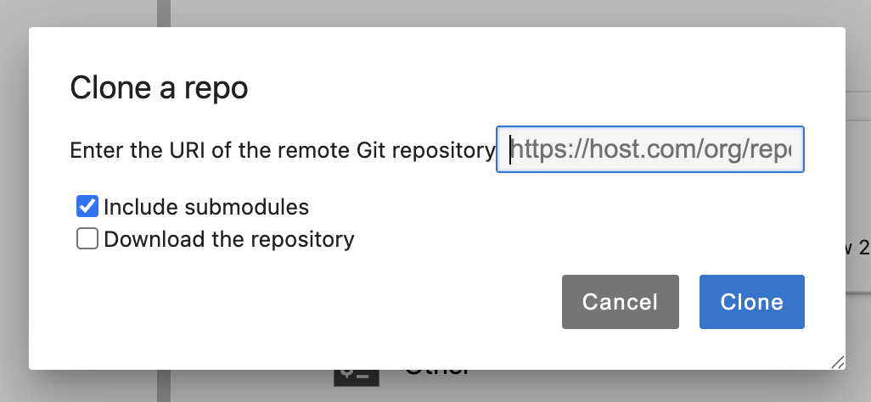
Today:
Open Google Cloud instance.
Make sure you’re in your home directory.
Open Git panel & Click ”Clone a Repository”.
Enter the below URL & click ”Clone”:
Open Lesson 1 & Get started!
https://ak-inbre-dsc/dsc_workshop_2026/notebooks/Git
Notes:
Everyone works at a different pace. Will talk about second part of this topic at 10:15

