Slide 1

Essential Tools for Reproducible Research
Pipelines, Workflow Management Systems & Containers

Slide 2

The Challenge in Bioinformatics Research
Computational Chains
Environmental Drift
Distinct, often interdependent computational steps → Failure in one script affects the entire pipeline.
Software versions, operating systems, and installed libraries can be inconsistent → significant variance in results.

Slide 3






So... What Can We Do?
Workflow Management Systems
Pipelines
Containers
Defining the automated sequence of your research steps.
“Freezing” the software environment to ensure consistency.
Orchestrating the execution across computational resources.

Slide 4
Pipelines: What & Why?
A specific set of programs or scripts run in a predefined, automated sequence.
Reduce Manual Errors: Eliminates human mistakes
Saves Time: Re-run complex analyses instantly on new datasets.
Detailed Records: Step-by-step history of your data’s history.
Notes:
Reduce Manual Errors: Eliminates human mistakes during command entry and file handling.

Slide 5
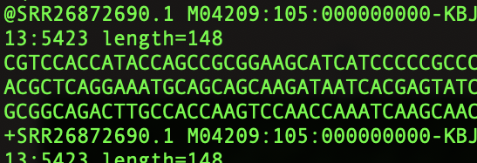
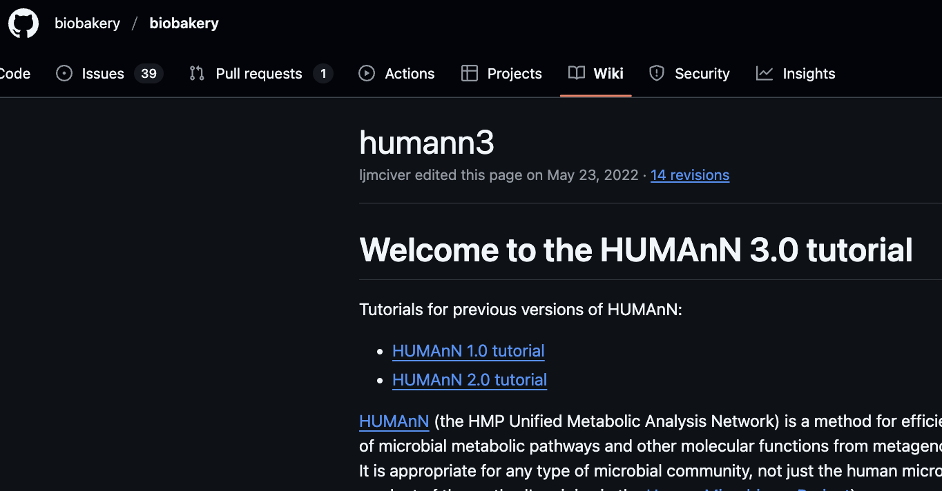

Example: Metagenomics Analysis
MetaPhlAn
Bowtie2
DIAMOND
Metagenomic Reads
Taxonomic Profiling
Pangenome Search
Translated Alignment
HUMAnN3
Pathway Reconstruction
Output
MinPath
https://huttenhower.sph.harvard.edu/humann/
Notes:
One of the many metagenomic pipelines
You have run a metagenomics pipeline yesterday. These usually consist of a combination of steps.
These pipelines contain different programs. All of which have different versions, dependencies et. Do you want to set and download all these manually every time you run the analysis? Room for error!

Slide 6
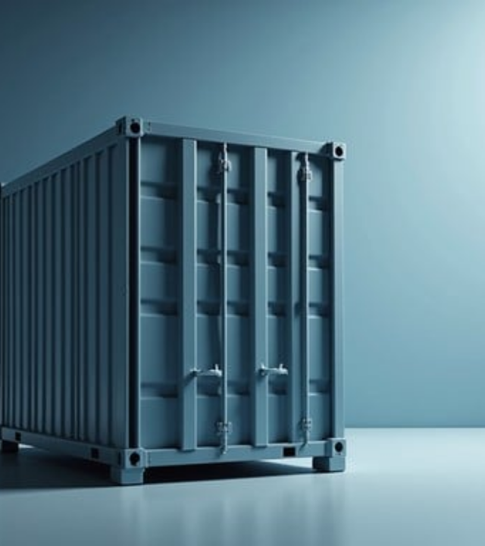
Containers
Keeping things constant!
Self-contained, executable packages that bundle code, libraries, and settings.
Containers solve the "dependency hell" problem by ensuring your analysis runs identically, anywhere, anytime.

Slide 7



Key Container Tools
Docker
Apptainer
The most widely used platform for developing and running apps in isolated environments. Ideal for local and cloud work.
Formerly Singularity. Designed for HPC and shared clusters where security and root-less execution are required.

Slide 8
Example Docker Container
Elements:
Base Operating System: Ubuntu (Version 24.04 LTS)
R Version → R version 4.3.2
R Packages → ggplot2 version 3.4.4, ggplot version 1.1.4
R Script → my_analysis.R
Filesystem → the layered structure combining all elements above
Notes:
Can include part of pipeline (single program to small pipeline or script)

Slide 9
How do we keep our pipelines and containers organized?

Slide 10
Workflow Management Systems
Elements A software framework that helps you build and execute pipelines (often inside containers)
Manages dependencies and tasks
Handles resource distribution
Scales computation across CPUs/Nodes
Improves project organization

Slide 11


→ Scaling Science
Highly scalable and portable pipelines for clusters and cloud platforms.

Slide 12
Introducing GitHub
A Web-Based Platform
Built around Git, GitHub is an online infrastructure for scientific collaboration
A remote location for tracked files
Visual interface for project history
Secure cloud-based backup

Slide 13






GitHub: The Central Hub
Version Control
Collaboration
Provenance
A cloud-based platform to store pipeline code and container "recipes" (Dockerfiles) with full history tracking.
Enables teams to review code, track issues, and manage scientific tasks in a single centralized environment.
Ensures every analytical result can be traced back to the exact version of the code used during processing.

Slide 14


Beyond Version Control
A Research Suite
Documentation: READMEs and Wikis
Project Management
GitHub Pages: Host lab websites, tutorials

Slide 15


GitHub as the Glue
Seamless Integration
GitHub integrates directly with WMS tools like Nextflow. You can run a pipeline directly from a repo with a single command:
It also hosts container registries (GitHub Packages), linking your analysis code to the software images it requires.

Slide 16
”Well, it worked on my machine!"
— Famous Last Words in Research

Slide 17
Lesson 2: Git & Github
Notebook: Lesson2_Git_Github.ipynb
Set up a Github Account
Connect your local Git repo to your Github

