Slide 1
LIBRARY MANAGEMENT PROJECT

Slide 2
Description
Project Contains 3 apps -1)Admins 2)Students 3)Book
Admins app manages admin login and signup
Student app manages student view
Book app has model that stores books, and it contains all the operations that can be performed on a book by admin

Slide 3
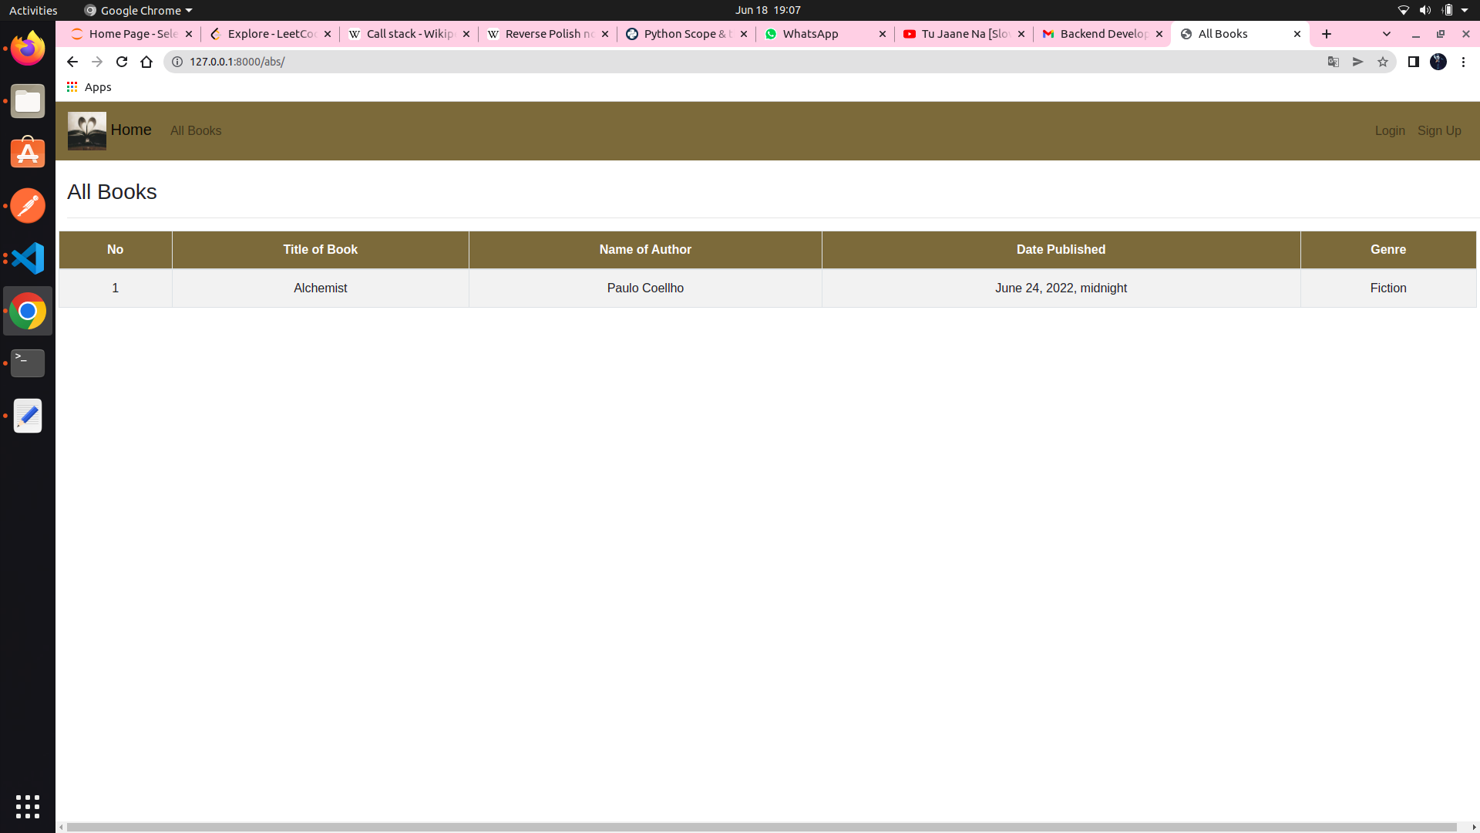
This is the all books view for student.

Slide 4
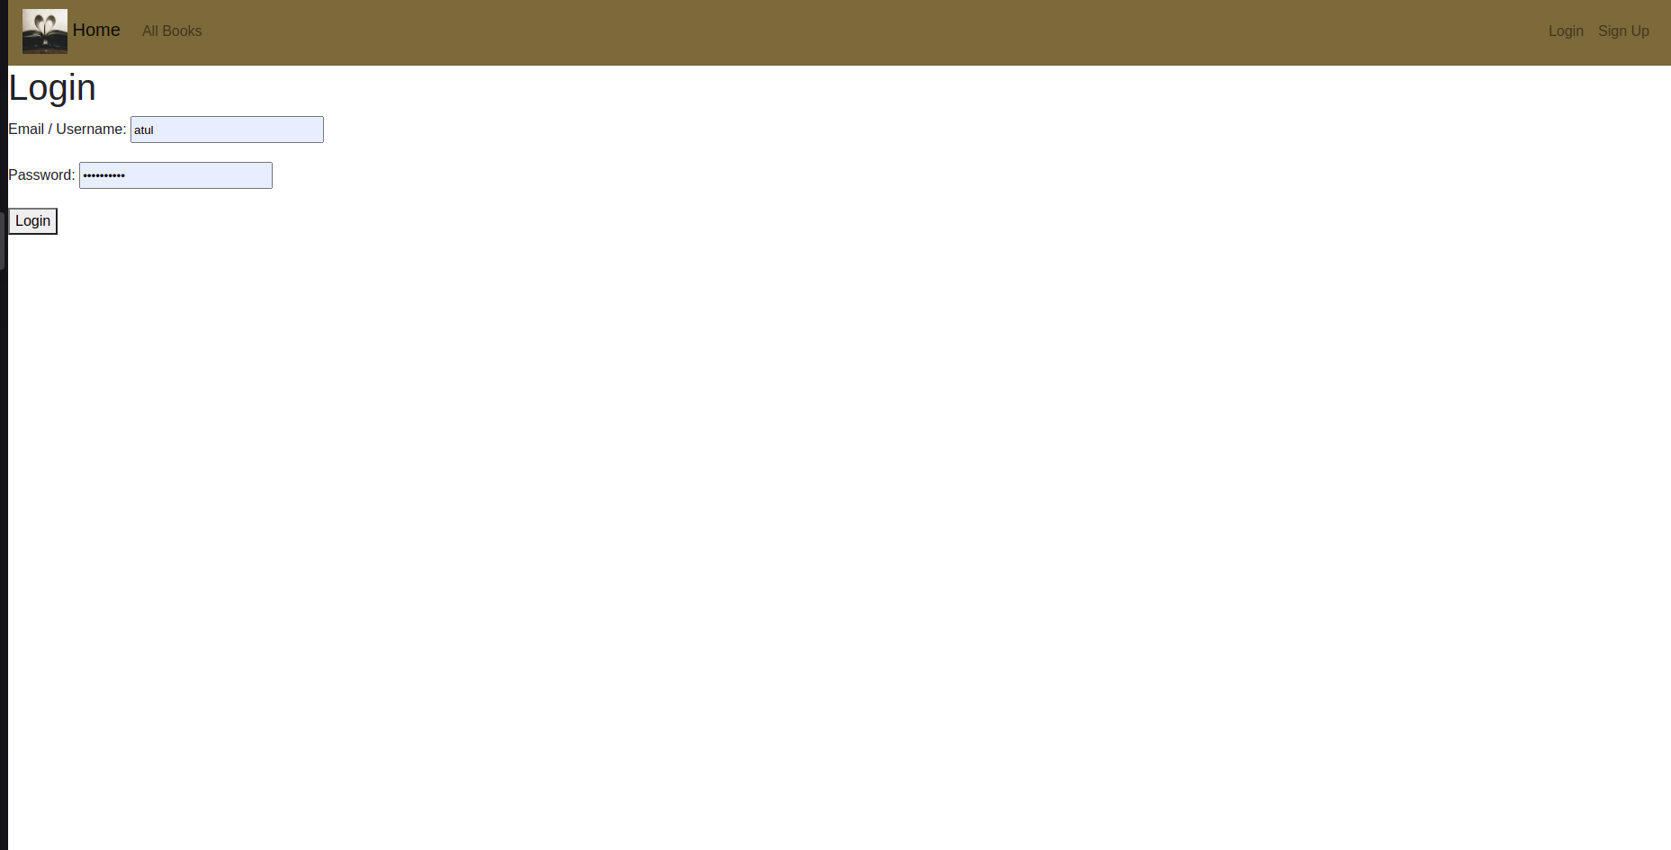
An admin can login using either username/email.(both of them are unique in database)

Slide 5
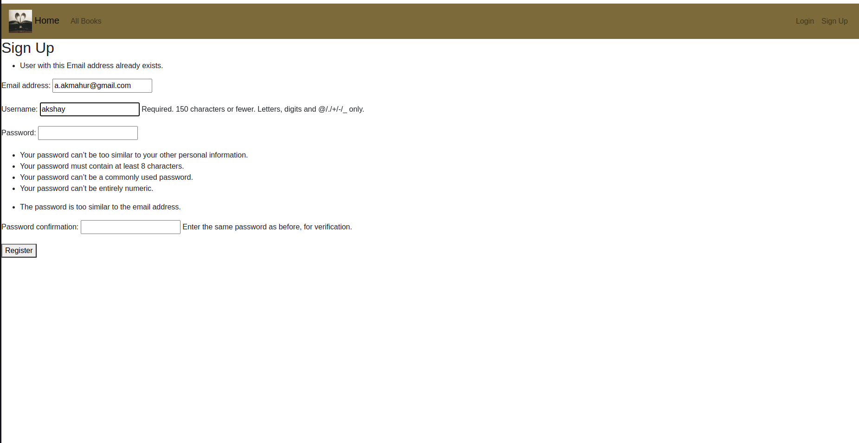
Here an admin can register himself and his email and username shouldn’t be already in database

Slide 6
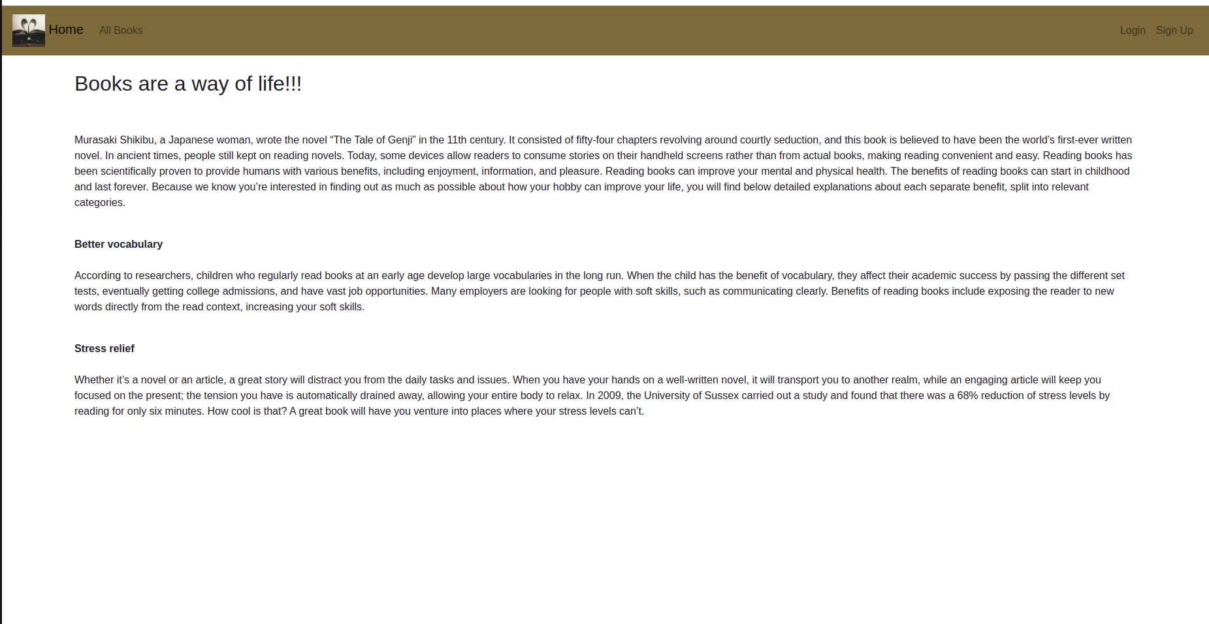
This is the welcome page, it will be visible to all

Slide 7
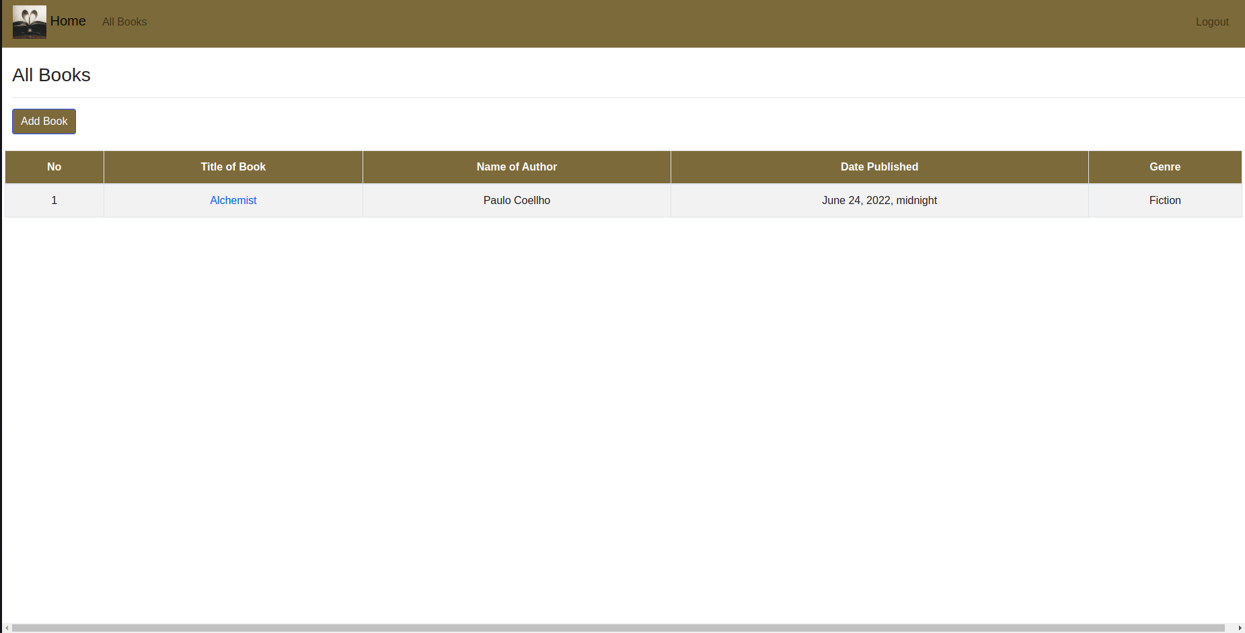
This is all books view for admins. Admins will see title of book as clickable link. This would take them to option of Editing or deleting the book
Clicking on add book would take admin to a page where he can add a new book into system

Slide 8
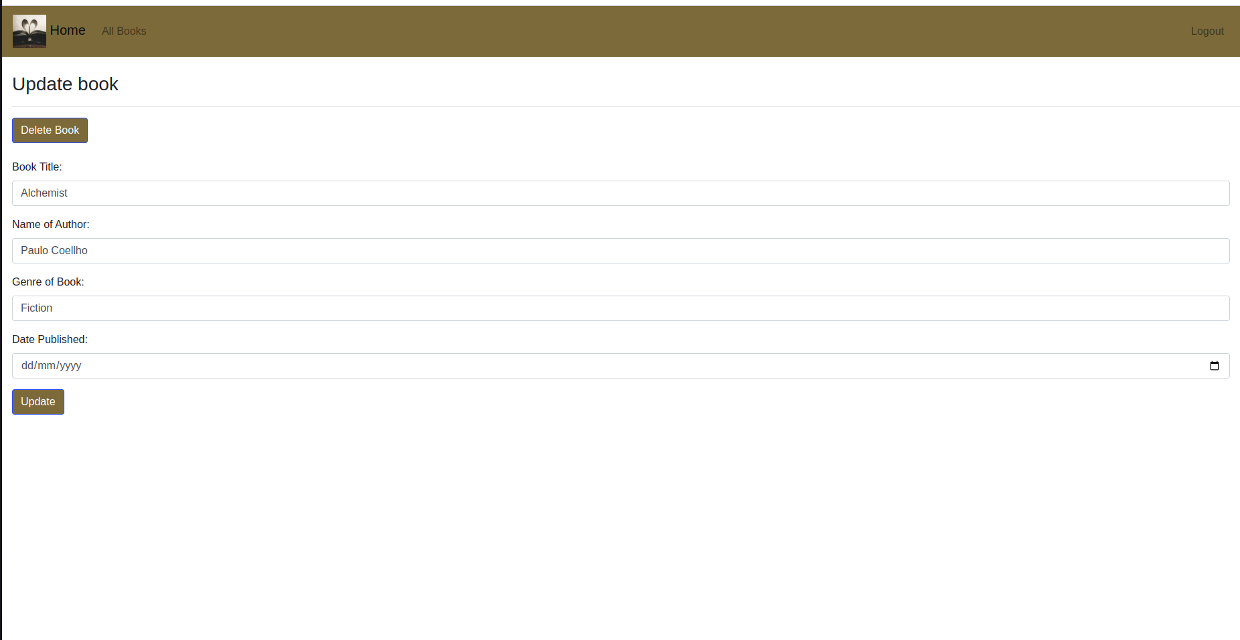
This is the view where admin can update or delete the book

Slide 9
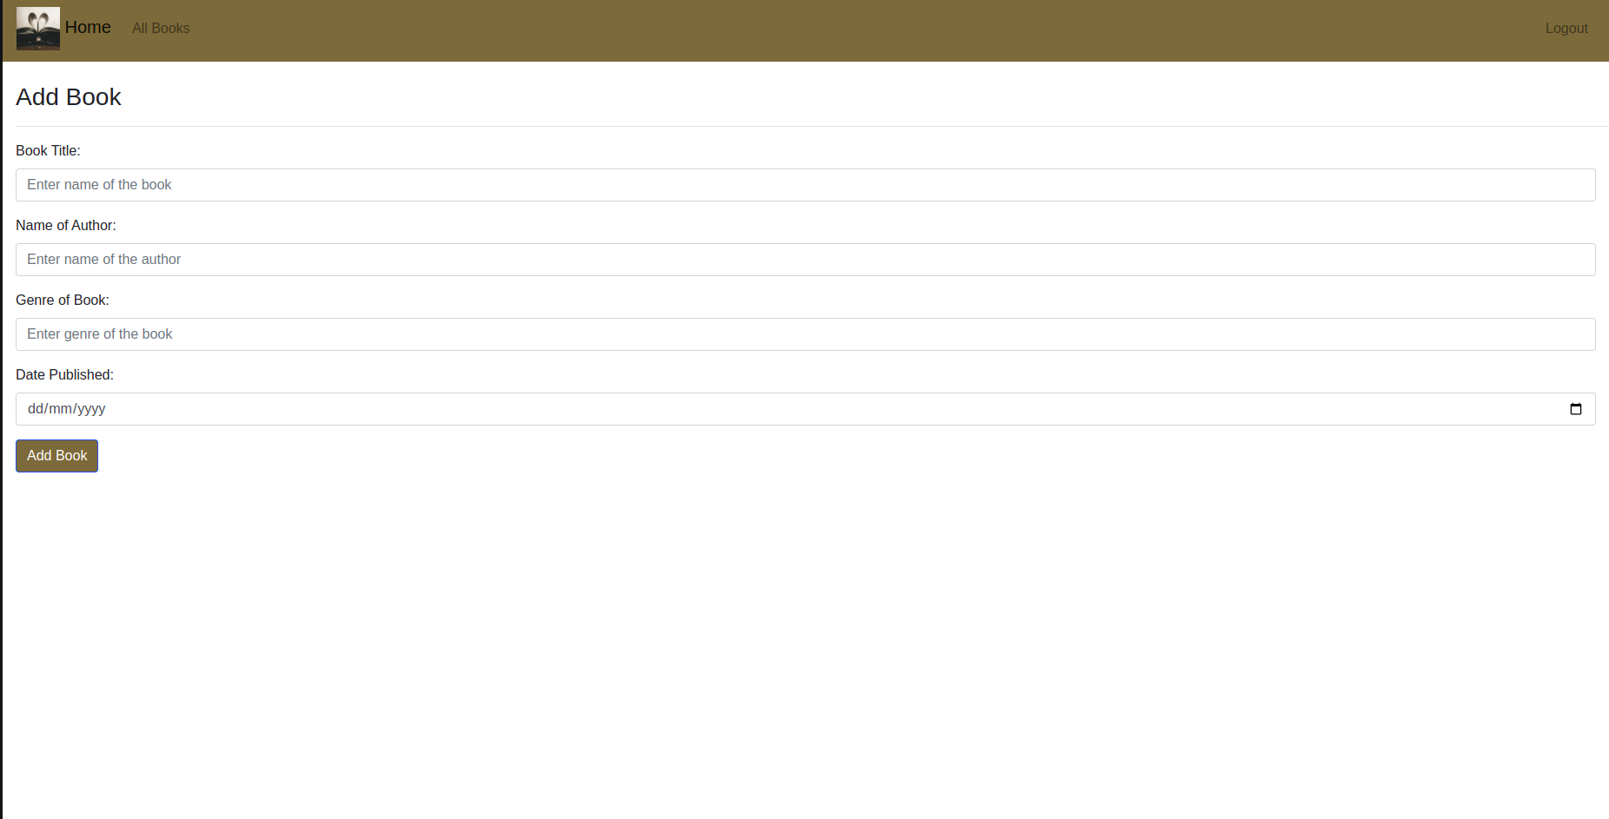
This is the view where admin can add a book

