Slide 1
Introduction to Algorithms Dynamic Programming – Part 2
CSE 680
Prof. Roger Crawfis

Slide 2
The 0/1 Knapsack Problem
Given: A set S of n items, with each item i having
w_{i} - a positive weight
b_{i} - a positive benefit
Goal: Choose items with maximum total benefit but with weight at most W.
If we are not allowed to take fractional amounts, then this is the 0/1 knapsack problem.
In this case, we let T denote the set of items we take
Objective: maximize
Constraint:

Slide 3
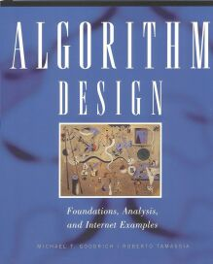
Example
Given: A set S of n items, with each item i having
b_{i} - a positive “benefit”
w_{i} - a positive “weight”
Goal: Choose items with maximum total benefit but with weight at most W.
“knapsack”
Items:
box of width 9 in
1
2
3
4
5
Solution:
item 5 ($80, 2 in)
item 3 ($6, 2in)
item 1 ($20, 4in)
Weight:
4 in
2 in
2 in
6 in
2 in
Benefit:
$20
$3
$6
$25
$80

Slide 4
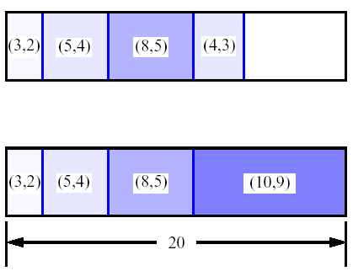
First Attempt
S_{k}: Set of items numbered 1 to k.
Define B[k] = best selection from S_{k}.
Problem: does not have sub-problem optimality:
Consider set S={(3,2),(5,4),(8,5),(4,3),(10,9)} of (benefit, weight) pairs and total weight W = 20
Best for S₄:
Best for S₅:

Slide 5
Second Attempt
S_{k}: Set of items numbered 1 to k.
Define B[k,w] to be the best selection from S_{k} with weight at most w
This does have sub-problem optimality.
I.e., the best subset of S_{k} with weight at most w is either:
the best subset of S_{k-1} with weight at most w or
the best subset of S_{k-1} with weight at most w−w_{k} plus item k

Slide 6
Knapsack Example
item weight value
1 2 $12
2 1 $10
3 3 $20
4 2 $15
Knapsack of capacity W = 5
w₁ = 2, v₁= 12 w₂ = 1, v₂= 10
w₃ = 3, v₃= 20 w₄ = 2, v₄= 15
Max item allowed | Max Weight
 | 0 | 1 | 2 | 3 | 4 | 5
0 | 0 | 0 | 0 | 0 | 0 | 0
1 | 0 | 0 | 12 | 12 | 12 | 12
2 | 0 | 10 | 12 | 22 | 22 | 22
3 | 0 | 10 | 12 | 22 | 30 | 32
4 | 0 | 10 | 15 | 25 | 30 | 37

Slide 7
Algorithm
Since B[k,w] is defined in terms of B[k−1,*], we can use two arrays of instead of a matrix.
Running time is O(nW).
Not a polynomial-time algorithm since W may be large.
Called a pseudo-polynomial time algorithm.
Algorithm 01Knapsack(S, W):
Input: set S of n items with benefit b_{i} and weight w_{i}; maximum weight W
Output: benefit of best subset of S with weight at most W
let A and B be arrays of length W + 1
for w ← 0 to W do
B[w] ← 0
for k ← 1 to n do
copy array B into array A
for w ← w_{k} to W do
if A[w−w_{k}] + b_{k} > A[w] then
B[w] ← A[w−w_{k}] + b_{k}
return B[W]

Slide 8
Longest Common Subsequence (LCS)
A subsequence of a sequence/string S is obtained by deleting zero or more symbols from S. For example, the following are some subsequences of “president”: pred, sdn, predent. In other words, the letters of a subsequence of S appear in order in S, but they are not required to be consecutive.
The longest common subsequence problem is to find a maximum length common subsequence between two sequences.

Slide 9
LCS
For instance,
Sequence 1: president
Sequence 2: providence
Its LCS is priden.
president
providence

Slide 10
LCS
Another example:
Sequence 1: algorithm
Sequence 2: alignment
One of its LCS is algm.
a l g o r i t h m
a l i g n m e n t

Slide 11
Naïve Algorithm
For every subsequence of X, check whether it’s a subsequence of Y .
Time: Θ(n2^{m}).
2^{m} subsequences of X to check.
Each subsequence takes Θ(n) time to check: scan Y for first letter, for second, and so on.

Slide 12
Optimal Substructure
Theorem
Let Z = ⟨z₁, . . . , z_{k}⟩ be any LCS of X and Y .
1. If x_{m} = y_{n}, then z_{k} = x_{m} = y_{n} and Z_{k-1} is an LCS of X_{m-1} and Y_{n-1}.
2. If x_{m} ≠ y_{n}, then either z_{k} ≠ x_{m} and Z is an LCS of X_{m-1} and Y .
3. or z_{k} ≠ y_{n} and Z is an LCS of X and Y_{n-1}.
Notation:
prefix X_{i} = ⟨x₁,...,x_{i}⟩ is the first i letters of X.

Slide 13
Optimal Substructure
Theorem
Let Z = ⟨z₁, . . . , z_{k}⟩ be any LCS of X and Y .
1. If x_{m} = y_{n}, then z_{k} = x_{m} = y_{n} and Z_{k-1} is an LCS of X_{m-1} and Y_{n-1}.
2. If x_{m} ≠ y_{n}, then either z_{k} ≠ x_{m} and Z is an LCS of X_{m-1} and Y .
3. or z_{k} ≠ y_{n} and Z is an LCS of X and Y_{n-1}.
Proof: (case 1: x_{m} = y_{n})
Any sequence Z’ that does not end in x_{m} = y_{n} can be made longer by adding x_{m} = y_{n} to the end. Therefore,
longest common subsequence (LCS) Z must end in x_{m} = y_{n}.
Z_{k-1} is a common subsequence of X_{m-1} and Y_{n-1}, and
there is no longer CS of X_{m-1} and Y_{n-1}, or Z would not be an LCS.

Slide 14
Optimal Substructure
Theorem
Let Z = ⟨z₁, . . . , z_{k}⟩ be any LCS of X and Y .
1. If x_{m} = y_{n}, then z_{k} = x_{m} = y_{n} and Z_{k-1} is an LCS of X_{m-1} and Y_{n-1}.
2. If x_{m} ≠ y_{n}, then either z_{k} ≠ x_{m} and Z is an LCS of X_{m-1} and Y .
3. or z_{k} ≠ y_{n} and Z is an LCS of X and Y_{n-1}.
Proof: (case 2: x_{m} ≠ y_{n}, and z_{k} ≠ x_{m})
Since Z does not end in x_{m},
Z is a common subsequence of X_{m-1} and Y, and
there is no longer CS of X_{m-1} and Y, or Z would not be an LCS.

Slide 15
Recursive Solution
Define c[i, j] = length of LCS of X_{i} and Y_{j} .
We want c[m,n].

Slide 16
How to compute LCS?
Let A=a₁a₂…a_{m} and B=b₁b₂…b_{n} .
len(i, j): the length of an LCS between a₁a₂…a_{i} and b₁b₂…b_{j}
With proper initializations, len(i, j) can be computed as follows.

Slide 17
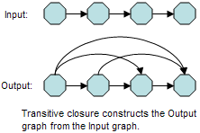
Transitive Closure
Compute the transitive closure of a directed graph
If there exists a path (non-trivial) from node i to node j, then add an edge to the resulting graph.
Also called the reachability: If a can reach b and b can reach c, then a can reach c.
From Wikipedia.org: http://en.wikipedia.org/wiki/File:Transitive-Closure.PNG

Slide 18
Warshall’s Algorithm
On the k^{th} iteration, the algorithm determines for every pair of vertices i, j if a path exists from i and j with just vertices 1,…,k allowed as intermediate nodes.
R(k-1)[i,j] (path using just 1 ,…,k-1)
R(k)[i,j] = or
R(k-1)[i,k] and R(k-1)[k,j] (path from i to k
and from k to j
using just 1 ,…,k-1)
{
k
i
Initial condition?
j

Slide 19
Warshall’s Algorithm
Constructs transitive closure T as the last matrix in the sequence of n-by-n matrices R(0), … , R(k), … , R(n) where
R(k)[i,j] = 1 iff there is nontrivial path from i to j with only the first k vertices allowed as intermediate
Note that R(0) = A (adjacency matrix), R(n) = T (transitive closure)
Example: Path’s with only node 1 allowed.
3
3
1
1
2
4
2
4

Slide 20
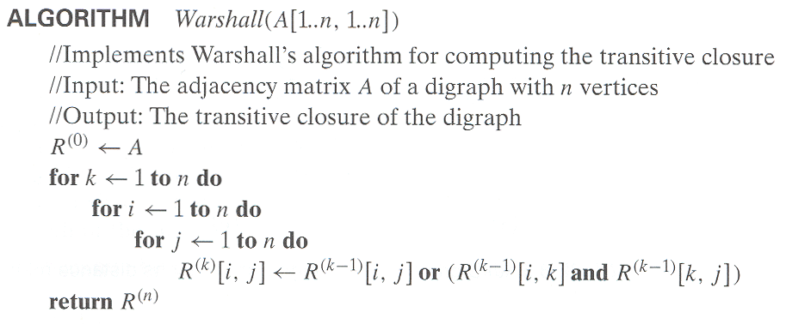
Warshall’s Algorithm
Time efficiency: Θ(n³)

Slide 21
Warshall’s Algorithm
Complete example:
3
3
3
3
3
1
1
1
1
1
4
4
4
2
4
4
2
2
2
2
R⁽⁰⁾
0 0 1 0
1 0 0 1
0 0 0 0
0 1 0 0
R⁽¹⁾
0 0 1 0
1 0 1 1
0 0 0 0
0 1 0 0
R⁽²⁾
0 0 1 0
1 0 1 1
0 0 0 0
1 1 1 1
R⁽³⁾
0 0 1 0
1 0 1 1
0 0 0 0
1 1 1 1
R⁽⁴⁾
0 0 1 0
1 1 1 1
0 0 0 0
1 1 1 1

Slide 22
Conclude
Matrix Chaining optimization
Longest Common Subsequence
0-1 Knapsack Problem
Transitive Closure of a direct graph

