Slide 1
Introduction to Algorithms Dynamic Programming
CSE 680
Prof. Roger Crawfis

Slide 2
Fibonacci Numbers
Computing the n^{th} Fibonacci number recursively:
F(n) = F(n-1) + F(n-2)
F(0) = 0
F(1) = 1
Top-down approach
int Fib(int n)
{ if (n <= 1) return 1; else return Fib(n - 1) + Fib(n - 2); }
F(n)
F(n-1) + F(n-2)
F(n-2) + F(n-3) F(n-3) + F(n-4)

Slide 3
Fibonacci Numbers
What is the Recurrence relationship?
T(n) = T(n-1) + T(n-2) + 1
What is the solution to this?
Clearly it is O(2^{n}), but this is not tight.
A lower bound is Ω(2^{n/2}).
You should notice that T(n) grows very similarly to F(n), so in fact T(n) = Θ(F(n)).
Obviously not very good, but we know that there is a better way to solve it!

Slide 4
Fibonacci Numbers
Computing the n^{th} Fibonacci number using a bottom-up approach:
F(0) = 0
F(1) = 1
F(2) = 1+0 = 1
…
F(n-2) =
F(n-1) =
F(n) = F(n-1) + F(n-2)
Efficiency:
Time – O(n)
Space – O(n)

Slide 5
Fibonacci Numbers
The bottom-up approach is only Θ(n).
Why is the top-down so inefficient?
Recomputes many sub-problems.
How many times is F(n-5) computed?
F(n)
F(n-1) + F(n-2)
F(n-2) + F(n-3) F(n-3) + F(n-4)
… … …
n levels

Slide 6
Fibonacci Numbers
Fib(5) +
Fib(4) +
Fib(3) +
Fib(3) +
Fib(2) +
Fib(2) +
Fib(1)
Fib(2) +
Fib(1)
Fib(1)
Fib(0)
Fib(1)
Fib(0)
Fib(1)
Fib(0)

Slide 7
Dynamic Programming
Dynamic Programming is an algorithm design technique for optimization problems: often minimizing or maximizing.
Like divide and conquer, DP solves problems by combining solutions to sub-problems.
Unlike divide and conquer, sub-problems are not independent.
Sub-problems may share sub-sub-problems,

Slide 8
Dynamic Programming
The term Dynamic Programming comes from Control Theory, not computer science. Programming refers to the use of tables (arrays) to construct a solution.
In dynamic programming we usually reduce time by increasing the amount of space
We solve the problem by solving sub-problems of increasing size and saving each optimal solution in a table (usually).
The table is then used for finding the optimal solution to larger problems.
Time is saved since each sub-problem is solved only once.

Slide 9
Dynamic Programming
The best way to get a feel for this is through some more examples.
Matrix Chaining optimization
Longest Common Subsequence
0-1 Knapsack Problem
Transitive Closure of a direct graph

Slide 10
Matrix Chain-Products
Review: Matrix Multiplication.
C = A*B
A is d × e and B is e × f
O(d⋅e⋅f ) time
f
B
j
e
e
A
C
d
i
i,j
d
f

Slide 11
Matrix Chain-Products
Matrix Chain-Product:
Compute A=A₀*A₁*…*A_{n-1}
A_{i} is d_{i} × d_{i+1}
Problem: How to parenthesize?
Example
B is 3 × 100
C is 100 × 5
D is 5 × 5
(B*C)*D takes 1500 + 75 = 1575 ops
B*(C*D) takes 1500 + 2500 = 4000 ops

Slide 12
Enumeration Approach
Matrix Chain-Product Alg.:
Try all possible ways to parenthesize A=A₀*A₁*…*A_{n-1}
Calculate number of ops for each one
Pick the one that is best
Running time:
The number of parenthesizations is equal to the number of binary trees with n nodes
This is exponential!
It is called the Catalan number, and it is almost 4^{n}.
This is a terrible algorithm!

Slide 13
Greedy Approach
Idea #1: repeatedly select the product that uses the fewest operations.
Counter-example:
A is 101 × 11
B is 11 × 9
C is 9 × 100
D is 100 × 99
Greedy idea #1 gives A*((B*C)*D)), which takes 109989+9900+108900=228789 ops
(A*B)*(C*D) takes 9999+89991+89100=189090 ops
The greedy approach is not giving us the optimal value.

Slide 14
Dynamic Programming Approach
The optimal solution can be defined in terms of optimal sub-problems
There has to be a final multiplication (root of the expression tree) for the optimal solution.
Say, the final multiplication is at index k: (A₀*…*A_{k})*(A_{k+1}*…*A_{n-1}).
Let us consider all possible places for that final multiplication:
There are n-1 possible splits. Assume we know the minimum cost of computing the matrix product of each combination A₀…A_{i} and A_{i}…A_{n}. Let’s call these N_{0,i} and N_{i,n}.
Recall that A_{i} is a d_{i} × d_{i+1} dimensional matrix, and the final product will be a d₀ × d_{n}.

Slide 15
Dynamic Programming Approach
Define the following:
Then the optimal solution N_{0,n-1} is the sum of two optimal sub-problems, N_{0,k} and N_{k+1,n-1} plus the time for the last multiplication.

Slide 16
Dynamic Programming Approach
Define sub-problems:
Find the best parenthesization of an arbitrary set of consecutive products: A_{i}*A_{i+1}*…*A_{j}.
Let N_{i,j} denote the minimum number of operations done by this sub-problem.
Define N_{k,k} = 0 for all k.
The optimal solution for the whole problem is then N_{0,n-1}.

Slide 17
Dynamic Programming Approach
The characterizing equation for N_{i,j} is:
Note that sub-problems are not independent.
However, sub-problems of size m, are independent.
Also note that, for example N_{2,6} and N_{3,7}, both need solutions to N_{3,6}, N_{4,6}, N_{5,6}, and N_{6,6}. Solutions from the set of no matrix multiplies to four matrix multiplies.
This is an example of high sub-problem overlap, and clearly pre-computing these will significantly speed up the algorithm.

Slide 18
Recursive Approach
We could implement the calculation of these N_{i,j}’s using a straight-forward recursive implementation of the equation (aka not pre-compute them).
Algorithm RecursiveMatrixChain(S, i, j):
Input: sequence S of n matrices to be multiplied
Output: number of operations in an optimal parenthesization of S
if i=j
then return 0
for k ← i to j do
N_{i, j} ← min{N_{i,j}, RecursiveMatrixChain(S, i ,k) + RecursiveMatrixChain(S, k+1,j) + d_{i} d_{k+1} d_{j+1}}
return N_{i,j}

Slide 19
Dynamic Programming Algorithm
High sub-problem overlap, with independent sub-problems indicate that a dynamic programming approach may work.
Construct optimal sub-problems “bottom-up.” and remember them.
N_{i,i}’s are easy, so start with them
Then do problems of length 2,3,… sub-problems, and so on.
Running time: O(n³)
Algorithm matrixChain(S):
Input: sequence S of n matrices to be multiplied
Output: number of operations in an optimal parenthesization of S
for i ← 1 to n − 1 do
N_{i,i} ← 0
for b ← 1 to n − 1 do
{ b = j − i is the length of the problem }
for i ← 0 to n − b - 1 do
j ← i + b
N_{i,j} ← +∞
for k ← i to j − 1 do
N_{i,j} ← min{N_{i,j}, N_{i,k} + N_{k+1,j} + d_{i} d_{k+1} d_{j+1}}
return N_{0,n-1}

Slide 20
Algorithm Visualization
The bottom-up construction fills in the N array by diagonals
N_{i,j} gets values from previous entries in i-th row and j-th column
Filling in each entry in the N table takes O(n) time.
Total run time: O(n³)
Getting actual parenthesization can be done by remembering “k” for each N entry
answer
N
0
1
2
i
j
…
n-1
0
1
…
i
j
n-1

Slide 21
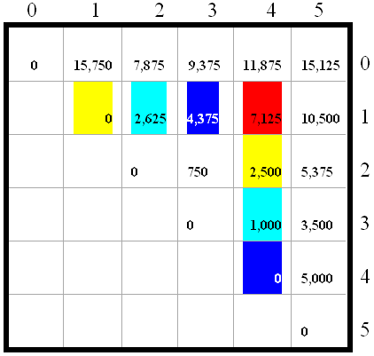
Algorithm Visualization
A₀: 30 X 35; A₁: 35 X15; A₂: 15X5;
A₃: 5X10; A₄: 10X20; A₅: 20 X 25

Slide 22
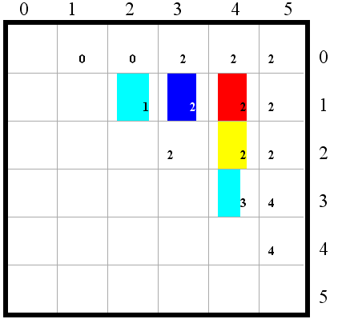
Algorithm Visualization
(A₀*(A₁*A₂))*((A₃*A₄)*A₅)

Slide 23
Matrix Chain-Products
Some final thoughts
We reduced replaced a O(2^{n}) algorithm with a Θ(n³) algorithm.
While the generic top-down recursive algorithm would have solved O(2^{n}) sub-problems, there are Θ(n²) sub-problems.
Implies a high overlap of sub-problems.
The sub-problems are independent:
Solution to A₀A₁…A_{k} is independent of the solution to A_{k+1}…A_{n}.

Slide 24
Matrix Chain-Products Summary
Determine the cost of each pair-wise multiplication, then the minimum cost of multiplying three consecutive matrices (2 possible choices), using the pre-computed costs for two matrices.
Repeat until we compute the minimum cost of all n matrices using the costs of the minimum n-1 matrix product costs.
n-1 possible choices.

